Slide 1
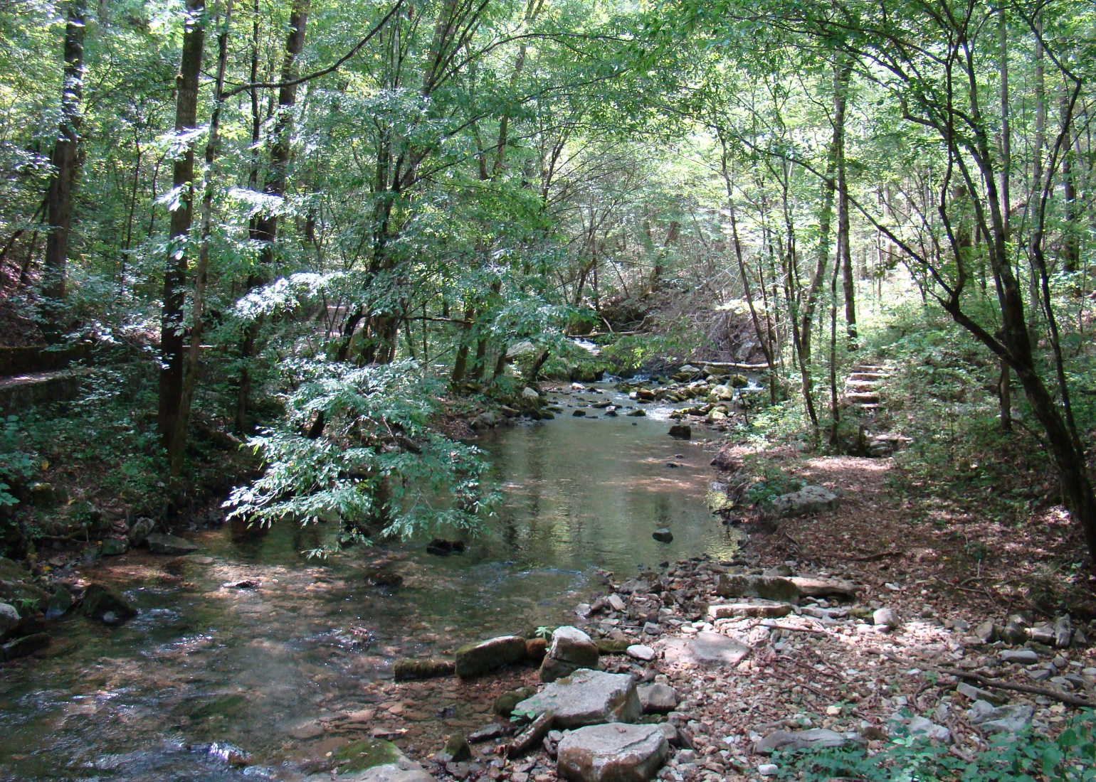

Arkansas Forestry Commission
U of A
Cooperative
Extension Service
September 27-28,
2017
2017 NPS 319(h) Project Review

Slide 2

Intentions may be great, but action may be lacking.
I’m Interested in 319h grant projects but eating lunch just wore me out today.

Slide 3
Arkansas Silvicultural NPS Project
Best Management Practices Assessment
Grant # C999610323
Project 15-1200
Major Task Include;
Technical Logger-Forester BMP Training
Non-Technical Landowner BMP Training
Courtesy Exams
AFC BMP Guideline Books and Materials
AFC Silviculture 8th BMP Implementation Assessment

Slide 4
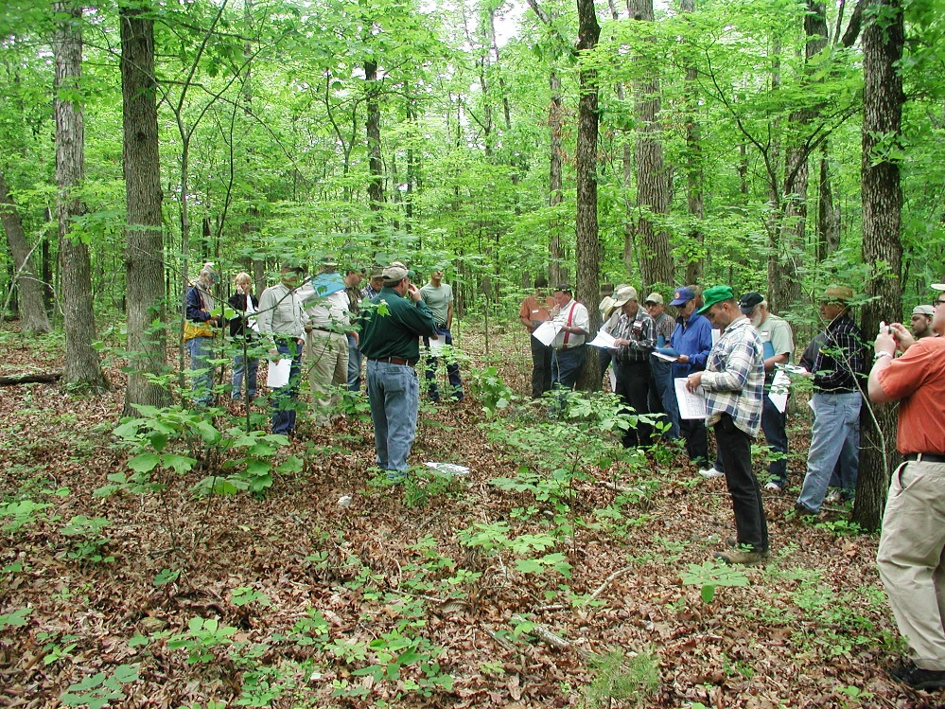
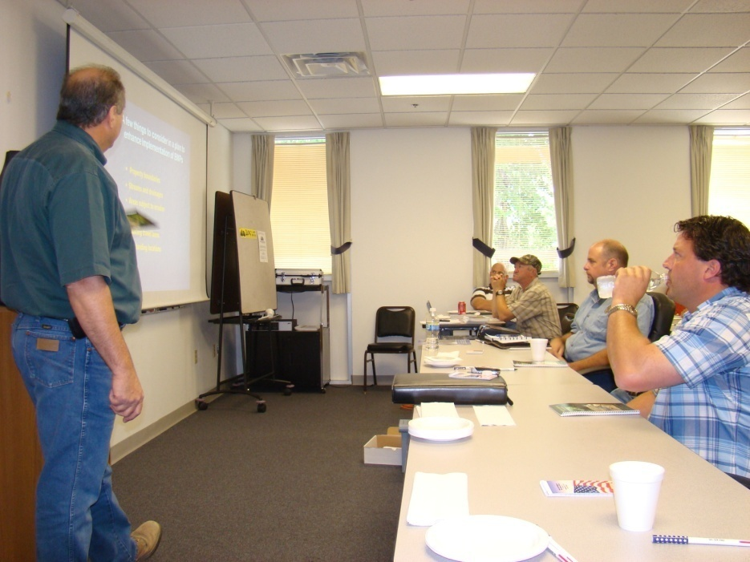
Technical BMP Training
Forester – Logger Training
Will conduct 9 BMP workshops
  Trainings will be both class room and Field
  To date 8 workshops with 409 Trainees

Slide 5
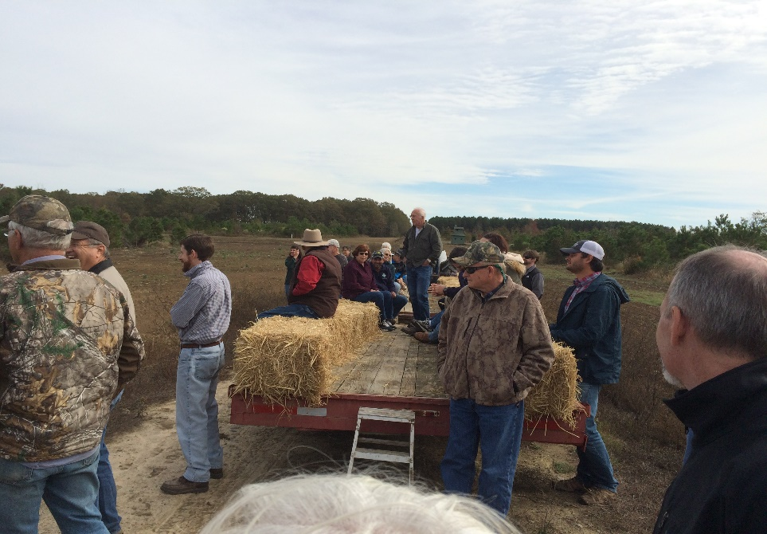
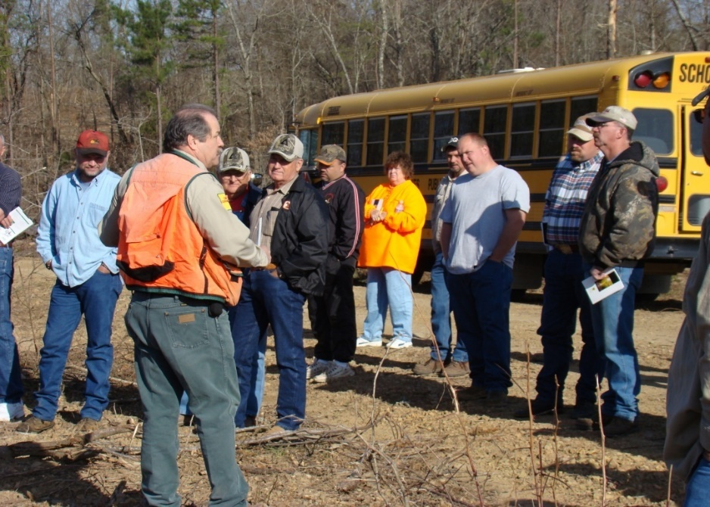
Non-Technical BMP Training
Landowner BMP Training
  Increase Landowner Awareness by conducting 3 workshops
  To date 2 Workshops have been held with 146 participants

Slide 6
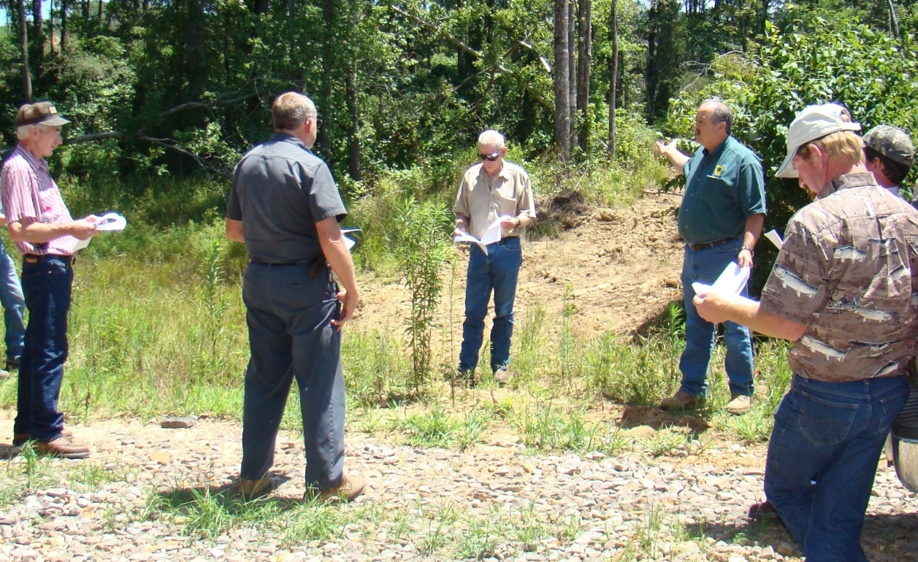
Courtesy Exams
Prevent before the event
  Provide 3 site specific technical on the ground assistance
  2 Sessions with 8 Foresters, 5 Loggers, 2 Contractors and 4 Landowners
  Exam address SMZ, temporary road BMP’s, and a technical assistance summary report of site specific BMP recommendations.

Slide 7
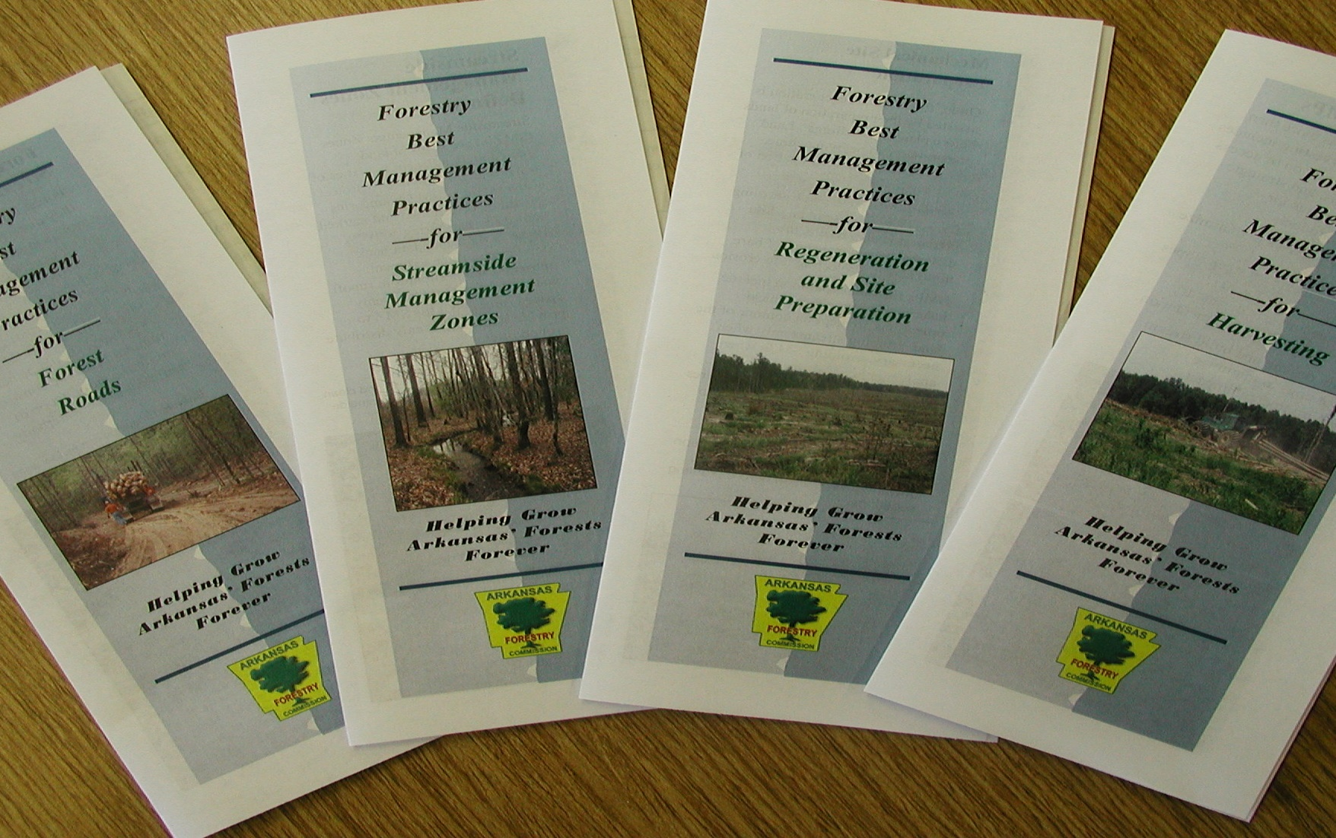
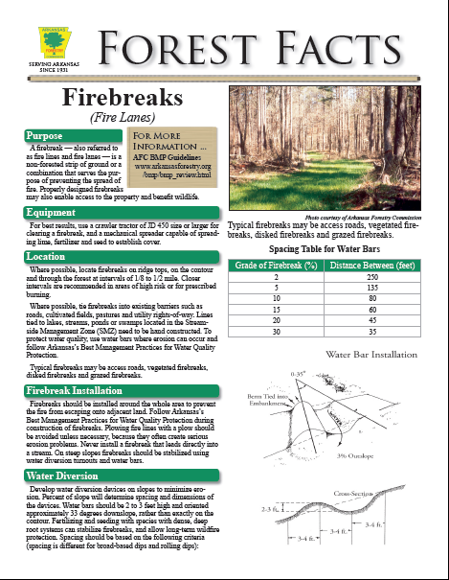

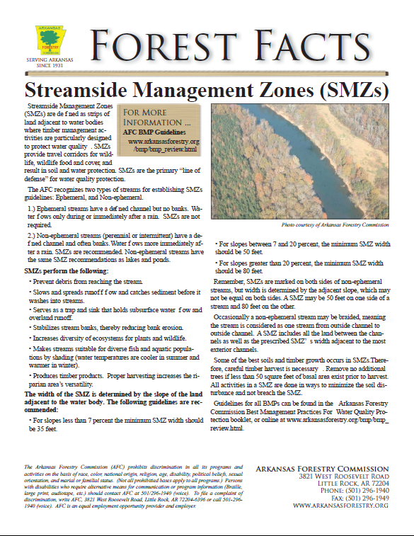
BMP Guideline Book & Materials
AFC will redesign and print handouts
Will re-print AFC BMP BOOK

Slide 8

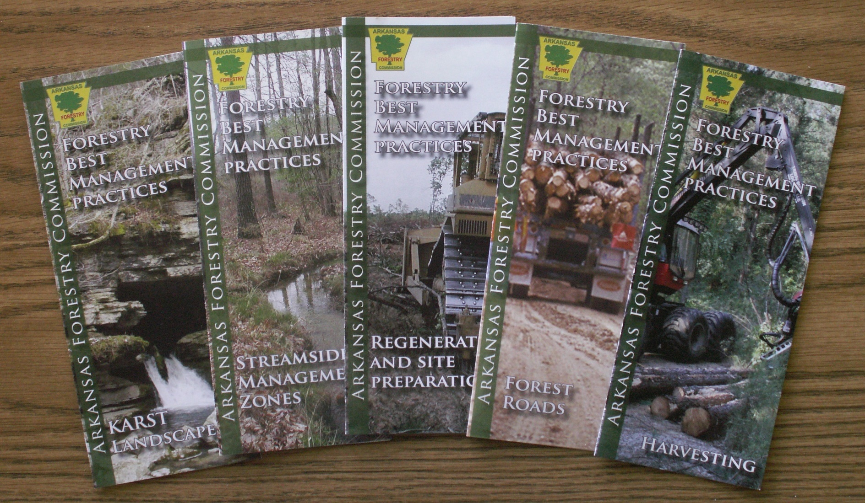
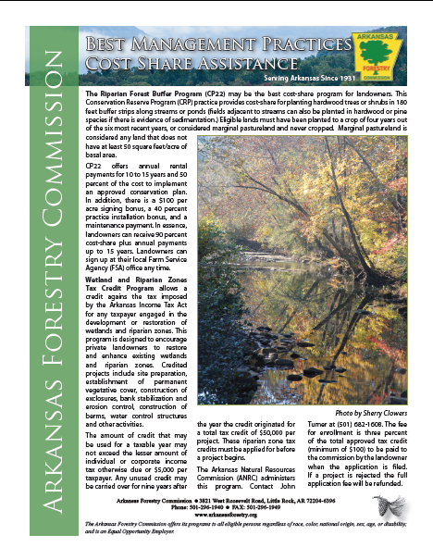
BMP Guideline Book & Materials

Slide 9
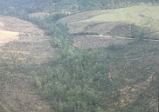
Silvicultural BMP Assessment
Previous BMP Implementation Averages
  7: 2010-2011 - 89%
  6: 2007-2008 - 86%
  5: 2005-2006 - 87%
  4: 2002-2003 - 85%
  3: 2000-2001 - 83%
  2: 1998-1999 - 80%
  1: 1996-1997 - 85%
  2016 – 2017: In Progress
  Using Landsat Imagery we collected 3012 pool sites
  Started to look at 250 random selected sites starting July 2017
  Plan to complete survey by January 2017
  Plan to analyze data and publish data by April 2017

Slide 10
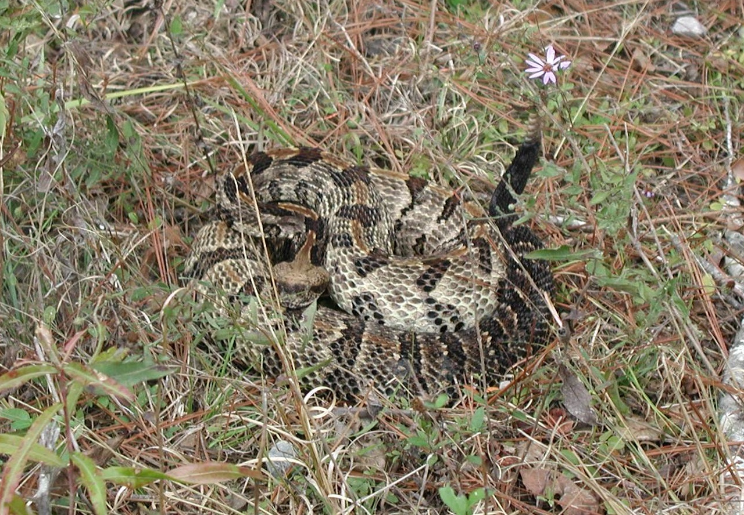
Obstacles Encountered
None up to this point

Slide 11





Acknowledgements
Arkansas Natural Resource Commission
Environmental Protection Agency,
Region 6
Arkansas Timber Producers Association
Arkansas Forestry Association
School of Forest Resources

Slide 12
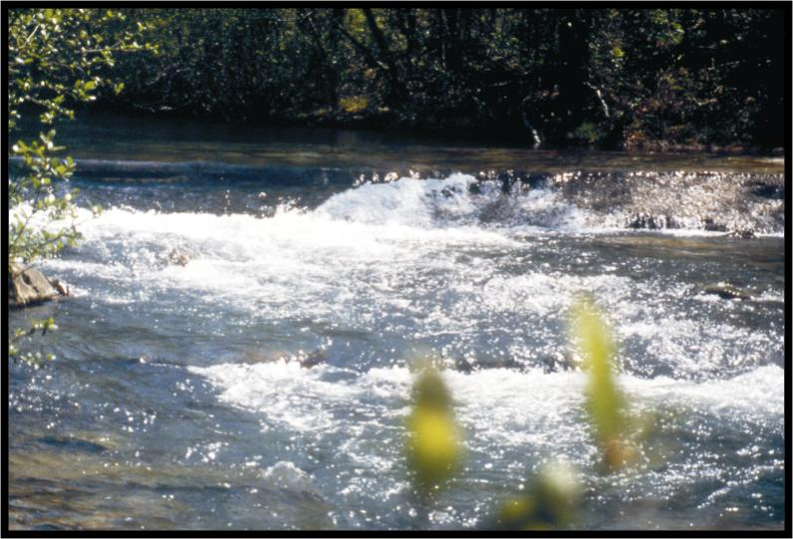

Arkansas Forestry Commission
Questions?
www.arkansasforestry.org
Arnold Hameister
AFC BMP Coordinator

Slide 13
8th BMP Implementation Survey Considerations
Site Selection Method
satellite imagery, severance tax, deeds, etc.
Ensuring Randomness
random number generator
Stratification
county, landowner, watershed.
Data Storage
database, spreadsheet, paper trail
Data Analysis

