Slide 1
Big Creek-White River Watershed Project
Project 16-300
Crooked Creek Conservation District
Mike Parkinson District Technician

Slide 2
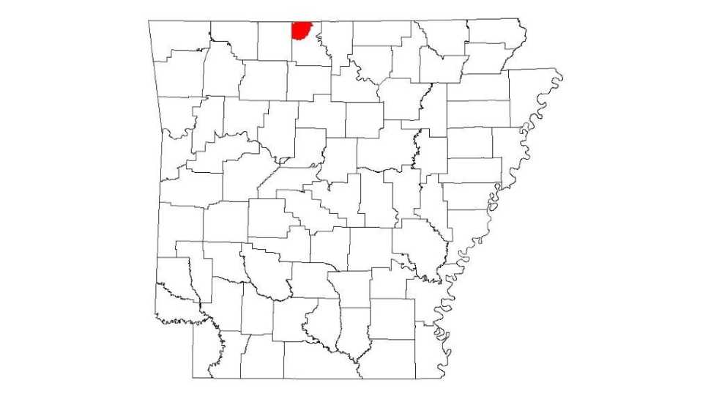
Project Location
City of Marshall
Town of Valley Springs
Town of Lead Hill
Town of Leslie
Nail-Swain Water Assoc
Morning Star Water Assoc
Pathenon Water Assoc
Deer Community Water Assoc
City of Jasper
City of Diamond City
Town of Western Grove
Mt shermen Water Assoc
East Newton County Water assoc
Mockingbird Hill Water assoc
Lake bull Shoals Estate water

Slide 3
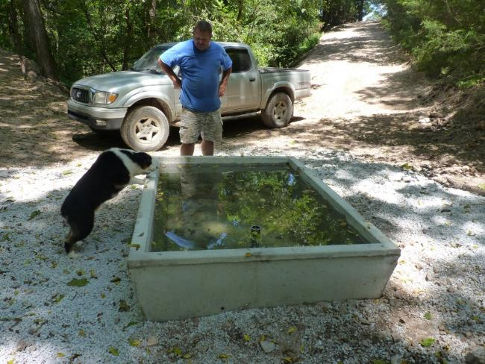
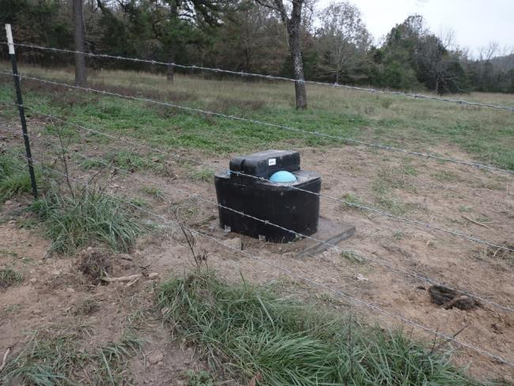
Livestock water
2 ball water tank installed for this pasture to have water since the cross fence was installed for pasture rotation on Project 319
Spring Tank installed from an existing pipeline from years ago, old tank fell apart and prefab tank installed that Crooked Creek Conservation Sales Spring tank installed on Project 319

Slide 4
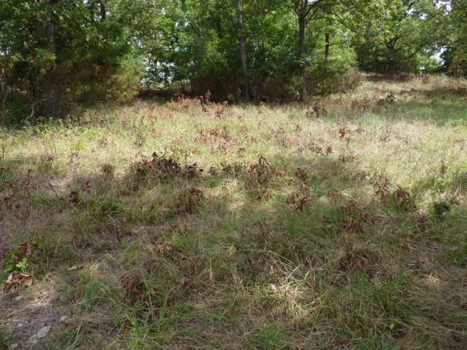
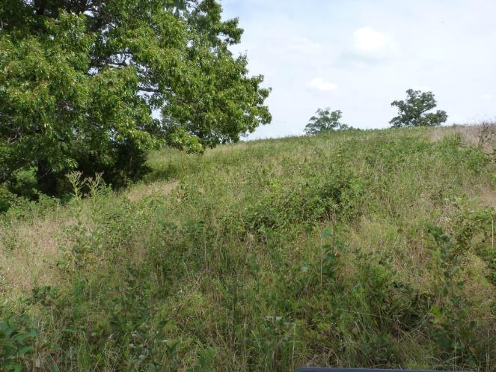
Brush Management
After spraying blackberries and Sericea Lespedeza, Good Kill on these brush. Remedy and Trooper used.
Can see the Blackberries and Sericera Lespedeza in June with full leaf. Not a lot of grass or ground cover for water quality

Slide 5
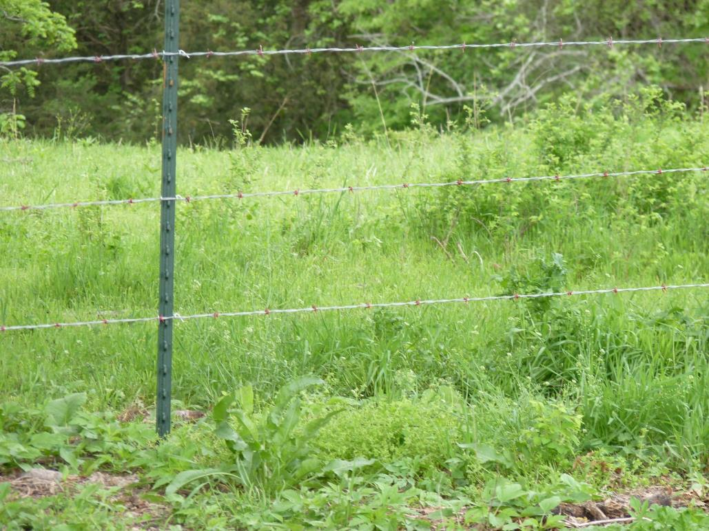
Fencing
Cross/Exclusion fencing helps with pasture rotation, exclusion from streams, and ground cover to improve water quality.

Slide 6
Crooked Creek Conservation District Accomplishments
54- PLANS WRITTEN FROM OCTOBER 1, 2016 TO SEPTEMBER 22, 2017
23- PLANS HAVE BEEN COMPLETED
31- PLANS STILL ACTIVE
HAVE SENT OUT (3) NEWLETTERS TO AREA FARMERS AND LANDOWNERS WITH THE FOURTH BEING PRINTED

