Slide 1
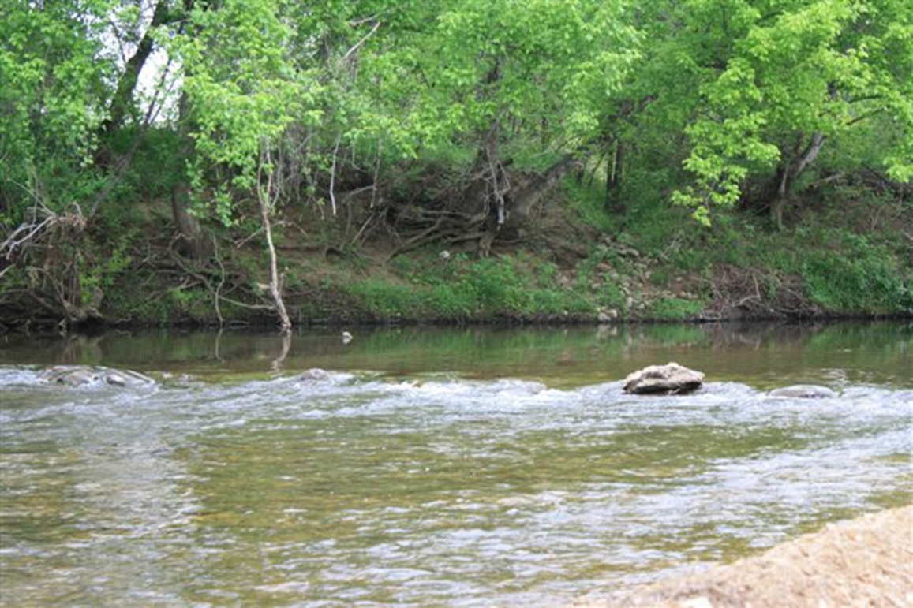
BAXTER COUNTY
CONSERVATION DISTRICT
FY16-200

Slide 2
Those aiding in the project
Baxter County Conservation District
Arkansas Natural Resources Commission
US Environmental Protection Agency
Arkansas Association of Conservation Districts
Baxter County Cattlemen’s Association
Baxter County Cooperative Extension Service
Farmers of Baxter County

Slide 3
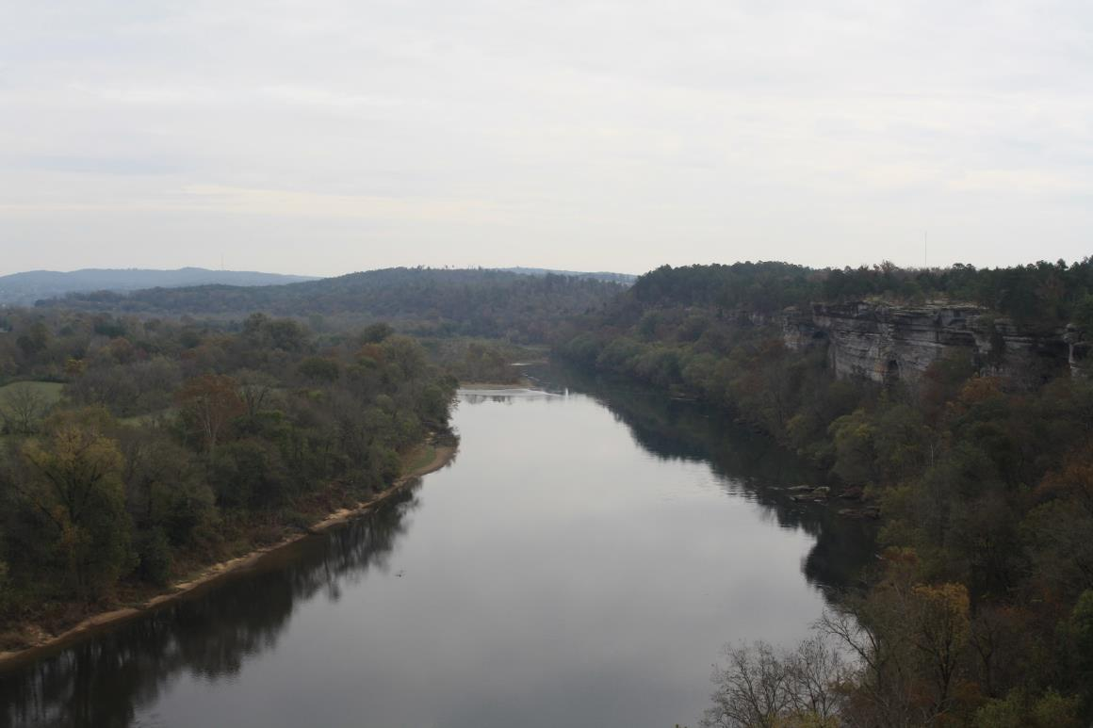
Improving The Land
And Water Quality

Slide 4
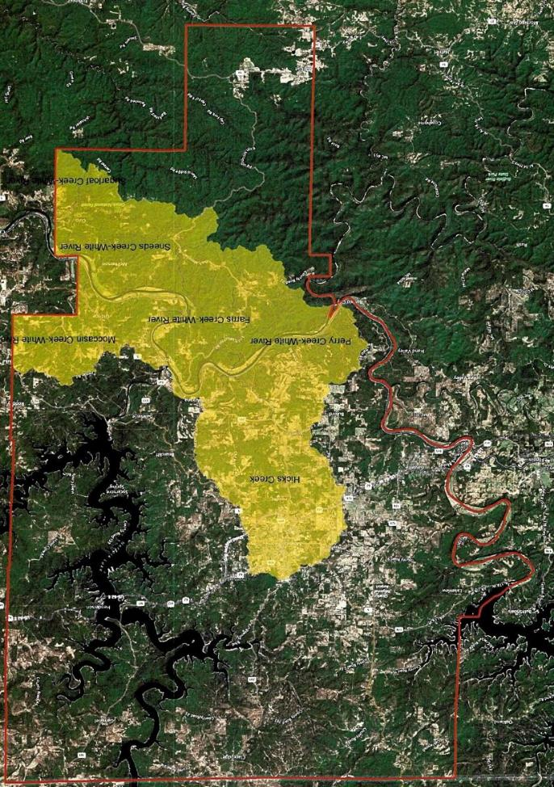
Hicks Creek Watershed

Slide 5
Best Management Practices
Cost Share
Cross Fencing
Pasture Establishment
Brush Management
Watering Facilities
Heavy Use Areas
Livestock Pipeline
Spring Development
Pond With Tank

Slide 6
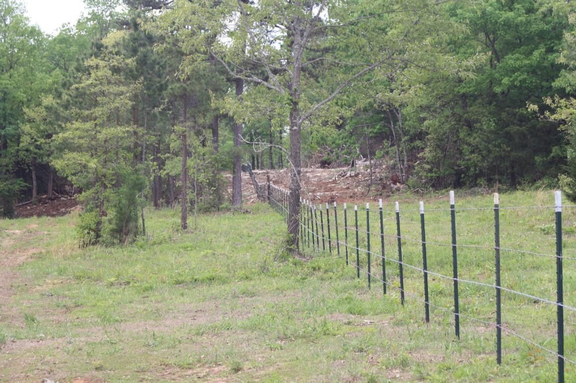
Fencing

Slide 7
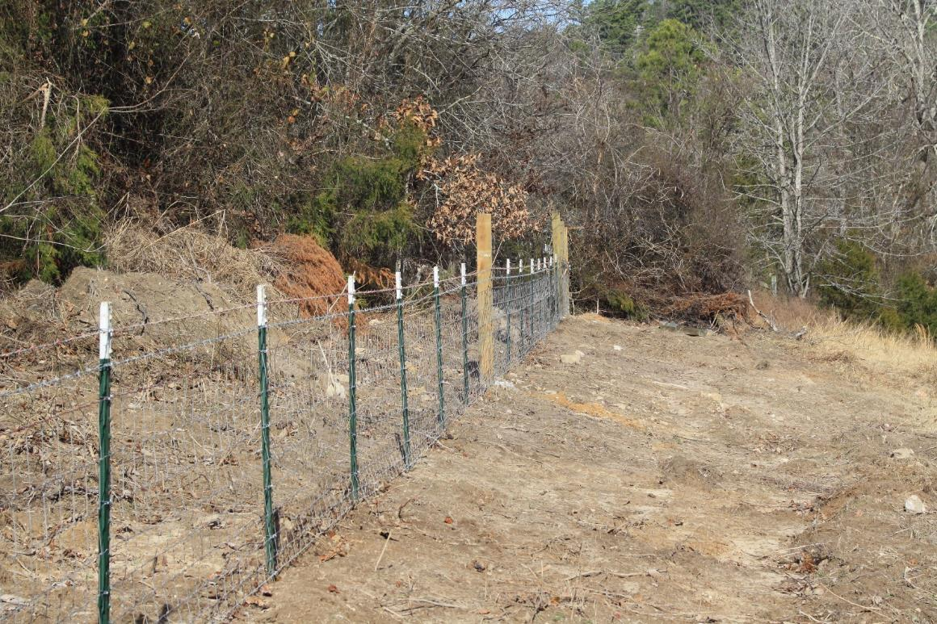

Slide 8
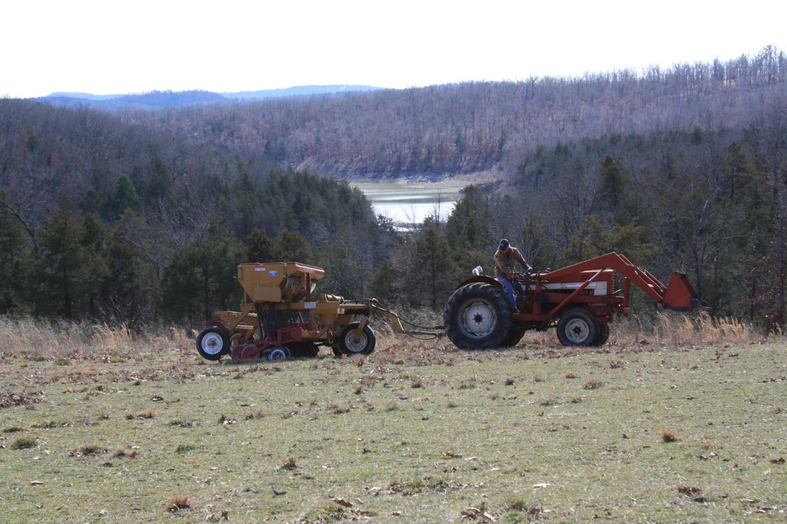
Cool Season Pasture Establishment

Slide 9
Equipment for Rent
Two No-Till Drills
Two Pull-Type Sprayers
One Field Roller

Slide 10
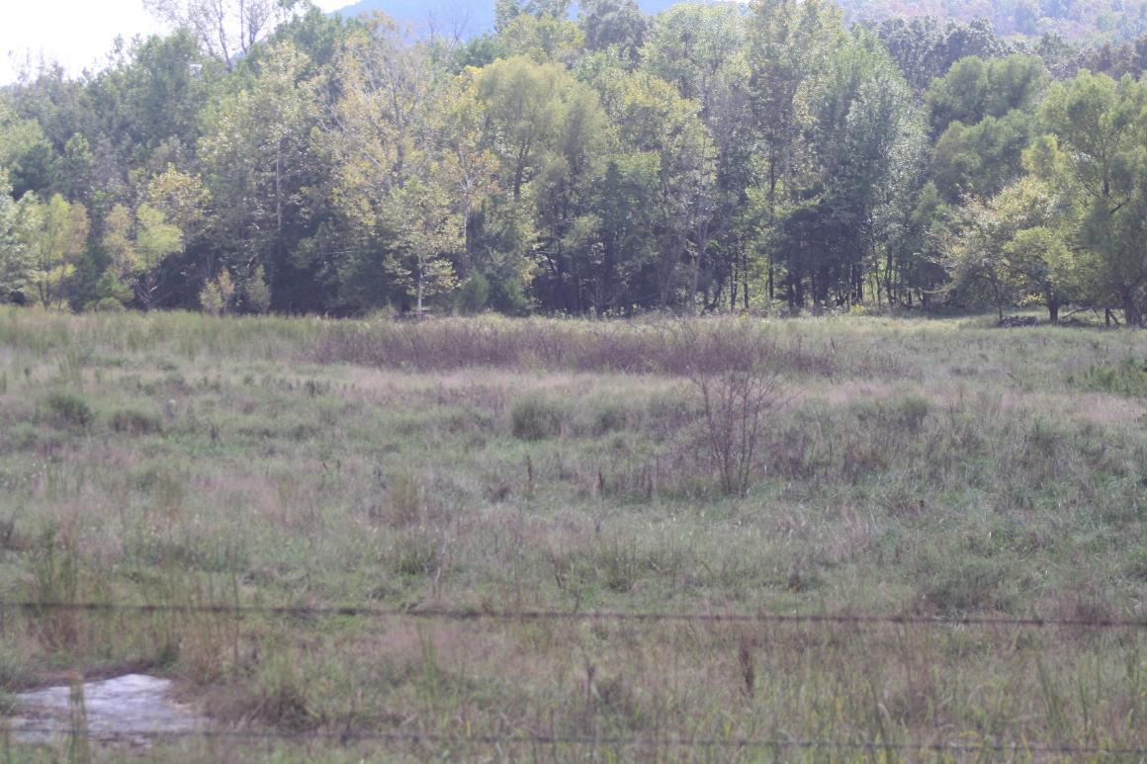
Brush Management

Slide 11
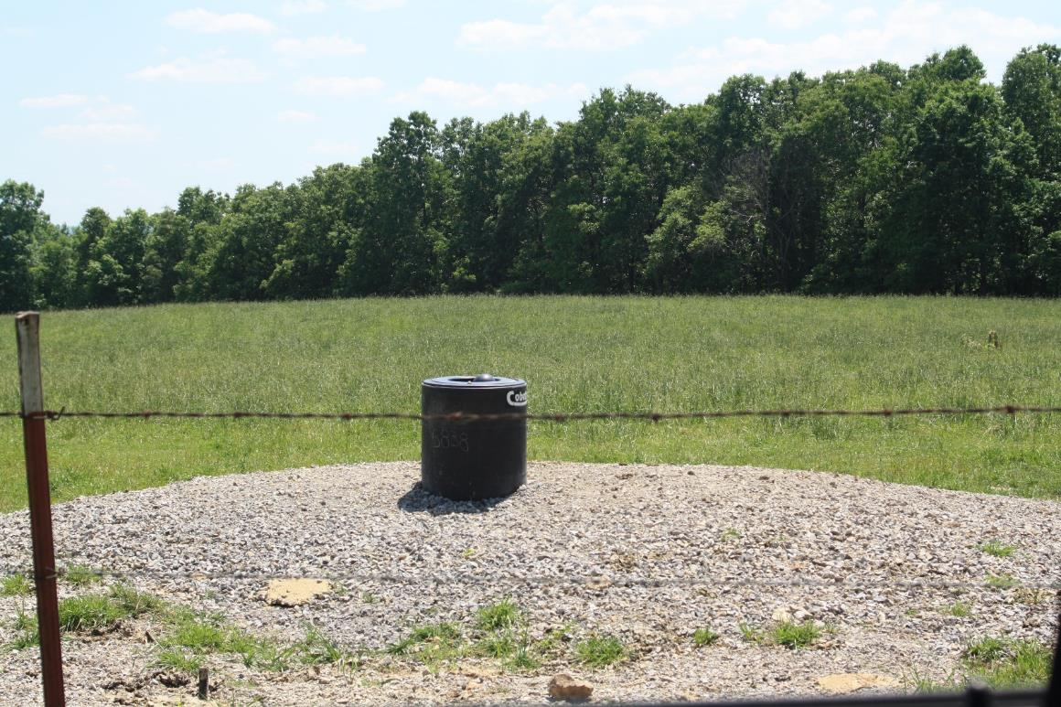
Watering Facilities

Slide 12
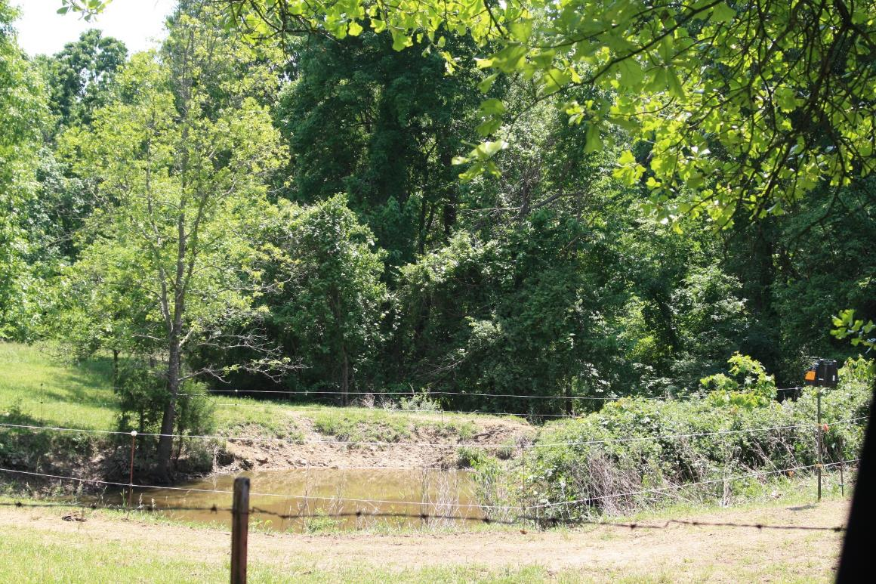

Slide 13
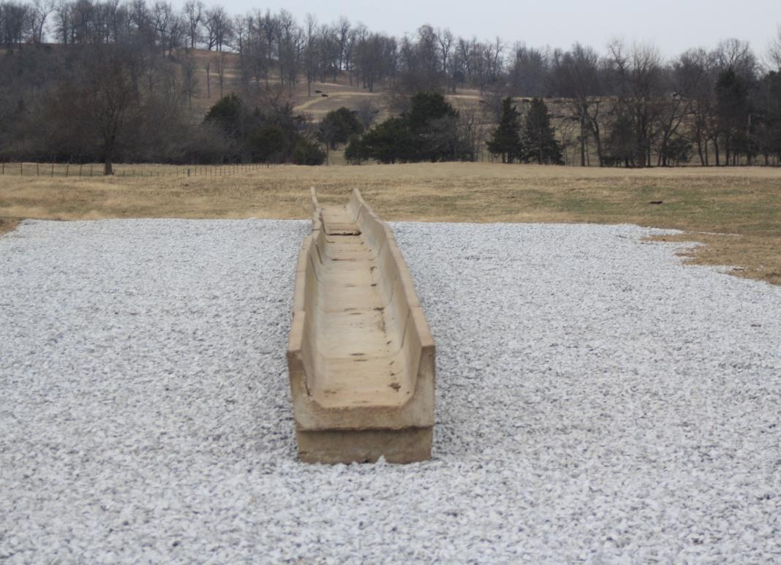
Heavy Use Areas

Slide 14
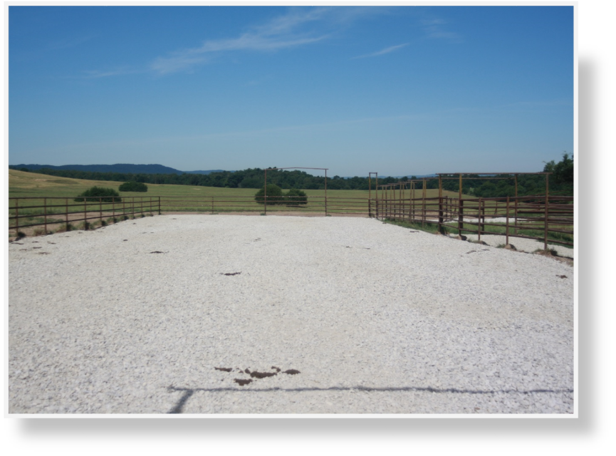
Heavy Use Areas

Slide 15
Outreach to Improve
Water Quality
Field Day on April 13
Cattleman’s Meeting
Almost 700 Quarterly Newsletters
Email over 600 Newsletters
Radio Advertisements
Visit Local Feed Stores
Farm Bureau Meetings

Slide 16
Accomplishments
Developed 60 Farm Plans
24 Completed Contracts
55 BMP’s Implemented
106 Return Farm Visits
Farmer awareness of water quality

Slide 17
Questions?
Baxter County Conservation District
Hicks Creek-White River
Watershed Project
FY16-200

