Slide 1
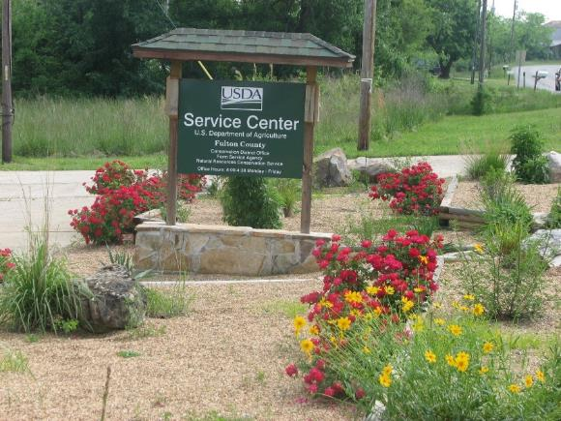
Fulton County Conservation District
236 Byron Road
Salem, AR 72576

Slide 2
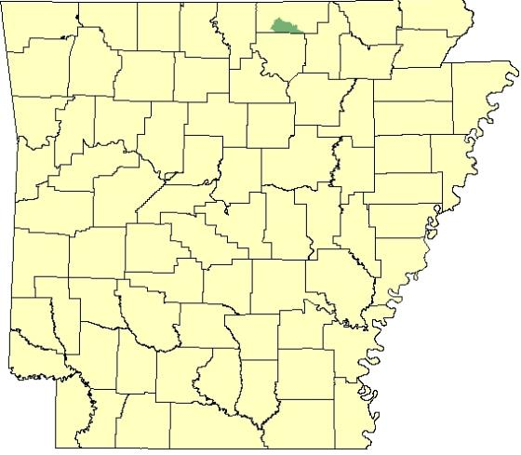
Strawberry River
Sub Watershed Project
Project 15-1100

Slide 3
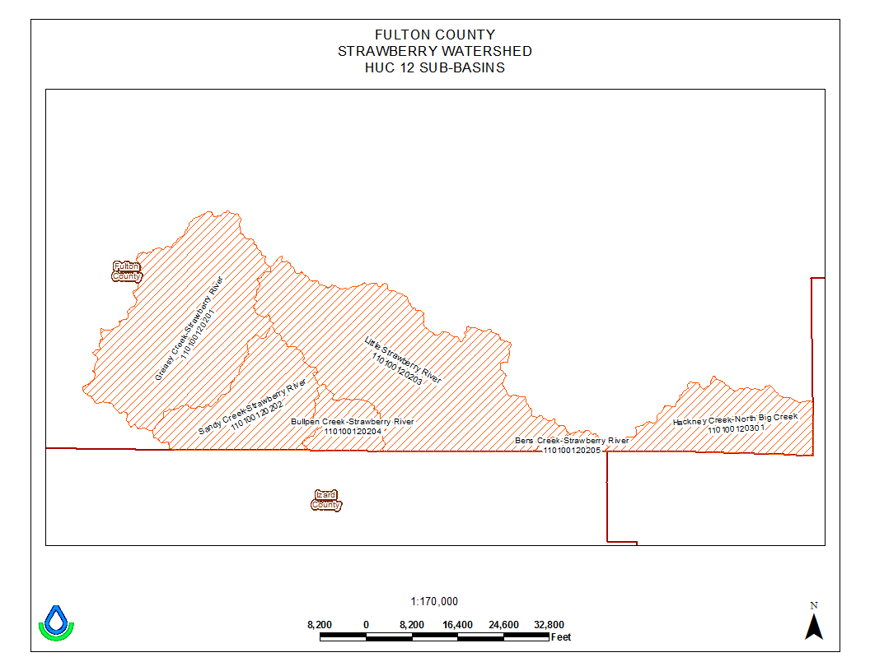
Six sub watersheds:
Greasy Creek Bullpen Creek
Bens Creek Sandy Creek
Hackney Creek Little Strawberry

Slide 4
Priorities for Planning
Farms that are within or partially within a wellhead protection area.
All farms with riparian access along blue line streams as indicated on the 7.5 minute USGS quadrangle maps.
All farms within 1 mile of a blue line stream.
Conservation planning and financial assistance to implement BMPs will result in the establishment of vegetative cover on the pastureland.
Promoting and measuring the receptiveness of landowners in the project area to the transfer of poultry litter from nutrient surplus areas to areas where the litter will result in improved ground cover decreasing sedimentation.

Slide 5
Objectives
The primary objective is to maintain or restore
all designated uses of the Strawberry River Sub Watershed Project by:
Implementing a program that will bring about VOLUNTARY participation of landowners in the application of the necessary BMPs.
Implementation of 150 conservation plans.

Slide 6
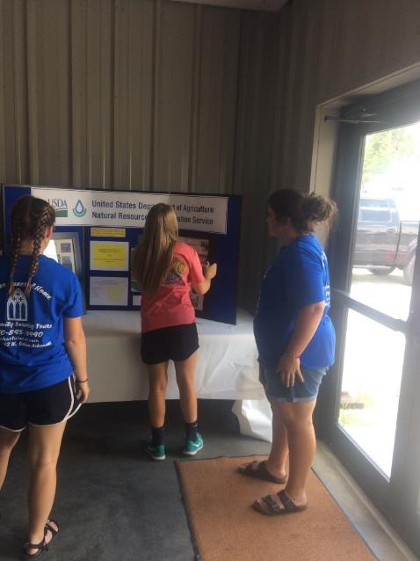
OUTREACH
Fulton County Fair Booth
Quarterly Newsletter
Each quarter color newsletter mailed
Each quarter 4 radio spots
Each quarter place newspaper article
2 outreach meetings highlighting 319 project
1 field day highlighting best management practices

Slide 7
EQIP-MRBI funded through NRCS
Mississippi River Basin Initiative started in 2015
The Strawberry River Watershed was selected as a priority watershed for being listed as impaired by the State and consistently failing to meet water quality standards.
Total contracts: 35
Total paid: $233,467.28
Total acres: 4,530.9

Slide 8
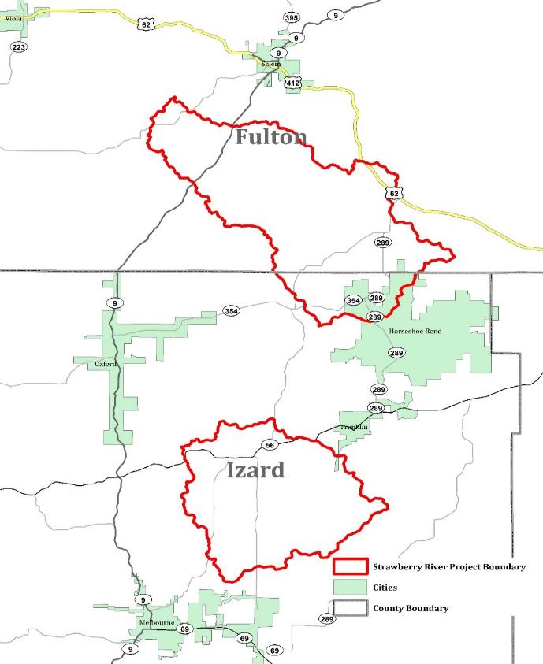

Slide 9
Recommended practices for implementation
Fence
Pond
Watering facility
Pipeline
Pasture planting
Critical area planting
Herbaceous weed control
Heavy use area
Brush control

Slide 10
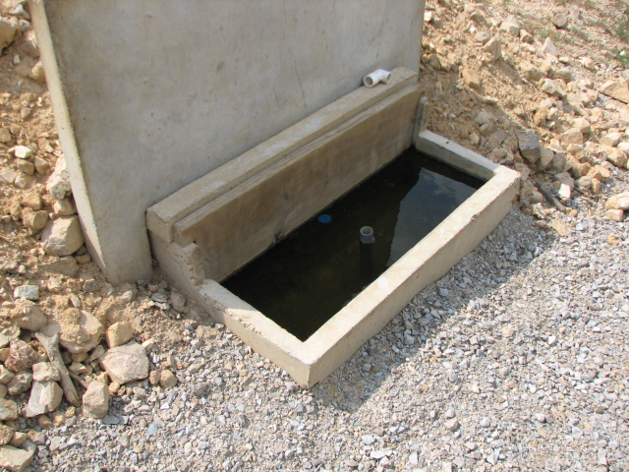
Notes:
Freeze proof tank

Slide 11
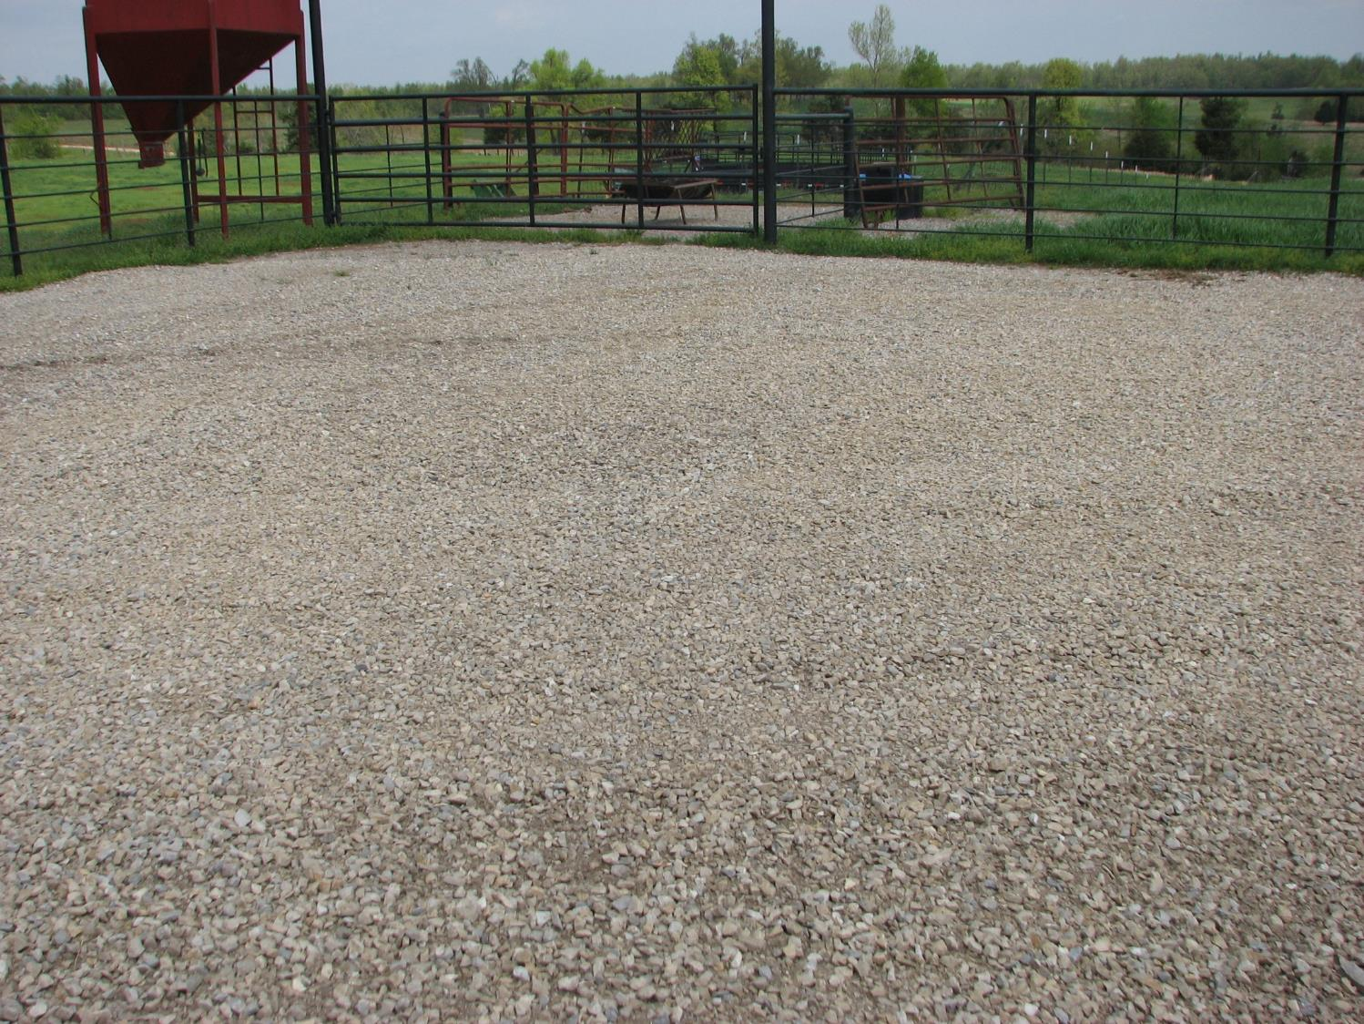

Slide 12
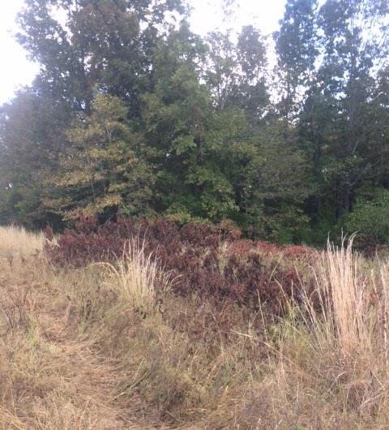
Notes:
(314) Brush management

Slide 13
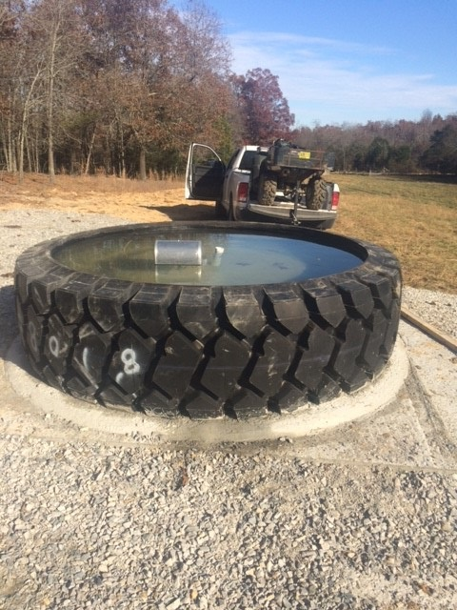
Notes:
(614) Watering facility- Tire Tank
(516) Pipeline (561) Heavy Use Area Protection
(561) Heavy use area

Slide 14
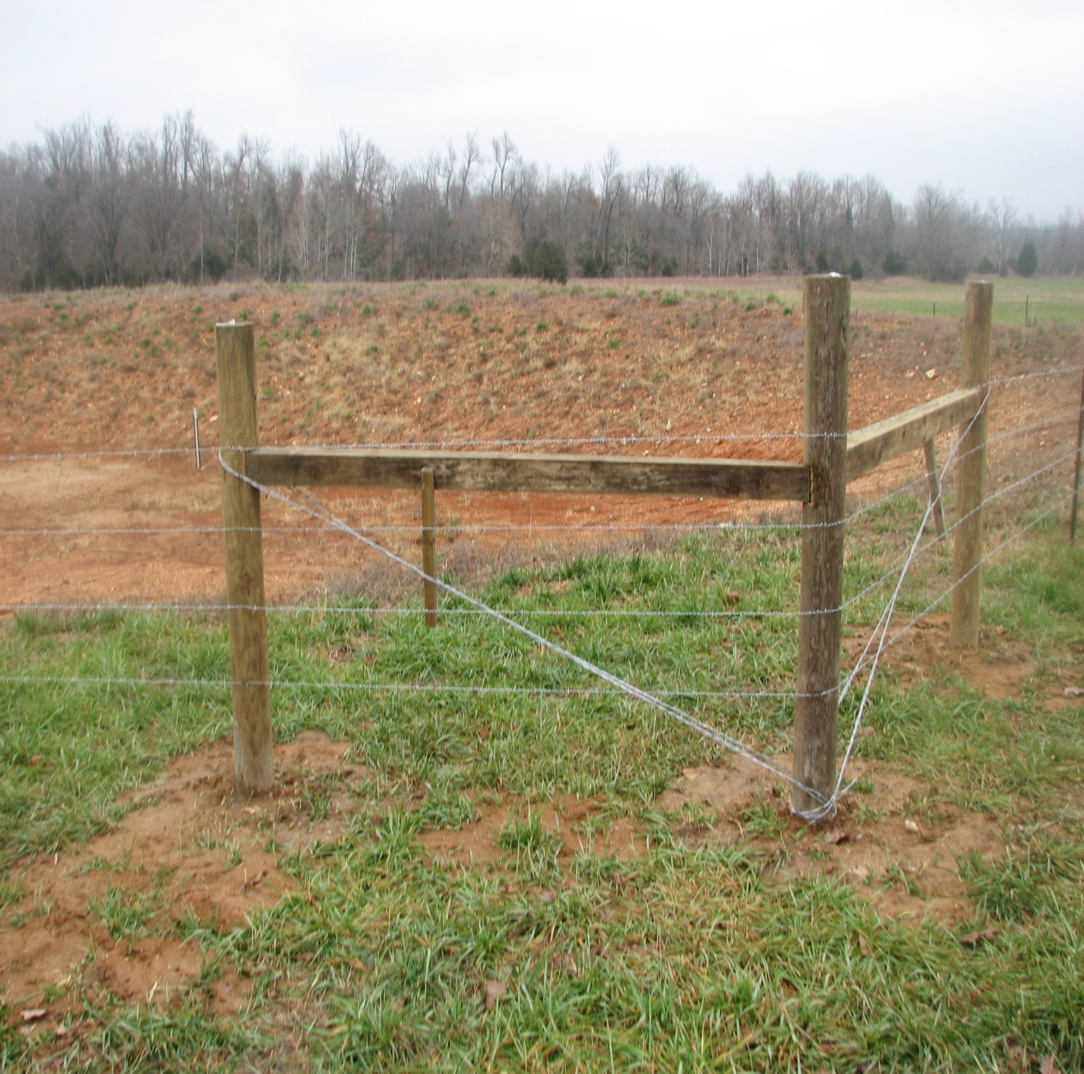
Notes:
(382) Fence

Slide 15
BMPs Installed
Herbaceous Weed Control (315)…...438.6 ac
Pasture Planting (512)…………………...683.4 ac
Fence (382)………………………………….16,406.6 ft
Watering Facilities (614)………………………..6 ea
Heavy Use Area Protection (561)…… 4,557 sq ft
Brush Management (314)………………….696.6 ac
Pond (378)………………………………… 1ea- 1500 cy
Pipeline (516)………………………..…….6,371.8 ft

Slide 16
Conservation Planning
116 Farm Plans with 44 contracts
Contracts for $100,734.77
$62,852.47 paid to farmers as of 9/28/2017

Slide 17
Conservation Planning
QUESTIONS
OR
COMMENTS?????

