Slide 1
Boone County Beaver Reservoir Watershed Project
Presented By: Boone County Conservation District

Slide 2


Boone County Beaver Reservoir Watershed Project
Beaver Lake Watershed Protection Strategy: adopted by the US EPA
Beaver and Table Rock Lake-supplies drinking water
Causes of impairment: sediment/nutrient/chemical residues
Adverse effects on several species
Project Goal
Encourage voluntary participation of Best Management Practices (BMPs) on 50% of pastureland (approximately 22,500 acres)

Slide 3
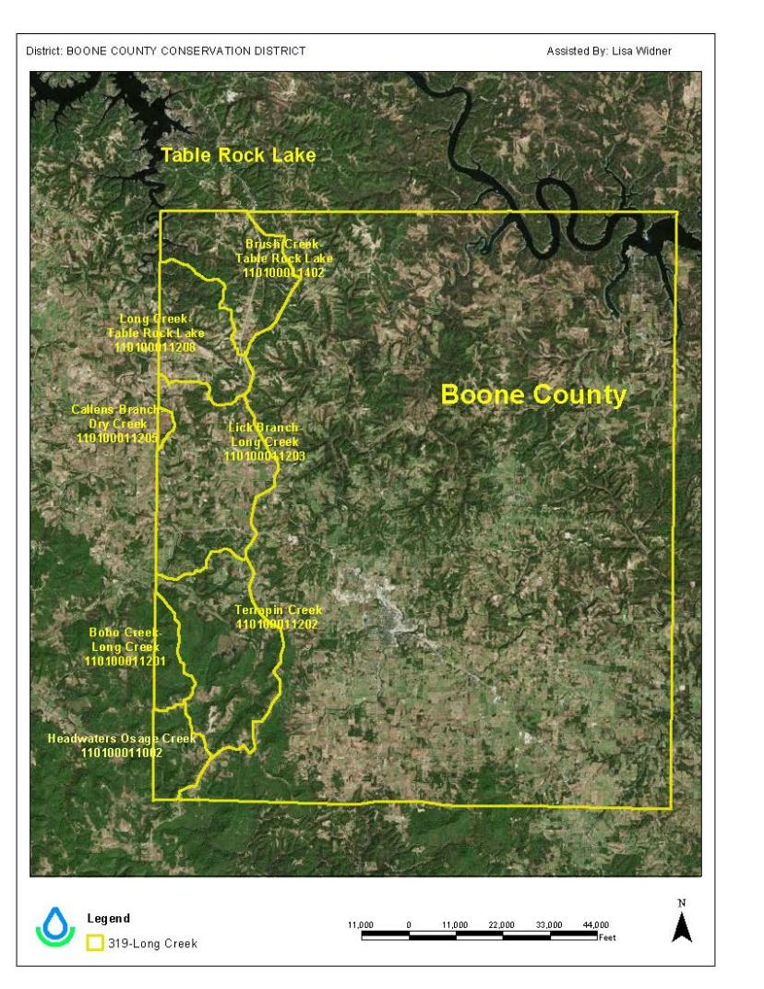
Boone County Beaver Reservoir Watershed Project
Project Focus
Sub watersheds:
Brush Creek-Table Rock Lake
Long Creek-Table Rock Lake
Lick Branch-Long Creek
Callens Branch-Dry Creek
Terrapin Creek
Bobo Creek-Long Creek
Headwaters Osage Creek

Slide 4

Boone County Beaver Reservoir Watershed Project
Pasture Management Discussion
March 28,2016
Speakers included the:
NRCS Technicians
Dirk Philipp, Ph.D., U of A
BCCD Technicians & Board
Testimonials from land owners
Focused on:
Increasing Awareness for Water Quality Protection: Stream Restoration through Temporary & Permanent Animal Access Restriction

Slide 5
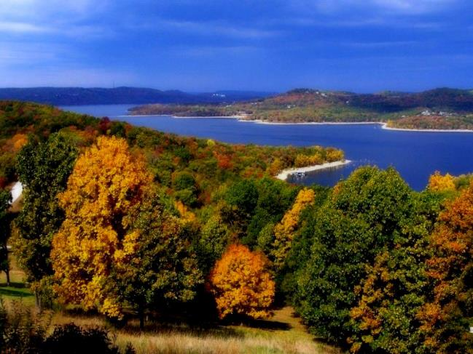

Boone County Beaver Reservoir Watershed Project
Outreach
Newsletter Inserts Quarterly
Facts Sheets
Fair Booth at the Northwest
Arkansas District Fair
Project Highlighted on District’s
  Website www.boonecd.com
Radio Spots & Newspaper
Articles

Slide 6
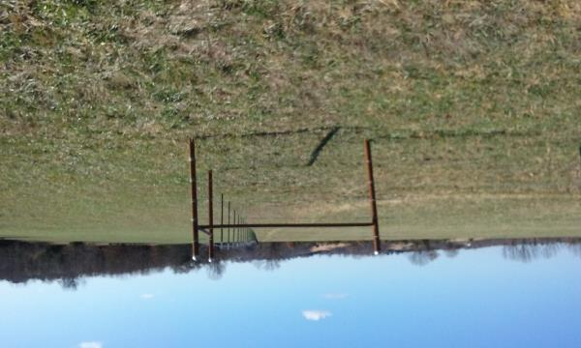
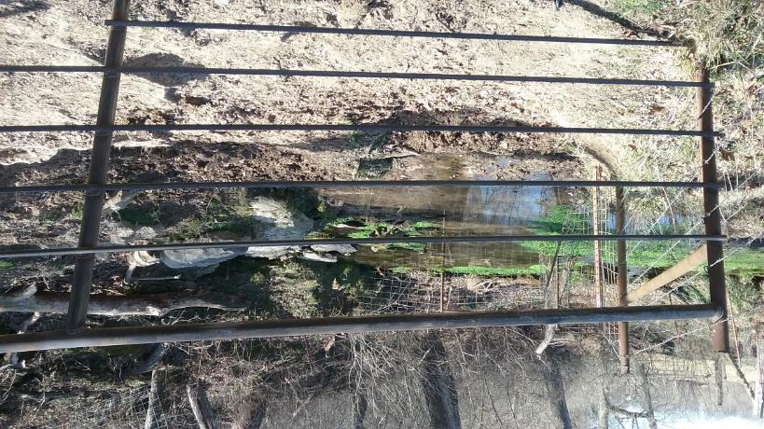
Boone County Beaver Reservoir Watershed Project
Other BMPs Completed
Forage & Biomass Planting (512) 312.3 ac
Brush Mgt (314) 10 ac

Slide 7
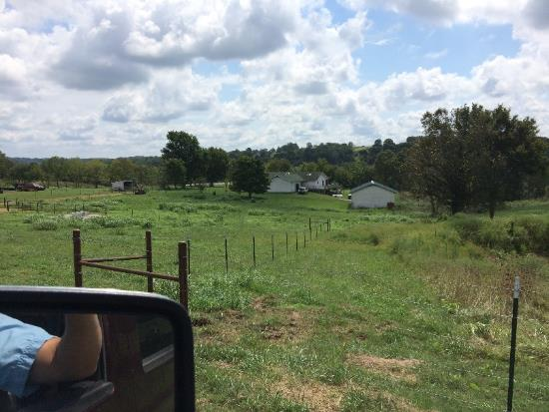
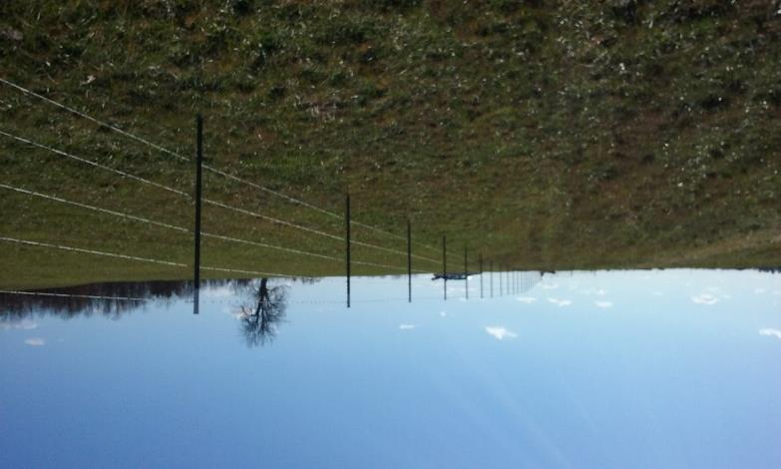
Boone County Beaver Reservoir Watershed Project
Completed Practices
Fencing (382)
22,424.20 ft.

Slide 8
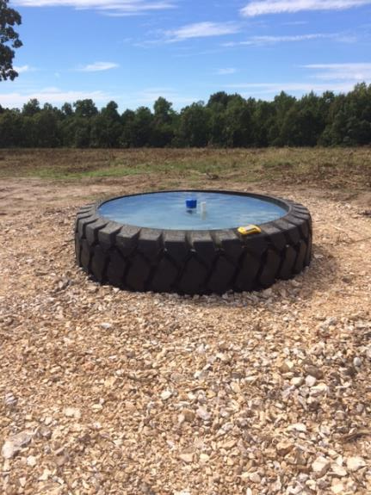
Boone County Beaver Reservoir Watershed Project
Other BMPs Completed
Pipeline (516) 2001 ft.
Watering Facilities (614)
Heavy Use Area Protection (561)

Slide 9
Boone County Beaver Reservoir Watershed Project
Accomplishments to Date
Completed 17 conservation plans
Revised 5 Nutrient Management Plans & created 7 new plans
$27,720.36 has been paid to landowners, $41,580.61 landowner match

Slide 10
Boone County Beaver Reservoir Watershed Project
Those Aiding in the Project
Boone County Conservation District
Natural Resource Conservation Service
Boone County Extension Service
Arkansas Natural Resources Commission
US Environmental Protection Agency

Slide 11
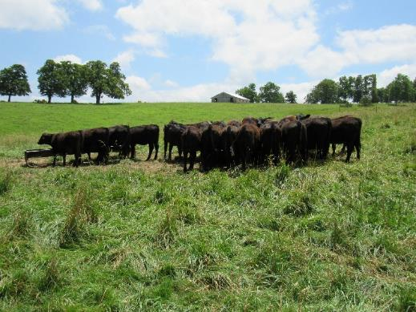

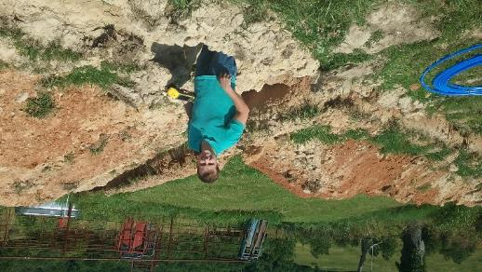
Boone County Beaver Reservoir Watershed Project
Questions?

