Slide 1


Little River Ditches
Watershed Monitoring
14-400
Jennifer L. Bouldin, PhD
Ecotoxicology Research Facility
Arkansas State University

Slide 2
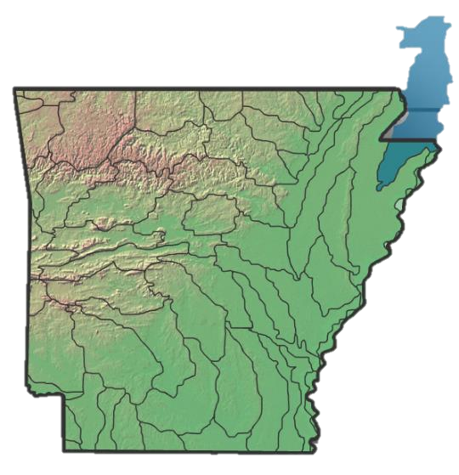
Background
Primarily agricultural land use
  81.4% cropland
  11.0% forested
Sampled weekly
when water is present

Slide 3
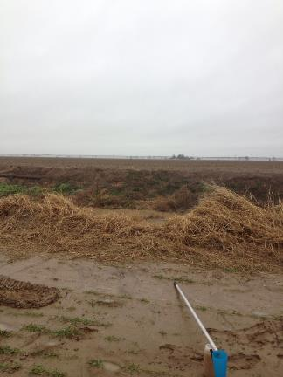
Measured Parameters
pH
Dissolved Oxygen
Conductance (μS/cm)
Total Suspended Solids (TSS)
Turbidity
Dissolved Nitrate, Nitrite,
Orthophosphate
Total Nitrogen,
Total Phosphorus

Slide 4
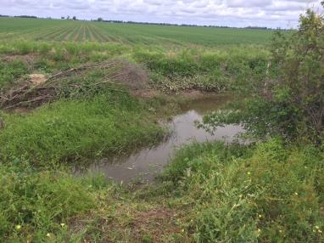
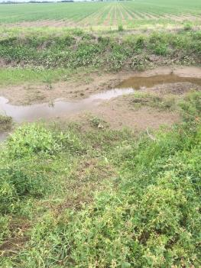
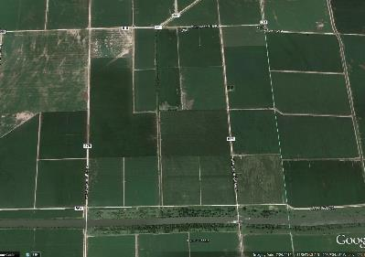
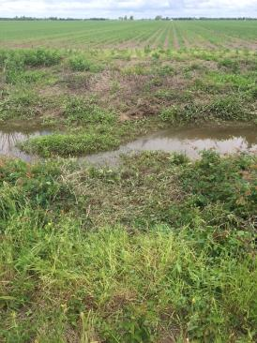
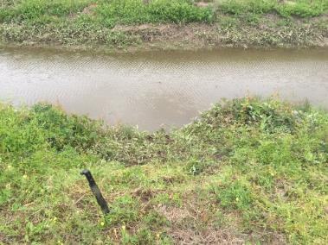
1
2
Flow
4
3
2
1
3
4

Slide 5
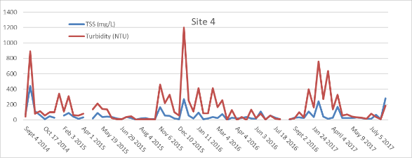
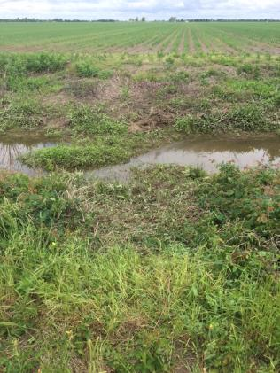
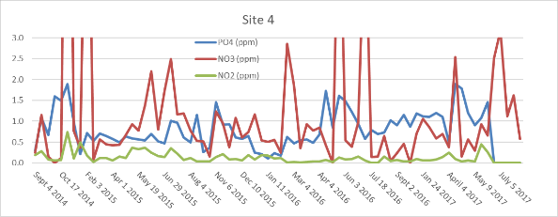
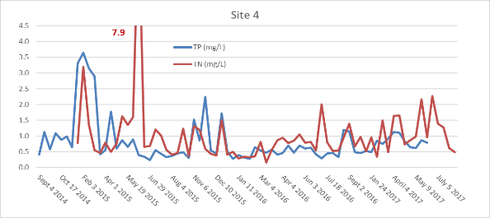
Site 4
4

Slide 6
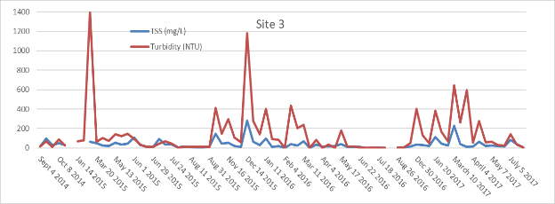
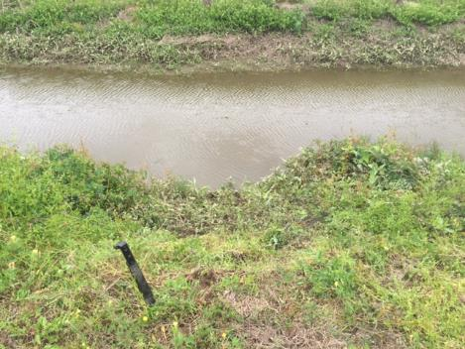
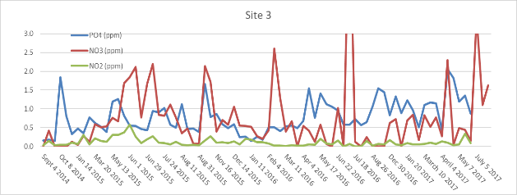
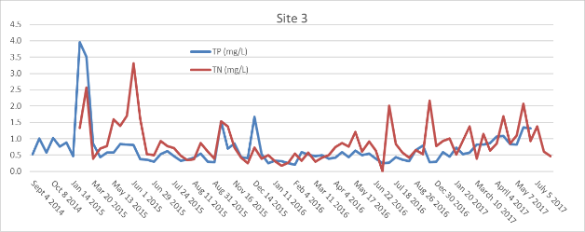
Site 3
6.7
3

Slide 7
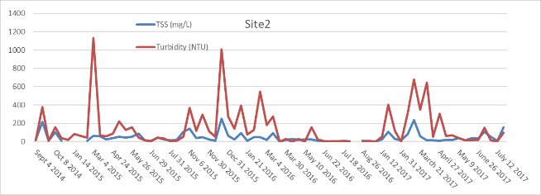
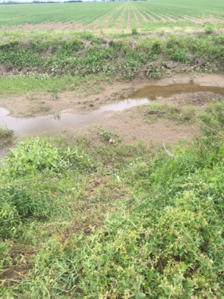
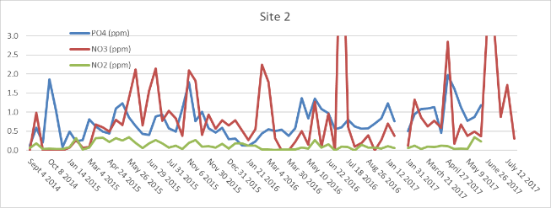
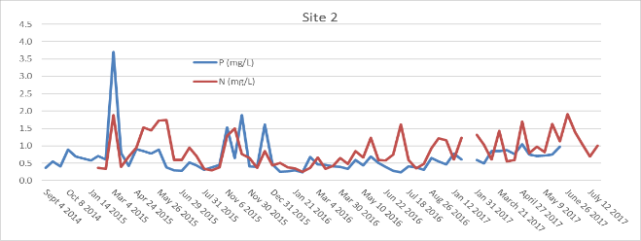
Site 2
7.1
3.5
3.2
2

Slide 8
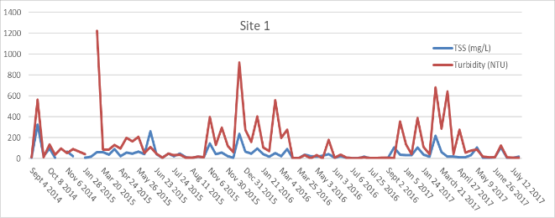
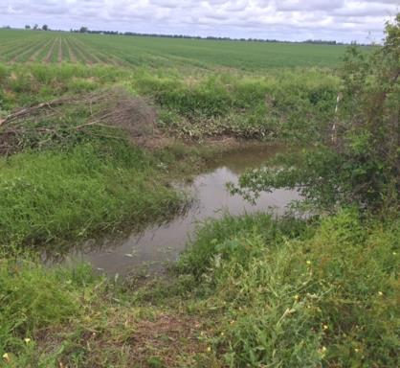
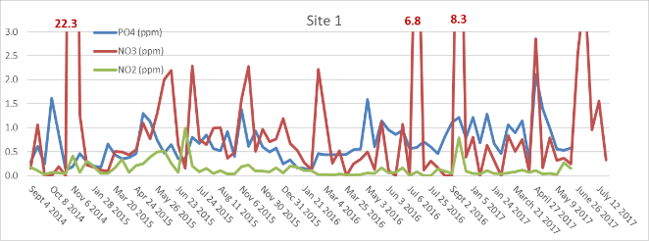
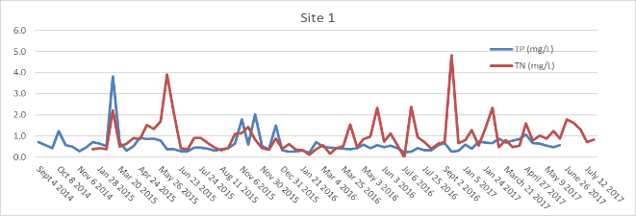
Site 1
1

Slide 9
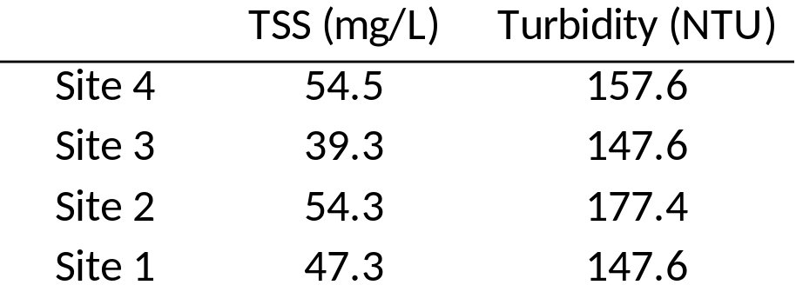
Mean TSS & Turbidity
Flow
No significant differences from upstream to downstream

Slide 10
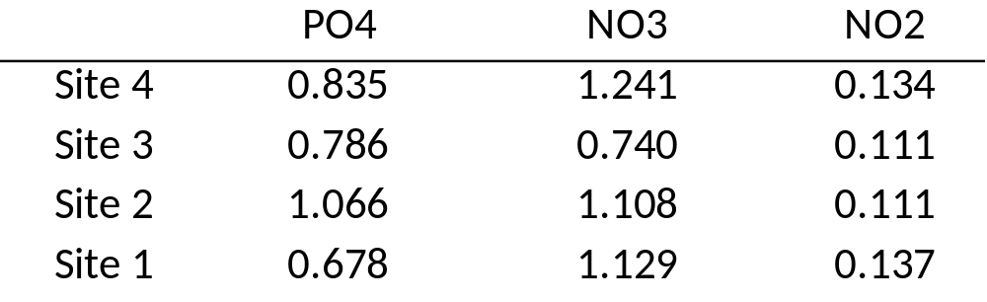
Dissolved nutrients (ppm)
Flow
Decrease in PO₄
NO₃/NO₂ statistically same from Site 4 to Site 1

Slide 11
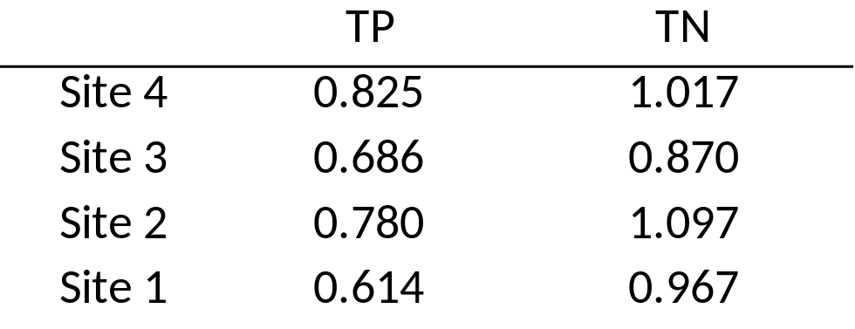
Total N & P
Flow
Decrease in TP
Decrease in TN from Site 4 to Site 1

Slide 12
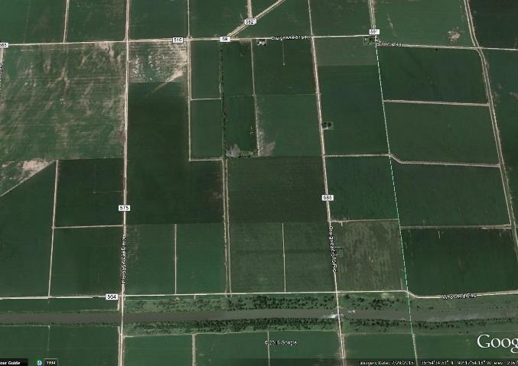
4
Flow
3
2
1
Questions??

