Slide 1
ADEQ Approaches to the Assessment Methodology
NPS Annual Stakeholder Meeting
September 27, 2017

Slide 2
Overview
Process of assessing Waters of the State
State of the Waters
Public Participation opportunities

Slide 3
Clean Water Act Requirements
Defines Water Quality goals
40 CFR 130.3 and 131
Adopt Water Quality Standards
Data collection based on need
40 CFR 130.4
Monitor Waters of the State
Determines attainment
40 CFR 130.8
Assessment
305(b) Integrated Report
Identifies Quality Limited Waters
40 CFR 130.7(b)(1)
List Impaired Waters
303(d) List
Defines Waste Loads
40 CFR 130.7
Develop TMDLs
Implementation
40 CFR Part 122
Develop Permit Limits

Slide 4
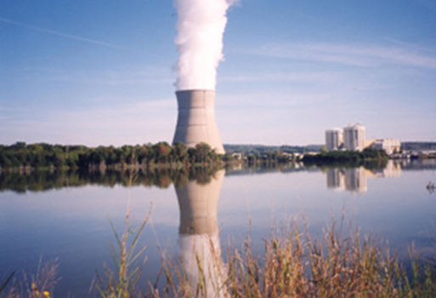
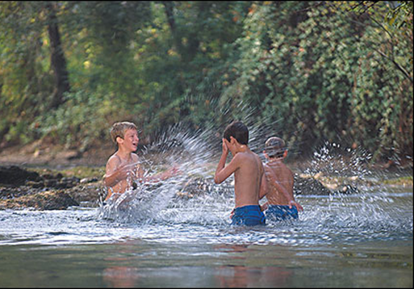
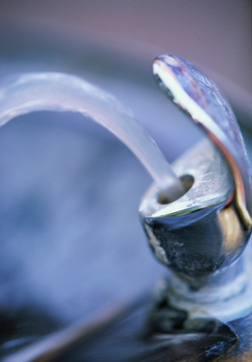
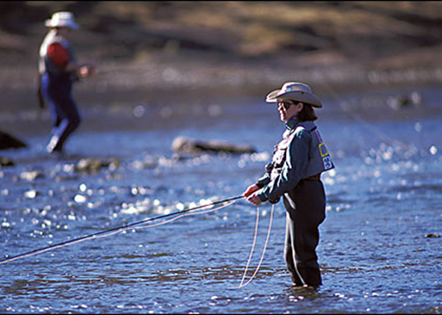
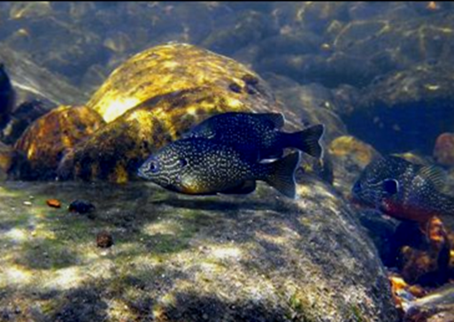
Designated Uses
Industrial Water Supply
Primary Contact Recreation
Domestic
Water Supply
Secondary Contact Recreation
Aquatic Life

Slide 5
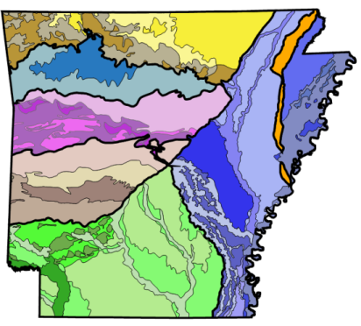
Water Quality Criteria
Ecoregion Based
Ecoregions | Temp (°C) | Turbidity
 |  | Base | All
Ozark Highlands | 29 | 10 | 17
Boston Mountains | 31 | 10 | 19
Arkansas River Valley | 31 | 21 | 40
Ouachita Mountains | 30 | 10 | 18
Gulf Coastal Plain Typical Springwater-influenced | 30 30 | 21 21 | 32 32
Mississippi Alluvial Plain Least Altered Channel Altered | 30 32 | 45 75 | 84 250

Slide 6
Clean Water Act Requirements
Defines Water Quality goals
40 CFR 130.3 and 131
Adopt Water Quality Standards
Data collection based on need 40 CFR 130.4
Monitor Waters of the State
Determines attainment
40 CFR 130.8
Assessment
305(b) Integrated Report
Identifies Quality Limited Waters
40 CFR 130.7(b)(1)
List Impaired Waters
303(d) List
Defines Waste Loads
40 CFR 130.7
Develop TMDLs
Implementation
40 CFR Part 122
Develop Permit Limits

Slide 7
Clean Water Act Requirements
Defines Water Quality goals
40 CFR 130.3 and 131
Adopt Water Quality Standards
Data collection based on need 40 CFR 130.4
Monitor Waters of the State
Determines attainment
40 CFR 130.8
Assessment
305(b) Integrated Report
Identifies Quality Limited Waters
40 CFR 130.7(b)(1)
List Impaired Waters
303(d) List
Defines Waste Loads
40 CFR 130.7
Develop TMDLs
Implementation
40 CFR Part 122
Develop Permit Limits

Slide 8
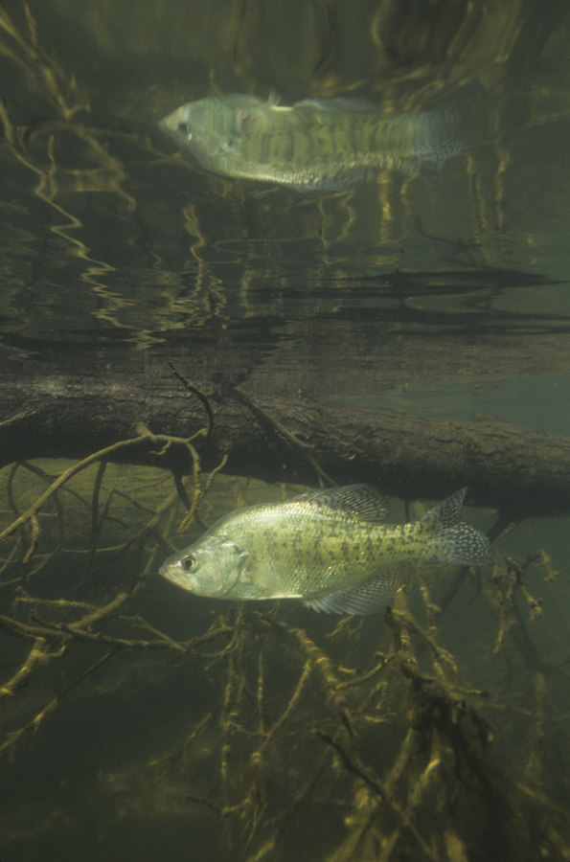
What is the
Assessment Methodology?
Every two years ADEQ must
assess the waters of the State
to determine if they are:
  supporting designated uses
  attaining water quality criteria
The Assessment Methodology
contains procedures for
this assessment
Photo: Jack Bissell

Slide 9
What is the
Assessment Methodology?
Prepared by ADEQ staff
Must be consistent with Reg. 2
Must be scientifically based
Assessment outcomes determine:
  Attainment
  Non-Attainment

Slide 10
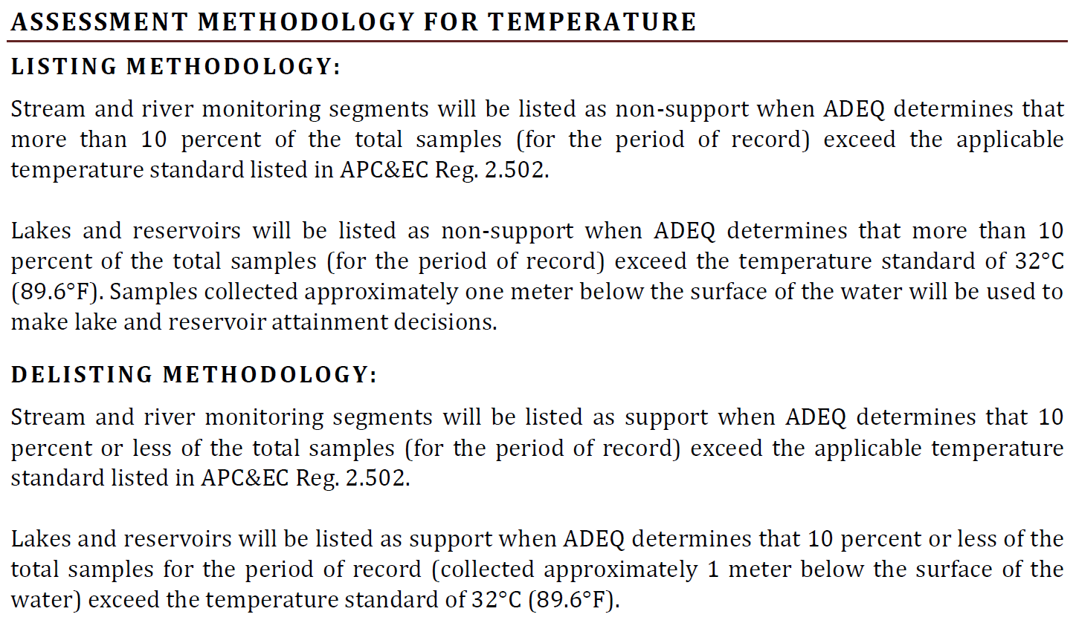
Water Quality Assessment
Water Quality Standard
Assessment Methodology
Ecoregions | Temp (°C)
Ozark Highlands | 29
Boston Mountains | 31
Arkansas River Valley | 31
Ouachita Mountains | 30
Gulf Coastal Plain Typical Springwater-influenced | 30 30
Mississippi Alluvial Plain Least Altered Channel Altered | 30 32
  +
=
Water Quality Standard Attainment Decision

Slide 11
Phase I and II Data Quality Requirements
QA/QC equivalent to ADEQ or USGS
Analysis must be from State certified lab
Reported in standard units
Characteristic of the main water body
Collected within the period of record
Phase II requirements are specific to each parameter

Slide 12
Assessment Example
ANRC Data for West Fork Point Remove Creek
Turbidity (NTU)
2011 | 7.2 | 6.2 | 5.1 | 32 | 29 | 91 | 14 | 17 | 19 | 31 | 17 | 12 | 10 | 9.1
2012 | 10 | 8.0 | 10 | 8.2 | 16 | 18 | 7.4 | 7.7 | 7.2 | 32 | 20 | 16 | 13 | 9.2 | 9.8 | 11 | 10 | 7.8
 | 4.6 | 4.3 | 44 | 5.8 | 16 | 4.1 | 4.4 | 5.1 | 5.5 | 4.1 | 11 | 12 | 17 | 5.9 | 11 | 15 | 39 | 32
 | 164 |  | 34 | 20 | 130 |  | 28 | 14 | 8.4 | 50 | 23 | 12 | 5.5 | 24
2013 | 4.9 | 83 | 55 | 27 | 19 | 11 | 8.0 | 21 | 11 | 10 | 7.2 | 5.7 | 5.0 | 4.6 | 16 | 7.7 | 7.5 | 10
 | 6.9 | 8.8 | 8.5 | 16 | 10 | 5.8 | 4.1
AR River Valley Turbidity Standard # Impairments
Base Flows (21 NTU)* 11/32 (34.4%) All Flows (40 NTU) 7/89 (7.8%)
The 2014 Assessment Methodology allows a 20% exceedance of the total base flow values and a 25% exceedance of the total all flow values.
*Base flow occurs between June 1 and October 31; all flows represent the entire calendar
year.

Slide 13
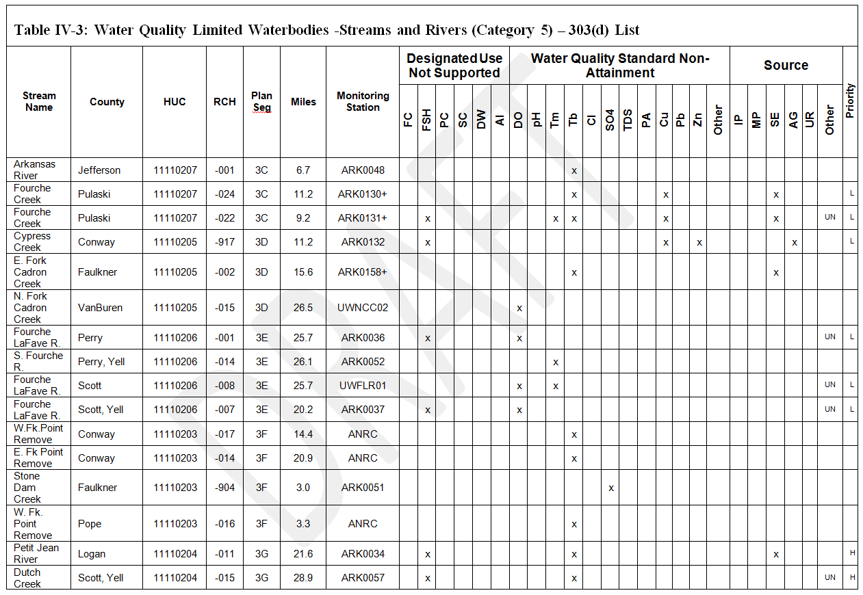
Assessment Example
ANRC Data for West Fork Point Remove Creek

Slide 14
Assessment Example
ANRC & ADEQ Data for West Fork Point Remove Creek River
 | Turbidity (NTU)
ANRC | 2011 | 7.2 | 6.2 | 5.1 | 32.6 | 29.4 | 90.6
 | 2012 | 44.0 | 5.8 | 15.7 | 4.1 | 4.4 | 5.1 | 5.5 | 4.1 | 10.7 | 12.2 | 17.4 | 5.9 | 10.5 | 15.3 | 38.7 | 143.0 | 38.3 | 32.3 | 24.3 | 164.0 | 33.6 | 19.6
 | 2013 | 15.9 | 10.3 | 5.8 | 4.1
ADEQ | 2012 | 8.10 | 7.95 | 14.8 | 10.0
AR River Valley Turbidity Standard: Base Flows (21 NTU)*
The 2014 Assessment Methodology allows a 20% exceedance of the total base flow values and a 25% exceedance of the total all flow values.
*Base flow occurs between June 1 and October 31; all flows represent the entire calendar year.
Data Sources # Impairments
ANRC 11/32 (34.38%)
ANRC & ADEQ 11/36 (30.56%)

Slide 15
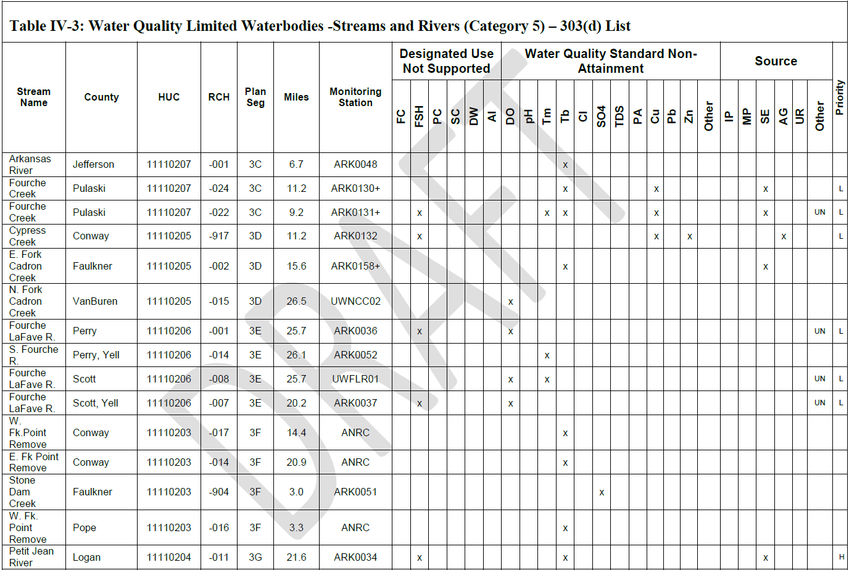
Assessment Example
ANRC & ADEQ Data for West Fork Point Remove Creek

Slide 16

The Stakeholder Process
Identify Stakeholders
Gather Input
Discuss Input
Make Recommendations

Slide 17
Revisions in current AM Draft
Methodology for continuous DO, pH and temperature measurement
Use of binomial method to reduce the probability of error in decision making
Clarification of data quality expectations and others

Slide 18
Timeline for Revision
Public Listening Session Oct 11, 2016
Input Period Closes Oct 31, 2016
Provide Summary of Input Nov 2016
Stakeholder Workgroup Dec-July 2017
Provide Summary of Input July 2017
Public Notice 2017
Response to Comments 2017
Finalize Methodology 2017

Slide 19
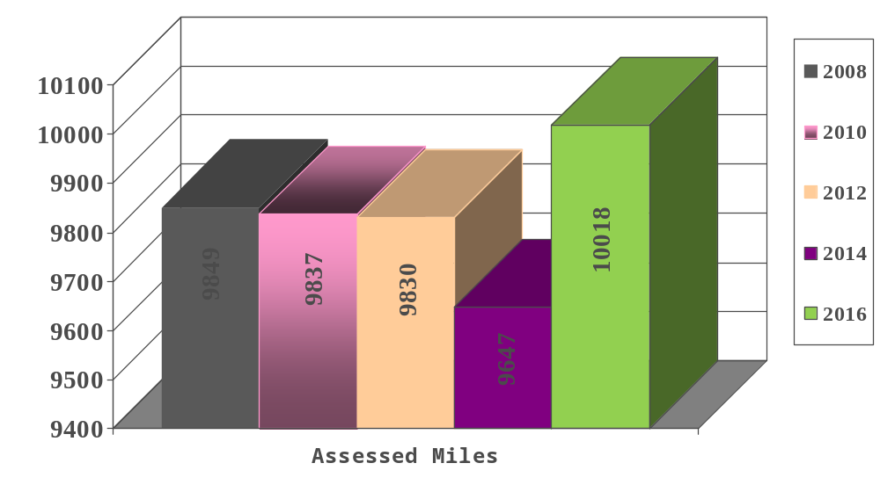
2016 Miles Assessed

Slide 20
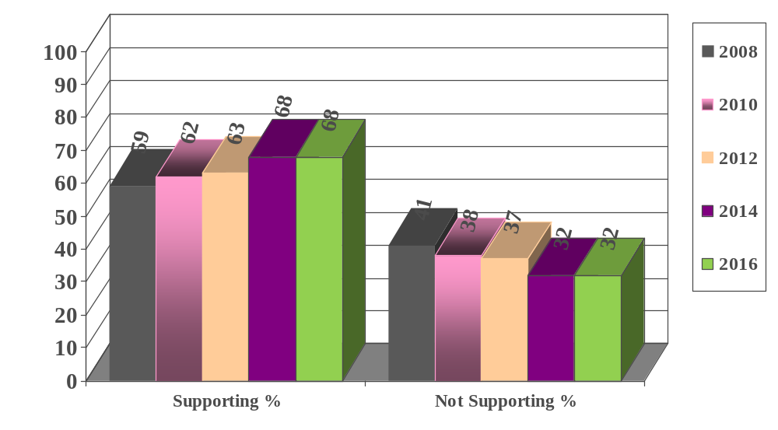
2016 Designated Use Support &
Water Quality Standards Attainment

Slide 21
New Listings for 2016
72 Pollutant Pairs
  Minerals - Cl, SO₄, TDS (19)
  Turbidity (3)
  Dissolved Oxygen (26)
  Metals - Cu, Pb, Zn, Se (13)
  Temperature (3)
  Pathogens (1)
  pH (7)

Slide 22
De-Listings for 2016
98 Pollutant Pairs
  Minerals - Cl, SO₄, TDS (31)
  Metals - Cu, Pb, Zn (27)
  Turbidity (20)
  pH (8)
  Dissolved Oxygen (4)
  Temperature (8)
  Pathogens (0)

Slide 23
Deferred Action-Streams
Bayou Bartholomew
Bayou DesArc
Bayou Deview
Cache River
Cossatot River
Cypress Creek
Huckleberry Creek
Hurricane Creek
S. Fork Little Red
Maumelle River
Ouachita River
White River
White Oak Bayou
W. Pt. Remove
W. Fork White
Unnamed Tribs.
Spring River
S. Fork Spring
Saline River
Red River
North & Middle Saline
Yount Creek
Notes:
EPA ROD 7/19/2017 “EPA is deferring action on 45 potential water body pollutant pairs with the expectation that the deferral will be reconsidered expeditiously. The EPA is working closely with ADEQ to assemble available data for these water bodies to determine whether an assessment is possible or if we agree that there is insufficient data for an assessment.

Slide 24
Deferred Action - Lakes
Dierks Lake
Gilham Lake
Lake Austelle
Lake Catherine
Poinsett Lake
Lake Cox Creek
Lake DeQueen
Lake Ouachita

Slide 25
Public Participation Opportunities
2018 Assessment Methodology
  Comment on Final Draft
Regulation No. 2 Triennial Review
  Stakeholder Group to begin in 2017
Continuous Planning Process
  Stakeholder Group to begin in 2018

Slide 26
Water Quality Criteria
ADEQ solicits water quality data from state and federal agencies, universities, and other entities.
  Data must meet or exceed ADEQ’s or USGS’ QA/QC protocols.
ADEQ assembles and evaluates all existing and readily available data.
  Data that does not meet QA/QC protocols will not be used to determine water quality standards attainment; however, these data may be used as a screening tool to determine whether additional monitoring is warranted.
Data sets containing <10 data points will be used as a screening sample.
  Segments with <10 data points and 2 or more exceedances will warrant additional monitoring and may be placed in Category 3 for further investigation.
Samples sizes of 10 data points or greater will be used to make water quality standard attainment decisions; appropriate exceedance rates apply.

Slide 27
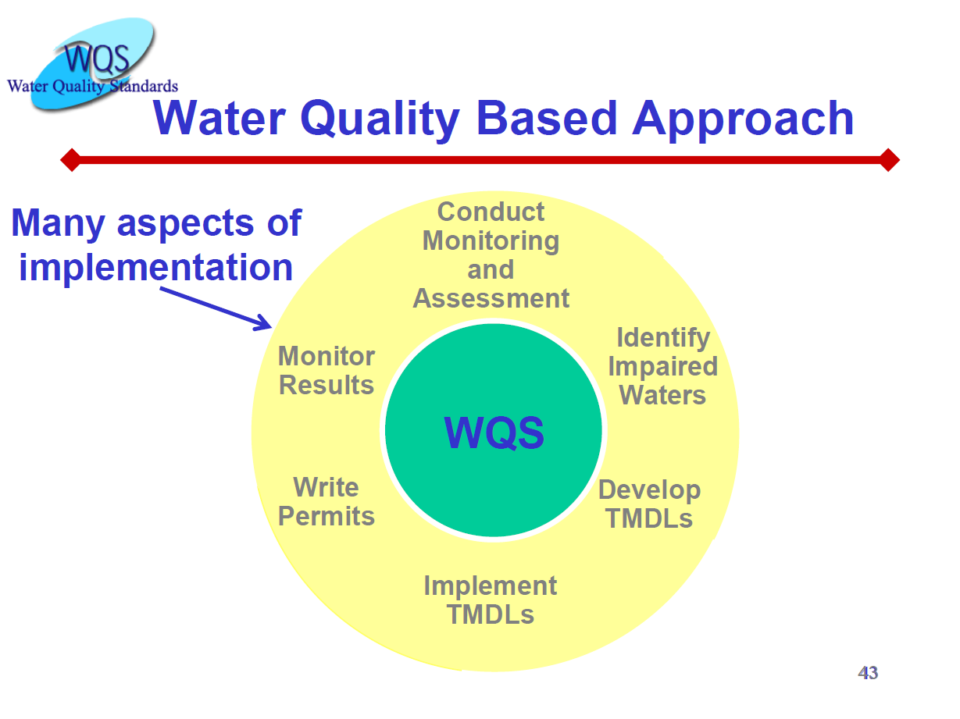

Slide 28

Water Quality Standards
Ecoregion Based
In Arkansas, water quality standards were developed using data from least-disturbed streams within each of the State’s six (6) ecoregions
The data used for standards development were collected during an intensive, statewide study of the physical, chemical, and biological characteristics of least-disturbed streams (1983-1986)

Slide 29
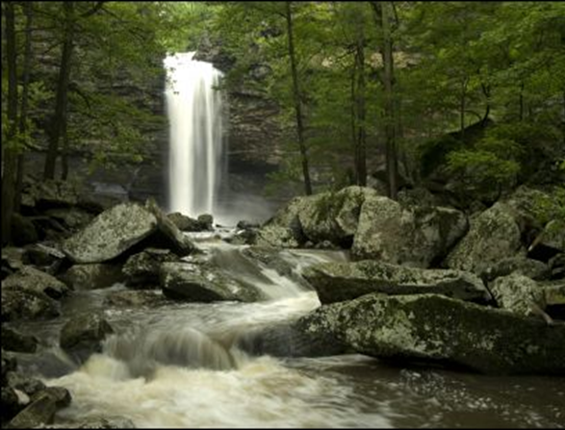
Water Quality Standards
Biological and water quality standards include criteria designed to prevent impairment of water quality data collected throughout the state are utilized to create water quality standards for the state’s surface waters.
  the designated uses.
These criteria serve as the regulatory basis for water quality-based treatment controls under Section 303(e) of the Clean Water Act

Slide 30
Assessment Process
Water Quality Data
Assessment Methodology
Impaired – 303(d) List
Not Impaired
Notes:
Water quality data must meet all data quality control (QC) requirements set forth in the assessment methodology. If it does, it will be assessed using the Assessment Methodology.

Slide 31
Water Quality Criteria
Assessment Methodology
Assessment Criteria | Exceedance Rates
Temperature (°C) | >10%
Turbidity | Base Flows >20%* | All Flows >25%
pH | not below 6.0 or above 9.0 s.u.
Dissolved Oxygen | >10%
Toxic Substances | >1 exceedance of the criterion
*Base flow values represent the critical season, June 1 to October 31.

