Slide 1
STATUS OF MRBI
VOLUNTARY CONSERVATION- WORKING?
STRENGTHEN PARTNERSHIPS?
MORE CONSERVATION GETTING ON GROUND?
IMPACT ON LOCAL ECONOMY?
287 projects selected
$815 million
Arkansas -10 RCPP projects
$28.6 million
          $4.2 million State projects
          $7.4 million CCA
          $17 million National
Notes:
Farm Bill Impacts on NRCS Program Administration
Key thoughts:
Streamlining/consolidation of programs and efforts brought about by program consolidation provides NRCS an opportunity to rethink how it delivers its conservation programs. Our goal is to use this opportunity to further improve our efficiency, streamline administration and reduce burden on the public and our field staff.
and;
Maintains NRCS opportunities and tools while enabling the agency to improve efficiency. Future applicants will be offered much the same opportunities to improve their stewardship with greater ease and increased transparency.
New focus on Regional Conservation Priorities: NRCS can maintain and strengthen existing regional initiatives while developing new priorities with partnership involvement.

Slide 2
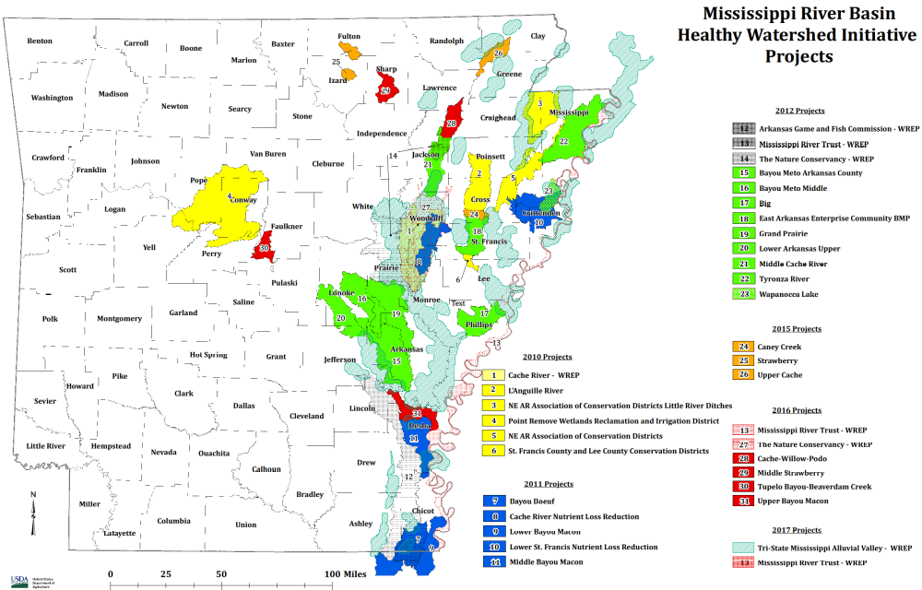
Notes:
Status of MRBI-Currently we have 7 projects receiving funds (2015 and 2016 projects) but funding will end in 2018 with current Farm Bill. However the projects will have contract implementations until year 2021. At that time all MRBI in Arkansas will be finalized.

Slide 3
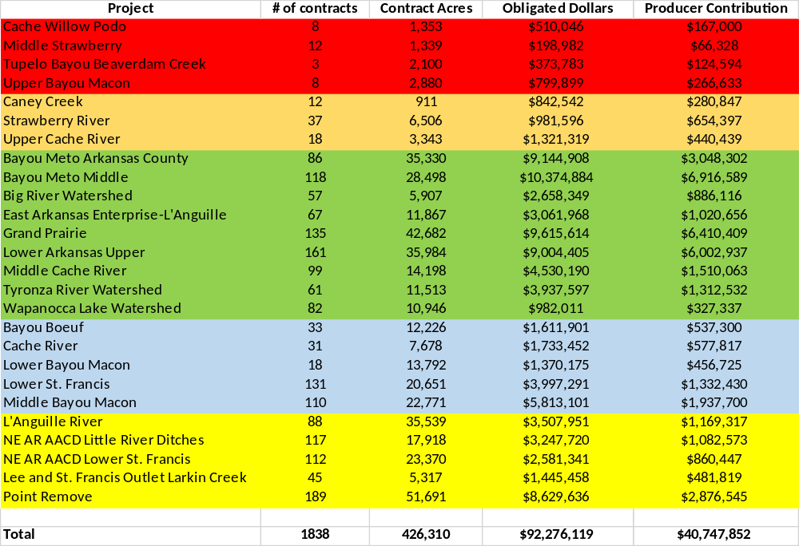
MRBI Projects 2010-2016
Notes:
Arkansas conservation partners were approved for four RCPP projects (2 State, 1 National, and 1 Critical Conservation Area (CCA)).
Red River, Illinois River, Bayou Meto, Rice Stewardship
RCPP projects in Arkansas will address water quality degradation, groundwater declines, and inadequate habitat for fish and wildlife on irrigated cropland; reducing nutrient and sediment load entering the Red River; improving water quality in the Illinois River Watershed so that all waters meet their designated uses; and assisting rice producers address water quantity, water quality, and wildlife habitat across 380,000 acres in Mississippi, Arkansas, California, Louisiana, Missouri, and Texas.

Slide 4
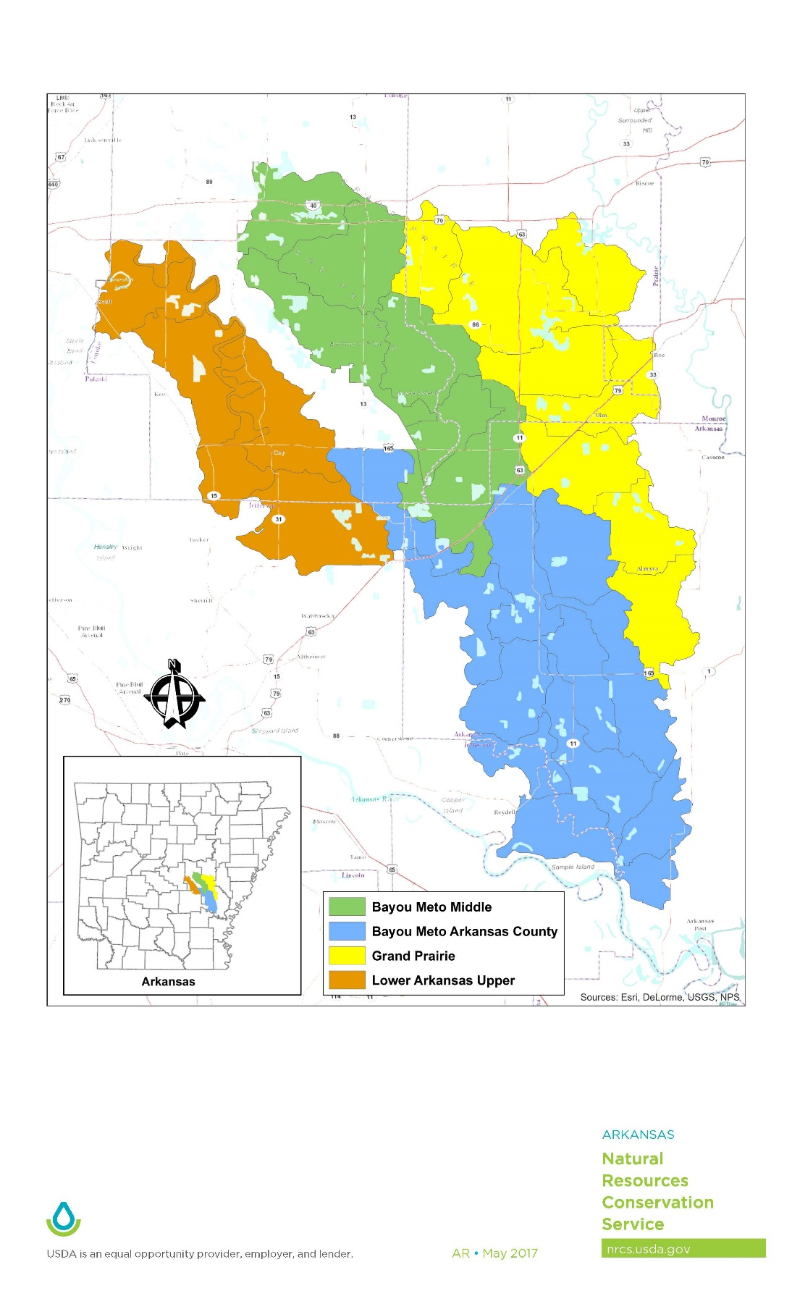
Summary of 4 MRBI Projects-Targeting
Project | Contracts | Acres treated | Obligated Funds
Bayou Meto Arkansas Co. | 86 | 35,330 | $9,144,908
Bayou Meto Middle | 118 | 28,498 | $10,374,884
Grand Prairie | 135 | 42,682 | $9,615,614
Lower Arkansas Upper | 161 | 35,984 | $9,004,405
 | 500 | 142,494 | $38,139,811
Notes:
These 4 projects contain 60% of the contracts, 33% of the contract acres, 41% of the funding obligated and 55% of the producers contribution

Slide 5
208,755 tons of sediment saved=Busch Stadium 32 feet of soil.
1,206, 227 lbs. of Nitrogen and Phosphorus has been kept out of the waterways. This equates to 360,387 bags of 13-13-13 fertilizer.
129.6 billion gallons of groundwater conserved per year =covering Monroe County with 1 foot of water
Notes:
Estimates were obtained by data provided from Lee Norfleet from our Tech Center. He is responsible for running models for MRBI and CEAP data. Data may vary in the furture as more finite data is used. Took estimated soil loss and factor the amount of N and P saved per ton of soil loss to get figures. Ground water was estimated at the savings per irrigation practices such as land leveling,

Slide 6
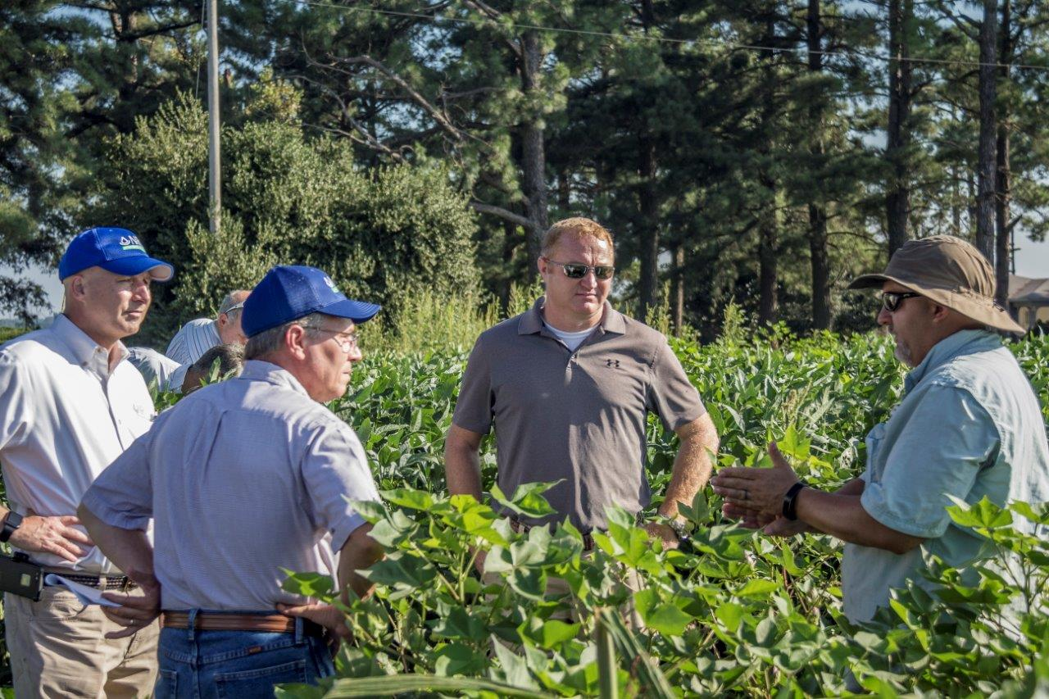
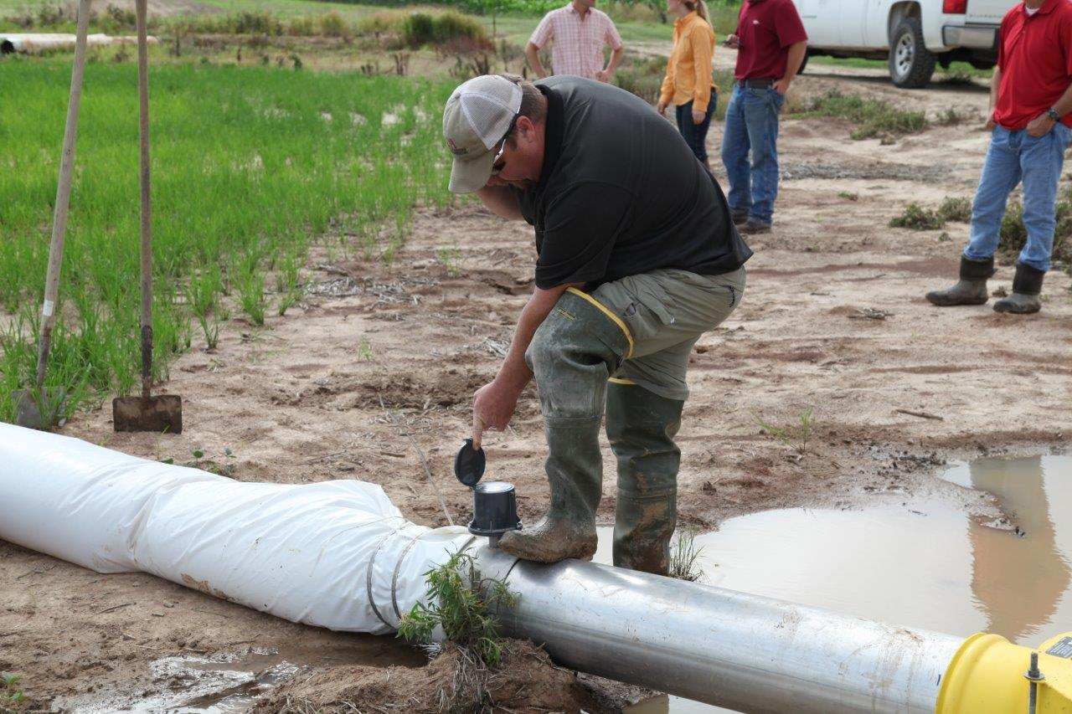
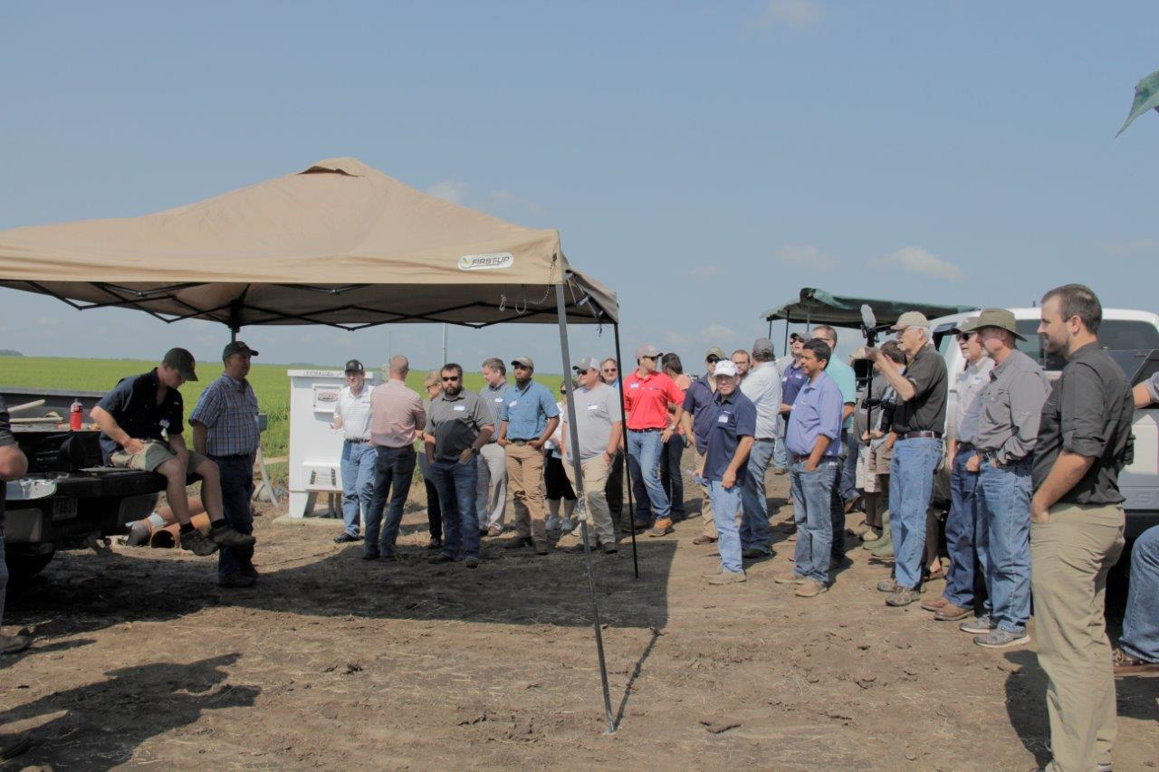
partners

Slide 7
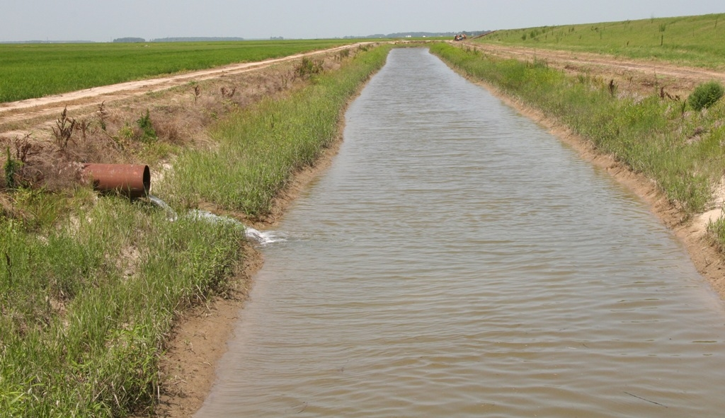
Tailwater Recovery

Slide 8
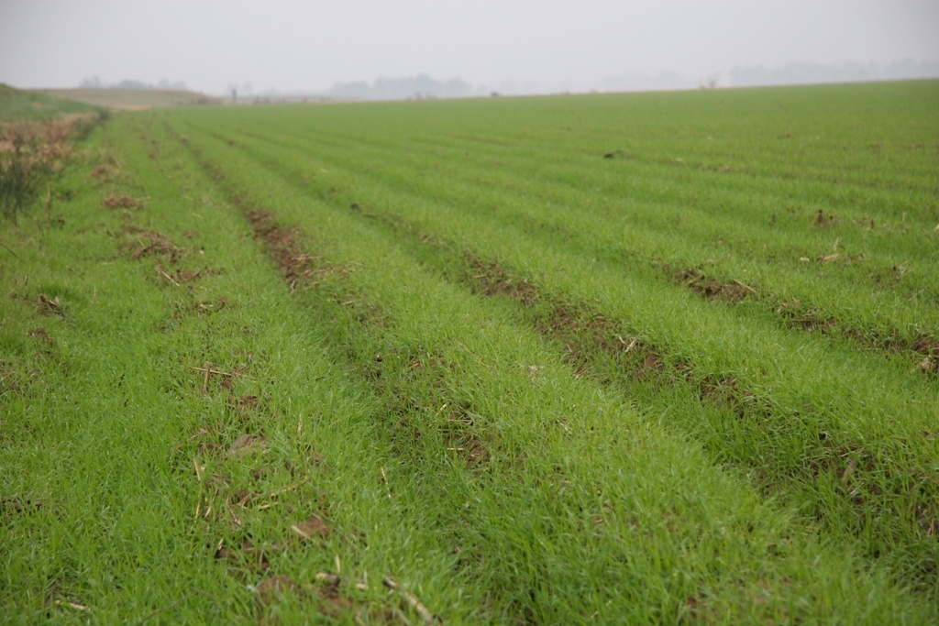
Cover Crop

Slide 9
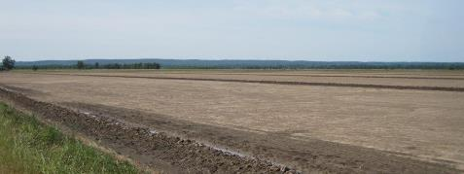
Notes:
Farm Bill Impacts on NRCS Program Administration
Key thoughts:
Streamlining/consolidation of programs and efforts brought about by program consolidation provides NRCS an opportunity to rethink how it delivers its conservation programs. Our goal is to use this opportunity to further improve our efficiency, streamline administration and reduce burden on the public and our field staff.
and;
Maintains NRCS opportunities and tools while enabling the agency to improve efficiency. Future applicants will be offered much the same opportunities to improve their stewardship with greater ease and increased transparency.
New focus on Regional Conservation Priorities: NRCS can maintain and strengthen existing regional initiatives while developing new priorities with partnership involvement.

Slide 10
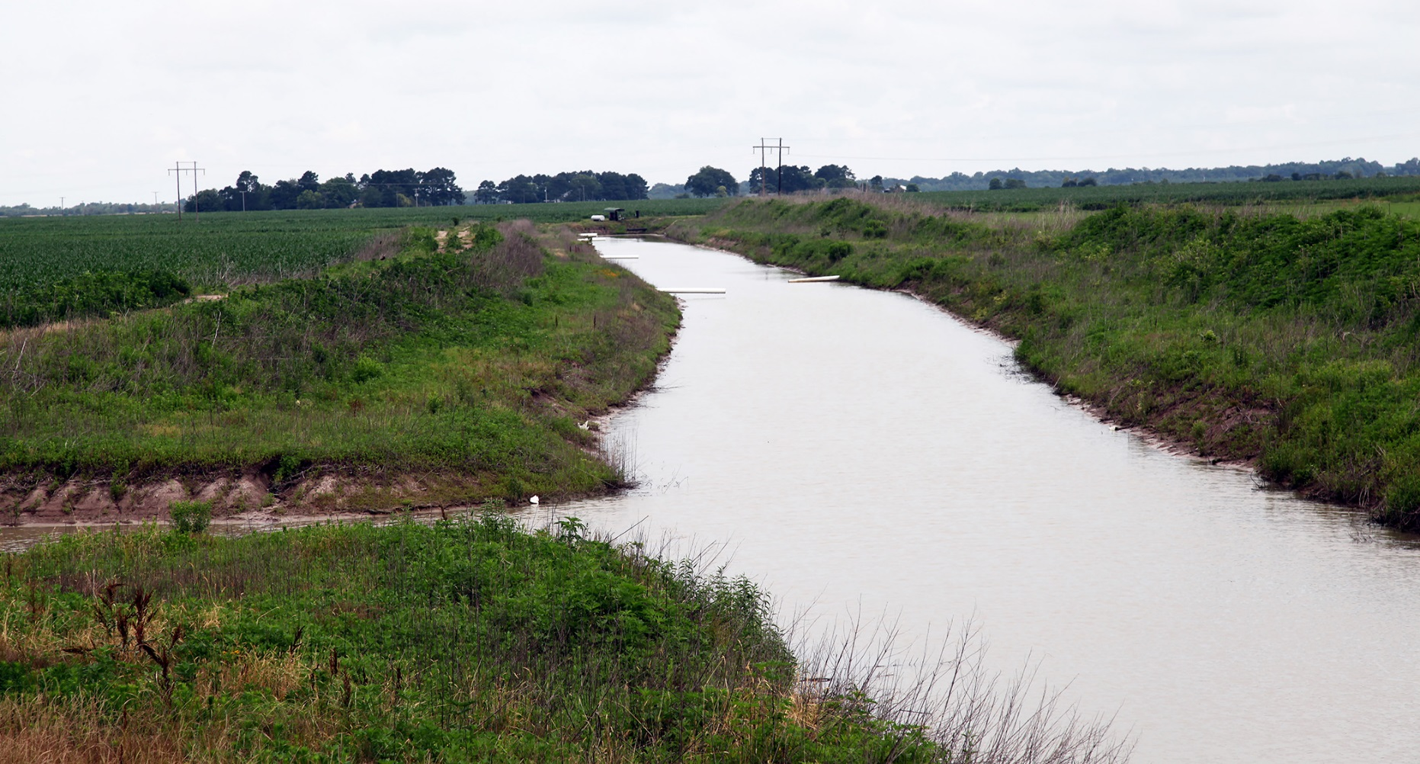
Notes:
Farm Bill Impacts on NRCS Program Administration
Key thoughts:
Streamlining/consolidation of programs and efforts brought about by program consolidation provides NRCS an opportunity to rethink how it delivers its conservation programs. Our goal is to use this opportunity to further improve our efficiency, streamline administration and reduce burden on the public and our field staff.
and;
Maintains NRCS opportunities and tools while enabling the agency to improve efficiency. Future applicants will be offered much the same opportunities to improve their stewardship with greater ease and increased transparency.
New focus on Regional Conservation Priorities: NRCS can maintain and strengthen existing regional initiatives while developing new priorities with partnership involvement.

Slide 11
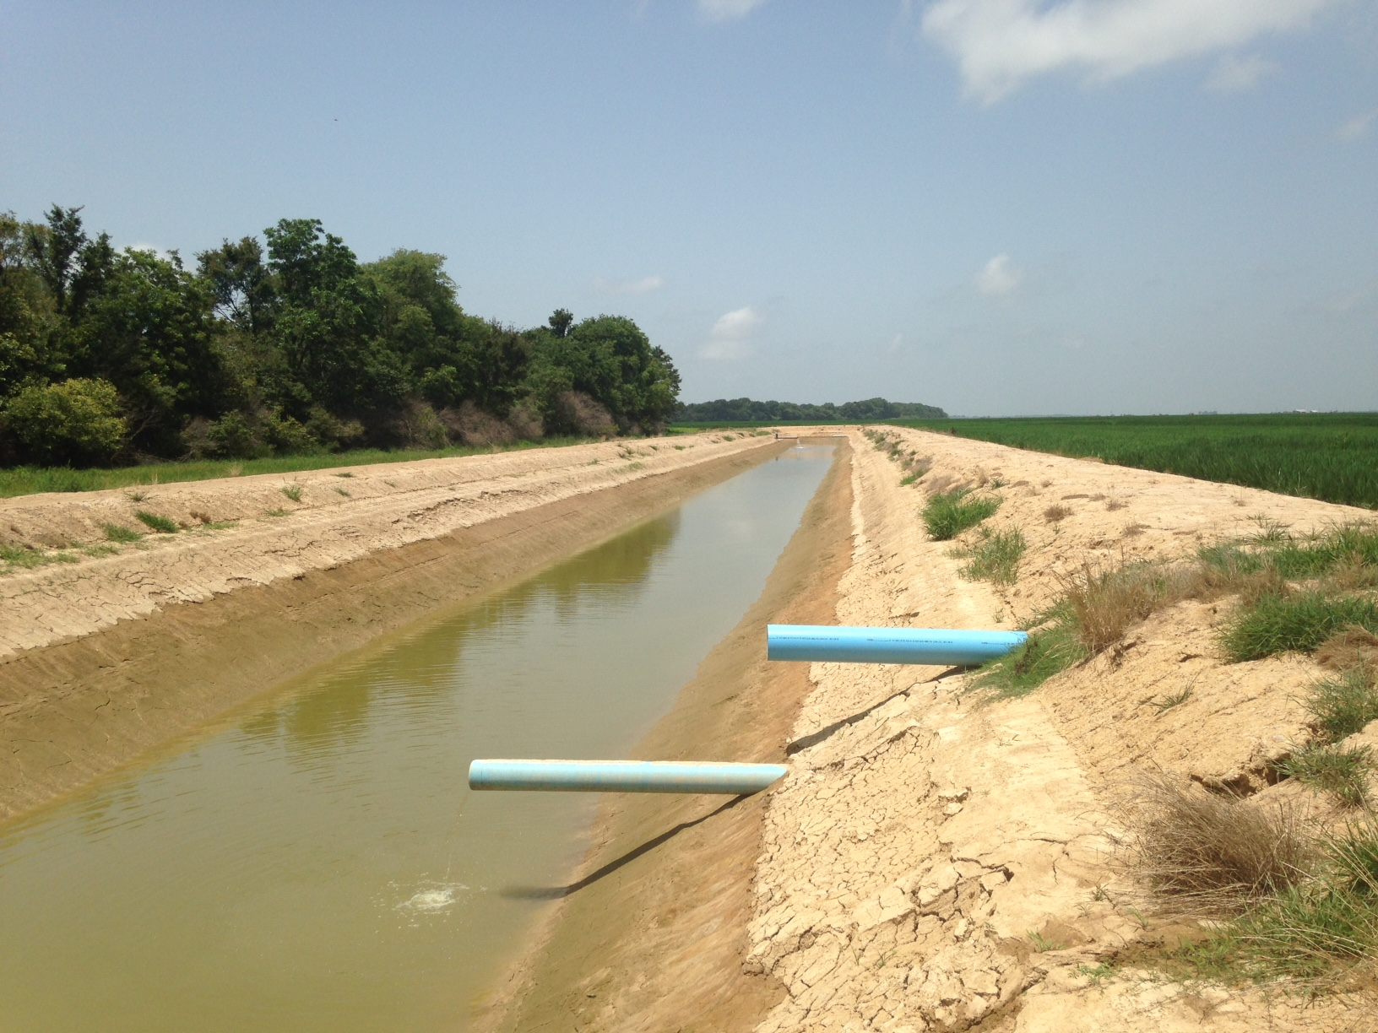
Notes:
Farm Bill Impacts on NRCS Program Administration
Key thoughts:
Streamlining/consolidation of programs and efforts brought about by program consolidation provides NRCS an opportunity to rethink how it delivers its conservation programs. Our goal is to use this opportunity to further improve our efficiency, streamline administration and reduce burden on the public and our field staff.
and;
Maintains NRCS opportunities and tools while enabling the agency to improve efficiency. Future applicants will be offered much the same opportunities to improve their stewardship with greater ease and increased transparency.
New focus on Regional Conservation Priorities: NRCS can maintain and strengthen existing regional initiatives while developing new priorities with partnership involvement.

Slide 12
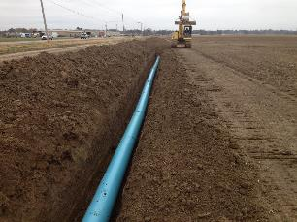
Notes:
Farm Bill Impacts on NRCS Program Administration
Key thoughts:
Streamlining/consolidation of programs and efforts brought about by program consolidation provides NRCS an opportunity to rethink how it delivers its conservation programs. Our goal is to use this opportunity to further improve our efficiency, streamline administration and reduce burden on the public and our field staff.
and;
Maintains NRCS opportunities and tools while enabling the agency to improve efficiency. Future applicants will be offered much the same opportunities to improve their stewardship with greater ease and increased transparency.
New focus on Regional Conservation Priorities: NRCS can maintain and strengthen existing regional initiatives while developing new priorities with partnership involvement.

Slide 13
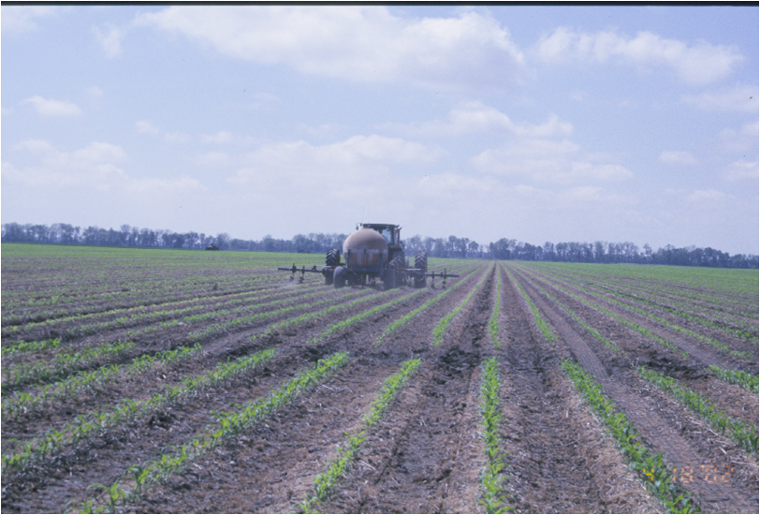
Nutrient Management

Slide 14
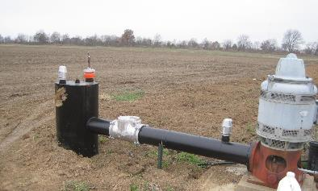
Notes:
Farm Bill Impacts on NRCS Program Administration
Key thoughts:
Streamlining/consolidation of programs and efforts brought about by program consolidation provides NRCS an opportunity to rethink how it delivers its conservation programs. Our goal is to use this opportunity to further improve our efficiency, streamline administration and reduce burden on the public and our field staff.
and;
Maintains NRCS opportunities and tools while enabling the agency to improve efficiency. Future applicants will be offered much the same opportunities to improve their stewardship with greater ease and increased transparency.
New focus on Regional Conservation Priorities: NRCS can maintain and strengthen existing regional initiatives while developing new priorities with partnership involvement.

Slide 15
Results: MRBI has shown that focused water quality efforts in high priority areas can be effective in building strong partners, increasing trust and partnerships with landowners and farmers, and getting more conservation systems on the ground.
Notes:
Farm Bill Impacts on NRCS Program Administration
Key thoughts:
Streamlining/consolidation of programs and efforts brought about by program consolidation provides NRCS an opportunity to rethink how it delivers its conservation programs. Our goal is to use this opportunity to further improve our efficiency, streamline administration and reduce burden on the public and our field staff.
and;
Maintains NRCS opportunities and tools while enabling the agency to improve efficiency. Future applicants will be offered much the same opportunities to improve their stewardship with greater ease and increased transparency.
New focus on Regional Conservation Priorities: NRCS can maintain and strengthen existing regional initiatives while developing new priorities with partnership involvement.

Slide 16
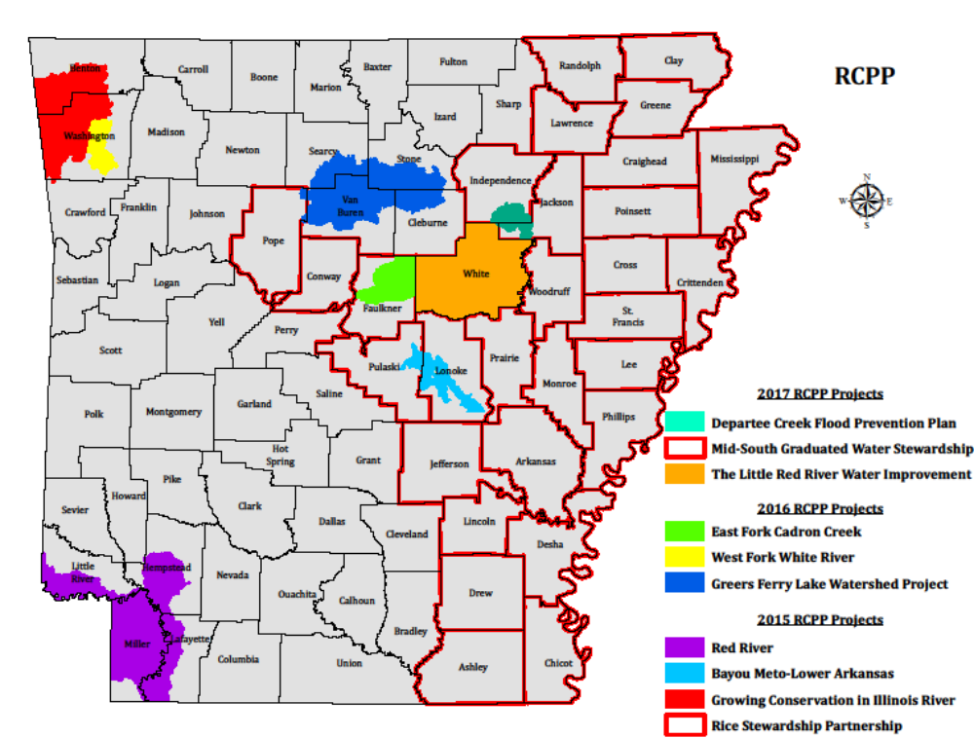
Regional conservation partnership program
Arkansas conservation partners have 10 RCPP projects:
  4 State-$4.2 million
  2 National-$17 million
  4 Critical Conservation Area (CCA)-$7.4 million
  Total-$28.6 million

Slide 17
Expected Water Quality Results
Reduced nitrogen and phosphorus loading into waterways
Reduced sediment from sheet & rill erosion
Reduced sediment from irrigation-induced erosion
Notes:
.

Slide 18
Project Sponsors | Monitoring Partners
Local Conservation Districts | University of Arkansas
Bayou Meto Water Mgmt | University of AR Extension
Ducks Unlimited USA Rice | Arkansas State University
The Nature Conservancy | Agricultural Research Service
IRWP, Little Red River Irrigation District | University of Arkansas at Pine Bluff
RC&D Council
Departee Creek Watershed Improvement District
Thank you for your time and attention!

Slide 19
To File a Complaint of Discrimination:
The U. S. Department of Agriculture (USDA) prohibits discrimination in all of its programs and activities on the basis of race, color, national origin, age, disability, and where applicable, sex, marital status, familial status, parental status, religion, sexual orientation, political beliefs, genetic information, reprisal, or because all or part of an individual’s income is derived from any public assistance program. (Not all prohibited bases apply to all programs.) Persons with disabilities who require alternative means for communication of program information (Braille, large print, audiotape, etc.) should contact USDA’s TARGET Center at (202) 720-2600 (voice and TDD).
To file a complaint of discrimination, write to USDA, Assistant Secretary for Civil Rights, Office of the Assistant Secretary for Civil Rights, 1400 Independence Avenue, S. W., Stop 9410, Washington, DC 20250-9410, or call toll-free at (866) 632-9992 (English) or (800) 877-8339 (TDD) or (866) 377-8642 (English Federal-relay) or (800) 845-6136 (Spanish Federal-relay). USDA is an equal opportunity provider and employer.

Slide 20
Contact information:
Amanda Mathis-NRCS
501-301-3162 office
or
Dianne Schlenker-NRCS
501-301-3152 office
Thank you for your time and attention!

