Slide 1

Non-Point Source Pollution Assessment and Management
NPS Pollution Stakeholder Meeting
September 27, 2017

Slide 2
GBM^{c} Experience in Watershed Assessment, Management and NPS Reductions
Written five Watershed Management Plans (WMP) in Arkansas
Written one Wetland Management Plan in Arkansas (using watershed approach)
Been principle investigator in seven additional watershed studies in Arkansas, Oklahoma and Missouri.
Designed and oversaw construction of multiple NPS treatment features

Slide 3
Primary Non-Point Source (NPS) Classifications
  Agricultural
    Pasture/hay
    Animal feed lots
    Row crops
  Urban/developed areas
    Residential
    Commercial
    Industrial
  All transported in storm water run-off

Slide 4
Common Agricultural NPS’s
Nutrients, sediment, pesticides, herbicides, heavy metals, bacteria, pharmaceuticals
Manure
Agrochemicals
Land erosion
  Over grazing
  Lack of soil BMPs on row crop land
Riparian destruction and stream bank erosion

Slide 5
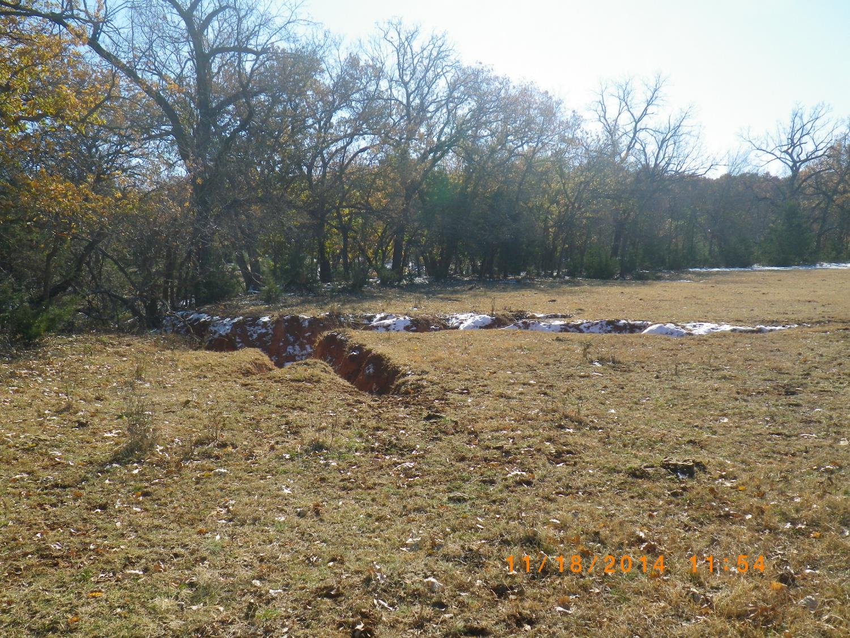
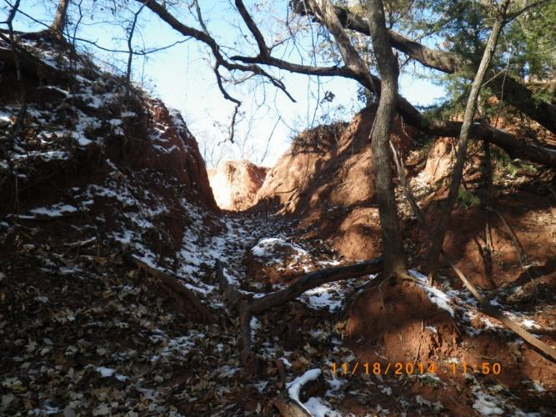
Major Gully Erosion
Creek
Over 100 tons of soil

Slide 6
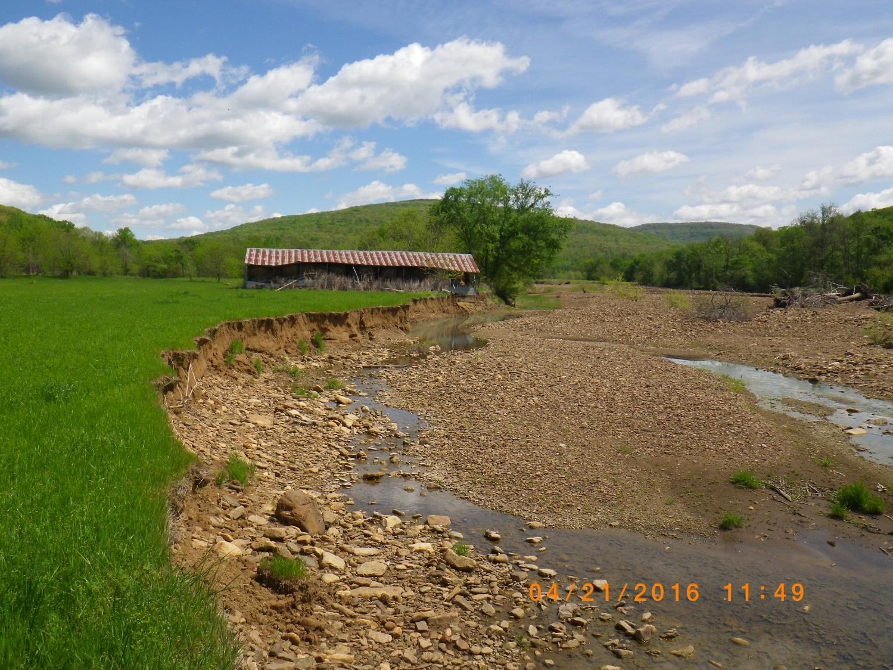
Stream Bank Erosion
(riparian buffer?)

Slide 7
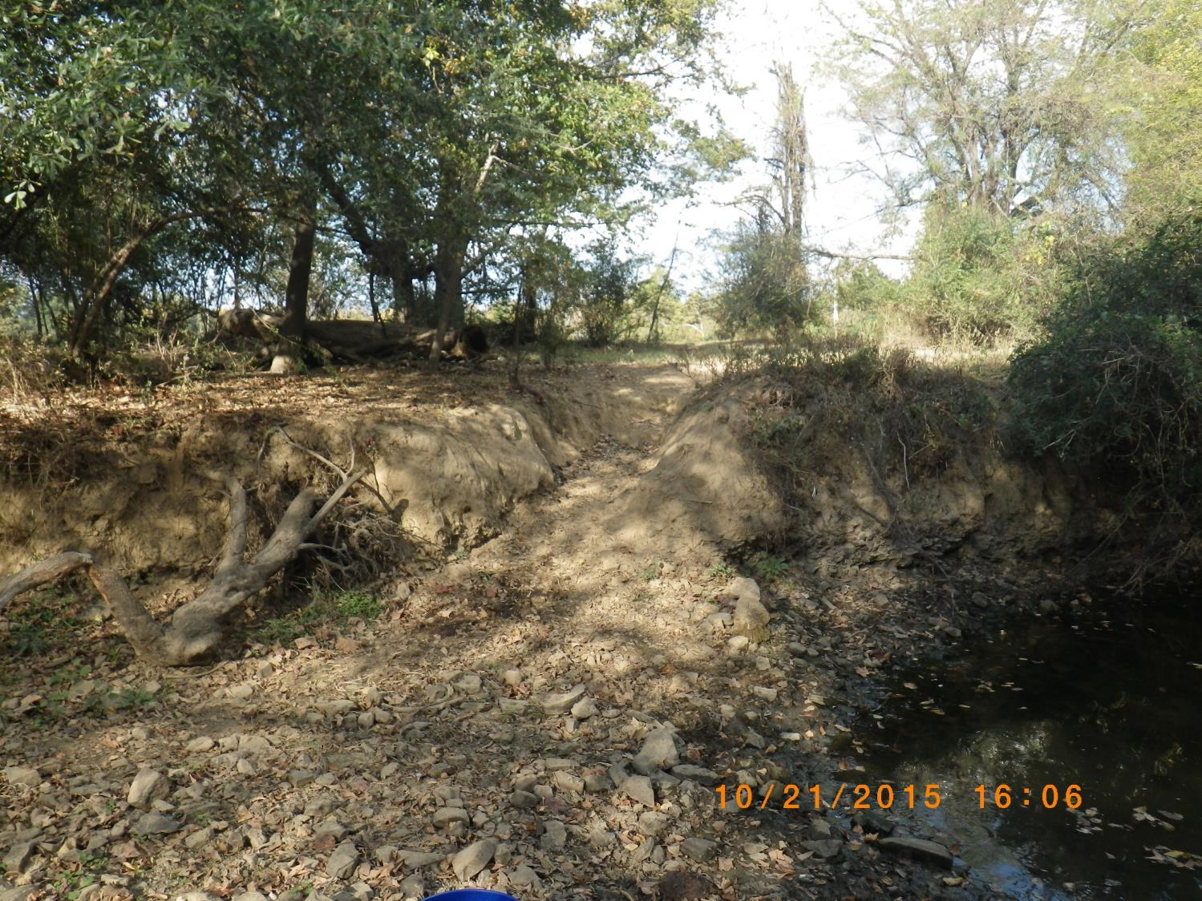
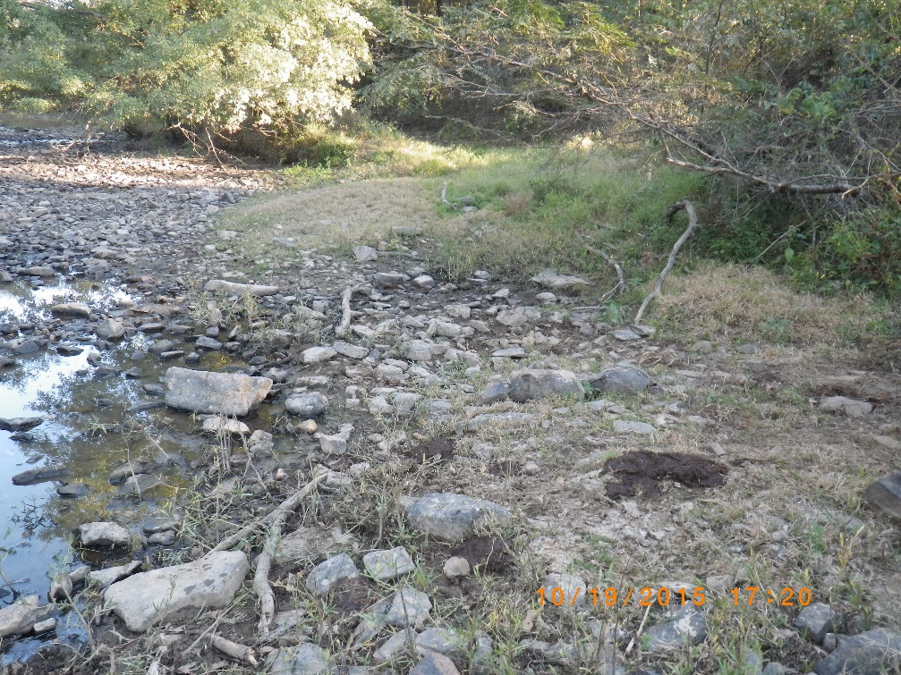

Slide 8
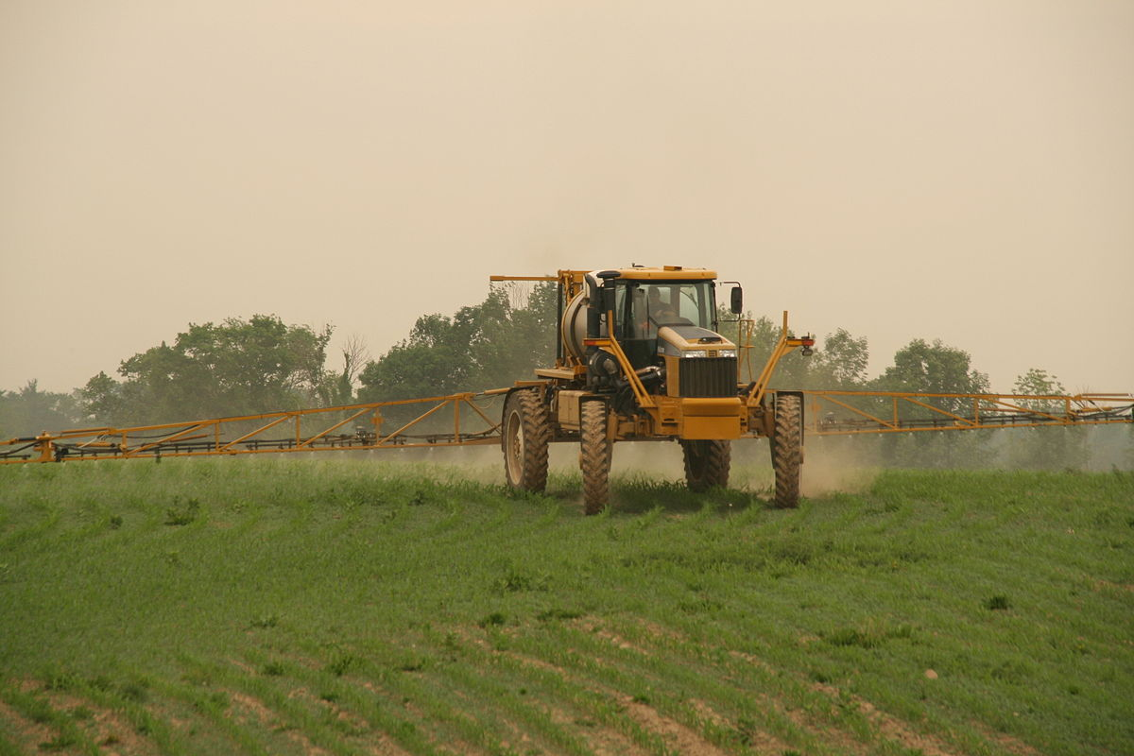
Image Courtesy of: By Pl77 - Own work, CC BY-SA 3.0, https://commons.wikimedia.org/w/index.php?curid=5935821

Slide 9
Common Urban NPS’s
Impervious surfaces
  Pavement (roads, parking lots)
  Roof tops
Typical city storm water systems
  Curb and gutter
Turf grass
Construction sites
Oil residue, gasoline, exhaust residue, bird droppings, chemicals from shingles, and roof sealants, lawn chemicals and fertilizer, pet waste, soils from erosion, trash, garbage, leaves, grass clippings………
BOD, hydrocarbons, heavy metals, sediment, nutrients, pesticides/herbicides, bacteria…………

Slide 10
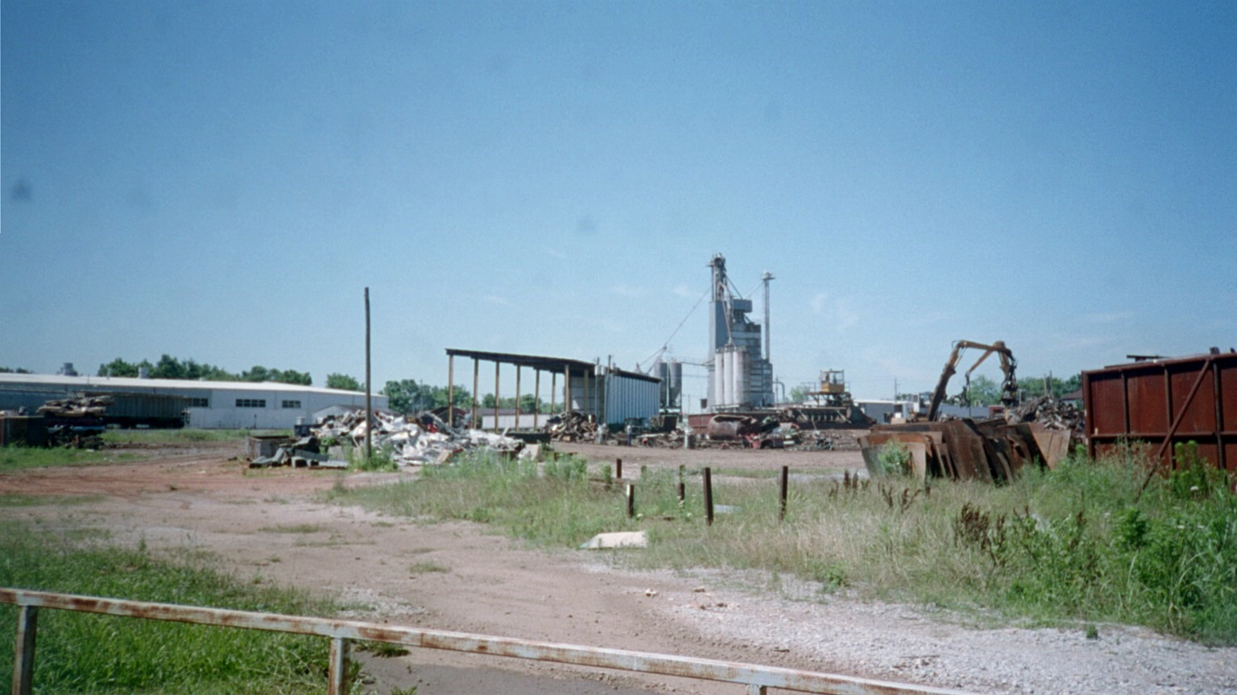
Recycling/Waste Transfer Stations

Slide 11
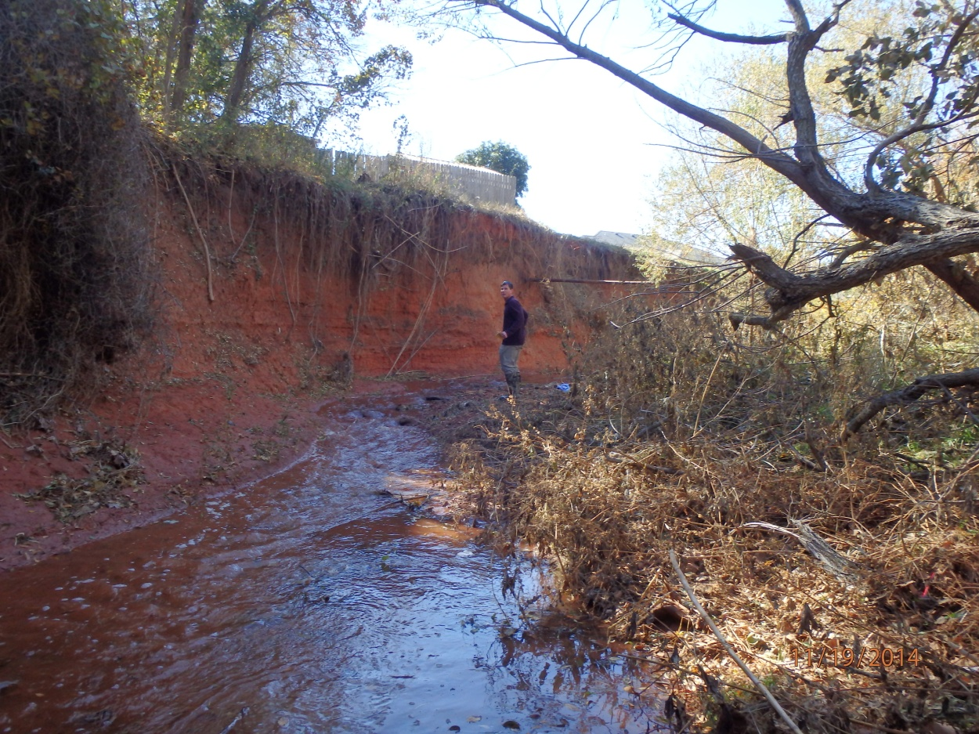

Slide 12
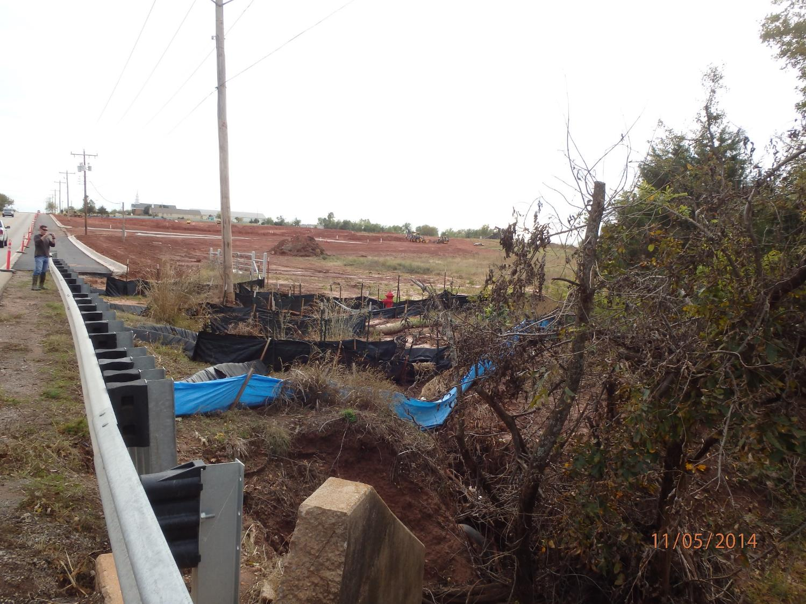
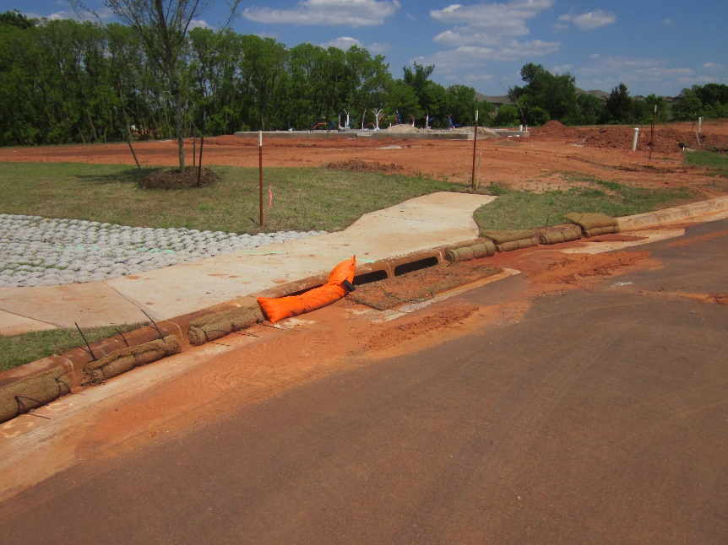

Slide 13
Watershed Management Planning
Assessment
Data Analysis and Area Ranking
Management Plan Development
Implementation
Adaptive Management
All Stakeholder Guided

Slide 14
Keys to effective NPS identification and reduction
Boots on the ground
Storm water run-off sampling
Watershed inspection during run-off events
Stakeholder input
Stakeholder buy-in

Slide 15
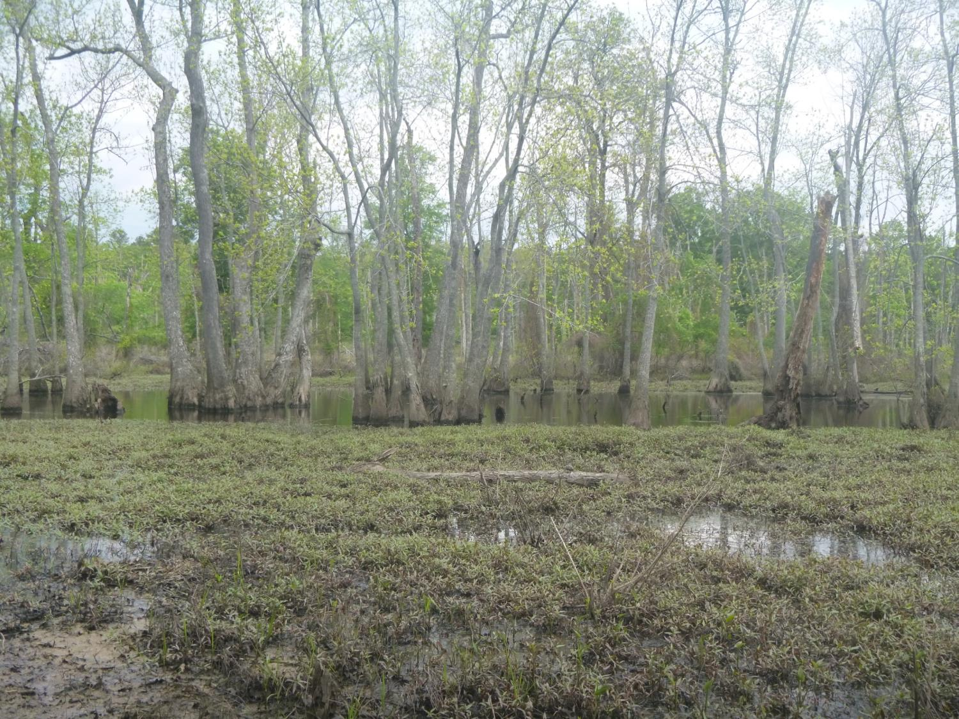


White Oak Bayou Management A watershed approach to wetlands management

Slide 16
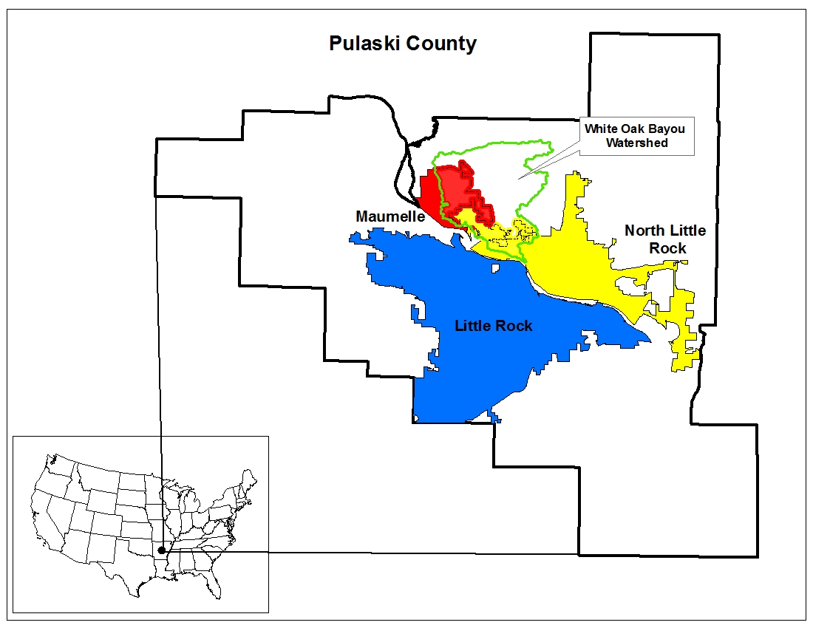

Slide 17
White Oak Bayou Stakeholders
City of Maumelle
Citizens of the Steering Committee
US EPA Region 6
USACE Little Rock District
Arkansas Natural Resources Commission
Arkansas Department of Environmental Quality
University of Central Arkansas (UCA)
Arkansas Natural Heritage Commission
City of North Little Rock and Pulaski County
http://www.whiteoakbayou.com/

Slide 18
Management Plan Tasks
Engage Stakeholders
Identify, Classify and Prioritize Wetlands
Protect and Manage Wetlands
  Physical protection (easements/deed restrictions)
  Smart growth planning
  Storm water quality controls
Educate Public
Disseminate information
NPS Management!

Slide 19
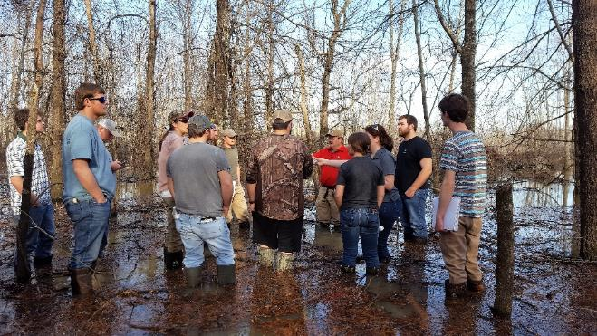
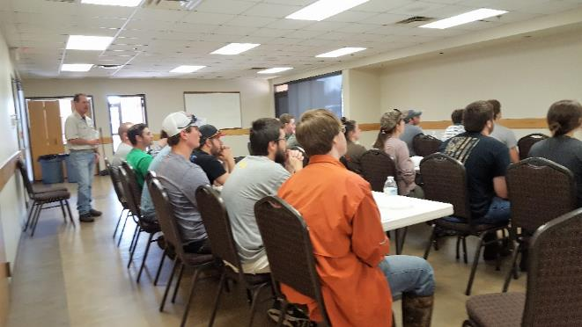
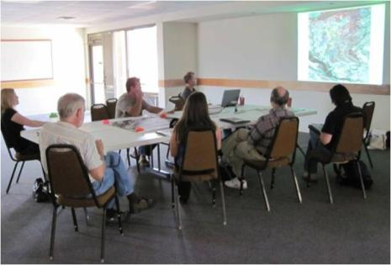
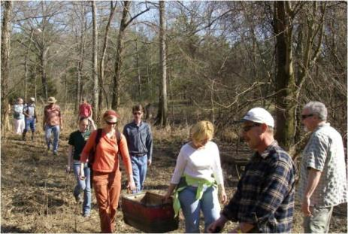
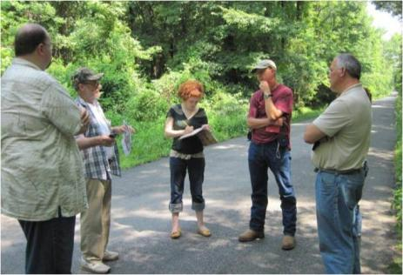
Technical Advisory Committee
focused on science/technical issues
Steering Committee
developed Mission Statement
focused on social and economic issues
formulated and steer goals and objectives
Engage & Educate
Stakeholders

Slide 20
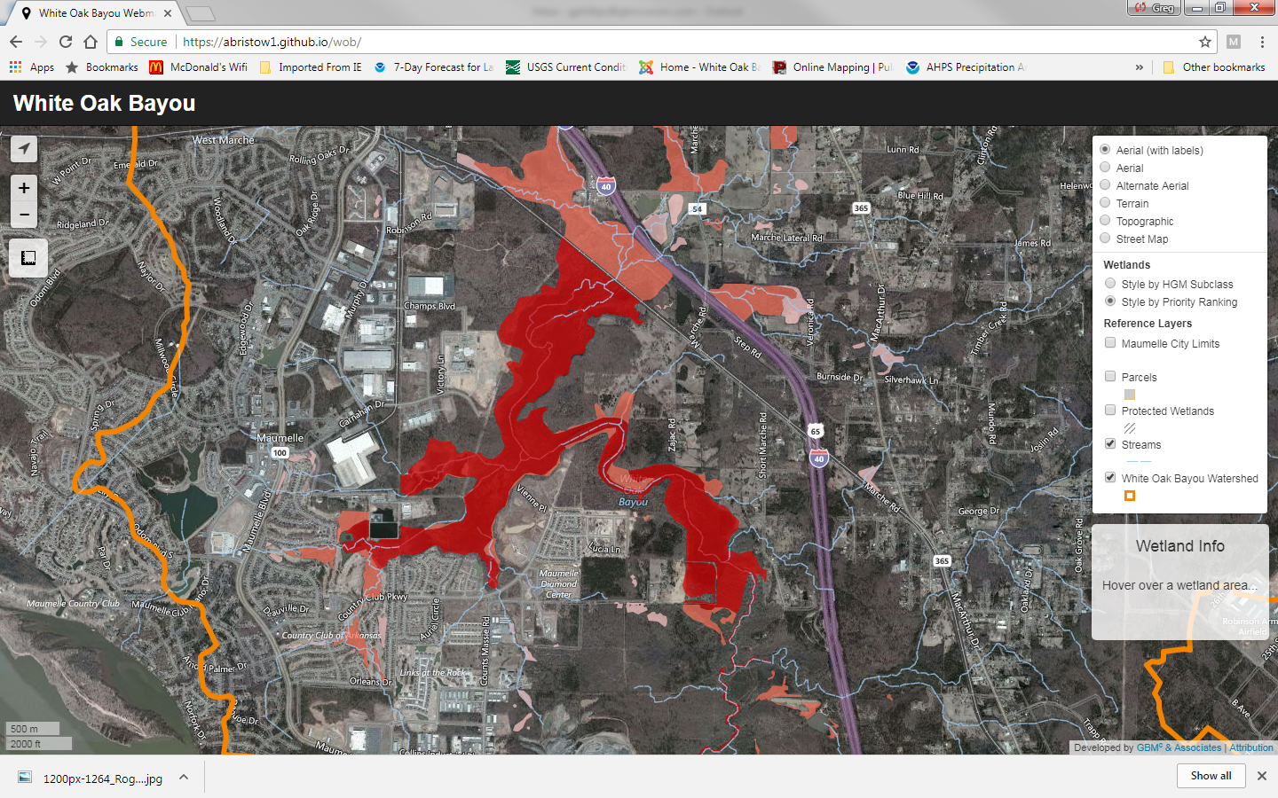
Identify, classify and prioritize

Slide 21
Water Quality Management
Monitoring water quality
Identify key sub-watersheds and NPS’s
Manage storm water run-off from urban/suburban and rural areas
  Ordinances
  Storm water treatment features
  Education

Slide 22
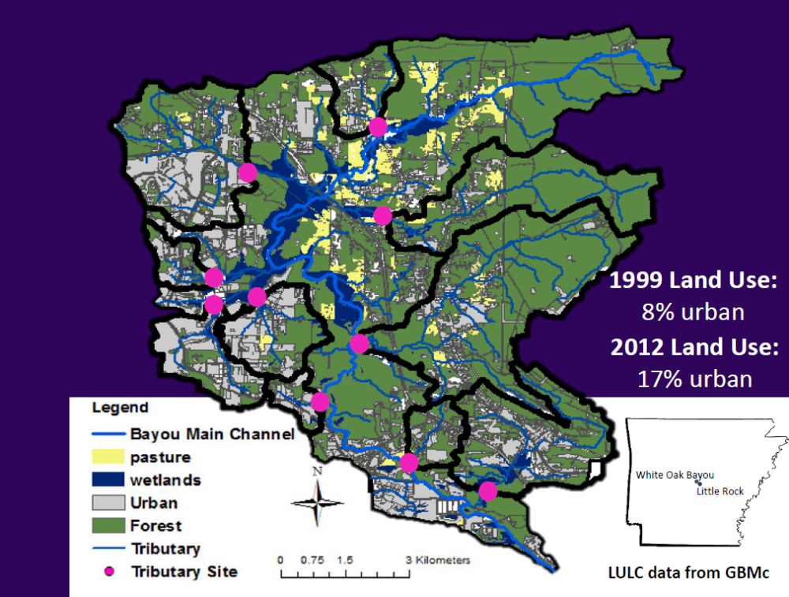
UCA Water Quality Monitoring
Sub-watershed outlets into wetlands

Slide 23
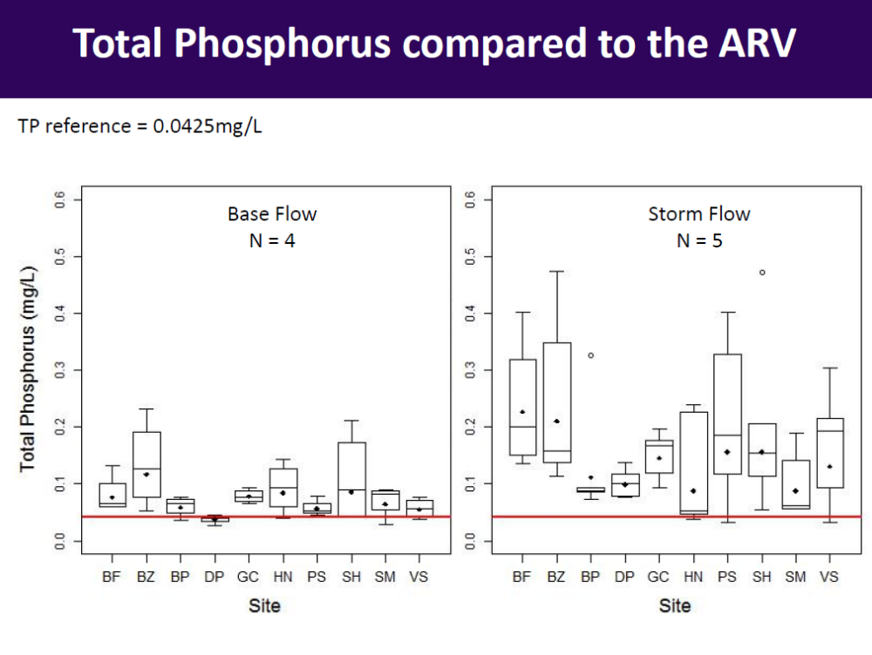

Slide 24
Existing City Ordinances
Storm Water Drainage
  Post Development Detention
Storm Water Pollution Prevention and Erosion Control
  Construction Storm Water Control
  Storm Water Treatment (Post development)
Riparian Buffer??
  No ordinance, but…….
  Incentives as Part of Wetland Mitigation

Slide 25
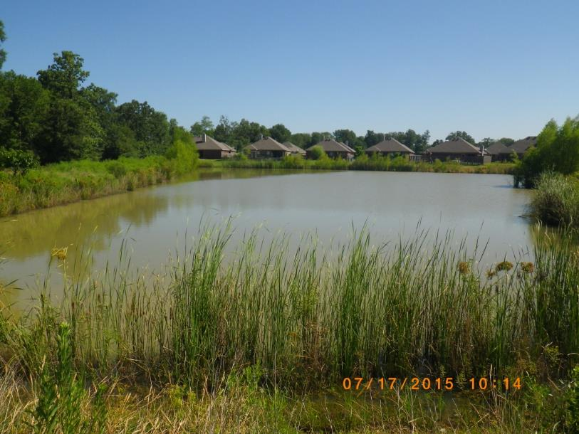
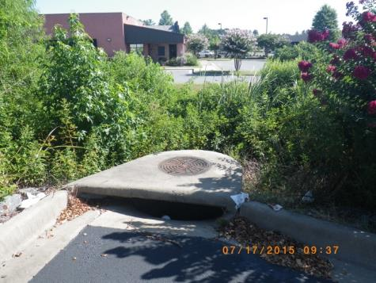
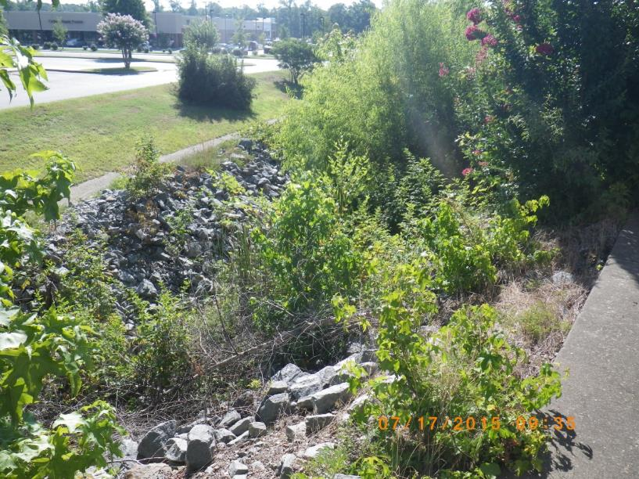
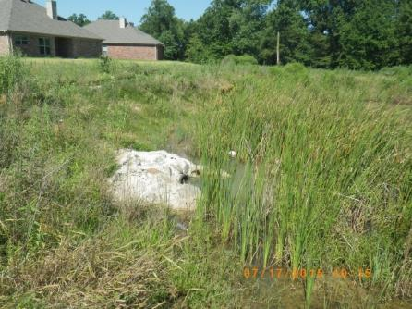
Detention
Main purpose usually to control the peak flow hydrograph.

Slide 26
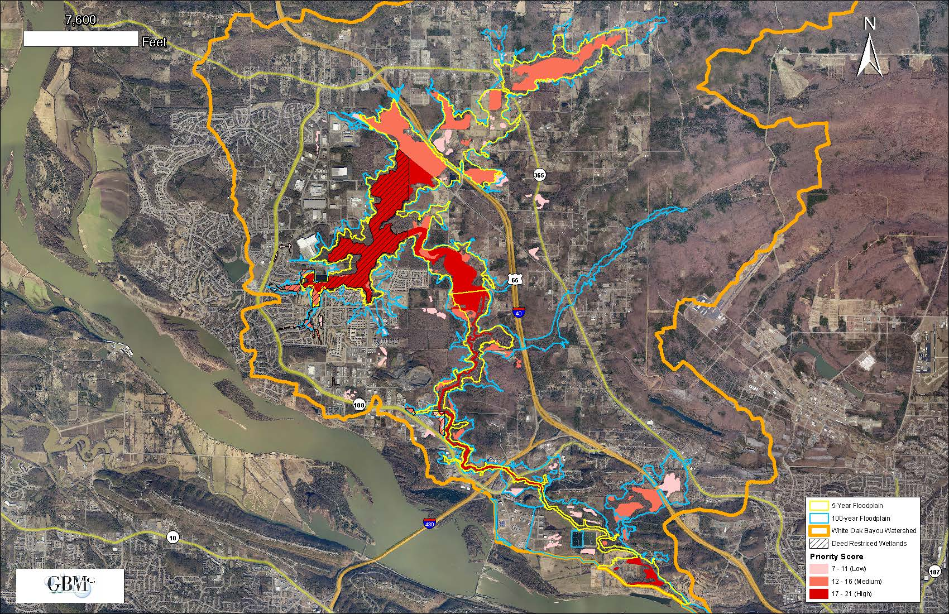
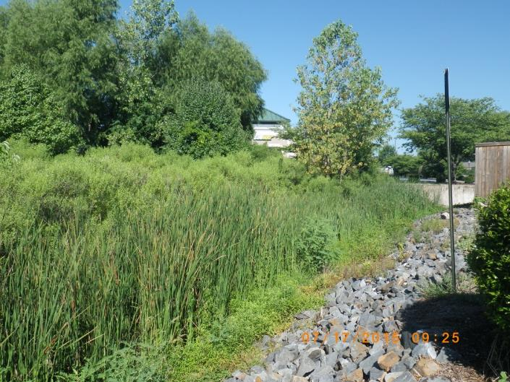
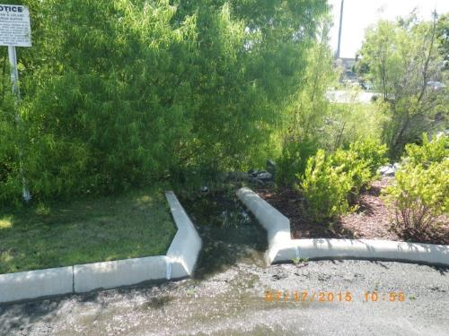
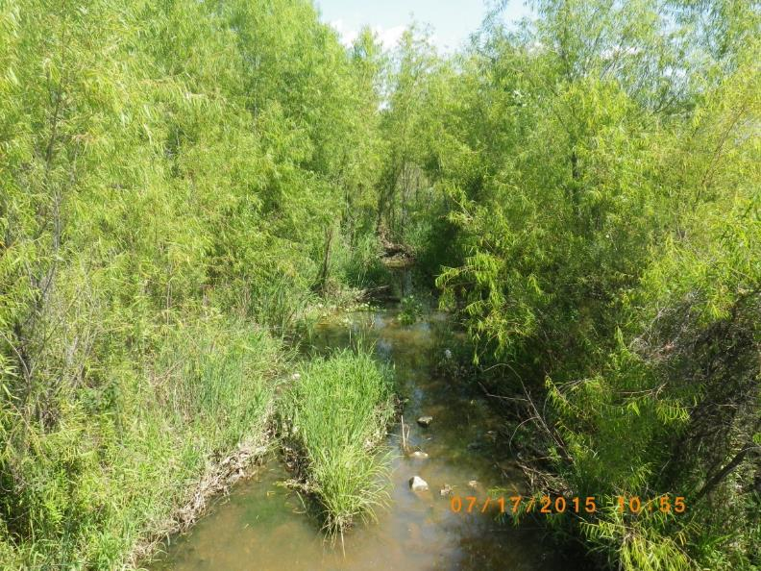
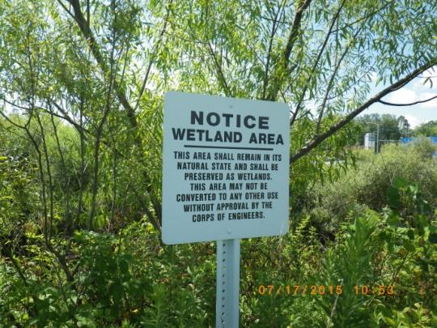
Wetlands Treatment and Detention
Key natural area protection
Usually controls the hydrograph and serves some WQ benefit.

Slide 27
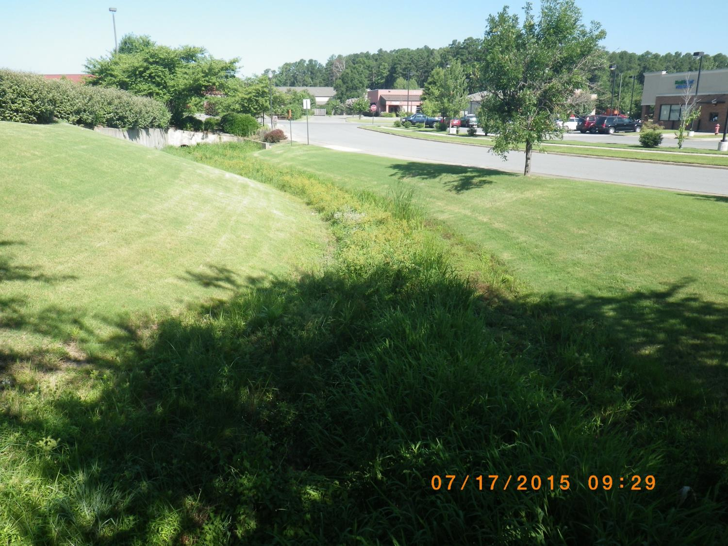
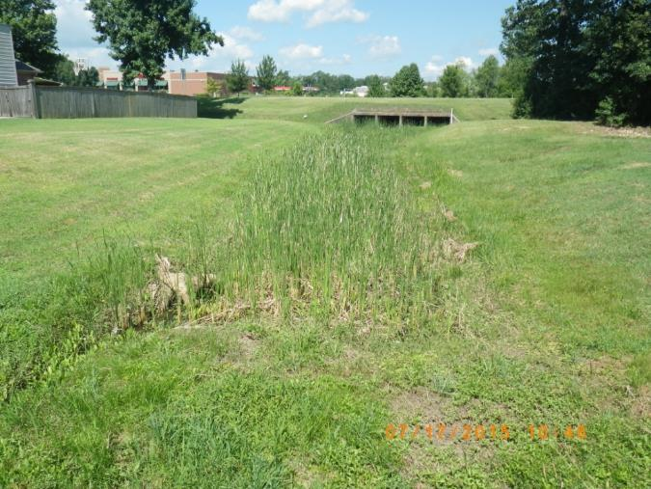
Vegetated Swales
Mostly WQ benefits and improved shallow GW recharge.

Slide 28
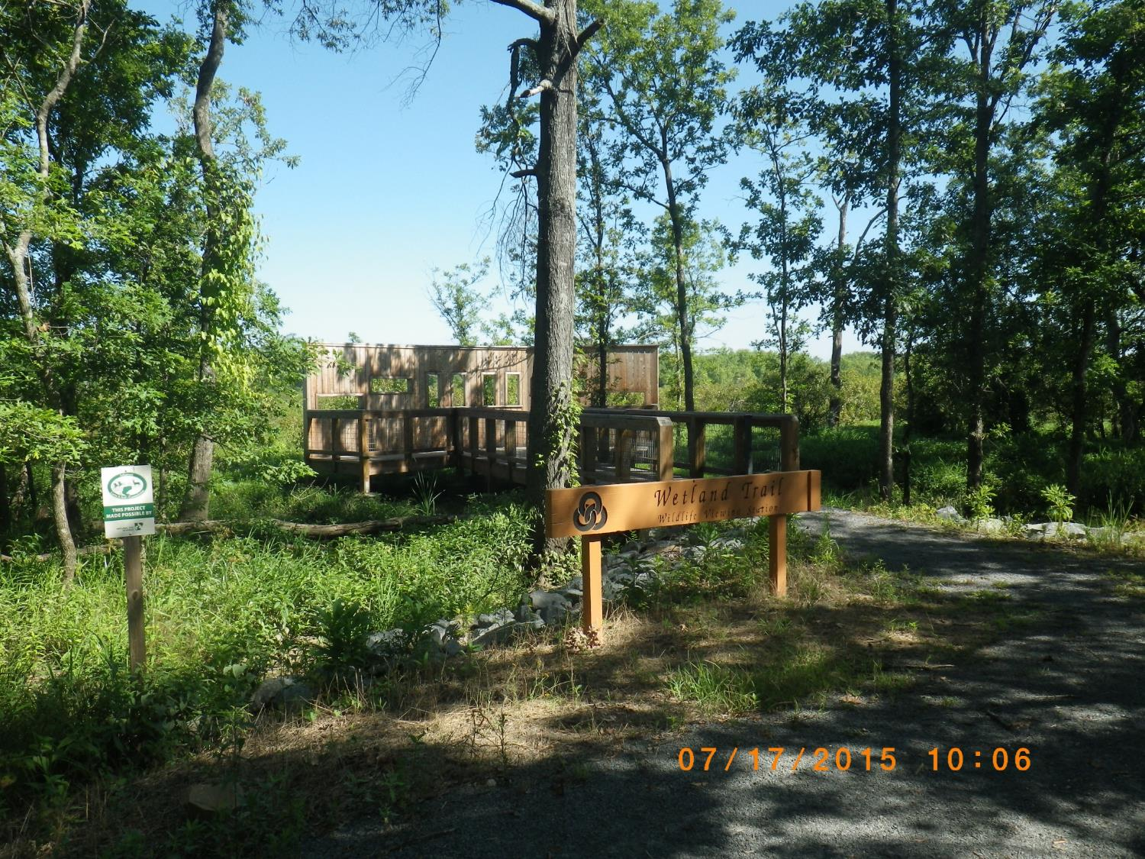
Education, Education…….
Partner with Schools
Trails Program
Booths at local events
Public forums
Wetland Hikes
Bayou Floats
The Cypress Knee

Slide 29
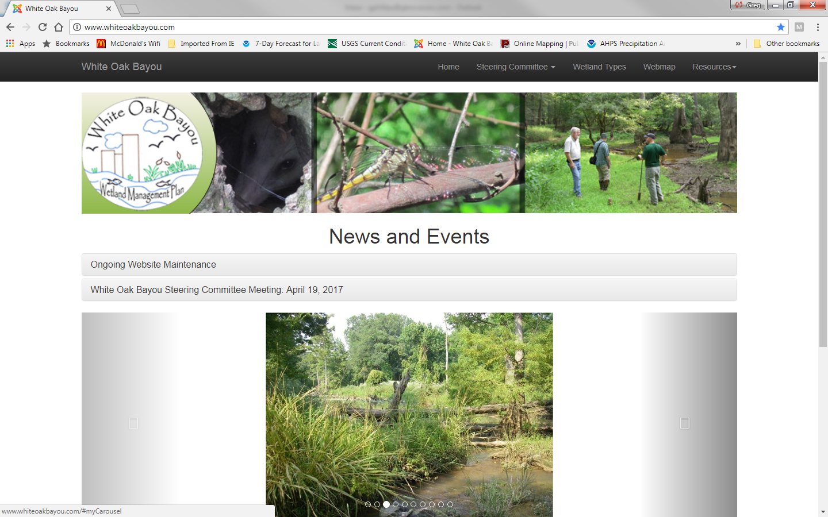
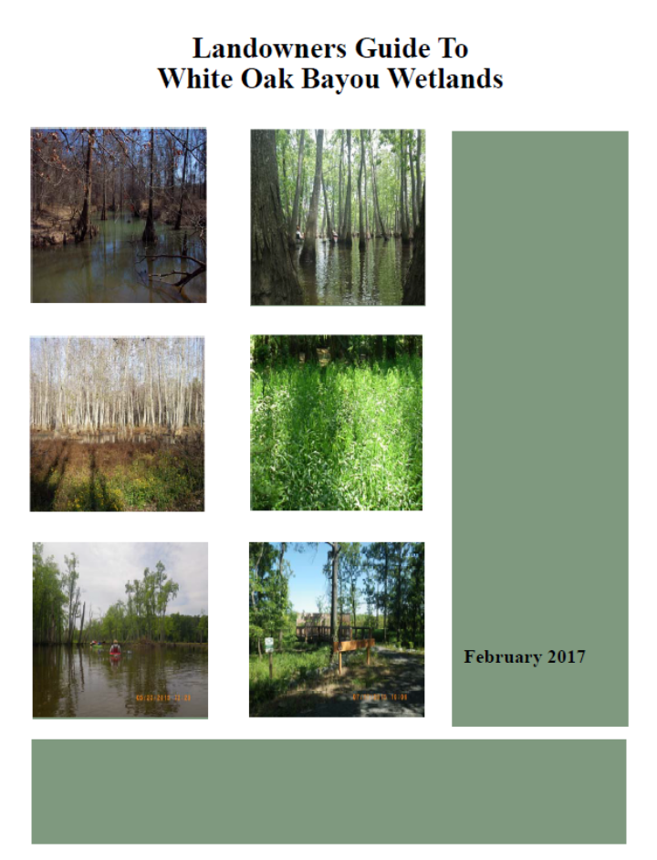
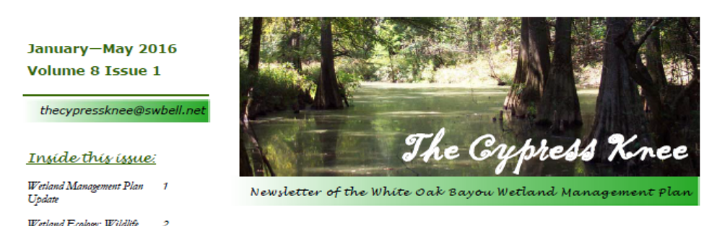

Slide 30
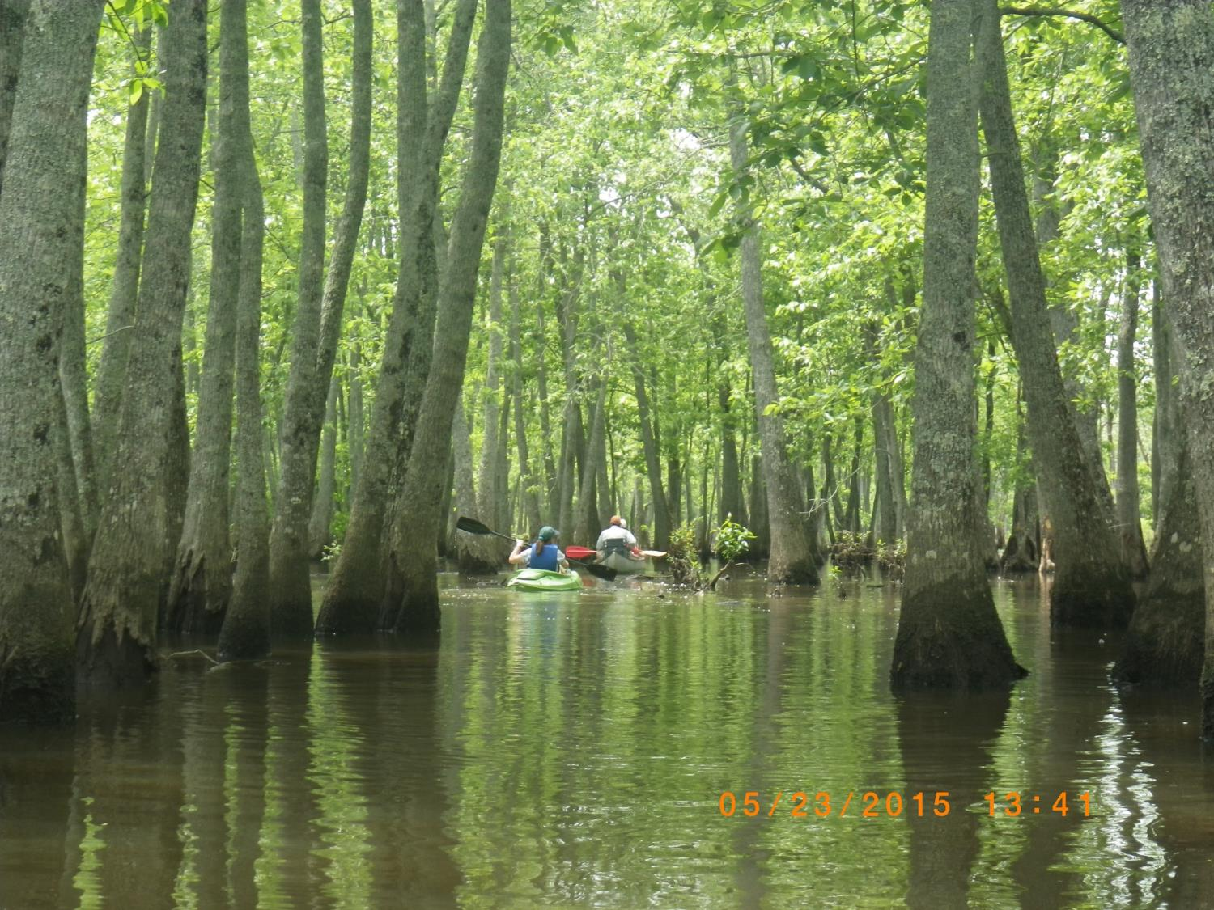
The Public are our Stakeholders
Sponsored float in 2015

Slide 31
Poteau River Watershed Assessment
Stakeholders
  City of Waldron
  Tyson Poultry
  ANRC
  EPA Region 6
  Local Farmers/Landowners
Funded by a 319 Grant from ANRC and EPA

Slide 32
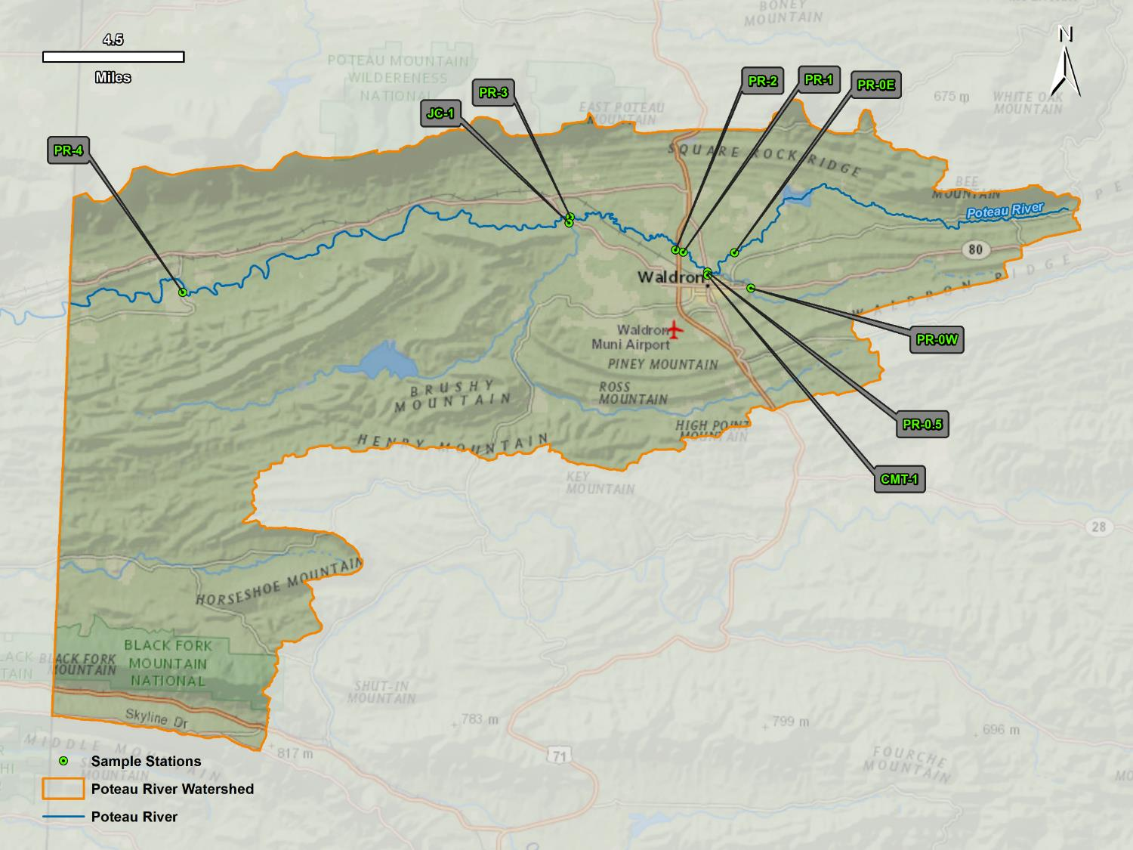
Upper Poteau River Watershed

Slide 33
Main Project Tasks
Water Quality Data Collection (baseflow and storm flow)
Flow Gauging (to provide load calculation)
Unified Stream Assessment
Historical Data Analysis

Slide 34
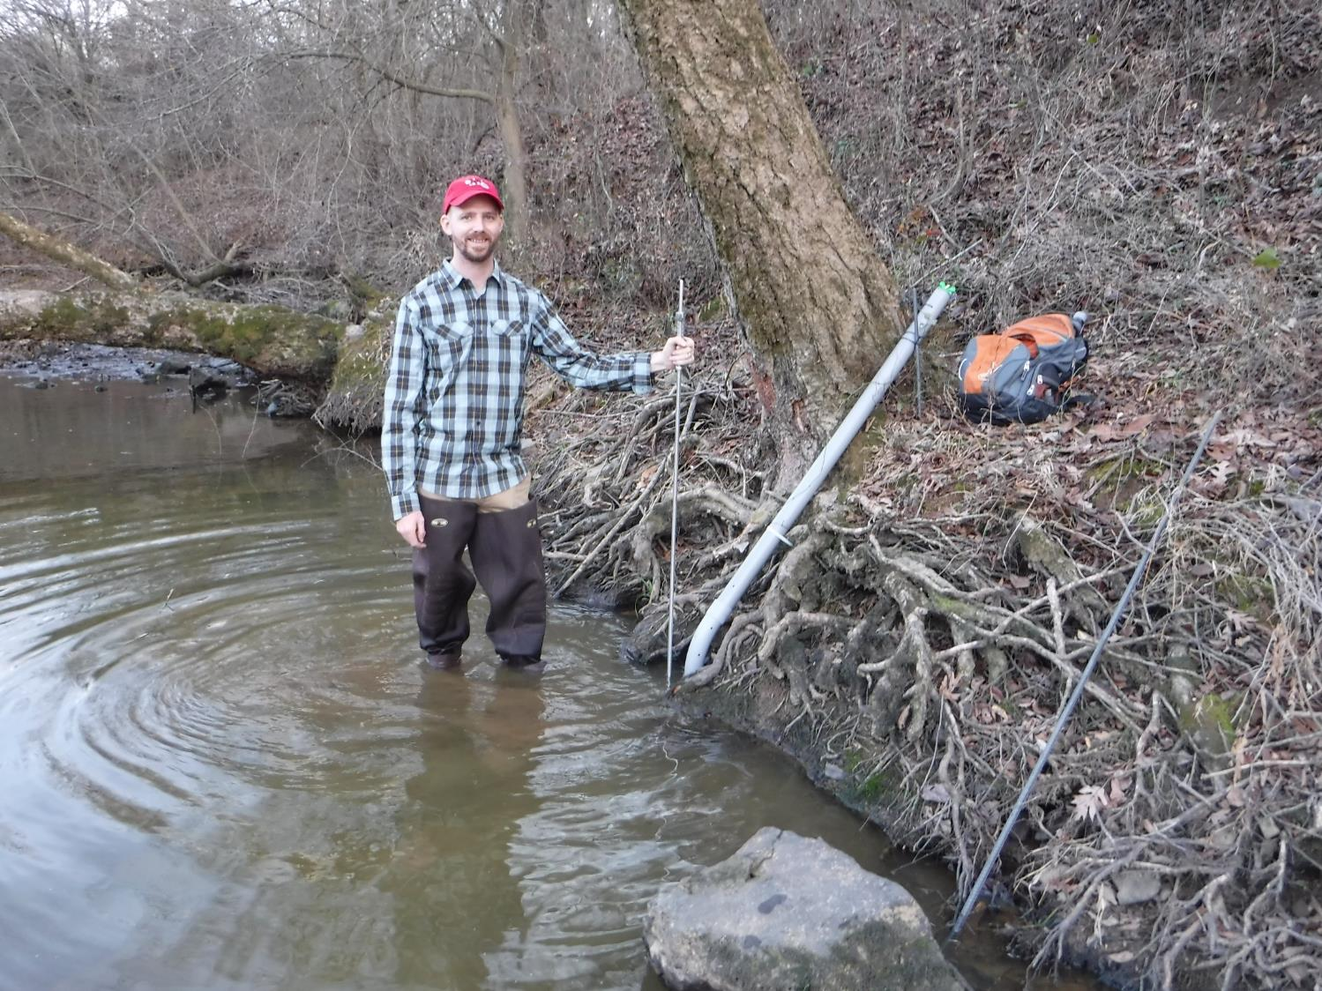
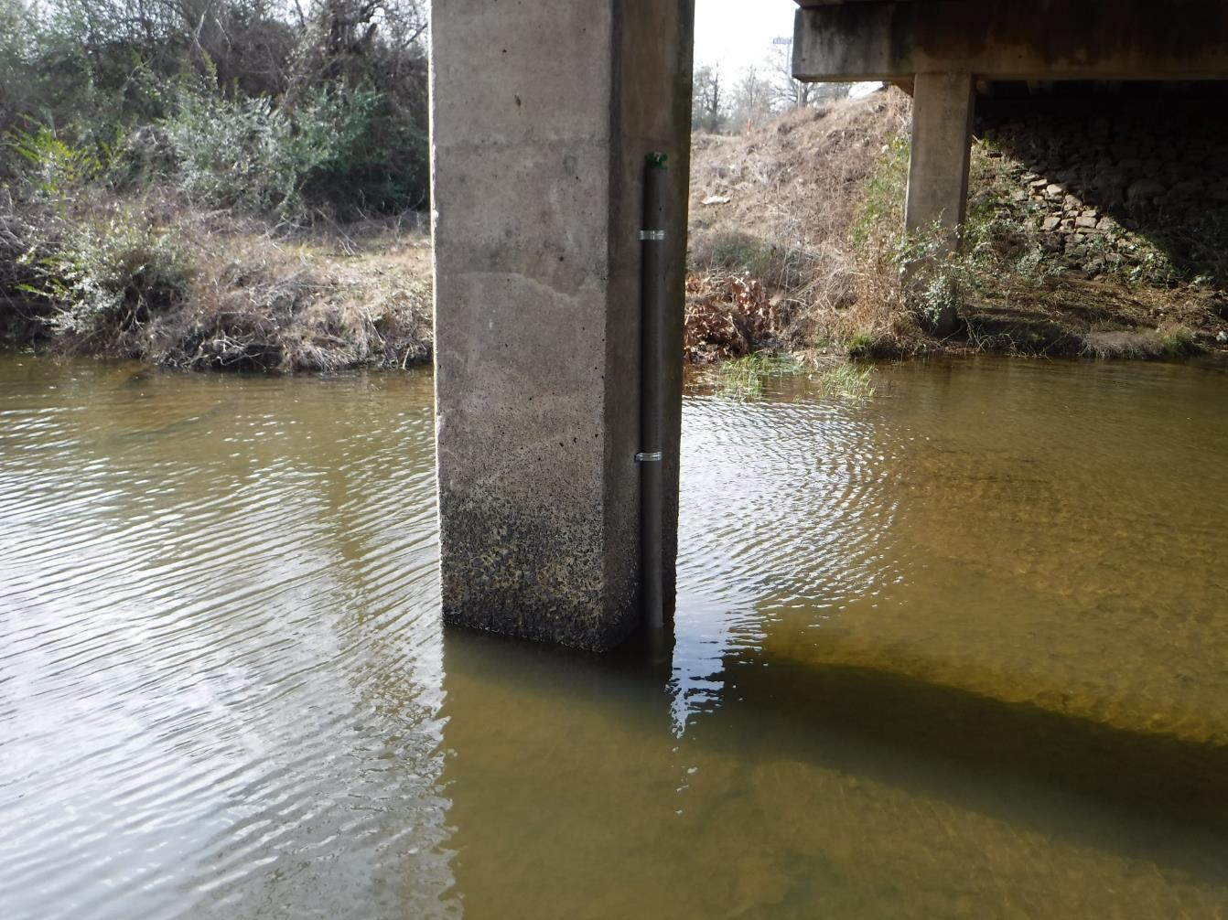
Flow Gauging

Slide 35
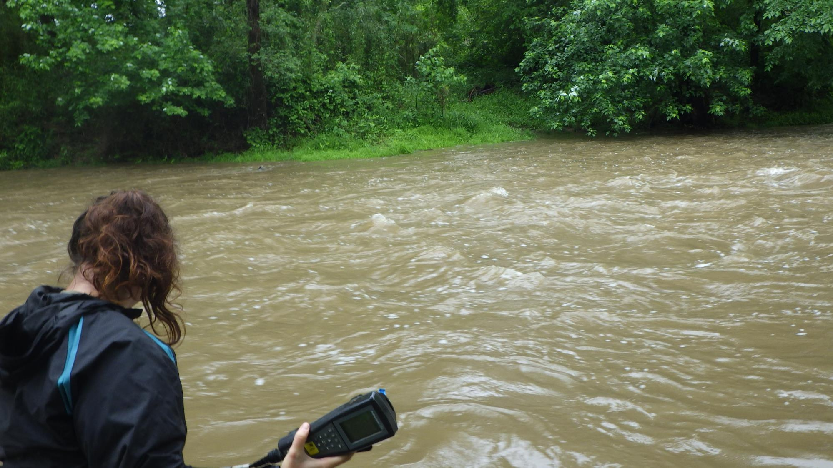
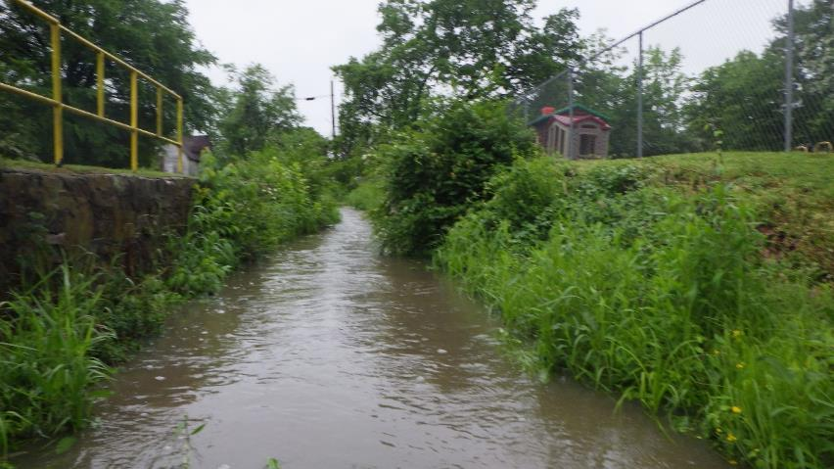
Storm Water Flow on the Poteau River
Same Day!
Storm water in road side ditches in Waldron

Slide 38

Questions?
For further information, contact:
Greg Phillips
(501) 847-7077
GBM^{c} & Associates
gphillips@gbmcassoc.com
www.gbmcassoc.com

