Slide 1
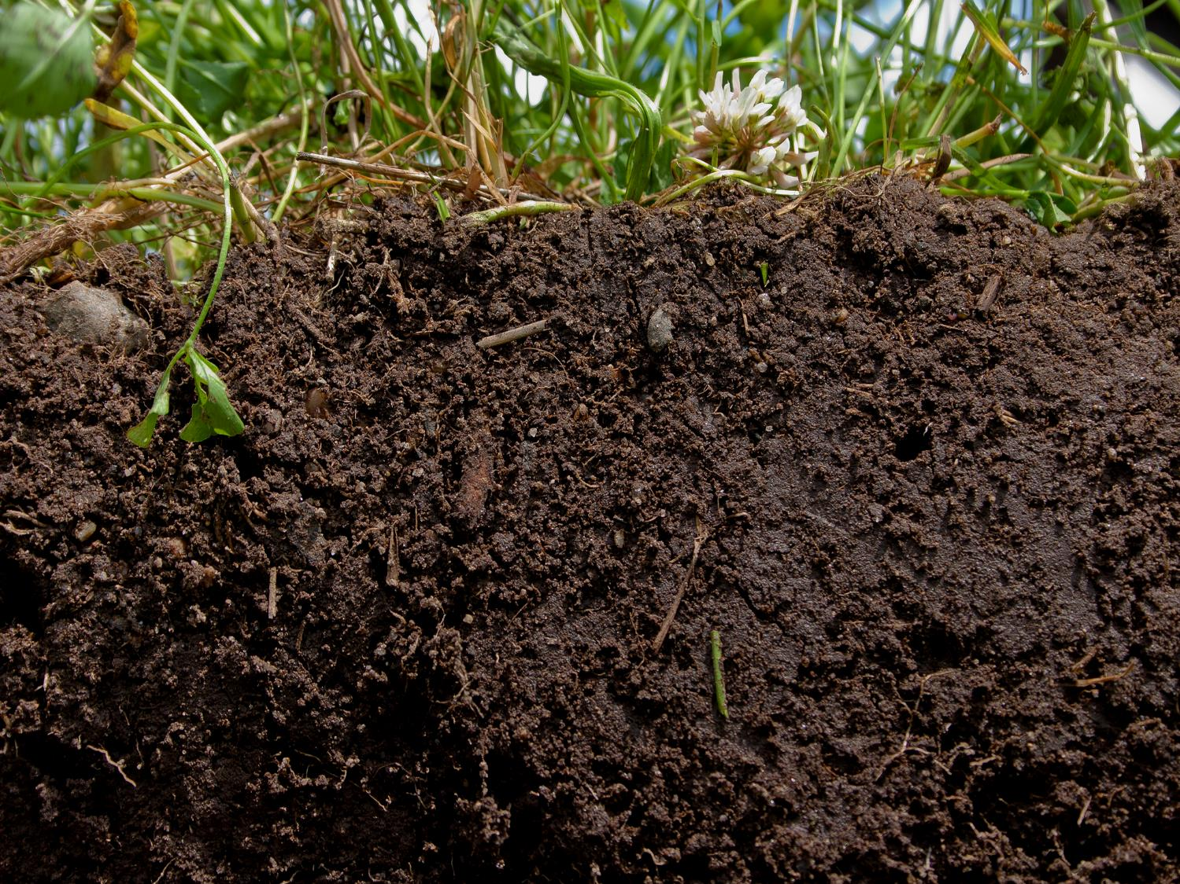



Arkansas Soil Health Alliance
Presented by:
Keith Scoggins
District Conservationist
NRCS Arkansas

Slide 2
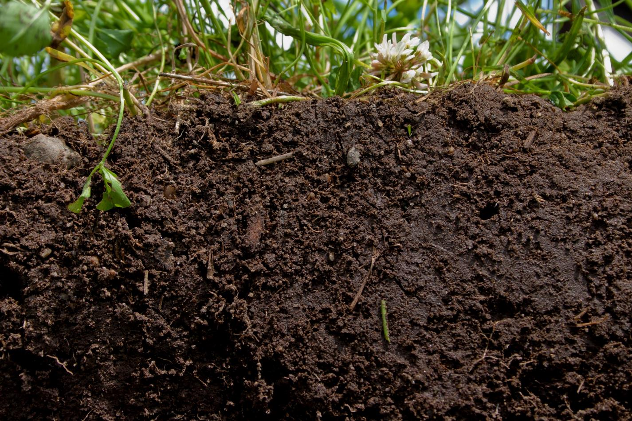
Arkansas Soil Health Alliance
The Arkansas Soil Health Alliance is a non-profit corporation and shall operate exclusively for educational and charitable purposes within the meaning of Section 501 (c)(3) of the Internal Revenue Code, or the corresponding section of any future Federal tax code. Increase tangible support for heightened focus on the importance of soil health on a local, state and national level; educate diverse audiences (from policy makers to the public) about the value and importance of healthy soils; and network and leverage resources and knowledge among conservation partners and organizations.

Slide 3
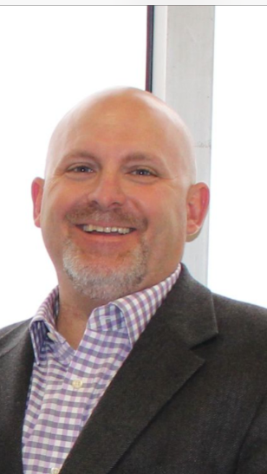

Arkansas Soil Health Alliance
Robbie Bevis
President
Bevis Farms 3000 ac.
Corn, Soybean, and Rice

Slide 4
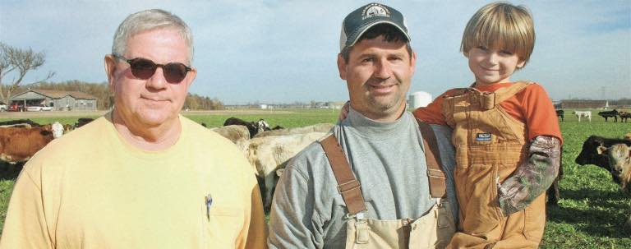
Arkansas Soil Health Alliance
Mike Taylor and Michael Taylor
Long Lake Plantation
5000 ac.
Corn, Soybeans, and Wheat

Slide 5
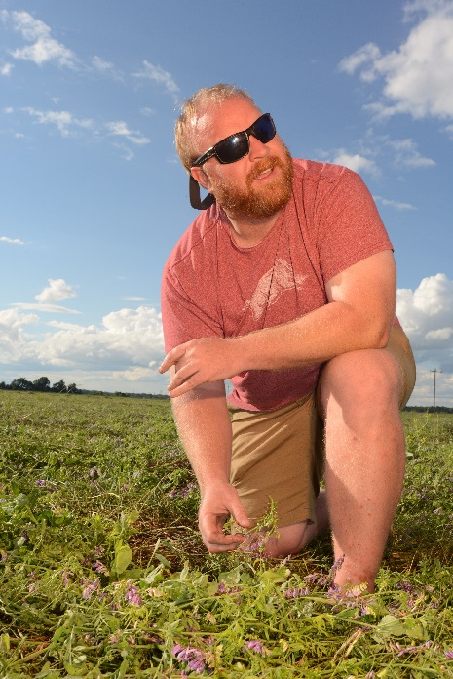
Arkansas Soil Health Alliance
Adam Chappell
Secretary
Chappell Brothers Farms
9000 ac.
Corn, Soybean, Wheat, Cotton and Rice

Slide 6
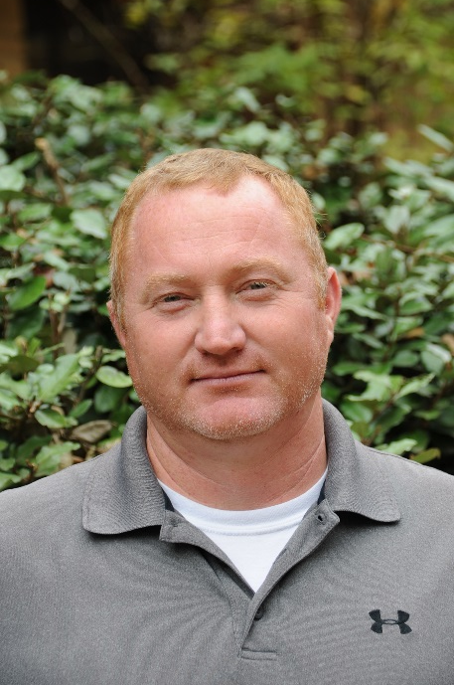
Arkansas Soil Health Alliance
Keith Scoggins
NRCS Liaison
1000 ac.
Soybean, and Rice

Slide 7
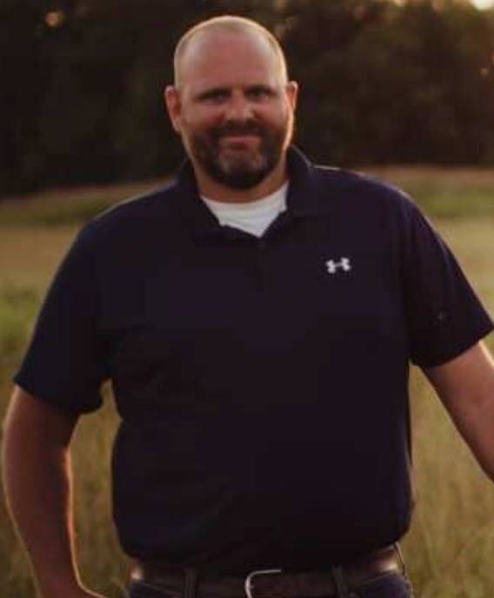
Arkansas Soil Health Alliance
Jeffrey Robinson
Robinson Revocable Trust
760 ac.
Livestock, Soybeans, Rice and Corn

Slide 8
Arkansas Soil Health Alliance
Tim Smith
Southern Soil Solutions
Specializing in Quality Cover Crop Seed, Equipment attachments, inoculants
Retired Farm Manager

Slide 9
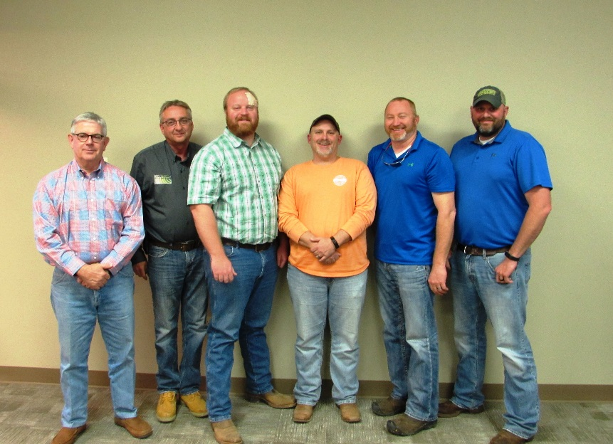
Arkansas Soil Health Alliance
Notes:
These are the original founding members we have since added members Bill Carwell, Parmer Hankins, and Brett Carwell

Slide 10
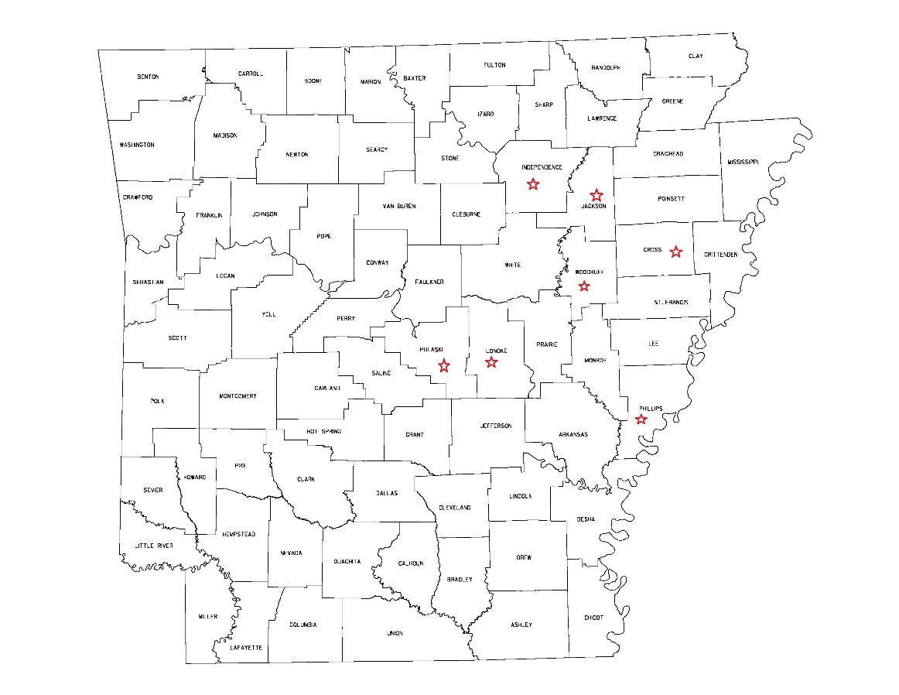
Arkansas Soil Health Alliance
Notes:
With a wide coverage over the state in the Mississippi river delta

Slide 11
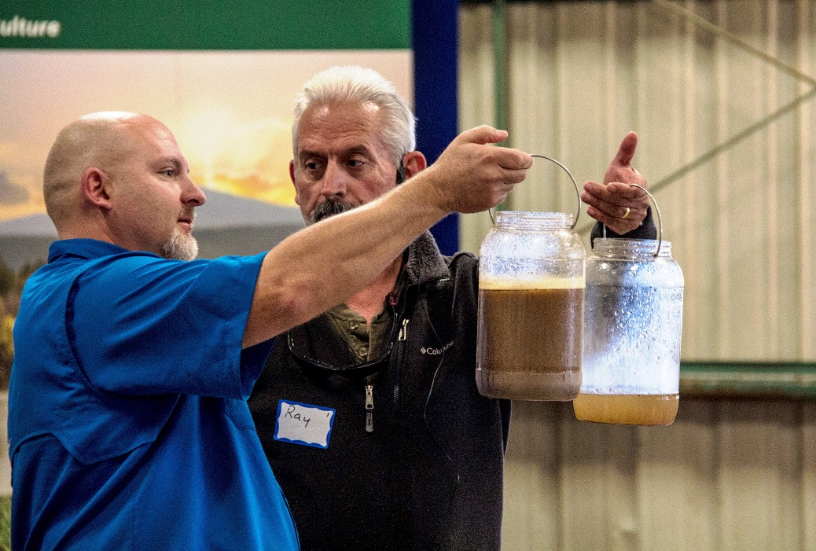
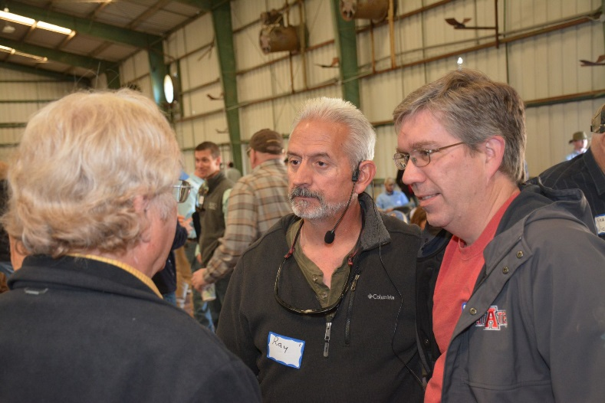
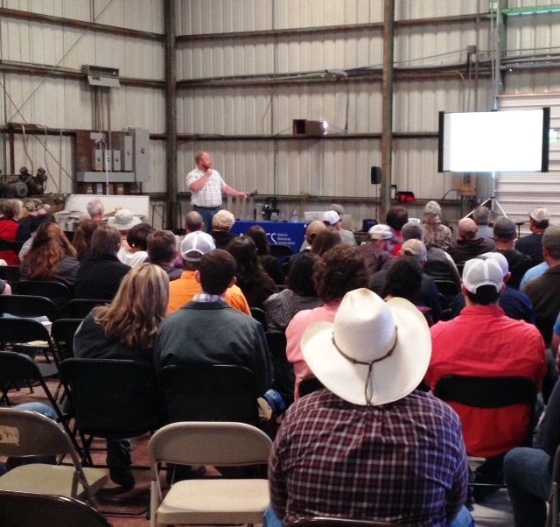
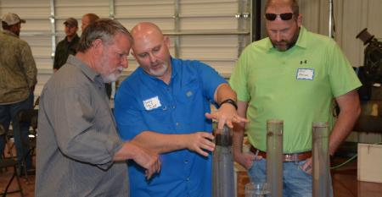
Arkansas Soil Health Alliance
Notes:
March 31st Cotton Plant, July 12th Greene county field day, July 18th Phillips County Field Day, August 4th Jackson County Field Day, St Francis County Field Day September 20,

Slide 12
Arkansas Soil Health Alliance
Partners
NRCS, AACD, AGLC, U of A, ASU, etc.

Slide 13


Questions?

Slide 14

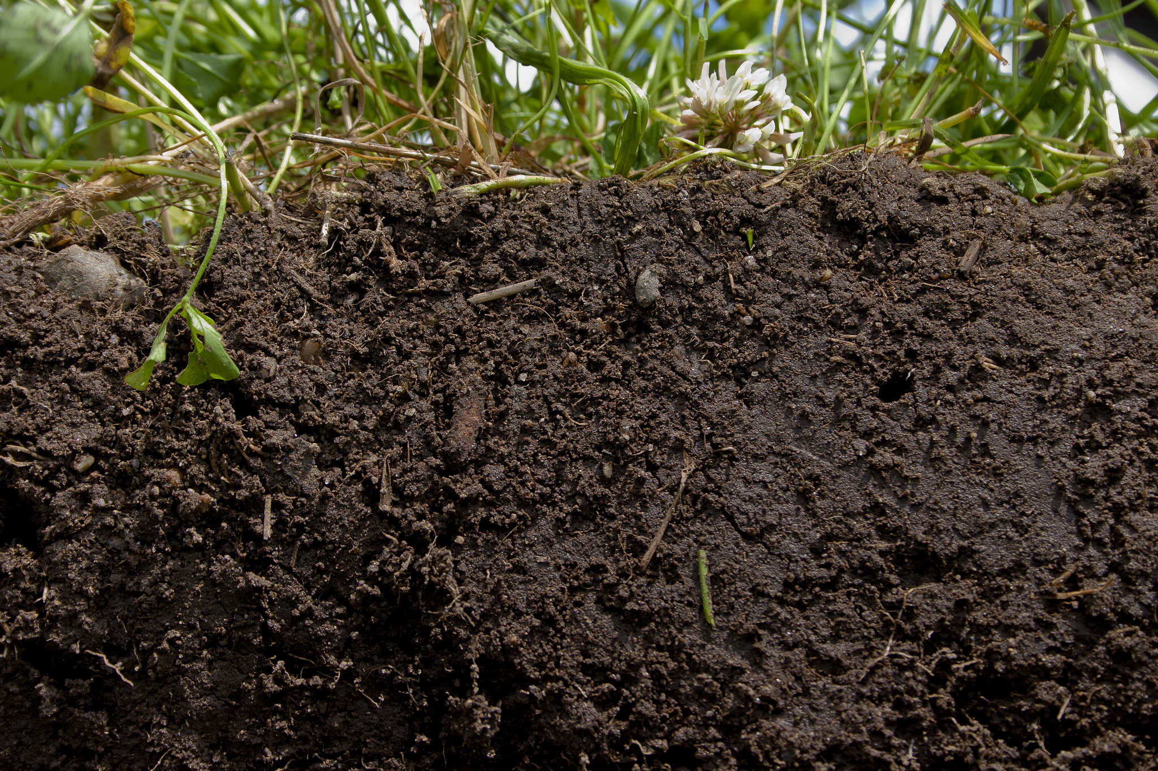

To File a Complaint of Discrimination
The U.S. Department of Agriculture (USDA) prohibits discrimination against its customers. If you believe you experienced discrimination when obtaining services from USDA, participating in a USDA program, or participating in a program that receives financial assistance from USDA, you may file a complaint with USDA. Information about how to file a discrimination complaint is available from the Office of the Assistant Secretary for Civil Rights. USDA prohibits discrimination in all its programs and activities on the basis of race, color, national origin, age, disability, and where applicable, sex (including gender identity and expression), marital status, familial status, parental status, religion, sexual orientation, political beliefs, genetic information, reprisal, or because all or part of an individual's income is derived from any public assistance program.
(Not all prohibited bases apply to all programs.)
To file a complaint of discrimination, complete, sign, and mail a program discrimination complaint form, available at any USDA office location or online at www.ascr.usda.gov, or write to:
USDA
Office of the Assistant Secretary for Civil Rights
1400 Independence Avenue
Southwest Washington, D.C. 20250-9410
Or call toll free at (866) 632-9992 (voice) to obtain additional information, the appropriate office or to request documents. Individuals who are deaf, hard of hearing, or have speech disabilities may contact USDA through the Federal Relay service at (800) 877-8339 or (800) 845-6136 (in Spanish).
USDA is an equal opportunity provider, employer, and lender.
Persons with disabilities who require alternative means for communication of program information (e.g., Braille, large print, audiotape, etc.) should contact USDA's TARGET Center at (202) 720-2600 (voice and TDD).

