Slide 1
12-400 Lower L’Anguille Watershed Cost Share
Patricia Perry
St. Francis County Conservation District

Slide 2
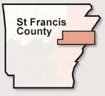
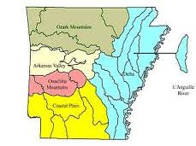
Project location – Lower L’Anguille River Watershed

Slide 3
Project Goals
Encourage use of BMPs to reduce erosion from agricultural land in the L’Anguille River Watershed
Introduce producers to core practices to avoid, control, and trap water pollutants
Provide incentives to implement conservation practices

Slide 4
Project Objectives
Conduct Annual Outreach Meeting
Transfer Knowledge
  Newsletters
  Newspaper Articles
  Radio Spots
  Mail Outs
Provide 40% Cost Share to Implement Practices
Cost Incentive Payments for Specific Practices
Reap Improved Water Quality Benefits

Slide 5
Best Management Practices
Sediment & Soil Erosion Practices
Reduced Runoff BMPs
Grade Stabilization Structure (410) 10 Yr. life
Water Control Structure (587) 20 yrs.
Irrigation Water Conveyance (430DD) 25 yrs.
Critical Area Treatment (342) 10 yrs.
Pasture Establishment (512) 10 yrs.
Stream bank Stabilization (580) 20 yrs.
Pond (378) 20 yrs.
Tree Establishment (612) 15 yrs.
All structural BMPs will be cost-shared at 40% of the actual cost of implementation.
.
Sediment and Water Control Structures (638) 10 yrs.
Diversion (362) 10 yrs.
Filter Strips (393) 10 yrs.
Cover Crop (340) 1 yr.
Prescribed Grazing (528A) 5 yrs.
Fencing (382) 20 yrs. Fencing will only be eligible when implemented with either pasture establishment or prescribed grazing.
All structural practices will be cost-shared at 40% and cover crop will receive a maximum of $25 per acre cost-share.

Slide 6
Project Funding
Federal dollars
Local match
Total
$125,000
Allocated to Date
$122,934.30
$162,760
Committed to Date
$205,234.25
$287,760
To Date
$328,165.55

Slide 7
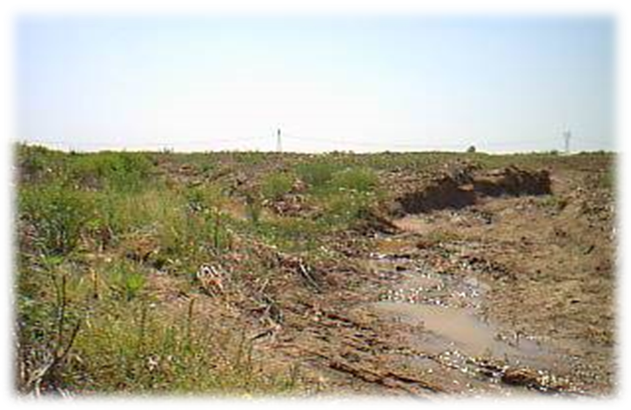
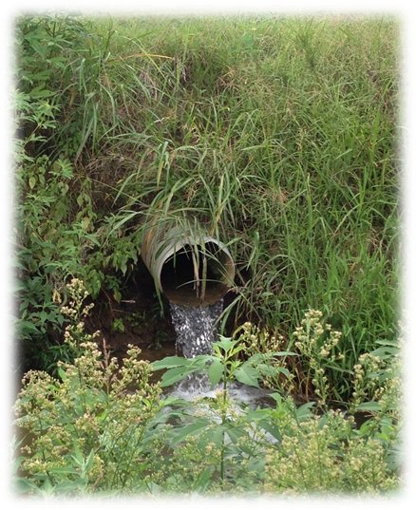
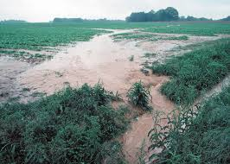
Drop Pipes & Water Control Structures
Erosion & Gullies Form Along the edge of the field dumping Sediment laden runoff into ditches and streams

Slide 8
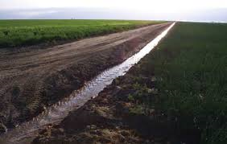
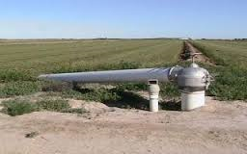
Irrigation Water Conveyance

Slide 9
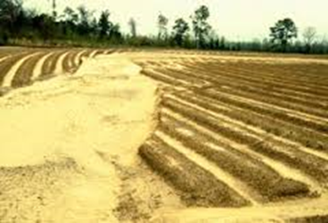
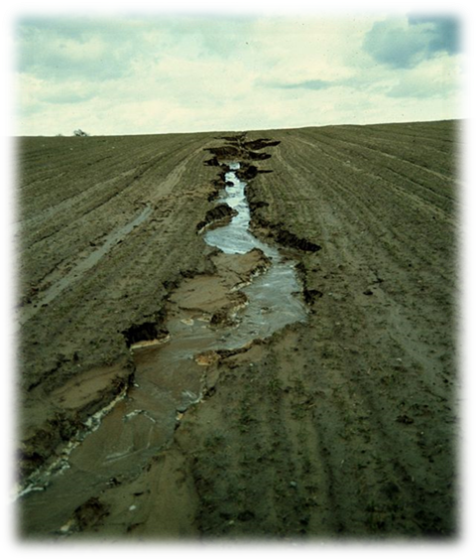
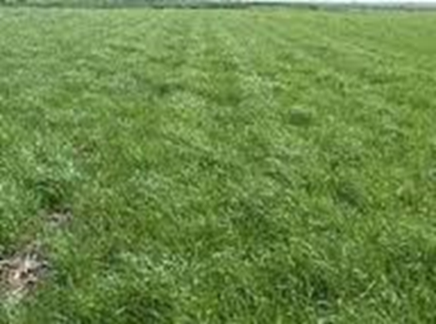
Winter Cover Crops

Slide 10
Project progress
36 Applications Received to Date
22 Have Practices installed & Completed
  29 Drop Pipes – Reducing Erosion on Approximately 1100 acres
  20,563 Feet of Irrigation Water Conveyance
  544 Acres Planted to Winter Cover Crop

Slide 11
Measures of Success
Producers Willingness to:
  Make Personal Investments in BMPs
  Change Historical Farming Practices
  Generate Interest in Other Producers
Life Expectancy of Practices Insures Long Term Success
Improved Water Quality
Improved Soil Fertility

Slide 12
Appreciation . . . .
Environmental Protection Agency 319 Program
Arkansas Natural Resources Commission 319 Program
USDA NRCs
Our producers

Slide 13
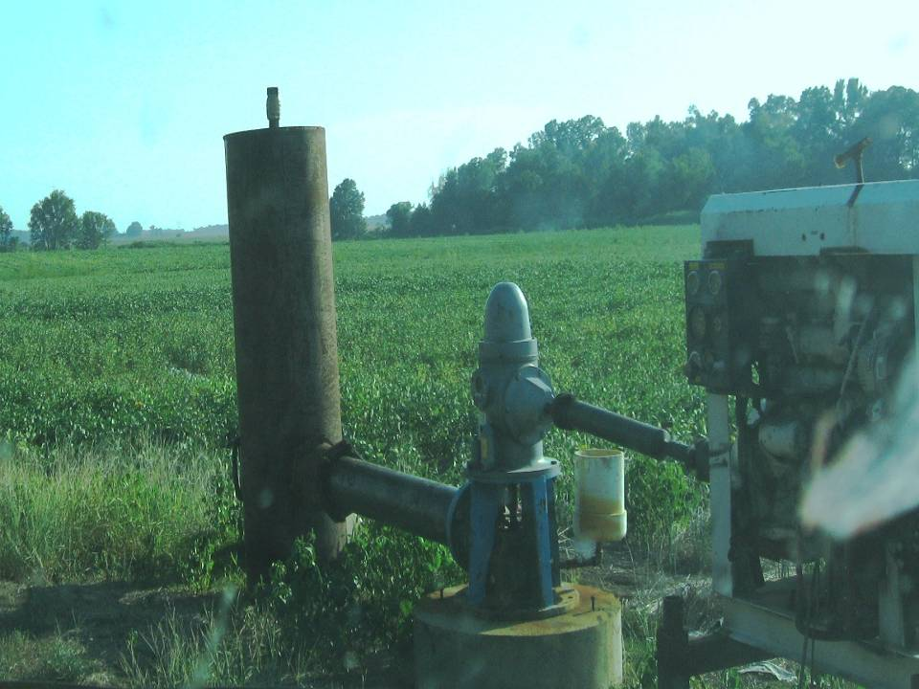
Questions?

