Slide 1
Cross County
L’Anguille River Watershed water quality project
Project #12-300
July 1, 2012-June 30, 2015

Slide 2
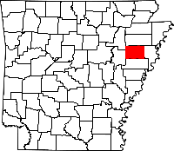
Project Location
The Cross County-L’Anguille River Watershed
WATER QUALITY PROJECT
Is on the East side of Arkansas
within Cross County.

Slide 3
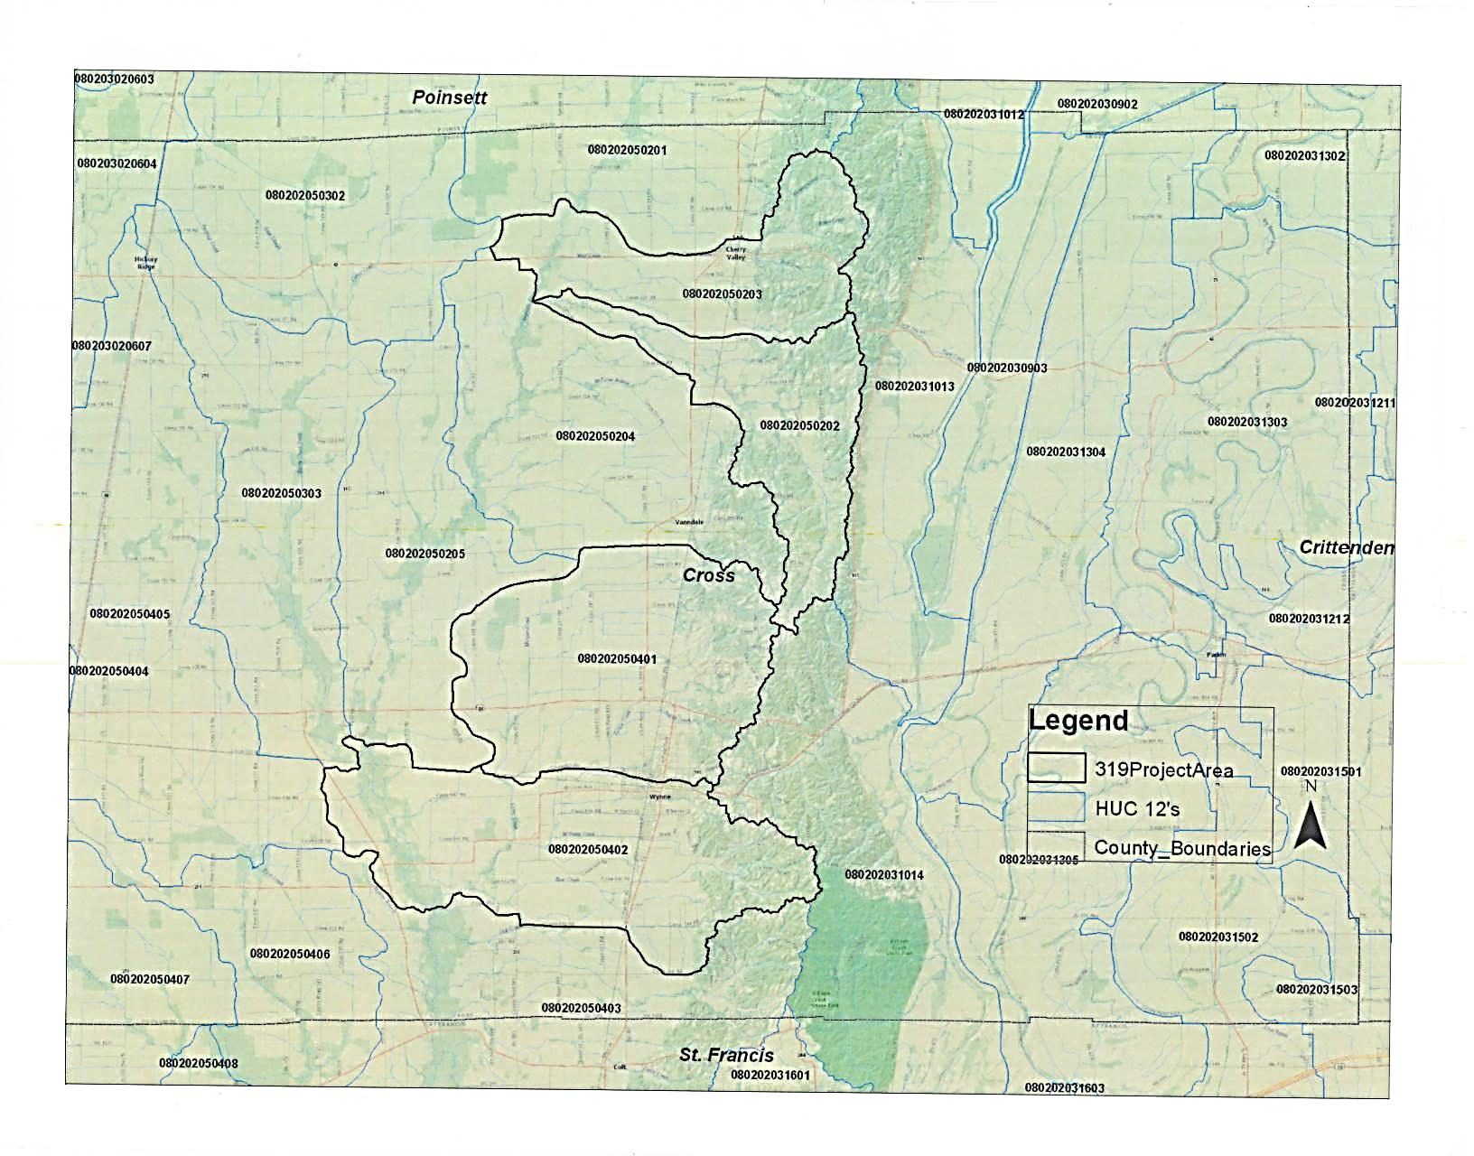
Project Area Map
Black outline is the priority project area
Blue outline is the 12 digit HUC project area

Slide 4
Project Goals/Objectives:
Reduce sedimentation
Improve water quality
Promote and encourage implementation of the Best Management Practices

Slide 5
Project promotion
Broadcast on local radio
Published in local newspaper
Published in District newsletters
Notes:
Important to have a successful project.

Slide 6
Project Planning
Reviewed location Maps with participants
Developed conservation plans
Completed cost share agreements with participants
Partnered with NRCS for technical assistance

Slide 7
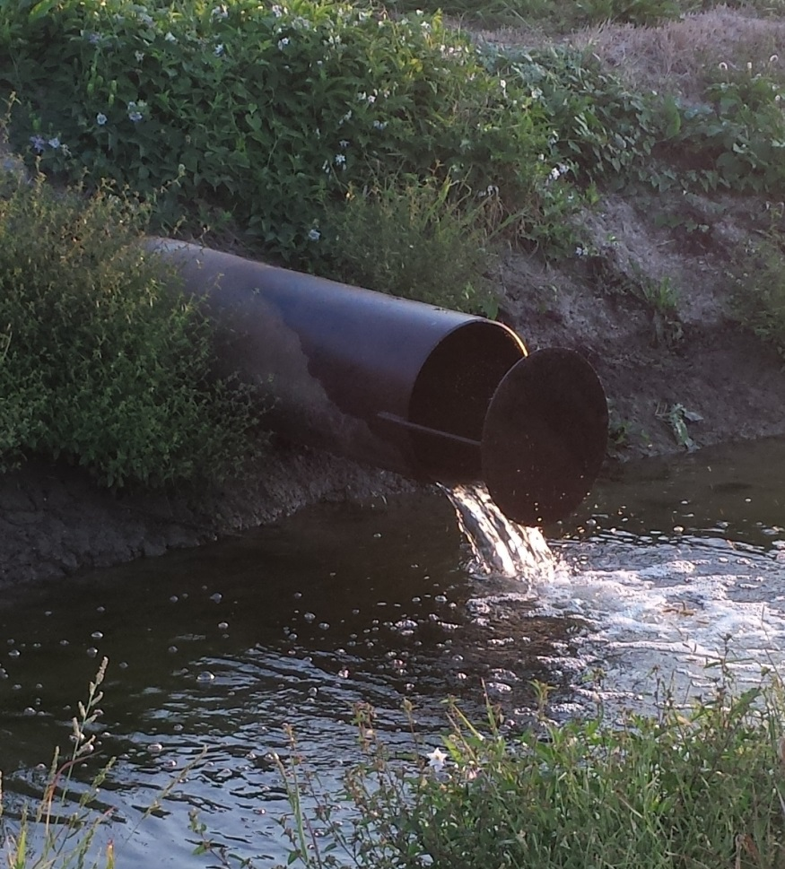
Water Control Structure
Splash guards control the velocity of water coming from the field minimizing erosion
Ditch View

Slide 8
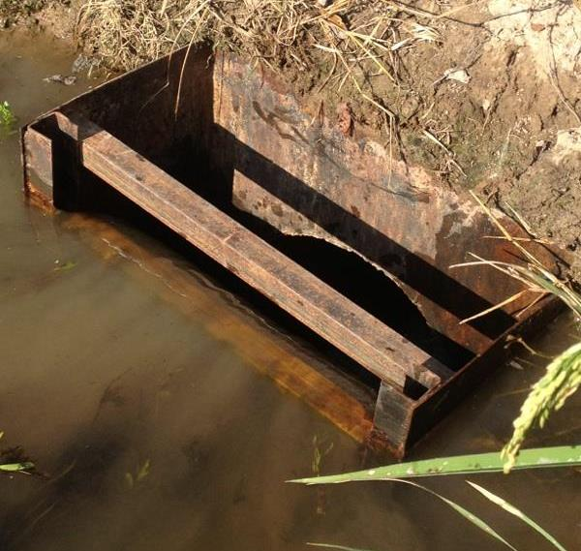
Water Control Structure Box
Landowners can control the water level in the field as well as control the flow of water coming from the field.
Landowners Insert boards to control water. Stopping erosion and keeping the top soil in the field.
Field View

Slide 9
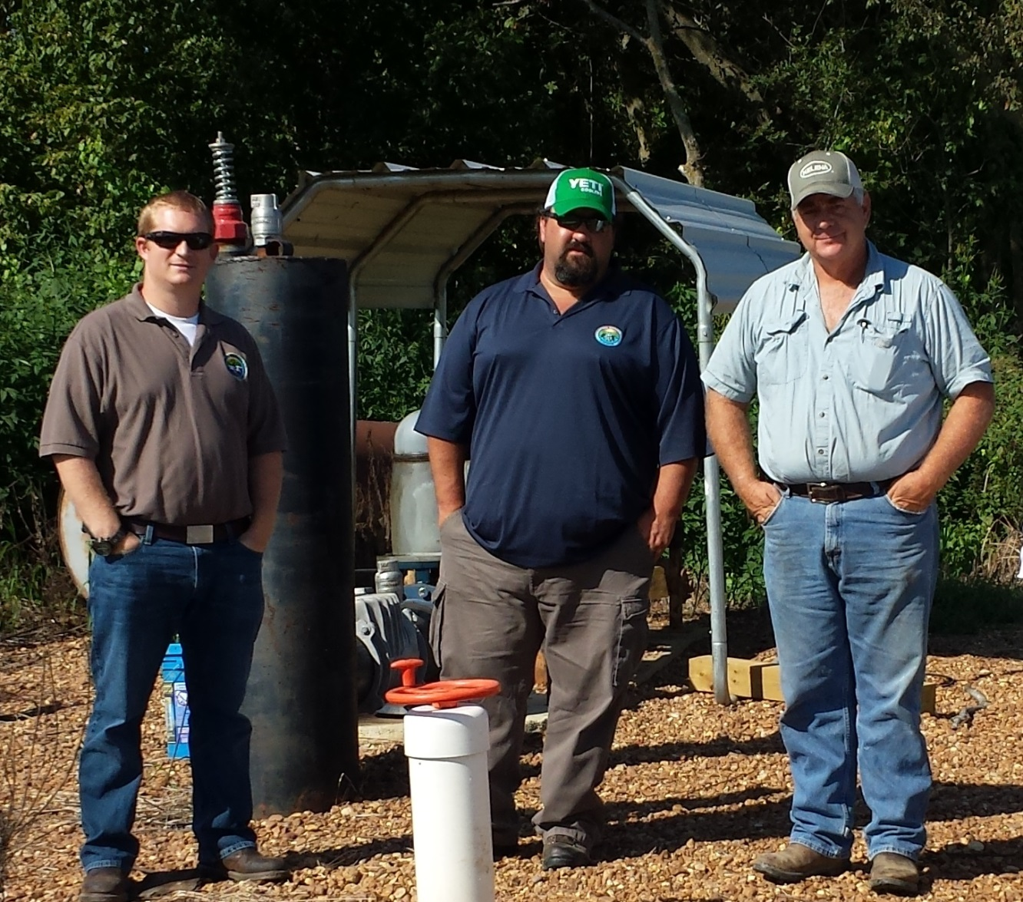
Site Visit - Robbie, Steve and landowner Tim Fisher
Water Transfer System
Water
transfer
systems were
installed with
risers placed
in the most
effective
locations.

Slide 10
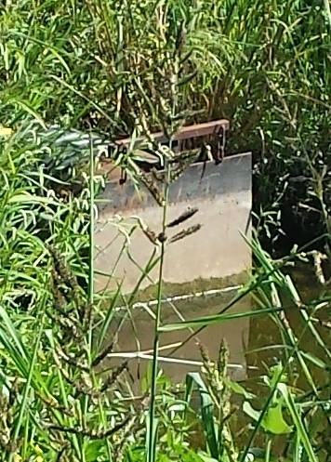
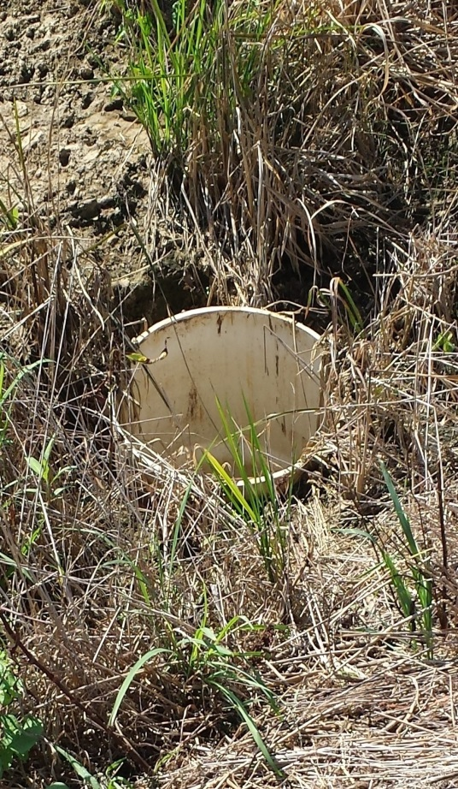
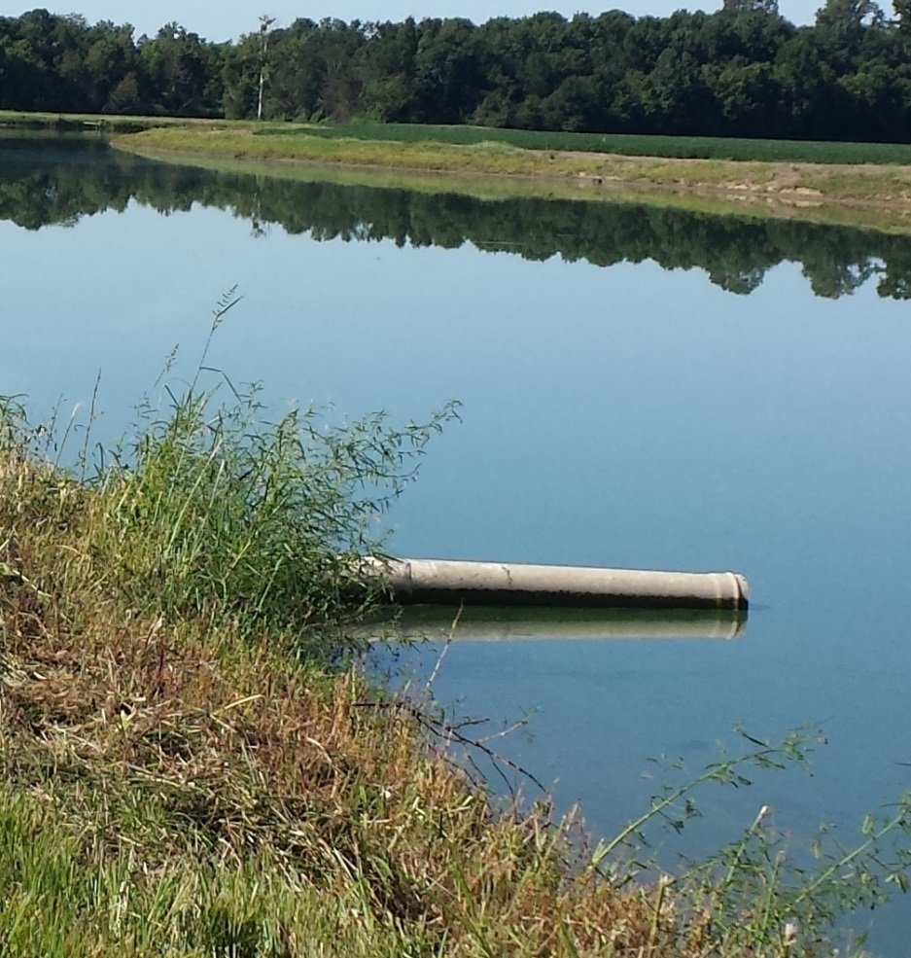
Project Progress & Success
Flapper Gate in ditch
Drop pipe in field
Pipe from field into reservoir
Total Practices complete: 48 = Structure for water control
25,607’ = Water transfer

Slide 11
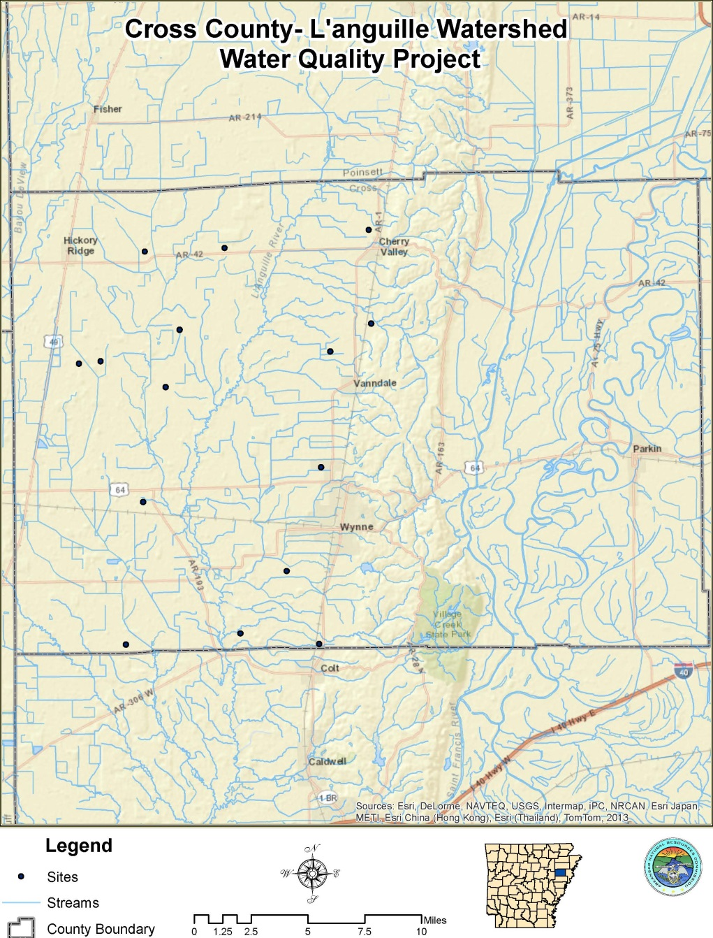
Project is at 80% completion
Map of Completed Practices

Slide 12
Project Funding Breakdown
$125,000.00 Federal funds
$187,500.00 Non-Federal funds.
$335,500.00 Project total

Slide 13
Acknowledgment
Cross County Conservation would like to acknowledge and commend the following:
          Tony Ramick, Grants Manager
          Robbie Alberson, ANRC Program Coordinator
          Steve Stake, ANRC Program Coordinator
          Pat Perry, 319 Area Coordinator
          EPA – for making these funds available and making our project possible

