Slide 1
Boone County Bull Shoals Watershed Project
Presented By: Boone County Conservation District

Slide 2

Boone County Bull Shoals Watershed Project
Bull Shoals Lake Watershed
711,467.07 acres
Source of drinking water for approximately 20,000 people in Boone, Newton, Marion, and Searcy Counties.
Our project area focuses on a total of 104,711 acres.

Slide 3
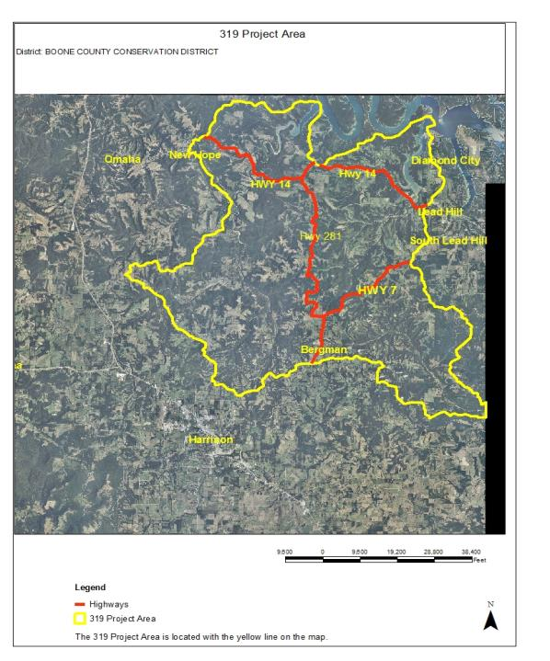


Boone County Bull Shoals Watershed Project
Project Focus
Five sub watersheds:
West Sugarloaf Creek
Middle Bear Creek
Lower Bear Creek
Cheatham Creek
Sugar Orchard Creek

Slide 4

Project Goal
Encourage voluntary participation of Best Management Practices (BMPs) on 50% of pastureland (approximately 12,065 acres)

Slide 5
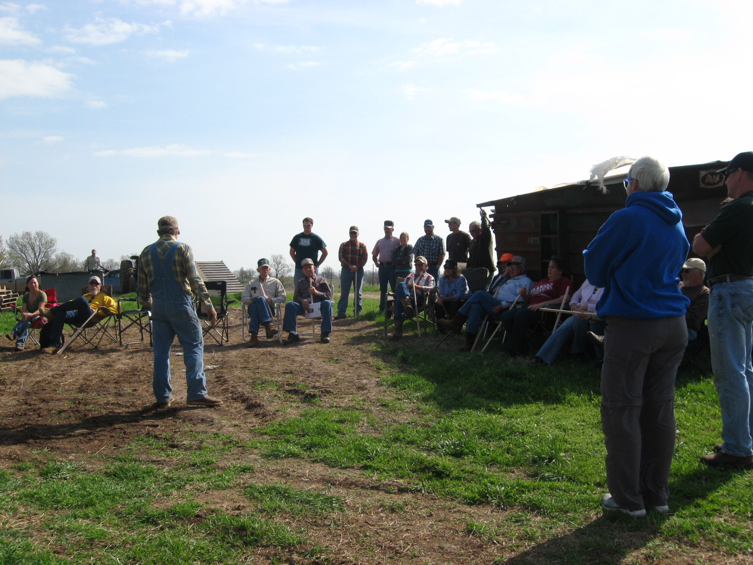
Boone County Bull Shoals Watershed Project
Pasture Field Day
April 12, 2014
37 in attendance
Speakers included the:
NRCS Grazing Lands Specialist
NRCS District Conservationist & Soil Technician
BCCD Technicians & Board
AR Game & Fish Biologist
Testimonials from land owners

Slide 6
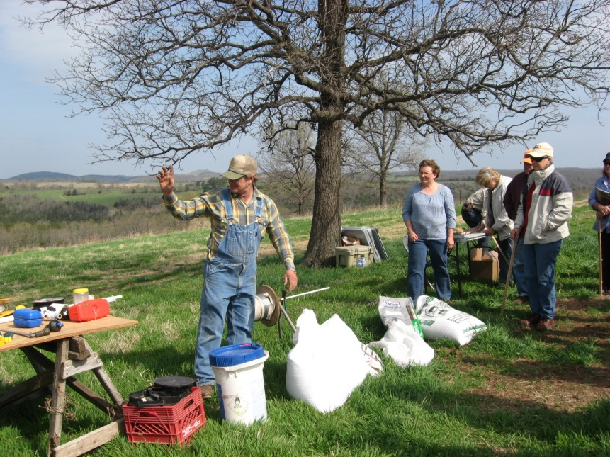
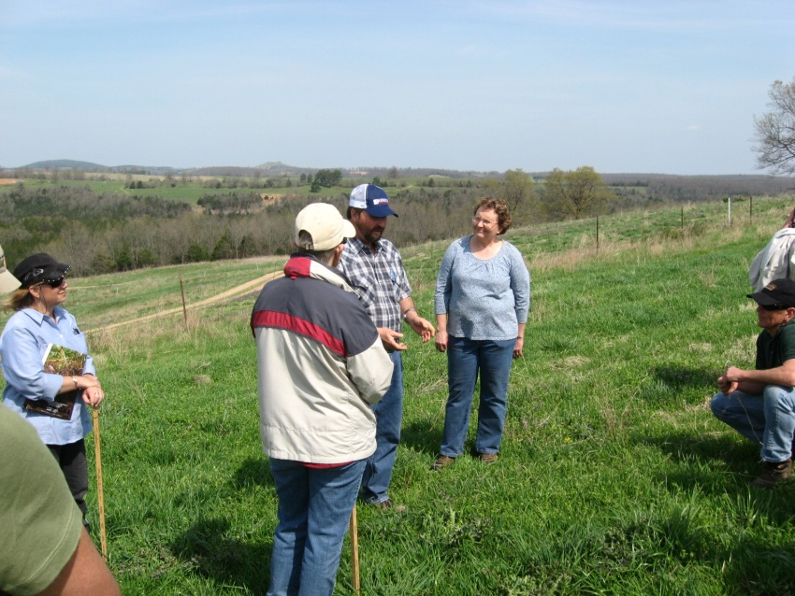
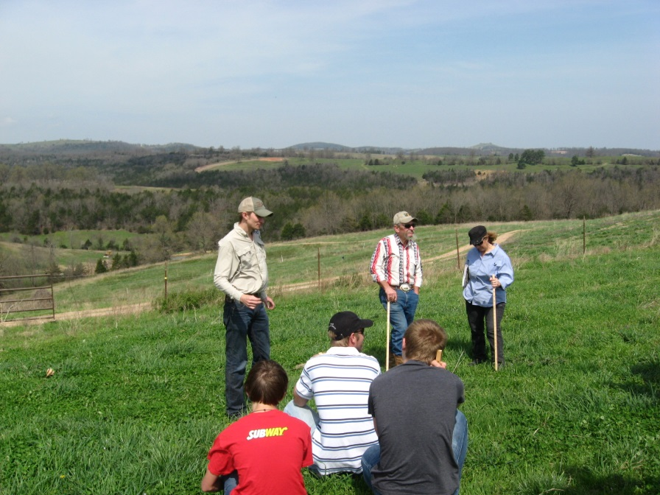
Boone County Bull Shoals Watershed Project
April 12, 2014 Pasture Field Day

Slide 7
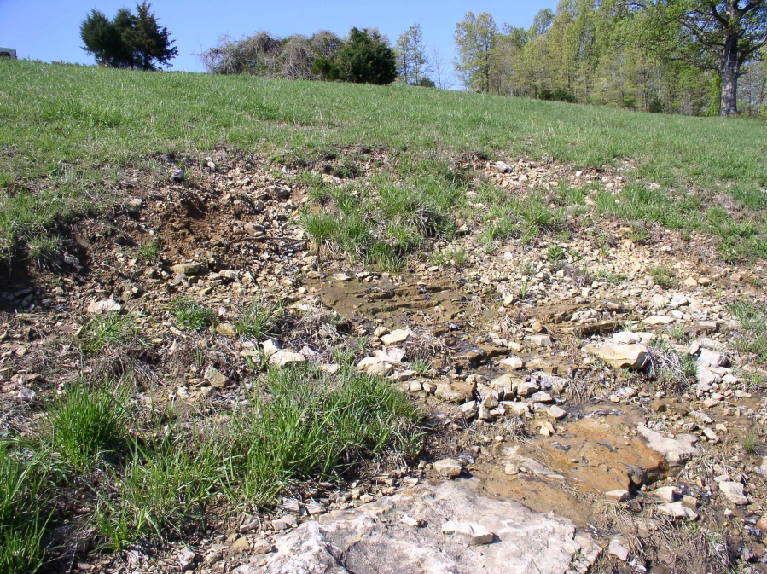
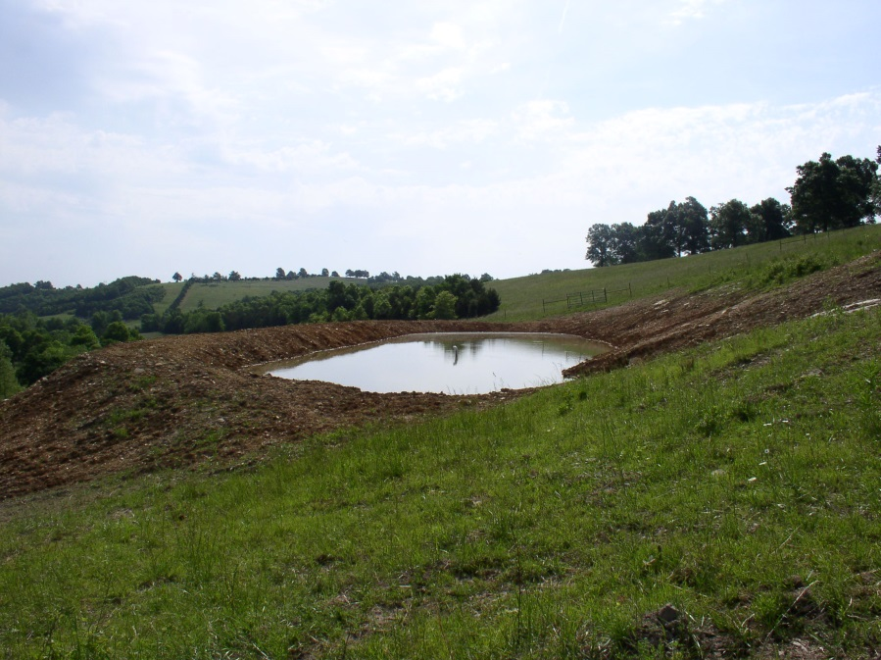
Boone County Bull Shoals Watershed Project
Completed Practices in Our Second Year
Ponds (378)
3,399.06 cu yds.

Slide 8
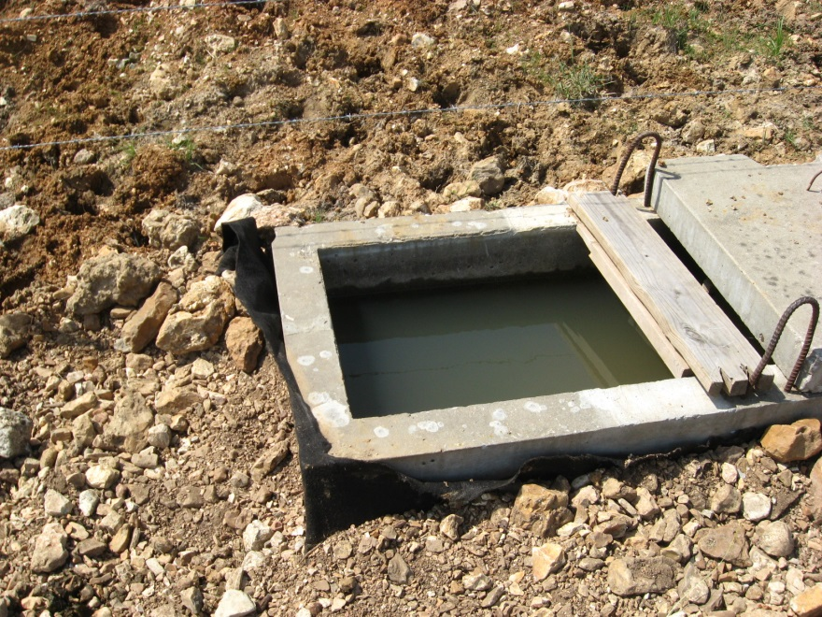
Boone County Bull Shoals Watershed Project
Other BMPs Completed in Our Second Year:
Pipeline (516) 500 ft.
Heavy Use Area Protection (561)
Watering Facilities (614)
Fencing (382) 1493 ft.

Slide 9
Boone County Bull Shoals Watershed Project
Accomplishments to Date
Purchased a laptop computer, color laser jet printer, and a Haybuster No Till Drill. (FY13)
Completed 23 conservation plans (15 in FY13, 8 in FY14)
Revised 7 Nutrient Management Plans & created 10 new plans
$28,662.96 has been paid to landowners, $45,004.09 landowner match (FY13&FY14)

Slide 10
Boone County Bull Shoals Watershed Project
Those Aiding in the Project
Boone County Conservation District
Natural Resource Conservation Service
Boone County Extension Service
Arkansas Natural Resources Commission
US Environmental Protection Agency

Slide 11
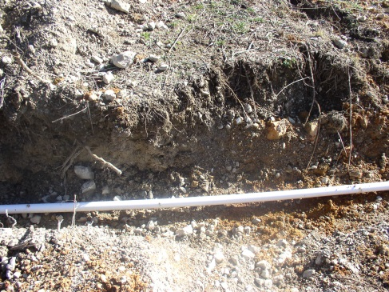
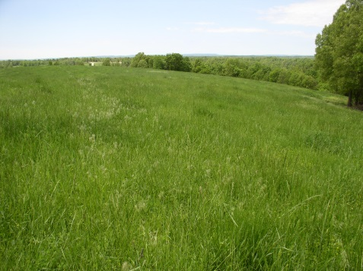
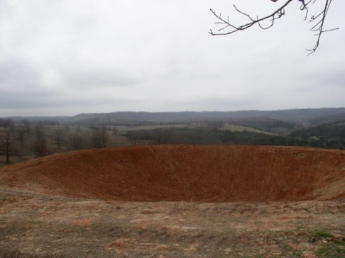
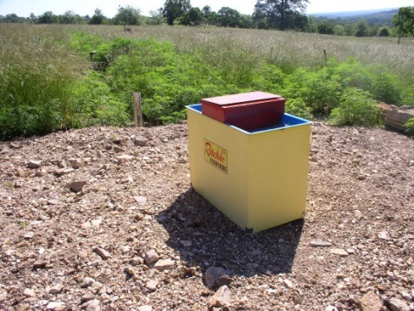
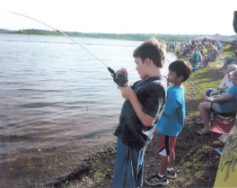
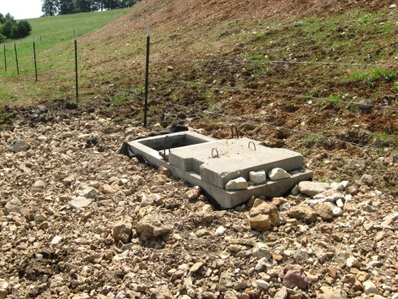
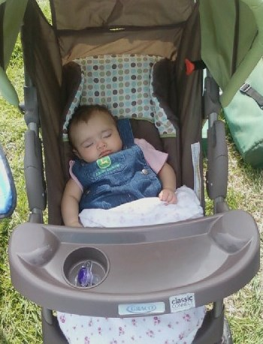
Boone County Bull Shoals Watershed Project
Questions?

