Slide 1
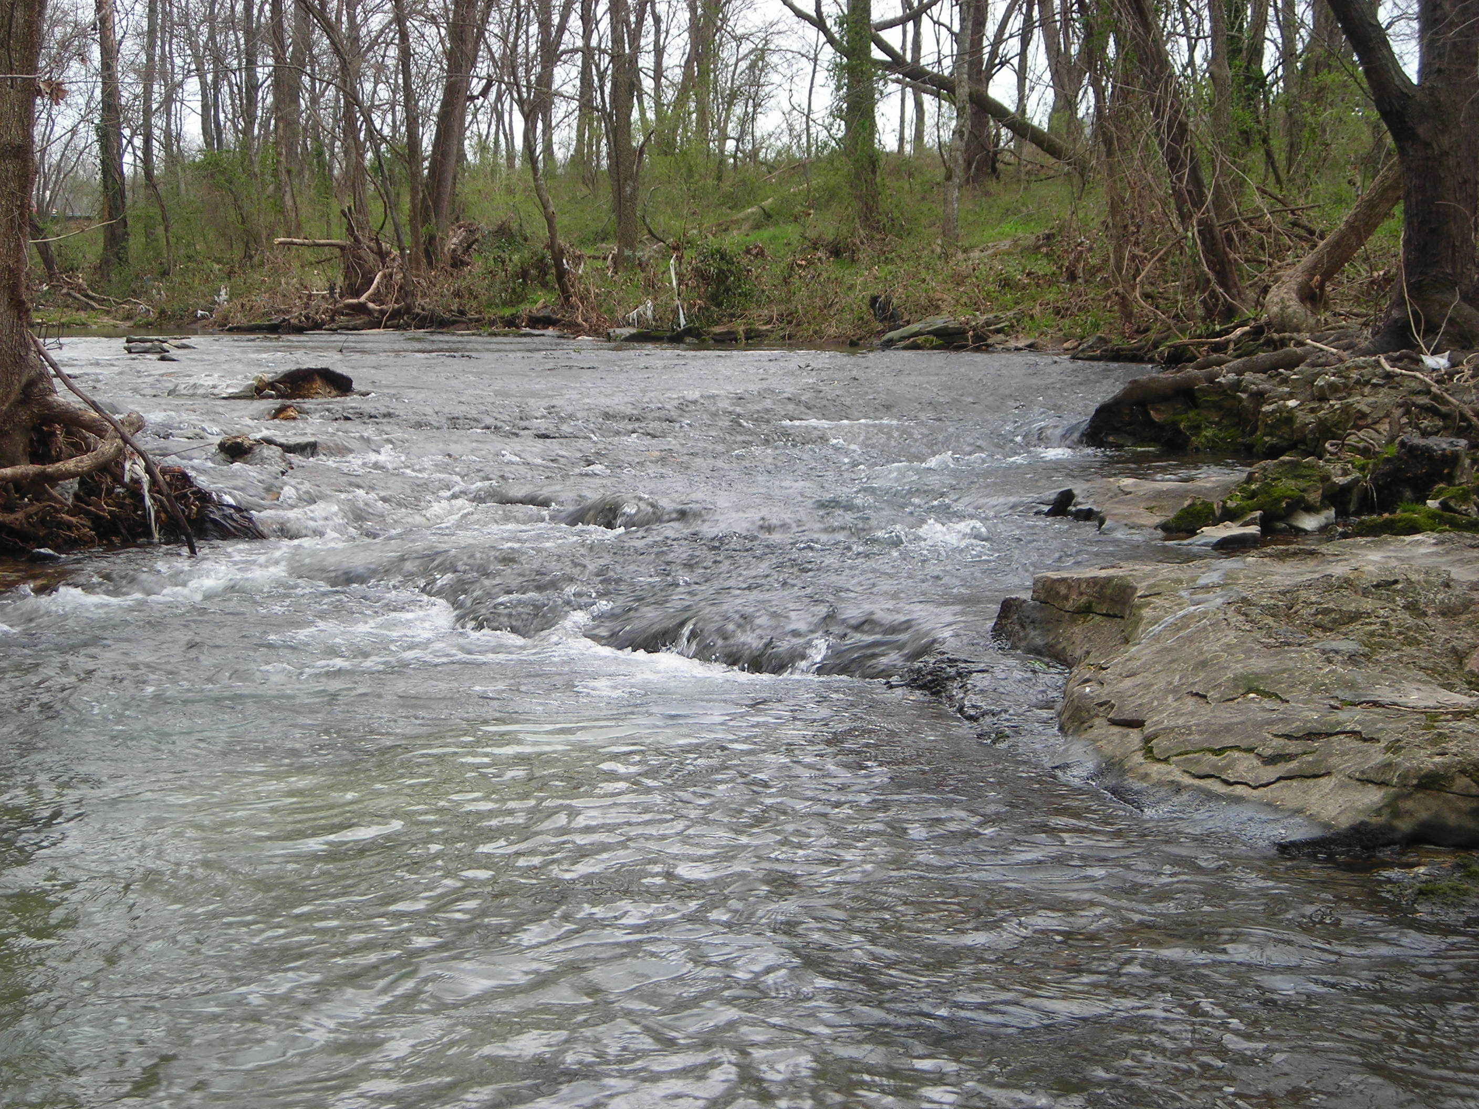
Upper Sager Creek Regional Treatment
319 Grant Project No. 13-800
Funded by: EPA Region 6, ANRC and the City of Siloam Springs

Slide 2
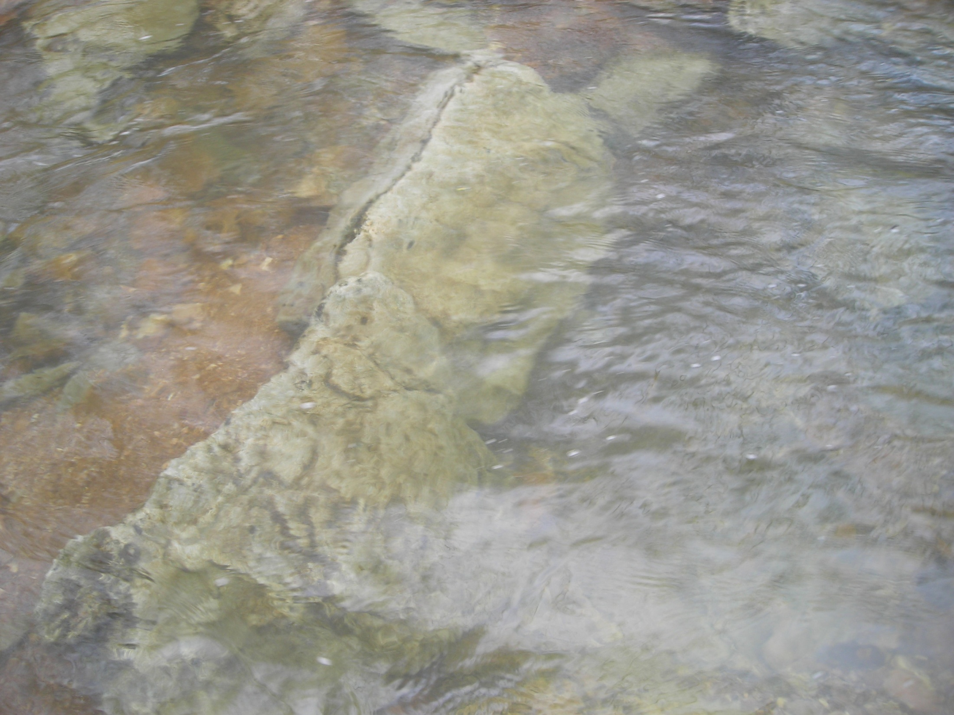
First; was the Sager Creek Watershed Assessment and Management Plan
Assessment and management plan completed in 2005
Critical stream reaches were identified
14 major environmental perturbations affecting water quality, aquatic biota and aesthetics were also identified and ranked
The City and the Sager Creek Advisory Commission used the management plan to initiate efforts to improve Sager Creek

Slide 3
Second; Was Implementation of the Management Plan
Stream channel restoration, bank stabilization and dam removal.
Sub-watershed UTS-1 regional treatment through detention and wetland creation.
Local ordinances
Creation of stream side buffers

Slide 4
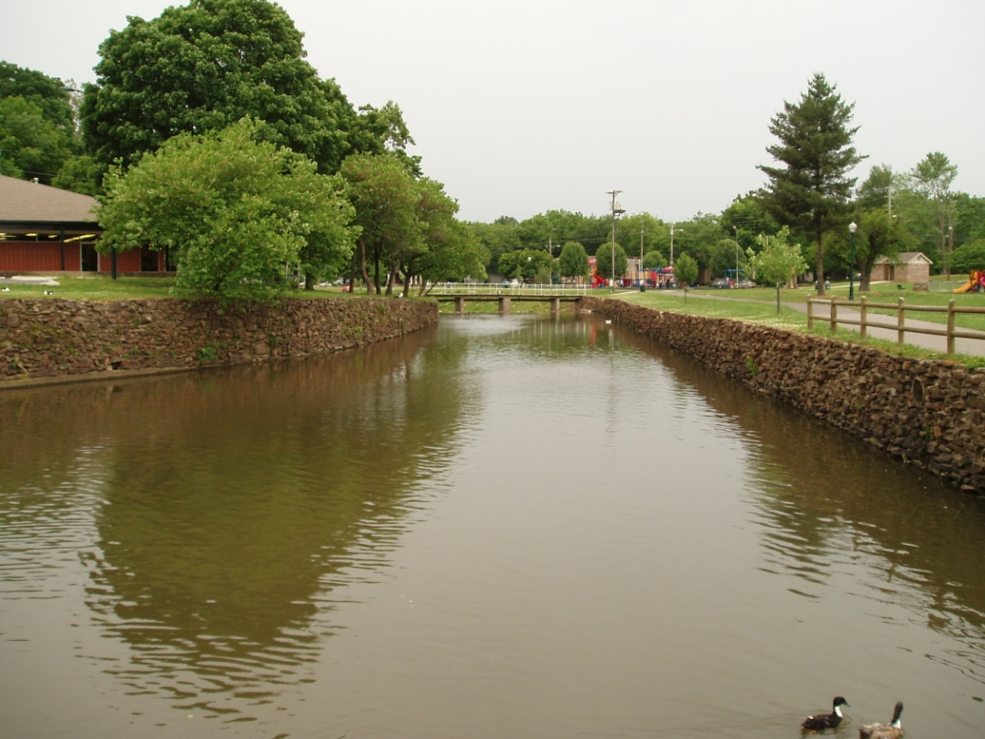
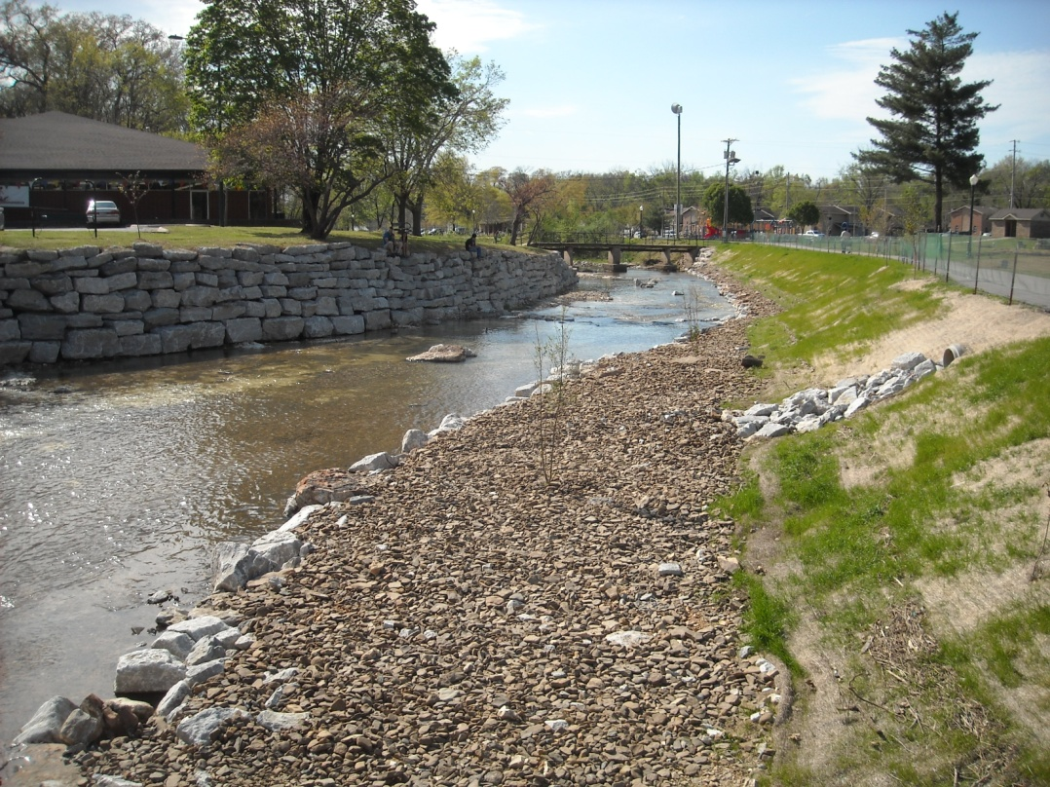
Restoration in Sager Creek
(Before and After)

Slide 5
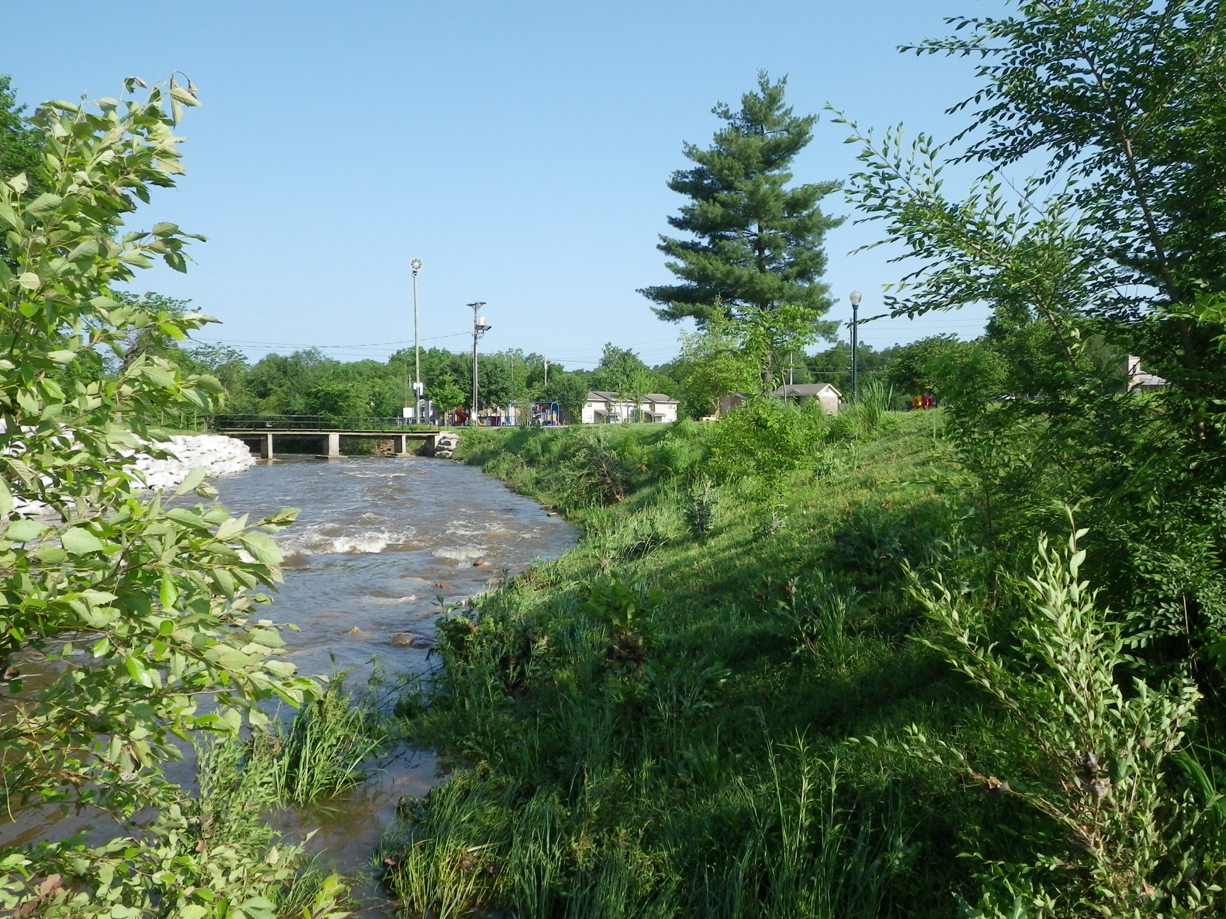
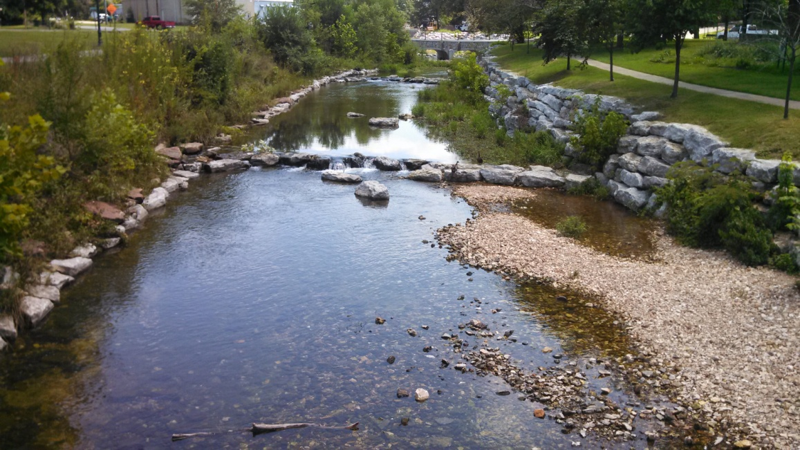
Sager Creek 2013

Slide 6
Now; Upper Sager Creek Regional Treatment Project
  Establish a regional treatment feature in the SC-1 sub-watershed (upper Sager Creek)
  Project funded through 319 program
  Land for project donated by local citizen
  City of Siloam Springs completed the construction and maintain the feature

Slide 7
Project Goal
The goal of this project was to construct a regional treatment feature in upper Sager Creek that will reduce peak flow, sediment and nutrient transport in the stream system during storm flow events.

Slide 8
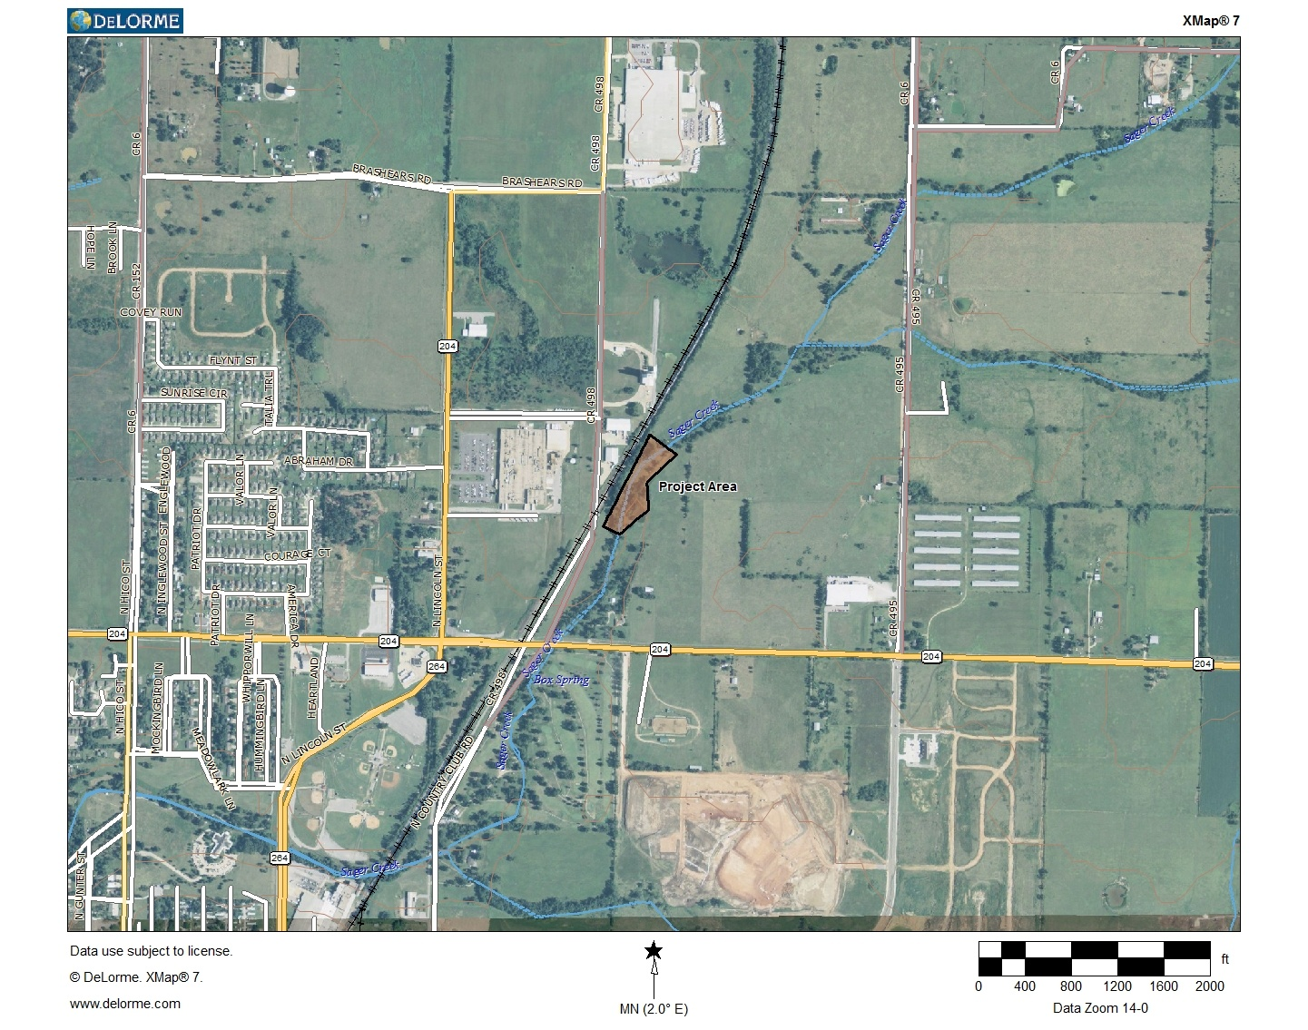

Slide 9
Intended Outcome
The project was anticipated to result in a system level reduction in sediment and nutrient loading and provide channel protection resulting from the decrease in peak flows.

Slide 10
Workplan Tasks
Task 1. Financial Review
Task 2. Monitoring and Quality Assurance Project Plan (QAPP)
Task 3. Topographic Survey
Task 4. Design and Construction of Regional Treatment Feature
Task 5. Reporting and Grant Coordination

Slide 11
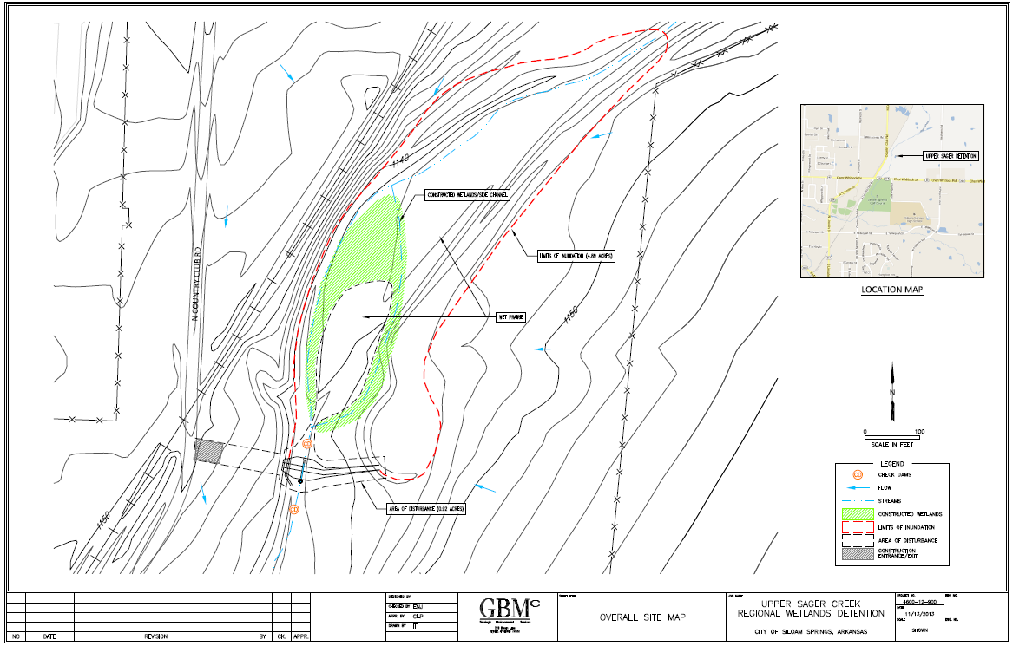

Slide 12
Schedule
The project began on May 1, 2013, and all construction activities on upper Sager Creek were completed by March 31, 2014.

Slide 13
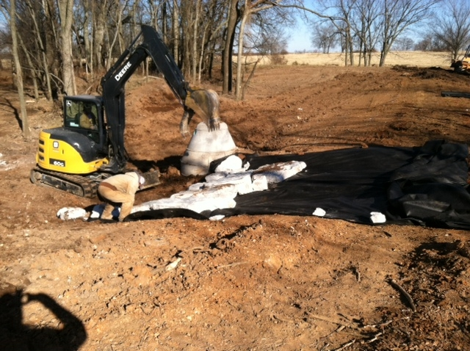
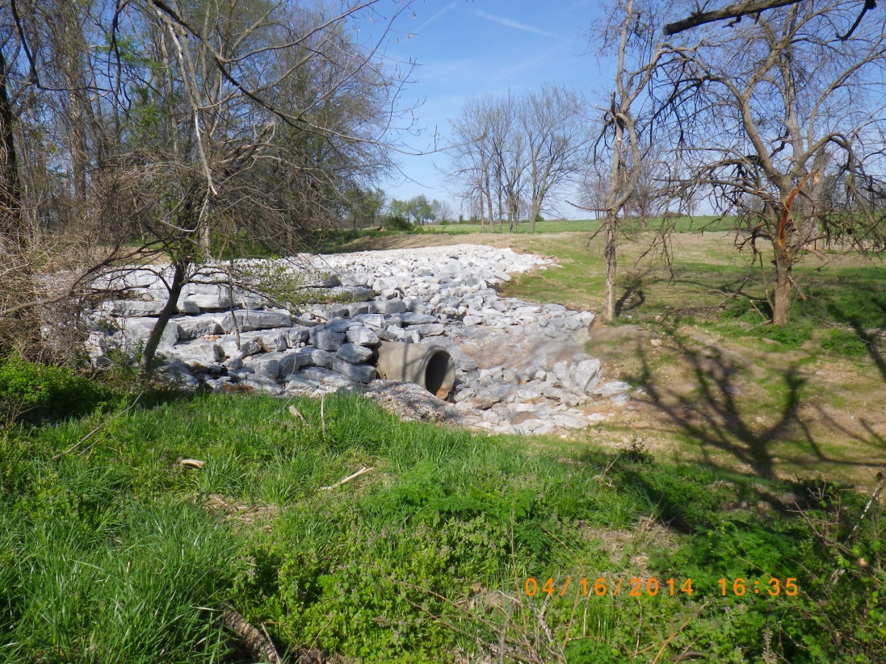
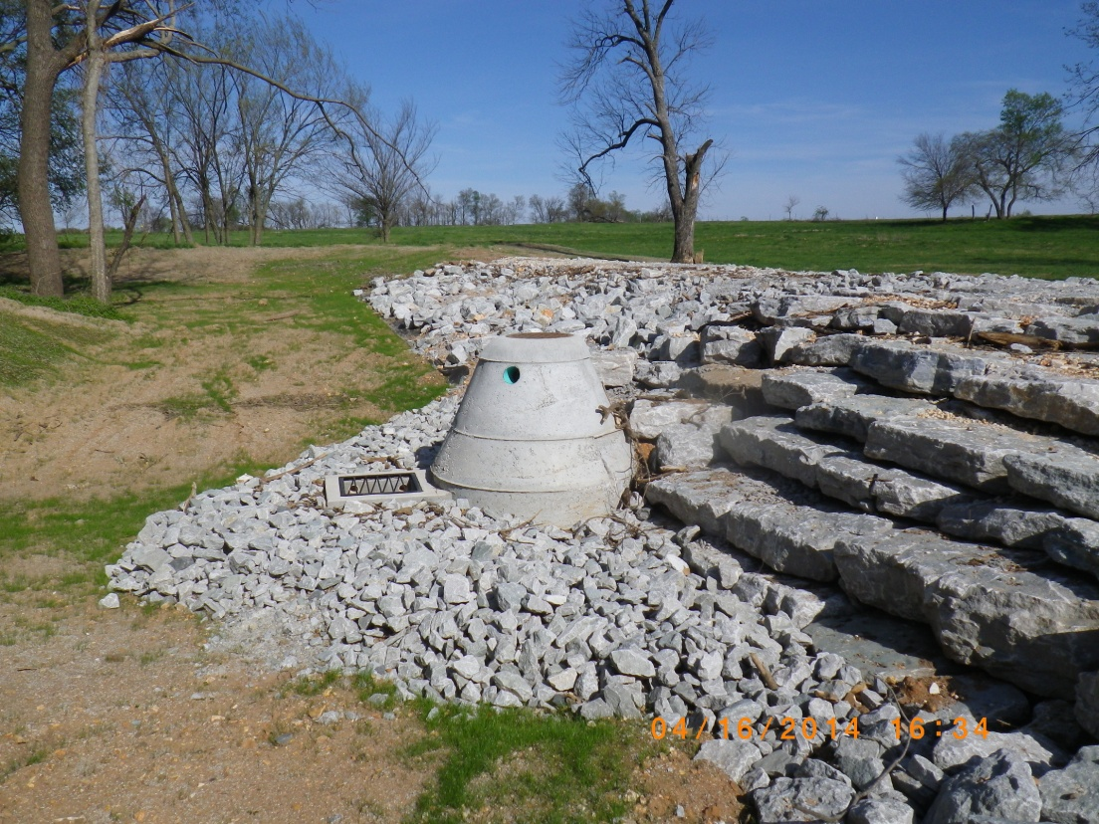
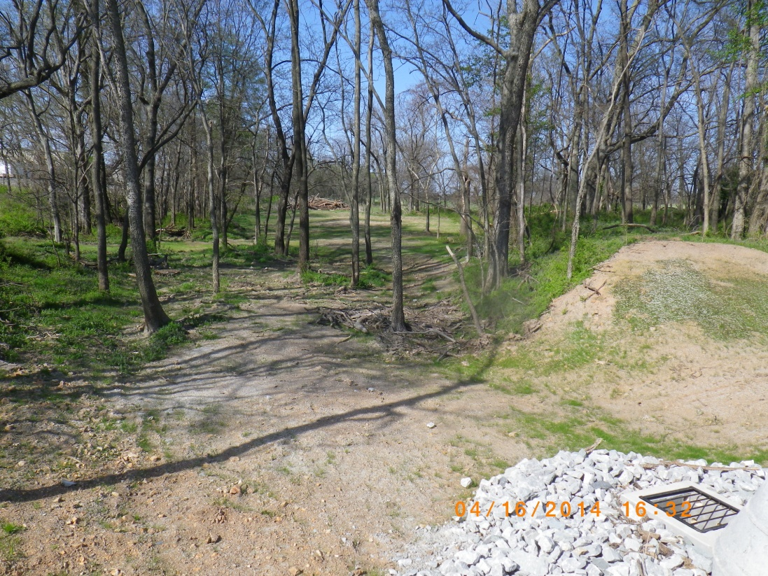

Slide 14
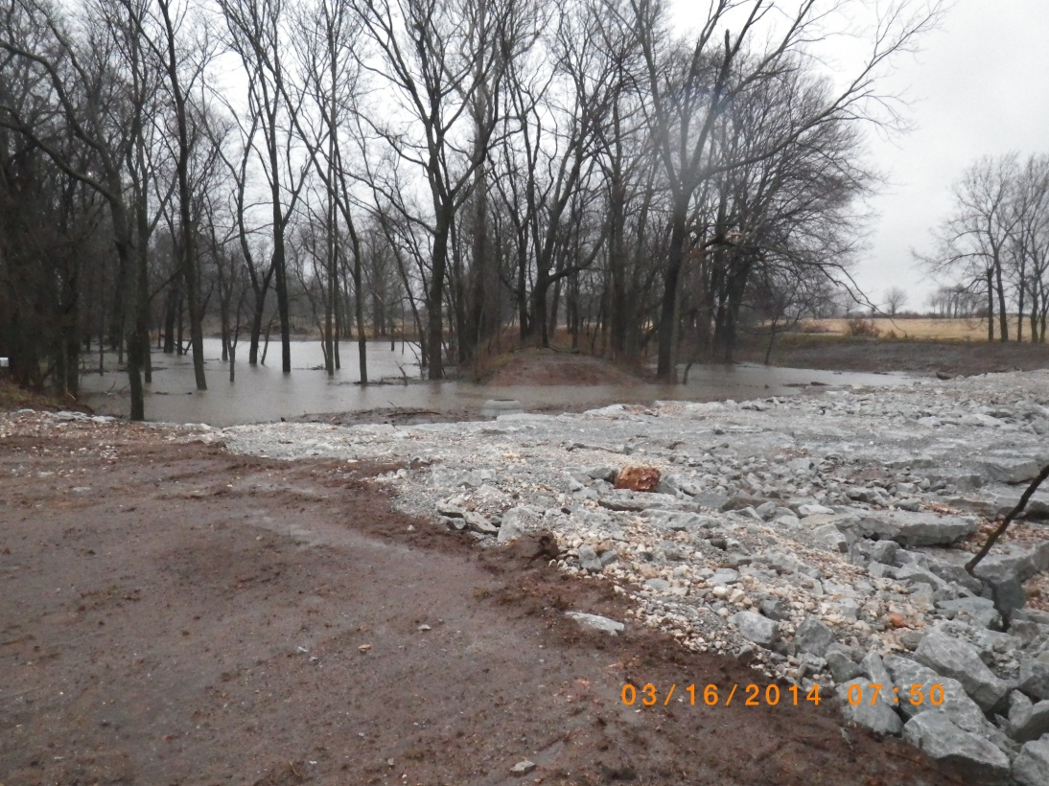
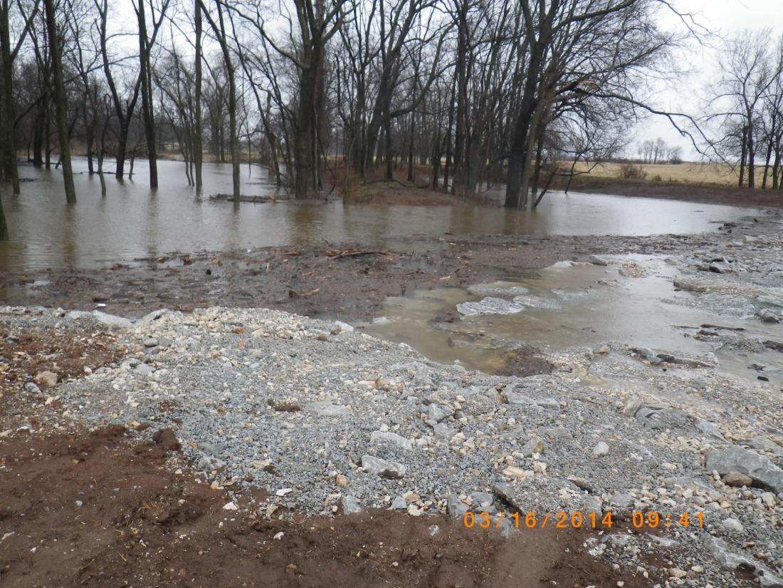
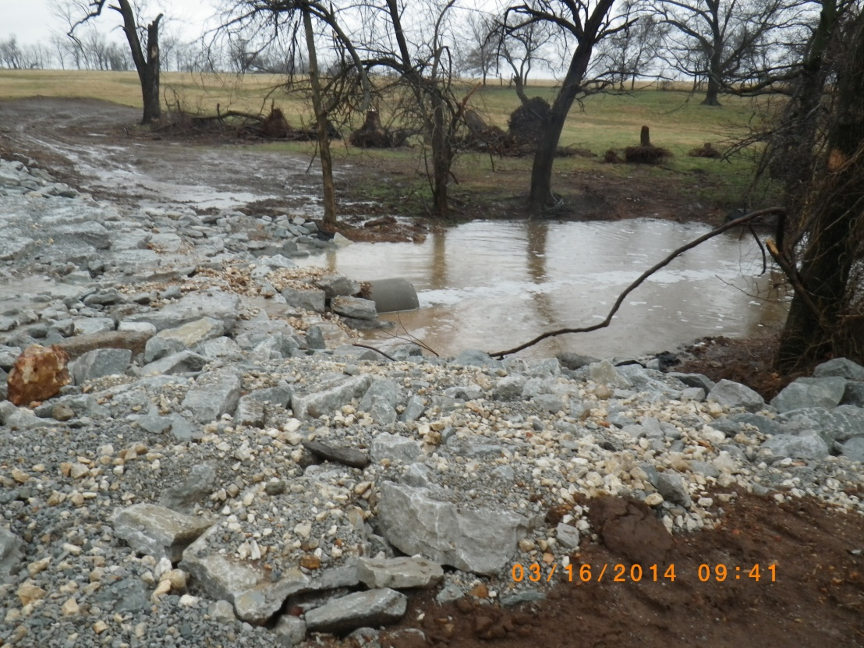
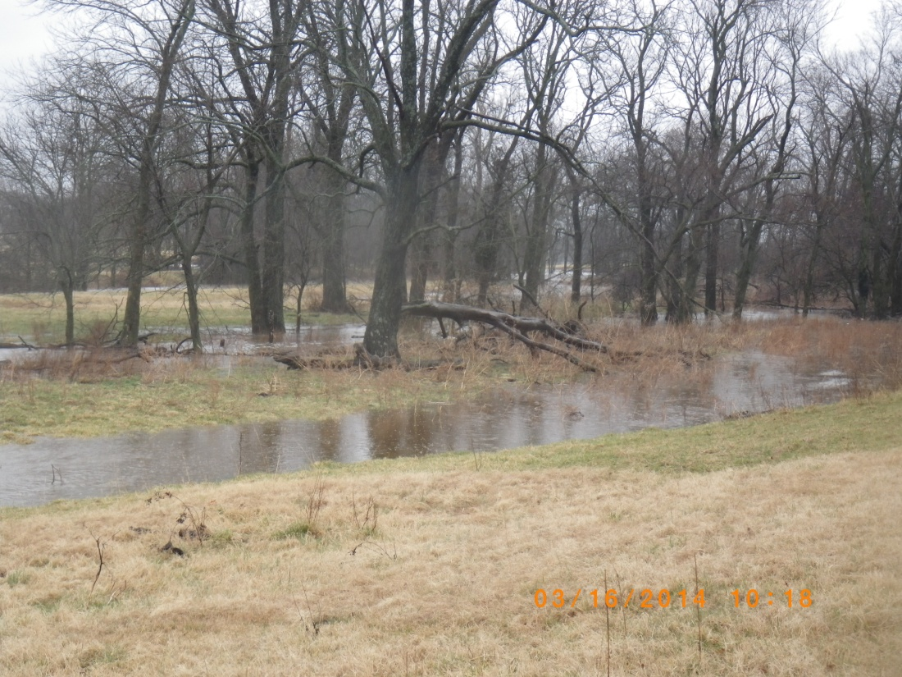

Slide 15
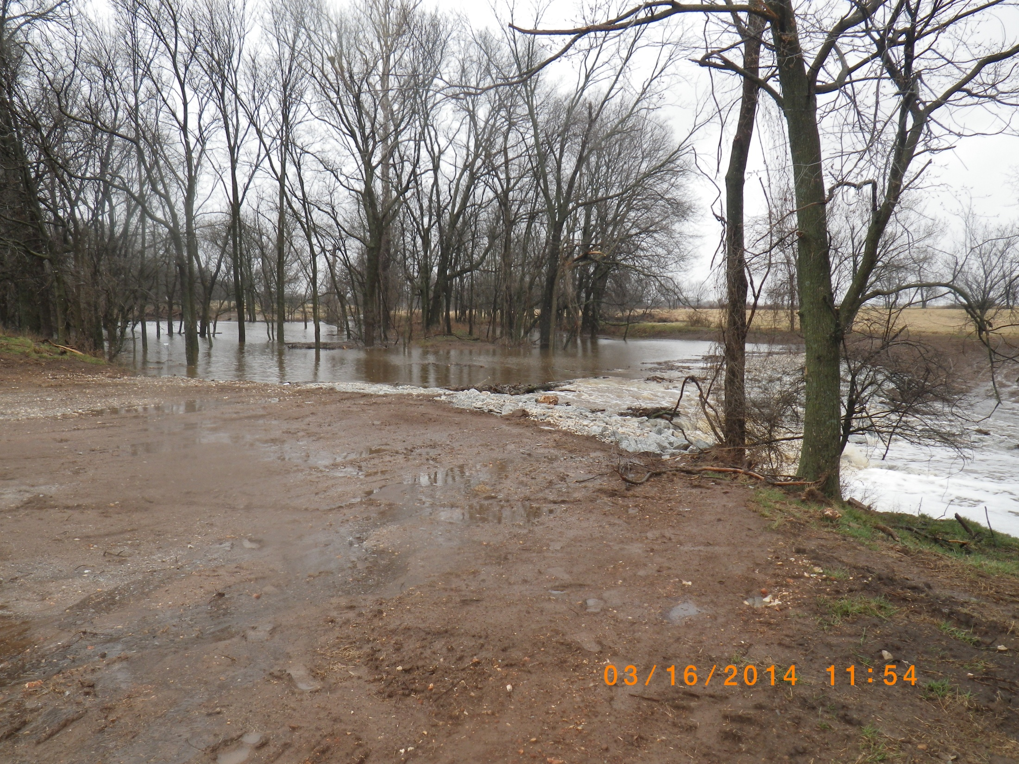

Slide 16
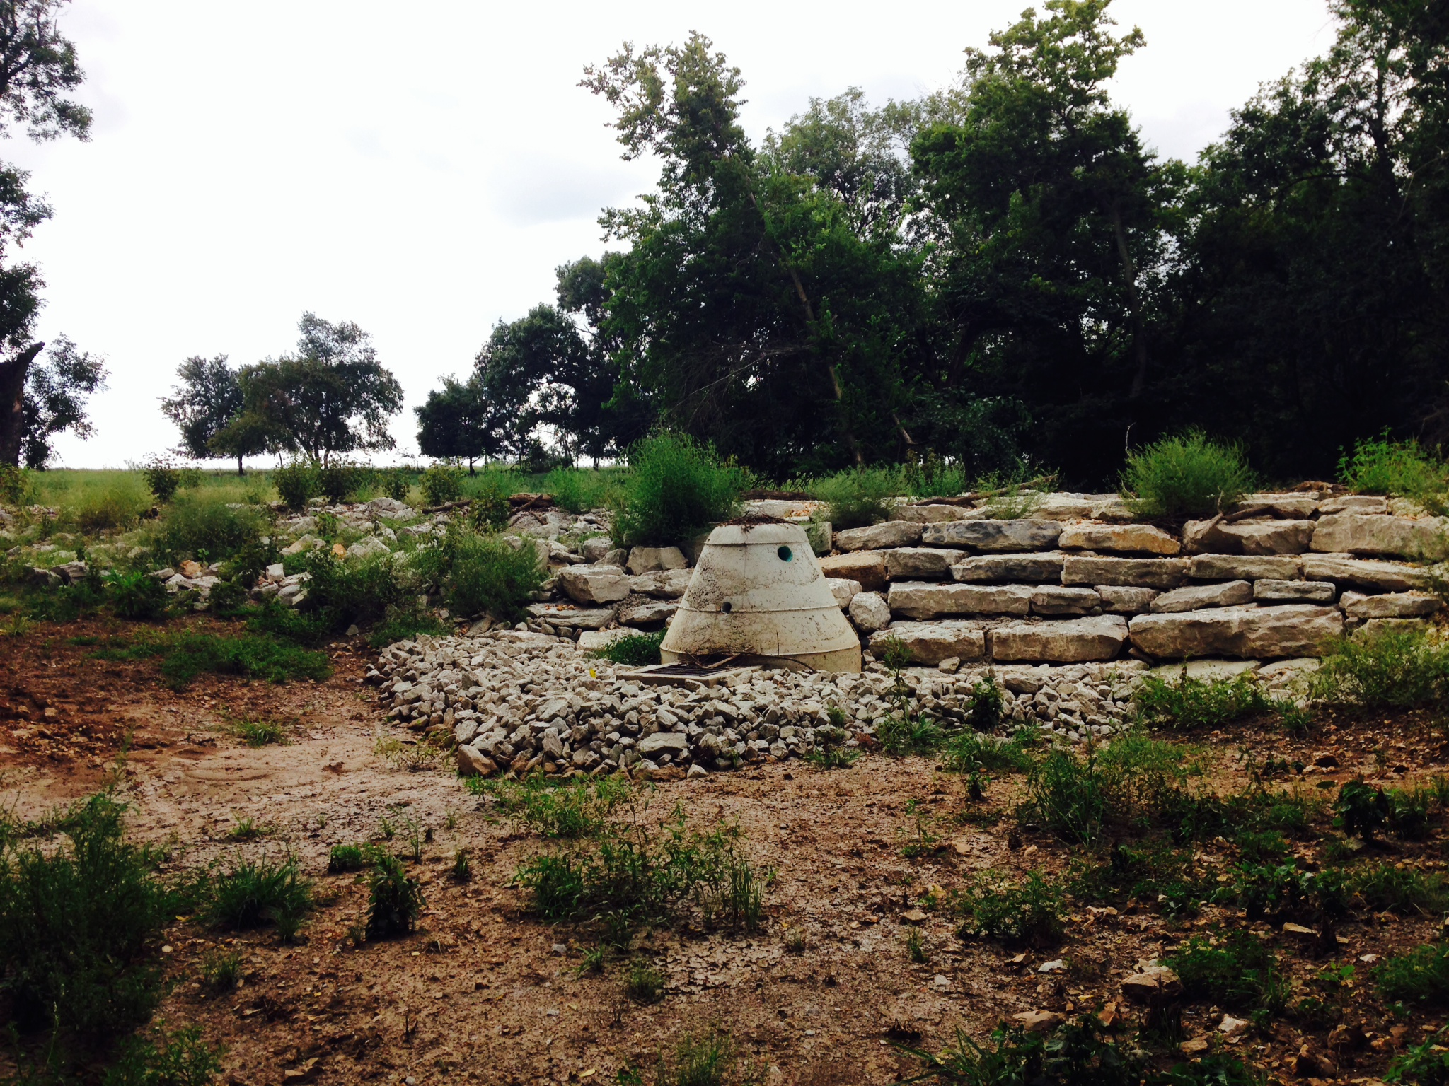
Sediment deposition

Slide 17
Measured Results
Sediment (TSS), nitrate and phosphorus loading has been shown by the monitoring to have decreased by as much as 57%.
Downstream flow during storm events has been reduced as much as 55% by the active detention of water in the SC-1 system and the low flow release structure.

Slide 19
Technical Transfer
Communicate needs and concerns to team..….. to ensure the outcome is what is needed and/or expected.
More time for monitoring post construction. This will help prove the full pollutant reduction potential the treatment feature can attain.

Slide 20


Thanks to:
Region 6

Slide 21

Questions?
For further information, contact:
Randy Atkinson
(479) 238-0927
City of Siloam Springs
ratkinson@siloamsprings.com
Greg Phillips
(501) 847-7077
GBM^{c} & Associates
gphillips@gbmcassoc.com

