Slide 1
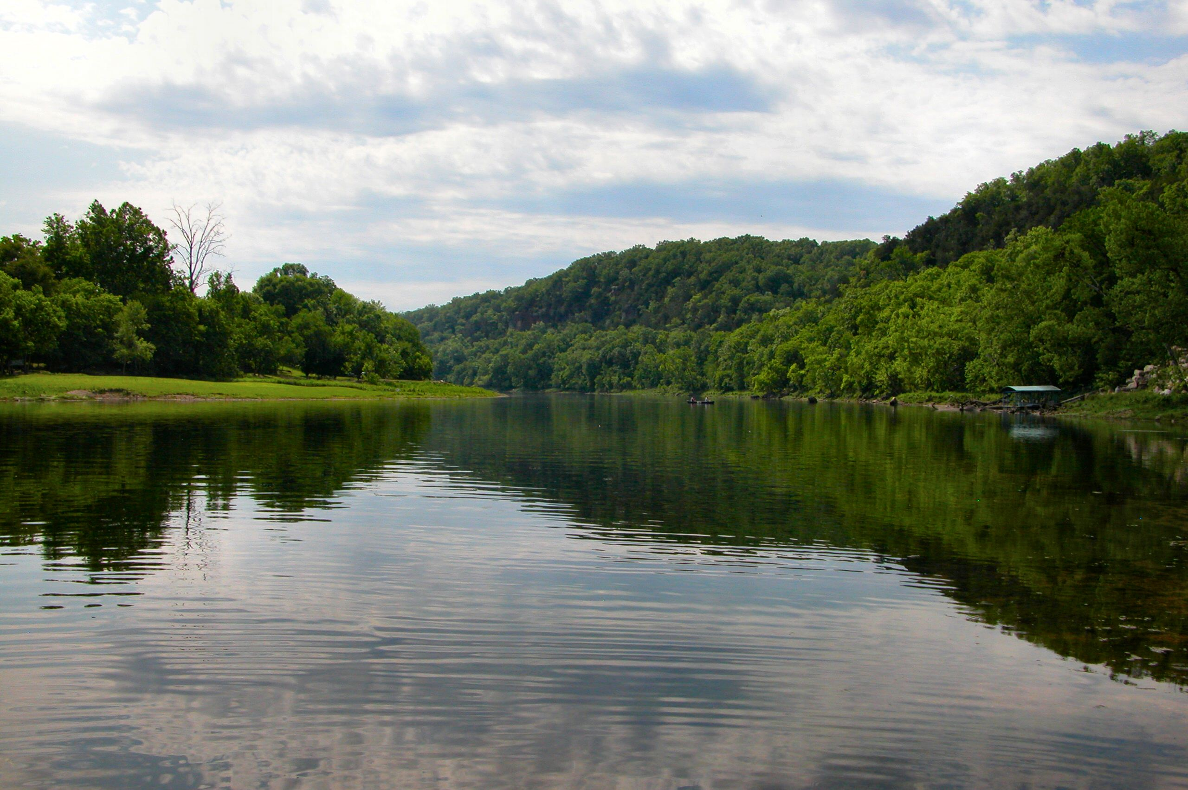

Project No. 13-700
Streband Cloud: a tool for conservation planners
Picture of White River near Flippin, AR, by James Powers
ANRC NPS Annual 319 Program Review Meeting, September 18, 2014

Slide 2

acknowledgment
Project Team- Dr. Mike Daniels, Mr. Nikhil Thomas, and Mr. Ben Hancock
Scientific Research Advisory (SRC):
Mr. Arnold Hameister (Arkansas Forestry Commission),
Mr. Caroll Guffey (University of Arkansas at Monticello),
Dr. Hal Liechty (University of Arkansas at Monticello),
Mr. Jim Wise (Arkansas Department of Environmental Quality),
Ms. Lauren Chambers (USDA Rural Development),
Mr. Rich Joslin (Natural Resources Conservation Service),
Mr. John Lee, (Natural Resources Conservation Service ) - special invitee, and
Mr. Tony Ramick (Arkansas Natural Resources Commission)
ANRC NPS Annual 319 Program Review Meeting, September 18, 2014
Arkansas Nonpoint Source Stakeholder Meeting- September 26, 2012

Slide 3
goal
Develop a Cloud Based Version of StreBanD
ANRC NPS Annual 319 Program Review Meeting, September 18, 2014
Arkansas Nonpoint Source Stakeholder Meeting- September 26, 2012

Slide 4
scope
Riparian buffer inventory analysis:
Type and extent
Identify gaps
Identify level of restoration needed
Complement studies on prioritization of future buffers
ANRC NPS Annual 319 Program Review Meeting, September 18, 2014
Arkansas Nonpoint Source Stakeholder Meeting- September 26, 2012
Notes:
Results from a watershed scale riparian buffer inventory could be used to characterize the type and extent of existing buffers in the watershed, identify gaps between buffers in the riparian corridor, and identify the level of restoration needed to make existing buffers fully functional. Such an inventory would be useful to complement those studies that prioritize the placement of future buffers based on their potential effectiveness in the landscape.

Slide 5
Long Term benefits
13,490 miles of rivers and streams digitized in the ADEQ Water Base Layer*.
Perform inventory of current level of perennial riparian vegetation (buffers) along rivers and streams
Geographic Information System (GIS) software based tool, hosted on cloud, overcome infrastructure limitations
*Source: 2014 Integrated Water Quality Assessment Report , ADEQ.
ANRC NPS Annual 319 Program Review Meeting, September 18, 2014
Arkansas Nonpoint Source Stakeholder Meeting- September 26, 2012

Slide 6
StreBanD Cloud
Updates
ANRC NPS Annual 319 Program Review Meeting, September 18, 2014
Arkansas Nonpoint Source Stakeholder Meeting- September 26, 2012

Slide 7
Input data required
Dataset | Source
Stream centerline | National Hydrography Dataset (NHD)
Orthographic imagery | Arkansas GeoStor
Land Use and Land Cover | Center for Advanced Spatial Technologies (CAST)
Digital Elevation Model (DEM) | Arkansas GeoStor
Slope % | Derived from DEM using gdaldem
ANRC NPS Annual 319 Program Review Meeting, September 18, 2014
Scientific Research Advisory Committee Meeting- September 10, 2012

Slide 8
Work flow
Create Streambanks*
Generate slope data from DEM
Perform vegetation inventory in the Riparian Zone using guidelines in NRCS code 391 and 393
Color code segments to indicate inventory status of Riparian Vegetation
(*source: Pai, N. and D. Saraswat. 2013. A geospatial tool for delineating streambanks. Environmental Modelling & Software 40(2):151-159. )
ANRC NPS Annual 319 Program Review Meeting, September 18, 2014
Scientific Research Advisory Committee Meeting- September 10, 2012

Slide 9
Decision criteria: ACT 391
Specifications for Zone 1 and 2 are provided in NRCS practice code 391
Zone 1 - minimum buffer width of 15 feet (forest cover)
Zone 2 - located upslope from Zone 1 a minimum buffer width of 20 feet (primarily consist of forest cover)
Zone 1 and 2- a combined minimum buffer width of 35 feet.
Depending on the adjacent land use (e.g. cropland, pasture, etc.) an additional filter strip needs to be implemented upslope from Zone 2.
ANRC NPS Annual 319 Program Review Meeting, September 18, 2014
2013 NPS Conference – September 18, 2013

Slide 10
Decision criteria: ACT 393
Specification for Zone 3 is provided in NRCS practice code 393
Filter strip (termed as Zone 3) should have a minimum buffer width of 30 feet, and include mostly herbaceous vegetation (NRCS, 2004).
Zones 1, 2, and 3 must have a minimum width of 65 feet.
ANRC NPS Annual 319 Program Review Meeting, September 18, 2014
2013 NPS Conference – September 18, 2013

Slide 11

Sampling Transects
Assign slope (Z1, Z2) and land-use distribution (Z1, Z2, Z3)
65 ft
Sample Points
_{n}
Average of (Zone1)^{n} and (Zone1)^{n+1} slope &
Average of (Zone2)^{n} and (Zone2)^{n+1} slope
Sample Points
_{n+1}
Assign slope (Z1, Z2) and land-use distribution (Z1, Z2, Z3)
Zone1 = 15 Feet
Zone2 = 20 Feet
Zone3 = 30 Feet
Slope & Land use data
Only Land use data
ANRC NPS Annual 319 Program Review Meeting, September 18, 2014
Arkansas Nonpoint Source Stakeholder Meeting- September 26, 2012

Slide 12
Sampling Transects
Assign slope (Z1, Z2) and land-use distribution (Z1, Z2, Z3)
65 ft
Sample Points
_{n}
Average of (Zone1)^{n} and (Zone1)^{n+1} slope &
Average of (Zone2)^{n} and (Zone2)^{n+1} slope
Sample Points
_{n+1}
Assign slope (Z1, Z2) and land-use distribution (Z1, Z2, Z3)
Per stream bank segment
  If (Zone 1 (15 ft.) < 50% forest) assign red color to the segment
  If (Zone 2 (20 ft.) < 50% forest) assign red color to the segment
  If (Zone 3 (30 ft.) < 50% forest and/or herbaceous) assign red color to the segment
  If (none of the above are True) assign blue color to the segment
Zone1 = 15 Feet
Zone2 = 20 Feet
Zone3 = 30 Feet
Slope & Land use data
Only Land use data
ANRC NPS Annual 319 Program Review Meeting, September 18, 2014
Arkansas Nonpoint Source Stakeholder Meeting- September 26, 2012

Slide 13
DEMO
ANRC NPS Annual 319 Program Review Meeting, September 18, 2014
Arkansas Nonpoint Source Stakeholder Meeting- September 26, 2012

Slide 14
Thanks
Questions?
ANRC NPS Annual 319 Program Review Meeting, September 18, 2014
Arkansas Nonpoint Source Stakeholder Meeting- September 26, 2012

