Slide 1
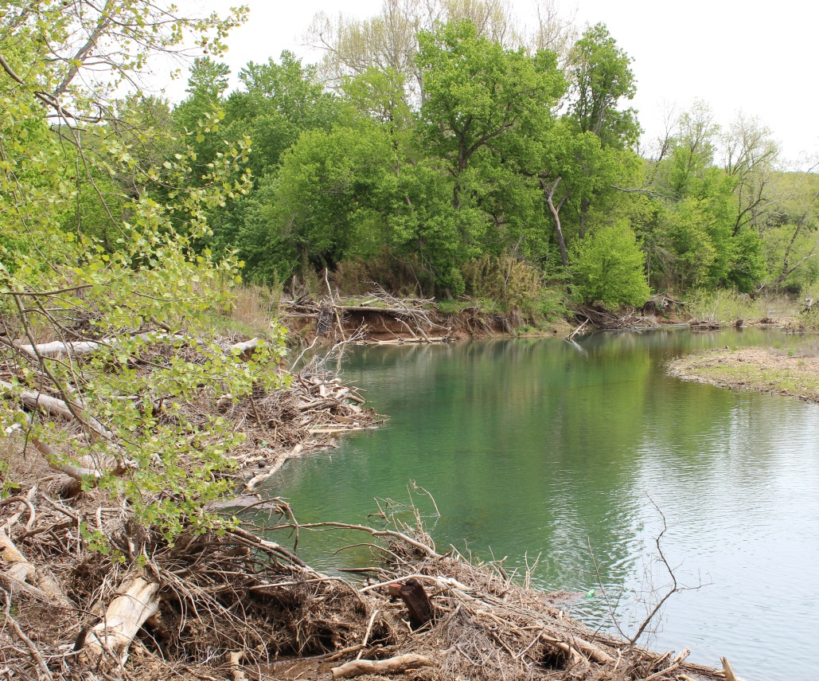
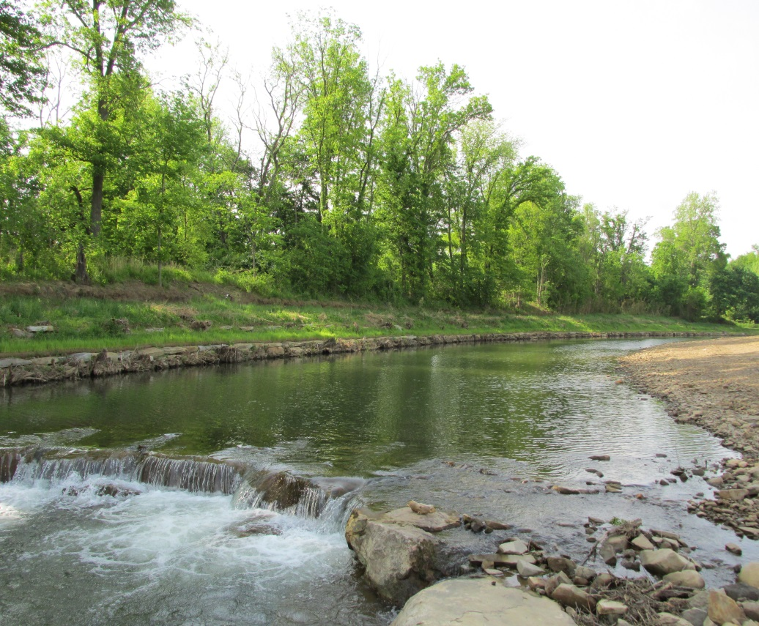
West Fork White River Restoration Project
Fayetteville Executive Airport
ANRC 09-1600
Watershed Conservation Resource Center
Matt Van Eps, PE
Nonpoint Source Review Meeting, September 18, 2014

Slide 2
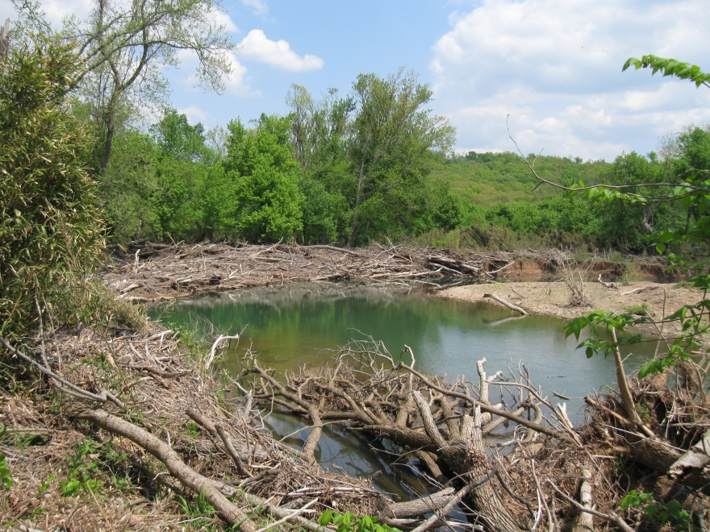
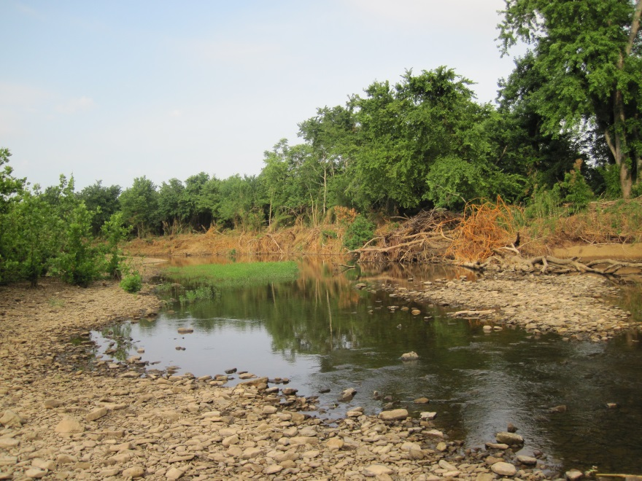
West Fork White River Restoration
Background: Purpose
Reduce Sediment and Nutrient Loading to the WFWR and Beaver Lake
Improve Habitat
Protect Land
  County Road
  Farmland
  Airport Safety Zone

Slide 3
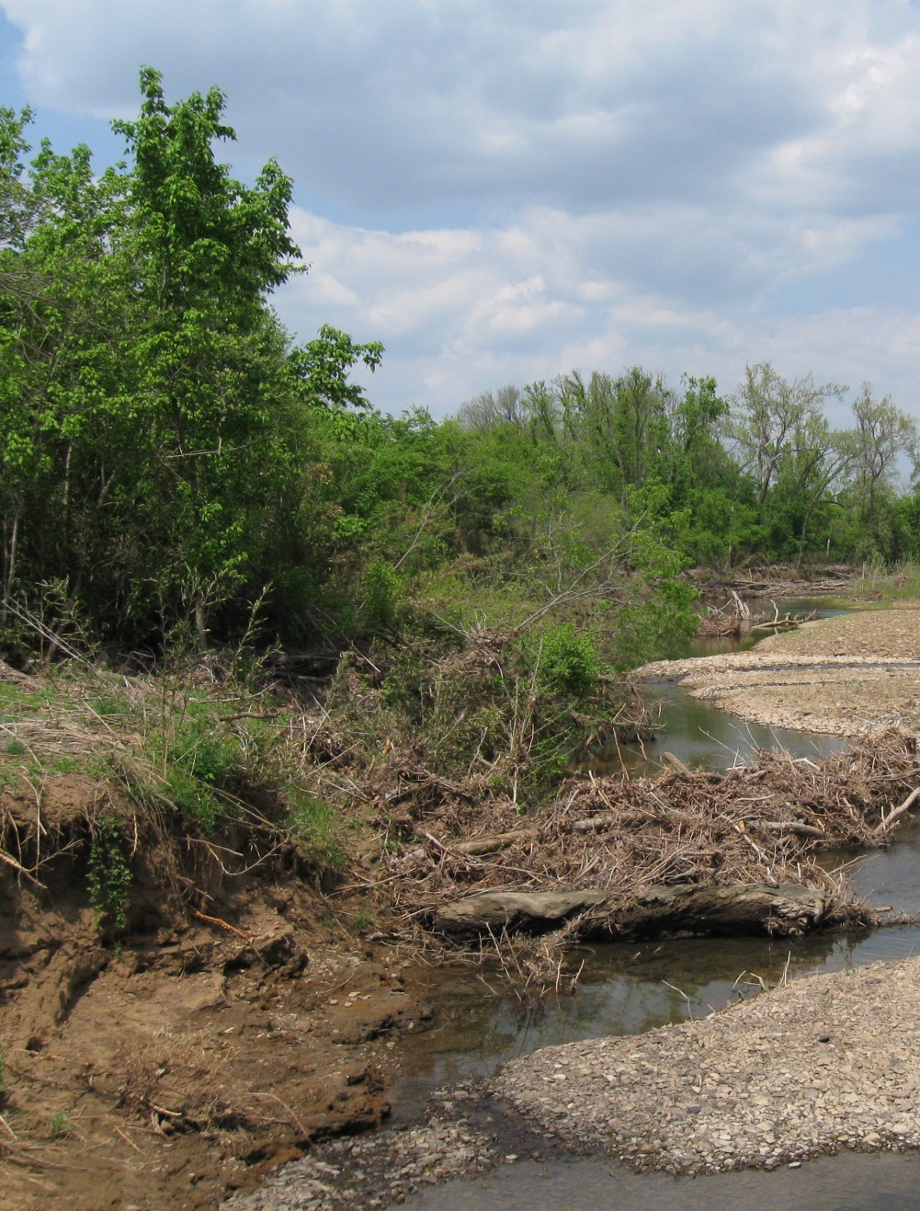
West Fork White River Restoration
Background: Partners
ANRC
EPA Region VI
WCRC
City of Fayetteville
Washington County, AR
Beaver Water District
Arkansas Game and Fish
Beaver Watershed Alliance
Walton Family Foundation

Slide 4
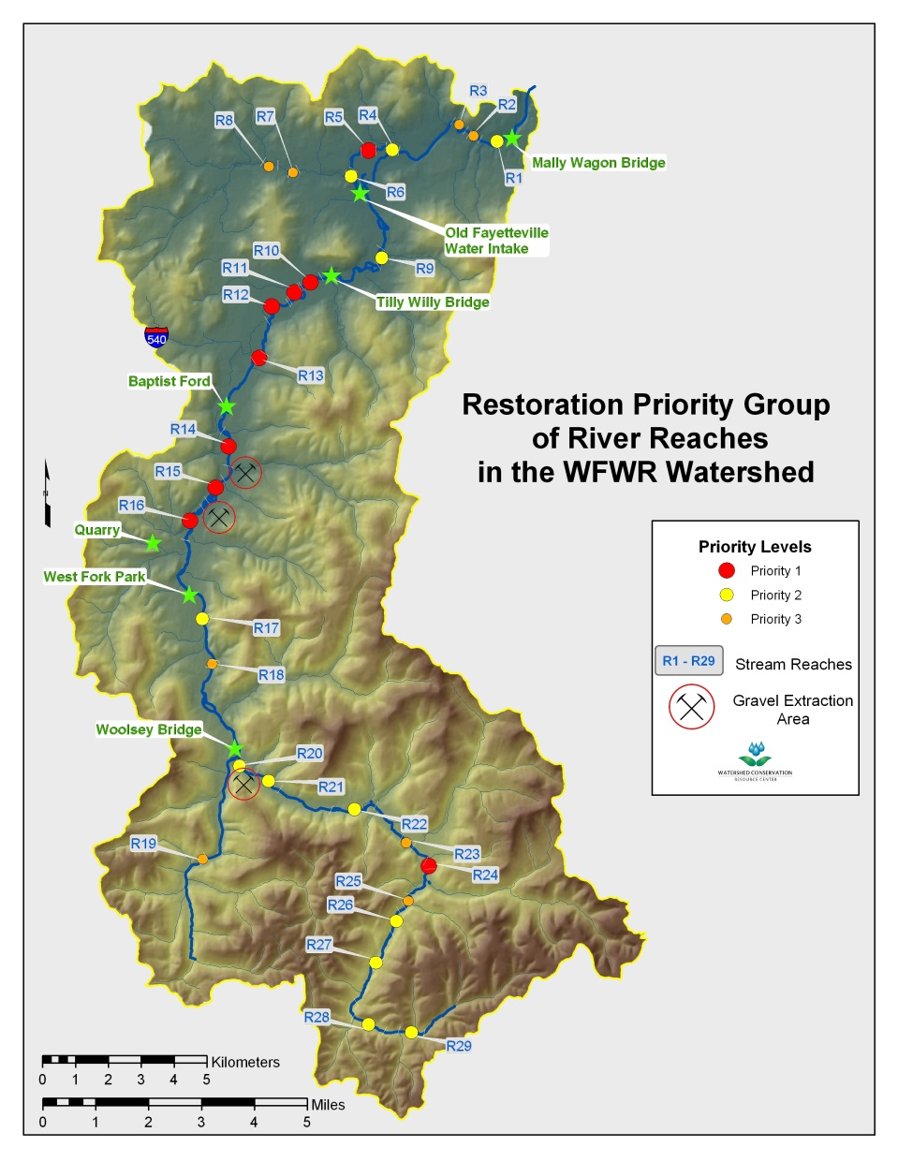
West Fork White River Restoration
Background: History
ADEQ conducted an assessment in 2004 as part of a 319 grant
Areas of significant channel instability and bank erosion were identified.
WCRC prioritized potential restoration areas in 2010
#2 Priority in Watershed
Phase I – Assessment and Design
Phase II – Design Implementation

Slide 5
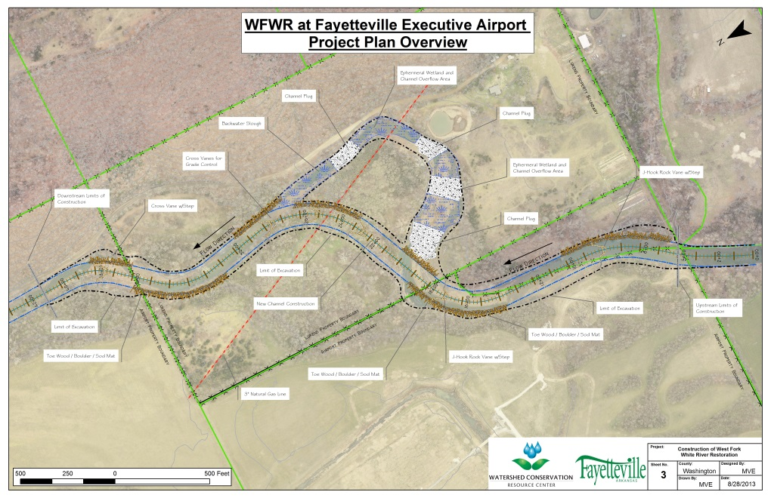
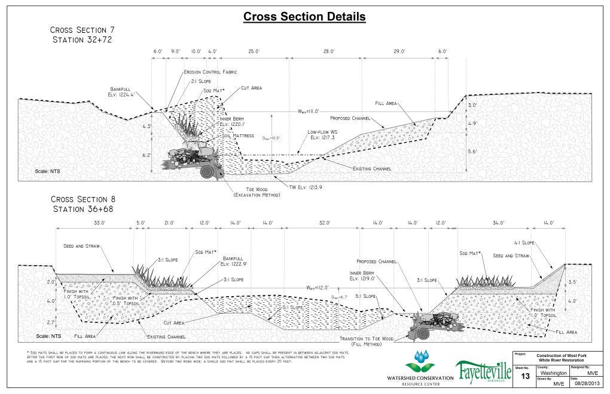
West Fork White River Restoration
Restoration Design
Developed using NCD approach.
Drainage Area = 83 mi²
Length = 4,600 ft
Q_{bkf} = 2,400 ft³/s
W_{bkf} = 110 ft
A_{bkf} = 530 ft²
D_{bkf} = 4.8 ft
Establish new planform
Re-distribute stream slope
Outside review from experts and peers

Slide 6
West Fork White River Restoration
Restoration Design

Slide 7
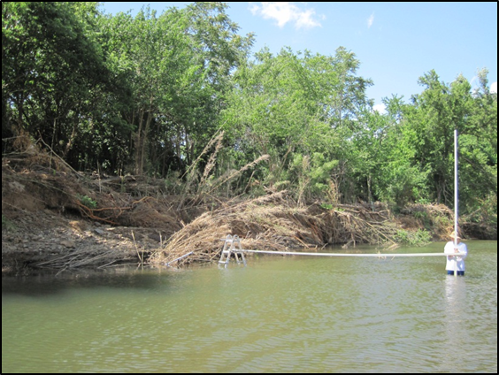
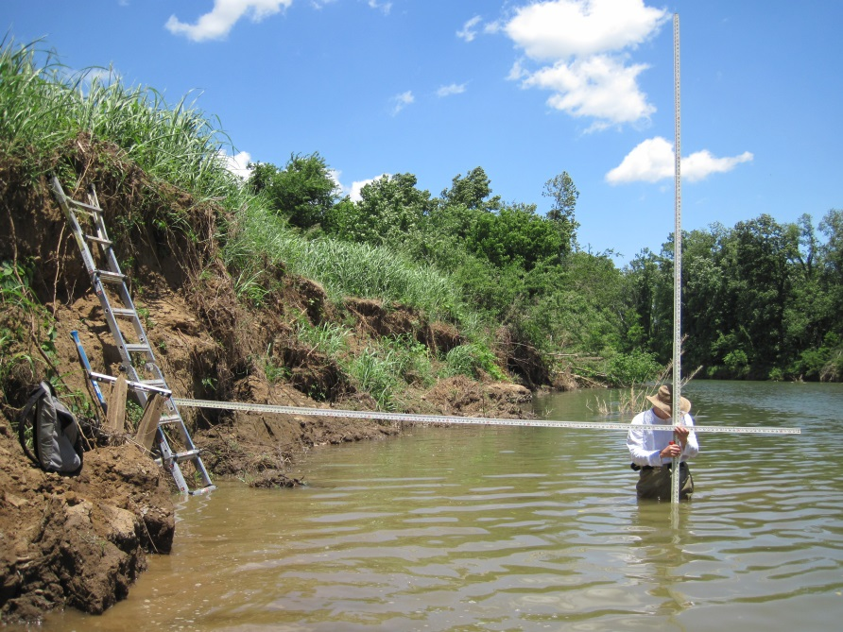
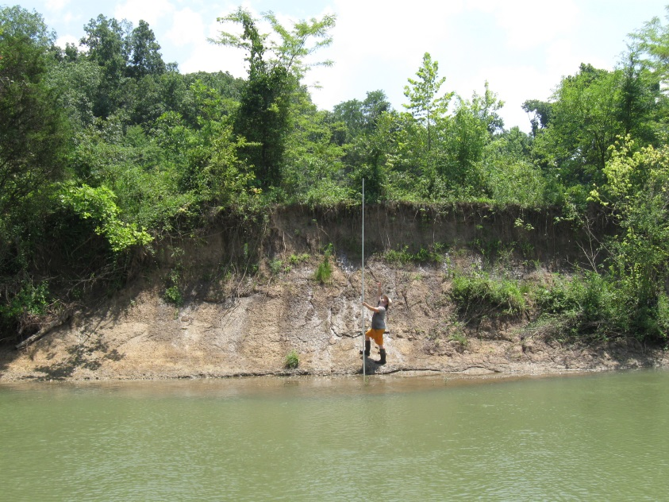
West Fork White River Restoration
Load Reductions
Before restoration streambank erosion generated 4,130 ton/yr of sediment
Measurements indicate as much as 3x during years with significant floods
Anticipate at least 80% reduction or 3,300 ton/yr

Slide 8
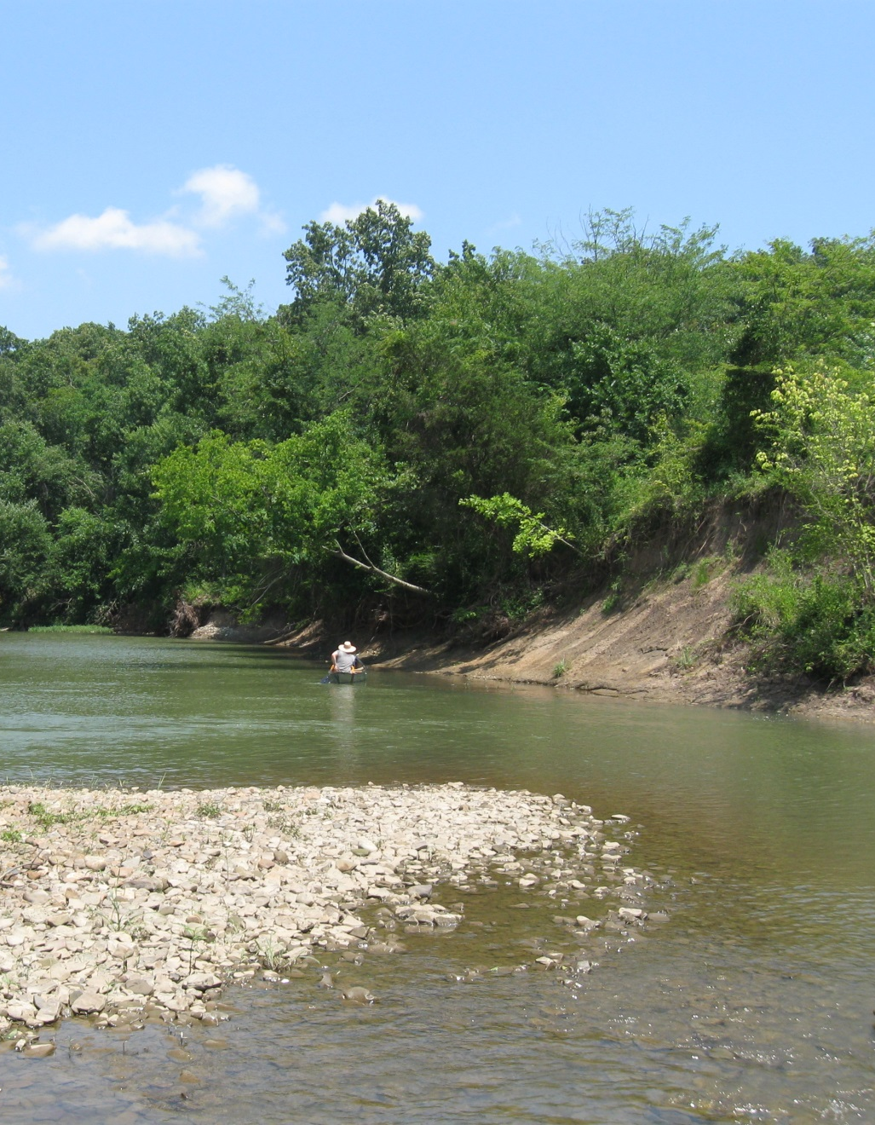
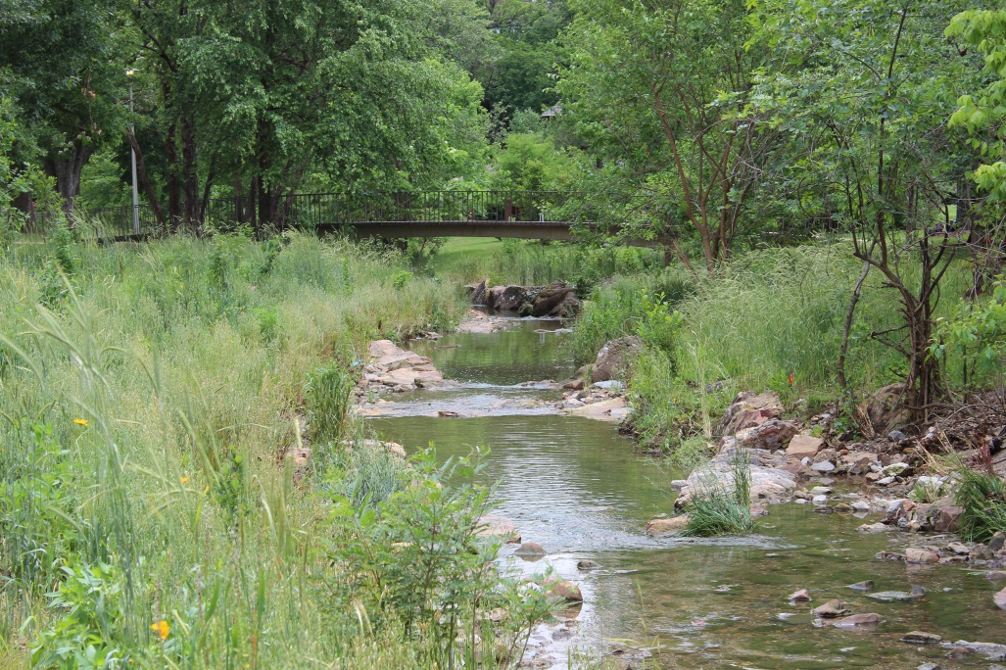
West Fork White River Restoration
Constraints and Hurdles: Scope and Scale
This project is not stream restoration!
We’re talking River Restoration!
  Impacts all phases of design and implementation
  Huge effort to acquire ample construction materials
  Construction costs are much harder to estimate

Slide 9
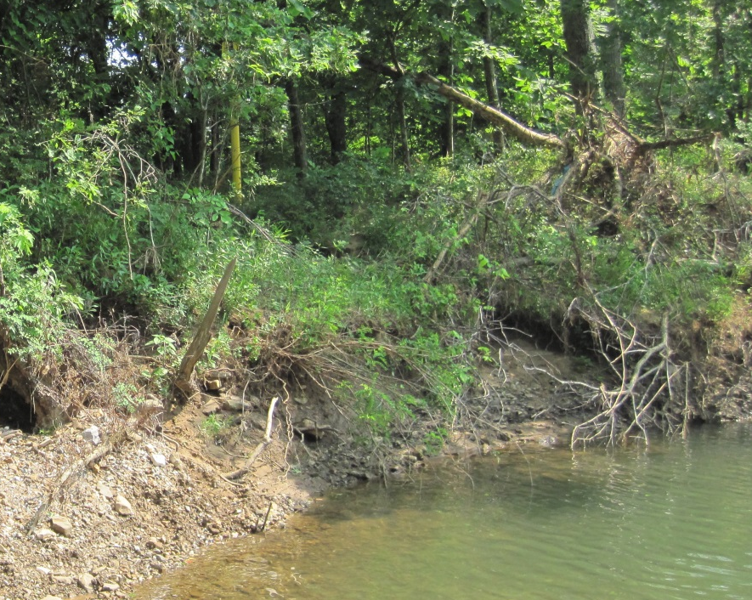
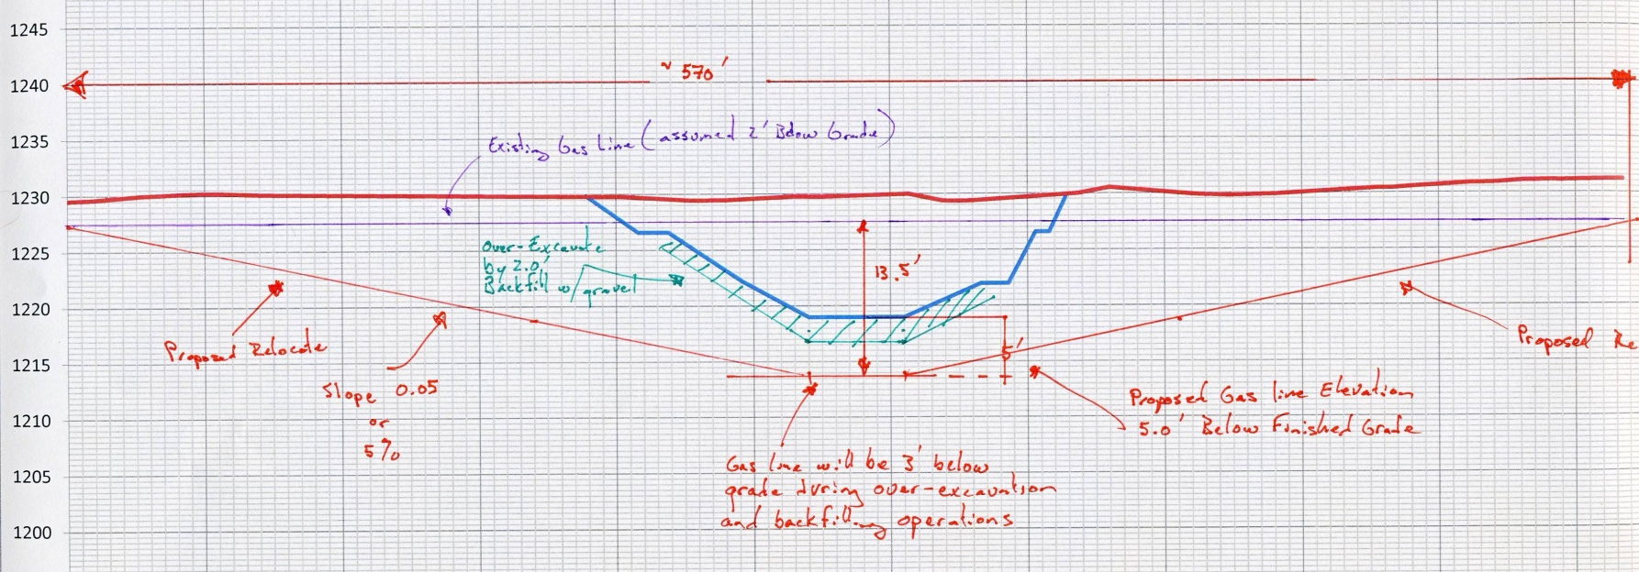
West Fork White River Restoration
Constraints and Hurdles: Gas Line
3” Natural Gas Pipeline
200 psi
Steel Pipe
Needs to Be Lowered +12’
Only 5% slope allowed
570’ of new gas line

Slide 10
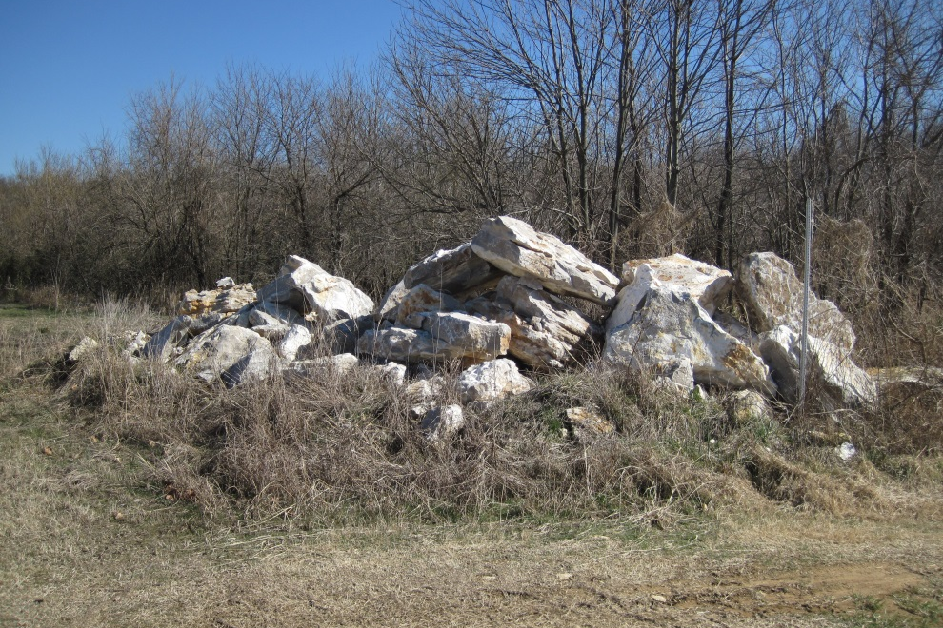
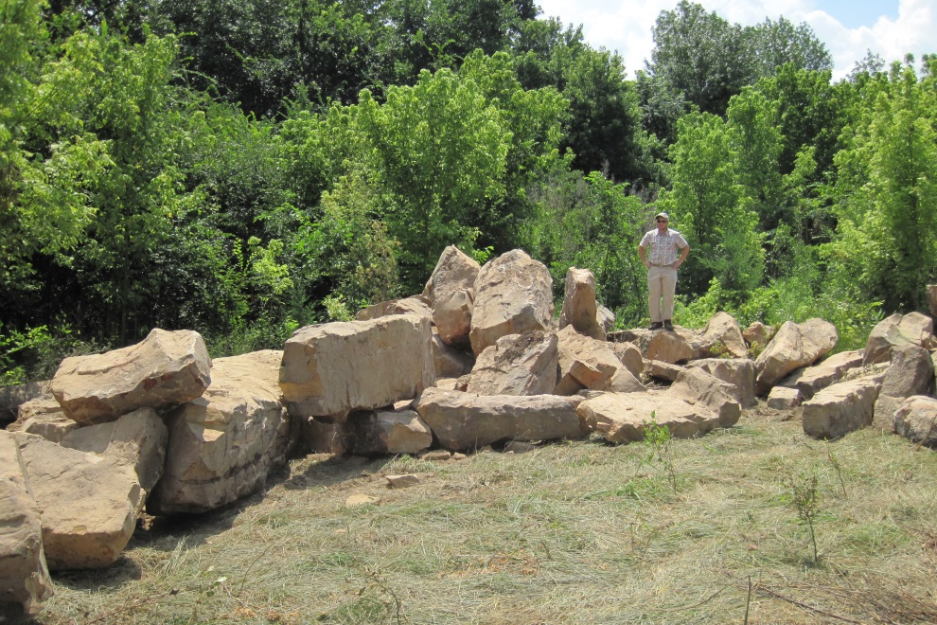
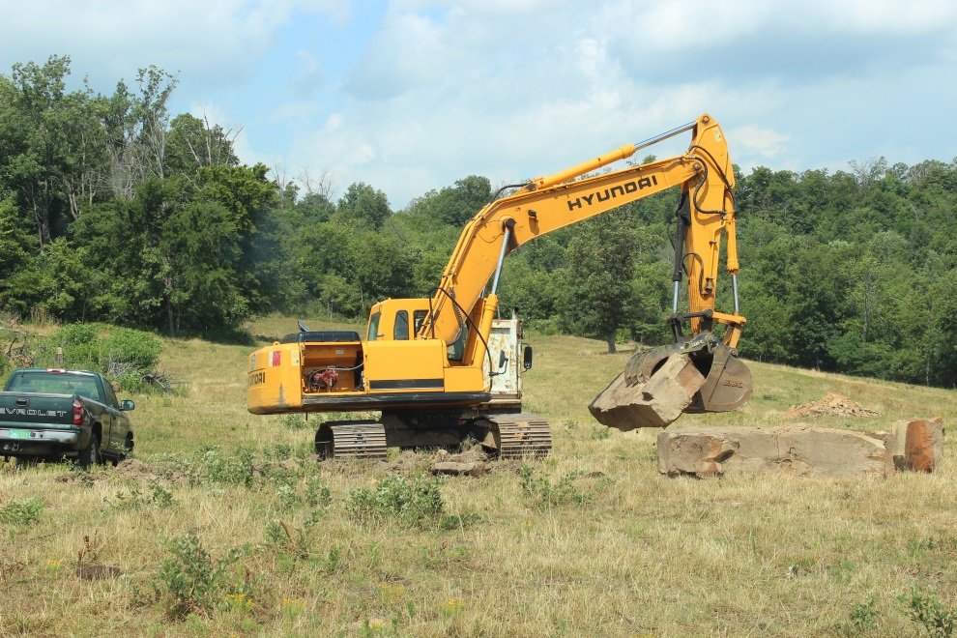
West Fork White River Restoration
Construction Materials
4,000 Ton Rock/Boulders
Several “Donated” Sources
  Washington County/AGFC
  Landowner/AGFC
  Harps/Sweetser
1,500 tons donated

Slide 11
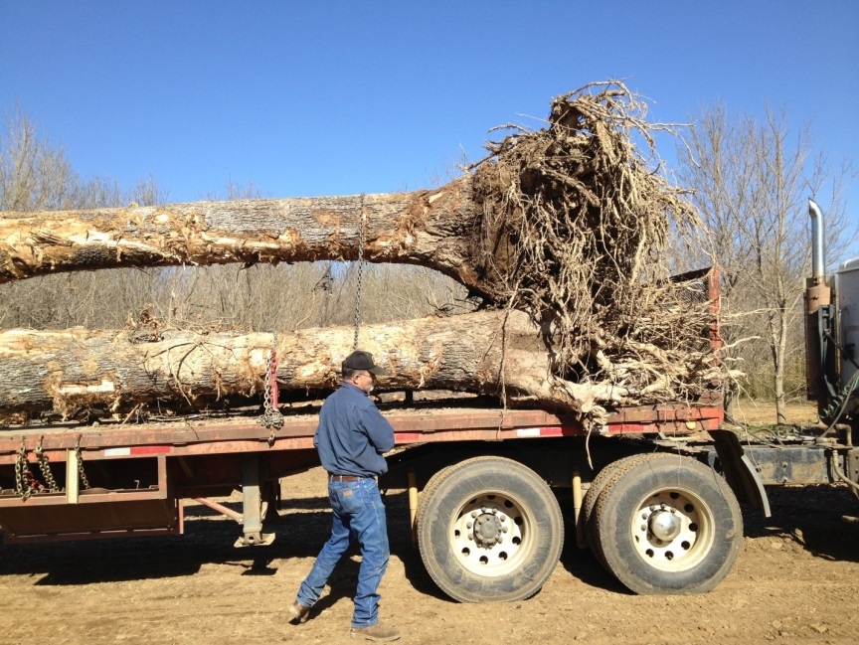
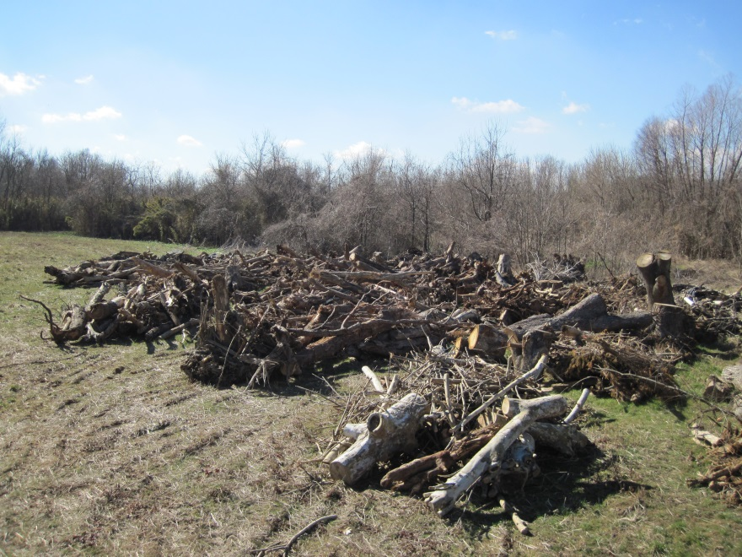
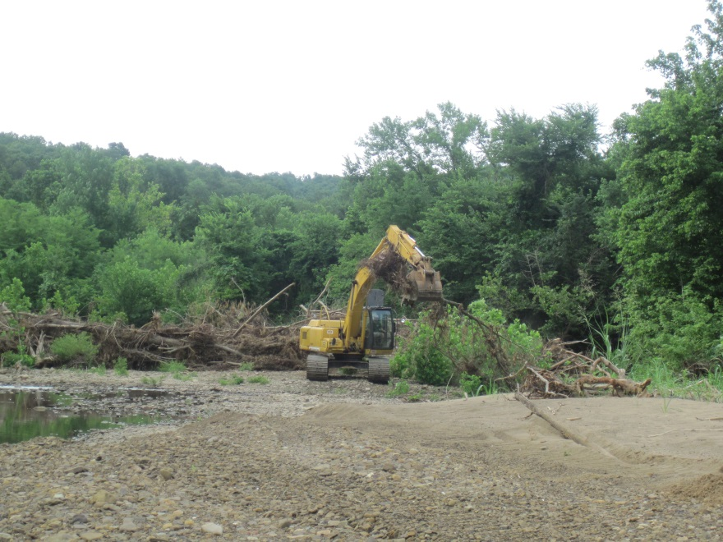
West Fork White River Restoration
Construction Materials
800 Tree Stems
Several “Donated” Sources
  Harps/Sweetser Construction
  City of Fayetteville
    Garland Avenue Project
    Water Tank Project
  Apartment Complex Development
200 donated

Slide 12
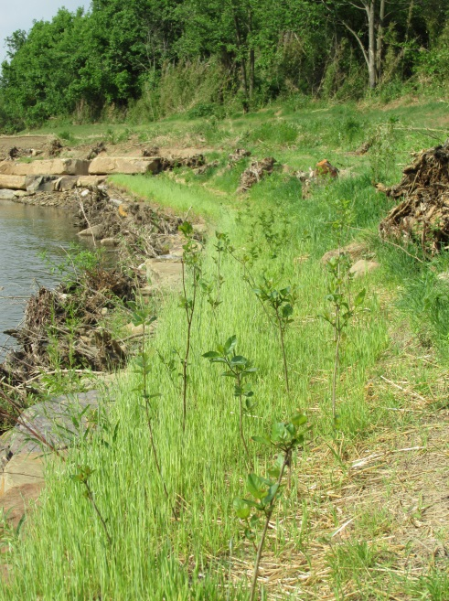
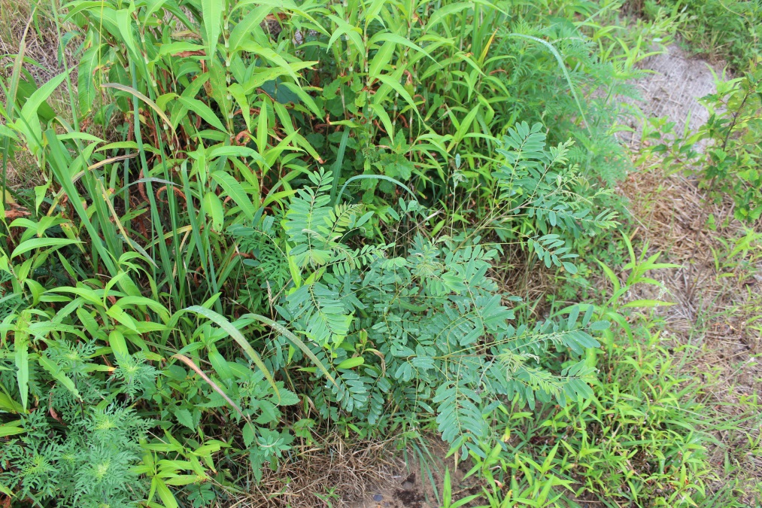
West Fork White River Restoration
Construction Materials
15,000 Bare Root Seedlings
5,000 Live Stakes
3,000 Grass Plugs
2,000 lb. Nursery Crop Seed
200 lb. Native Seed

Slide 13
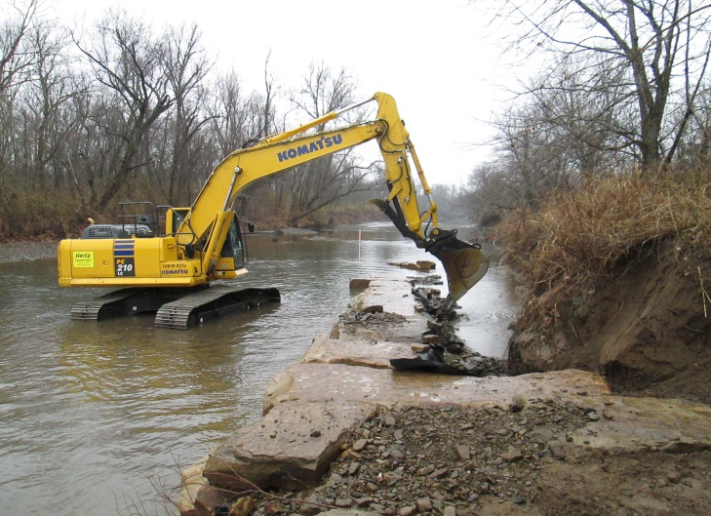
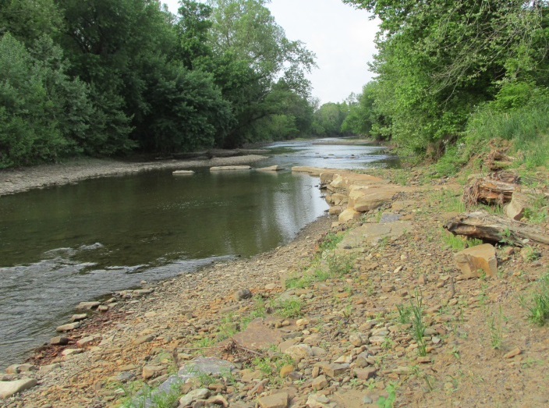
West Fork White River Restoration
Implementation

Slide 14
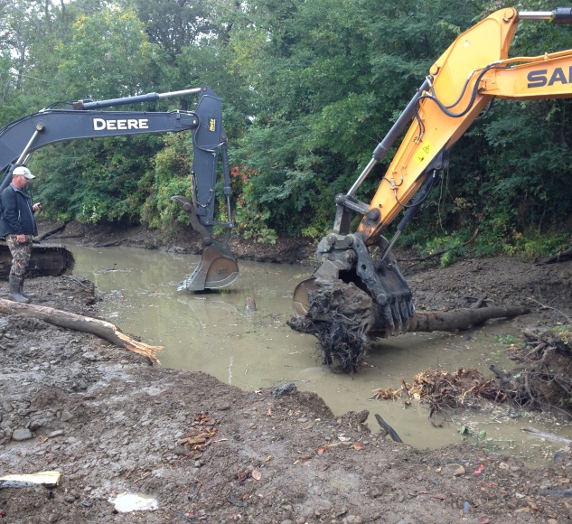
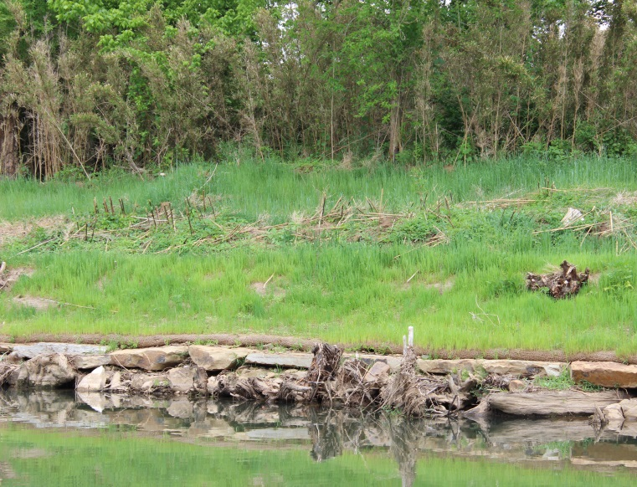
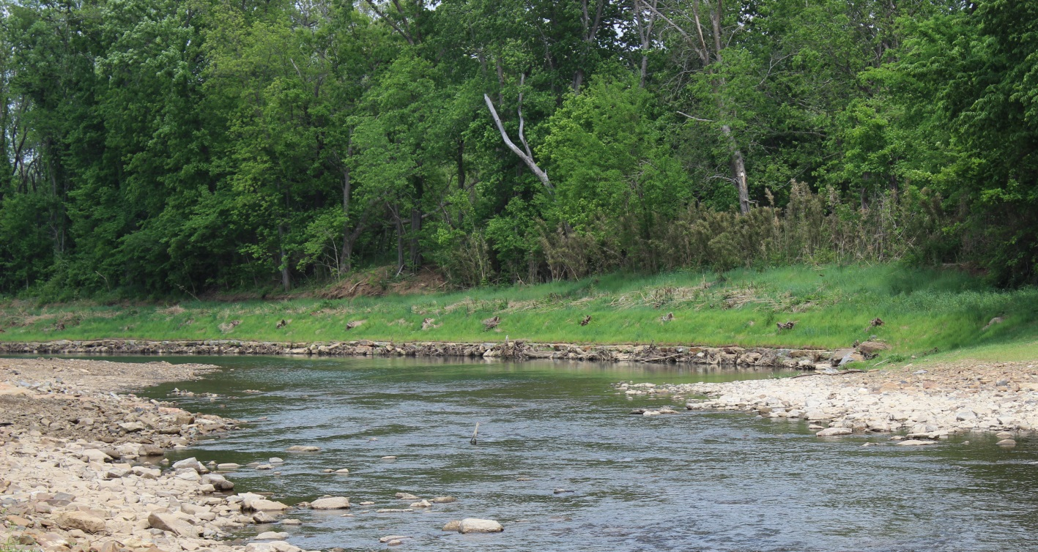
West Fork White River Restoration
Implementation
Terrace
Bankfull
Inner Berm
Toe-Wood

Slide 15
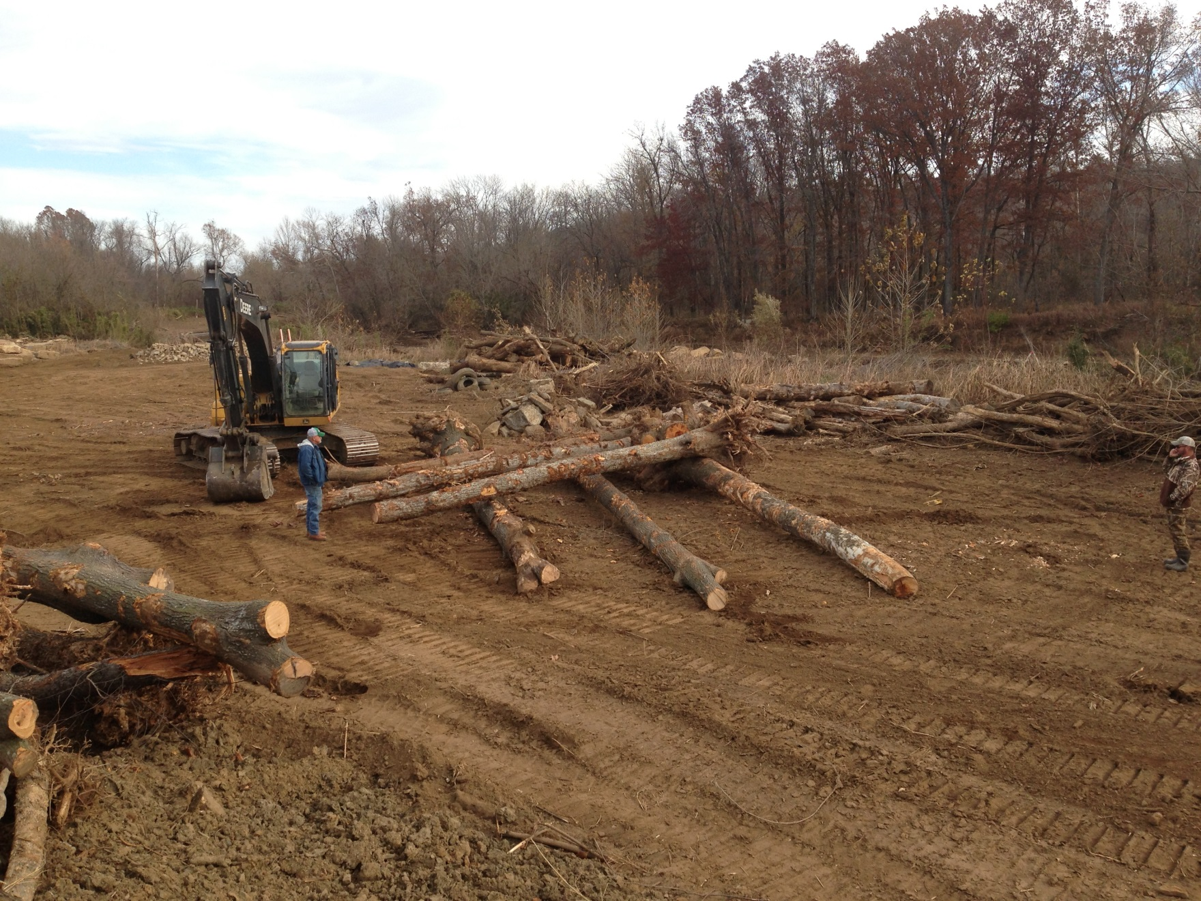
West Fork White River Restoration
Implementation

Slide 16
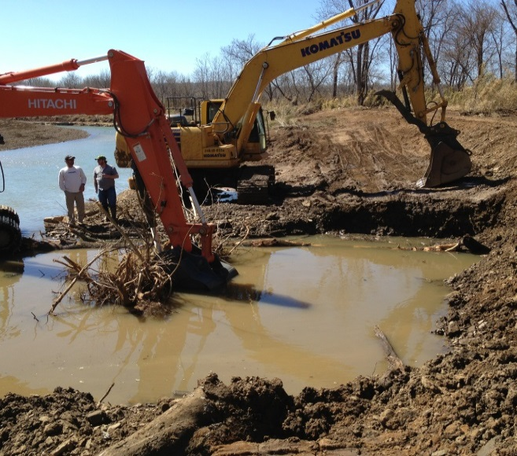
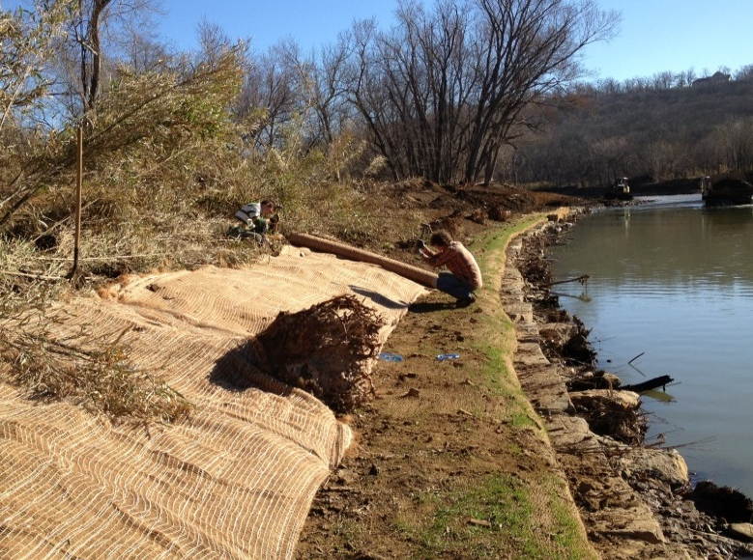
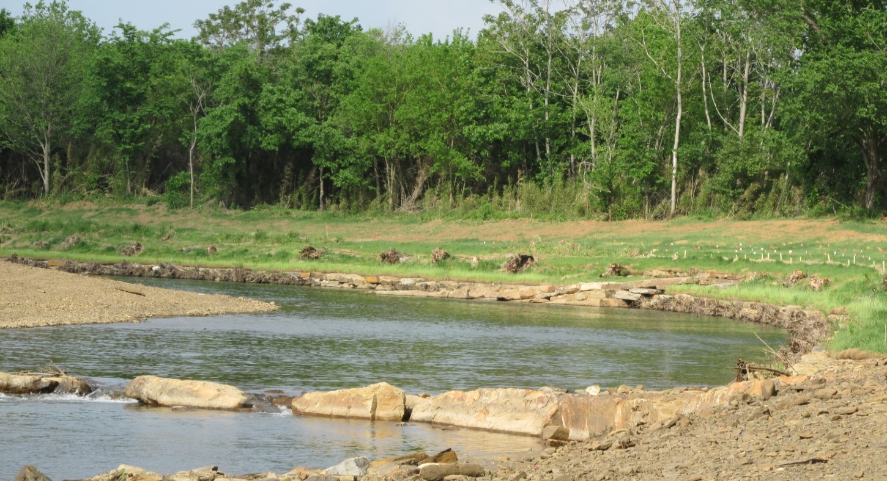
West Fork White River Restoration
Implementation

Slide 17
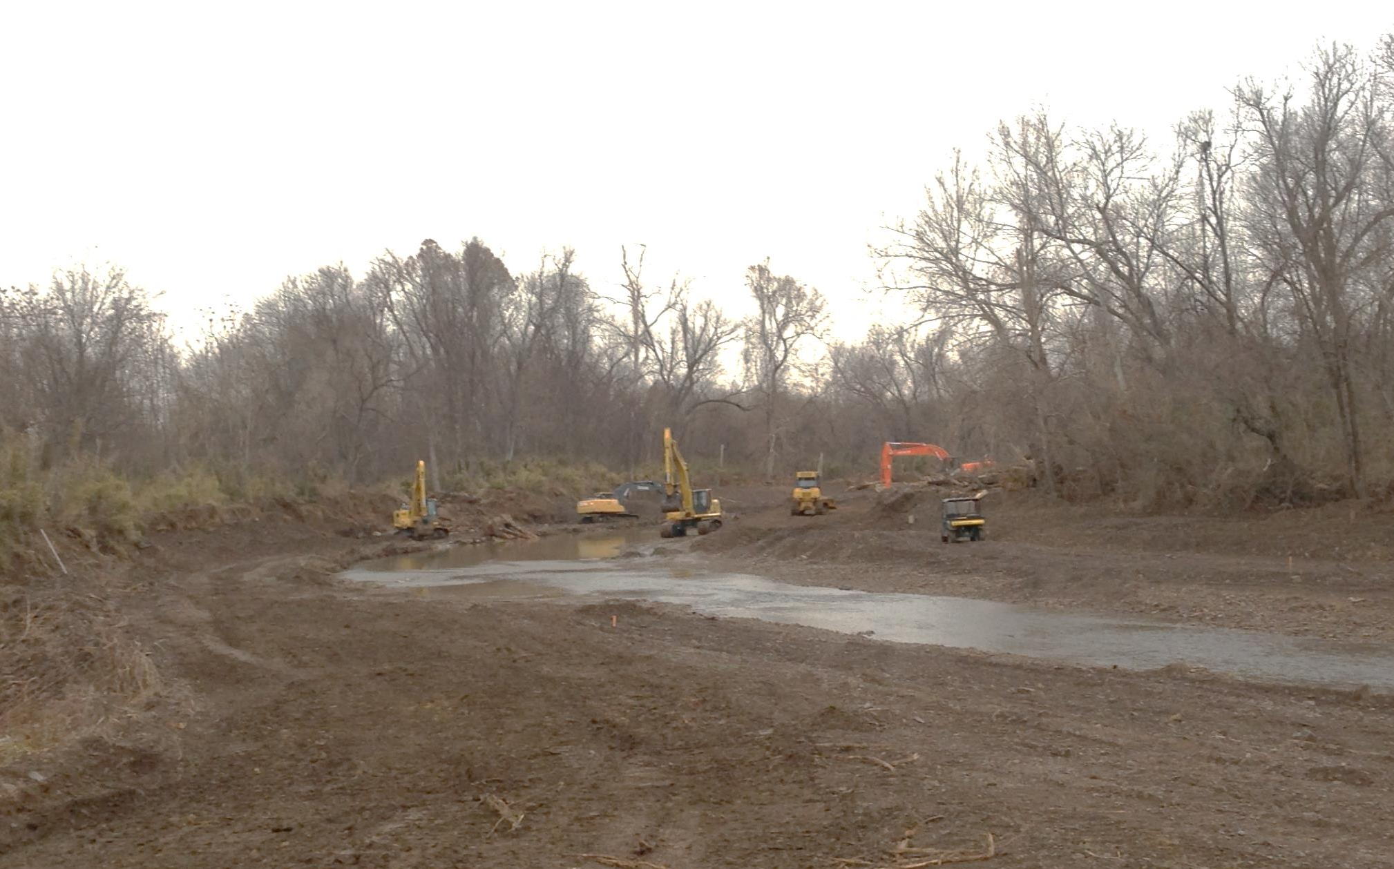
West Fork White River Restoration
Implementation

Slide 18
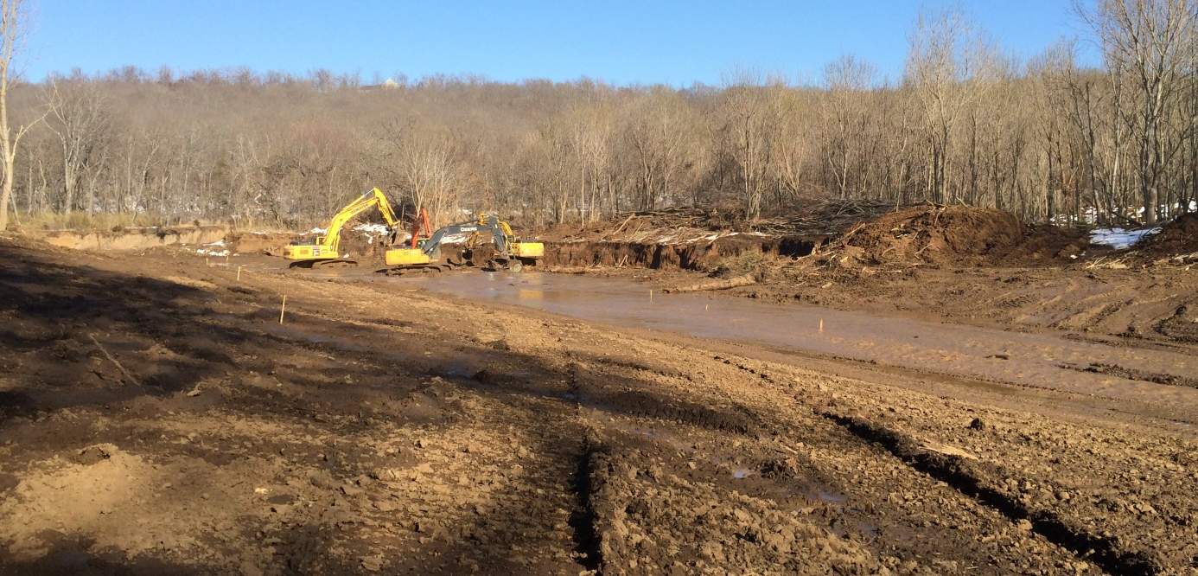
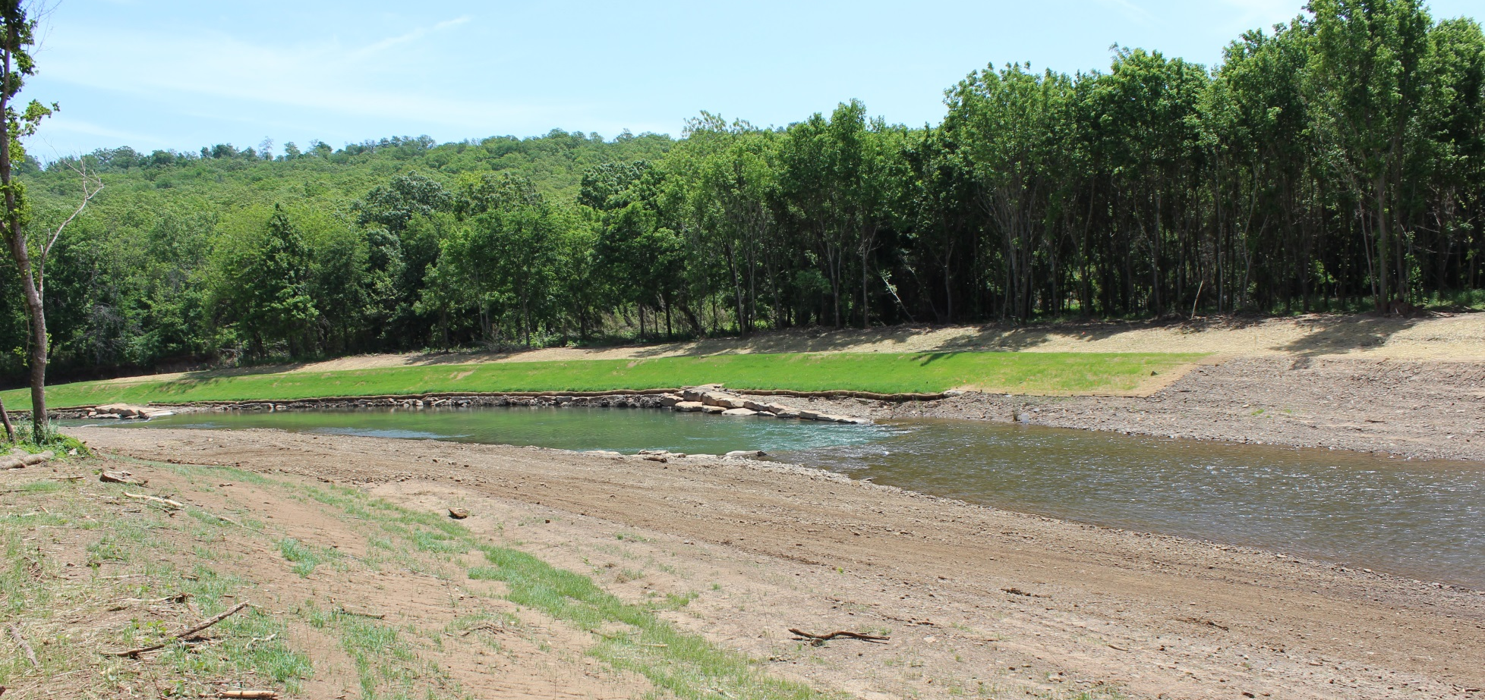
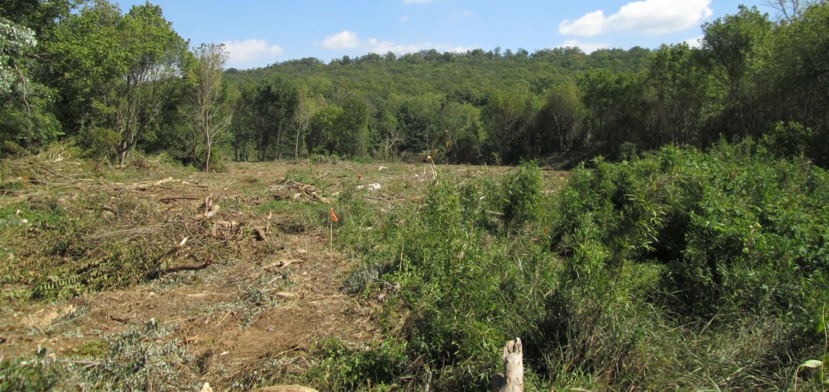
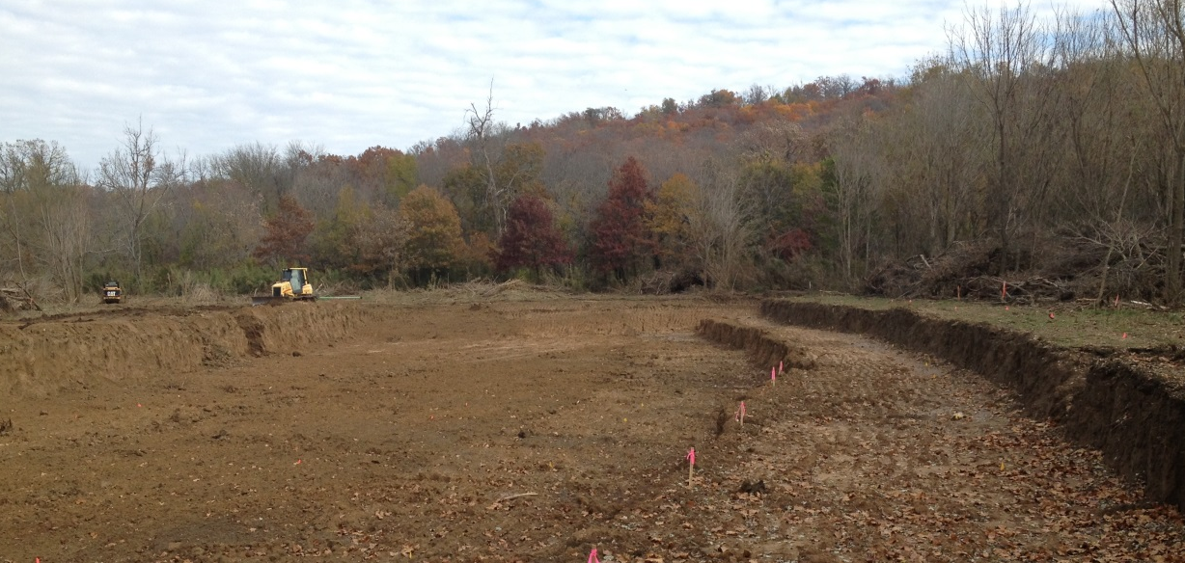
West Fork White River Restoration
Implementation
Figure 10 New Channel Cut – Top shows before excavation; middle shows top soil partially excavated; bottom shows most of the material has been excavated and channel shaping has been initiated.

Slide 19
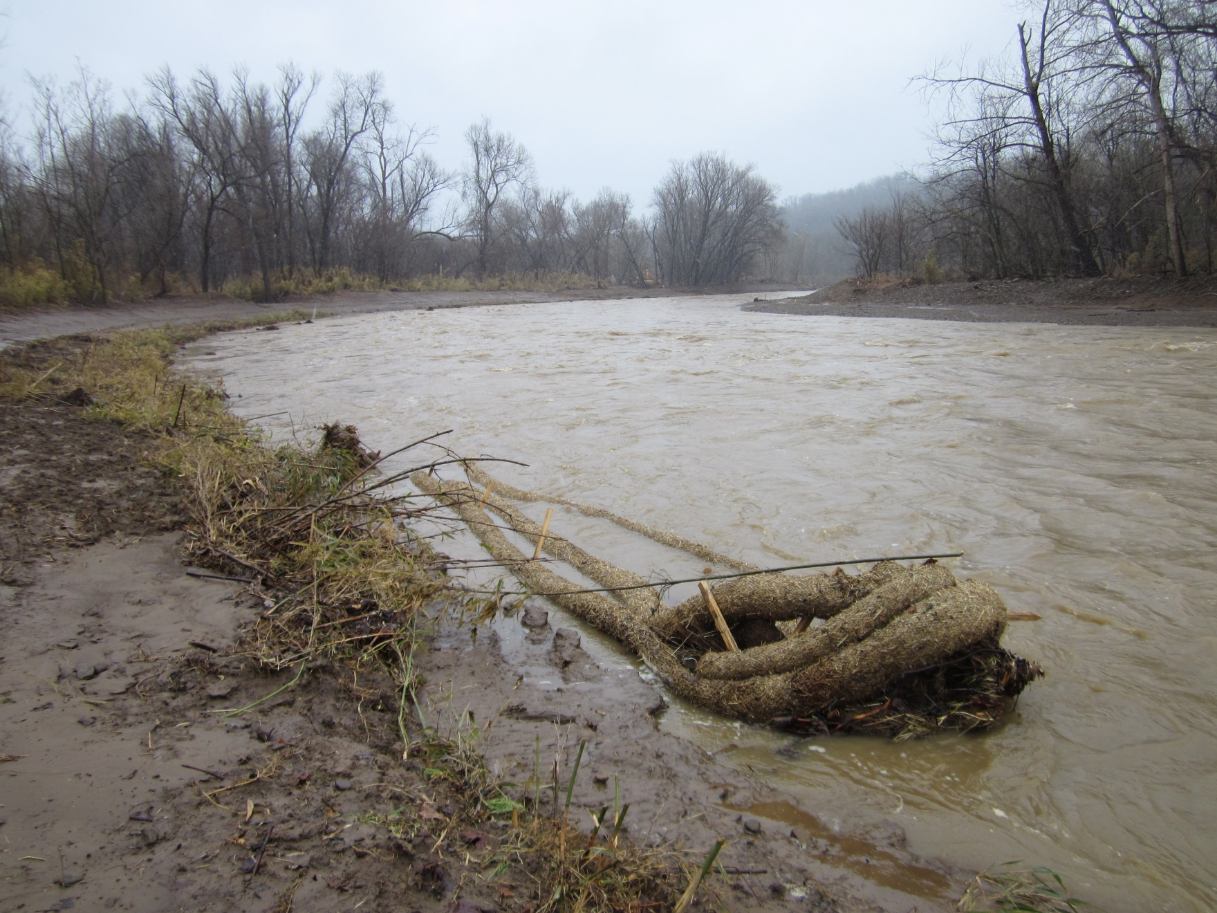
West Fork White River Restoration
Implementation
Figure 10 New Channel Cut – Top shows before excavation; middle shows top soil partially excavated; bottom shows most of the material has been excavated and channel shaping has been initiated.

Slide 20
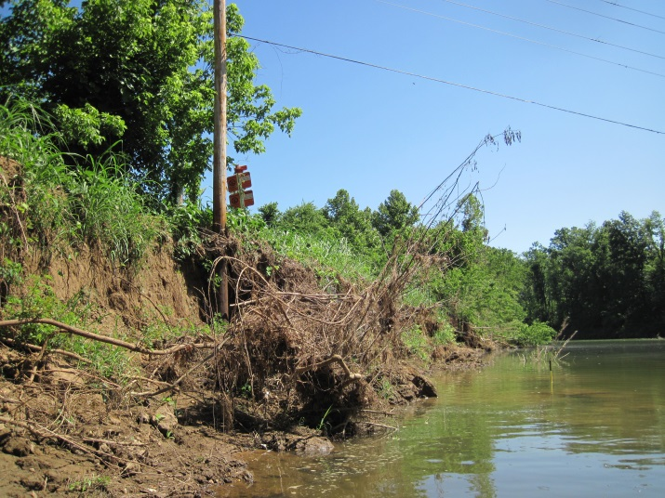
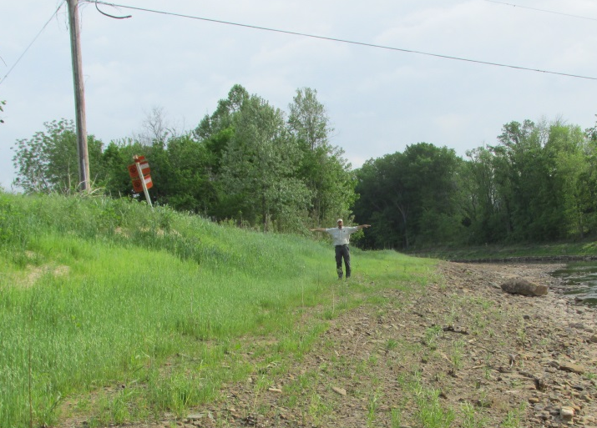
West Fork White River Restoration
Before and After

Slide 21
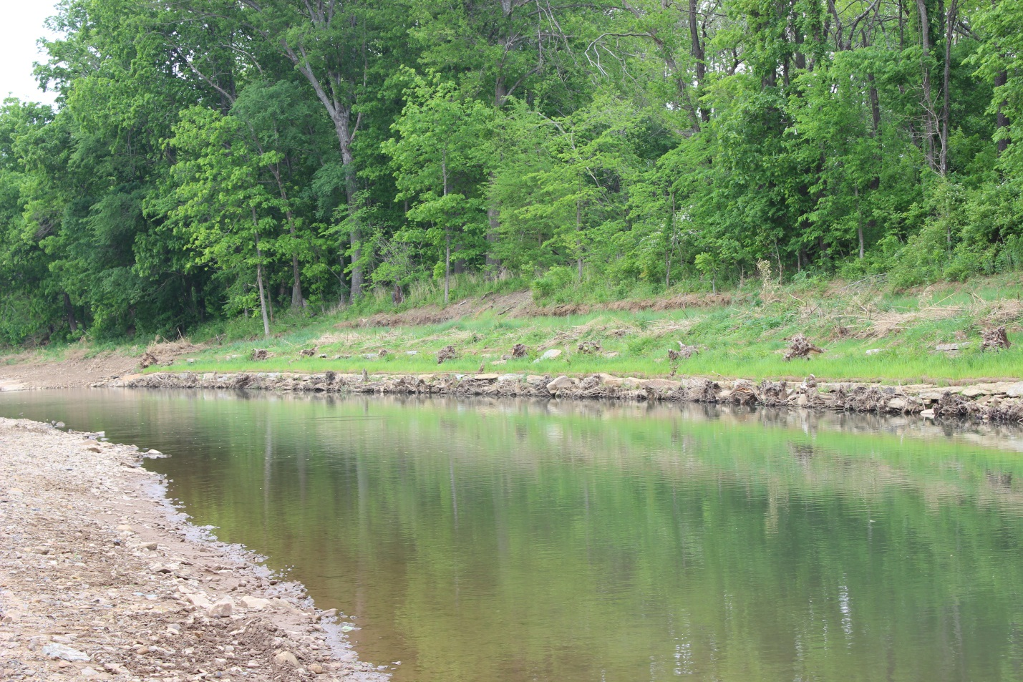
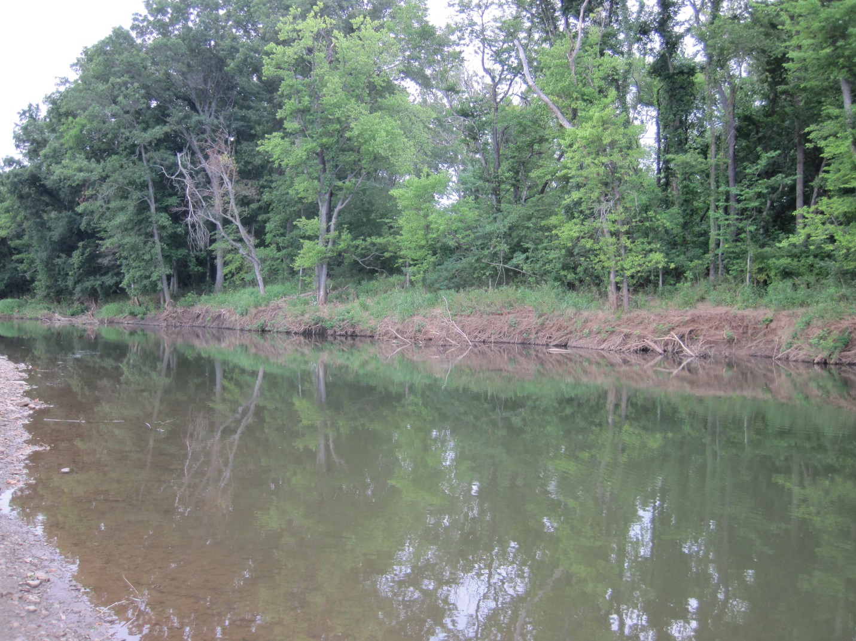
West Fork White River Restoration
Before and After

Slide 22
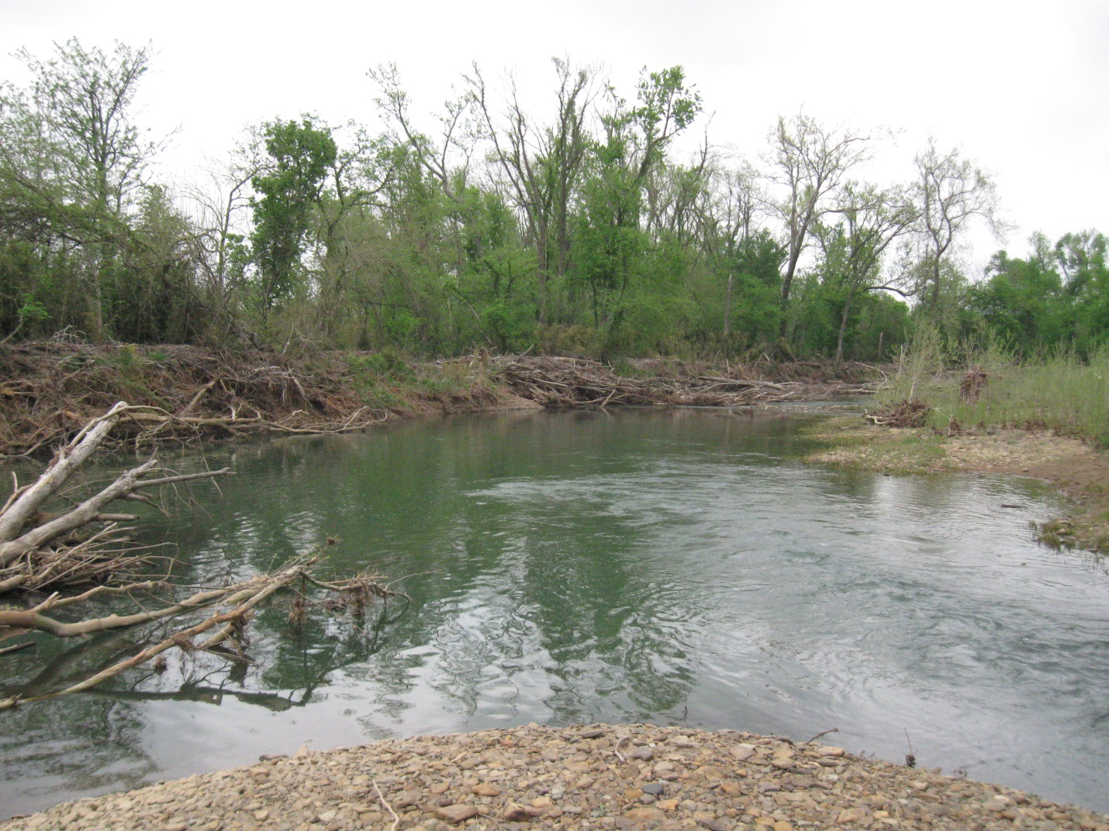
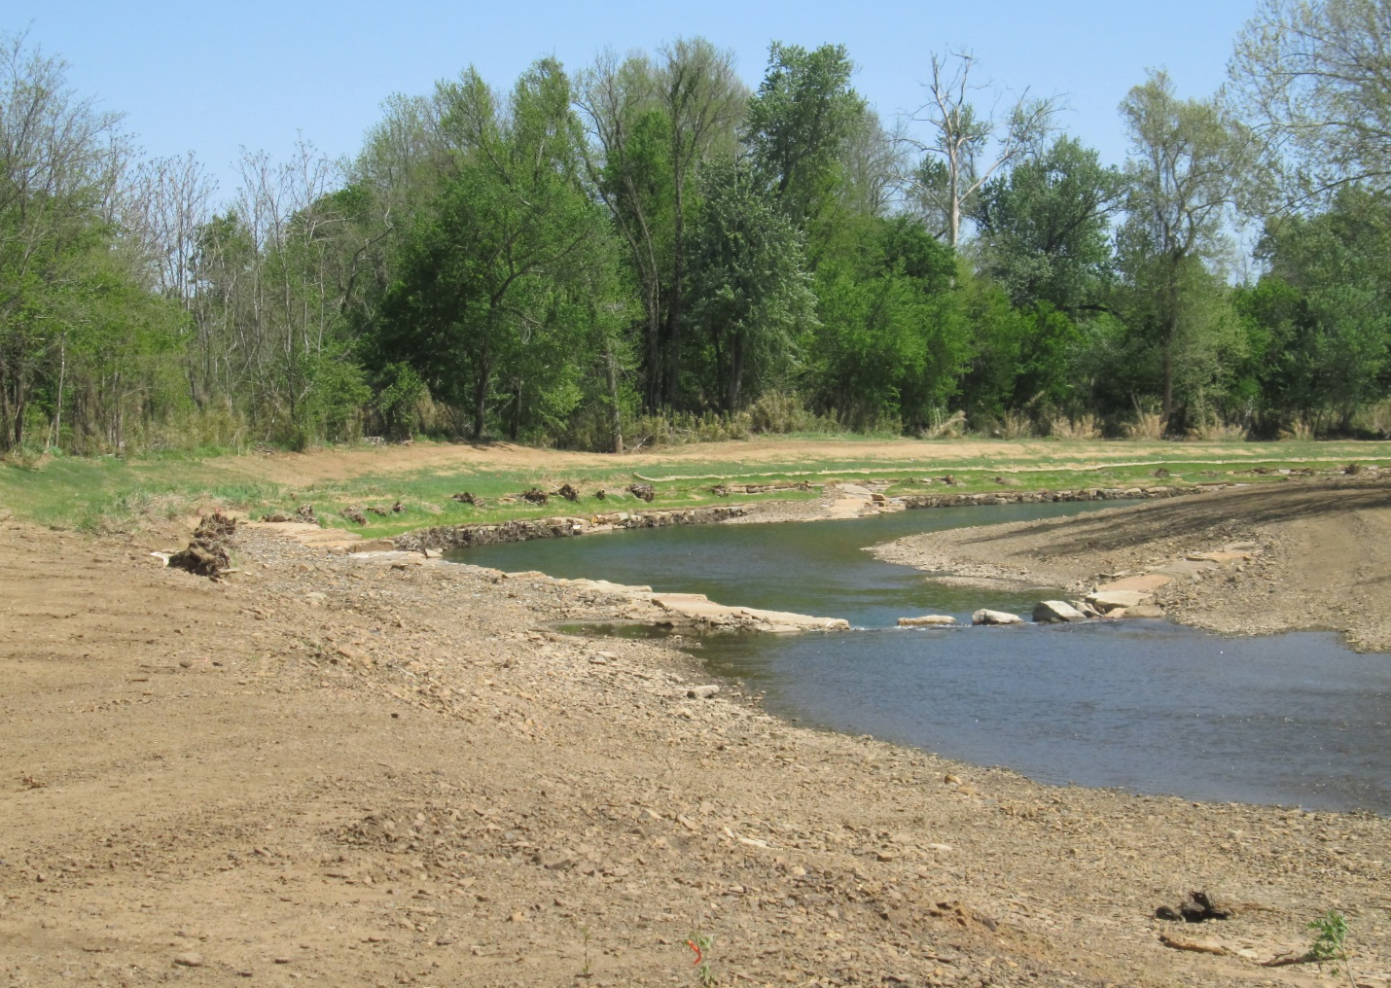
West Fork White River Restoration
Before and After

Slide 23
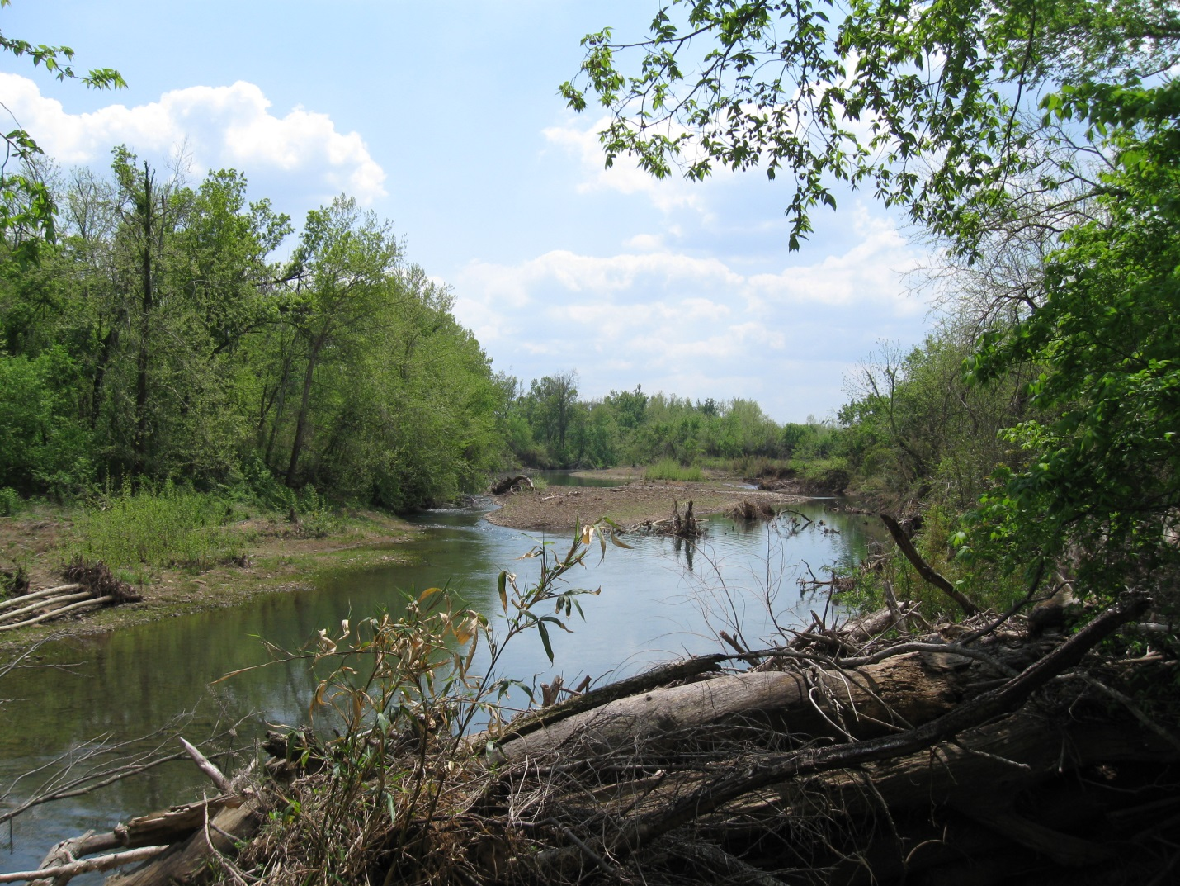
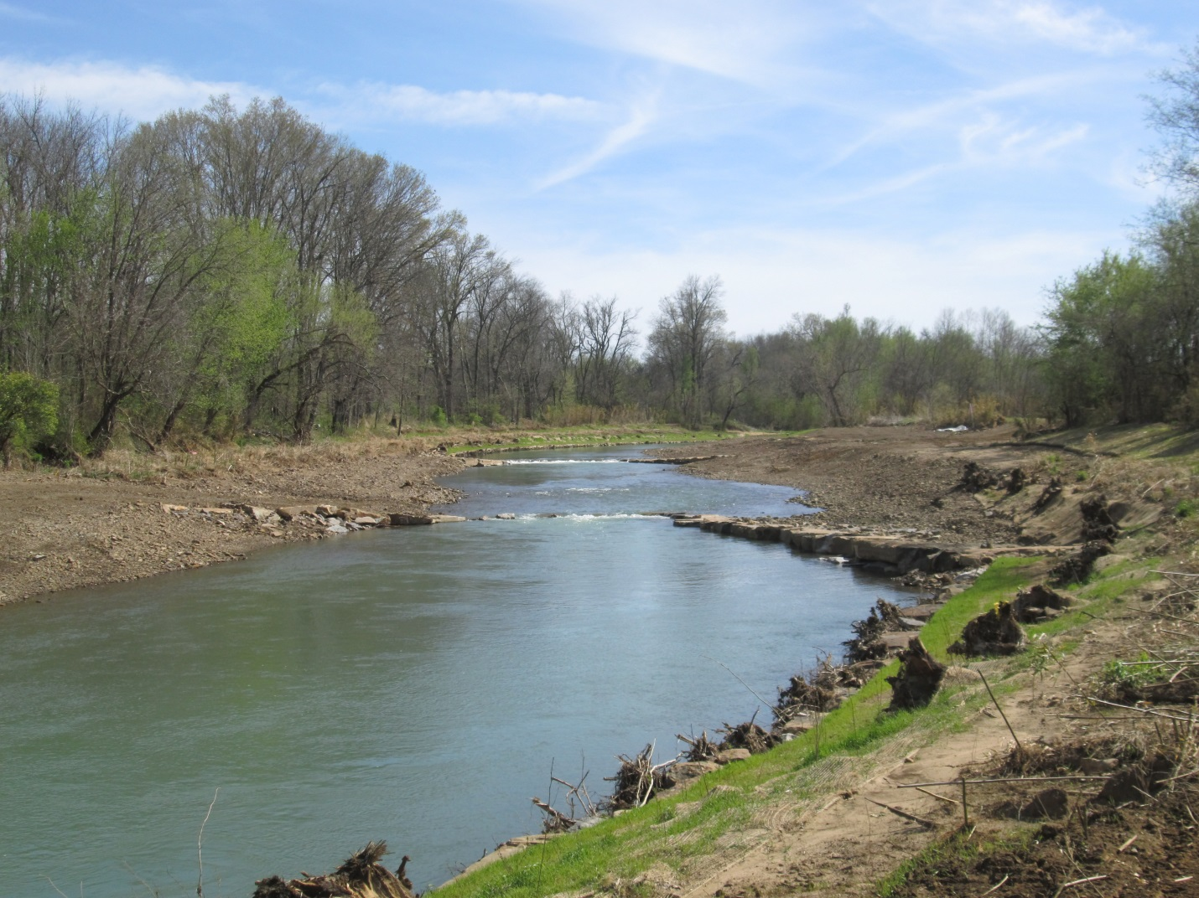
West Fork White River Restoration
Before and After

Slide 24
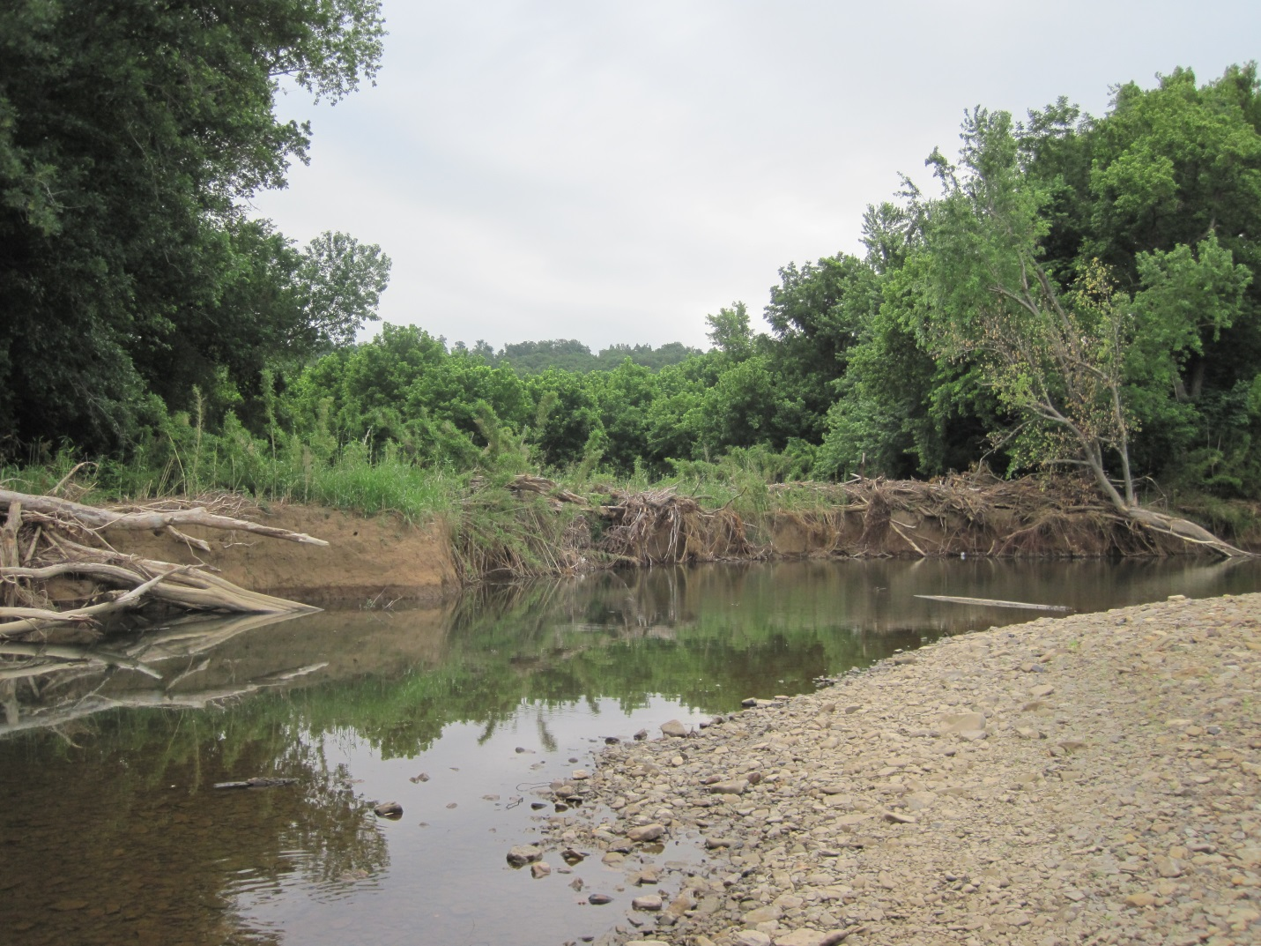
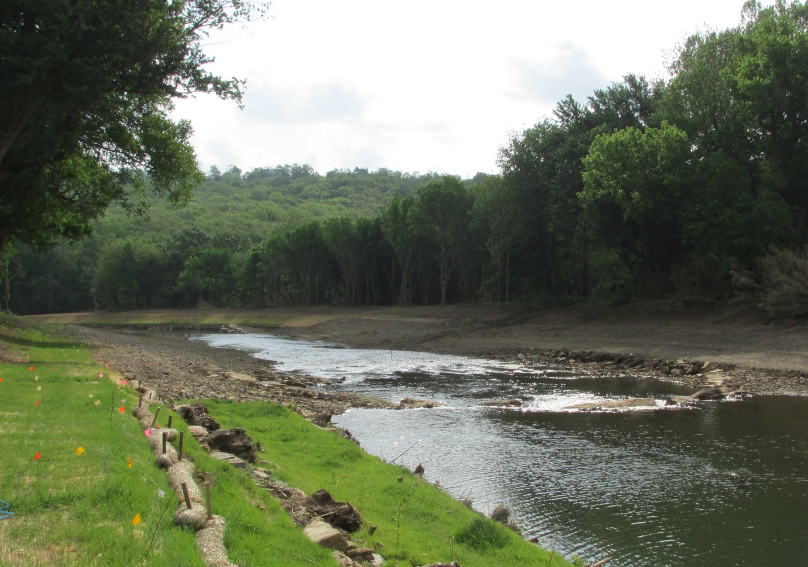
West Fork White River Restoration
Before and After

Slide 25
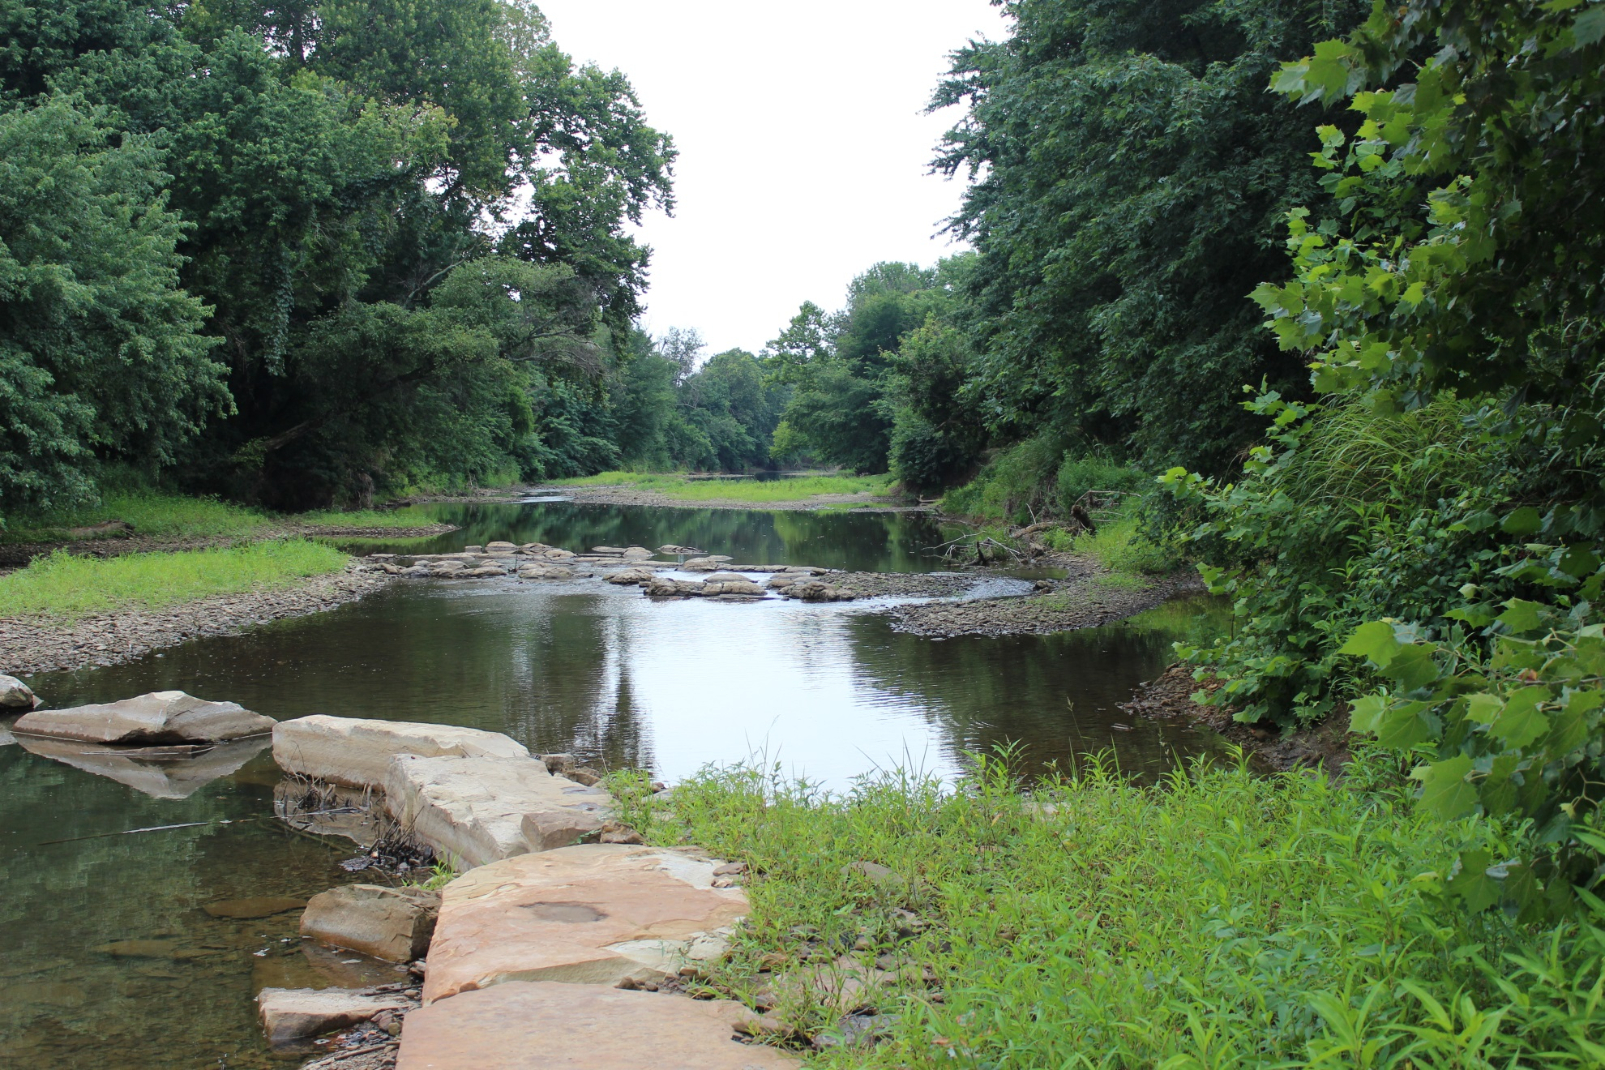
West Fork White River Restoration
Post - Implementation

Slide 26
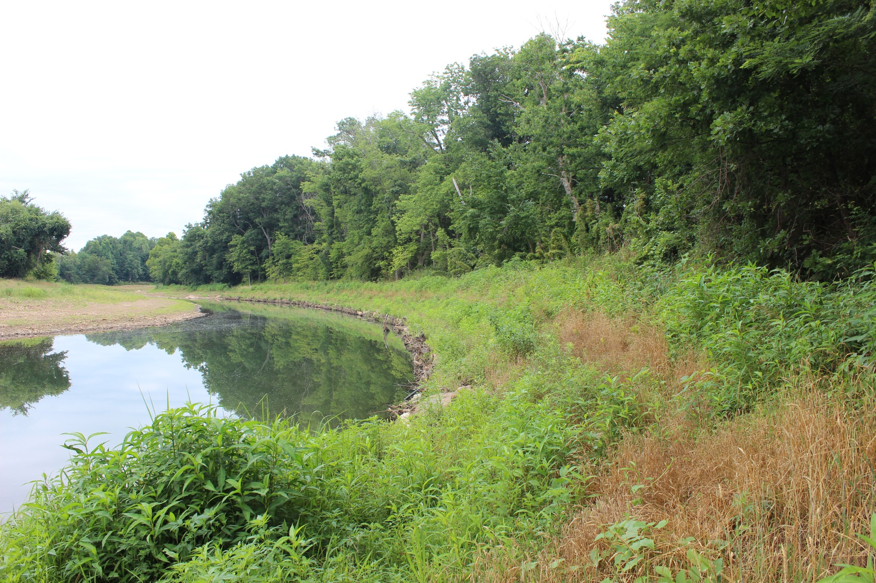
West Fork White River Restoration
Post - Implementation

Slide 27

West Fork White River Restoration
Post - Implementation

Slide 28

West Fork White River Restoration
Post - Implementation

Slide 29

West Fork White River Restoration
Post - Implementation

Slide 30

West Fork White River Restoration
Post - Implementation

Slide 31

West Fork White River Restoration
Post - Implementation

Slide 32

West Fork White River Restoration
Post - Implementation

Slide 33
West Fork White River Restoration
Post - Implementation

Slide 34
WCRC River and Streambank Restoration since 2008
Project | Area mile² | Length ft | Age yr | Cost | Sediment Reduced* Ton/yr | T. Phos. Reduced* Lb/yr
West Fork White River Brentwood Beaver Lake Watershed | 18 | 1,800 | 4.0 | $406,000 | 1,880 | 640
White River Stabilization Beaver Lake Watershed | 400 | 1,000 | 2.5 | $352,000 | 3,600 | 3,500
Mullins Branch Restoration Beaver Lake Watershed | 1 | 1,000 | 2.5 | $425,000 | 69 | 32
West Fork White River Fayetteville Airport Beaver Lake Watershed | 83 | 4,600 | 0.5 | $1,300,000 | 4,000 | 1,800
*Preliminary Results |  |  |  |  | 9,549 | 5,972

Slide 35


West Fork White River Restoration
Questions?
Thank You
Matt Van Eps
Watershed Conservation Resource Center
(501)352-7294

