Slide 1

Water Quality Monitoring and Parameter Load Estimations in
Lake Conway Point Remove Watershed,
L’Anguille River Watershed, and
Bayou Bartholomew
Presented by:
Dan DeVun, Equilibrium
devun@equilibrium-ar.org
www.equilibrium-ar.org
09/19/2014

Slide 2

Acknowledgements and Special Thanks
EPA Region 6
ANRC; Tony Ramick and Robbie Alberson
Wesley Griffin
Ouachita Baptist University
Dr. Tim Knight
Clark Kyper
Dr. Joe Nix
Natural State Streams
Ecological Design Group
Entergy, Inc.
HDR, Inc.

Slide 3


Projects Primary Goal
By collecting, analyzing and reporting water quality and discharge data; provide monthly and annual parameter loadings, as well as unit area loadings in numerous 12 digit HUCs.

Slide 4
Monitoring Structure – Similar activities are implemented in each monitored watershed that support each project’s primary goal.
Water Quality Requirements – Incorporates project design, collection methodology and analytical methodology to generate representative data and allow for an evaluation of water chemistry within the selected watersheds.
Discharge Requirements – Estimate the volume of water that passes the monitoring station during the sampling period.
Data Compilation and Statistical Analysis – Compile and statistically analyze the collected data to provide monthly, annual, and unit area loadings, as well as, compare results between monitoring stations.
Reporting Requirements – Provide the project participants with the project outcomes and make the results readily available to the natural resource and watershed professionals and the general public.

Slide 5
Equilibrium’s Water Quality
Monitoring Requirements
Sample Types – Discrete grab samples, when possible we collect depth integrated samples at the mid point of the stream
Collection Frequency – Once per week
In-situ Parameters – Temperature, dissolved oxygen, specific conductance, pH, and stage.
Record Field Notes – documentation that includes type of sample, time and date, site location, name of sampler, climatic characteristics during site visit, recognized problems, and corrective actions required or taken.

Slide 6
Equilibrium’s Water Quality
Monitoring Requirements
(Continued)
Laboratory Parameters – TSS, Turbidity, Total Phosphorus, Total Kjeldahl Nitrogen, Nitrate-Nitrogen, Ammonia-Nitrogen, Total Nitrogen, Chloride and Sulfate.
QAQC Samples – Samples taken to insure representativeness of collected data. (include replicate, field blanks, split and spiked samples)

Slide 7
Equilibrium’s Discharge
Requirements
Monitoring Station Location – When possible, locate monitoring stations where existing USGS stations are located. Unfortunately only 2 of 25 stations are located at USGS stations…
Discharge Parameters – Stage, Profile, and Velocity
  Stage – Utilize pressure transducers to measure stage every 30 minutes. Additionally, manually measure stage at the time of water quality collection.
  Profile – survey and record the stream’s cross sectional profile
  Velocity – utilize numerous instruments (electromagnetic and acoustic doppler methodologies) to calculate stream velocities

Slide 8
Equilibrium’s Discharge Requirements
(Continued)
Discharge Measurements – Stream discharge is measured at numerous points throughout the hydrograph. We attempt to measure discharge at a minimal of three different stages of each categorical flow.
Low Flow, Mid Flow, High Flow
Develop the Stage Rating Discharge Curve – determine the mathematical relationship between stage and discharge for the measured discharge points.
Utilize the Stage Rating Discharge Curve – estimate daily discharge from the continuously collected stage data.

Slide 9
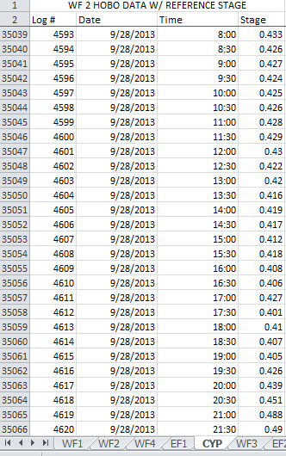
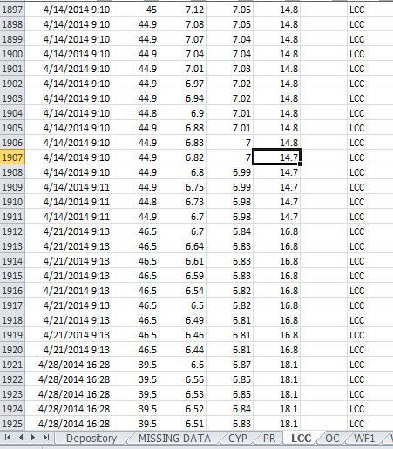
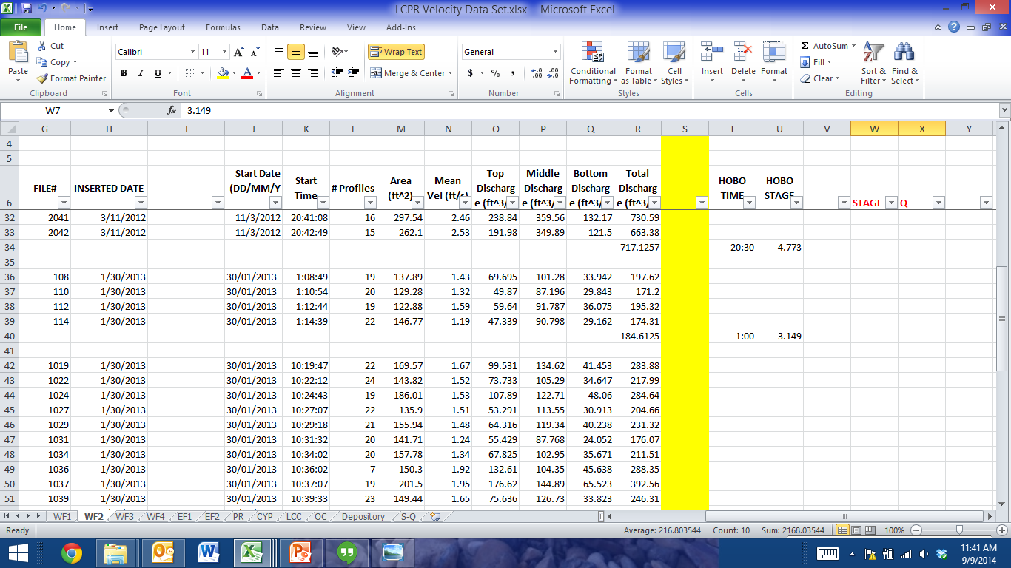

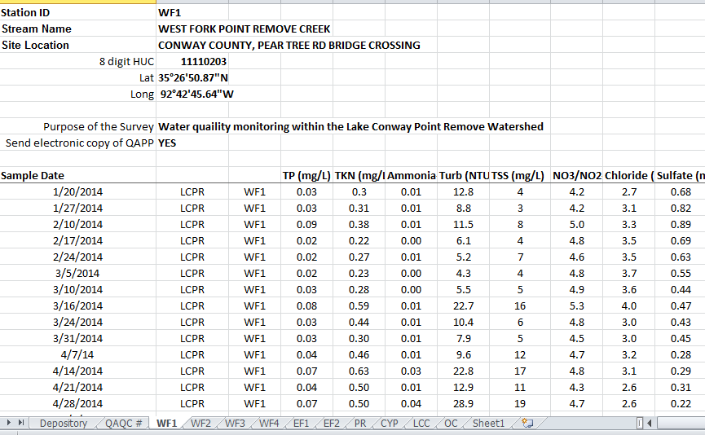
Data Compilation and Statistical Analysis
Compilation of collected data
  Laboratory Water Quality Data
  In-situ Water Quality Data
  Historical Water Quality Data
  QAQC Water Quality Data
  Stage Data
  Discharge Data
  Historical Discharge Data
  Precipitation Data
Statistical Analysis
  Statistical relationship between stage and discharge
  Calculation of parameter loadings
  Statistical comparison between monitoring stations.

Slide 10
Reporting
Provide all project participants with a final report.
Provide public access of our data through WQX.
Our collected data and analysis can be beneficial to numerous persons working in fields related to water quality and water quantity.

Slide 11
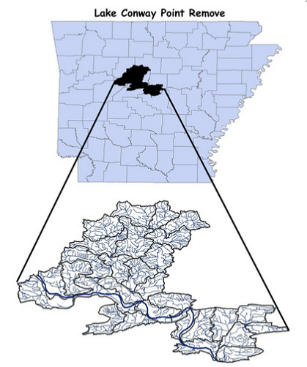
Lake Conway Point Remove Watershed
Ten monitoring stations
Project Period is July 2011 – October 2014
Monitoring the “outfalls” of 12 digit HUC
Completing data collection phase, preparing Final Report
LCPR scored 91 in the Final Risk Assessment Matrix Percentile of the
Arkansas’ Nonpoint Source Pollution Watershed Risk Matrix and has been
selected as a priority watershed.
NRCS identified LCPR as a priority in the
Mississippi River Basin Healthy Watershed Initiative.

Slide 12
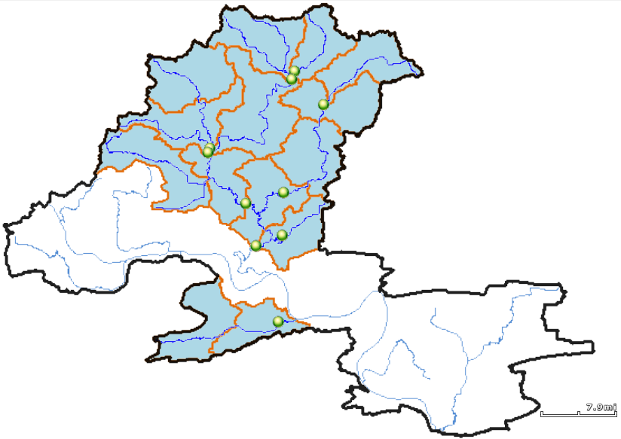

Slide 13
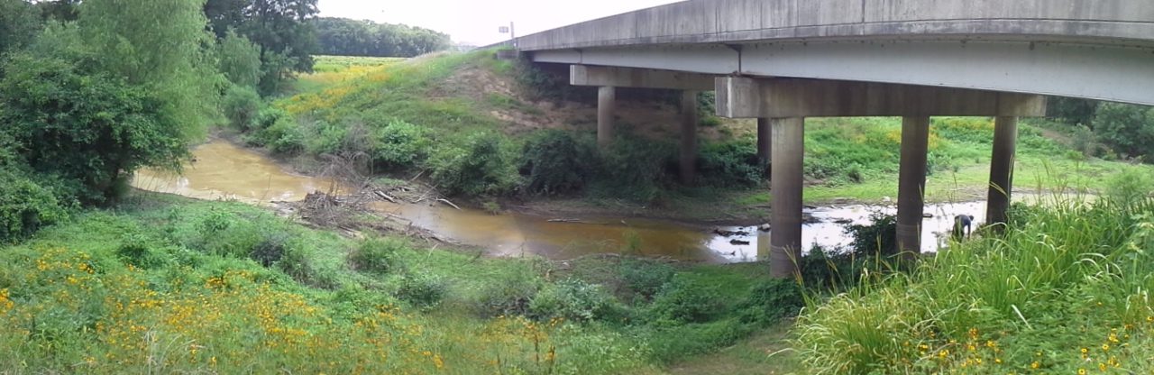
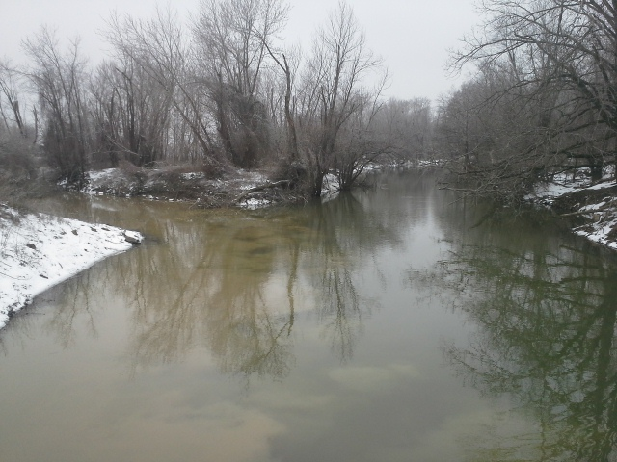
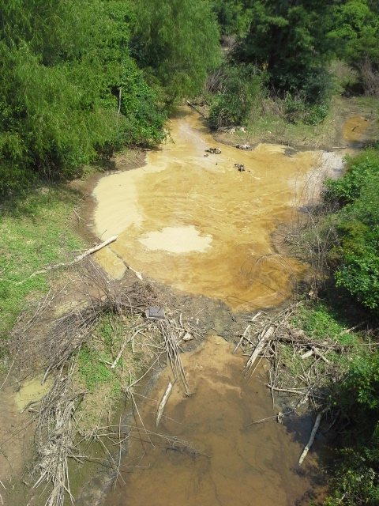

Slide 14
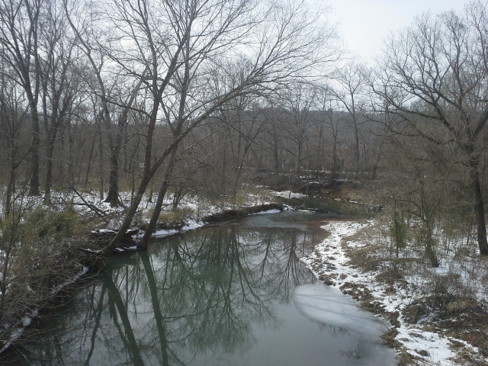
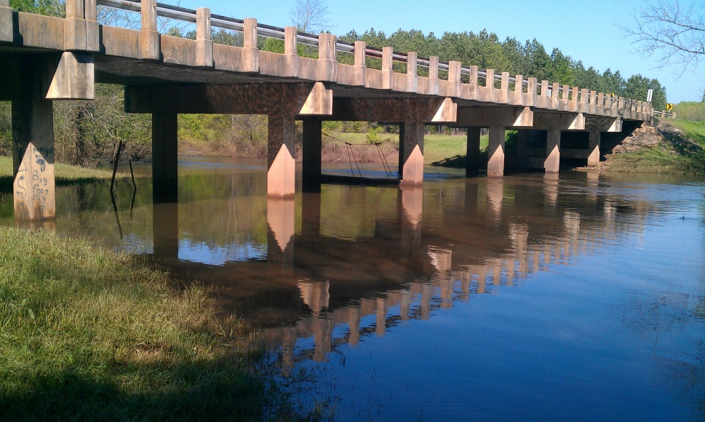

Slide 15
Lake Conway Point Remove Watershed
Mean Parameter Concentrations (MG/l)
 | WF1 | WF2 | WF3 | WF4 | EF1 | EF2 | PR | CYP | LCC | OC
TP | 0.069 | 0.039 | 0.049 | 0.121 | 0.047 | 0.09 | 0.103 | 0.131 | 0.067 | 0.151
TKN | 1.138 | 0.424 | 0.398 | 0.661 | 0.399 | 0.682 | 0.677 | 0.741 | 0.472 | 1.066
Ammonia | 0.245 | 0.038 | 0.031 | 0.038 | 0.023 | 0.114 | 0.063 | 0.061 | 0.032 | 0.102
Turbidity (NTU) | 13.689 | 17.269 | 9.397 | 22.173 | 11.942 | 16.034 | 24.415 | 24.018 | 10.148 | 70.406
TSS | 8.522 | 7.124 | 7.036 | 18.64 | 7.832 | 13.022 | 17.883 | 14.65 | 7.664 | 42.548
NO₃-N | 1.065 | 0.65 | 0.924 | 1.055 | 1.163 | 1.141 | 1.192 | 1.227 | 1.221 | 2.728
Chloride | 3.834 | 2.048 | 3.935 | 16.27 | 4.027 | 5.324 | 9.707 | 6.159 | 5.172 | 8.265
Sulfate | 6.176 | 3.525 | 2.586 | 7.879 | 4.324 | 3.099 | 6.119 | 4.712 | 2.978 | 13.051

Slide 16
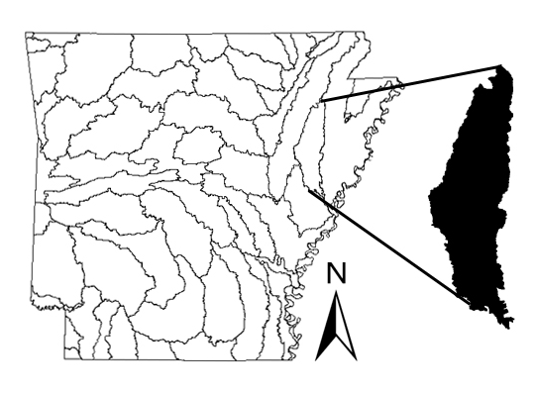
L’Anguille River Watershed
Five monitoring stations
Current Project Period
July 2012 – September 2015
Monitoring the “outfalls” of 12 digit HUC
Currently in data collection phase
The L'Anguille River was included on the Arkansas 1998 303(d) list for not supporting aquatic
life due to siltation/turbidity and has been on each subsequent 303(d) list.
ANRC has designated the watershed as a priority watershed.
NRCS also identified the L'Anguille River as a priority in the
Mississippi River Basin Healthy Watershed Initiative.

Slide 17
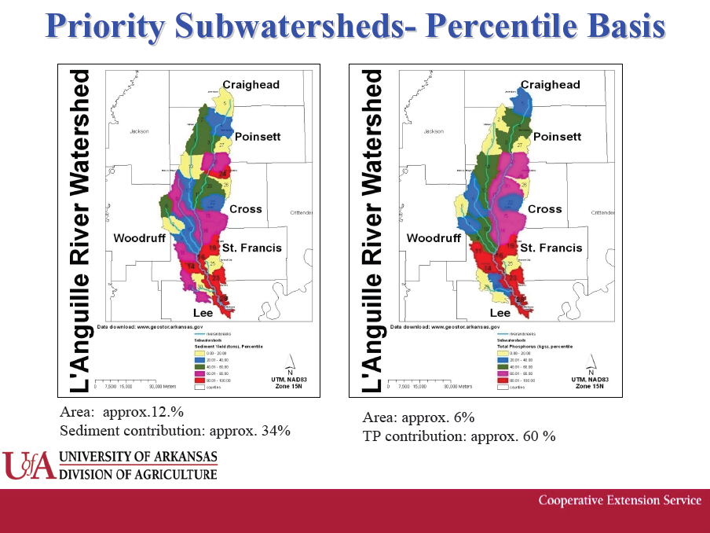

Slide 18
Priority Ranking by SWAT Model
12-Digit HUC Name | Drainage Size (Acres) | Sediment Load (Percentile) | Total Phosphorus Load (Percentile) | Erosion Rate | Cartographic Score
Copper Creek | 12,056 | 80-100 | 60-80 | Critical | Critical
Prairie Creek | 11,626 | 0-20 | 0-20 | Critical | Critical
Indian Creek | 21,034 | 20-40 | 20-40 | Moderate | Critical
Upper Brushy Creek | 21,718 | 40-60 | 0-20 | Slight | Slight
Middle Brushy Creek | 31,947 | 0-20 | 40-60 | Slight | Slight
Saraswat, et.al

Slide 19
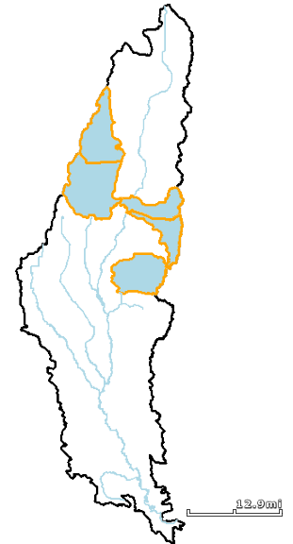
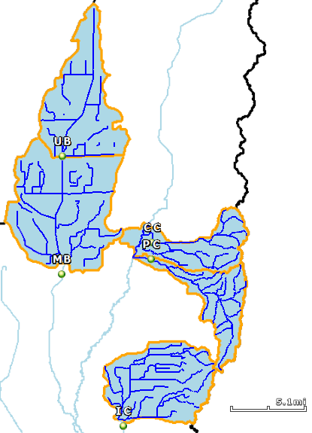

Slide 20
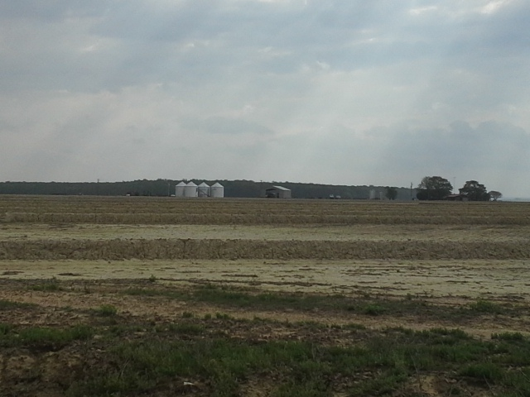
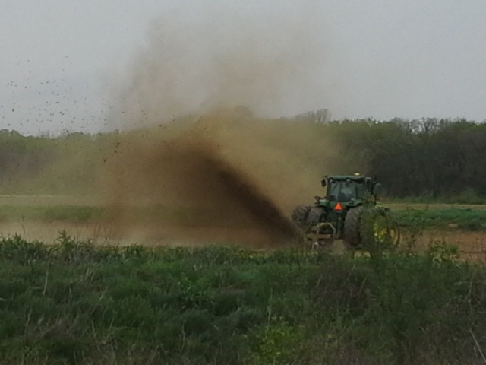
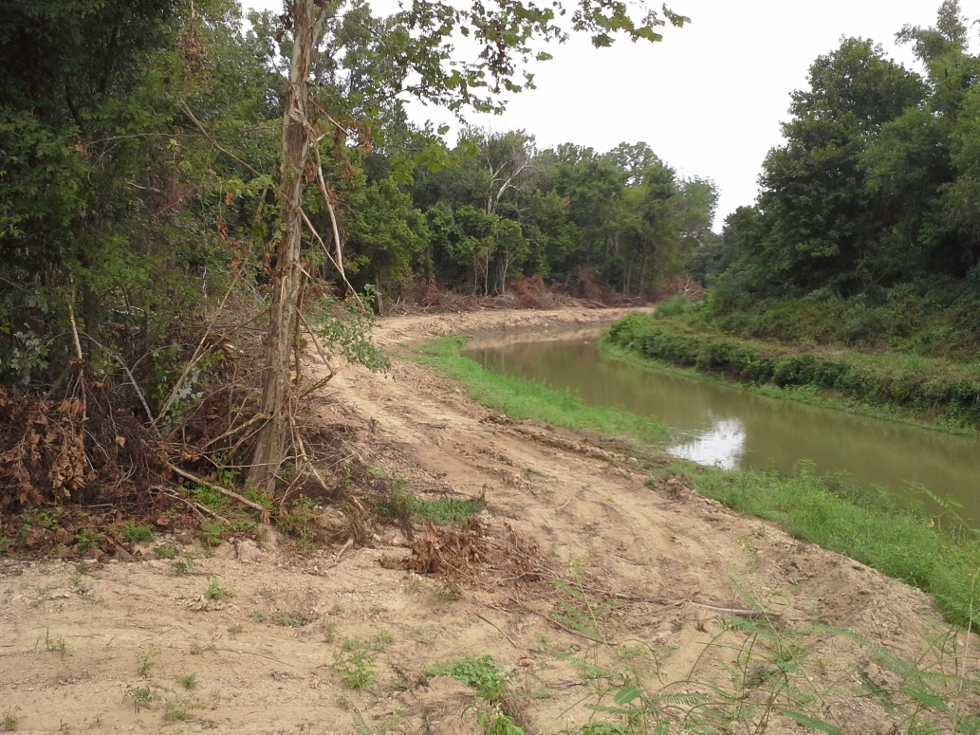
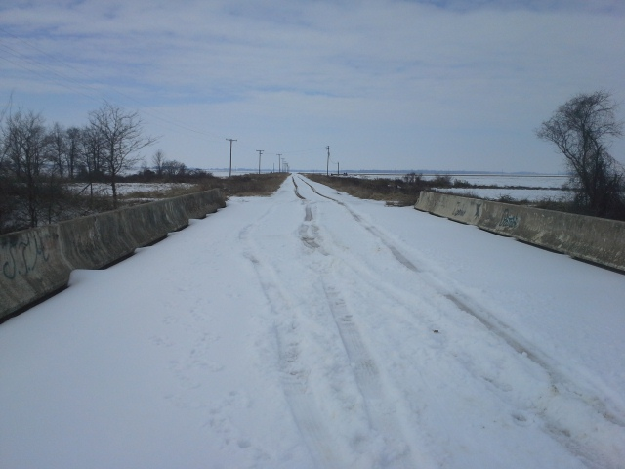

Slide 21
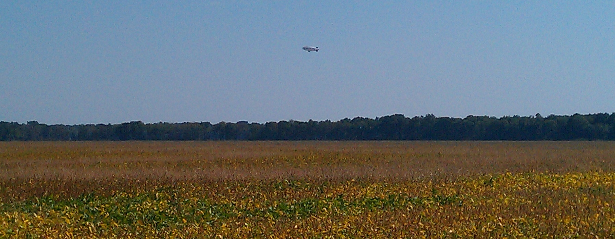
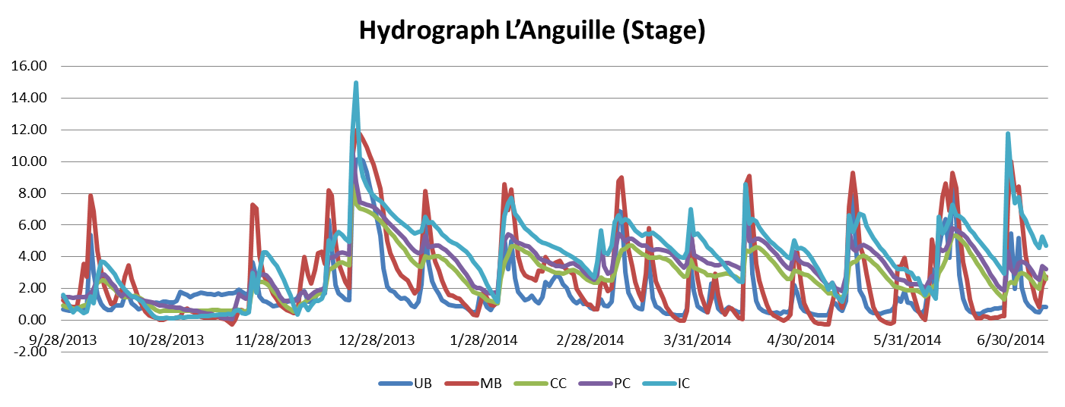

Slide 22
L’Anguille Watershed
Mean Parameter Concentrations (MG/l)
 | UB | MB | CC | PC | IC
Acres | 21,718 | 31,947 | 12,056 | 11,626 | 21,034
TP | 0.44 | 0.43 | 0.45 | 0.36 | 0.41
TKN | 1.58 | 1.52 | 1.54 | 0.99 | 1.35
Ammonia | 0.16 | 0.09 | 0.26 | 0.05 | 0.11
Turbidity (NTU) | 113.03 | 138.45 | 58.15 | 108.61 | 82.43
TSS | 74.60 | 89.16 | 42.24 | 87.03 | 52.56
NO₃-N | 1.45 | 1.81 | 2.95 | 2.91 | 1.85
Chloride | 20.71 | 19.97 | 10.99 | 11.44 | 14.72
Sulfate | 10.58 | 11.58 | 12.48 | 13.54 | 17.85

Slide 23
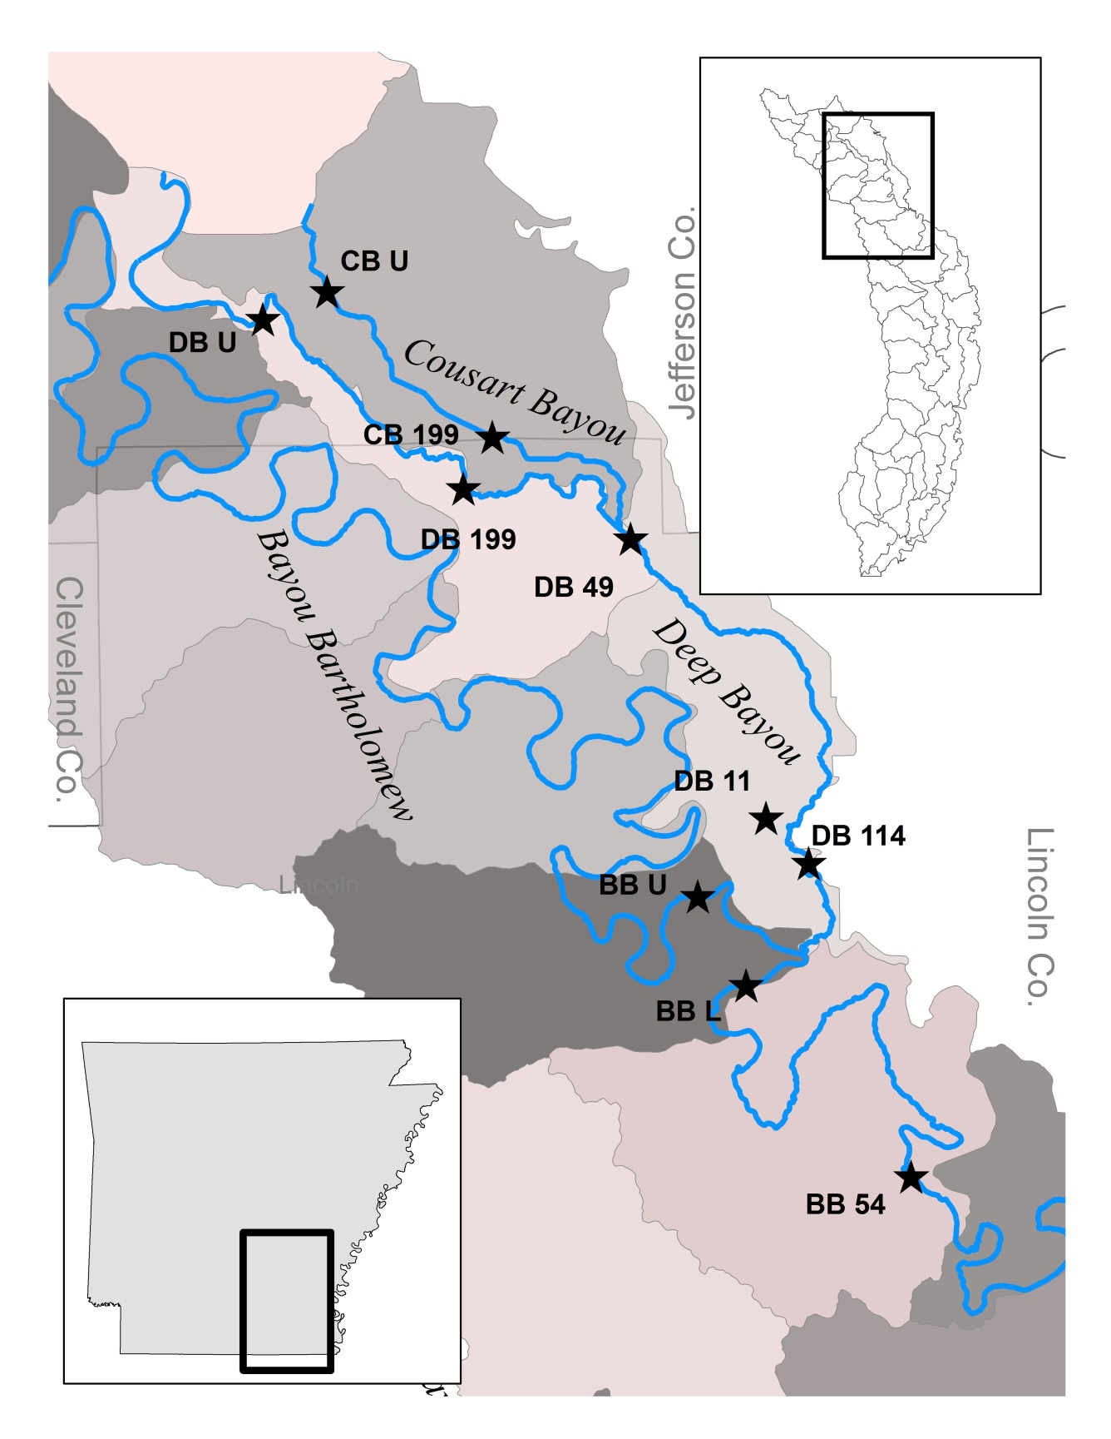
Bayou Bartholomew Watershed
Ten monitoring stations
Current Project Period
July 2013 – September 2017
Focusing on the Deep Bayou and Cousart Bayou Sub-watersheds
Currently in data collection phase
The Bayou Bartholomew was included on the Arkansas 2012 303(d) for not supporting
designated uses.
ANRC has designated the watershed as a priority watershed.
NRCS also identified the L'Anguille River as a priority in the
Mississippi River Basin Healthy Watershed Initiative.

Slide 24
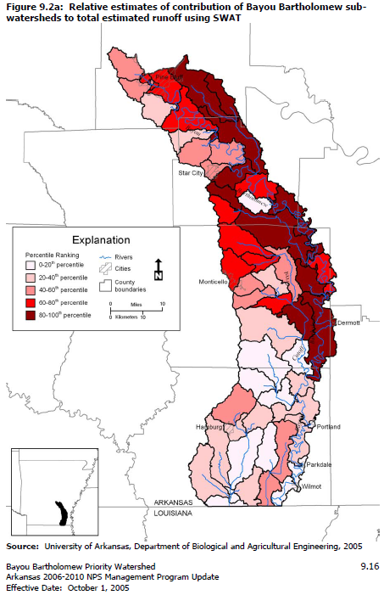
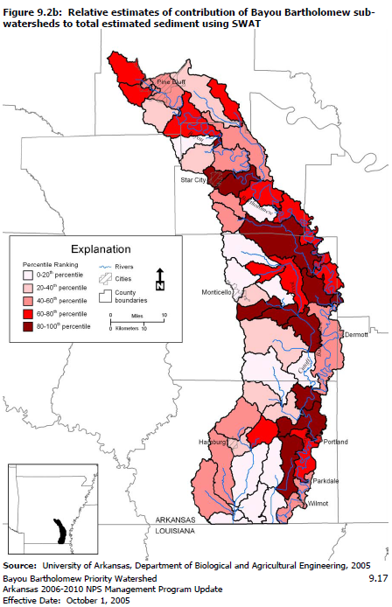

Slide 25
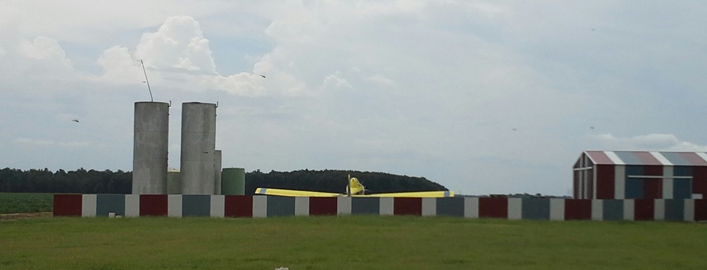
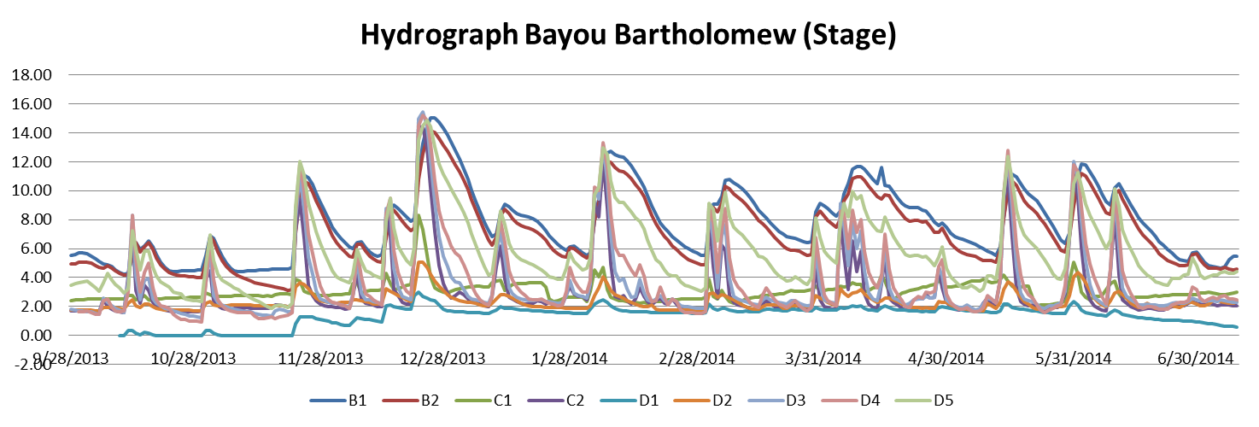

Slide 26
Bayou Bartholomew
Watershed
Mean Parameter Concentrations (MG/l)
 | B1 | B2 | B3 | C1 | C2 | D1 | D2 | D3 | D4 | D5
TP | 0.26 | 0.34 | 0.37 | 0.80 | 0.47 | 0.45 | 0.45 | 0.43 | 0.42 | 0.49
TKN | 0.94 | 1.17 | 1.12 | 1.89 | 1.41 | 1.41 | 1.34 | 1.34 | 1.29 | 1.39
Ammonia | 0.05 | 0.08 | 0.07 | 0.42 | 0.13 | 0.11 | 0.18 | 0.11 | 0.13 | 0.12
Turbidity (NTU) | 52.16 | 87.48 | 103.59 | 96.31 | 116.03 | 19.59 | 69.50 | 106.34 | 115.05 | 155.01
TSS | 26.29 | 48.06 | 45.54 | 54.56 | 60.51 | 9.67 | 38.00 | 57.74 | 53.40 | 79.26
NO₃-N | 4.21 | 4.11 | 4.11 | 2.89 | 7.23 | 0.94 | 1.28 | 8.73 | 5.59 | 5.00
Chloride | 5.33 | 8.03 | 8.40 | 4.98 | 24.46 | 2.57 | 5.32 | 18.95 | 18.35 | 17.71
Sulfate | 2.49 | 3.10 | 3.22 | 4.20 | 6.66 | 1.92 | 1.54 | 4.73 | 4.04 | 4.00

Slide 28
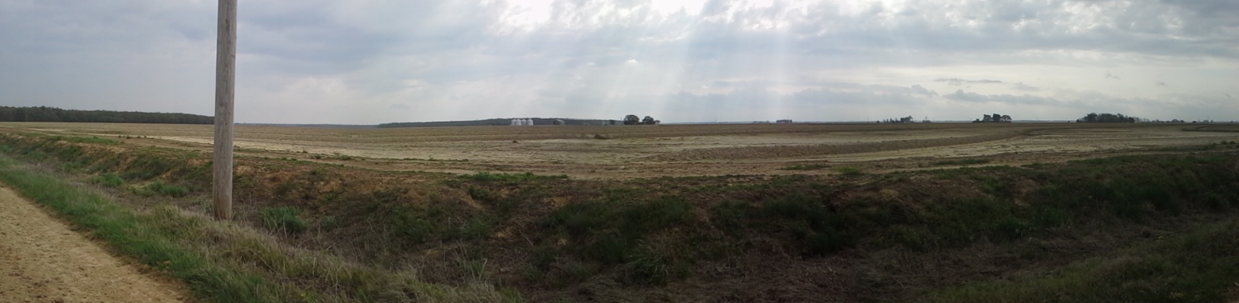
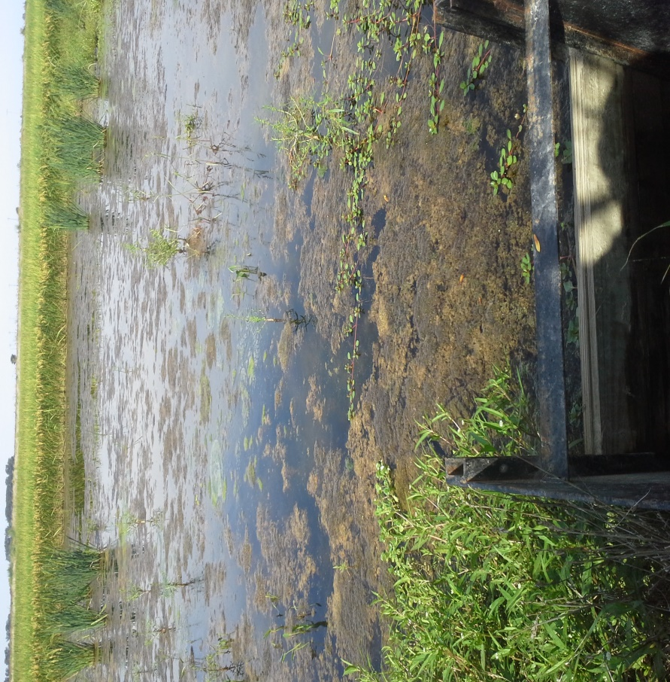
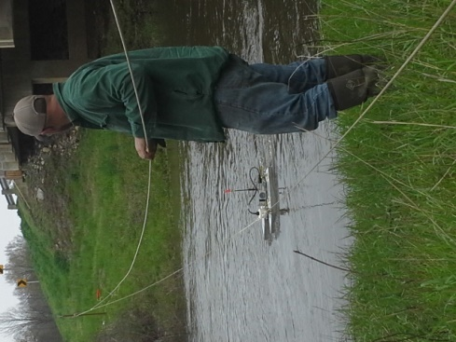

Slide 29
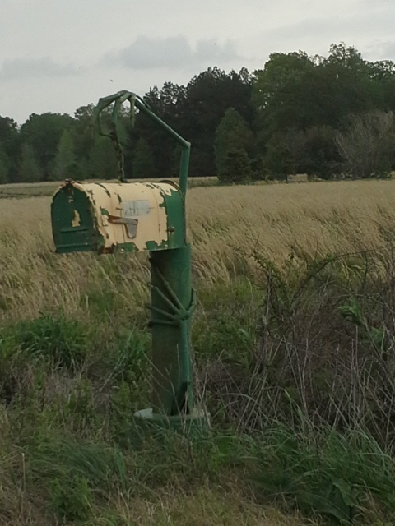
Project Difficulties
Harsh Winter
In Stream Activities
Unnatural Discharges
Equipment loss
Discharge Measurements
at 12 digit level

Slide 30
Questions?
?
Thank You
www.equilibrium-ar.org

