Slide 1


Cache River Monitoring
11-6000
Jennifer L. Bouldin, PhD
Ecotoxicology Research Facility
Arkansas State University

Slide 2
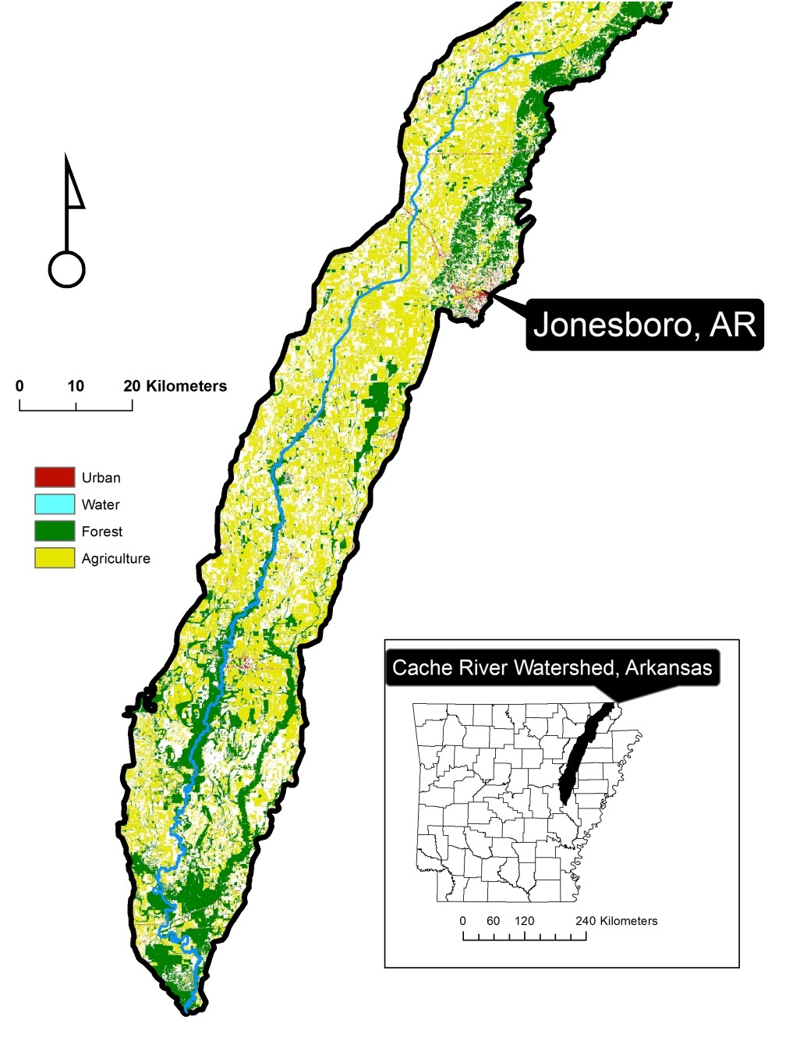
Cache River
Delta – bottomland hardwood forests
Agricultural land
2 main channels of watershed
Cache & Bayou DeView

Slide 3
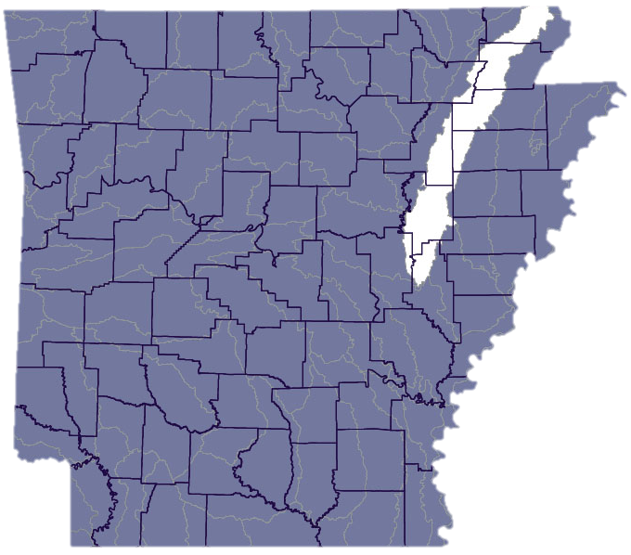
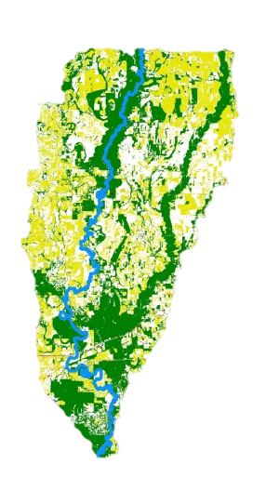
Cache River
95% of watershed in NE AR
Impairment turbidity, total dissolved solids, and lead.
  Agriculture activities the major source
Upper Cache highly channelized
Lower Cache not channelized
  Except for last 7 miles
Forms Big Woods connected to White River bottomland hardwood forests
arkansaswater.org

Slide 4
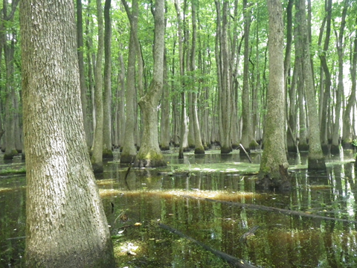
Ramsar Convention on Wetlands
  Intergovernmental treaty
  Wetlands of International Importance
Commitment to maintain
  Ecological character
  Sustainable use of all wetlands in their territories

Slide 5
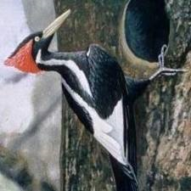
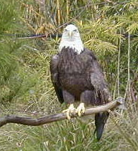
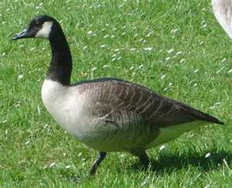
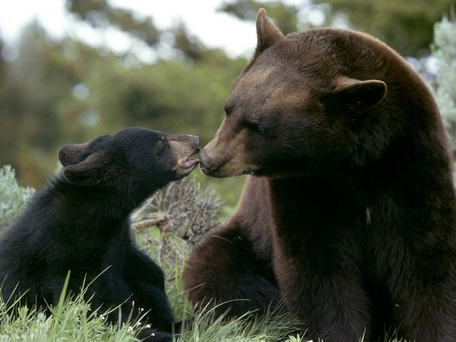
Wetland of International Importance
1989
Ramsar site 442

Slide 6
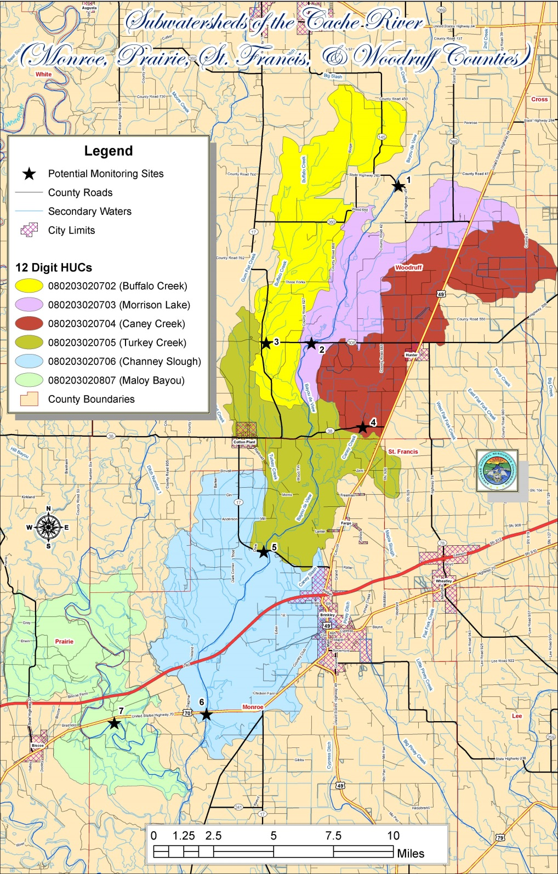
Sampling sites
1
Site 1 – upstream of target subwatersheds
Sites 2-6 – Bayou De View subwatersheds
Site 7 – Cache River main channel
3
2
4
5
7
6

Slide 7
Measured Parameters
pH
Dissolved Oxygen
Total Suspended Solids (TSS)
Turbidity
Dissolved Nitrate, Nitrite, Orthophosphate
Total Nitrogen, Total Phosphorus

Slide 8
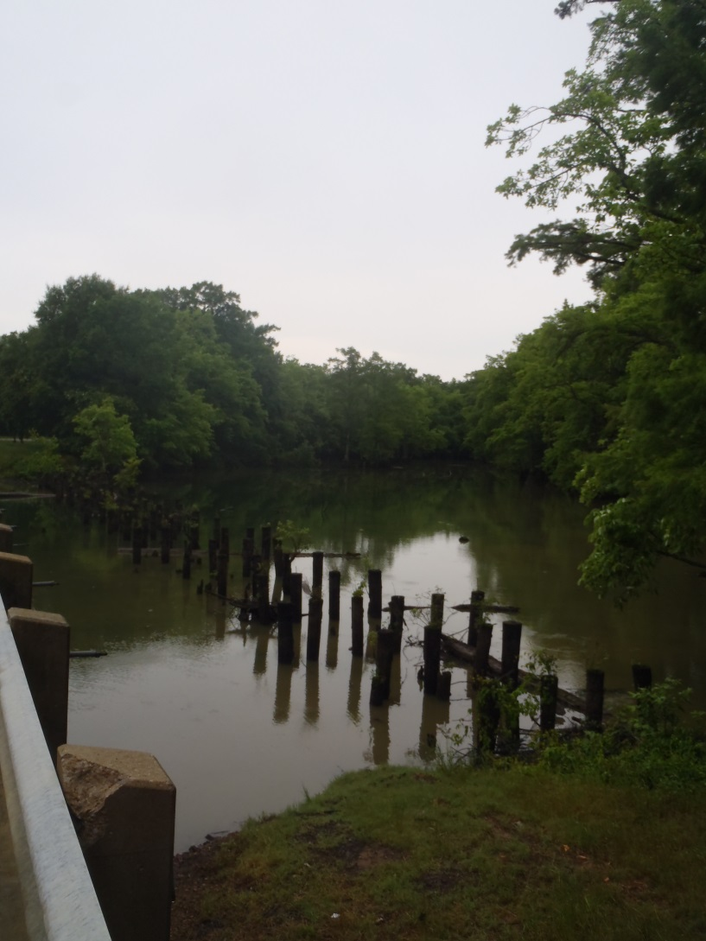
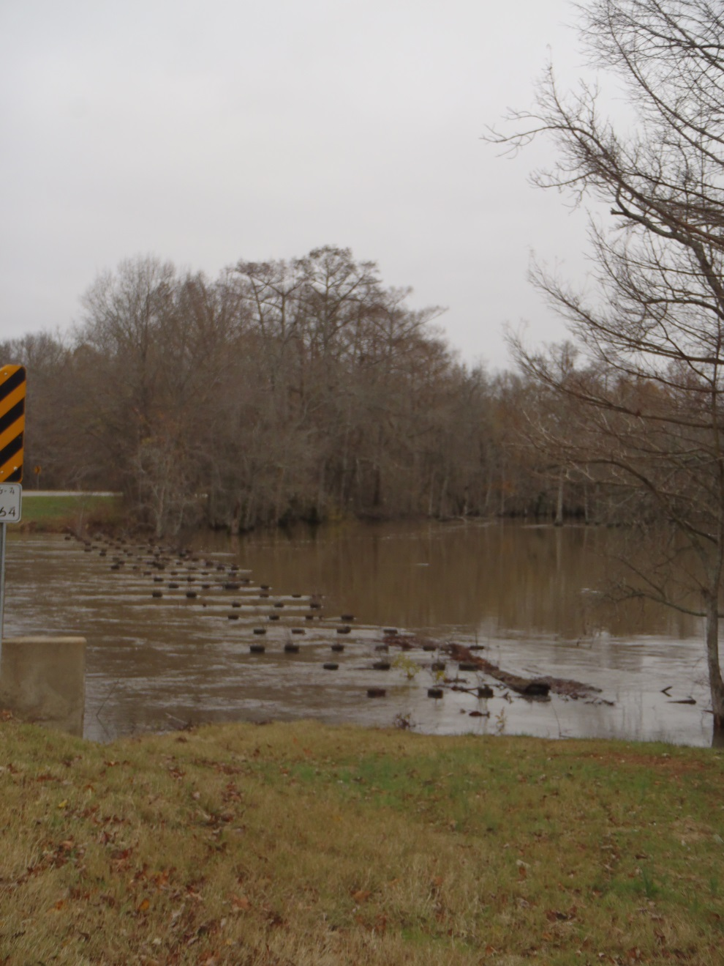

Site 1
Upper Cache River
1

Slide 9
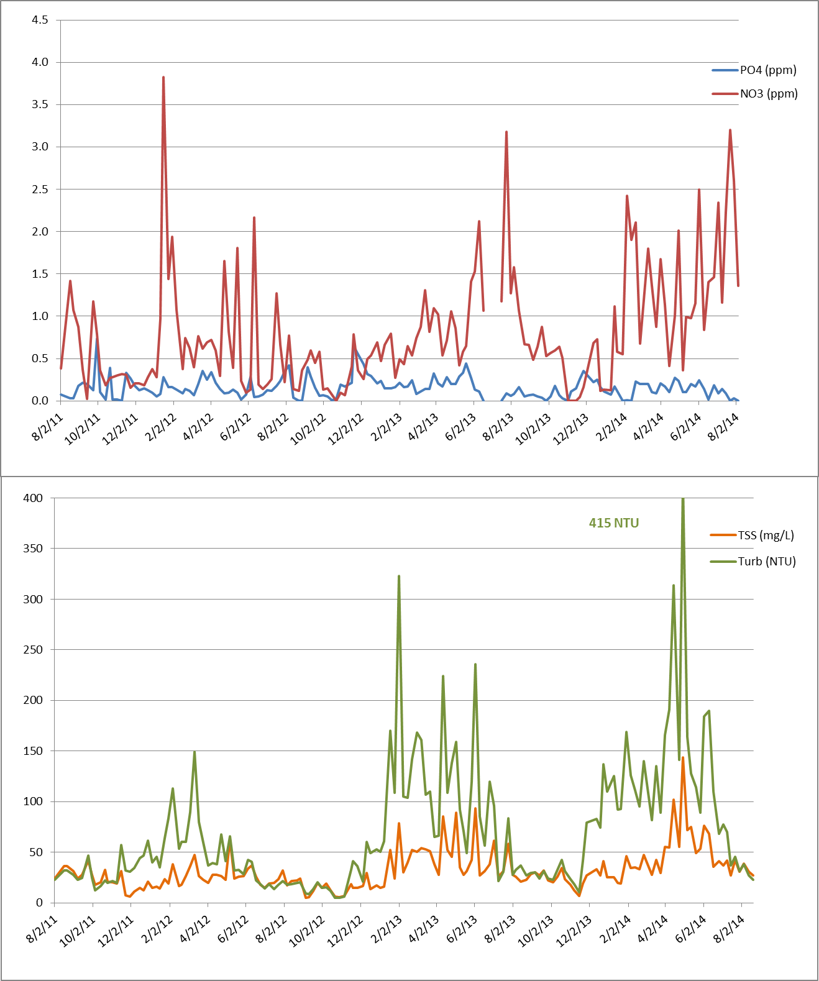

Site 1

Slide 10
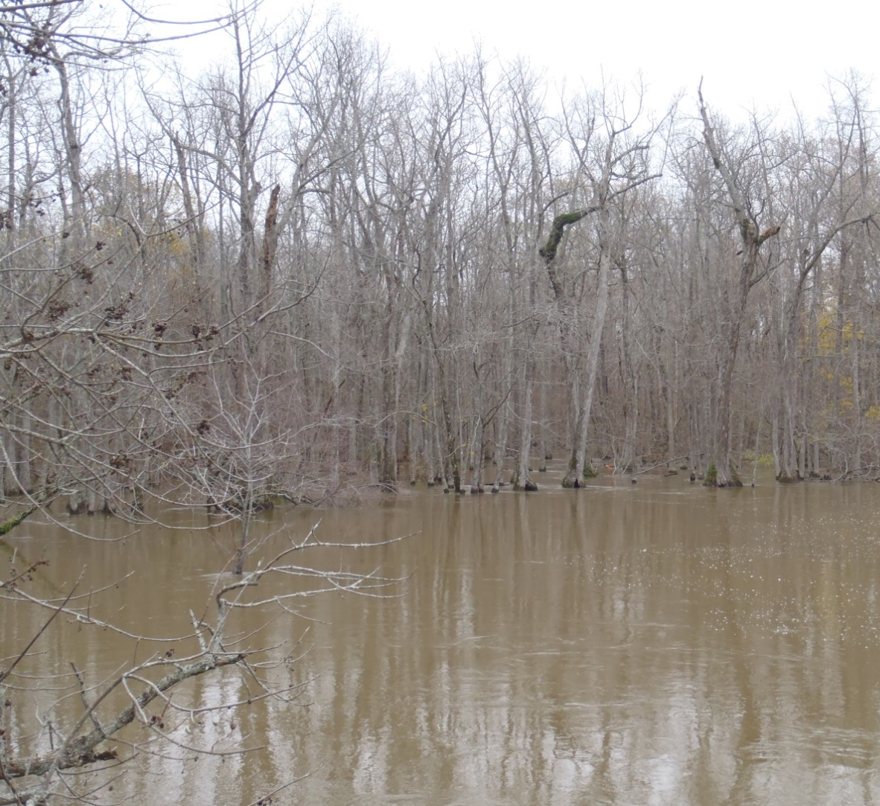
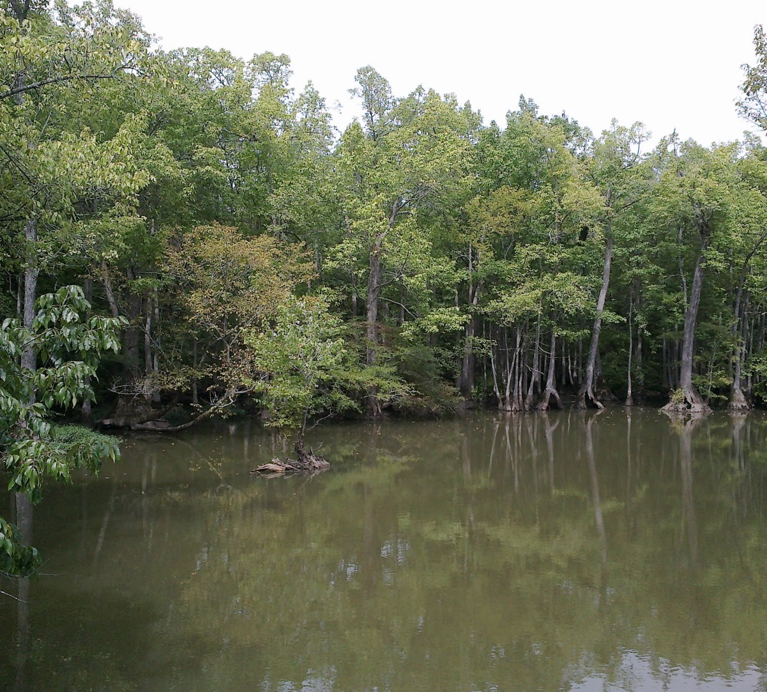
Site 2
Morrison Lake
2

Slide 11
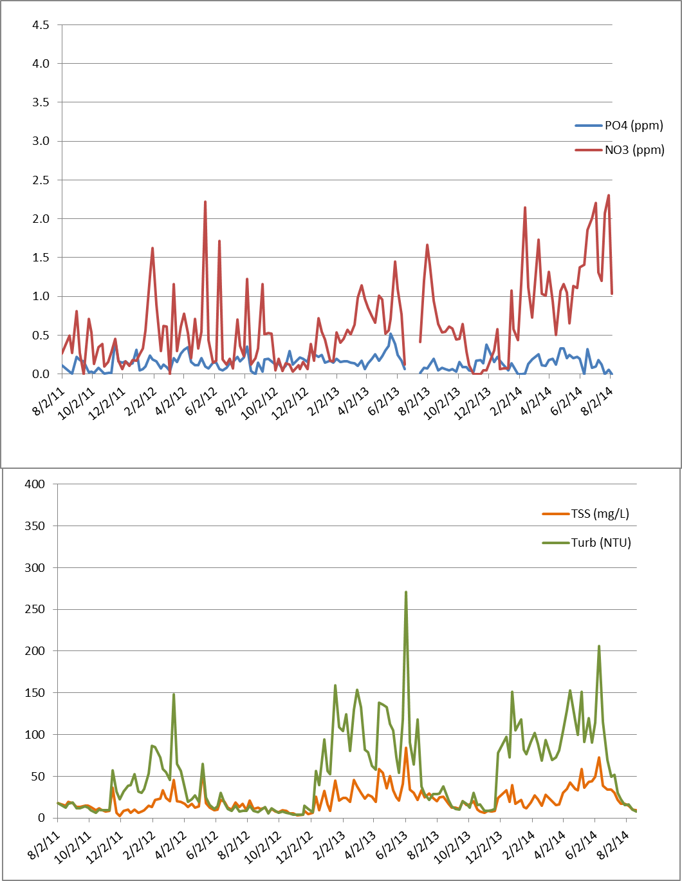
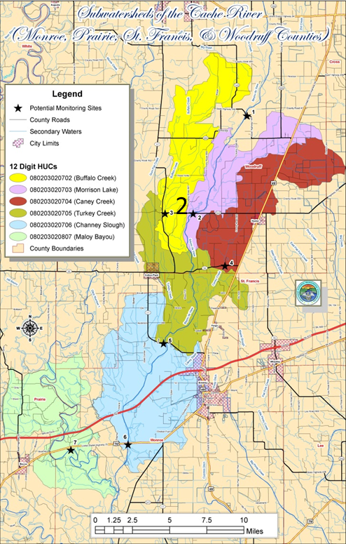
Site 2

Slide 12
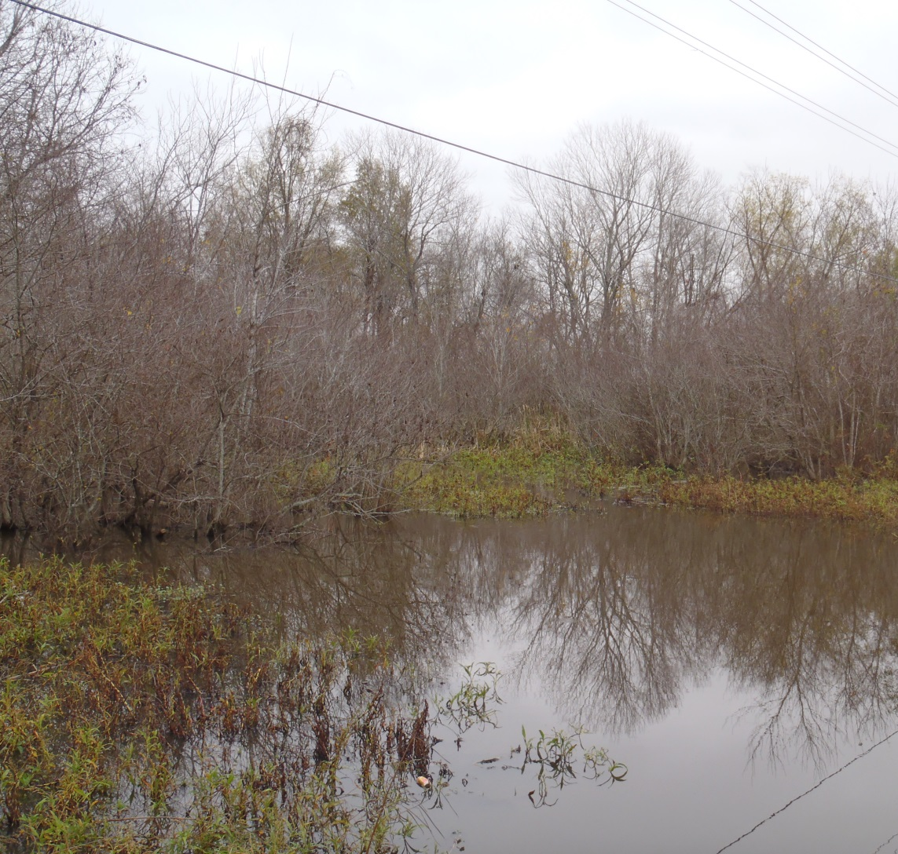
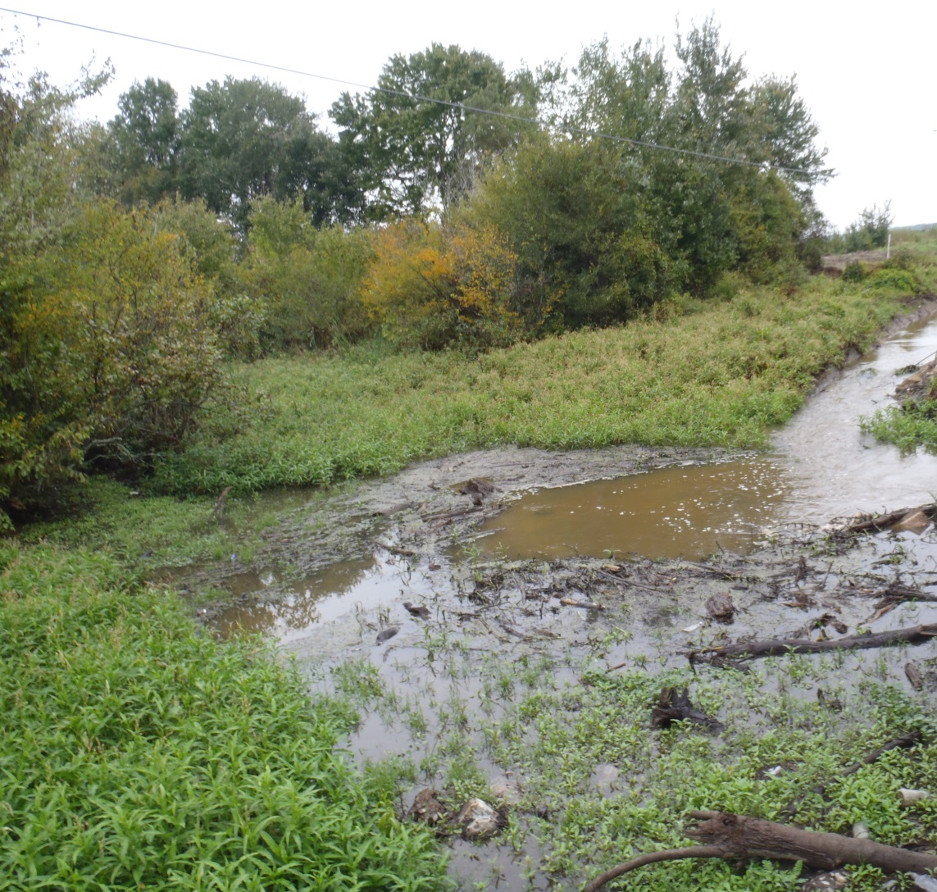
Site 3
Buffalo Creek
3

Slide 13
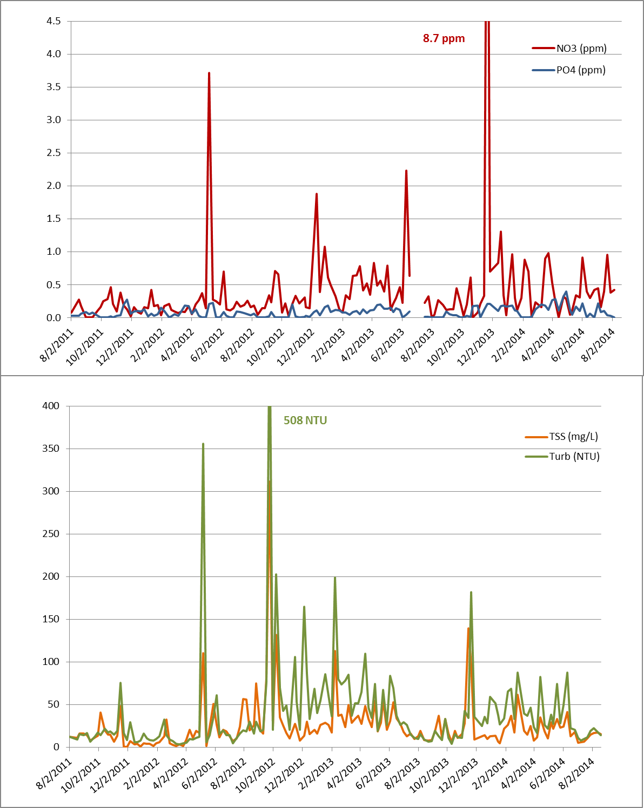
Site 3
3
3

Slide 14
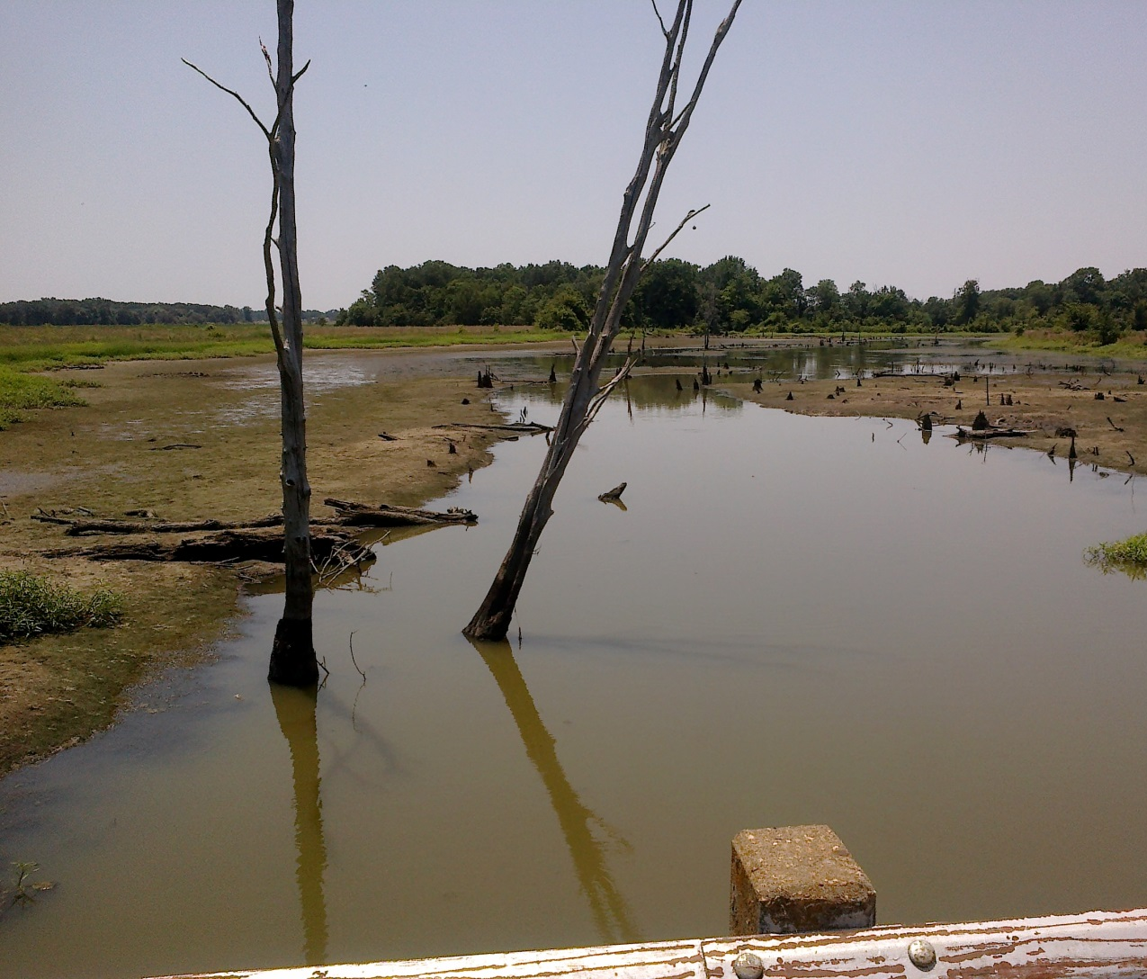
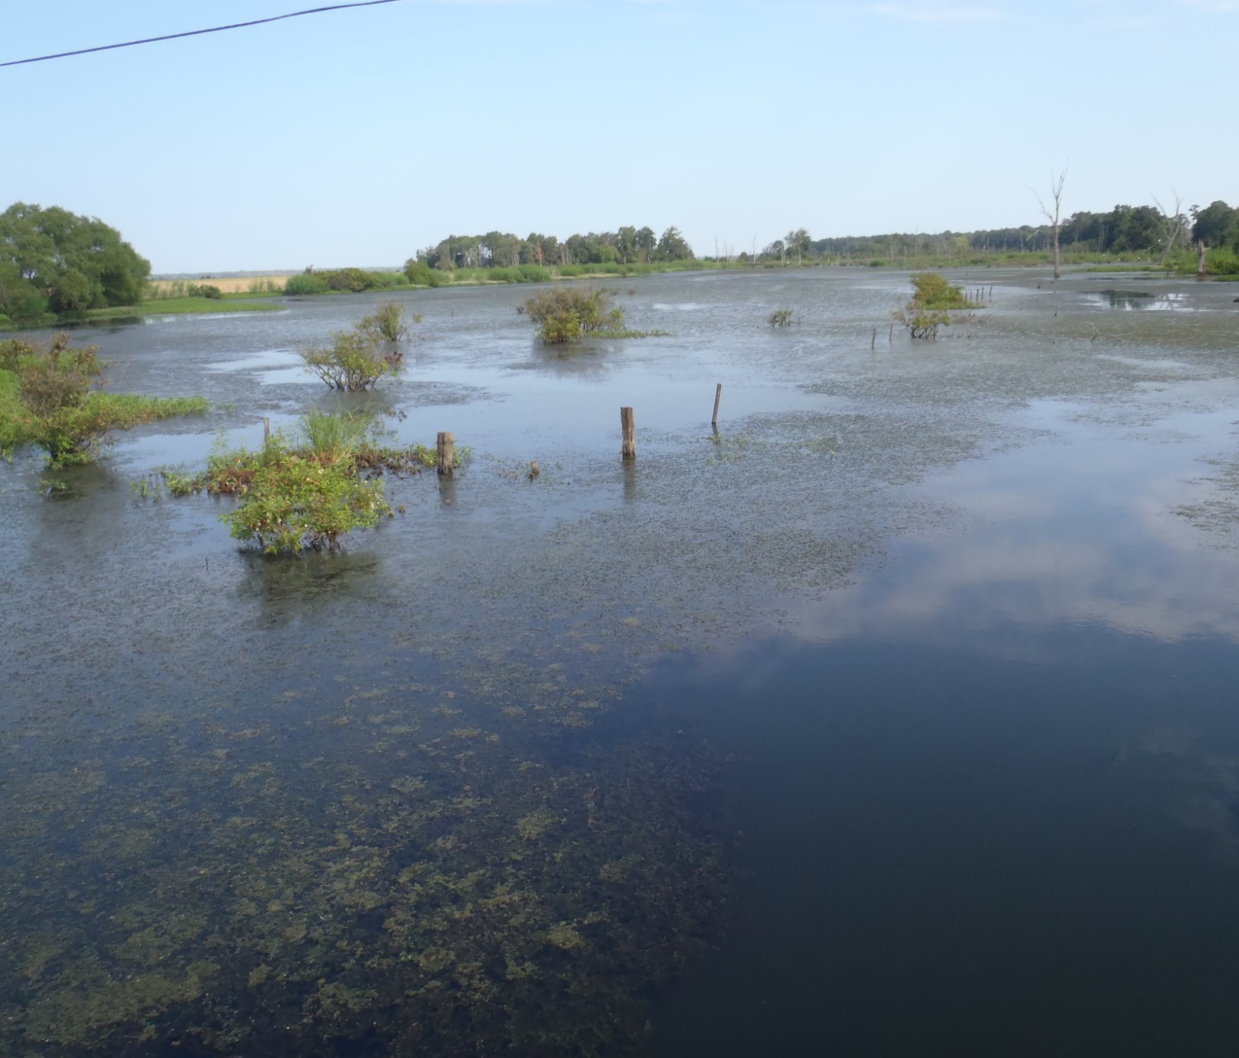
Site 4
Caney Creek
4

Slide 15
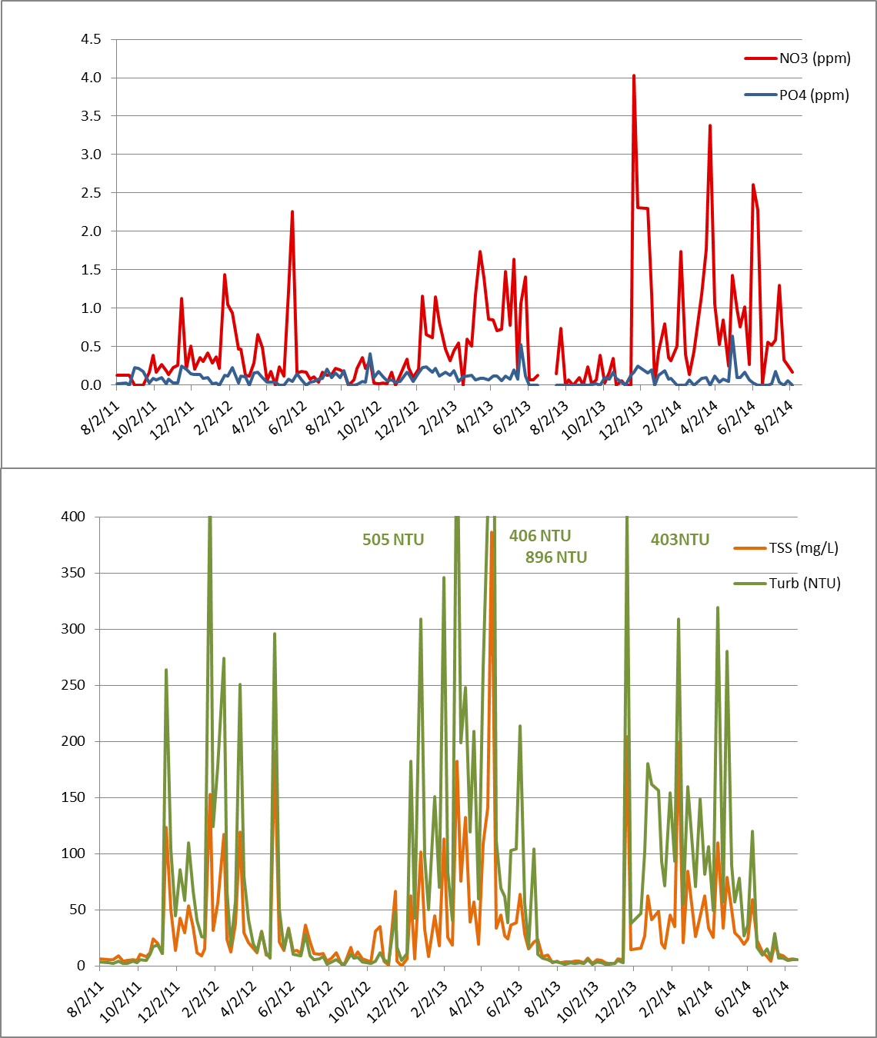
Site 4
4
4

Slide 16
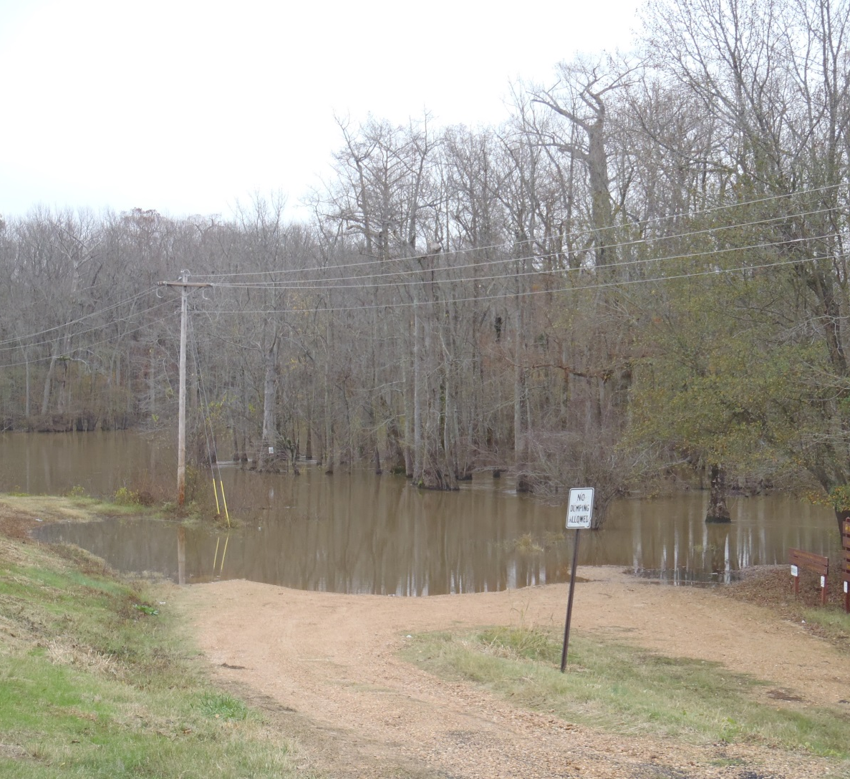
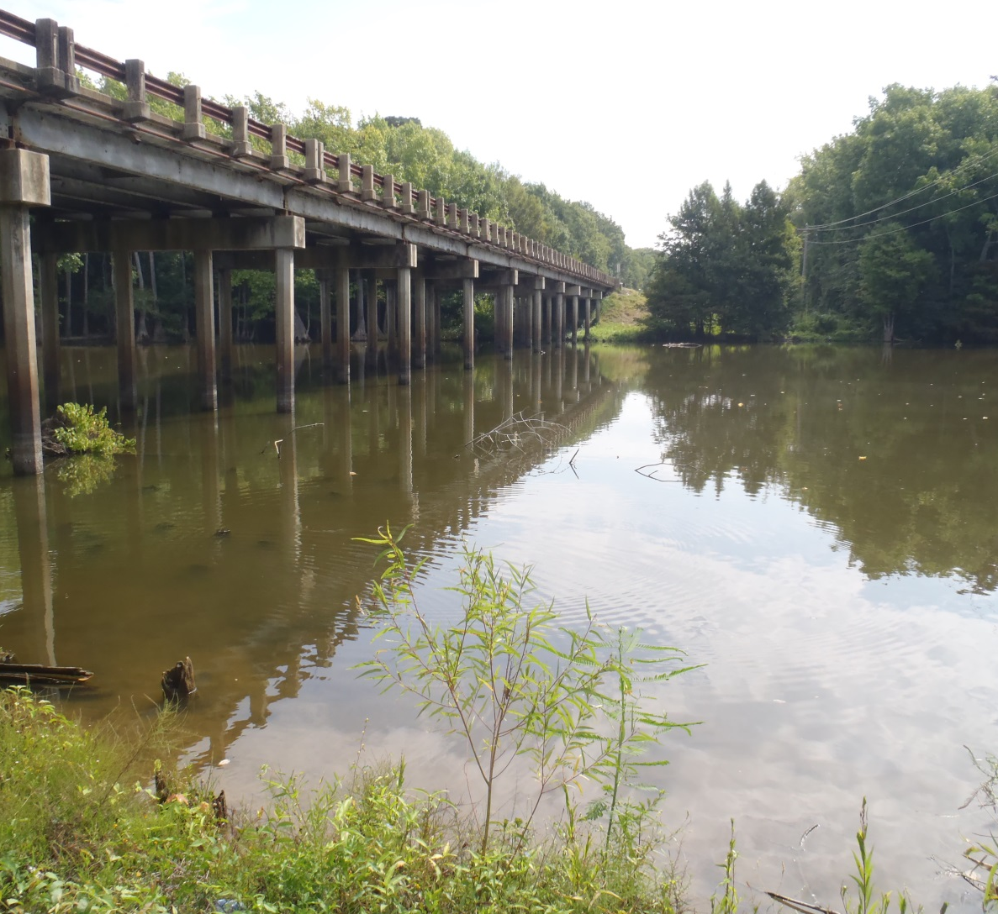
Site 5
Turkey Creek
5

Slide 17
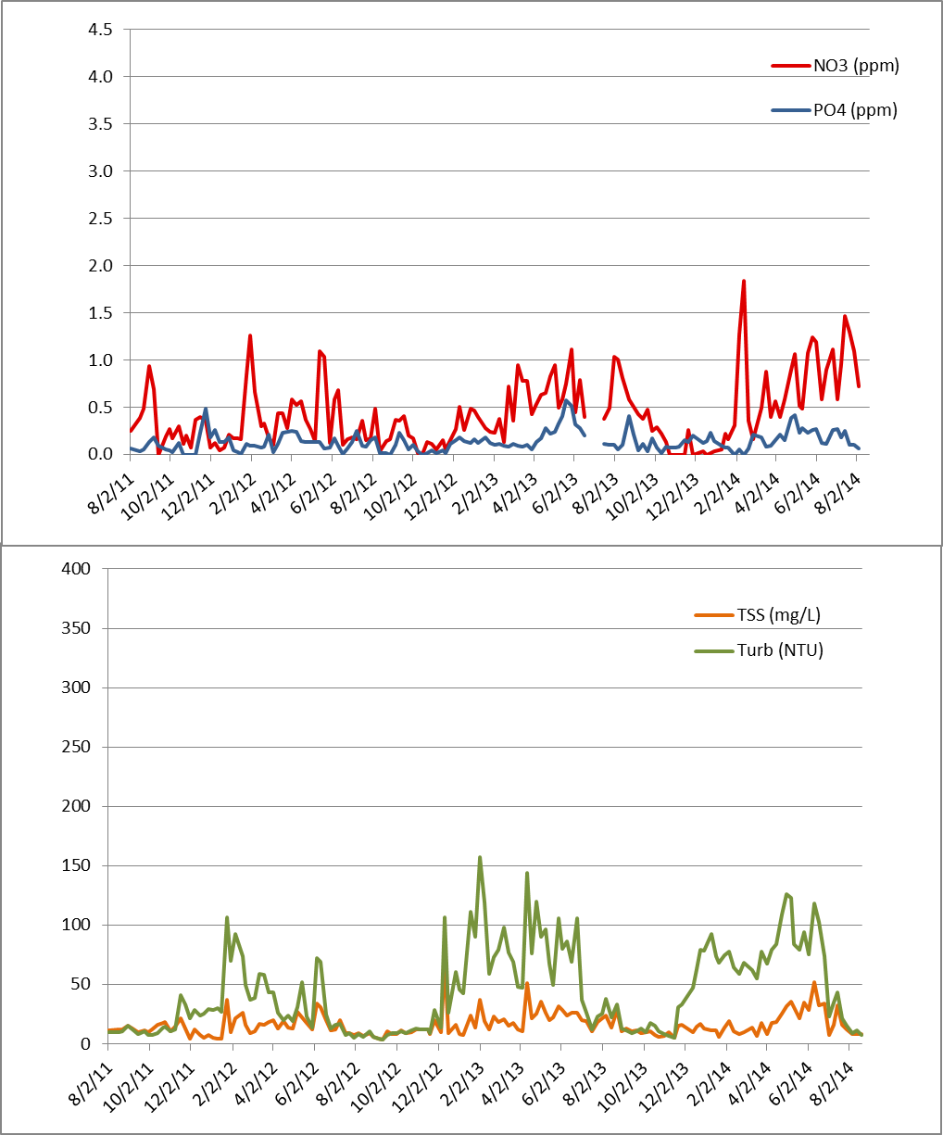
Site 5
5

Slide 18
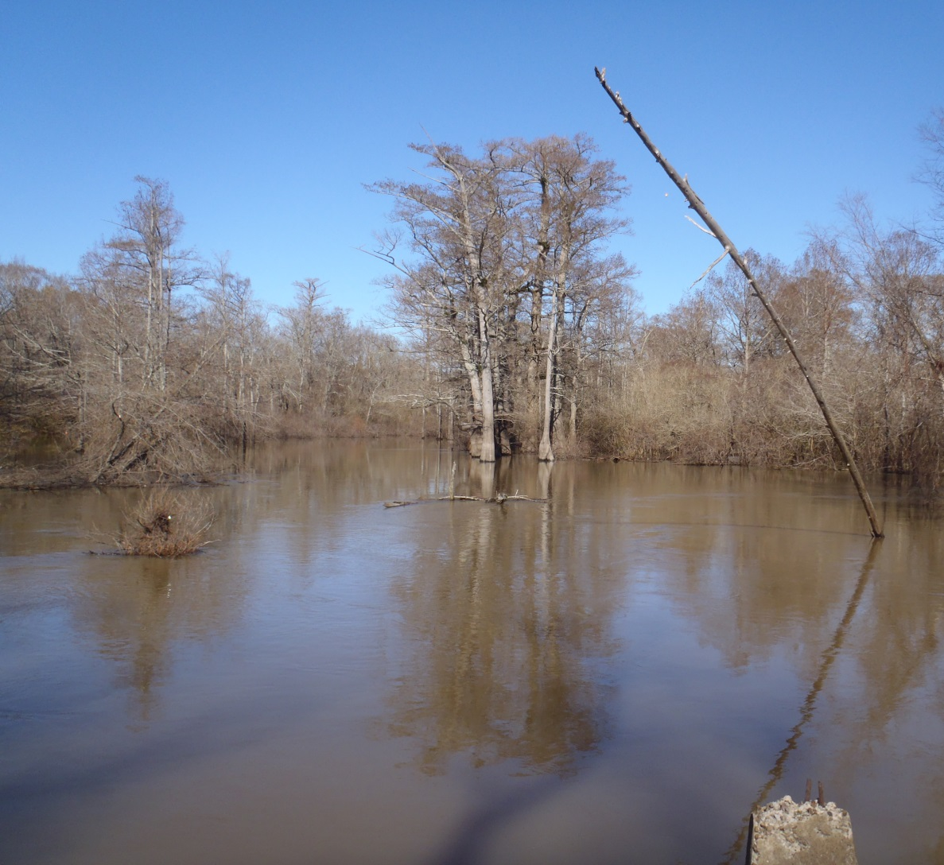
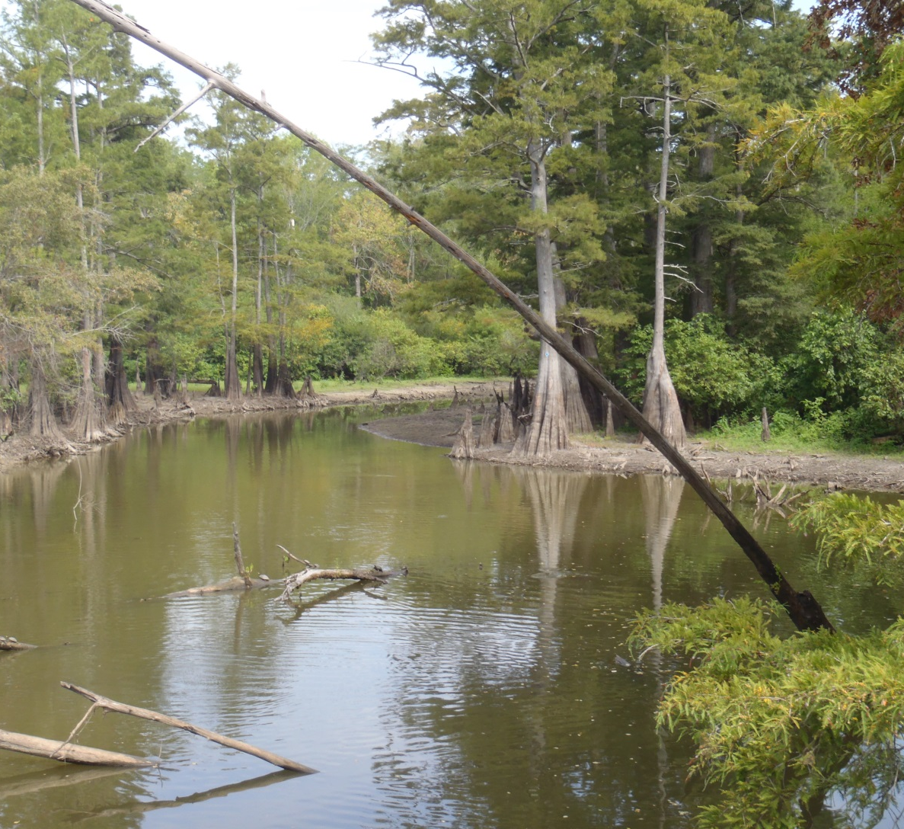
Site 6
Channey Slough
6

Slide 19
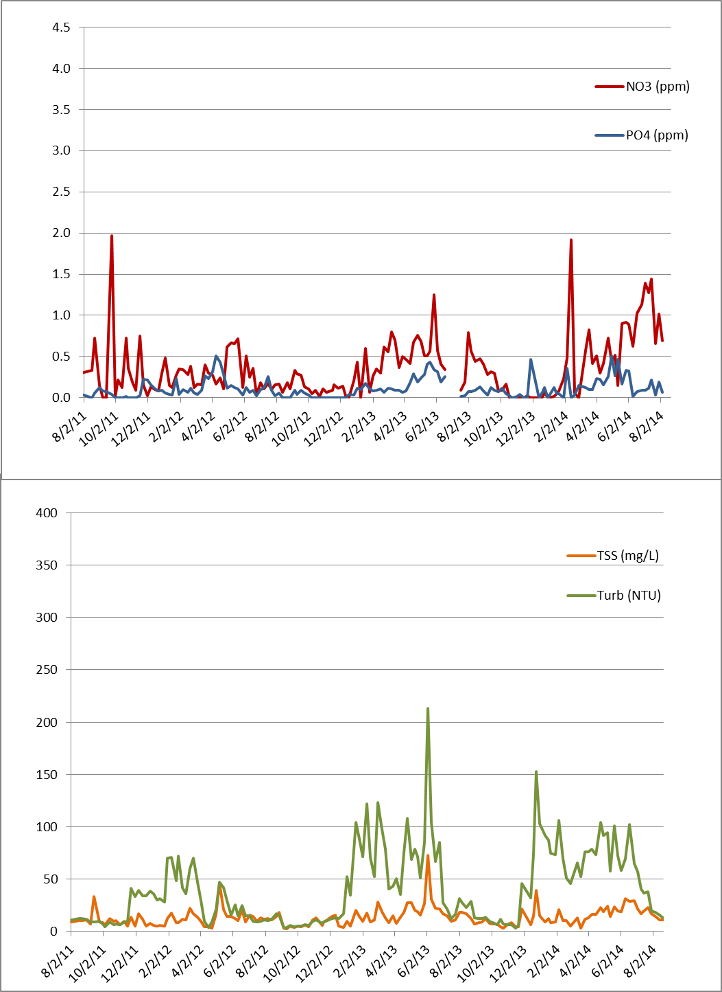
Site 6
6
6

Slide 20
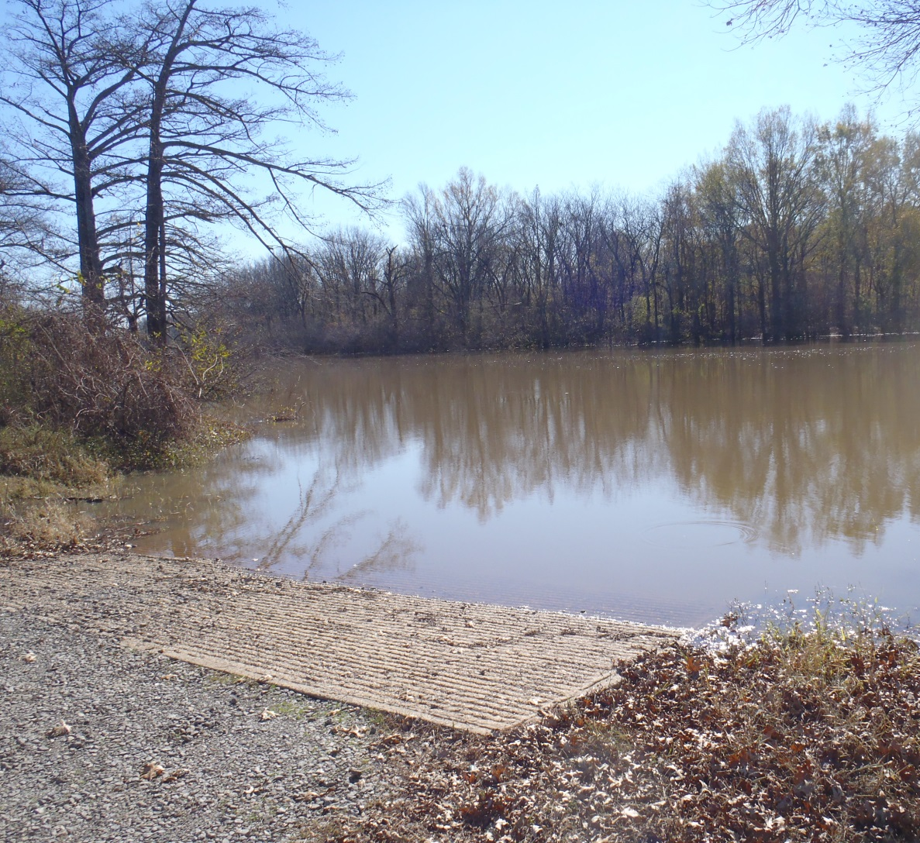
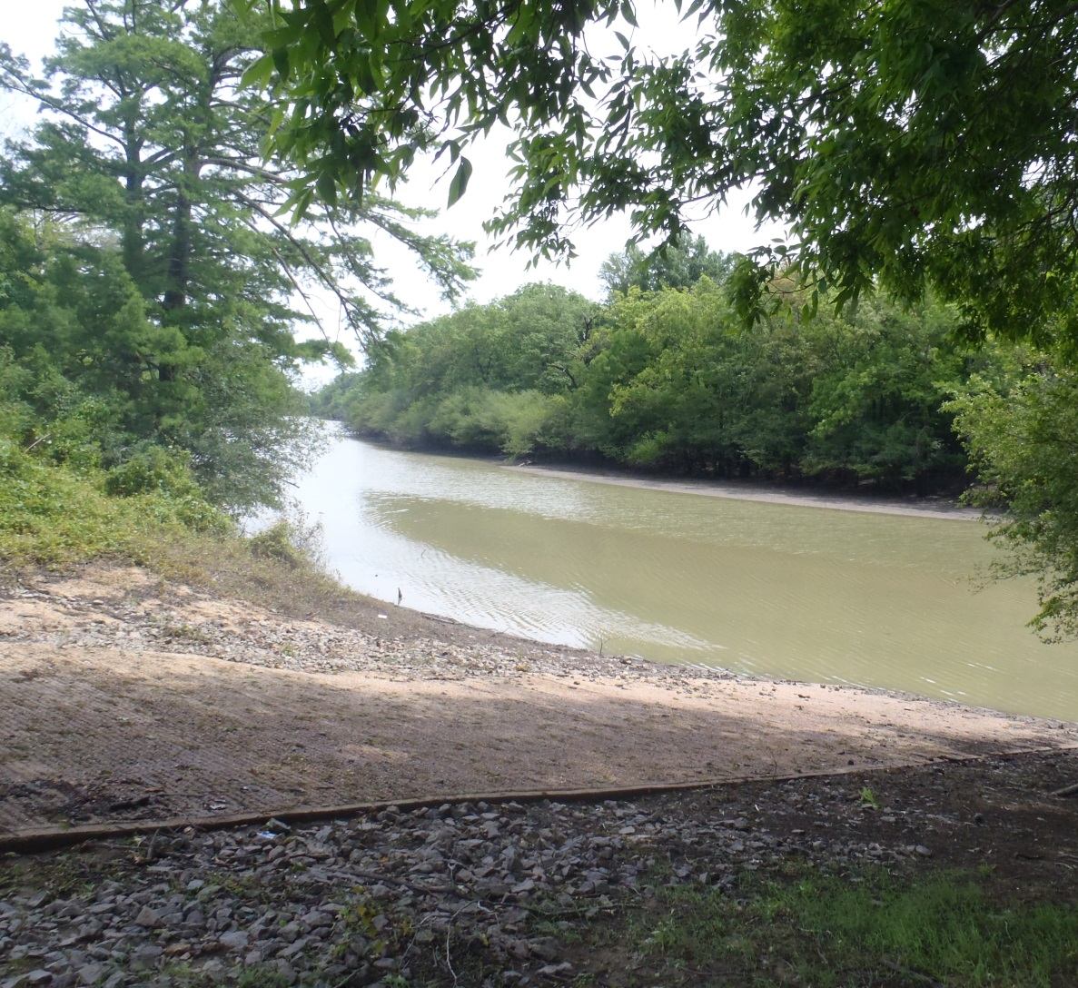
Site 7
Cache River
7

Slide 21
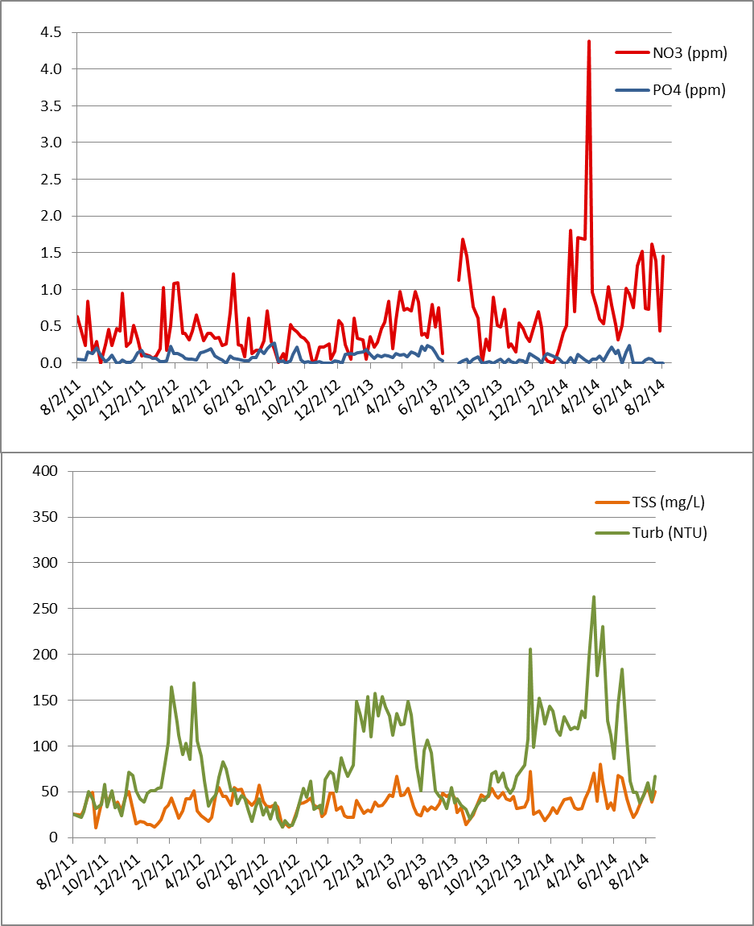
Site 7
7

Slide 22
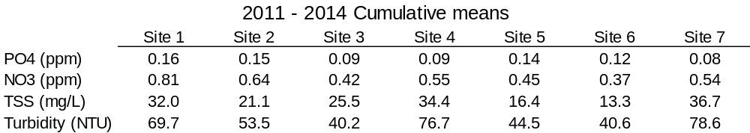

Bayou De View main channel:
Sites 1, 2, 5 & 6
Sampling ended August 2014
Separate rain and baseflow events for interpretation

Slide 23
Results
Nutrient spikes following applications and
rainfall events
Trend of lower sediment and nutrient values at
downstream sites
  Bayou De View channels
  Benefit from wetlands and natural meanders
Established wetlands should reduce nutrient and sediment loading
  Drought year (2012) and wet years (2013 & 2014)

Slide 24
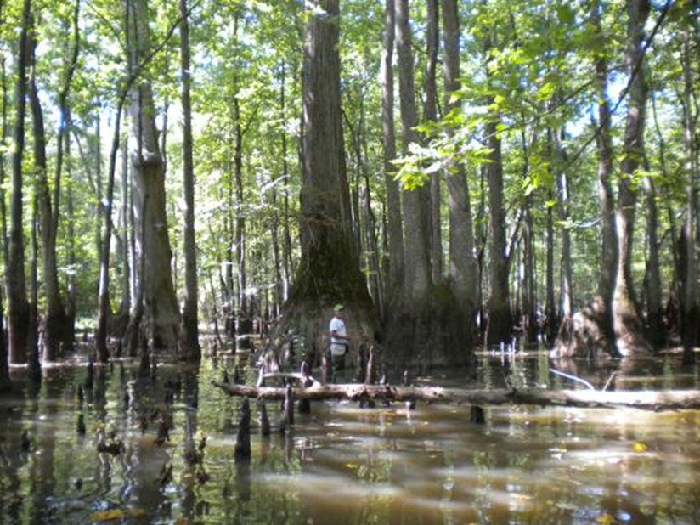
Questions?
Thanks to ANRC, Carlos Rosado-Berrios, students
and technicians at Ecotox

