Slide 1
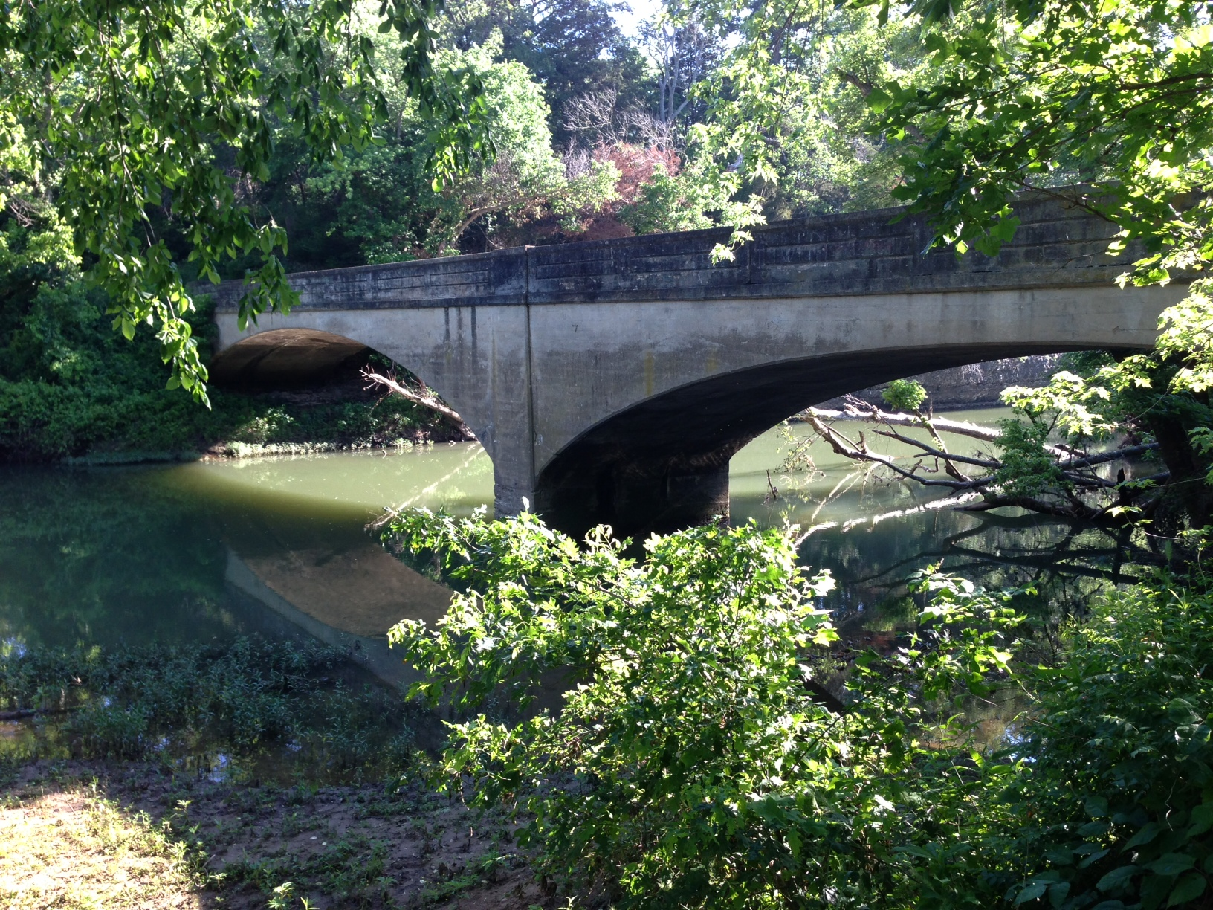


Water Quality Monitoring in the Upper Illinois River Watershed and Upper White River Basin
Project 11-500
UA Division of Agriculture Arkansas Water Resources Center

Slide 2
Project Team
Project Director – Dr. Brian Haggard
Project Manager – Erin Scott
Team Leads
  NWA monitoring –Morgan Welch
  Pathogen Sampling – Brina Smith
  D.O. Sampling – Eric Cummings

Slide 3
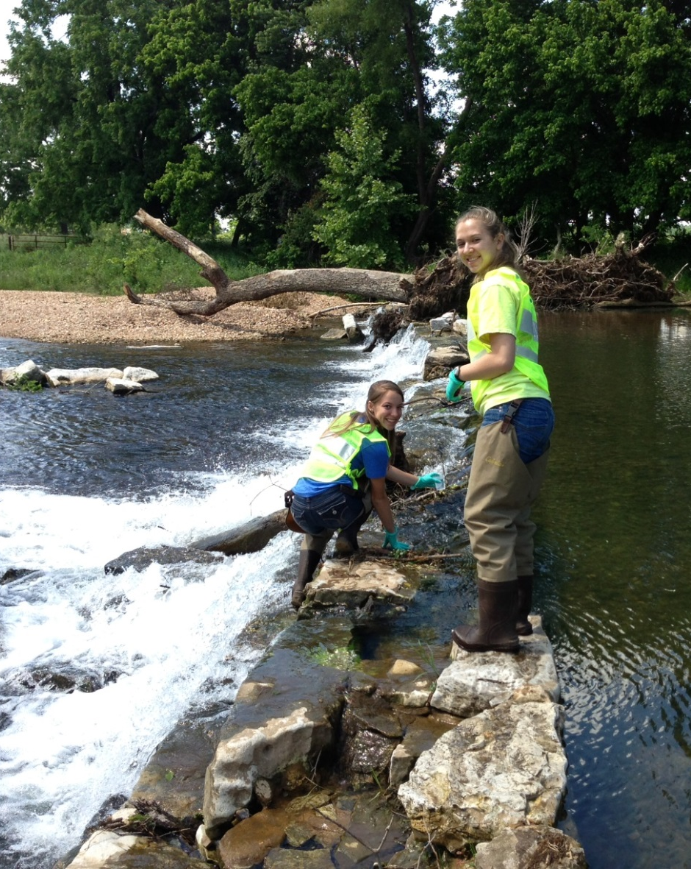
What is the purpose of project 11-500?
Quality of water in the Illinois River Watershed and Upper White River Basin.
  Flow in to neighboring states
  Focus of trans-boundary WQ issues
  319 priority catchment
Illinois River Watershed
  Streams listed impaired on 303(d)
    Nutrient, sediment, pathogens
Upper White River Basin
  Primary drinking source
  Some streams & Beaver Lake listed on 303(d)
    Sediment & Dissolved Oxygen

Slide 4
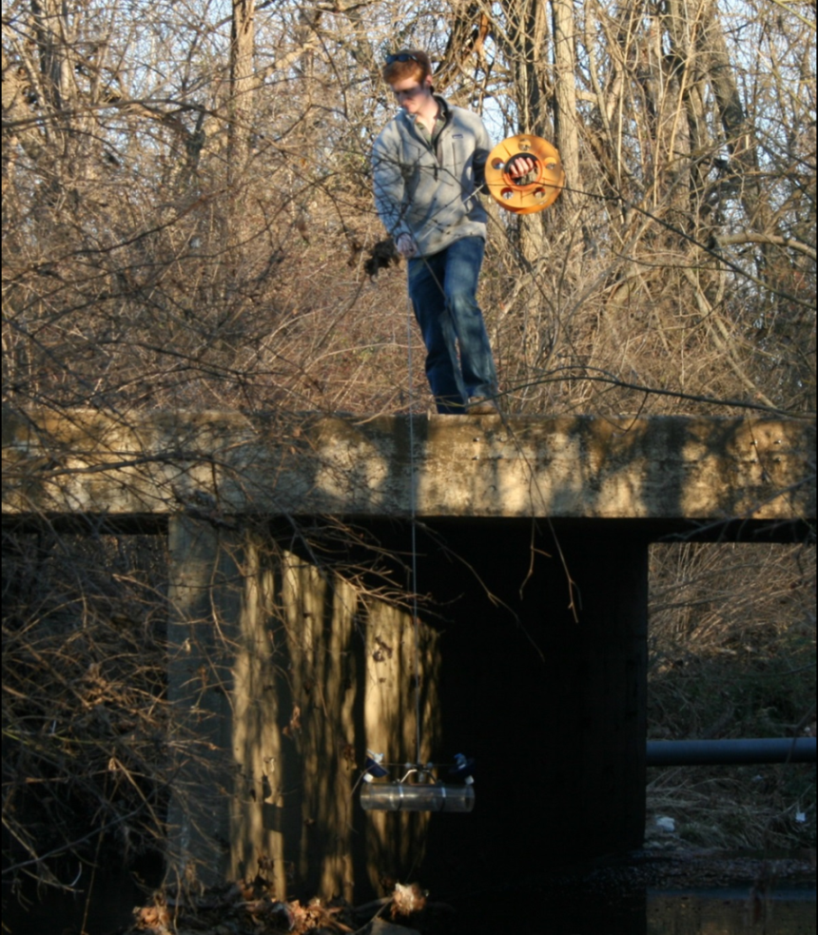
Water Quality Samples in the Upper Illinois River Watershed and Upper White River Basin
Sampling multiple sites in the 2 watersheds will help determine outcome from 319 funded projects
  Looking at concentrations and loads
Collect an average of 46 samples/year for base and storm flow conditions from 19 sites
Captured using alpha sampler in VCF
Constituents analyzed at AWRC include:
Total Nitrogen
Nitrate
Total Phosphorus
Phosphate
Total Suspended Solids

Slide 5
Water Quality Samples in the Upper Illinois River Watershed and Upper White River Basin

Slide 6
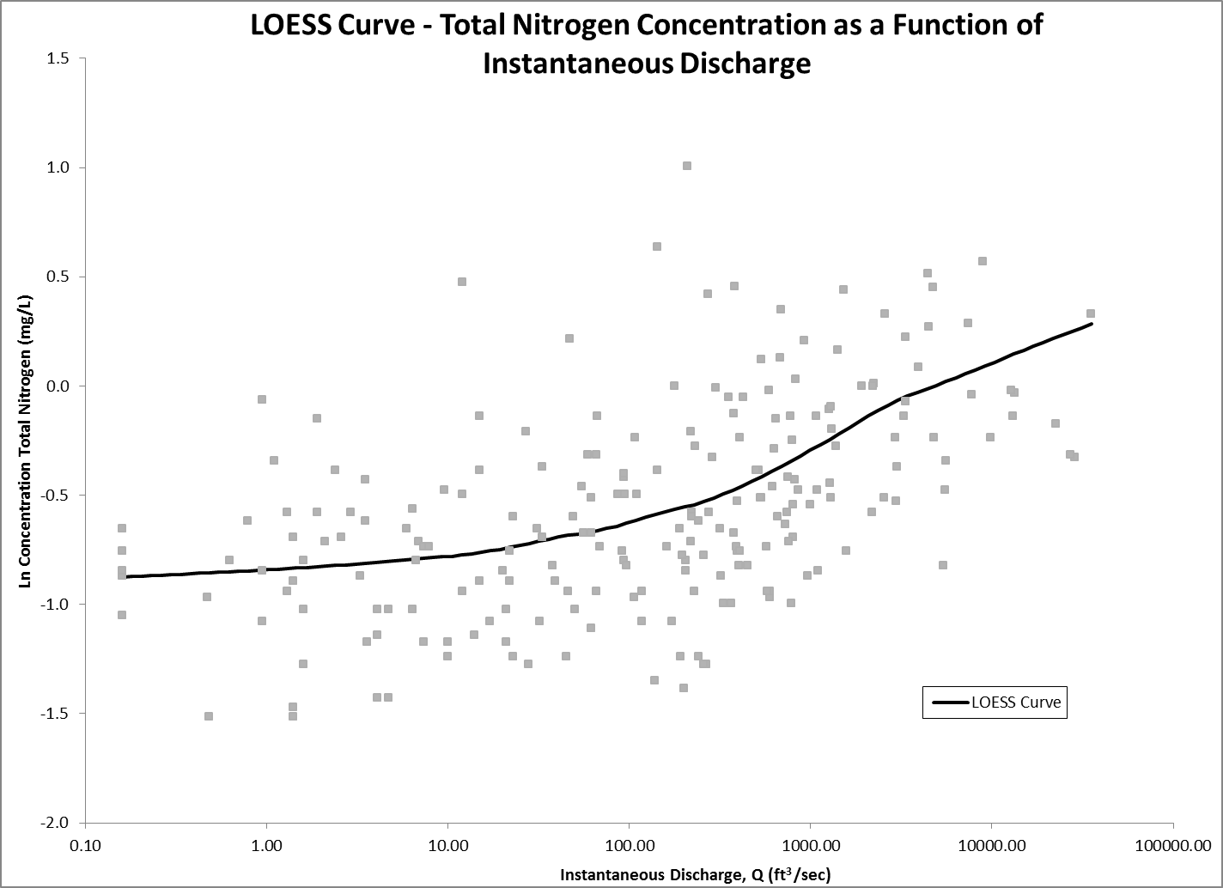
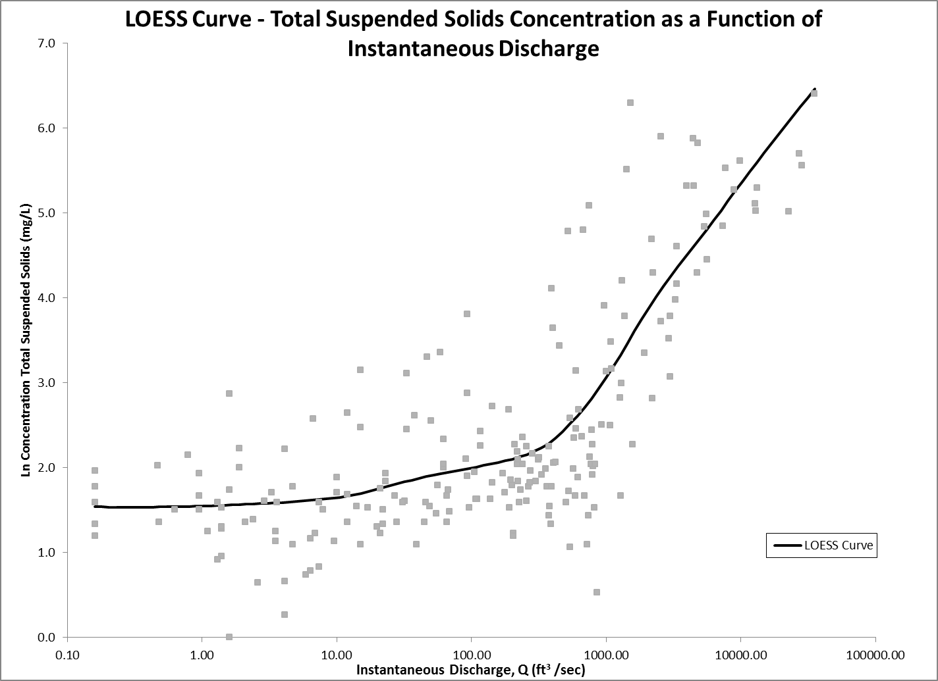
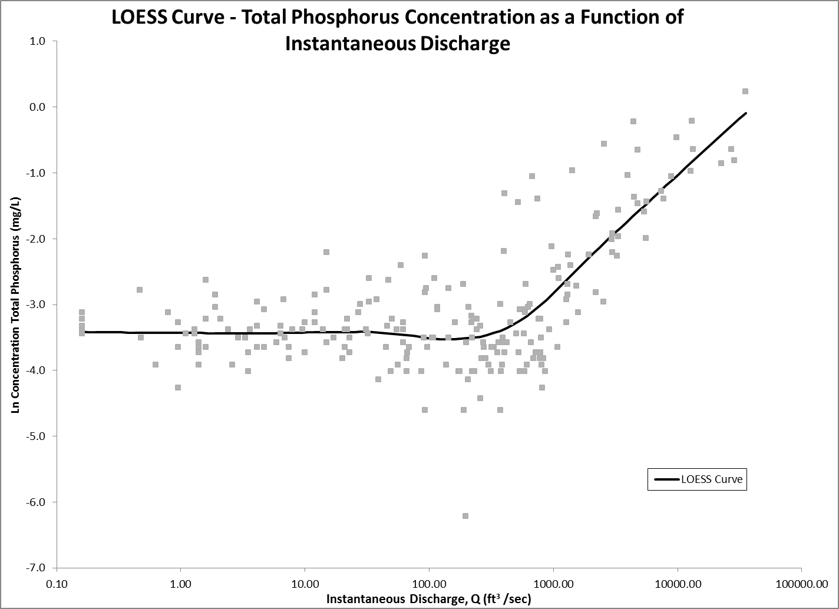
Water Quality Samples
Log-log transformations
  Minimize outlier influence
Relationship between concentration and discharge
LOESS regression (sigmaplot)
  a two dimensional smoothing technique

Slide 7
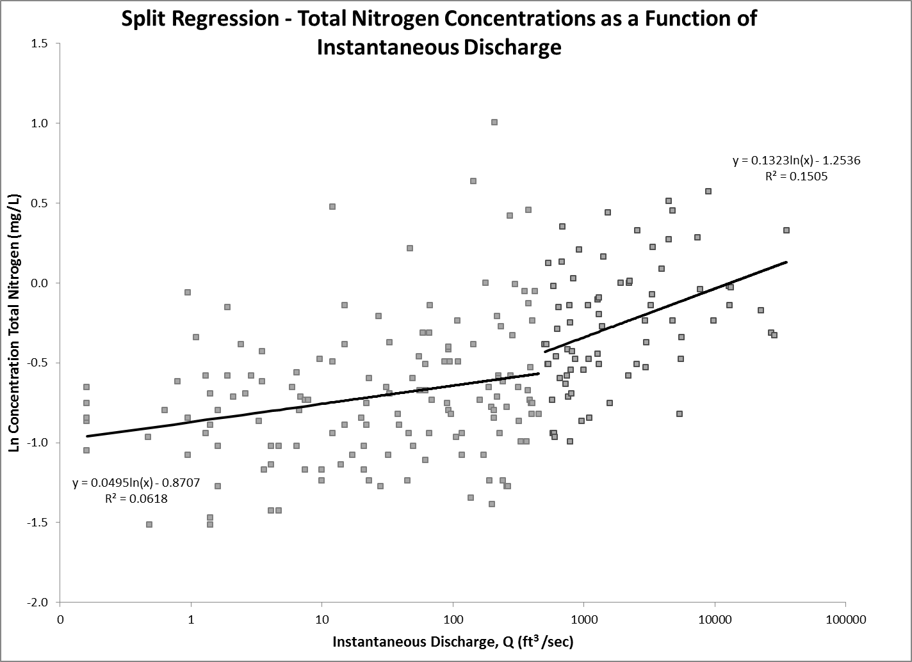
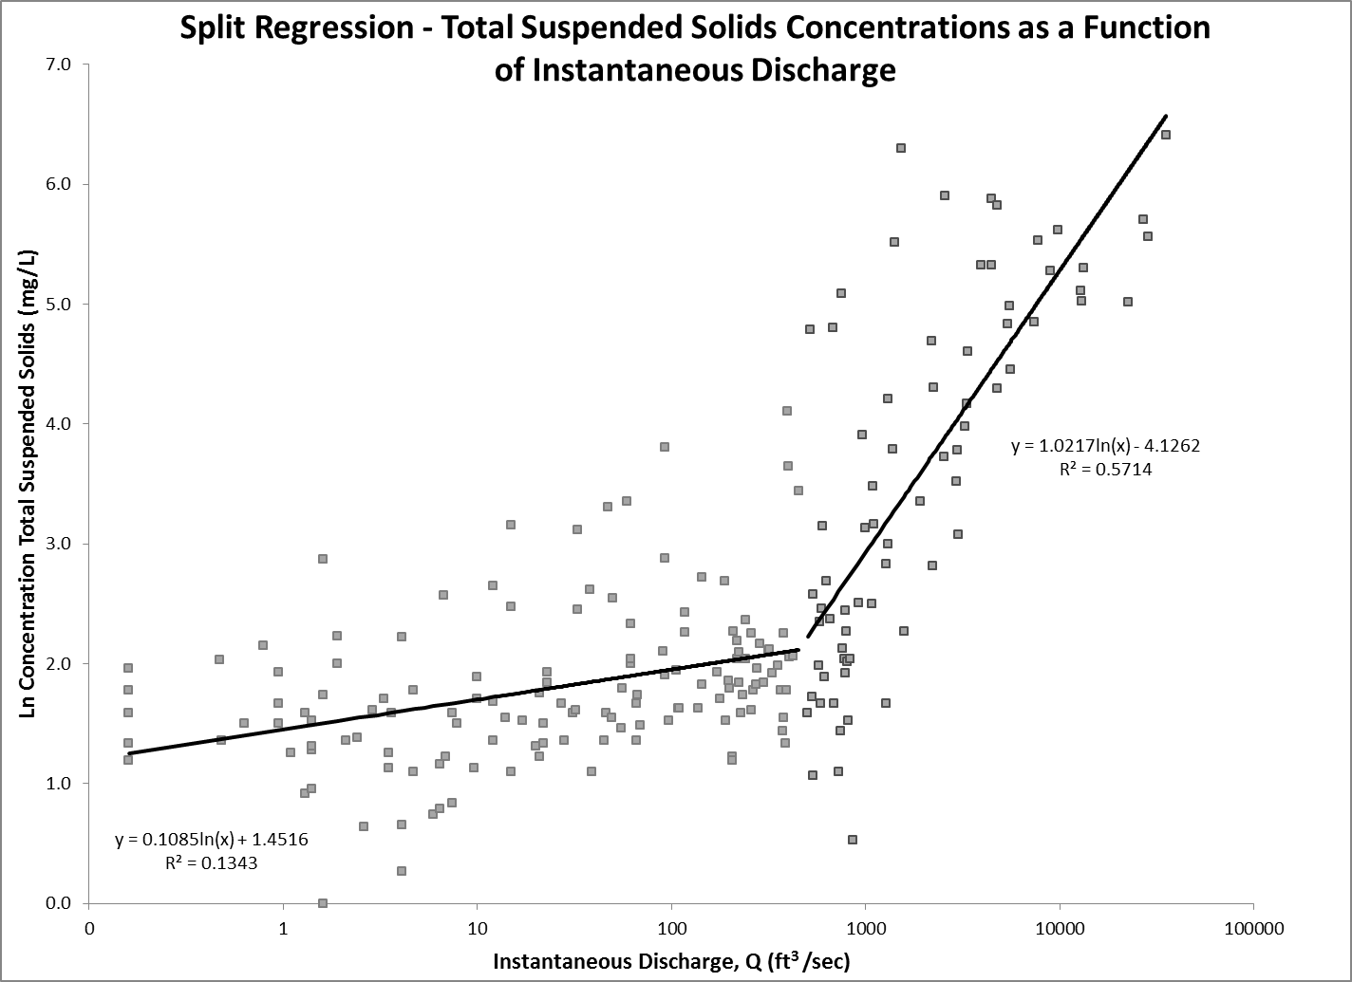
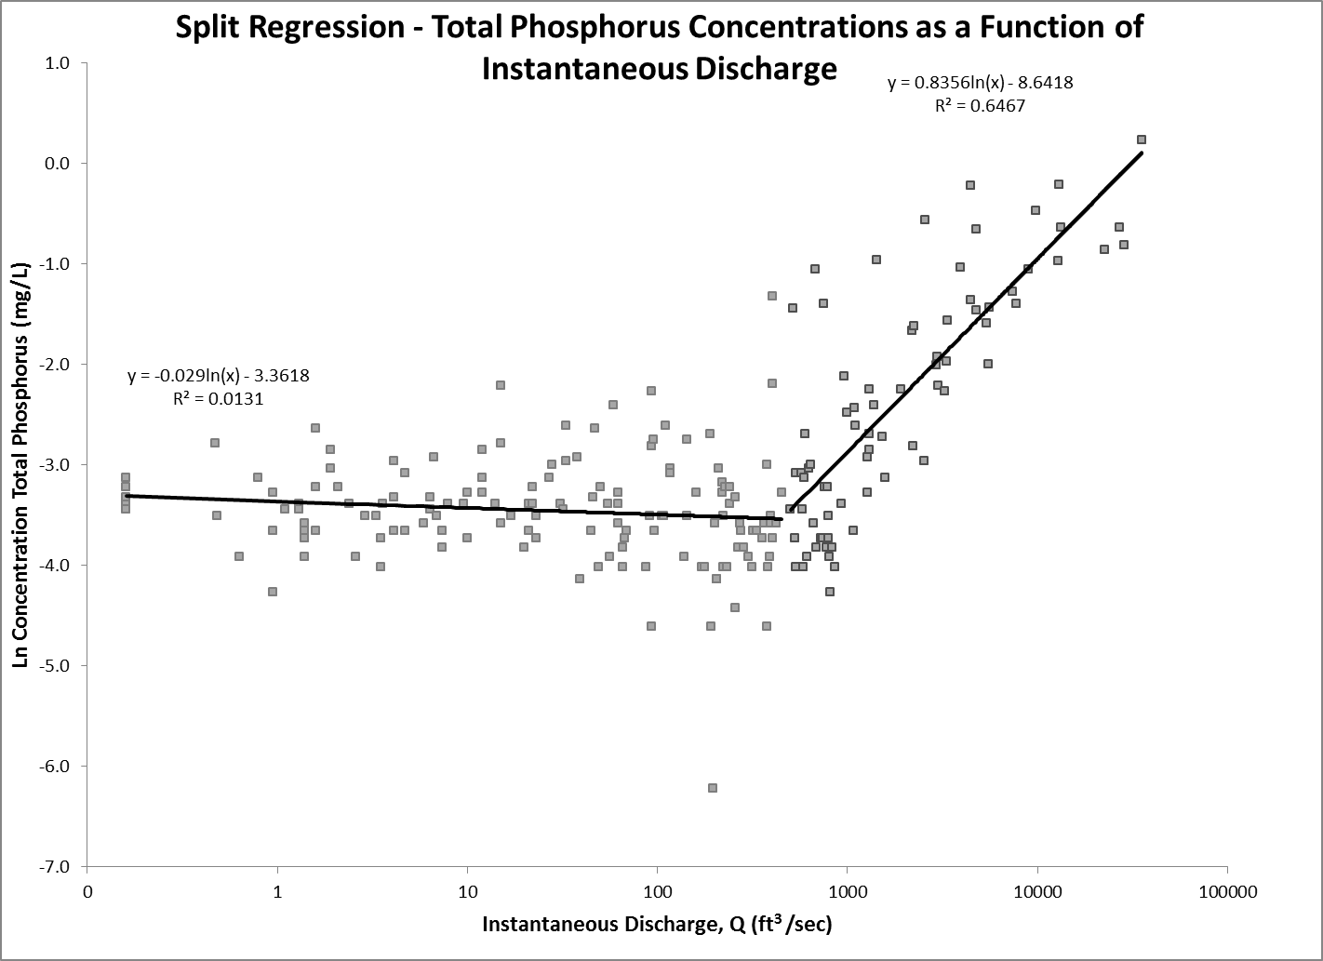
Water Quality Samples
Breakpoint regression shows changes at base and storm flow conditions
Combined with project 319 to acquire over 5 years of WQ data

Slide 8
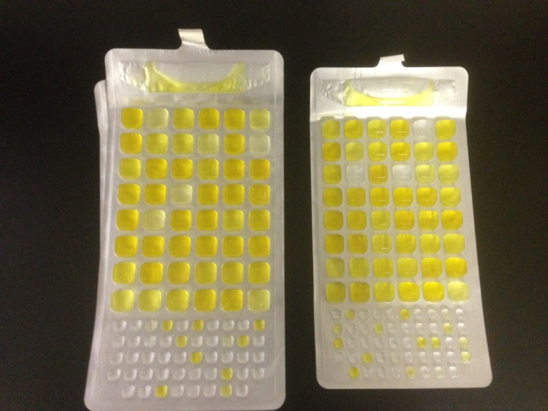
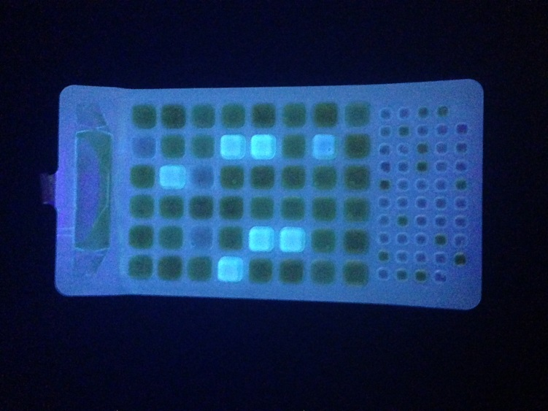
Water Samples for Bacteria in Upper Illinois Watershed
Measuring E. Coli and total coliform
Average of 3 sampling locations per reach
8 water samples collected between May 1st and Sept. 30th (Primary contact season)

Slide 9
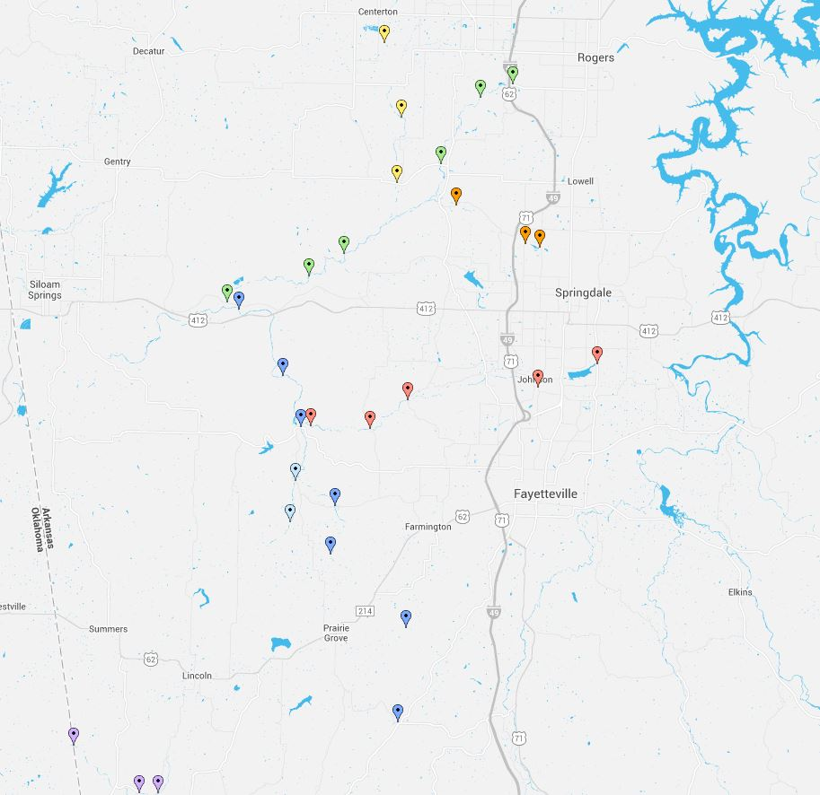
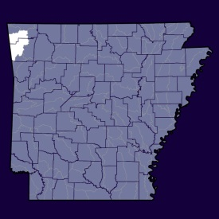
Water Samples for Bacteria in Upper Illinois Watershed
Little Osage Creek
Osage Creek
Spring Creek
Clear Creek
Muddy Fork
Illinois River
Baron Fork

Slide 10
Water Samples for Bacteria in Upper Illinois Watershed

Slide 11
Water Samples for Bacteria in Upper Illinois Watershed
29 sites were sampled along 7 different reaches.
6 of the 7 reaches contained sites that were on the 303 (d) list before the study.
From the preliminary analysis, there’s potential that Little Osage and will remain on 303(d).
The Illinois River shows one site far above primary contact standard, and Muddy Fork is near the limit.
Not source tracking, but potential causes along reaches are wildlife, cattle, septic

Slide 12
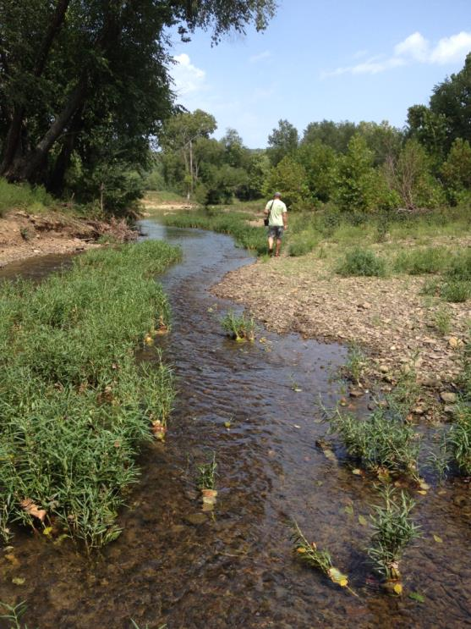
Diurnal Dissolved Oxygen Concentrations in Upper White River Basin
Four sites
  2: Kings River
  2: Leatherwood Creek
Data sondes deployed four times a year:
  Once: Jan. and April
  Twice: May and Sept.
  Once: Oct. and Dec.
72 hours at each site
  2 diurnal cycles
DO
  %sat, cond, pH, temp
Grab samples collected before and after

Slide 13
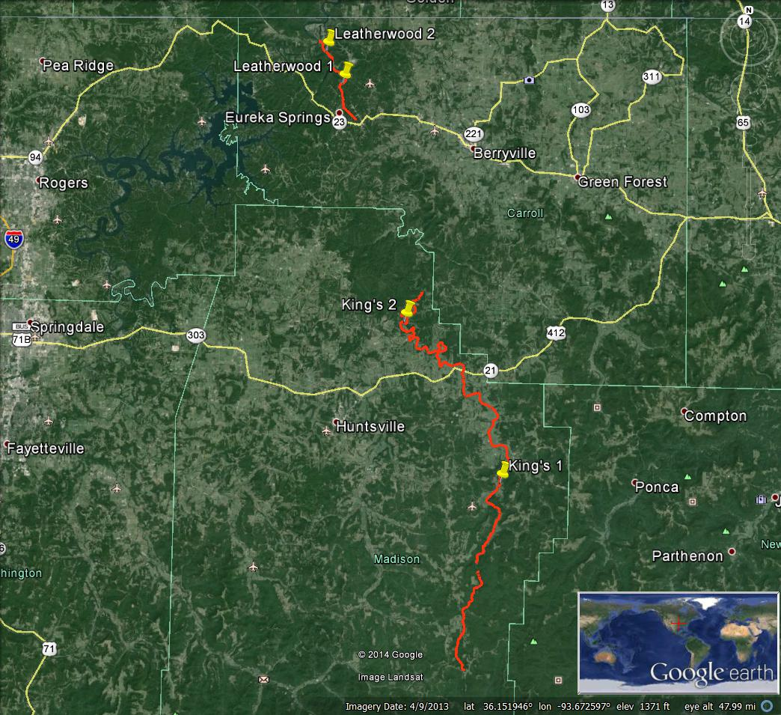
Notes:
Upper sampling location of the Kings is going to be located near Kingston, and the lower sampling point is downstream of the Marble access point.
The upper sampling location for Leatherwood Creek is located north of Eureka Springs, while the lower point is sampled before entering the Upper White River.

Slide 14
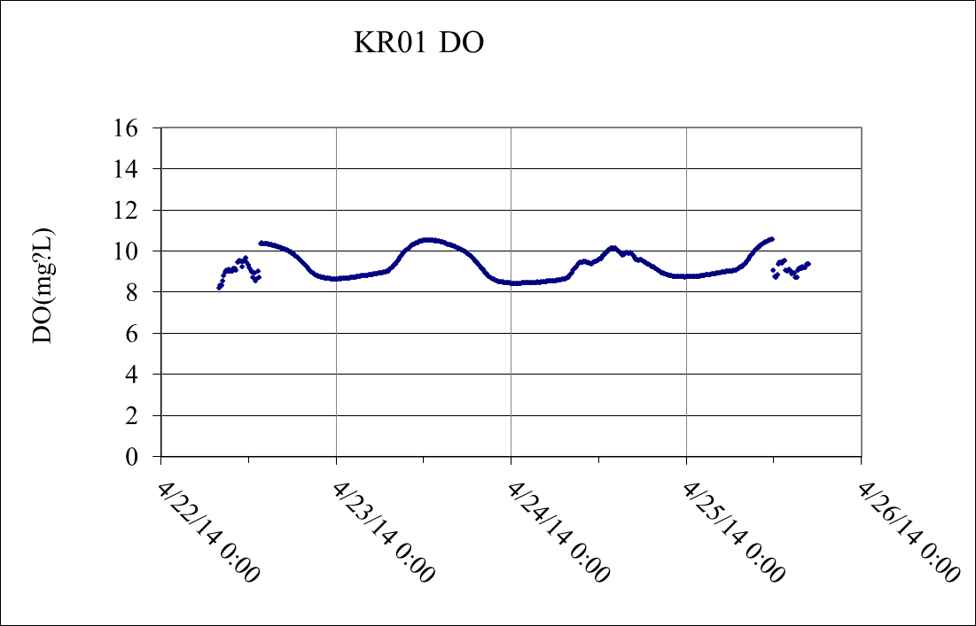
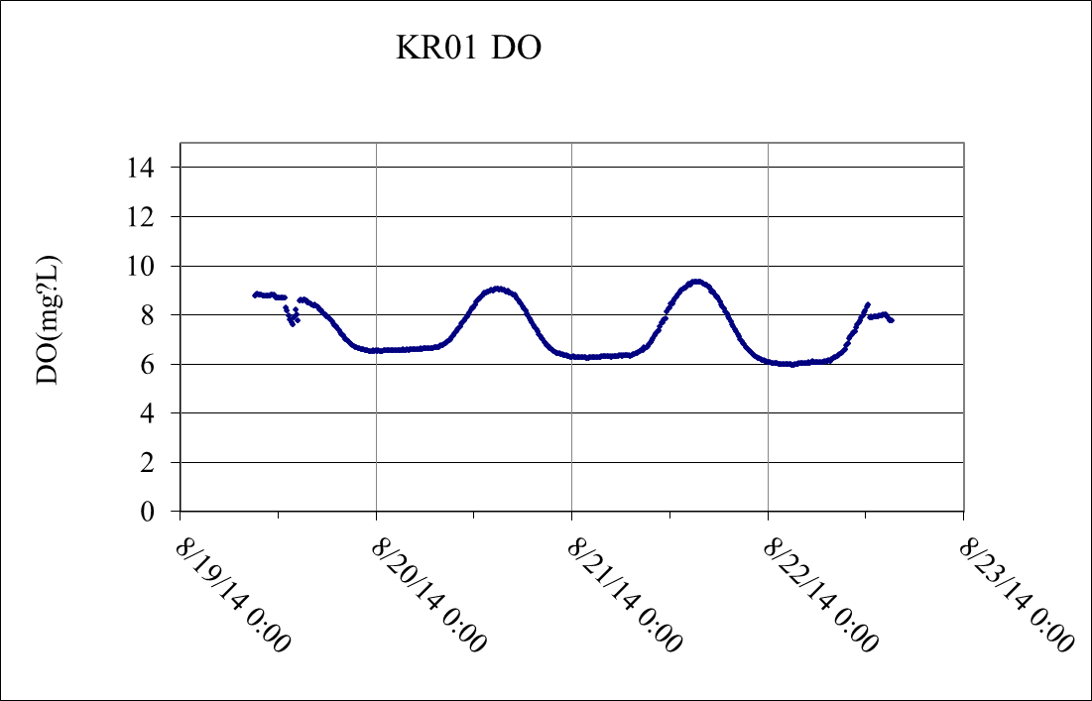
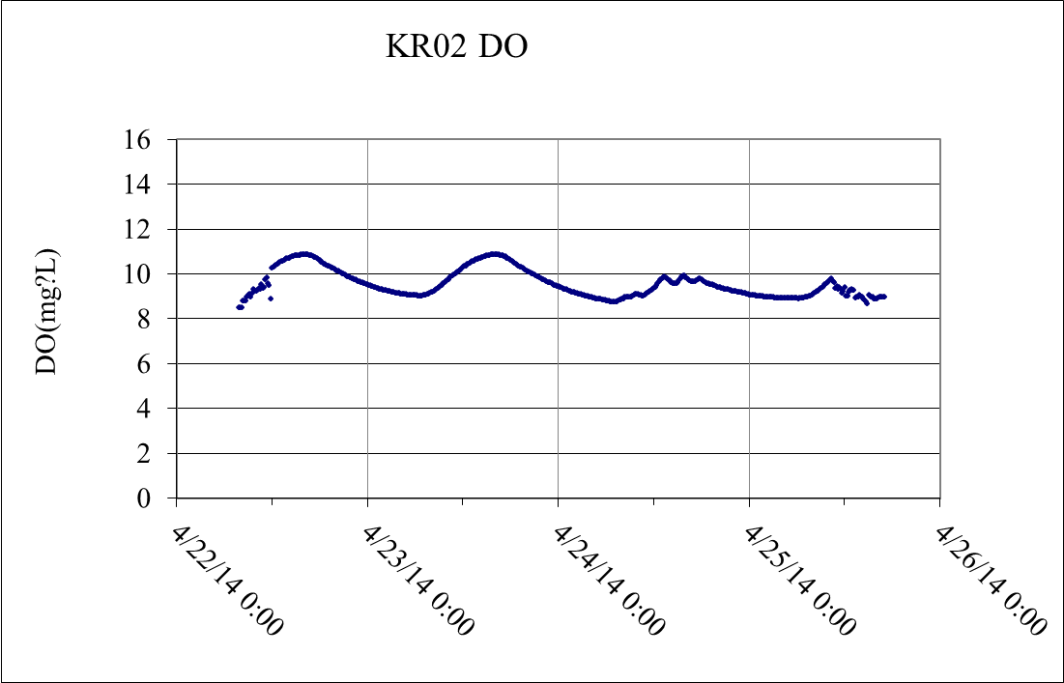
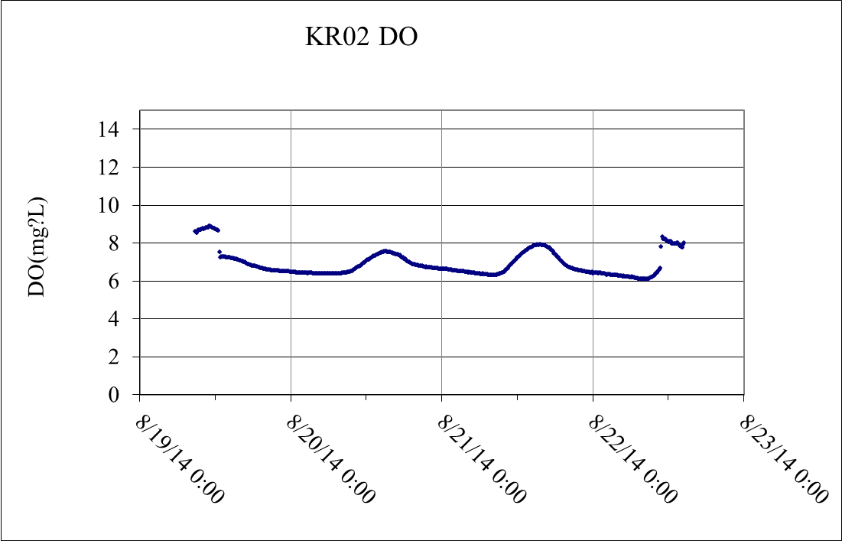
Diurnal Dissolved Oxygen Concentrations in the Upper Kings River (221 mi²)
April 2014
Primary - 6 (mg/L)
August 2014
Critical – 6 (mg/L)
Notes:
Upper kings river is over the 100 square mile watershed criteria, therefore, the minimum critical and primary DO levels (mg/l) throughout the year are equivalent.
During the previous primary sampling trip in April, both sampling locations stayed well in the 8-11 mg/L range. However, samples taken in August during the critical period were hovering at or below the required 6 mg/L DO during the night time.
However, when water temperatures
exceed 22°C (71.6°F), a 1 mg/L diurnal depression will be allowed below the
applicable critical standard for no more than 8 hours during any 24-hour period.
Kings river begins in the Boston mountains, and the majority of the watershed lies in the Ozark Highlands.

Slide 15
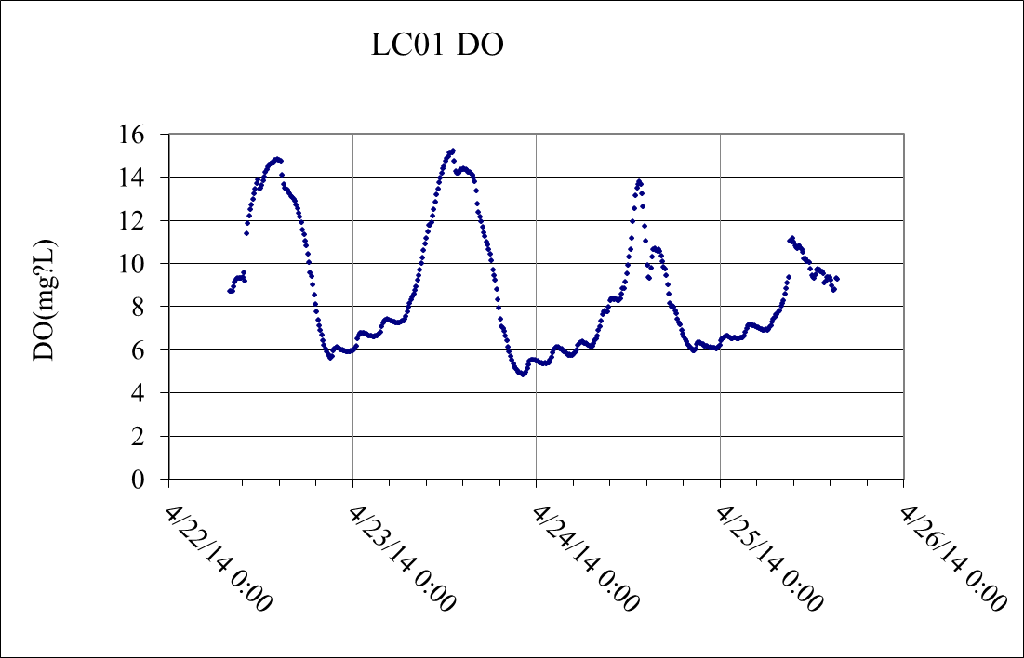
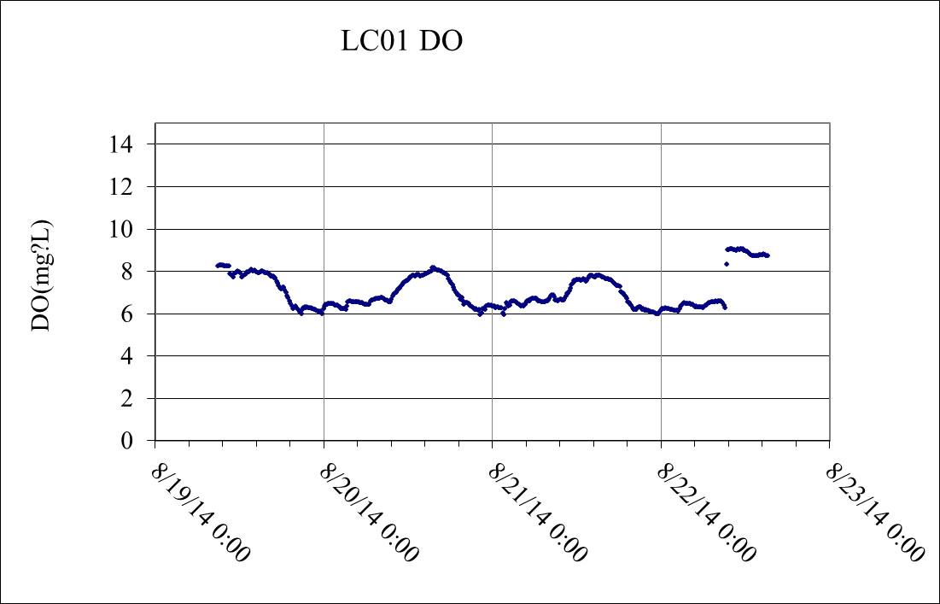
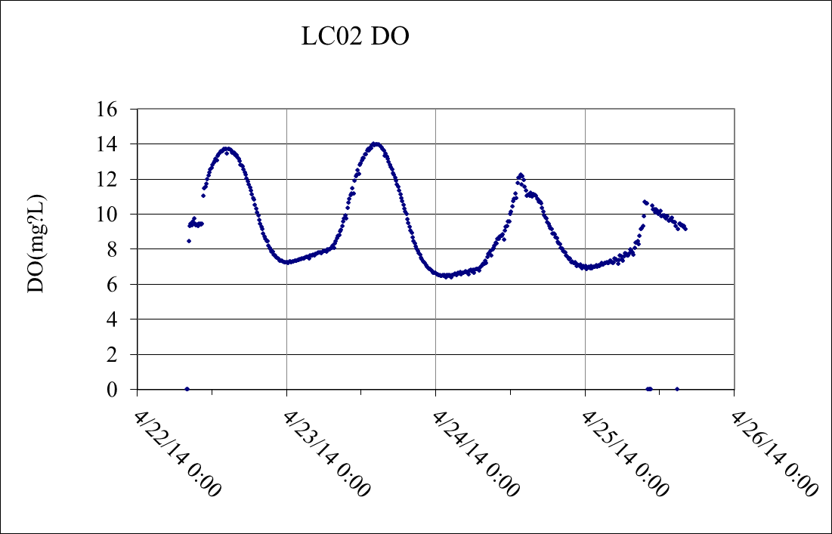
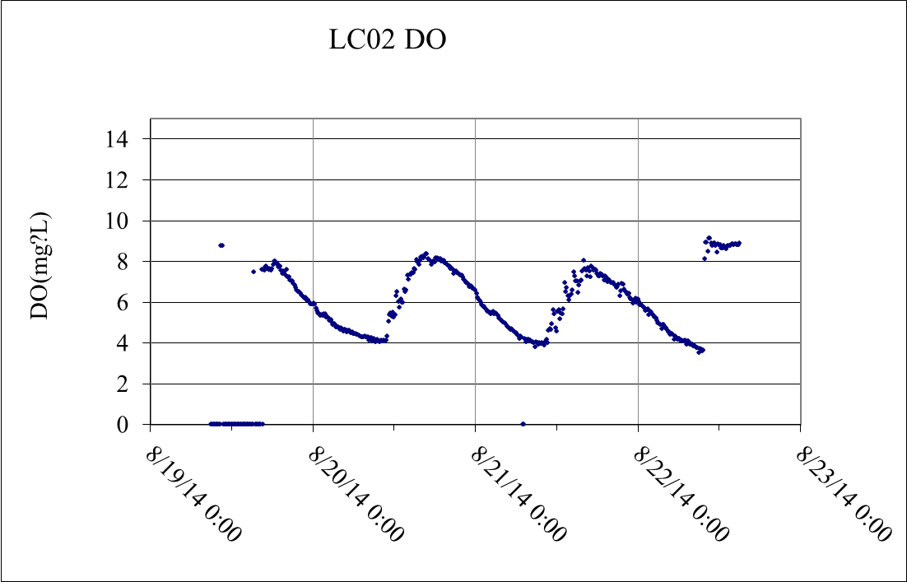
Diurnal Dissolved Oxygen Concentrations in Leatherwood Creek (30 mi²)
April 2014
Primary - 6 (mg/L)
August 2014
Critical – 5 (mg/L)
Notes:
Leatherwood watershed totals just below 30 sq. miles

Slide 16
Diurnal Dissolved Oxygen Concentrations in Leatherwood Creek (30 mi²)
April 2014
Primary - 6 (mg/L)
August 2014
Critical – 5 (mg/L)
Notes:
Leatherwood watershed totals just below 30 sq. miles. Areas of concern for this 303d listed river would be the end point of Leatherwood Creek during critical months.
DO dips to 4 mg/L, but it is unclear yet if this is when water temperatures
exceed 22°C (71.6°F), a 1 mg/L diurnal depression will be allowed below the
applicable critical standard for no more than 8 hours during any 24-hour period.

Slide 17
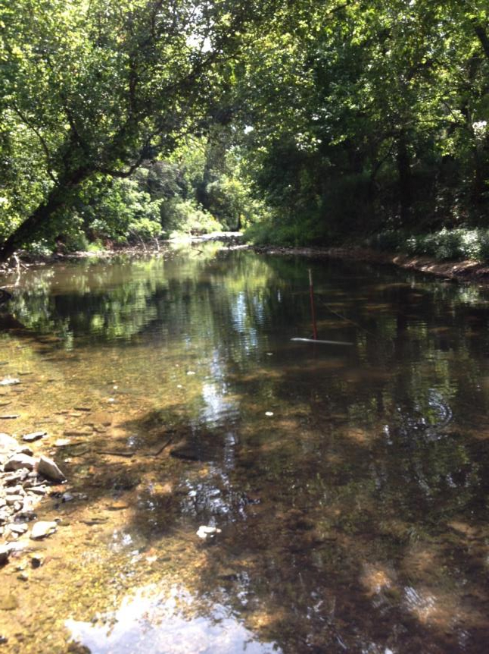
Project 11-500
This has been an update on the progress of project 11-500
This project will end June 2015
A more comprehensive analysis will follow after completion

Slide 18
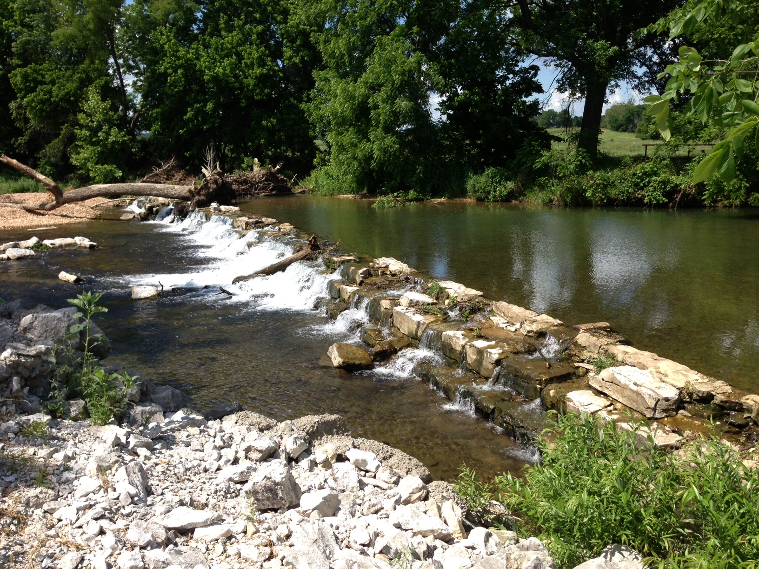
Questions?

