Slide 1
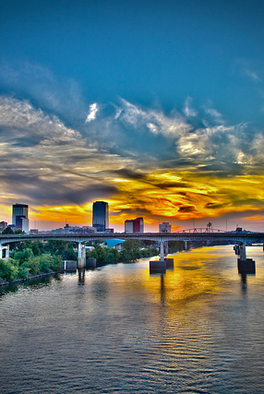
Water Quality Demonstration & Educational Program for Main Street
Little Rock

Slide 2
Nonpoint Source Management (319) Program
Total Project Cost $1,578,959
Federal $900,000
City of Little Rock $678,959 +
(Cash & Inkind)

Slide 3
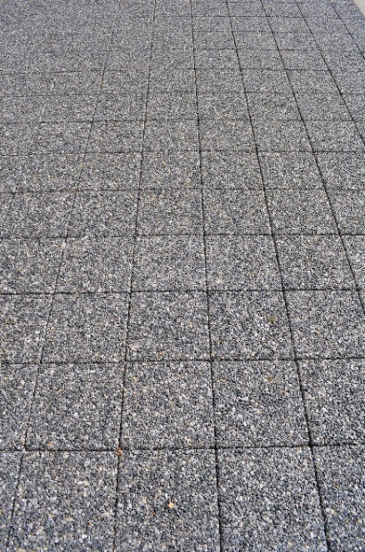
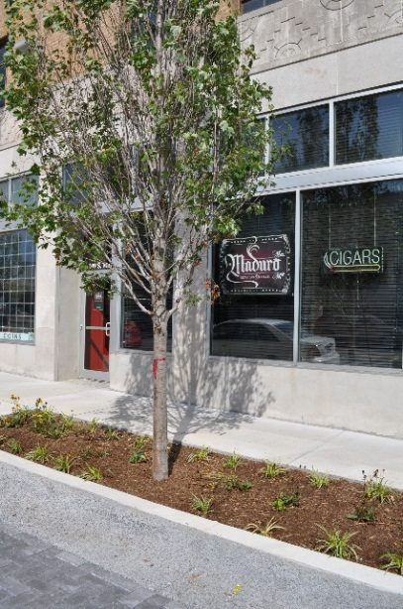
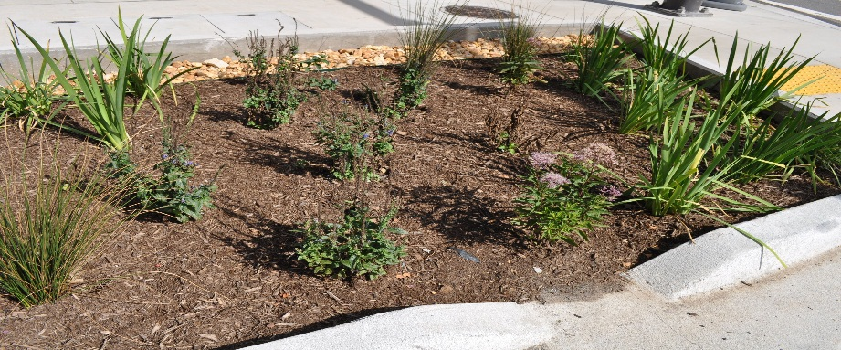
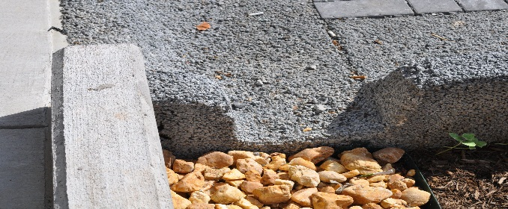
Demonstrate Benefits of
Low Impact Development
Porous Pavers
Tree Wells
Rain Gardens
Water Filtration

Slide 4
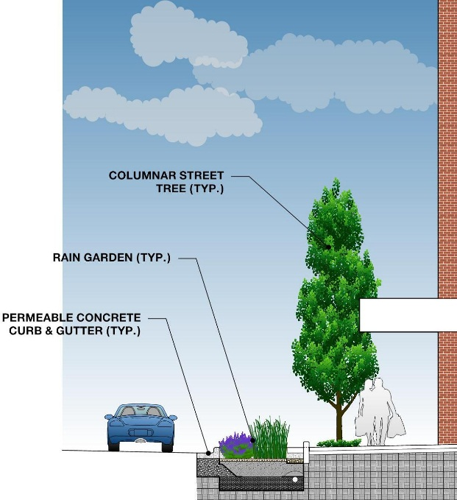
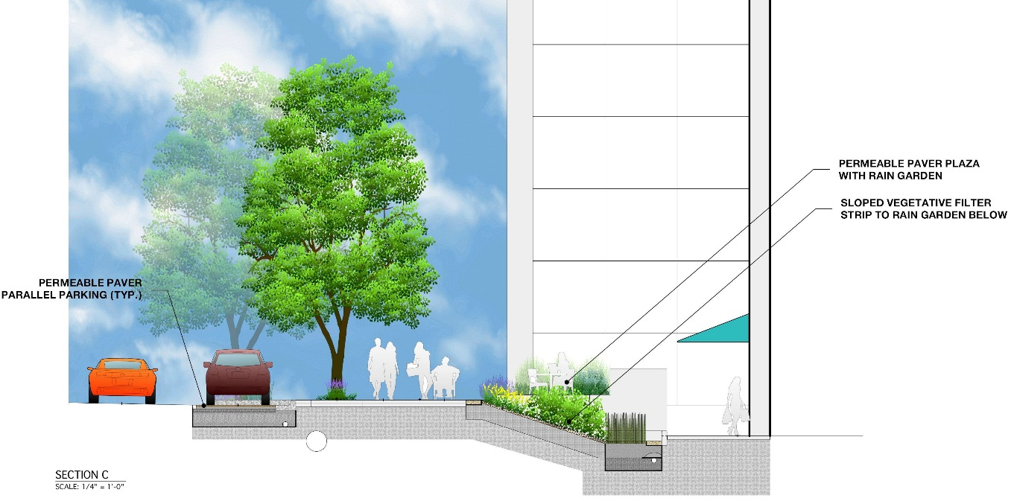
Rain Gardens, Permeable Concrete and Columnar Trees
Permeable Pavers and Vegetative Filter to Rain Garden

Slide 5
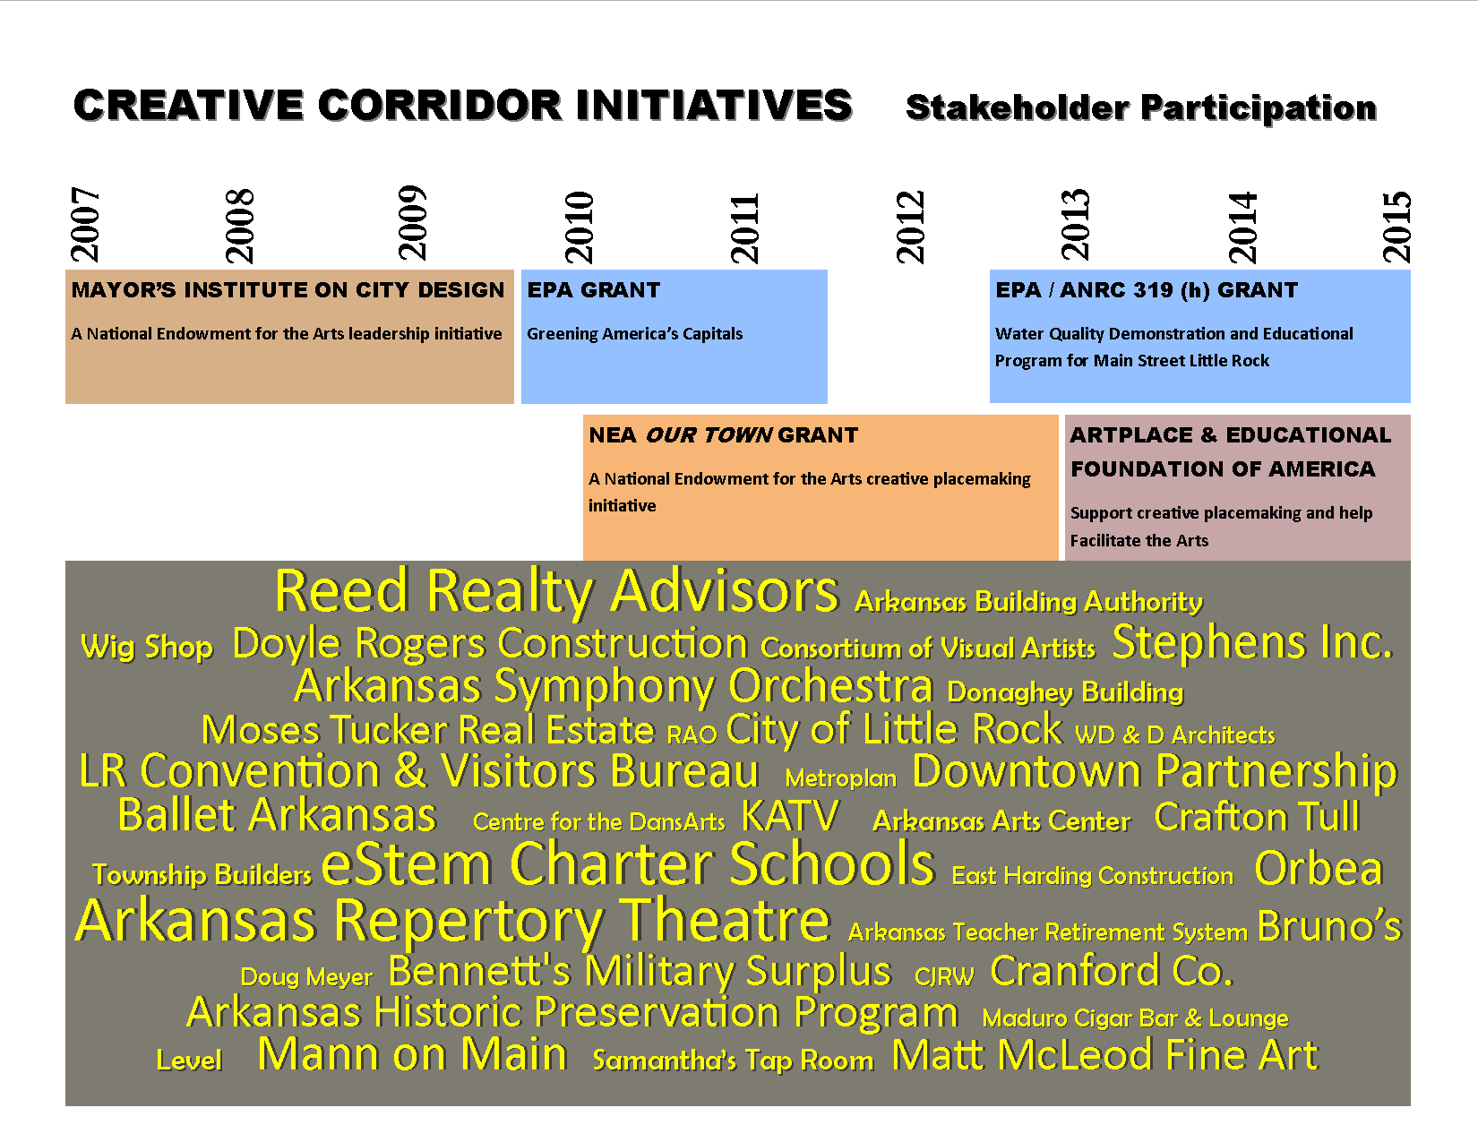

Slide 6

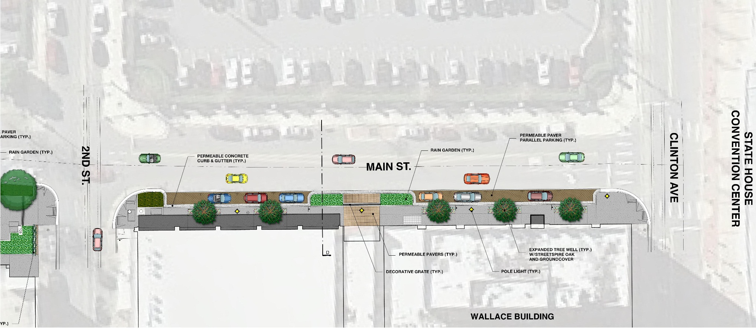
100 Block Main

Slide 7
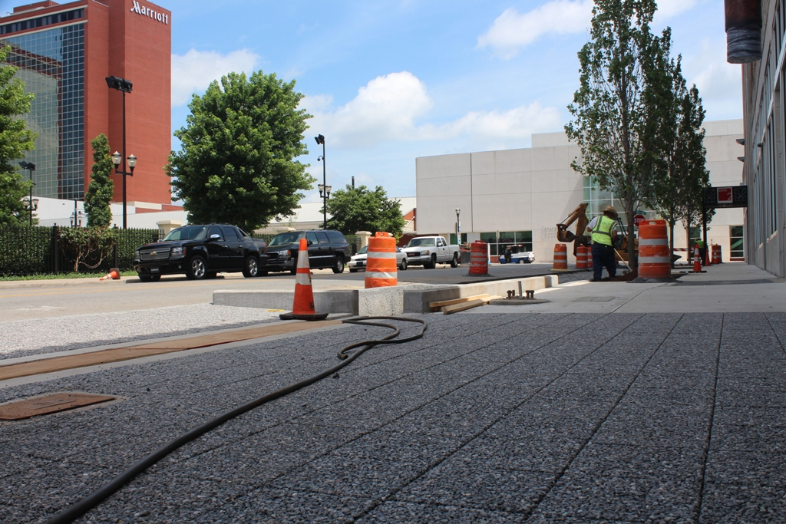

Slide 8
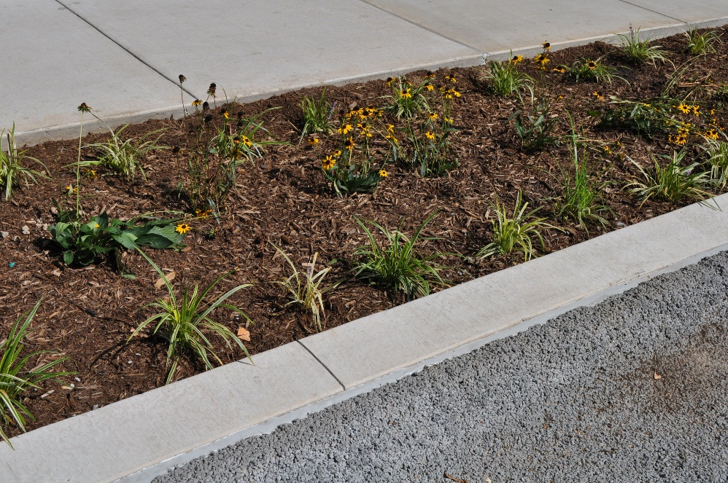
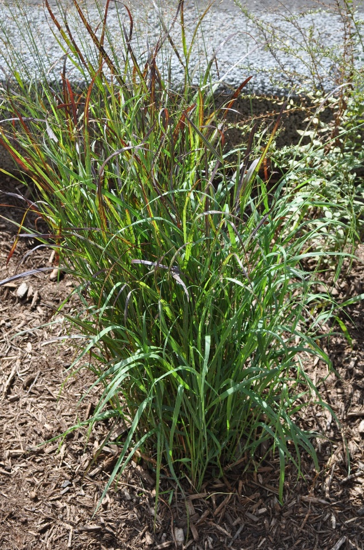

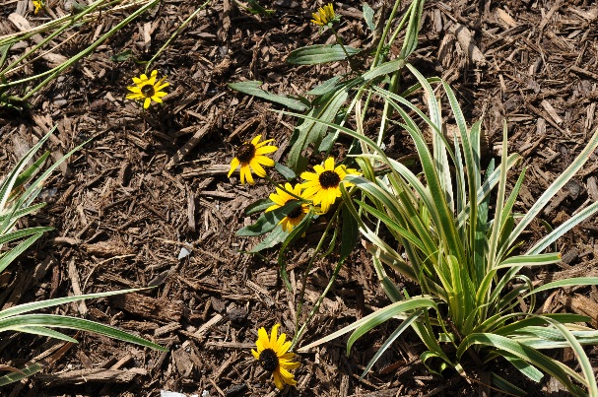

Slide 9
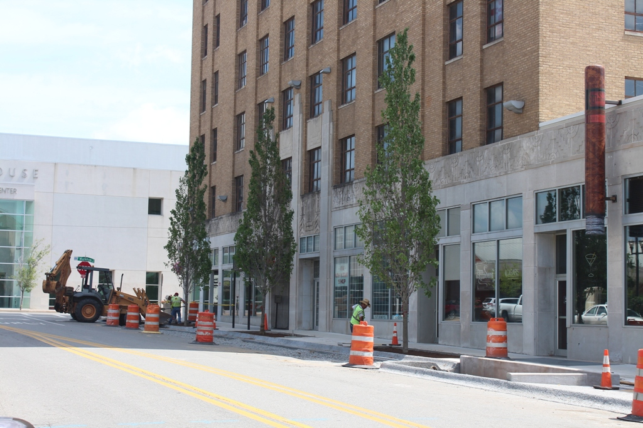

Slide 10
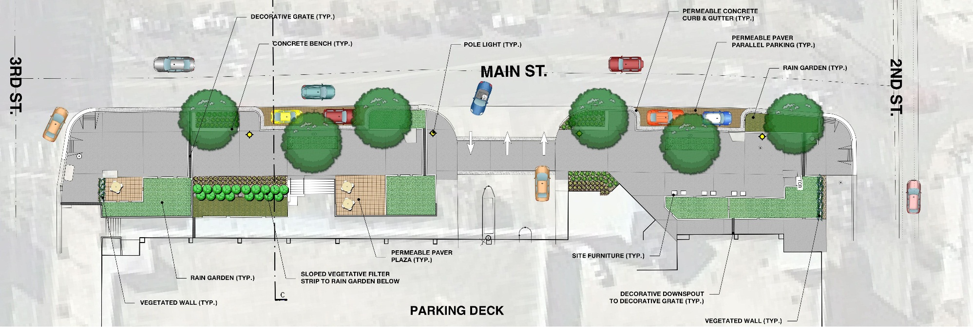
200 Block Main

Slide 11
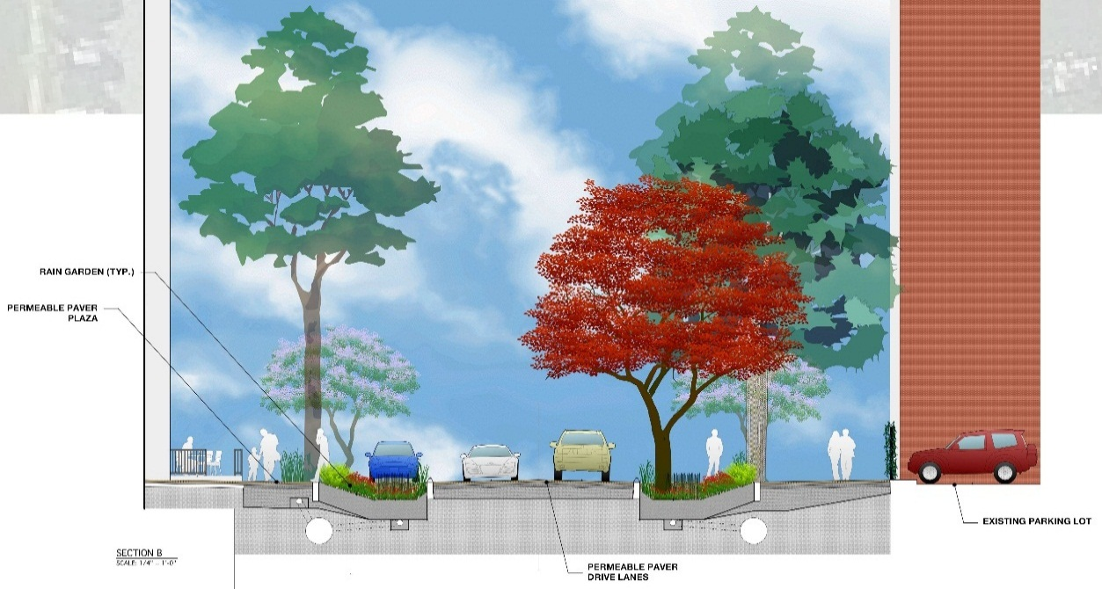
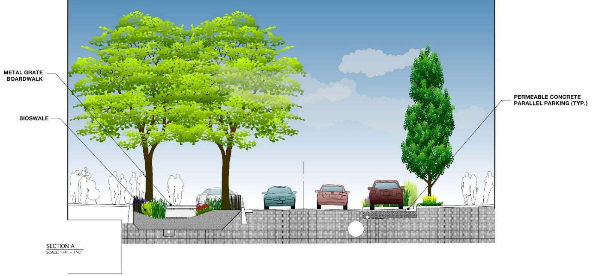
Rain Garden, Permeable Paver Plaza & Drive Lanes
Bioswale, Metal Grate Boardwalk & Permeable Concrete Parking

Slide 12
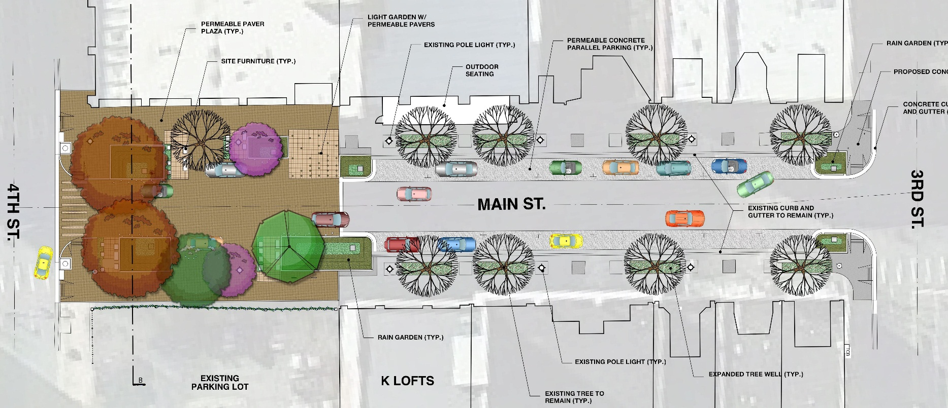
300 Block Main

Slide 13
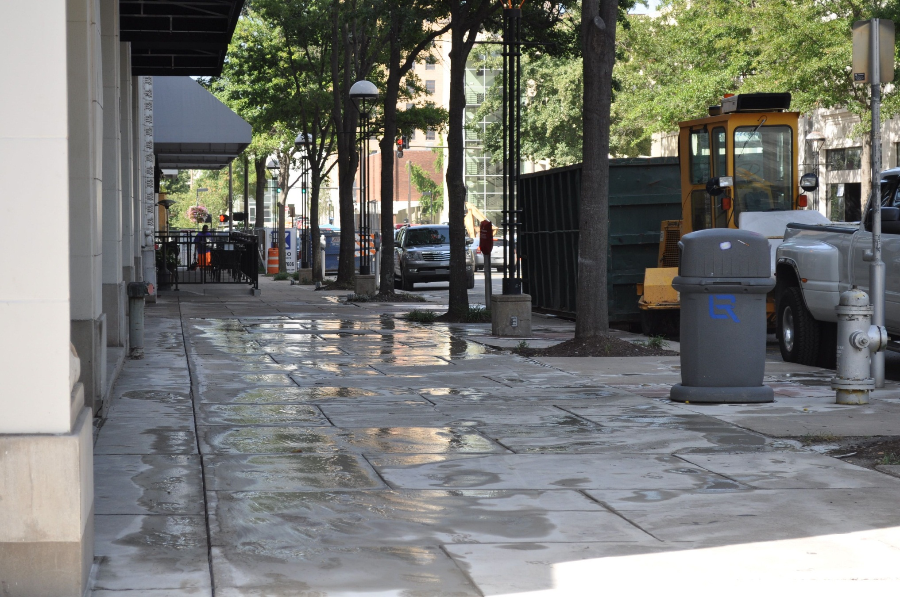

Slide 14
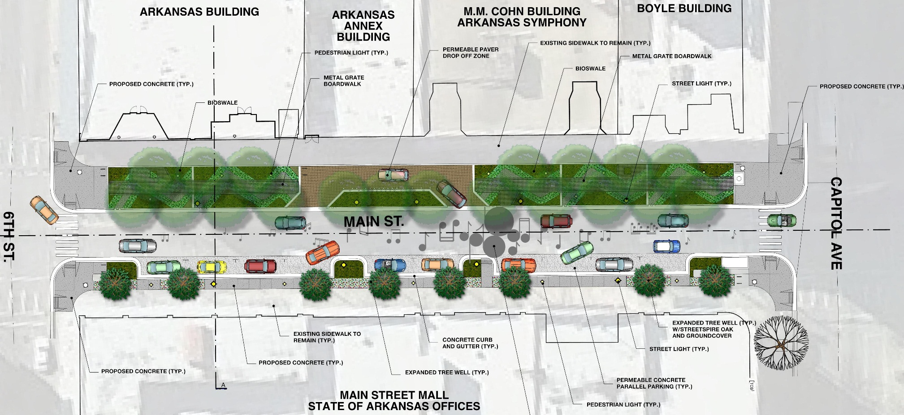
500 Block Main

Slide 15
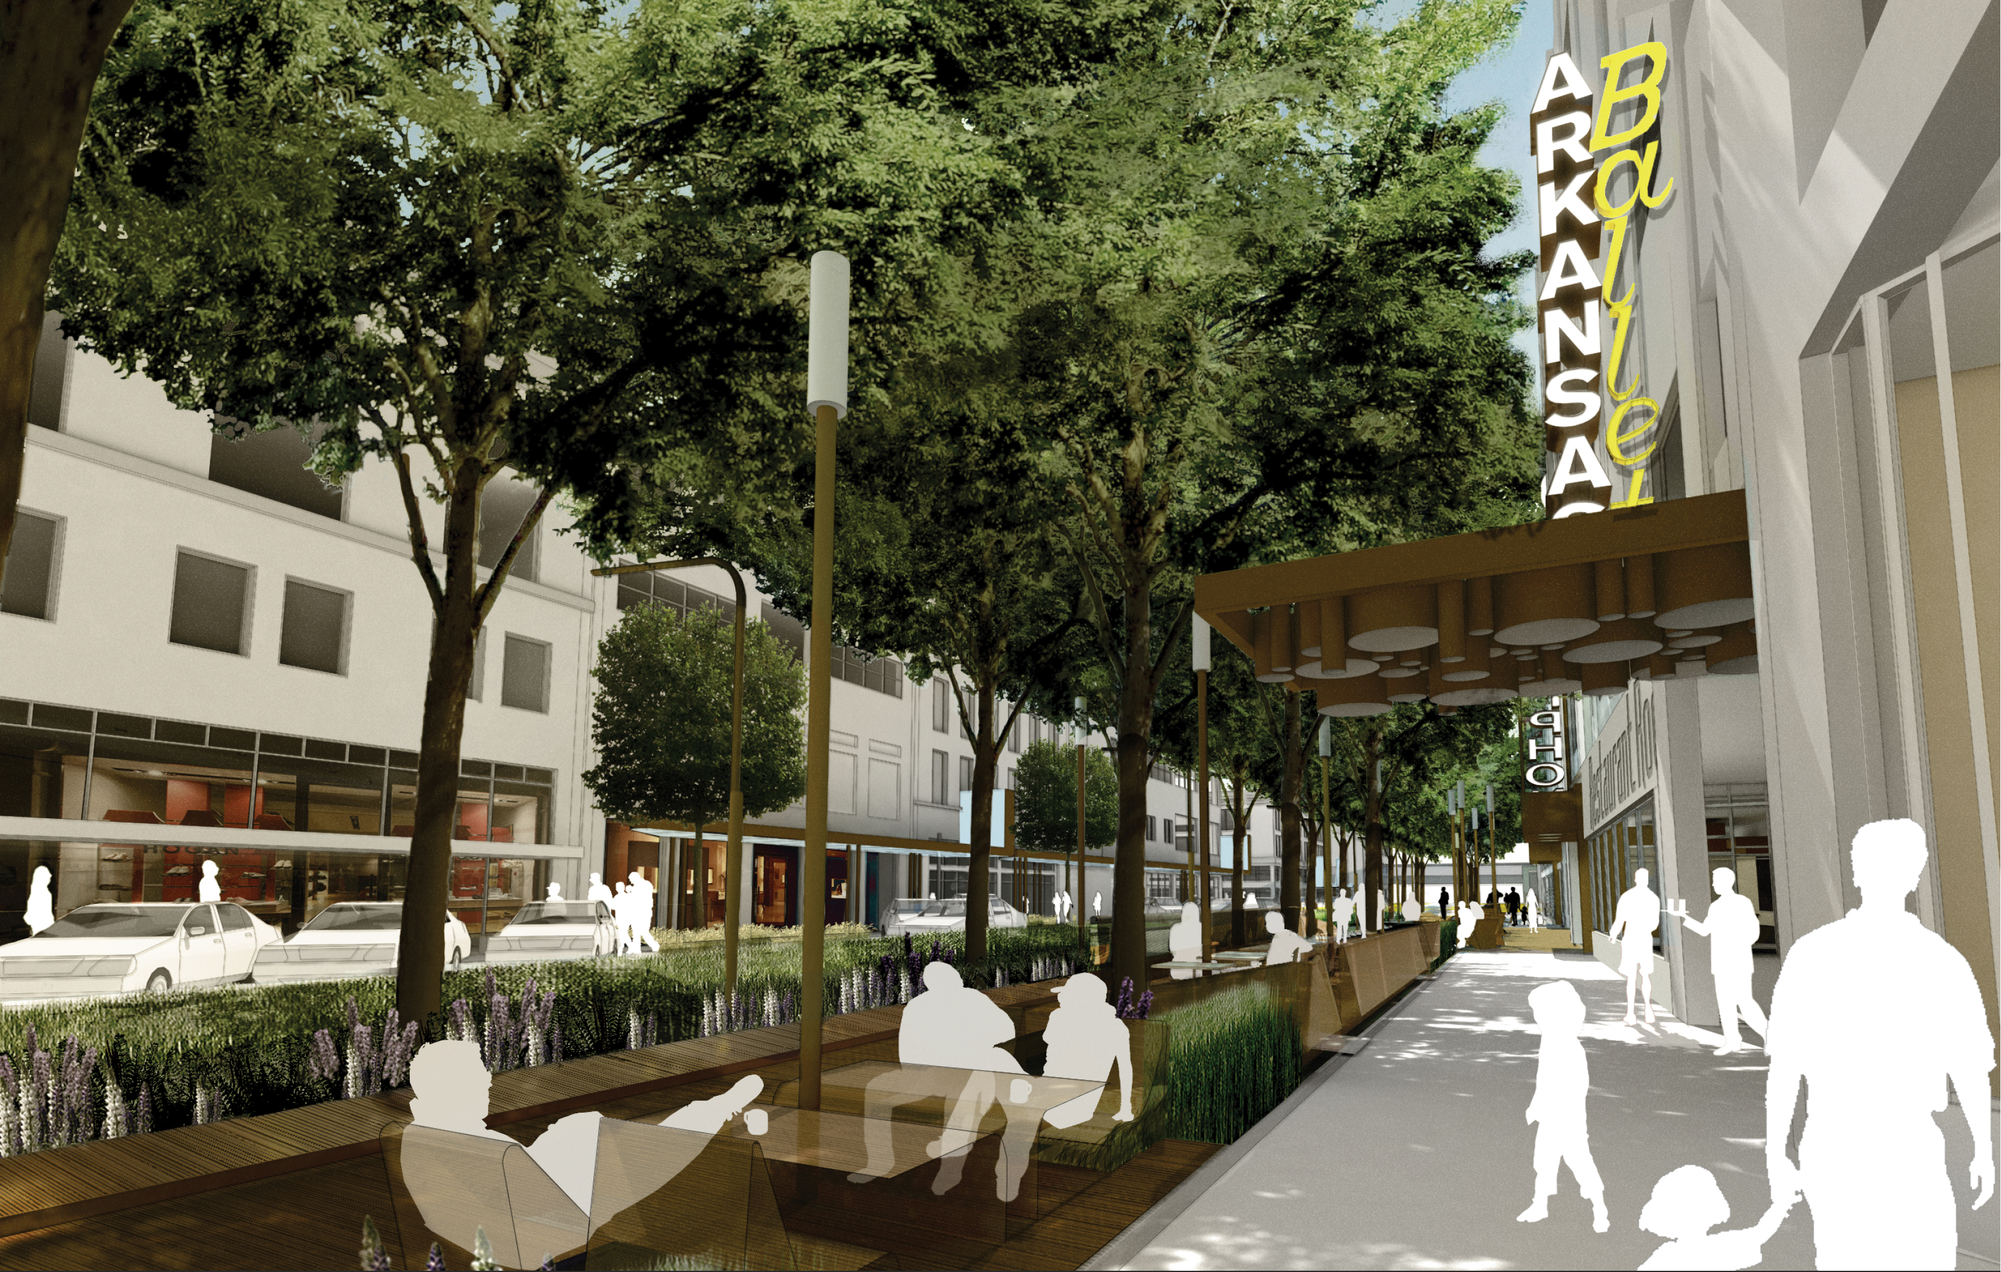

Slide 16
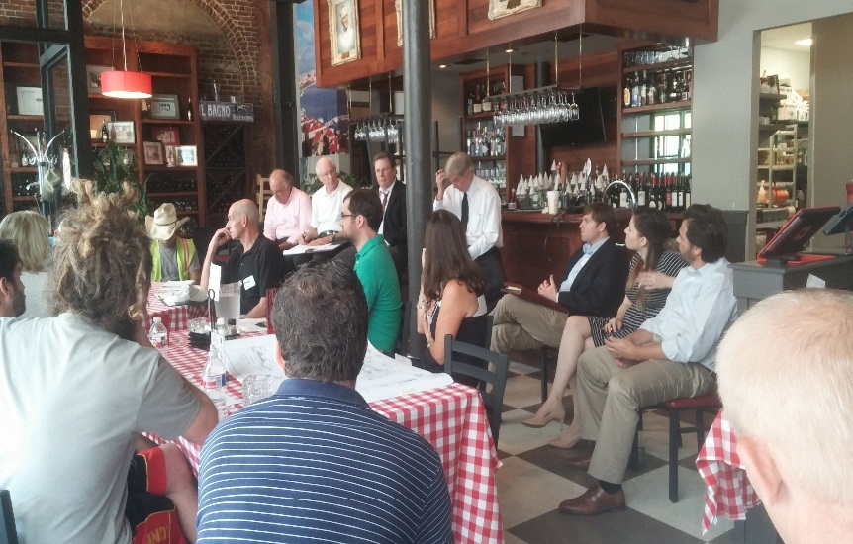
Educate
Public Meetings
Signage
Cable TV Updates
YouTube Educational Video
Educational Presentations

Slide 17
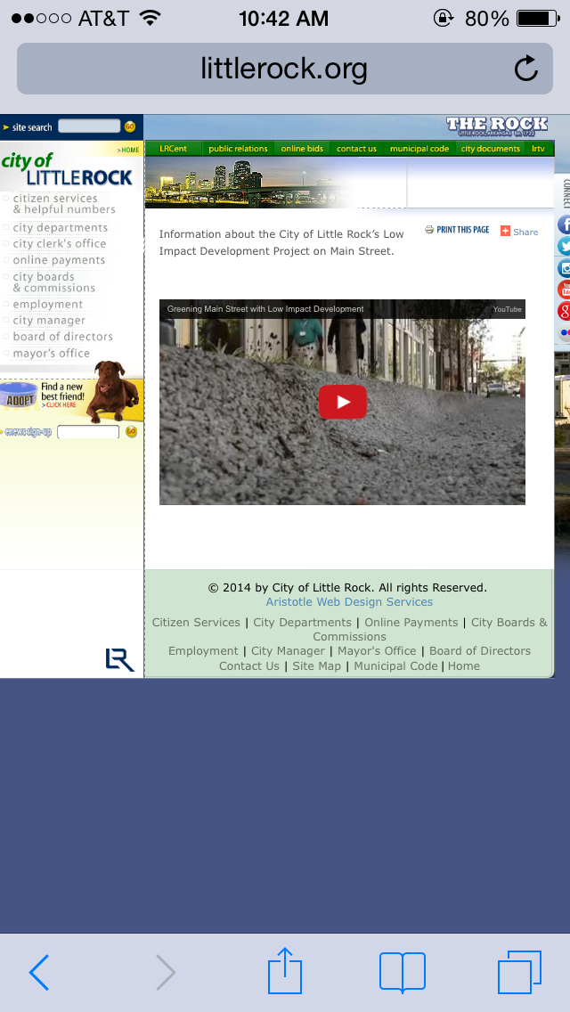
Educate and Involve the Community
Educational Video – City of Little Rock YouTube:
http://www.littlerock.org/vp/4489.aspx?url=/lid/

Slide 18
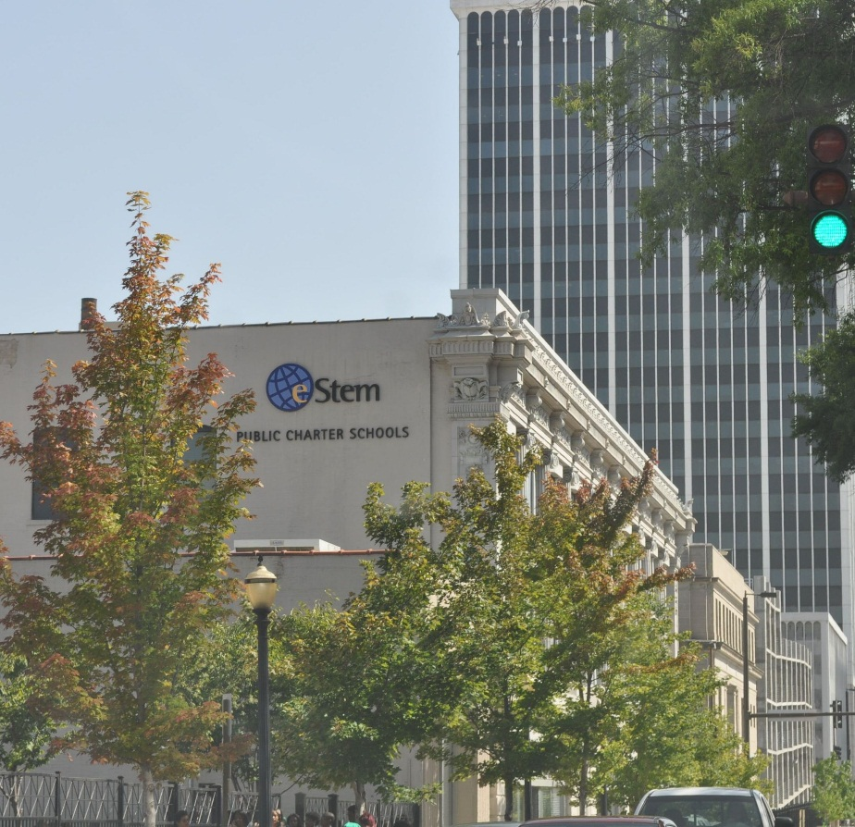
Partner
eStem Public Charter School
Committee of Teachers
Start with 7th Grade across-the-curriculum
AP Environmental Science Advanced Work

Slide 19
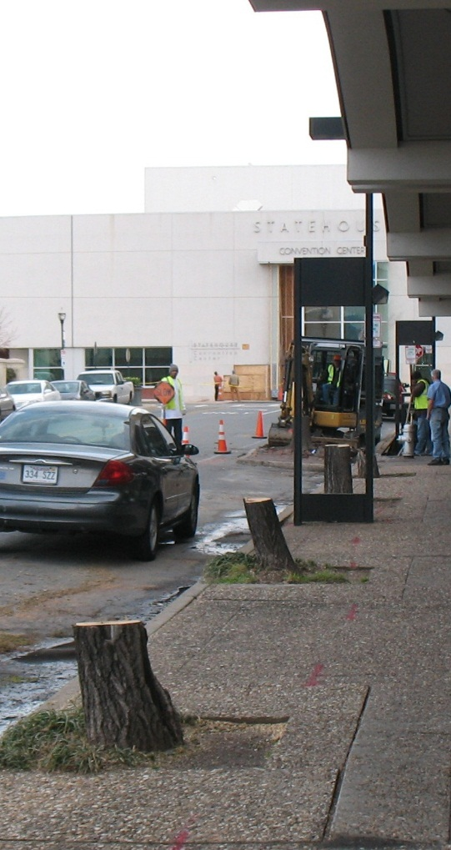
Challenges
Storm water
Beautification vs. Water Quality
Budget Constraints
Basements Under Street
“Challenged” Plants
Tree Removal/Replacements
Maintenance Issues

Slide 20
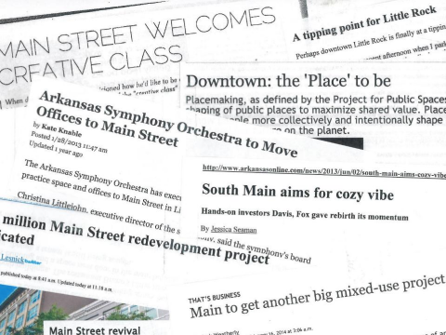

Slide 21
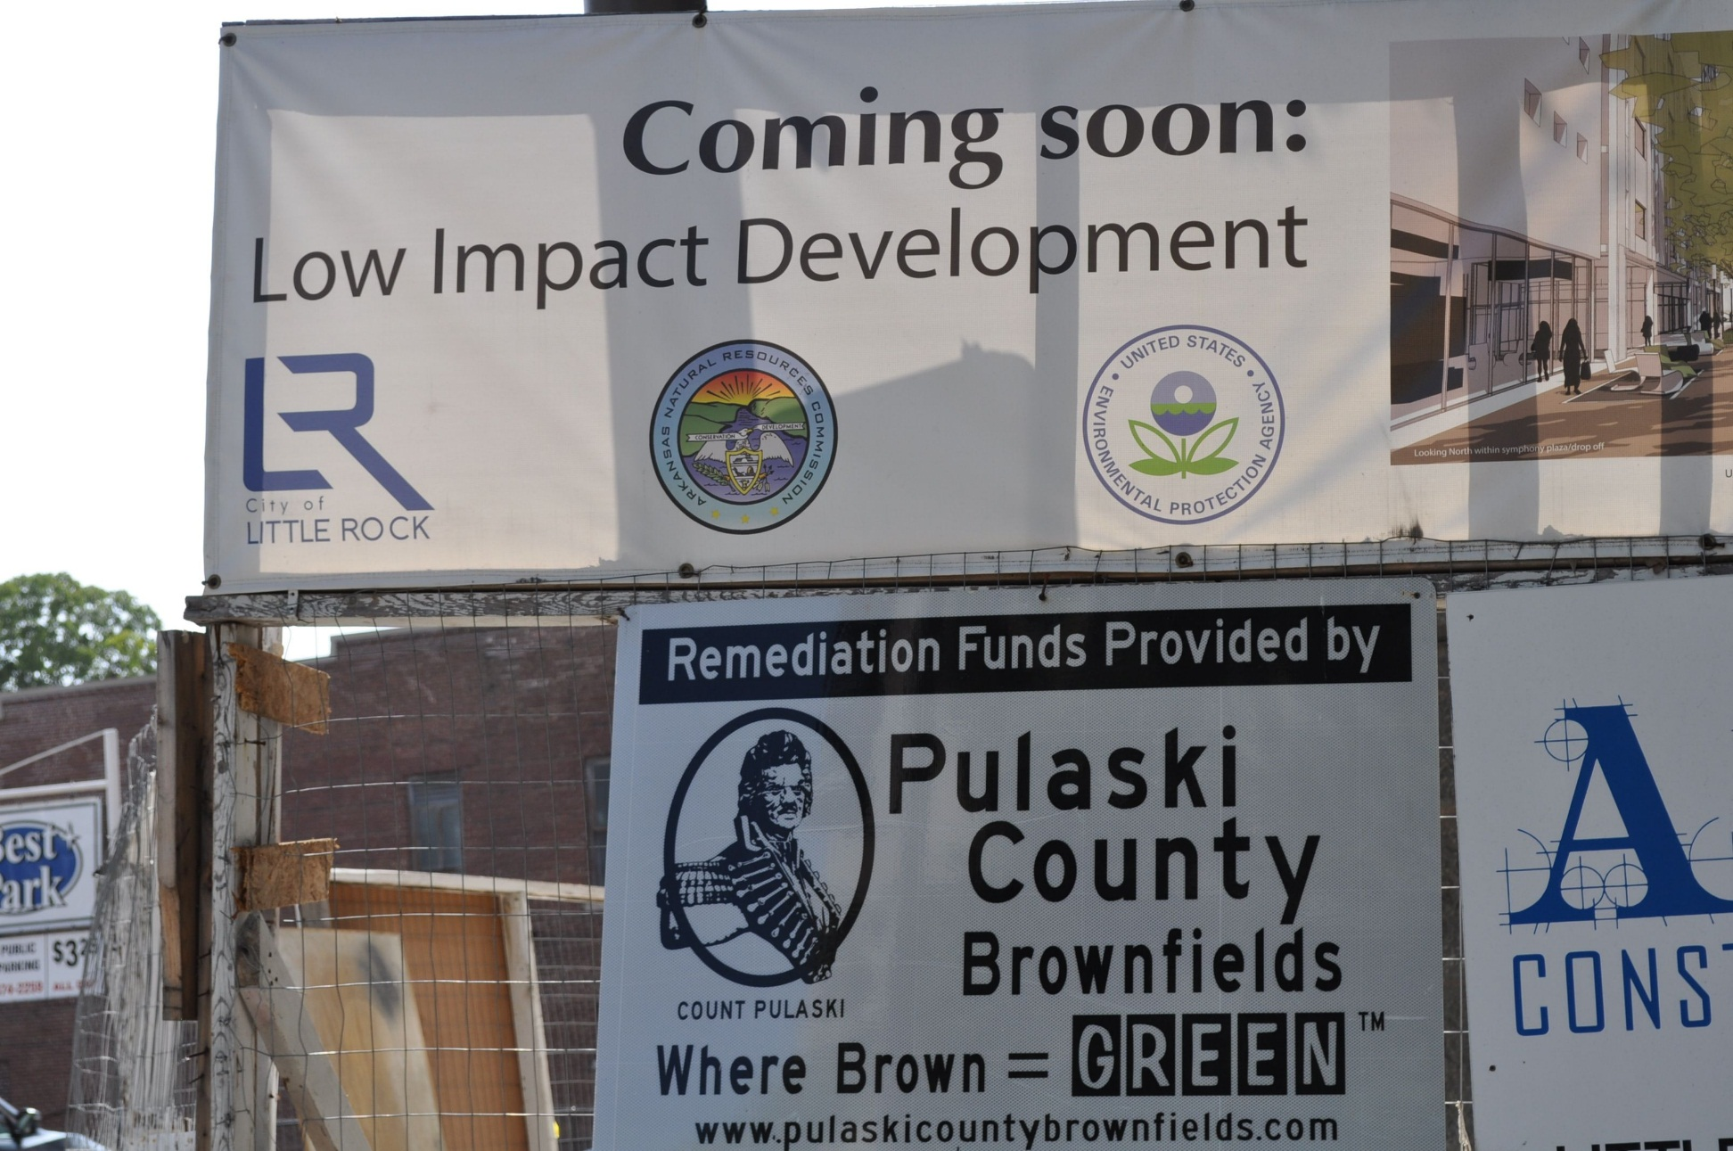

Slide 22
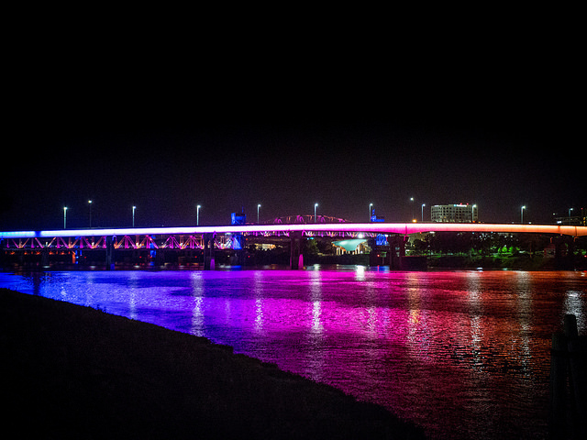





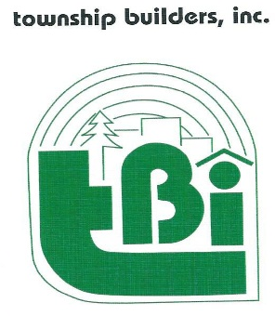

THANK YOU
City of Little Rock

