Slide 1



State NPS Meeting
September 18, 2014

Slide 2
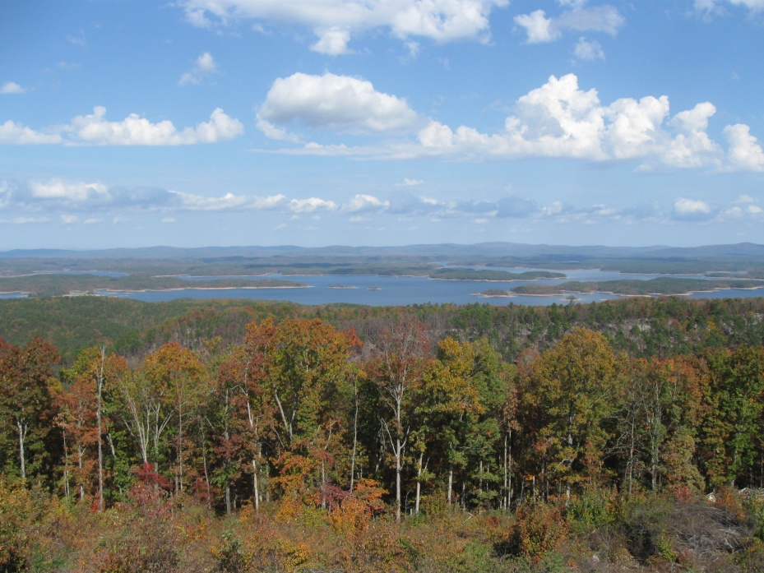
Rick Fields
Kristin Higgins
*Mike Daniels
Karl Vandevender
Tom Riley
Katie Teague
Special Thanks to John Pennington

Slide 3
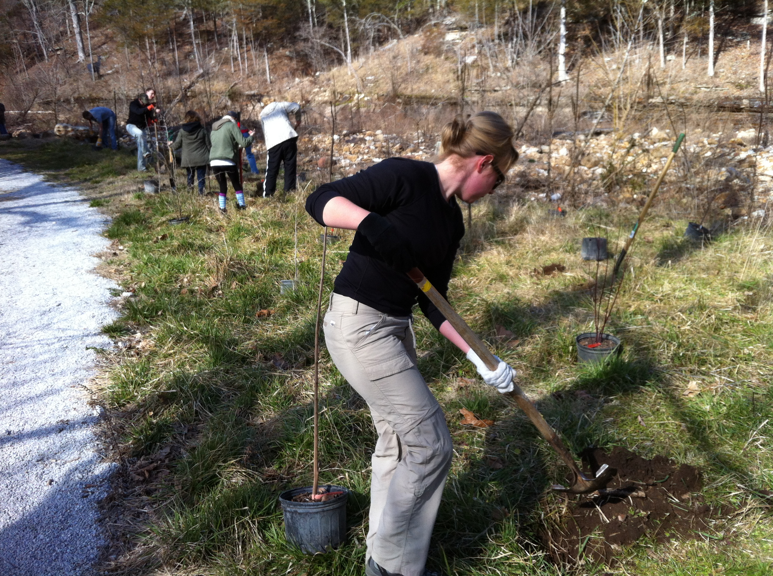
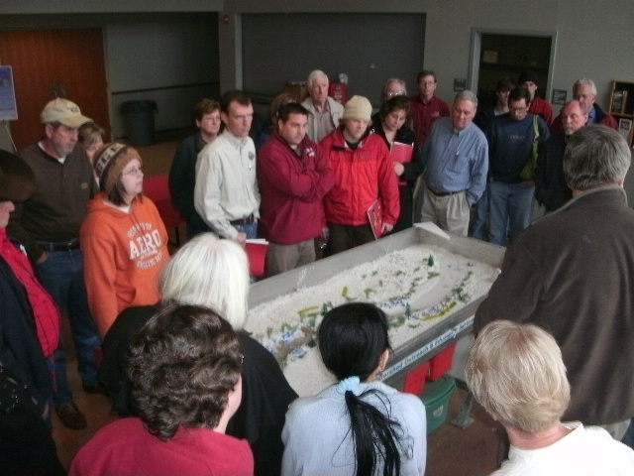
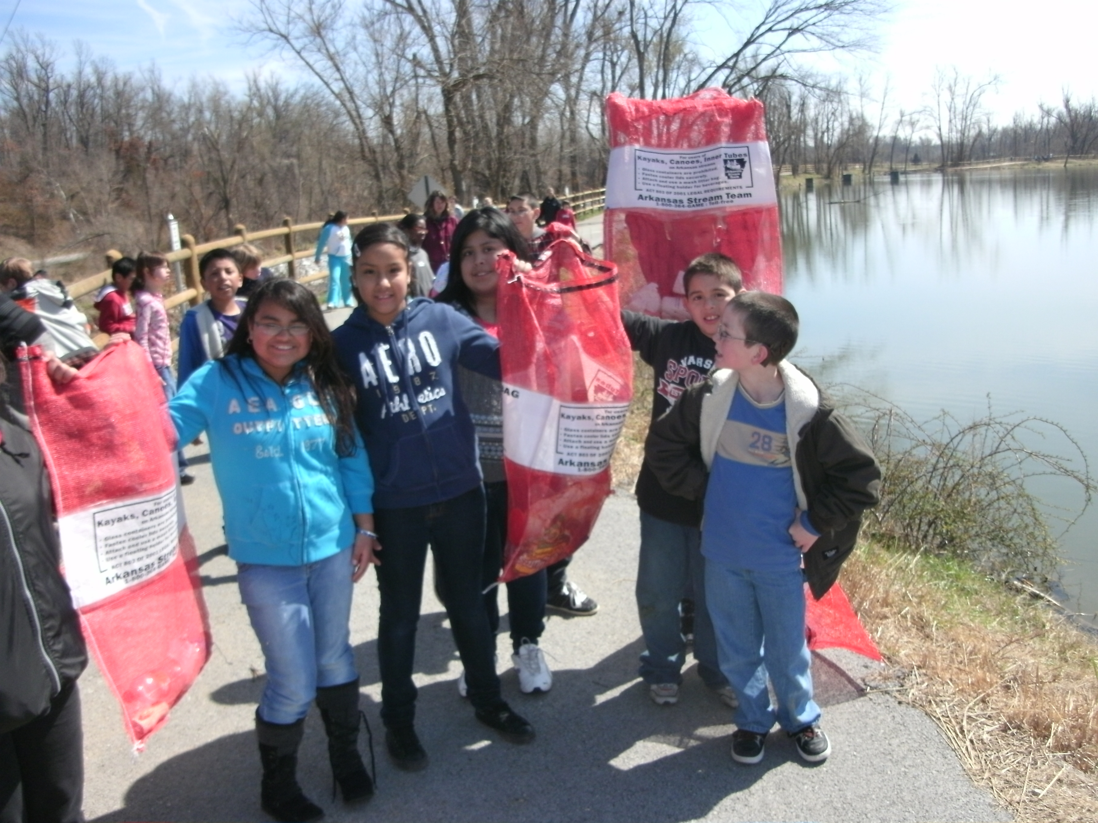

What is the AWS Program?
  AWS is a multi-agency project intended to:
  Increase participants awareness and knowledge of their watersheds and local water issues.
  Help participants become leaders in their community
  Motivate participants to facilitate local efforts in their watershed
  Improve & protect quality of local water resources
Notes:
The AWS program is a statewide educational training developed by Extension and partnering agencies and organizations, and funded by the Arkansas Natural Resources Commission and EPA to: Increase participants awareness and knowledge of their watersheds and local water issues. Help participants become leaders in their community, Motivate participants to facilitate local efforts in their watershed, Improve & protect quality of local water resources. And it’s focused in SOME of the priority watersheds throughout the state.

Slide 4
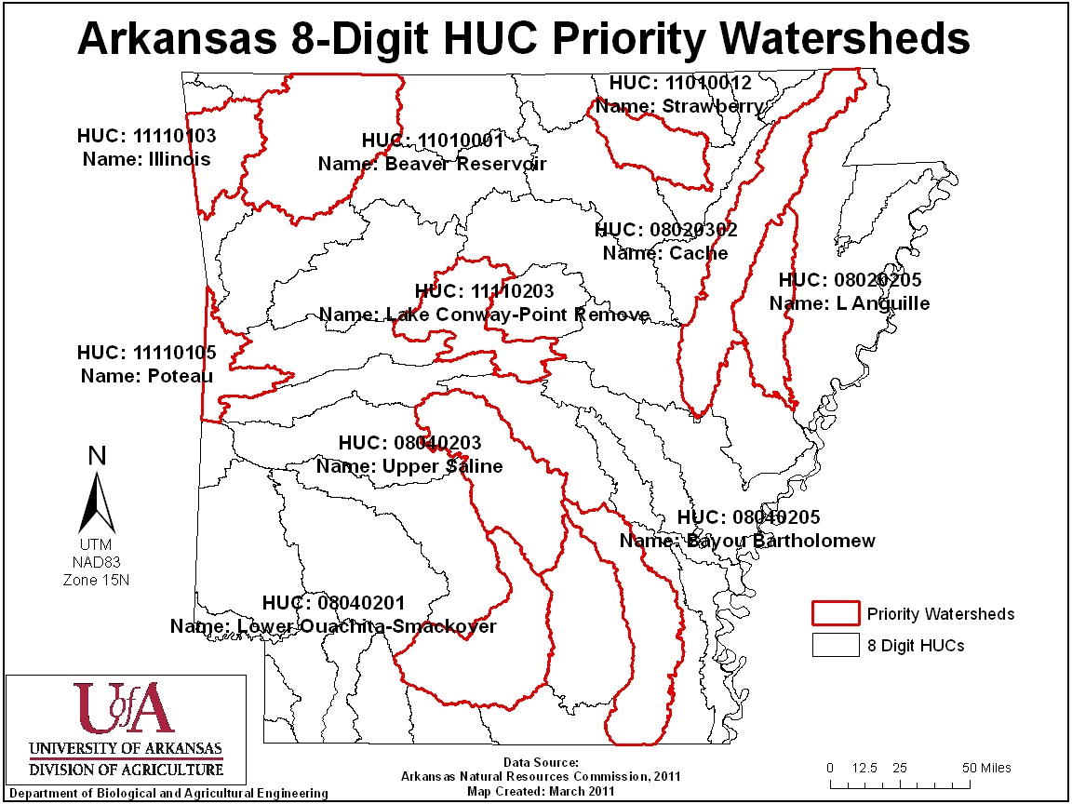
Priority Watersheds of Arkansas
Notes:
This is a map showing those priority watersheds. The Illinois and Beaver Reservoir have several functional watershed organizations, and community plans intended to help maintain or improve water quality so they are not really a focus of this grant. All of the other ones around here like Lake Conway-Point Remove, Upper Saline, and so on......could use some more attention or stewardship- in-action since they are high priority watersheds and have existing impairments.

Slide 5
AWS Program
Targeting 8 impaired watersheds in Arkansas
  Involves 47 Counties
  AWS project goal is to reach 200 people

Slide 6
Major Tasks
Form Advisory Committee
Develop Guide and Training Program
Deliver Training in 8 impaired watersheds in Arkansas

Slide 7
Agencies/ Organizations On Advisory Committee
ANRC
UACES
USGS, ADEQ, AACD, ADH, AFC, IRWP, LFWP, BWA, OWW, AWRC, CAW, BWD, ASU, WCRC
EPA
A Super Big Thanks to these groups and the Individuals who served
Notes:
Special thanks to these partners for funding and helping develop and carry out the AWS! I know Angela Gardner from ANRC is here today, or at least got me signed up to be here to day and she is the contact person from ADH that has been a real big help in this process. I just wanted to point that out real quick.

Slide 8
Importance of Advisory Committee
Diverse perspectives that can be utilized to reach a potentially diverse set of watershed stakeholders
Consensus Building
Imparts Ownership beyond project team to other valued partners
Reinforces Partnerships
Partners help with outreach
Helps with information gathering and expertise identification

Slide 9

  Arkansas Watershed Steward Handbook
Module 1
  Program Introduction
Module 2
  Overview of watershed systems
Module 3
  Overview of Impairments
Module 4
  Managing to improve watershed function
Module 5
  Community driven watershed Protection

Slide 10
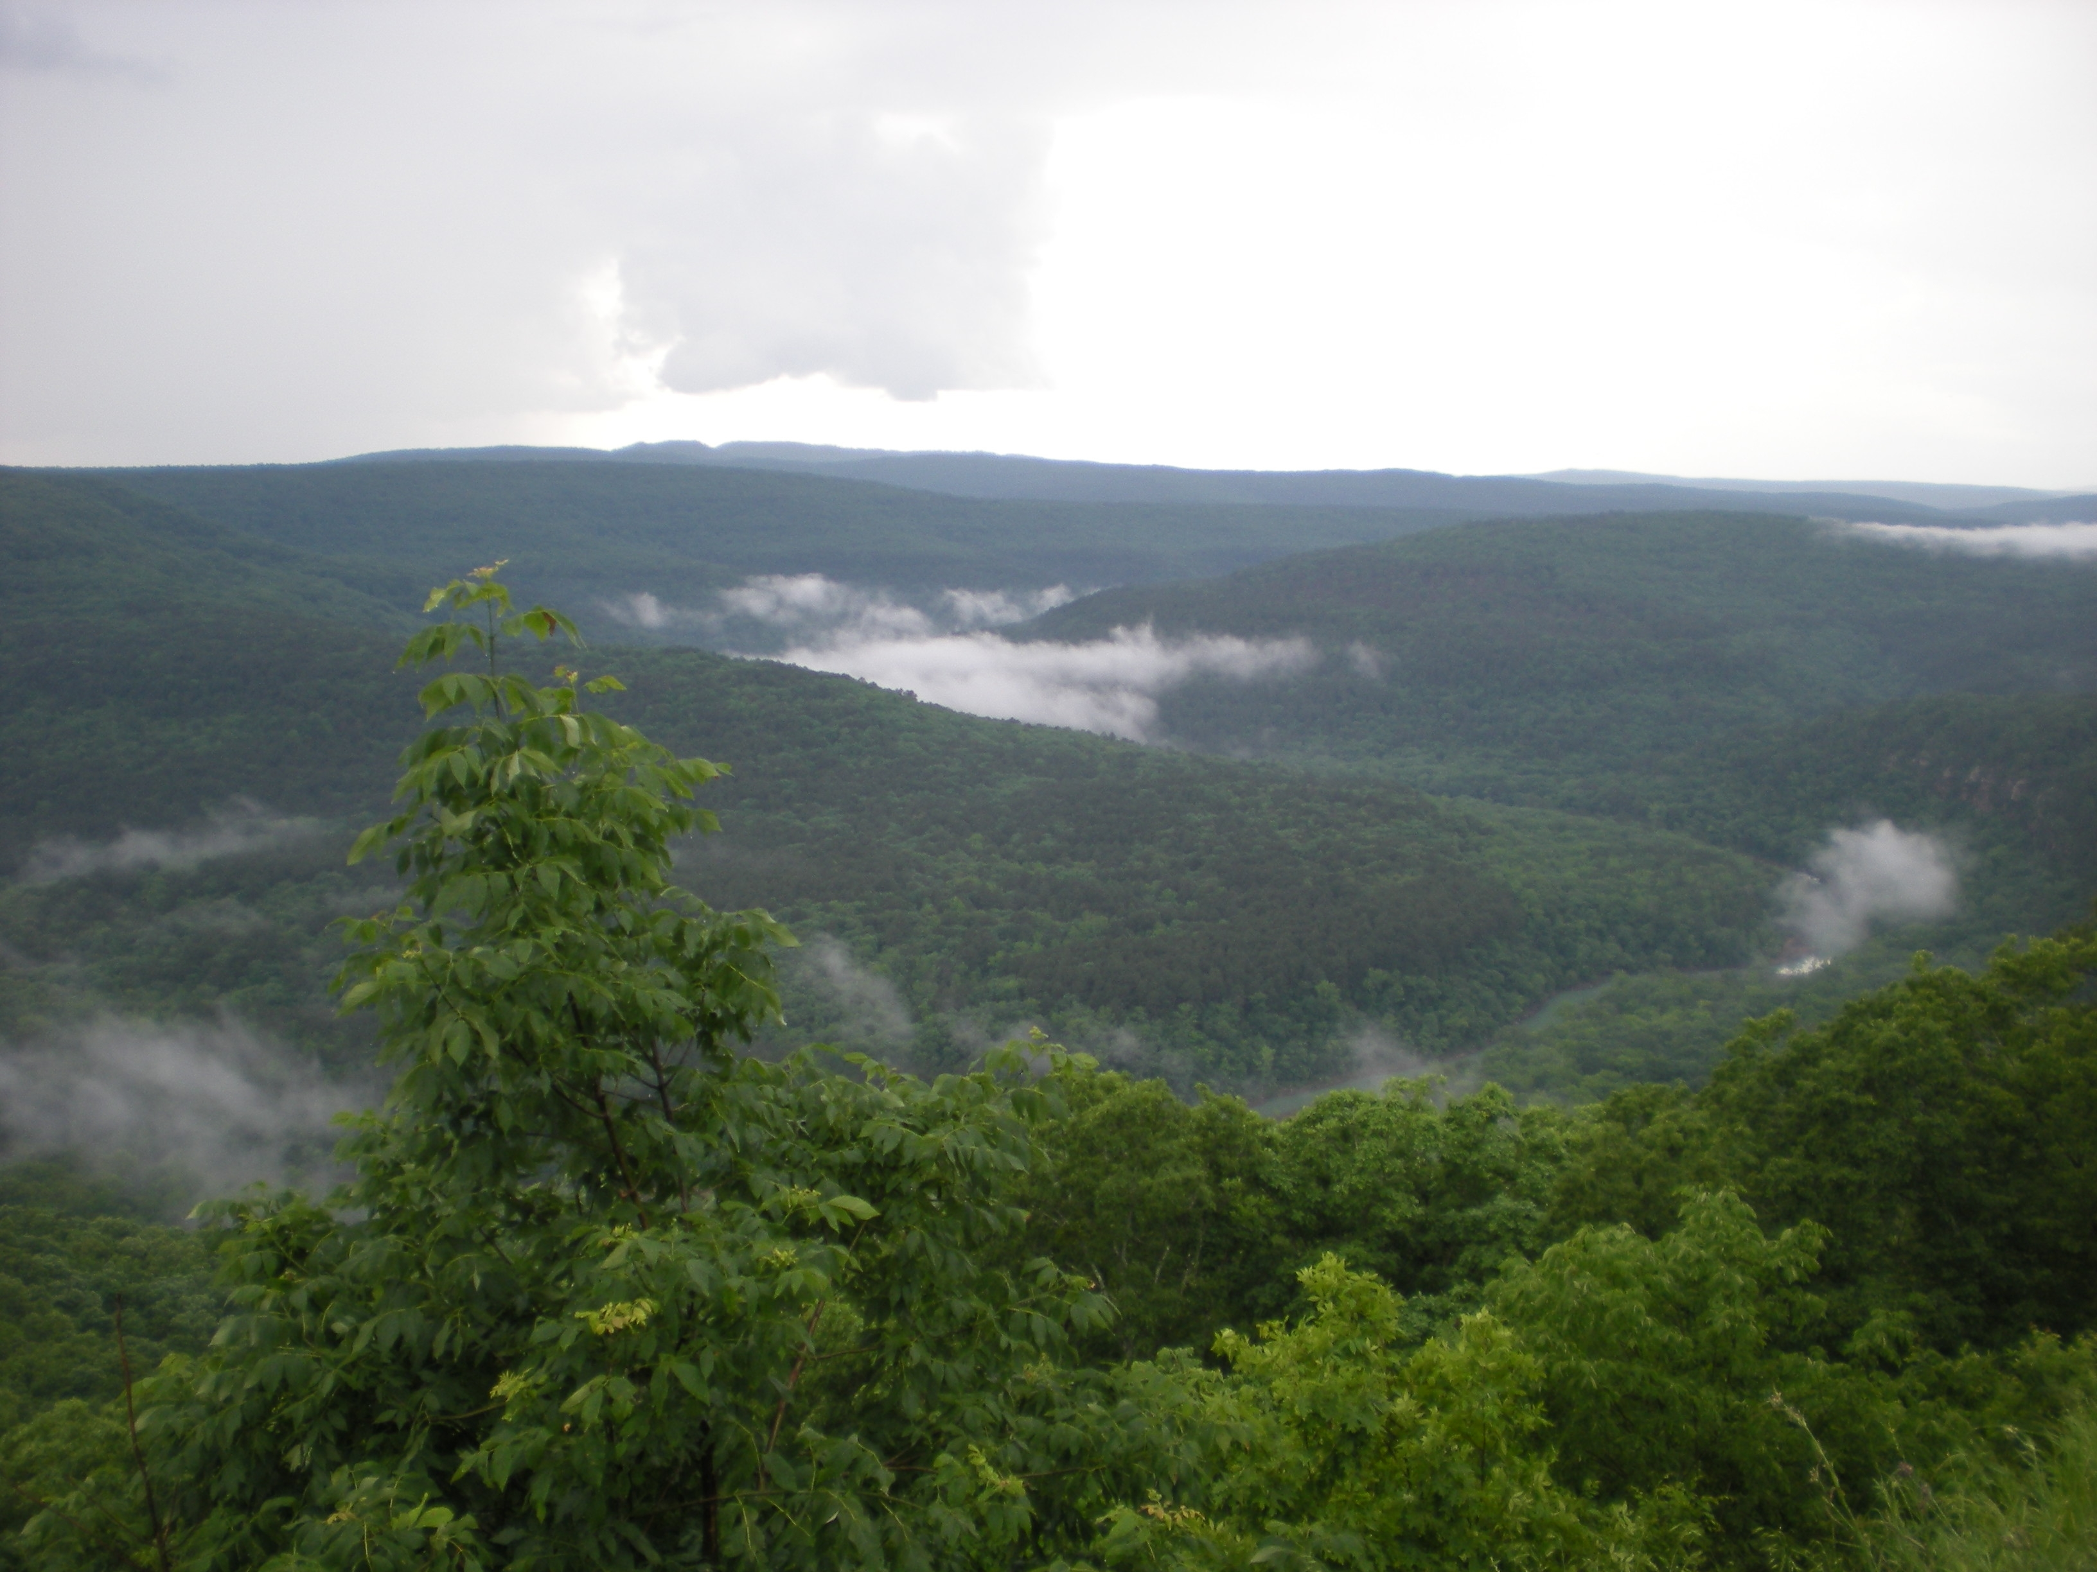

Module 2: Overview of Watershed Systems
Notes:
Now it’s time to talk about watersheds, and for instance.......what they are.......This is Big Piney Creek we are looking at right now from Dover Lights- Ozark National Forest Lookout. It’s really not that far from here and many of you are familiar with this area I am sure.

Slide 11
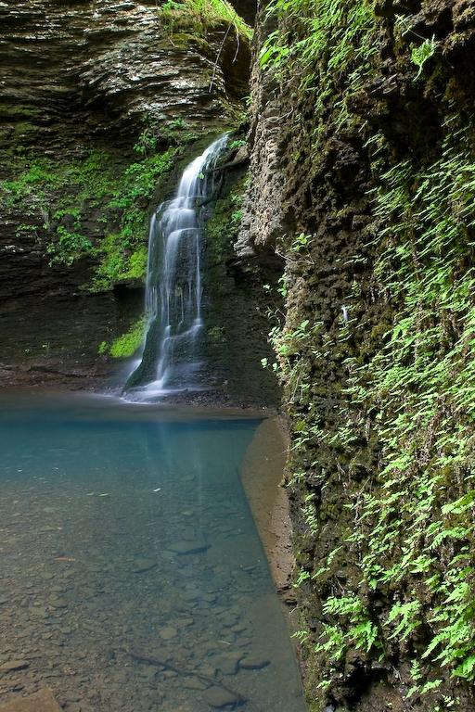
Module Outline
What is a Watershed?
Watersheds in Arkansas
How do Arkansans Use Watersheds?
Principles of Watershed Hydrology
Natural Watershed Functions and Features
Notes:
In this module participants are going to learn about watersheds, watersheds in Arkansas, uses of watersheds in Arkansas, principles of watershed hydrology, and natural watershed functions and features. For today we’re just going to briefly cover some info about these topics that are interesting.....or at least to me they are.

Slide 12
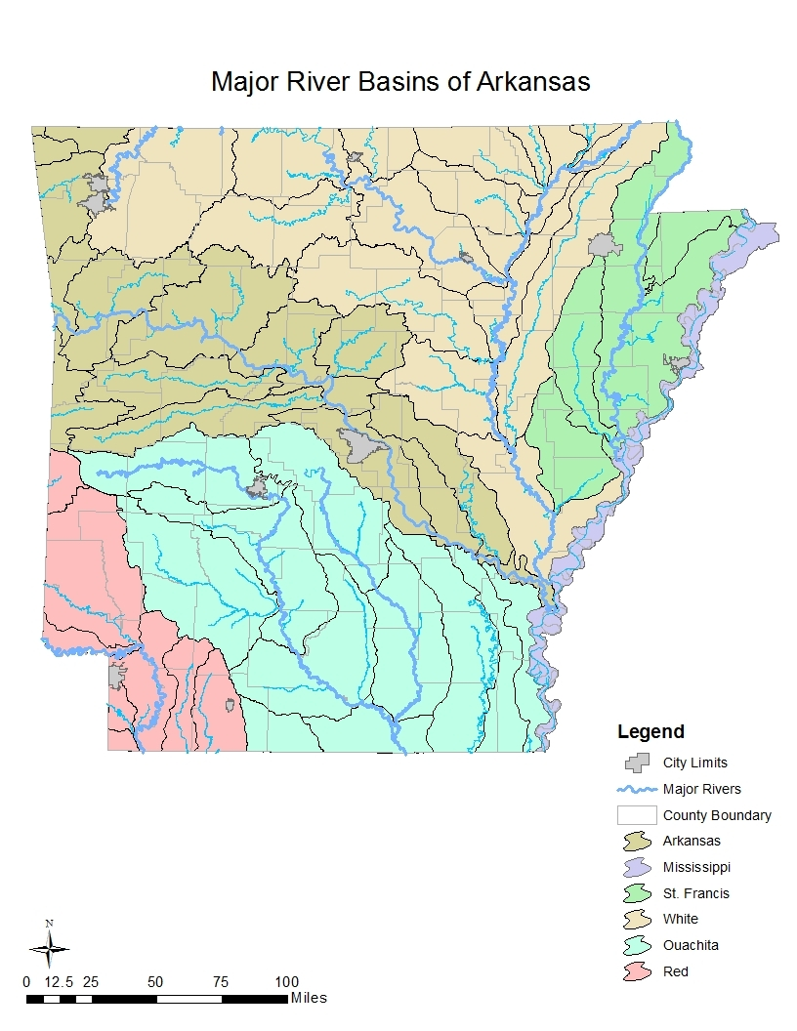
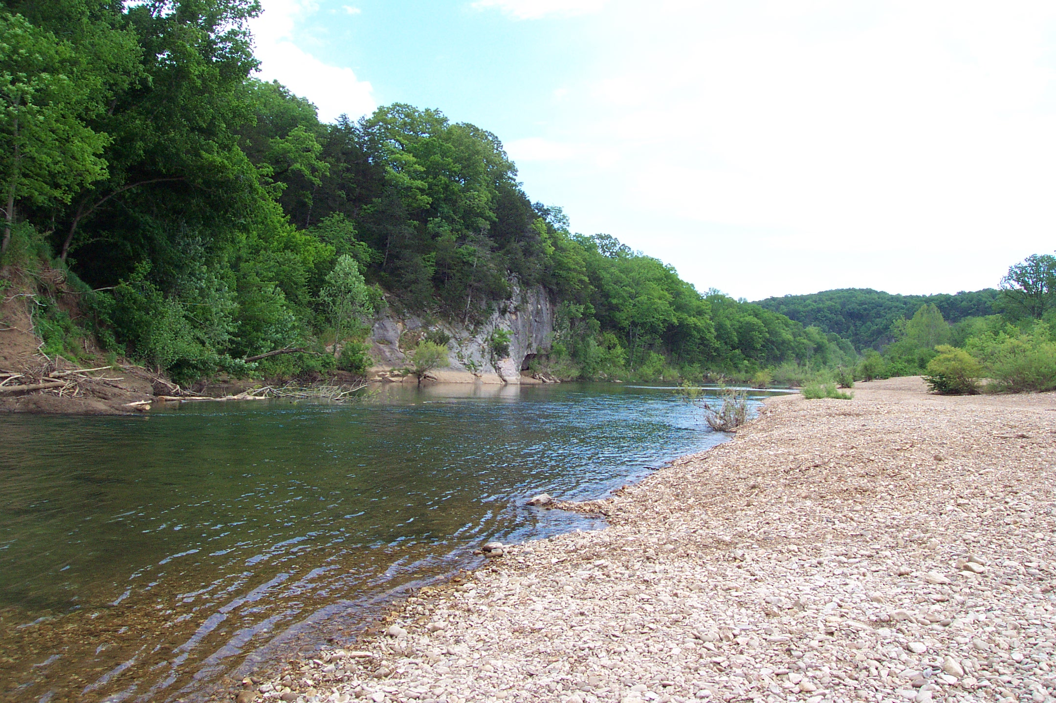
Arkansas River Basins
6 Major River Basins
Nearly 90,000 miles of streams and reservoirs
Notes:
Such as there are 6 major river basins in Arkansas and nearly 90,000 miles of streams. The White, Arkansas, St Francis, Ouachita, Red, and Mississippi are the six major basins. Of course many smaller watersheds, such as Lake Conway –Point Remove are within these larger drainage units. In this case the Arkansas River Watershed.

Slide 13
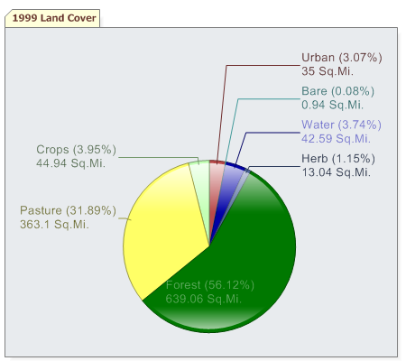
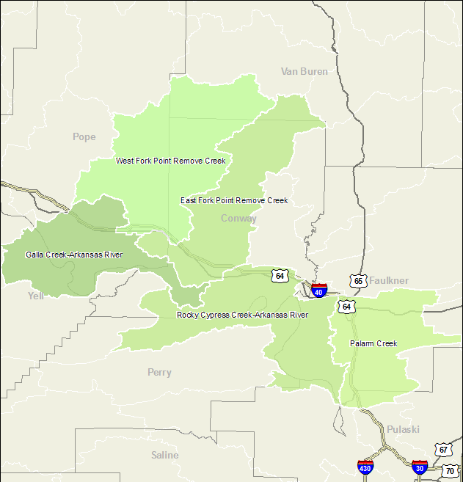
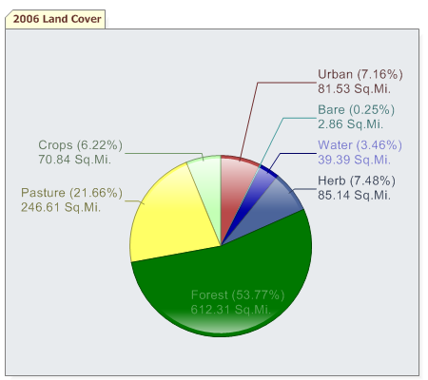
Let’s Learn More About Lake Conway-Point Remove
Notes:
Lake Conway-Point Remove watershed is a conglomeration of smaller watershed units that all drain to the Arkansas River at some point. Galla Creek, West Fork-Point Remove Creek, East-Fork Point Remove Creek, and so on as indicated in the map. Now lets check out some info about the entire watershed as a whole. Like it’s land cover changes from 1999 to 2006. Hmm, look at that. There are some considerable land use changes taking place it appears. I’ll be there have been even more since 2006.

Slide 14
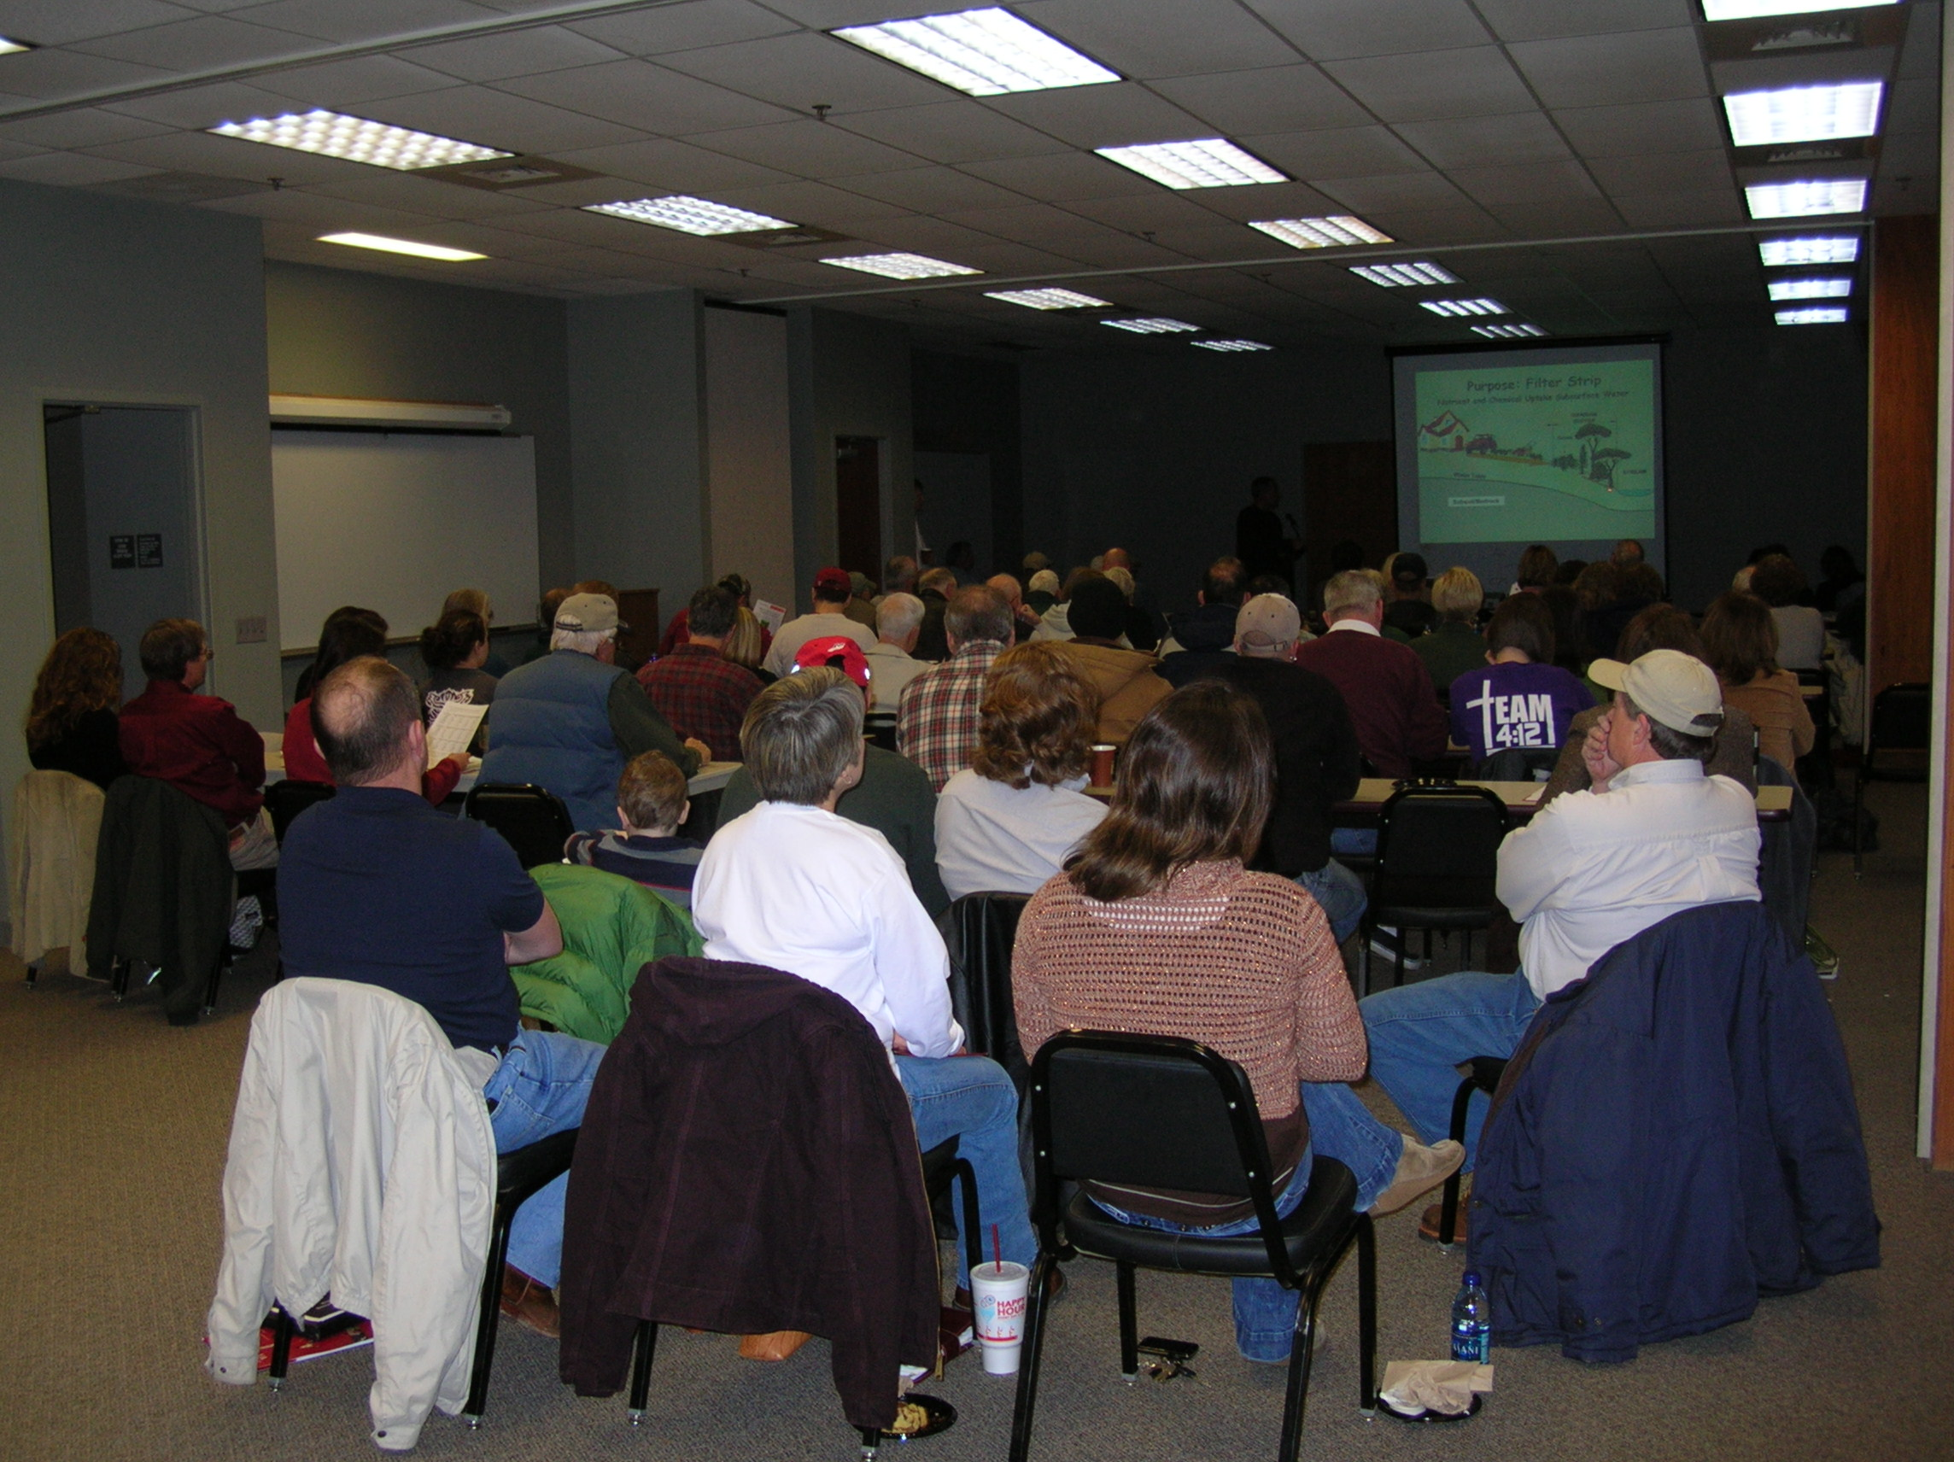
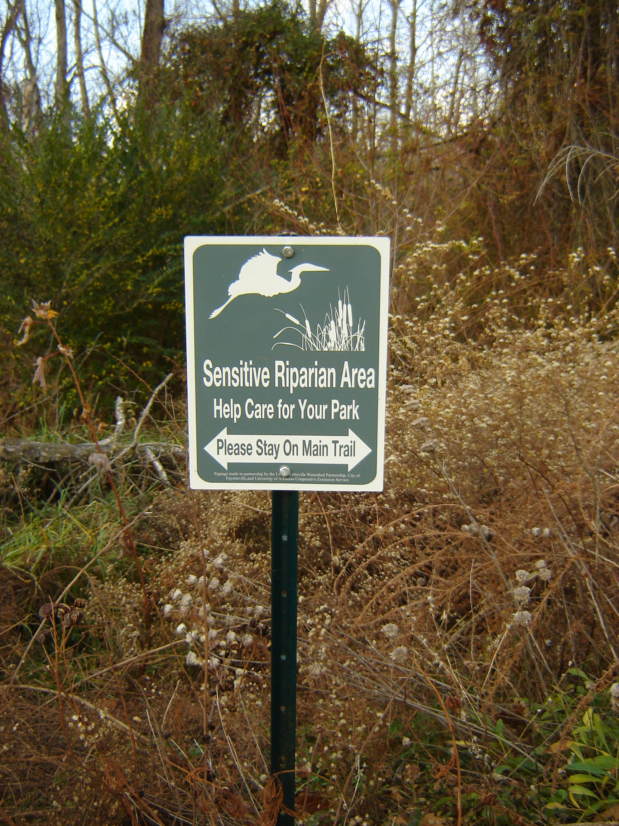
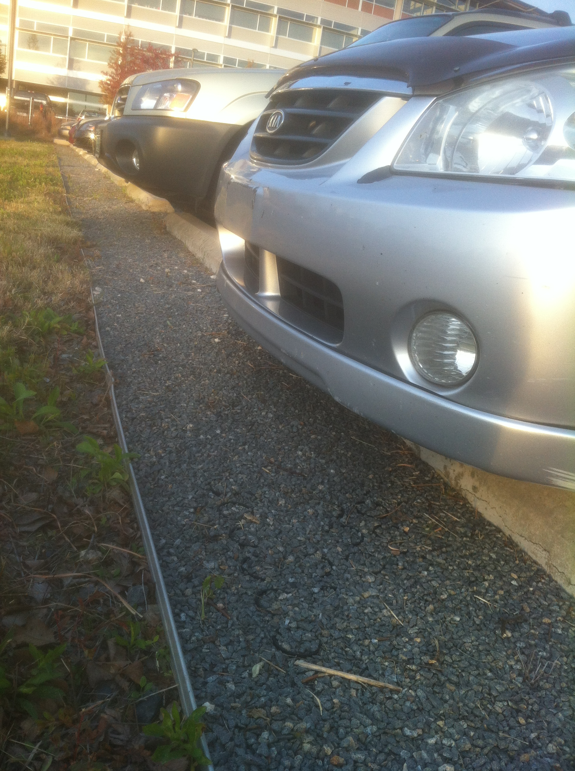
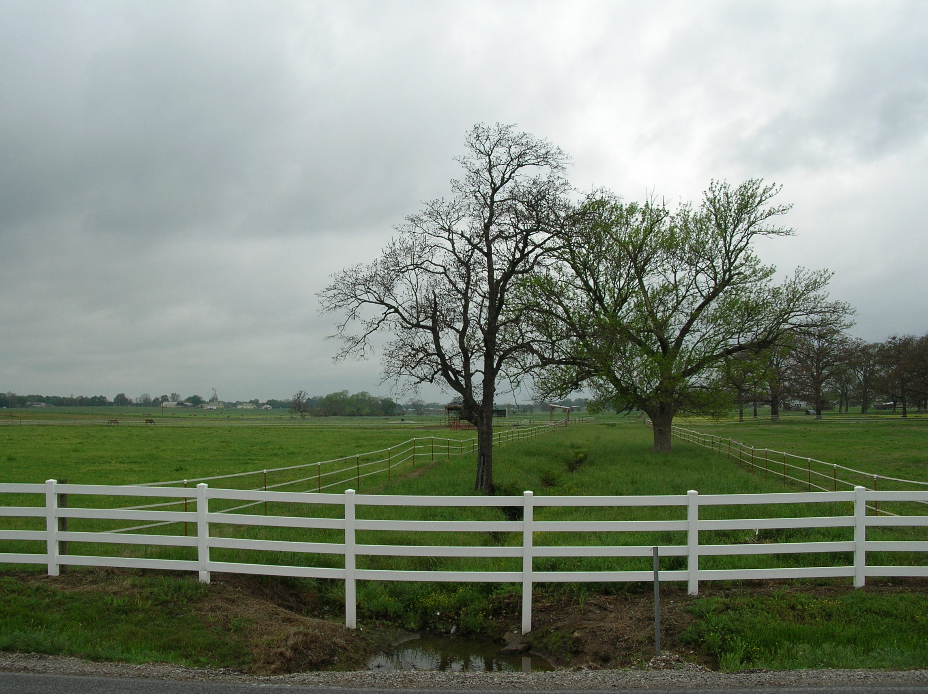
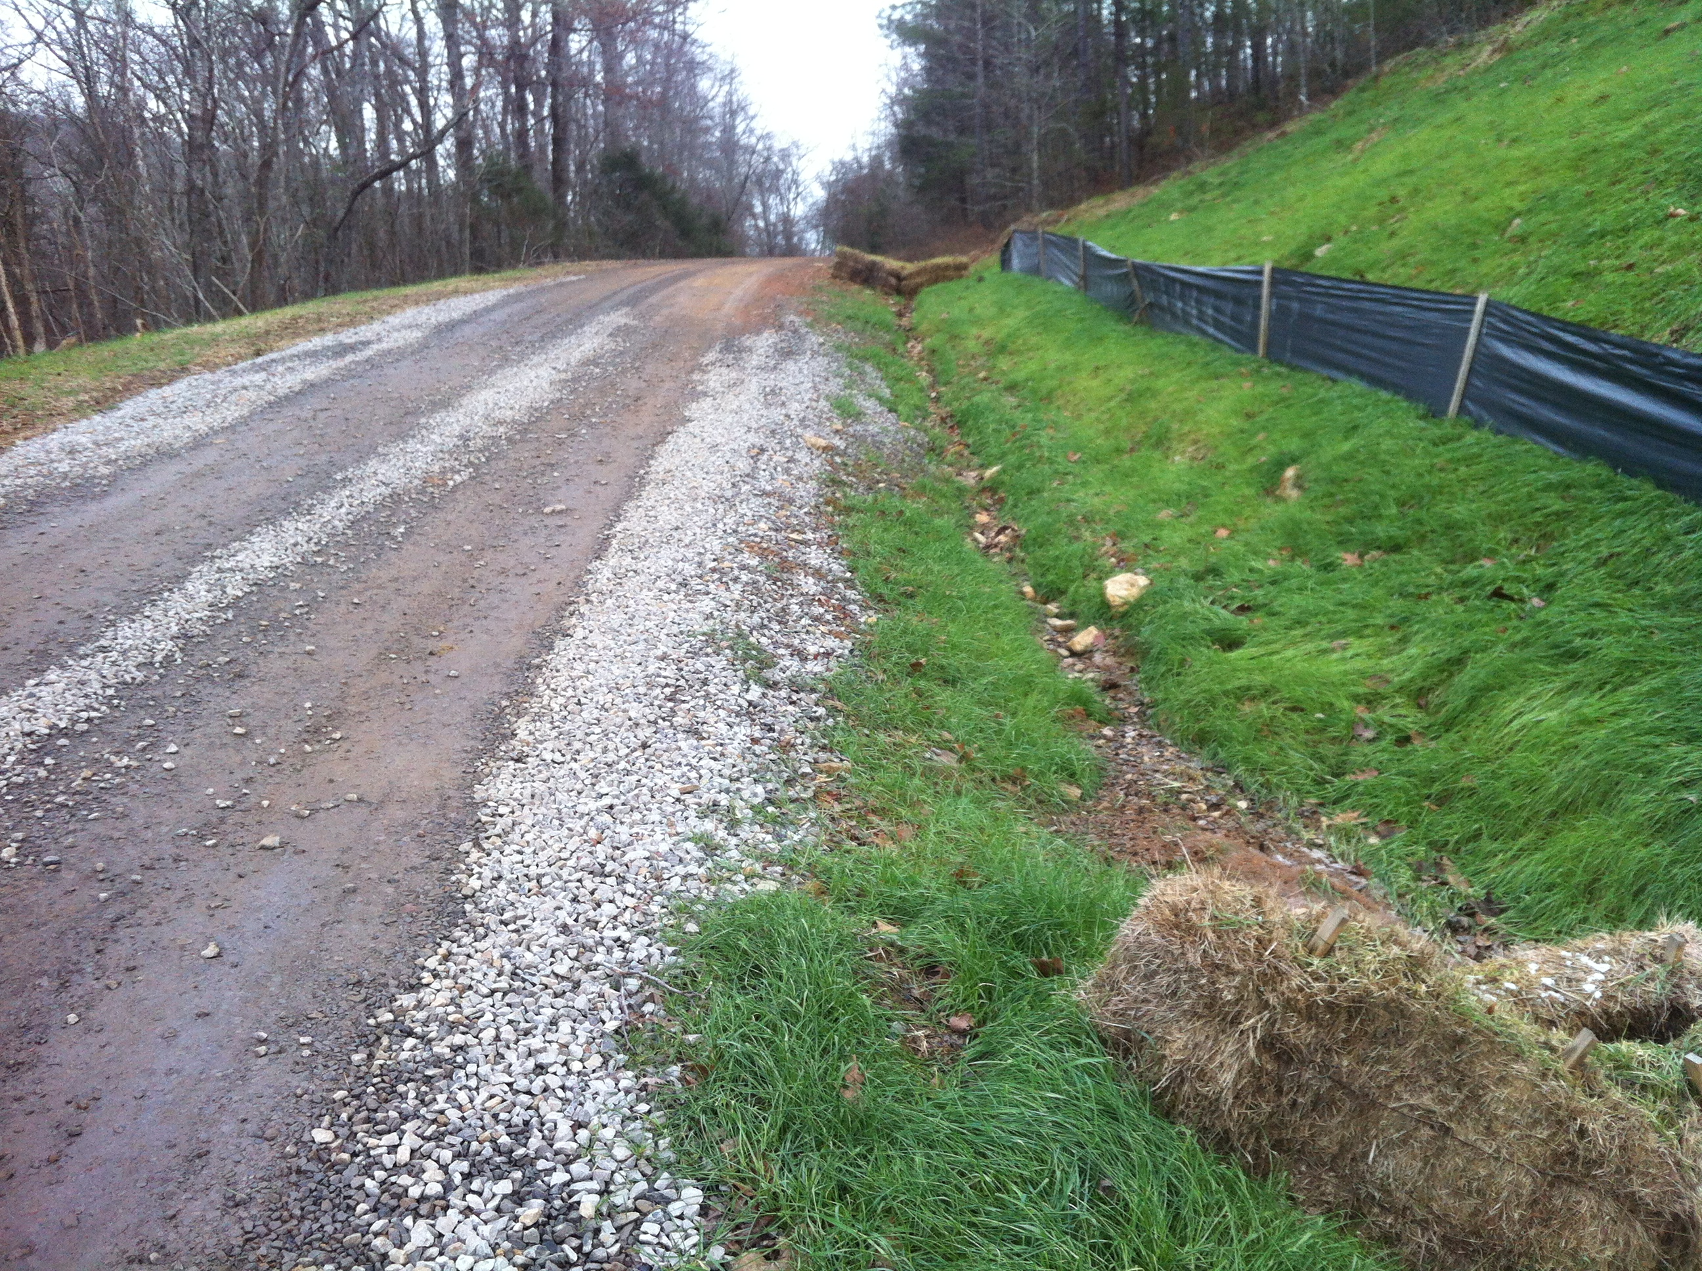
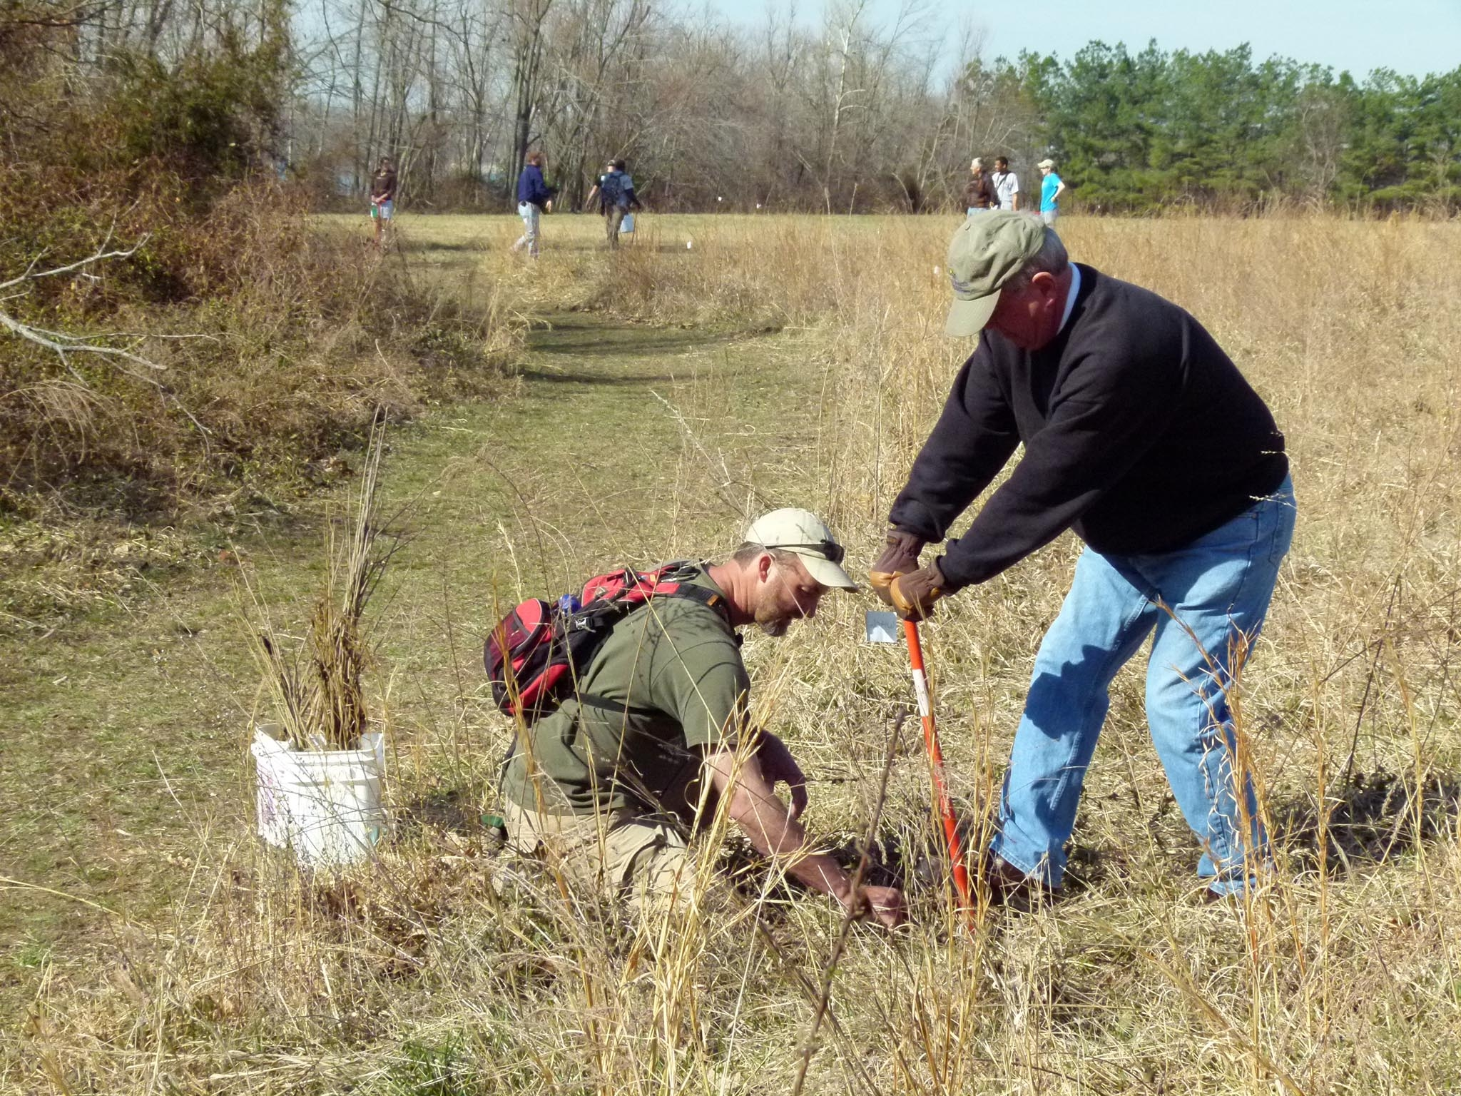
So What Happens Now?
Chapter 4: Managing to Improve Watershed Function
Notes:
I’m not sure what the best answer is here, I’ll bet it’s not having the EPA come in and tell anyone that they need significant upgrades to their municipal wastewater treatment plant! Or any other regulation for that matter. Still yet, that is very well what could happen unless efforts are undertaken to address these issues. And that is what this program is really all about. Informing citizens of Arkansas about these concepts and issues, in attempt to empower them to best address these issues and manage water resources wisely to the fullest extent.

Slide 15
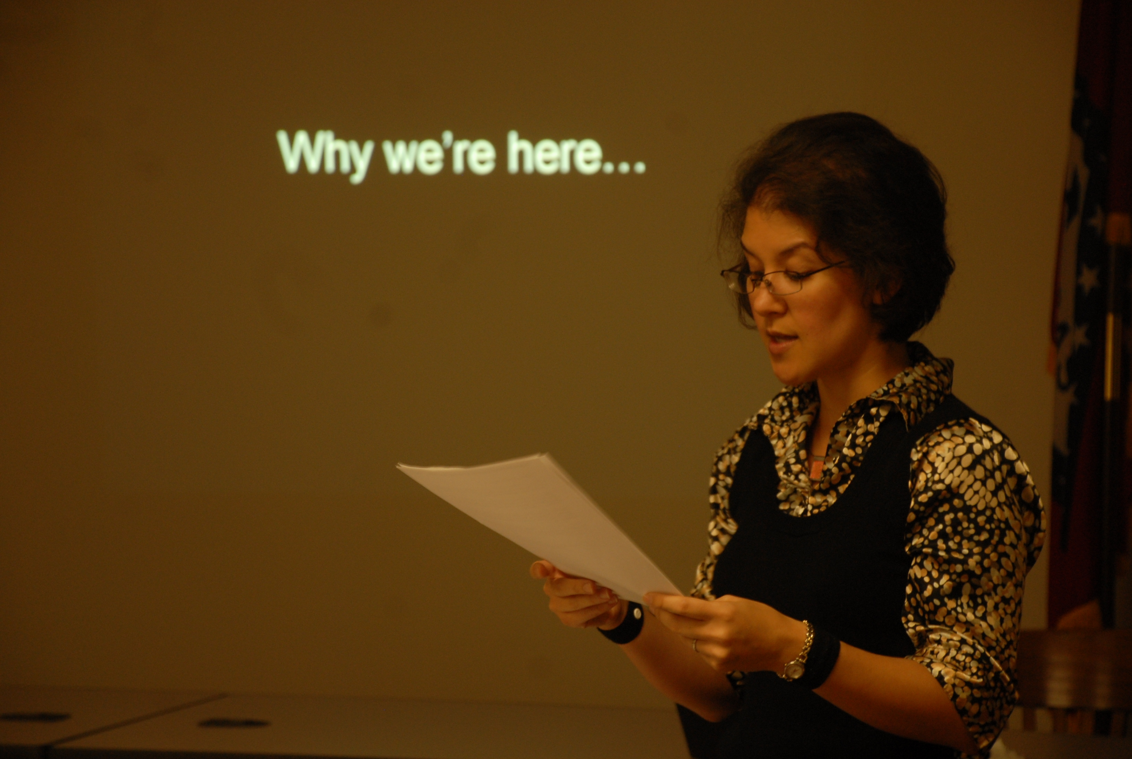
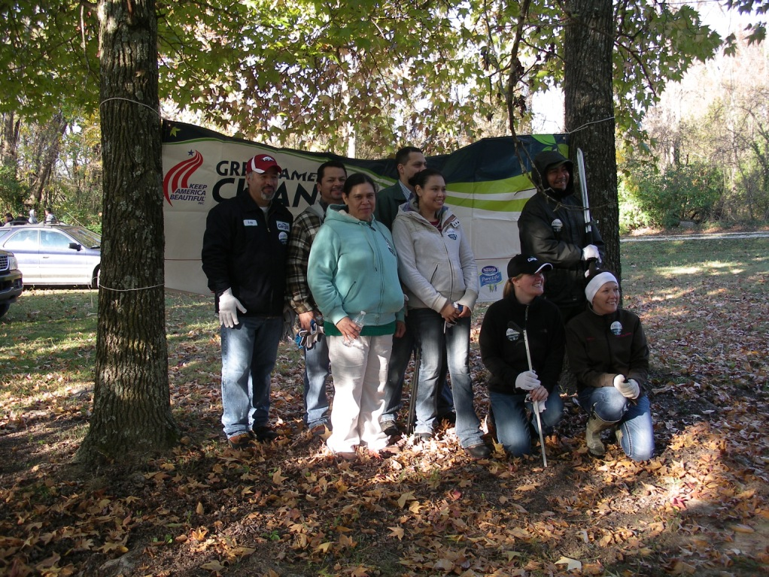
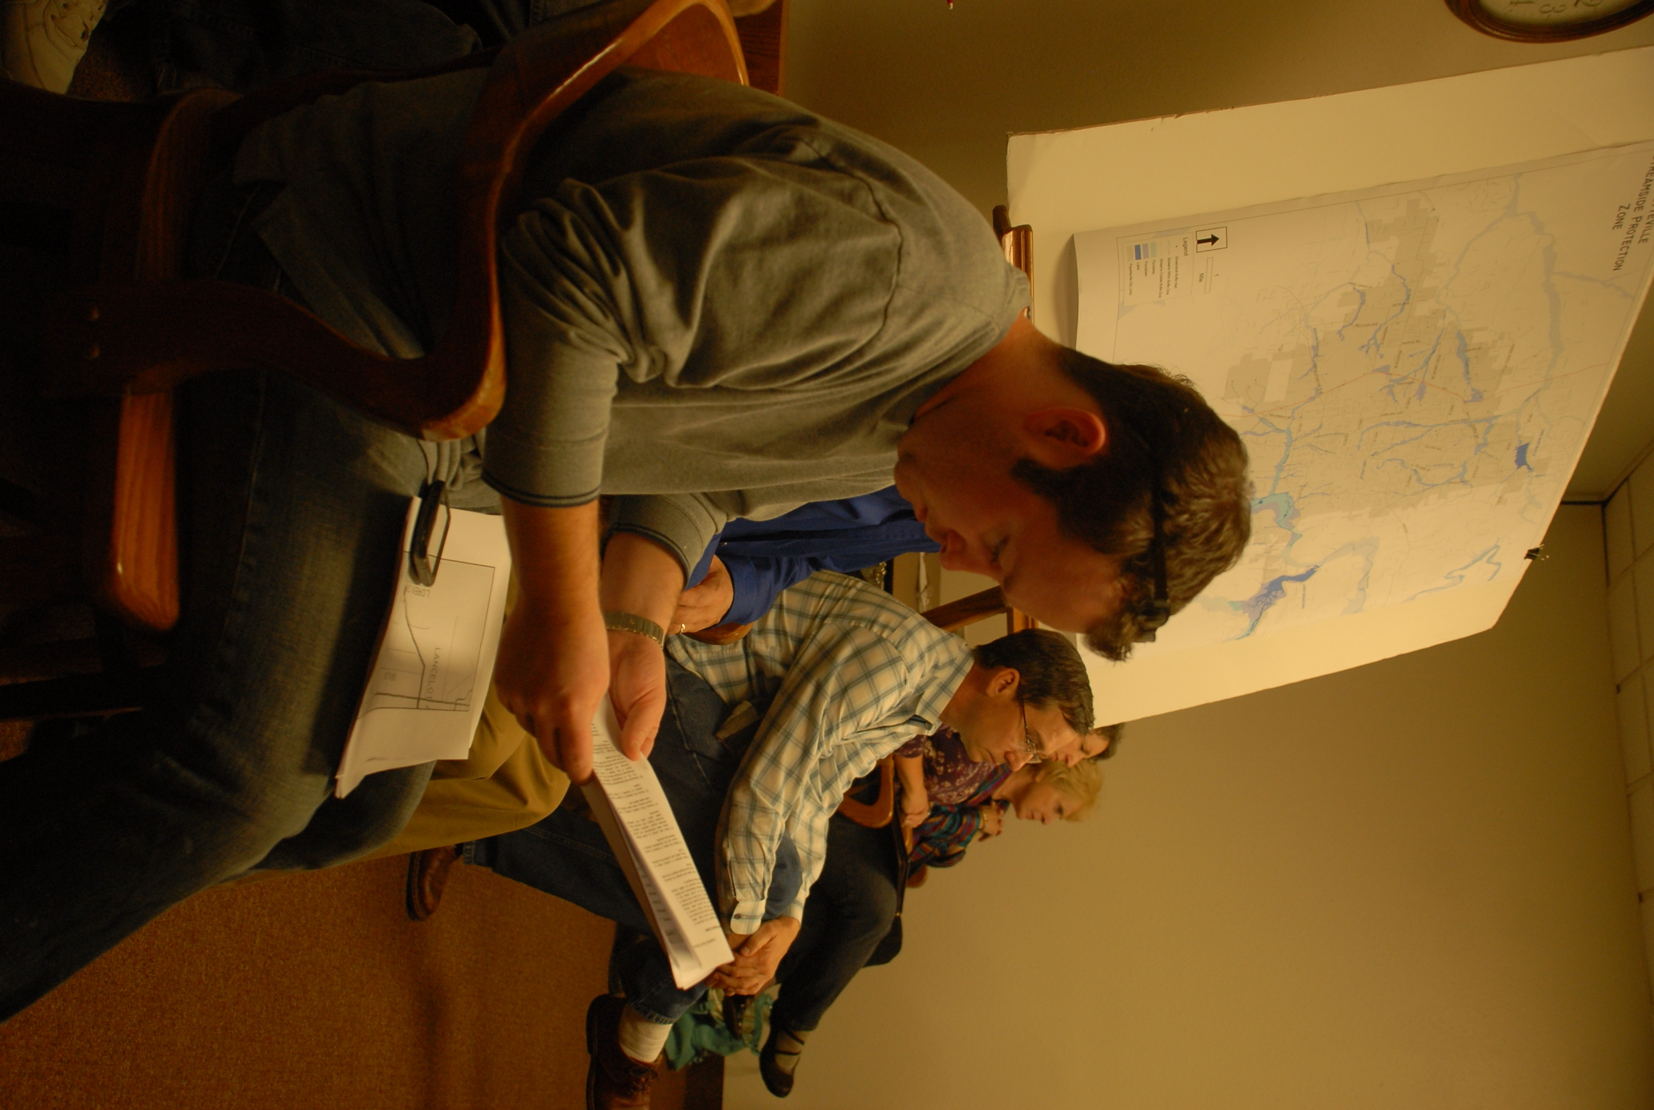
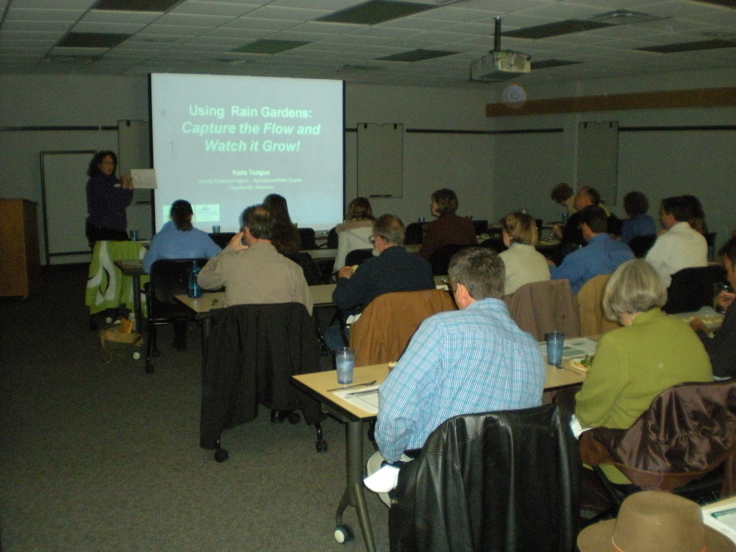
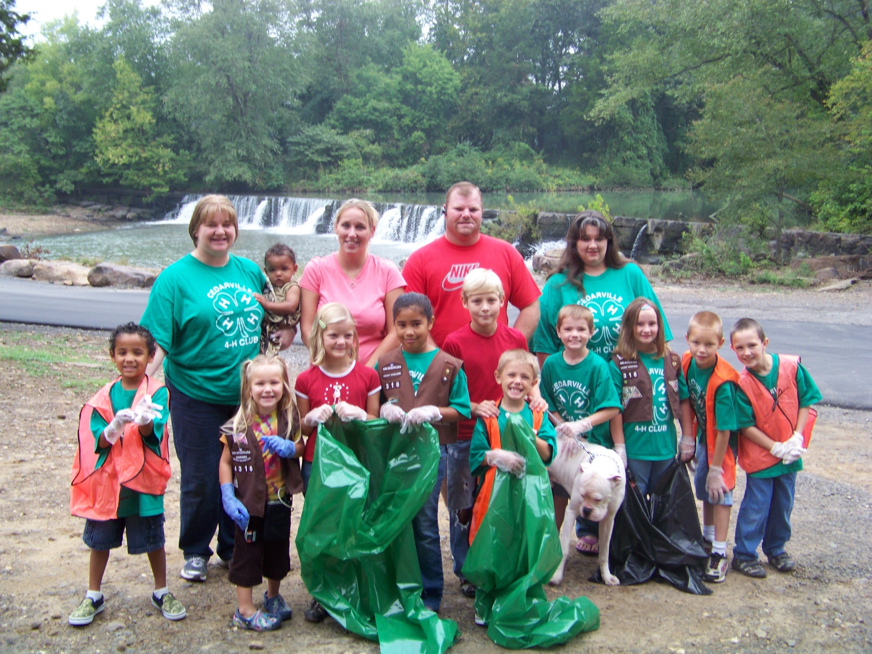
Community-Driven Watershed Protection and Management
Chapter 5
This is where you all come in....and everyone else of course
Notes:
Being actively engaged with community members to help inform them and get them involved with coming to the table to address real and serious community issues relating to water quality and quantity for the good of the community and future posterity. Are you willing to be involved? Are you willing to step up to the table? If so, please sign up on the form that is being passed around and include your contact info so that we can contact you when this program is offered in your neck of the woods. Also please feel free to contact me, if you are interested in having a portion of this program tailored for some of your programming needs.

Slide 16
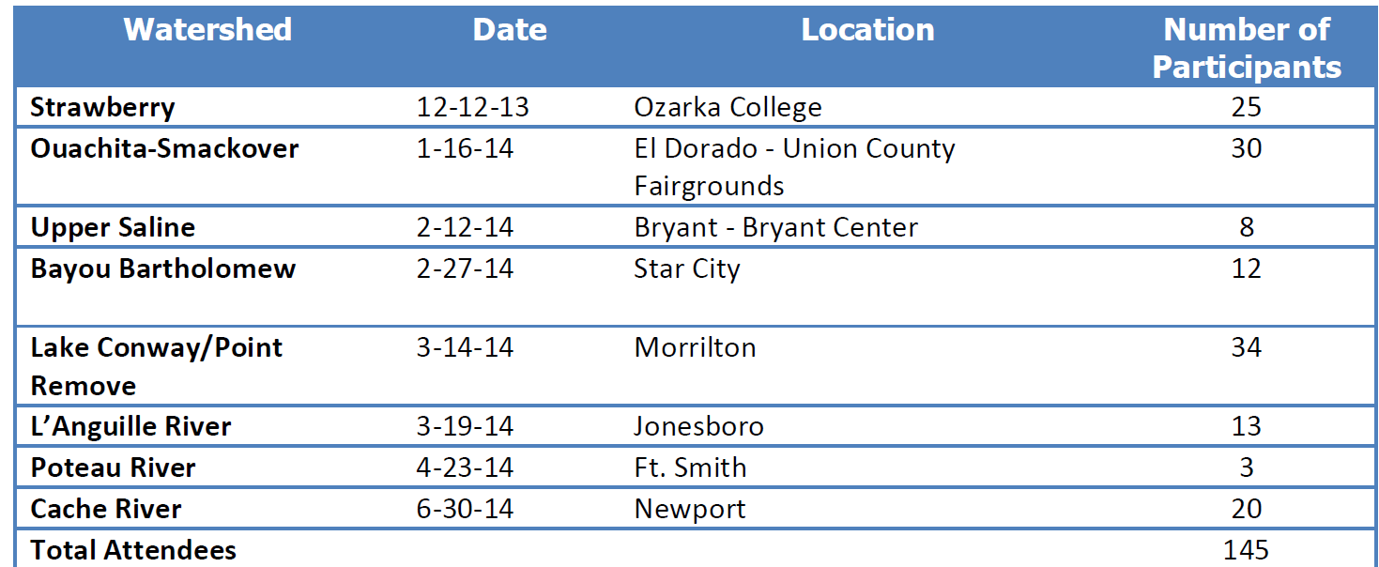
Workshops

Slide 17
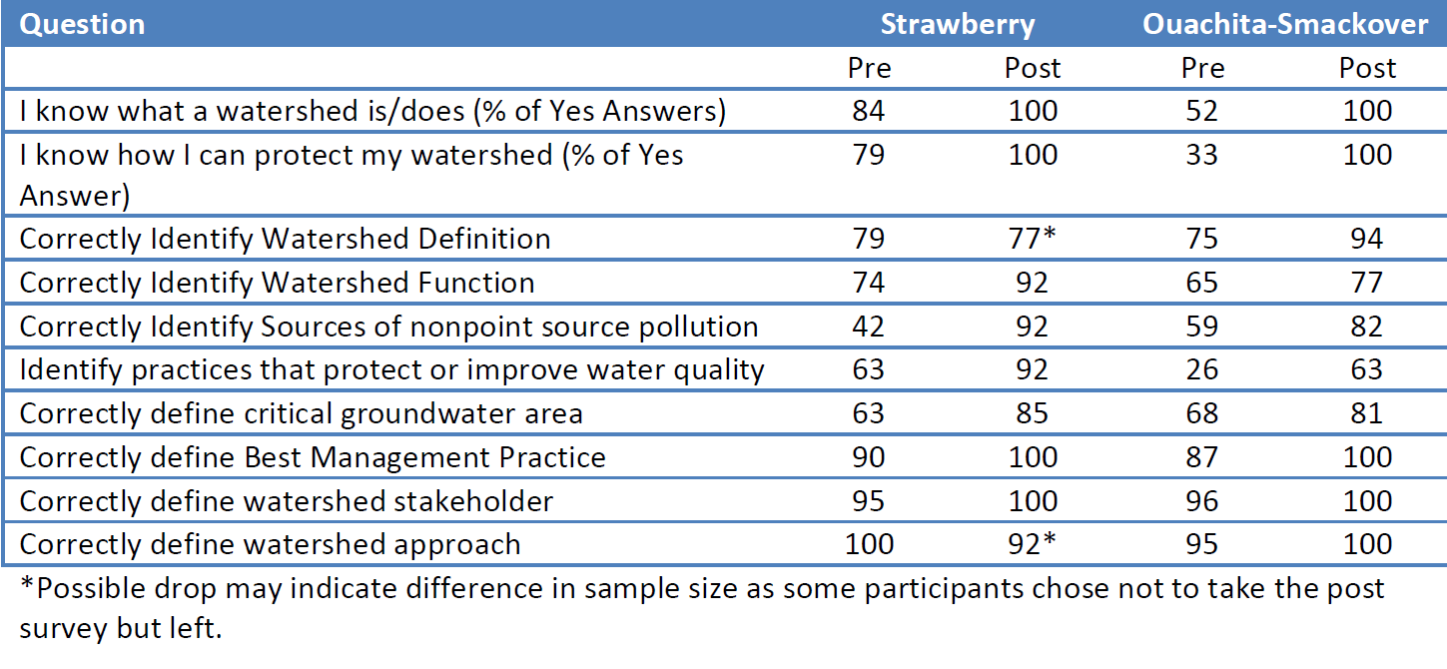
Feedback

Slide 18
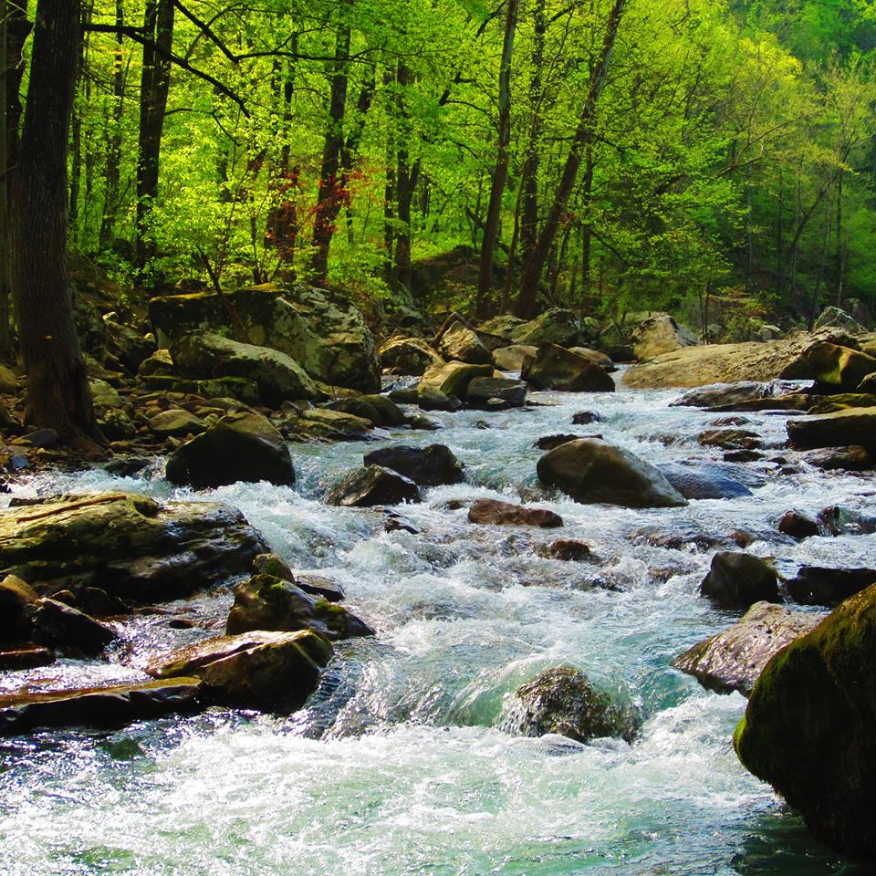
Questions

