Slide 1
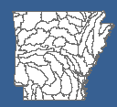

8-Digit HUC Watershed Prioritization in Arkansas
- Risk Assessment Matrix Approach
2014 Update
Threatened and Endangered (T&E) Species
Dharmendra Saraswat, Ph.D.
Associate Professor/Extension Engineer
Biological and Agricultural Engineering
Dsaraswat, 501-681-5987 (cell)
ANRC NPS Annual Stakeholder Meeting, September 17, 2014

Slide 2


What is Arkansas Watershed Prioritization Approach?
Pro-active stakeholder participation
A comparative risk assessment based collaborative process that integrate scientific analysis and stakeholder deliberation
For further details please refer:
Fact sheet #FSPPC 116- Watershed prioritization for managing nonpoint source pollution in Arkansas. Available at http://www.uaex.edu/publications/pdf/FSPPC116.pdf
ANRC NPS Annual Stakeholder Meeting, September 17, 2014
ANRC NPS Annual Stakeholder Meeting, September 17, 2014

Slide 3

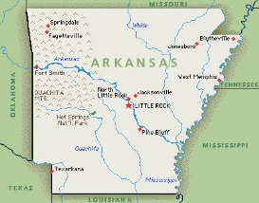
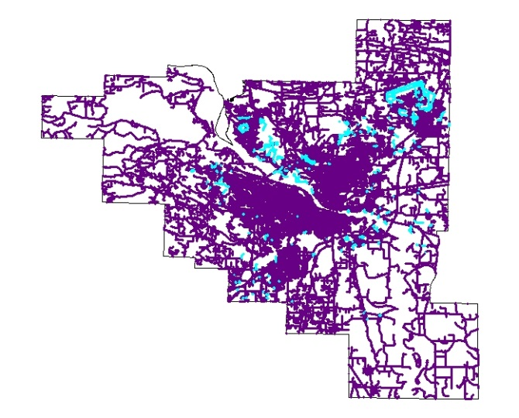


What Data Sources are considered?
Federal
State
NASS Data, Census Data, 303(d) list, Land Use Land Cover, and Road network
ANRC NPS Annual Stakeholder Meeting, September 17, 2014
ANRC NPS Annual Stakeholder Meeting, September 17, 2014

Slide 4
Continuous Stakeholder Engagement
2005-2009 Plan
2008 Revision
Sl# | Approved category
1 | Water Body impairment
2 | Human Health Impact
3 | Biotic Impacts
4 | Potential Human Exposure
5 | Construction
6 | Rural Roads
7 | Non-row Crop Agriculture
8 | Row Crop Agriculture
9 | Urban
10 | Forestry
11 | Priority of a Bordering State
Water Body Impairment
2. Designated Use Impact
3. Biotic Impacts
4. Potential Human Exposure
5. Urban and Suburban Population
6. Impervious Surface
7. Economic Activity
8. Cropland
9. Livestock and Pasture
10. Unpaved Roads
11. Forestry
12. Priority of Neighboring State
ANRC NPS Annual Stakeholder Meeting, September 17, 2014
ANRC NPS Annual Stakeholder Meeting, September 17, 2014

Slide 5
Scoring Approach
Assign Score for Each Category
Final Score
=
Overlay
3
4
8
10
3
4
8
10
3
4
8
10
3
4
8
10
3
4
8
10
2
6
8
6
2
6
8
6
2
6
8
6
1. Water Impairment
X
1. Water Impairment
3
4
8
10
(
2
6
8
6
2
6
8
6
3
10
5
1
3
10
5
1
3
10
5
1
2. Use Impact
3
4
8
10
2
6
8
6
3
10
5
1
3
7
9
10
3
10
5
1
3. Biotic Impact
3
7
9
10
3
7
9
10
3
4
8
10
2
6
8
6
3
10
5
1
4. Human Exposure
3
7
9
10
3
4
8
10
3
7
9
10
3
4
8
10
2
6
8
6
3
10
5
1
2
6
8
6
3
7
9
10
5. Urban/Suburban Population
2. Use Impact
3
4
8
10
2
6
8
6
3
10
5
1
3
10
5
1
3
7
9
10
6. Impervious Surface
3
4
8
10
3
7
9
10
2
6
8
6
3
10
5
1
3
7
9
10
7. Economic Activity
3
4
8
10
2
6
8
6
3
10
5
1
8. Cropland
0
10
0
10
3
7
9
10
3
4
8
10
2
6
8
6
3
10
5
1
9. Livestock & Pasture
10
0
0
0
3
7
9
10
3
4
8
10
2
6
8
6
3
10
5
1
10. Unpaved Roads
0
0
0
0
3
7
9
10
12. Neighboring State Priority
3
4
8
10
0
10
0
10
2
6
8
6
3
10
5
1
11. Forestry
0
0
0
10
3
7
9
10
)
2
6
8
6
10
0
0
0
12. Neighbor’s Priority
3
10
5
1
3
7
9
10
0
0
0
0
3
10
5
1
3
7
9
10
0
0
0
10
ANRC NPS Annual Stakeholder Meeting, September 17, 2014
ANRC NPS Annual Stakeholder Meeting, September 17, 2014
3
7
9
10

Slide 6
Proposed Revision- Time line
During 2013 ANRC NPS Annual Stakeholder meeting, a proposal to include Threatened and Endangered (T&E) species in the matrix was considered
A workgroup was formed to discuss adding T & E species as matrix variable
The group met on November 6, 2013 and May 28, 2014 and came up with an approach for consideration by the stakeholders group
ANRC NPS Annual Stakeholder Meeting, September 17, 2014
ANRC NPS Annual Stakeholder Meeting, September 17, 2014

Slide 7
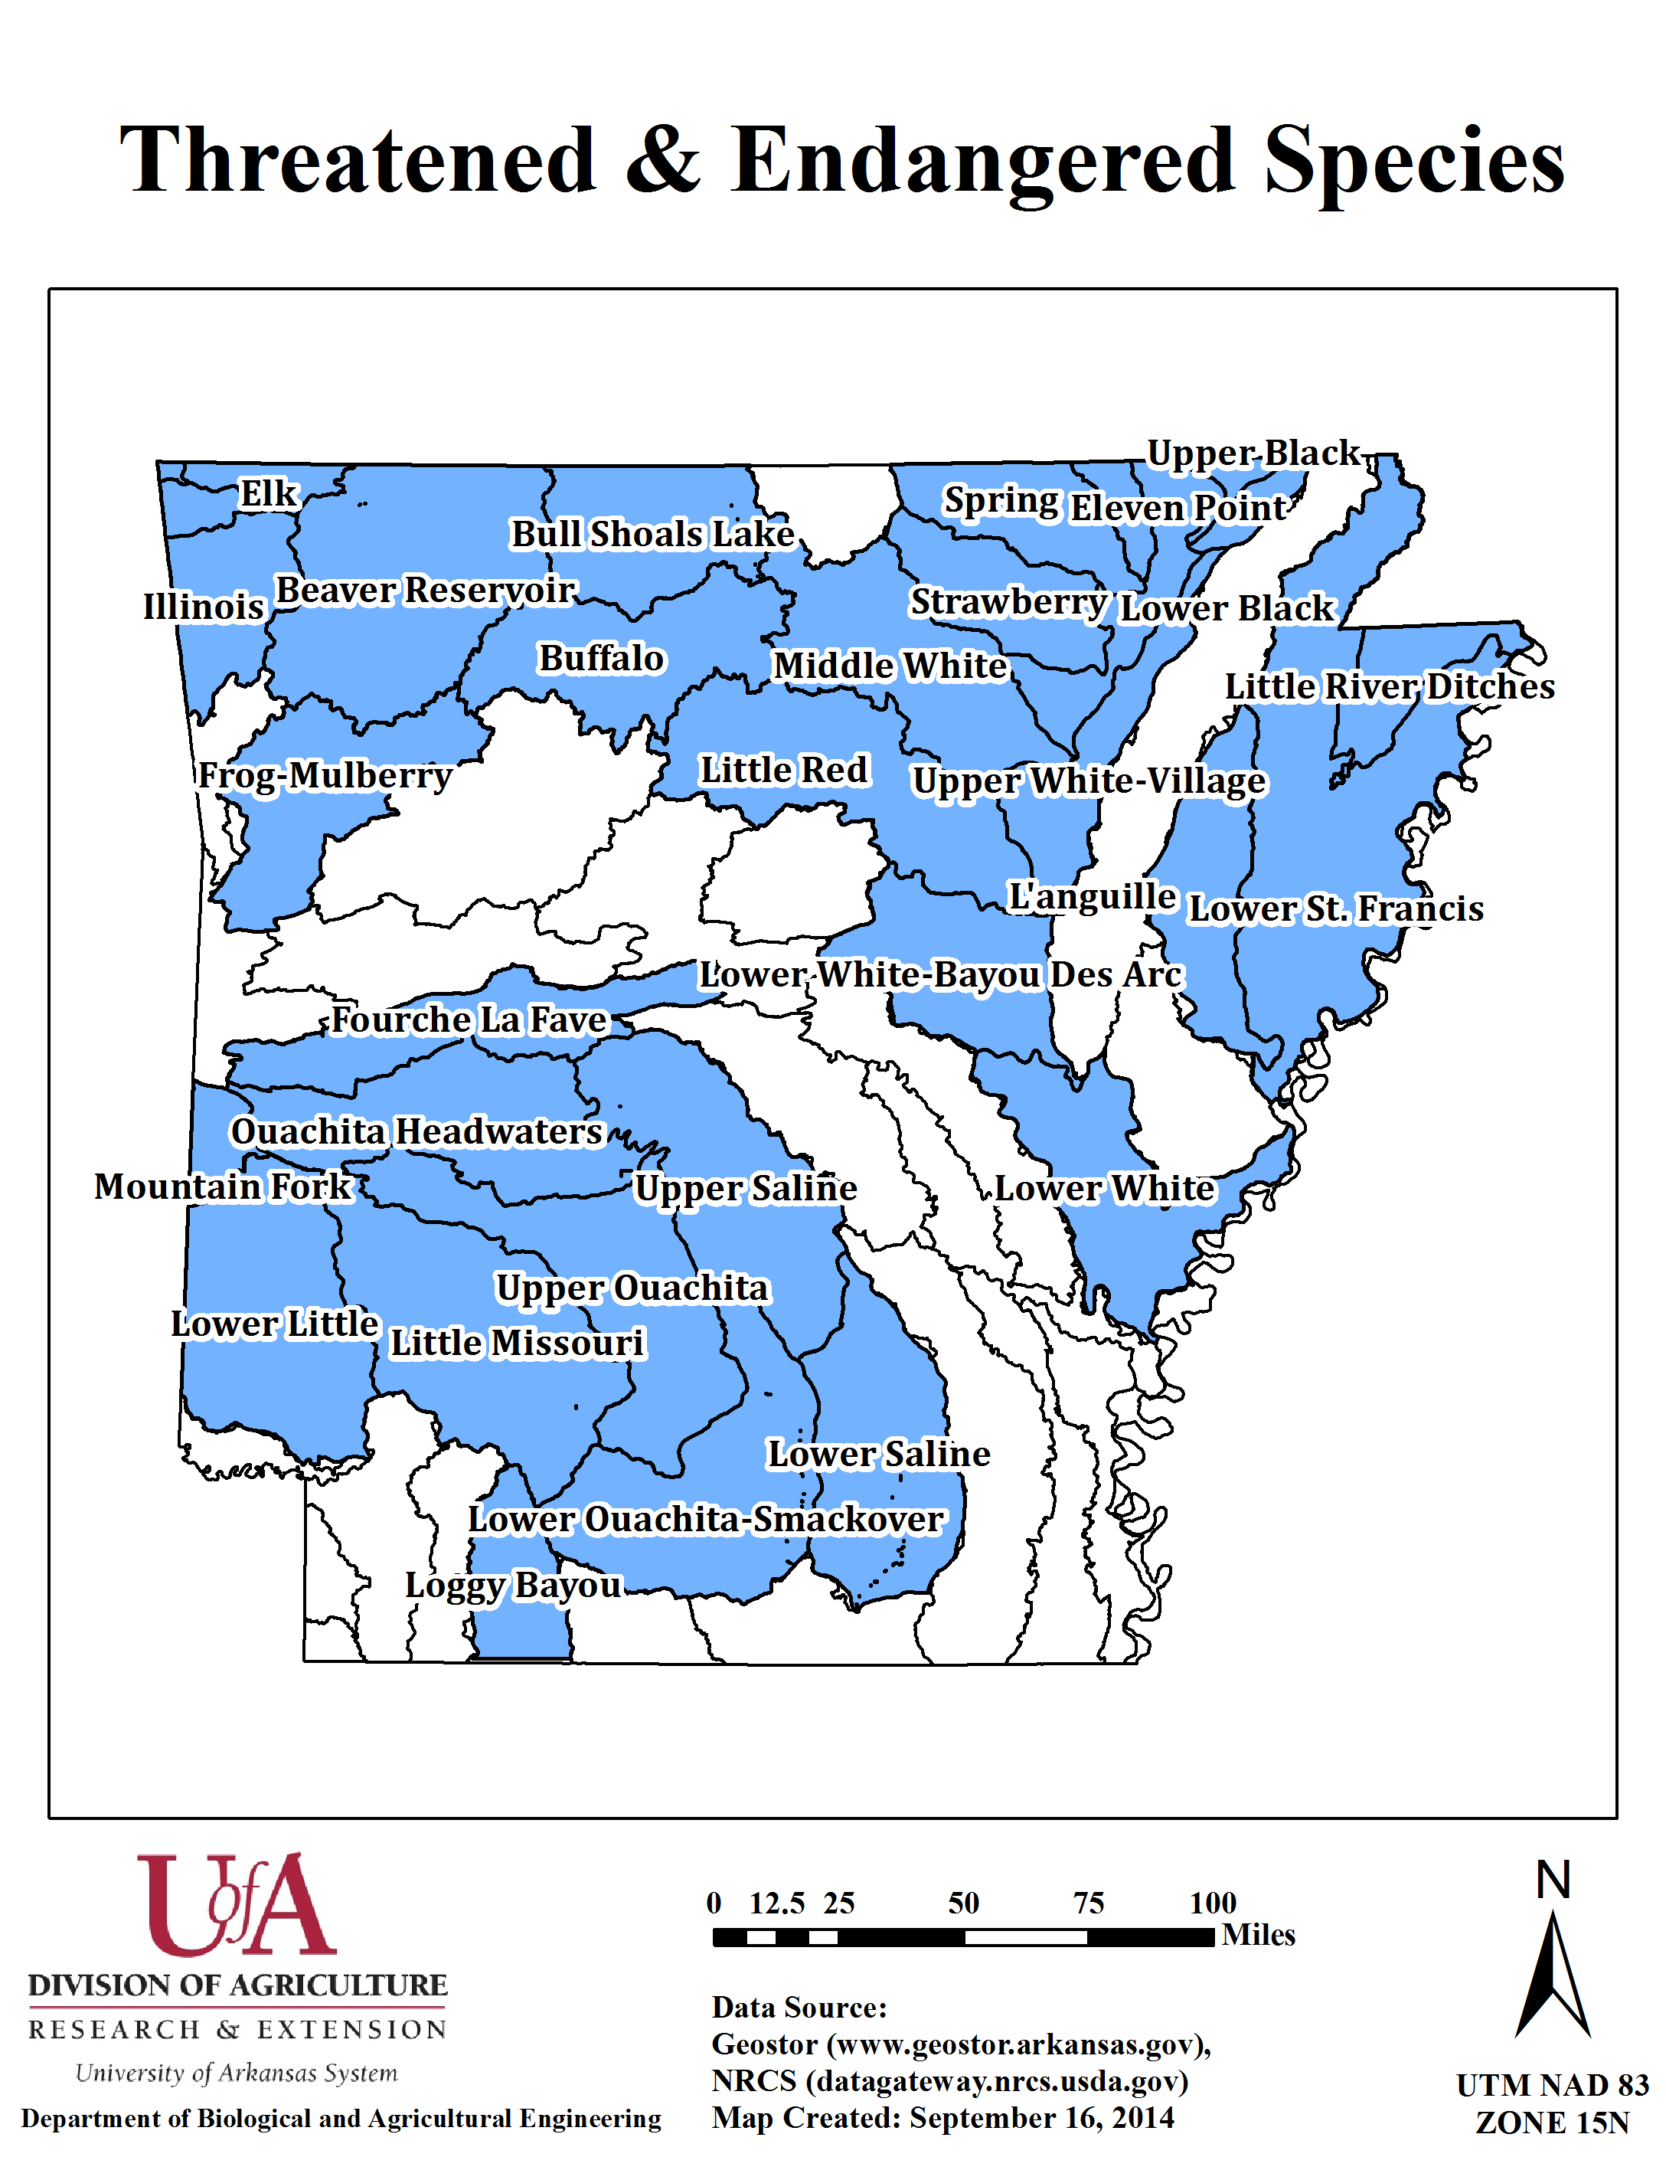
T&E Species in AR Watersheds
Present in 32 (out of 58)
8-digit HUC watersheds
Source: Chris Davidson, US Fish and Wildlife Service
ANRC NPS Annual Stakeholder Meeting, September 17, 2014
ANRC NPS Annual Stakeholder Meeting, September 17, 2014

Slide 8
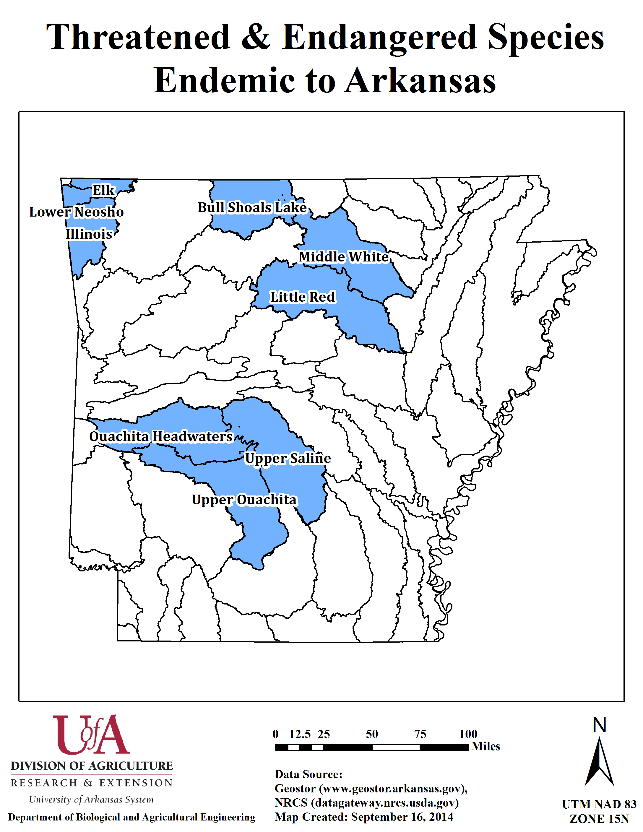
T&E Species Endemic to Arkansas
Present in 9 (out of 58)
8-digit HUC watersheds
Source: Chris Davidson, US Fish and Wildlife Service
ANRC NPS Annual Stakeholder Meeting, September 17, 2014
ANRC NPS Annual Stakeholder Meeting, September 17, 2014

Slide 9
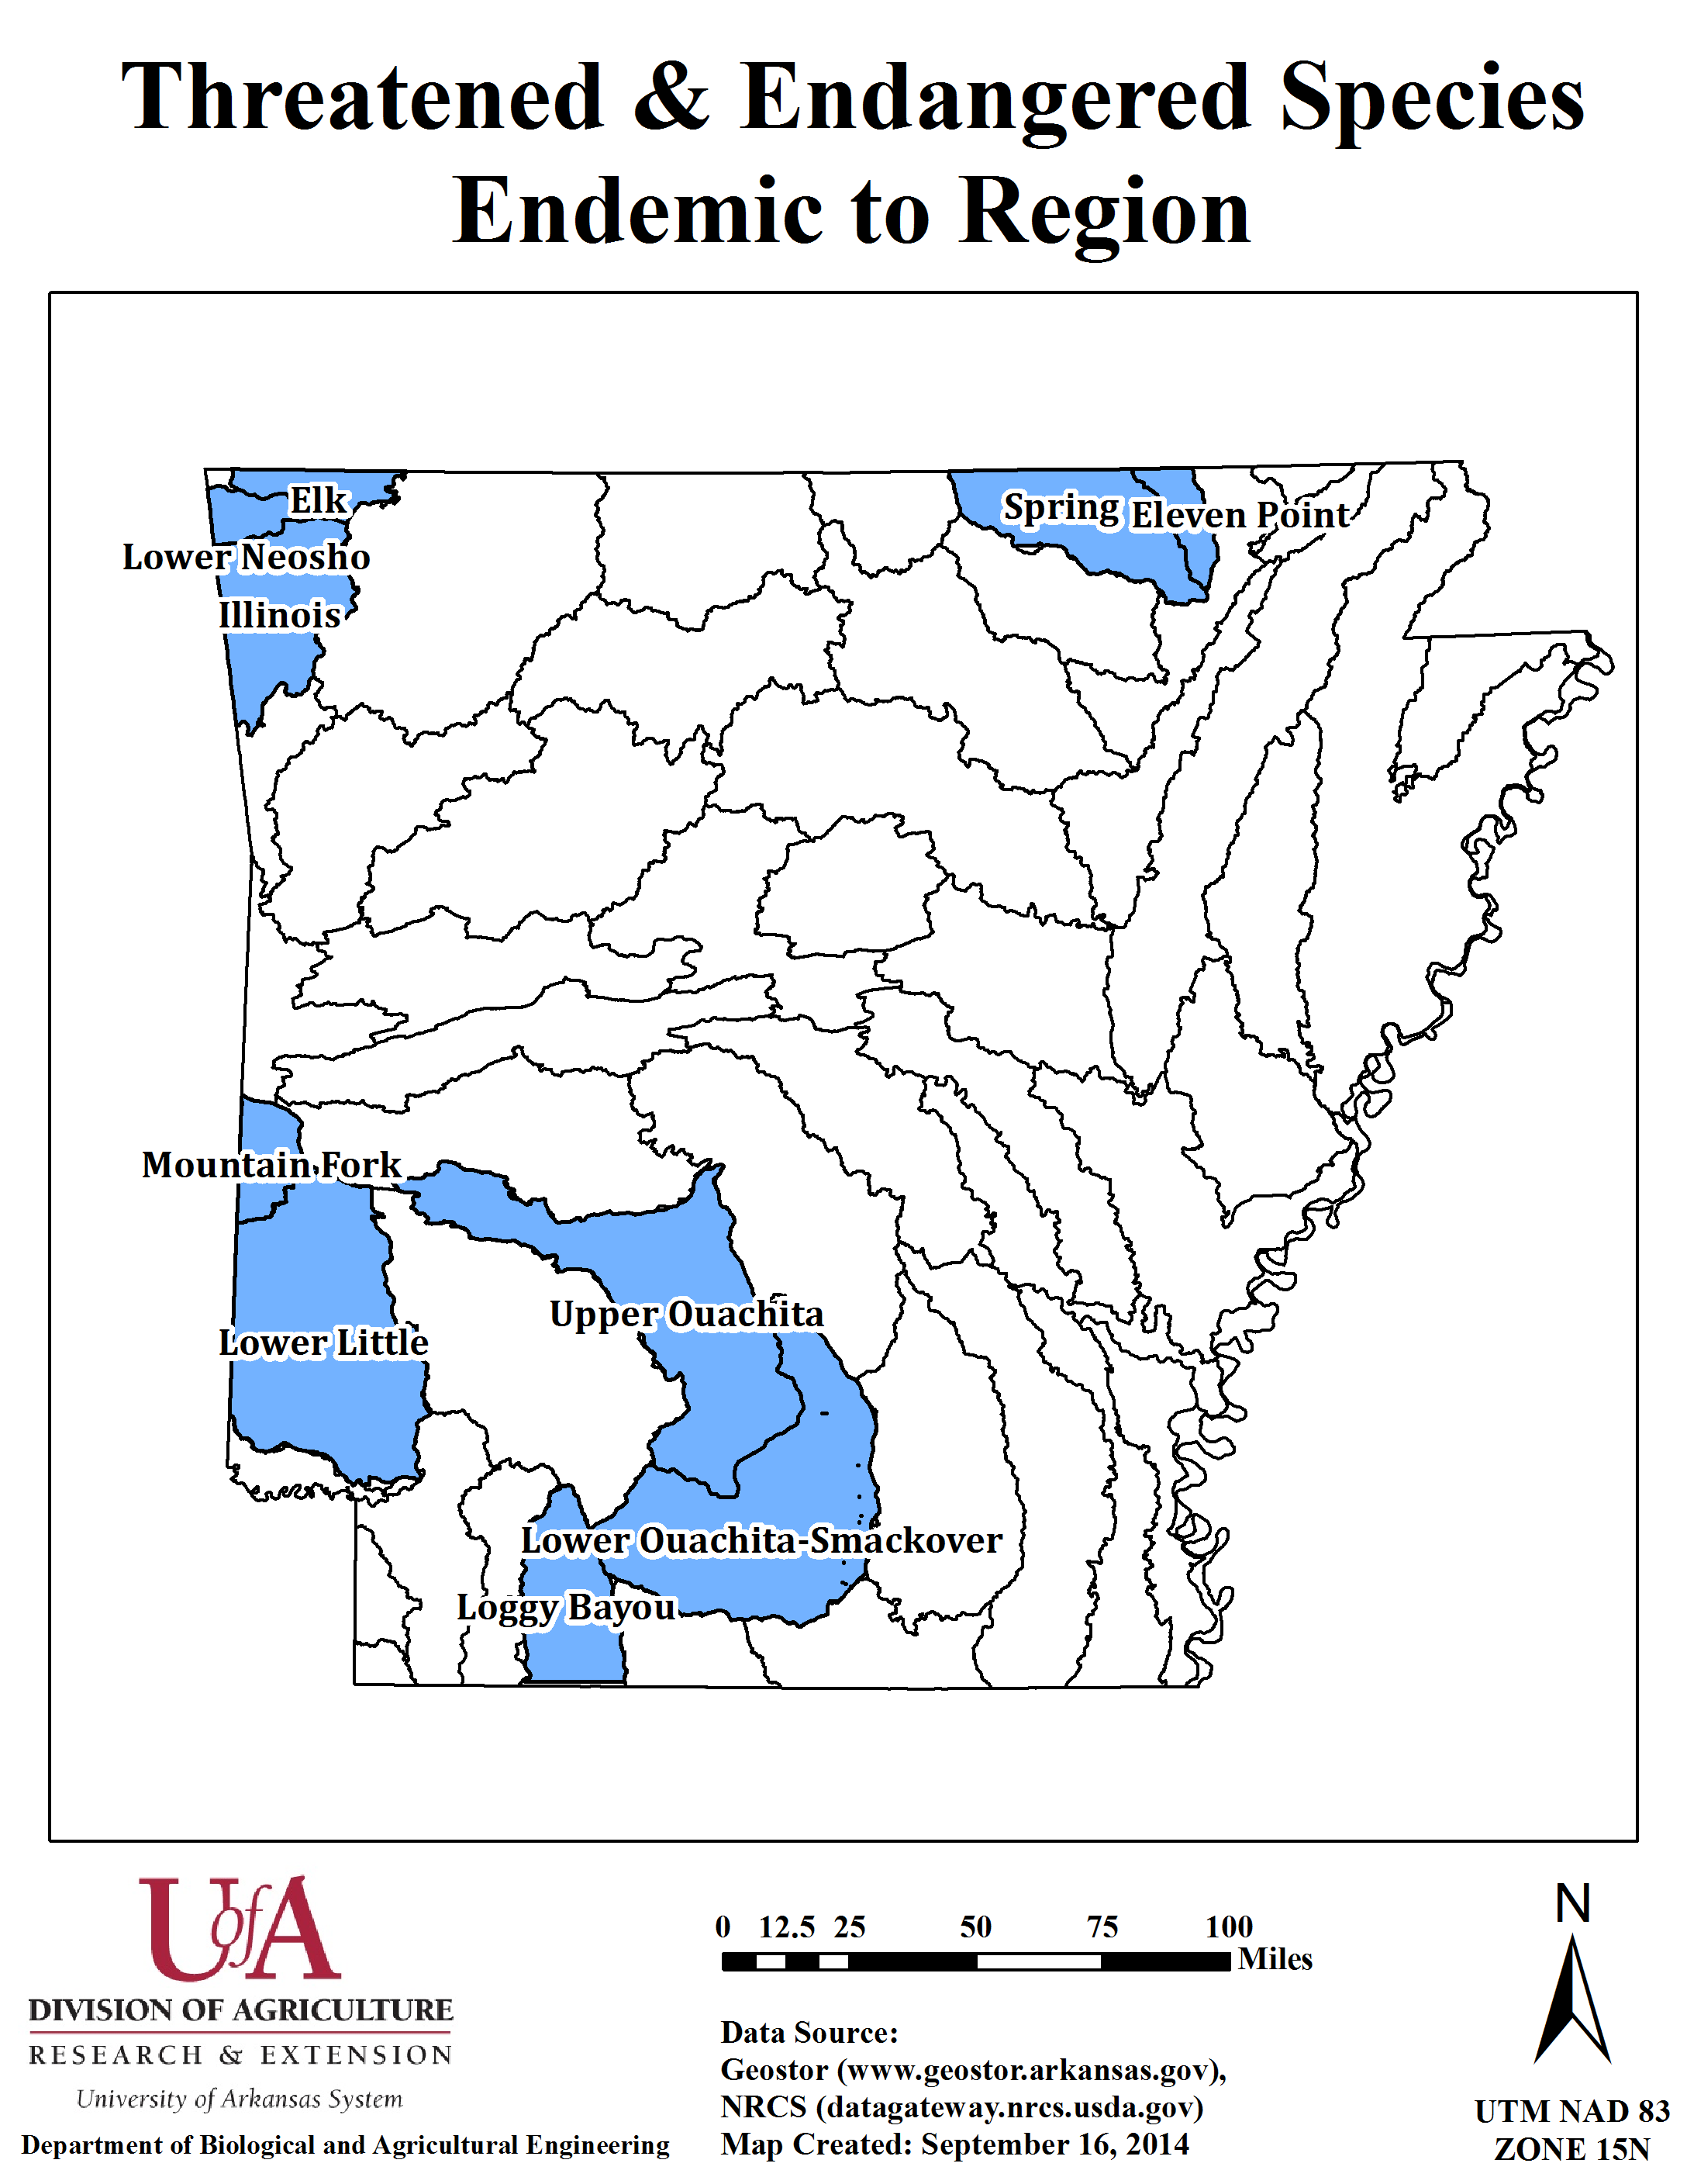
T&E Species Endemic to Region
Present in 10 (out of 58)
8-digit HUC watersheds
Source: Chris Davidson, US Fish and Wildlife Service
ANRC NPS Annual Stakeholder Meeting, September 17, 2014
ANRC NPS Annual Stakeholder Meeting, September 17, 2014

Slide 10
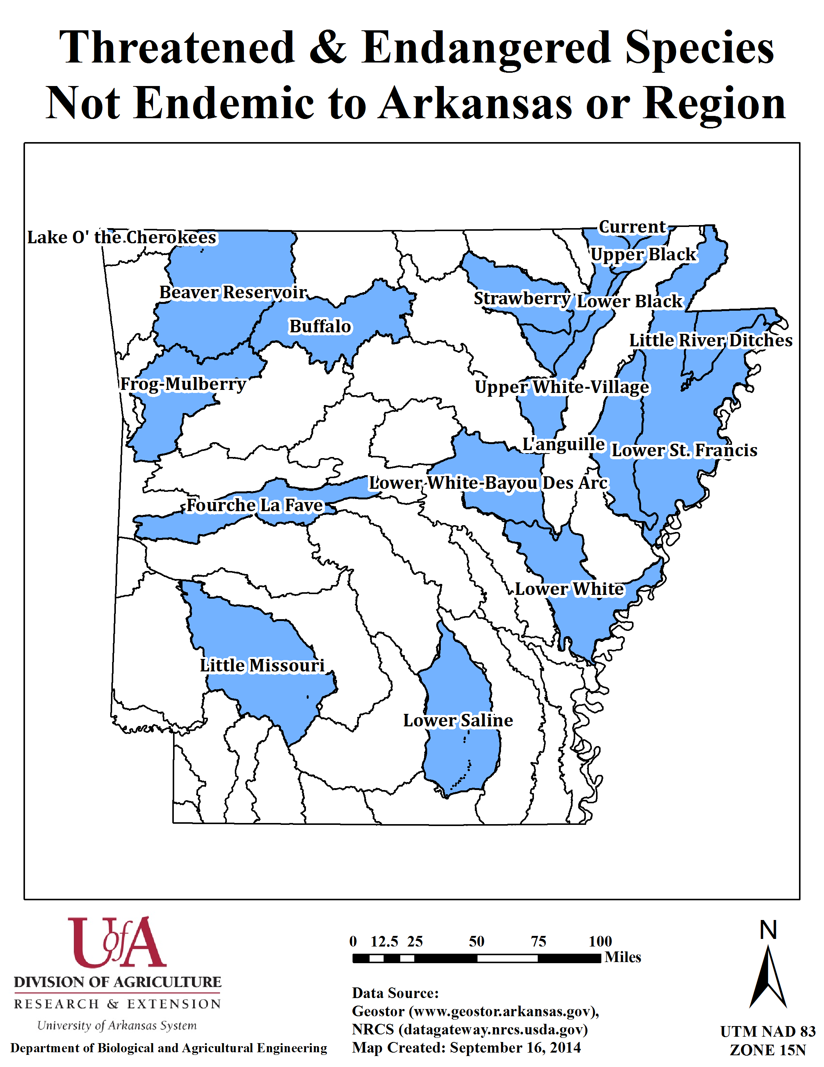
T&E Species Neither Endemic to Arkansas or Region
Present in 17 (out of 58)
8-digit HUC watersheds
Source: Chris Davidson, US Fish and Wildlife Service
ANRC NPS Annual Stakeholder Meeting, September 17, 2014
ANRC NPS Annual Stakeholder Meeting, September 17, 2014

Slide 11
Demo
ANRC NPS Annual Stakeholder Meeting, September 17, 2014
ANRC NPS Annual Stakeholder Meeting, September 17, 2014

Slide 12
Priority Map (excluding T&E)
ANRC NPS Annual Stakeholder Meeting, September 17, 2014
ANRC NPS Annual Stakeholder Meeting, September 17, 2014

Slide 13
Acknowledgments
Mr. Tom Riley, Retired Director, Public Policy Center, University of Arkansas Division of Agriculture Cooperative Extension Service
Ben Hancock, Staff Member at Biological and Agricultural Engineering Department
ANRC NPS Annual Stakeholder Meeting, September 17, 2014
ANRC NPS Annual Stakeholder Meeting, September 17, 2014

Slide 14
Questions/Discussions
ANRC NPS Annual Stakeholder Meeting, September 17, 2014
ANRC NPS Annual Stakeholder Meeting, September 17, 2014

Slide 15
Priority Watersheds
Subwatershed Name | HUC (8-digit) | Drainage Area (km²) | Majority Land Use | Final Risk Matrix Percentile
Beaver Reservoir | 11010001 | 5625.71 | Forest (64%) | 100
Poteau | 11110105 | 1442.52 | Forest (61%) | 98
Bayou Bartholomew | 08040205 | 3976.38 | Forest (59%) | 97
Illinois | 11110103 | 1962.51 | Pasture (45%) | 95
Ouachita Headwaters | 08040101 | 4007.36 | Forest (77%) | 93
Lake Conway-Point Remove | 11110203 | 2961.08 | Forest (54%) | 91
Upper Ouachita | 08040102 | 4542.74 | Forest (79%) | 90
Upper Saline | 08040203 | 4442.43 | Forest (78%) | 88
L Anguille | 08020205 | 2473.54 | Crops (71%) | 85
Cache | 08020302 | 5067.21 | Crops (67%) | 85
Strawberry | 11010012 | 1971.50 | Forest (58%) | 83
Lower Ouachita-Smackover | 08040201 | 4662.94 | Forest (82%) | 81
ANRC NPS Annual Stakeholder Meeting, September 17, 2014
ANRC NPS Annual Stakeholder Meeting, September 17, 2014

Slide 16
Risk Matrix Summary
Watershed | HUC 8 digit | C1 | C2 | C3 | C4 | C5 | C6 | C7 | C8 | C9 | C10 | C11 | C12 | Total
Beaver Reservoir | 11010001 | 10 | 10 | 10 | 10 | 8.28 | 5.69 | 7.93 | 4.14 | 8.79 | 2.76 | 6.31 | 10 | 838.97
Poteau | 11110105 | 10 | 0 | 10 | 10 | 8.62 | 8.62 | 9.22 | 2.41 | 4.31 | 5.86 | 3.45 | 10 | 725.00
Bayou Bartholomew | 8040205 | 10 | 10 | 10 | 8 | 4.14 | 3.62 | 2.47 | 6.72 | 4.05 | 4.31 | 7.41 | 10 | 707.24
Illinois | 11110103 | 8 | 5 | 0 | 10 | 9.31 | 9.66 | 9.91 | 5.34 | 8.10 | 8.45 | 5.52 | 10 | 650.34
Ouachita Headwaters | 8040101 | 10 | 5 | 10 | 10 | 7.24 | 8.28 | 5.14 | 0.86 | 3.19 | 8.79 | 5.57 | 0 | 640.69
Lake Conway-Point Remove | 11110203 | 8 | 10 | 10 | 10 | 7.93 | 9.14 | 9.48 | 5.17 | 6.55 | 3.62 | 5.69 | 0 | 620.69
Upper Ouachita | 8040102 | 10 | 10 | 10 | 10 | 3.97 | 6.03 | 4.53 | 0.69 | 1.72 | 7.93 | 6.78 | 0 | 616.55
Upper Saline | 8040203 | 8 | 10 | 10 | 10 | 8.10 | 8.45 | 5.31 | 1.72 | 1.90 | 9.31 | 5.97 | 0 | 566.07
Cache | 8020302 | 10 | 4 | 10 | 2 | 5.86 | 3.79 | 6.90 | 8.97 | 2.16 | 7.59 | 5.17 | 0 | 564.31
L Anguille | 8020205 | 10 | 10 | 10 | 2 | 4.83 | 5.00 | 3.07 | 9.14 | 1.38 | 7.41 | 3.60 | 0 | 564.31
Strawberry | 11010012 | 10 | 10 | 10 | 2 | 3.28 | 5.17 | 3.45 | 5.00 | 3.45 | 8.28 | 4.91 | 0 | 555.34
Lower Ouachita-Smackover | 8040201 | 10 | 10 | 10 | 8 | 2.07 | 3.28 | 6.29 | 0.34 | 1.90 | 5.69 | 7.12 | 0 | 546.90
*C1 = Water body impairment, C2 = Designated usage, C3 = Biotic impact, C4 = Potential human impact, C5 = Urban suburban population,
C6 = Impervious surface, C7 = Economic activity, C8 = Cropland, C9 = Livestock and pasture, C10 = Unpaved roads, C11 = Forestry,
C12 = Adjacent state priority
ANRC NPS Annual Stakeholder Meeting, September 17, 2014
ANRC NPS Annual Stakeholder Meeting, September 17, 2014

Slide 17
Selected Priority Watersheds
Name | HUC 8 Digit | Name of impaired streams/segments | Causes for impairment* | Source
Ouachita Headwaters | 8040101 | Marzam Creek | pH | NO T SPECIFIED
 |  | Little Marzam Creek | pH | UN
 |  | Prairie Creek | DO, Cu, Tb | SE
Upper Ouachita | 8040102 | Cove Creek | pH, SO4, TDS | RE, UN
 |  | Chamberlain Creek | pH, SO4, TDS, Cu, Zn, Cd | RE
 |  | Lucinda Creek | pH, SO4, Zn | RE
 |  | D.C. Creek | Zn | RE
 |  | Caddo River | Tb, Zn | RE
 |  | Ouachita River | Zn | UN
 |  | Deceiper Creek | pH | UN
 |  | Freeo Creek | pH | UN
 |  | White Oak Creek | pH | UN
 |  | Tulip Creek | pH | UN
 |  | Cypress Creek | pH | UN
 |  | S. Fork Caddo | Cu, Zn | RE
ANRC NPS Annual Stakeholder Meeting, September 17, 2014
ANRC NPS Annual Stakeholder Meeting, September 17, 2014

Slide 18
Selected Priority Watersheds
Name | HUC 8 Digit | Name of impaired streams/segments | Causes for impairment* | Source
Cache | 8020302 | Cache River | TDS, Pb, Tb | AG
 |  | Frierson Lake | Sl, Cu | UN
 |  | Old Town | NU | UN
 |  | Bayou DeView | Cl, TDS, Pb | IP, MP, AG
 |  | Lost Creek Ditch | Cl | UN
Strawberry | 11010012 | Strawberry River | Tb, PA | SE
Lower Ouachita-Smackover | 8040201 | Moro Creek | Cu, Pb, Tb, Hg | UN, SE
 |  | Ouachita River | Cu, Zn, Hg | UN
 |  | L. Champagnolle Cr. | Hg | UN
 |  | Champagnolle | Hg | UN
 |  | Elcc Tributary | Cu, Zn, NO3, Cl, SO4, TDS, AM | IP
 |  | Flat Creek | Cu, Zn, Cl, SO4, TDS | RE, IP
 |  | Salt Creek | pH, Cu, Cl, TDS | RE, IP
 |  | Prairie Creek | Tb | SE
 |  | Smackover Creek | DO, Zn | UN
 |  | Jug Creek | Cu | MP
ANRC NPS Annual Stakeholder Meeting, September 17, 2014
ANRC NPS Annual Stakeholder Meeting, September 17, 2014

