Slide 1

Threatened and Endangered Species Overview
Chris Colclasure

Slide 2



Arkansas Natural Heritage Commission
The Arkansas Natural Heritage Commission is one of seven agencies of the Department of Arkansas Heritage.
These agencies work together to protect, preserve and interpret Arkansas’s natural and cultural heritage.

Slide 3
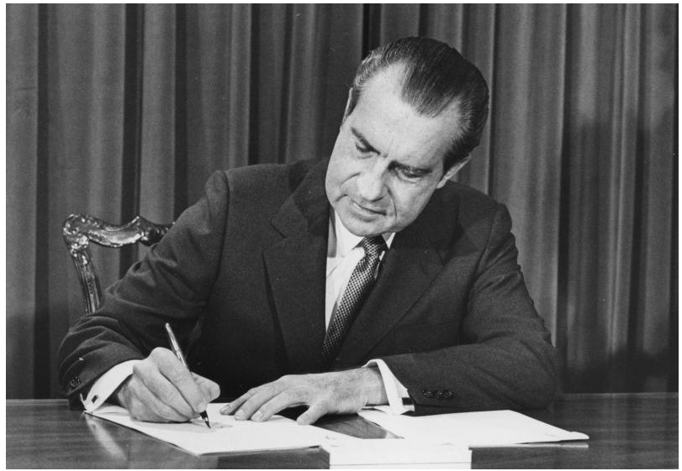
Endangered Species Act (ESA) of 1973 The purpose of the ESA is to protect and recover imperiled species and ecosystems upon which they depend.
The ESA defines an “endangered species” as any species in danger of extinction throughout all or a significant portion of its range.” A “threatened” species is one likely to become endangered within the foreseeable future throughout all or a significant portion of its range.”
The ESA has become one of the most effective tools in the continuing effort to protect imperiled species and their habitats in the U.S.

Slide 4
Before the ESA
1900: The Lacey Act became the first federal law protecting wildlife. Today it regulates the import of any species protected by international or domestic law and prevents the spread of invasive, or non-native, species.
1903: President Theodore Roosevelt establishes the first National Wildlife Refuge at Pelican Island, Florida, to protect wood storks, brown pelicans, and other dwindling water birds. (Today, national wildlife refuges support nearly 300 endangered and threatened plant and animal species.)
1914: The passenger pigeon, once the most abundant bird in North America, and perhaps the world, becomes extinct.
1916: The United States and Great Britain (on behalf of Canada) adopted a uniform system of protection for certain species of birds that migrate between the United States and Canada. On July 3, 1918, the United States passed the Migratory Bird Treaty Act to implement the treaty.

Slide 5
1944: The whooping crane population reaches its lowest population level, with only 21 birds remaining.
1966: Endangered Species Preservation Act of 1966 authorizes land acquisition to conserve “selected species of native fish and wildlife.”
1969: Endangered Species Conservation Act of 1969 expands on the 1966 act, authorizing the compilation of a list of animals “threatened with worldwide extinction” and prohibits their importation without a permit. Crustaceans and mollusks are included for protection, along with mammals, fish, birds, and amphibians.
1973: Convention on International Trade in Endangered Species of Wild Fauna and Flora (CITES) - 80 nations sign this treaty to protect designated plant an animal species by regulating or prohibiting international trade in certain taxa except by permit.

Slide 6
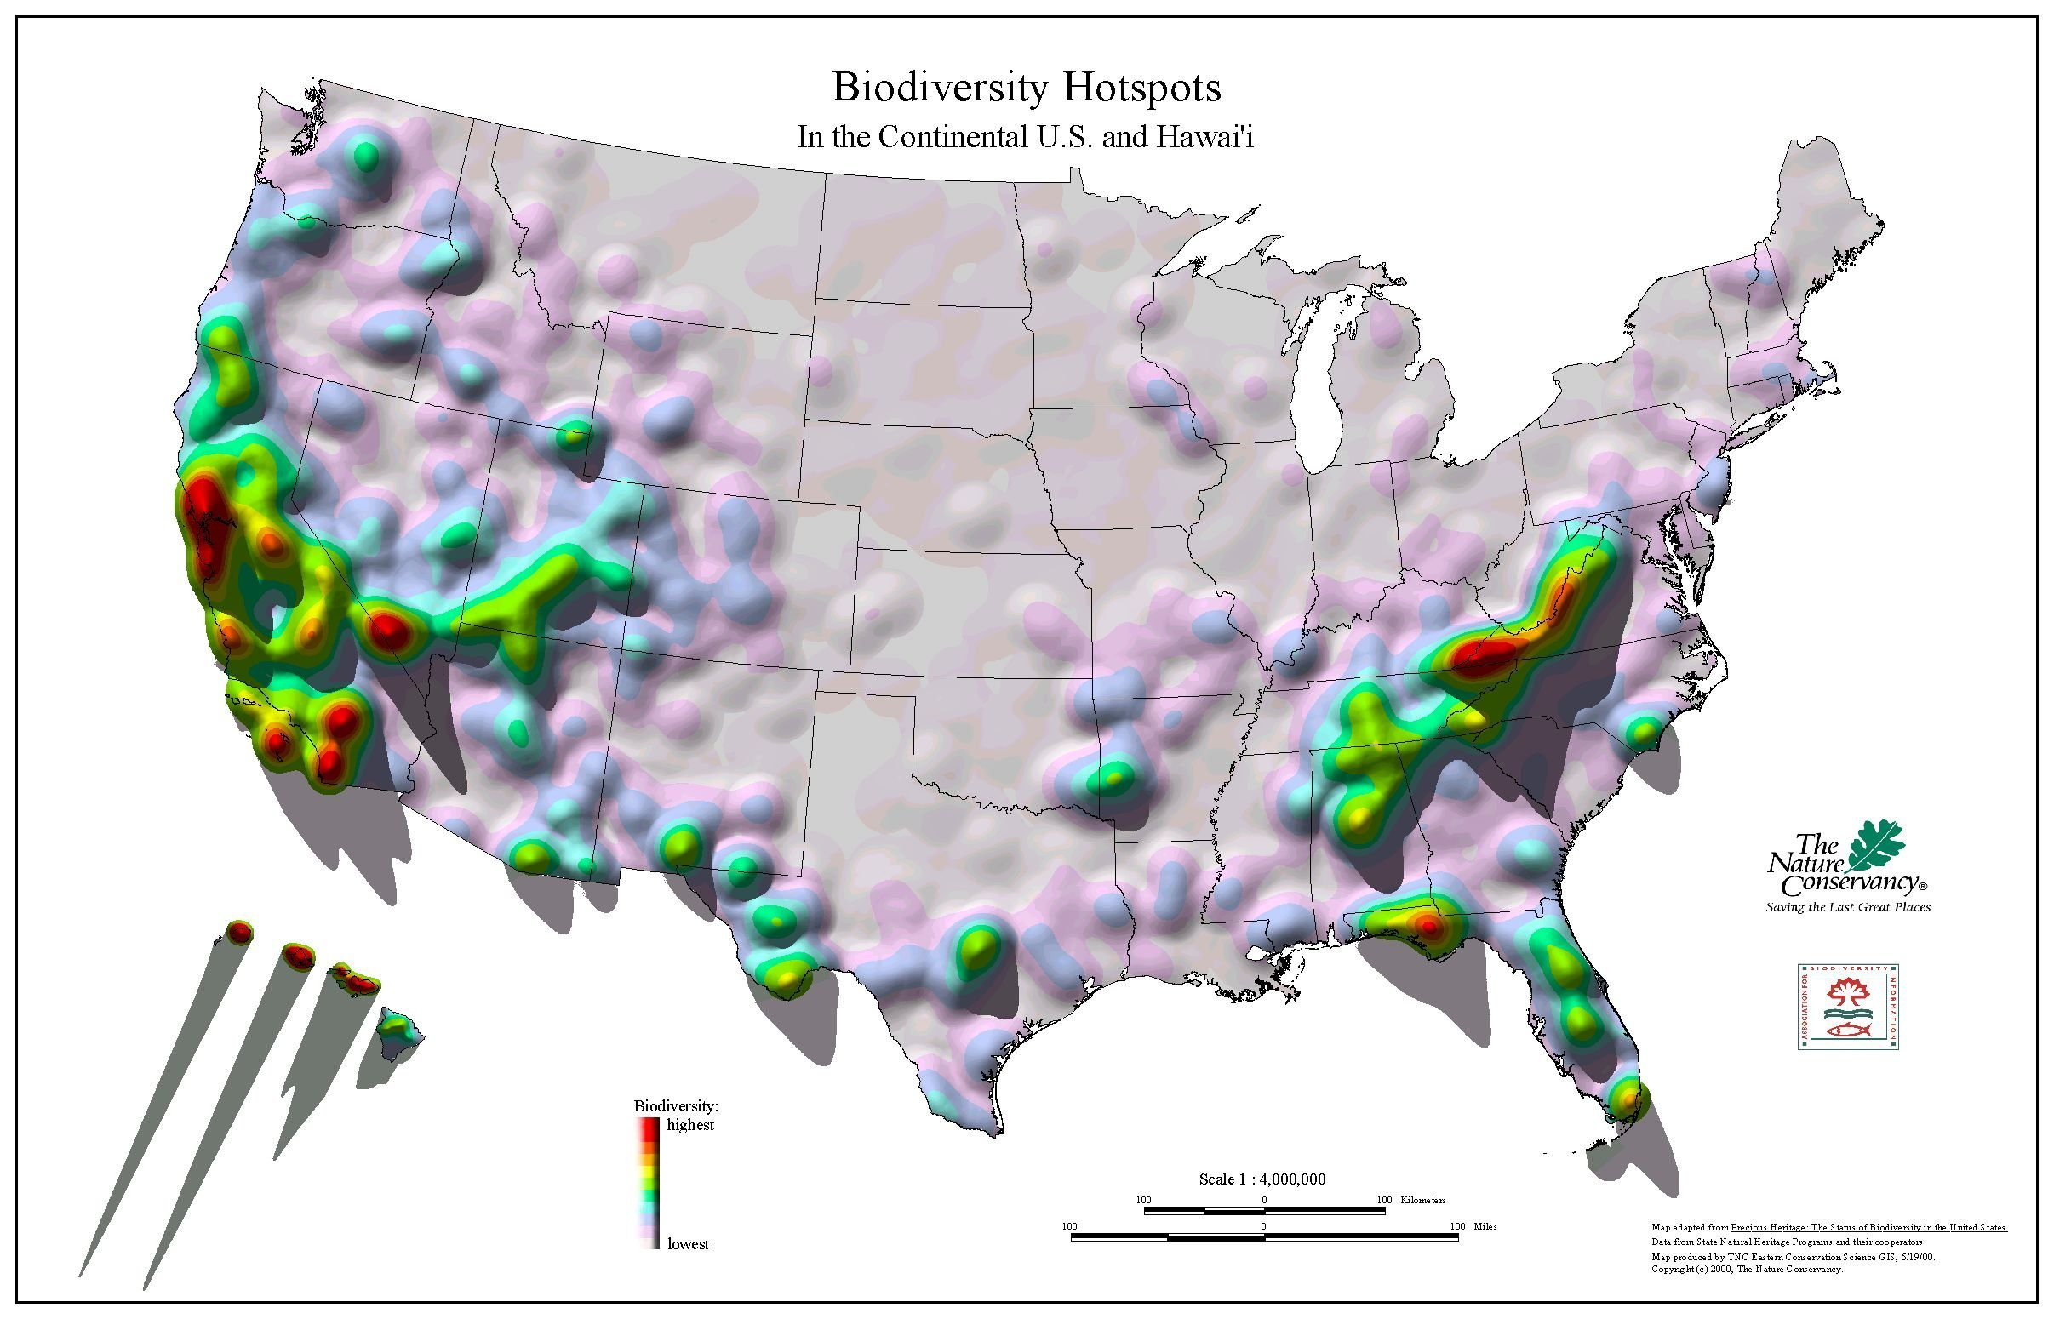
Why do we (AR) have T&E Species???

Slide 7
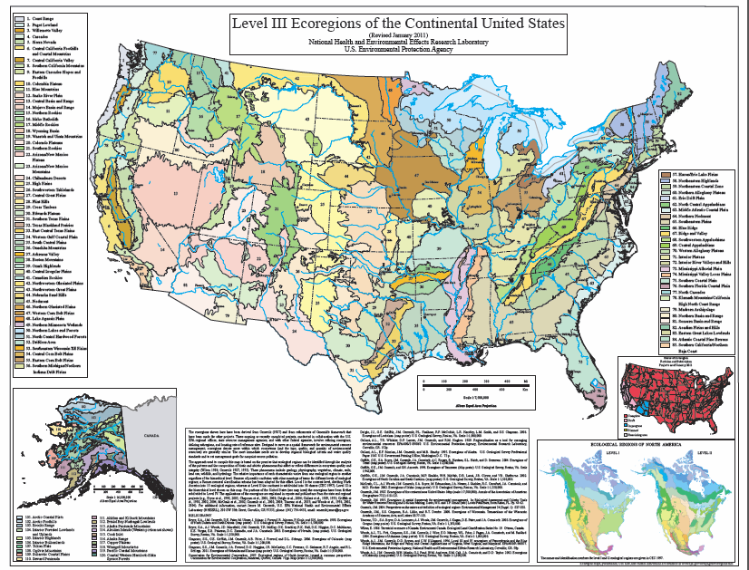

Slide 8
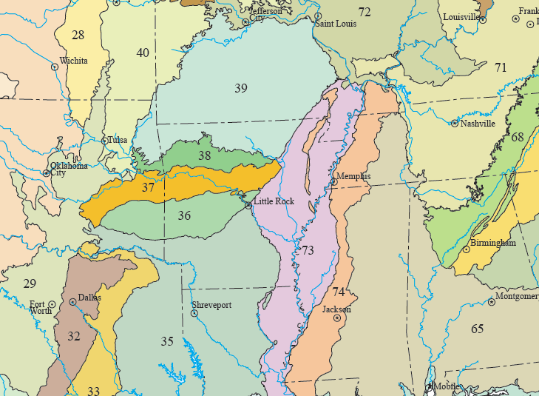
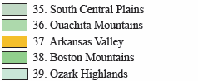
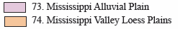
Level III Ecoregions

Slide 9
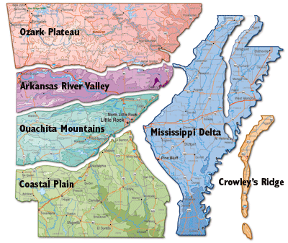
27 T&E Species in Arkansas
23 Animals
4 Plants
129 endemic species in Arkansas
117 Animals
12 Plants

Slide 10
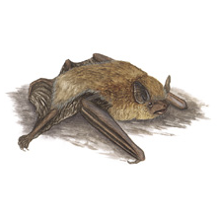
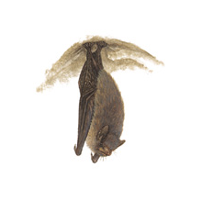
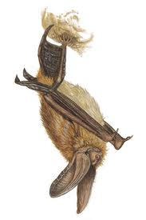
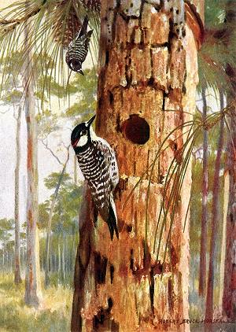
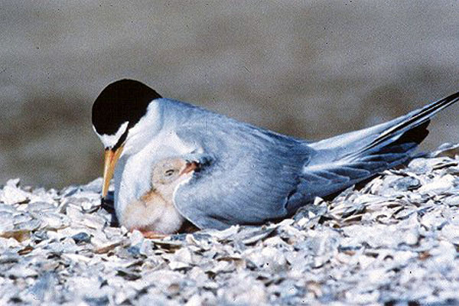
MAMMALS
Gray bat (Myotis griescens)
Indiana bat (Myotis sodalis)
Ozark big-eared bat (Corynorhinus townsendii ingens)
BIRDS
Interior Least Tern (Sterna antillarum)
Red-cockaded Woodpecker (Picoides borealis)

Slide 11
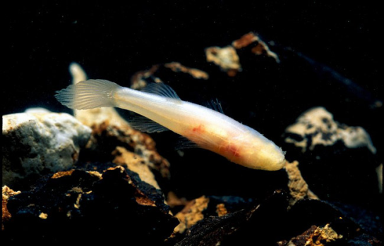
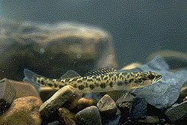
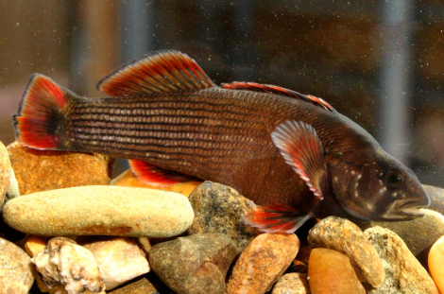
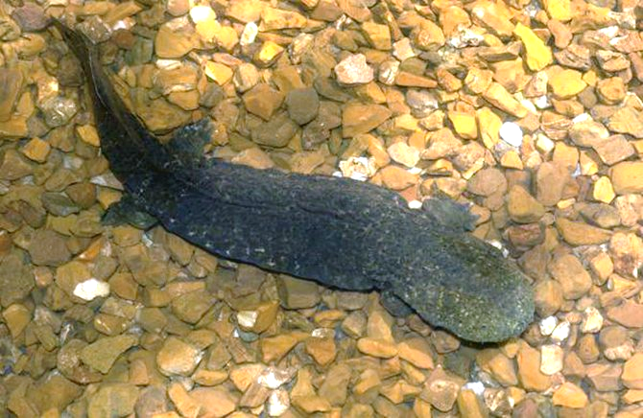
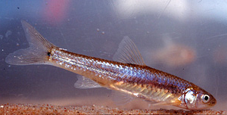
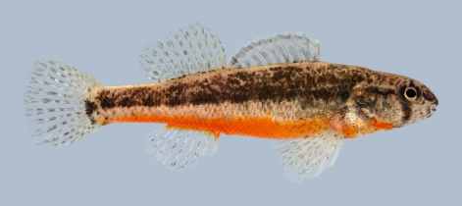
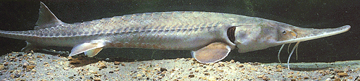
FISH
Ozark cavefish (Amblyopsis rosae)
Leopard darter (Percina pantherina)
Arkansas River Shiner (Notropis girardi)
Pallid sturgeon (Scaphirhynchus albus)
Yellowcheek darter (Etheostoma moorei)
Arkansas darter (Etheostoma cragini)
AMPHIBIAN
Ozark hellbender
(Crytobranchus alleganiensis bishopi)

Slide 12
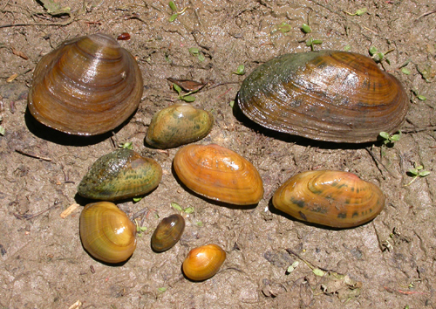
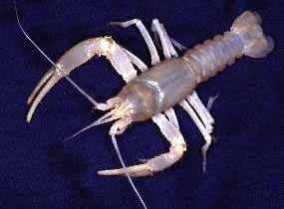
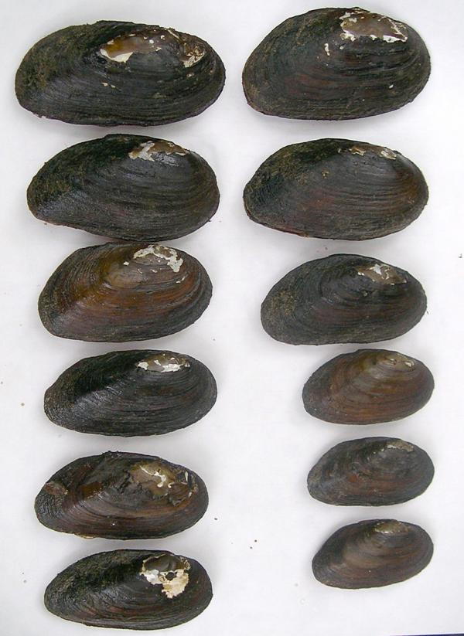
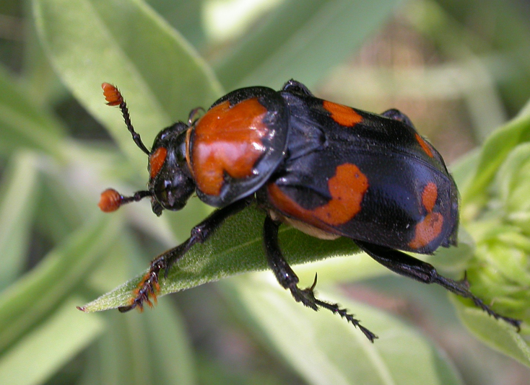
INVERTEBRATES
12 freshwater mussels
2 crayfish
1 insect

Slide 13
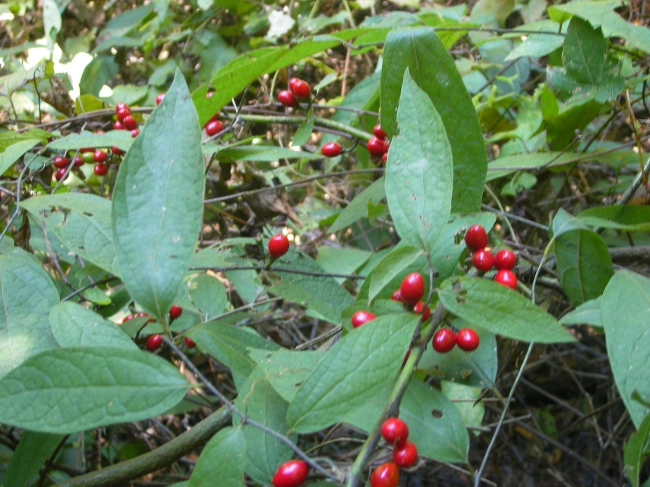
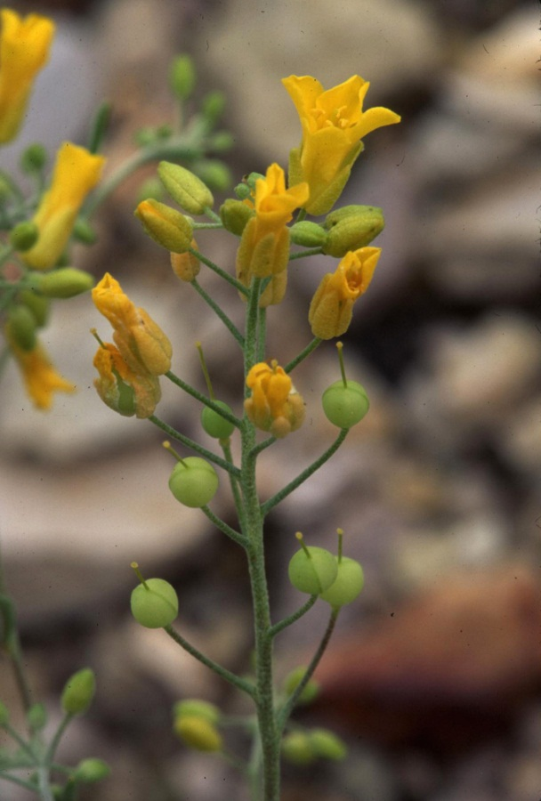
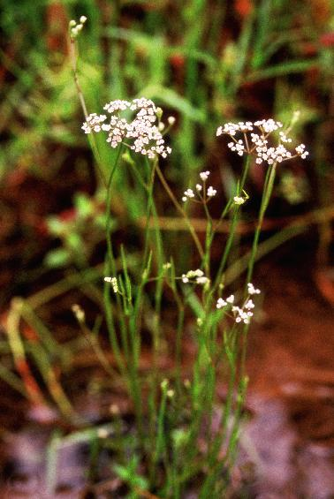
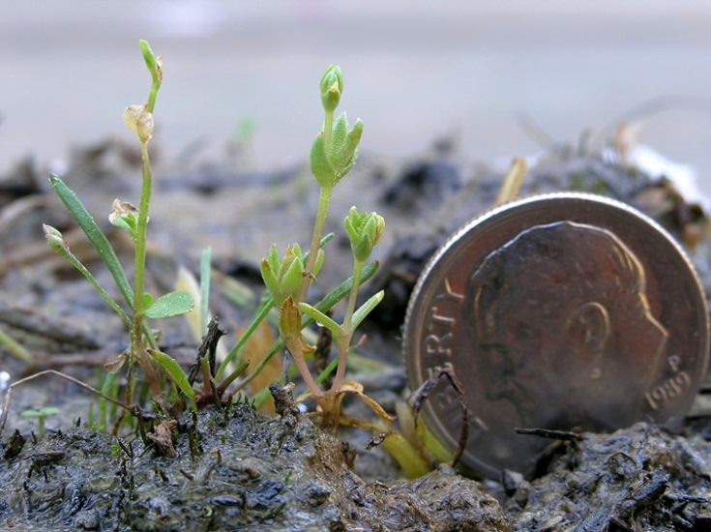
PLANTS (4)
Pondberry
(Lindera melissafolia)
Missouri bladderpod
(Lesquerella filiformis)
Harperella
(Ptilimnium nodosum)
Geocarpon
(Geocarpon minimum)

Slide 14
Information About Rare Species
USFWS
http://ecos.fws.gov/tess_public/pub/stateListingAndOccurrenceIndividual.jsp?state=AR
ANHC
http://www.naturalheritage.com/research-data/rarespecies-search.aspx

Slide 15
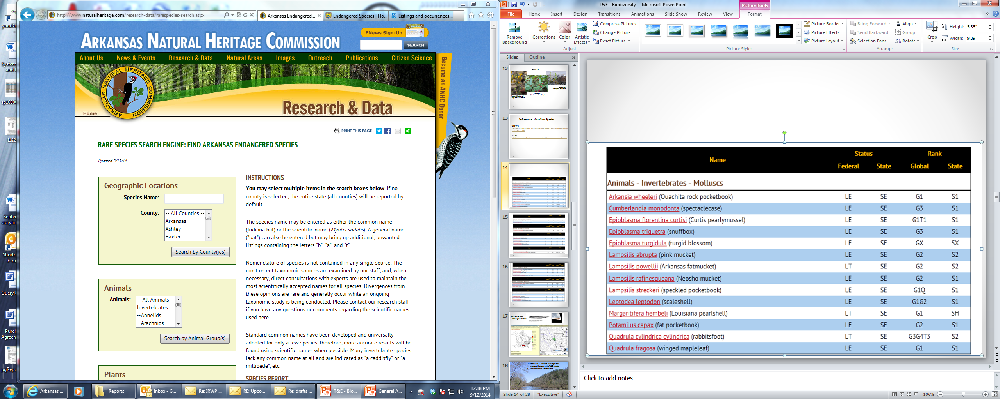
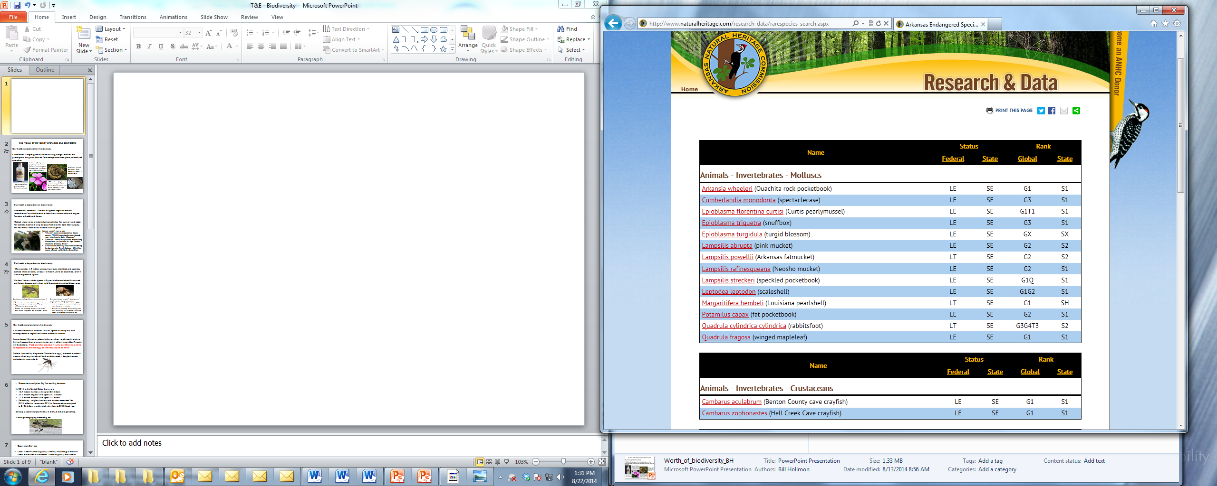

Slide 16
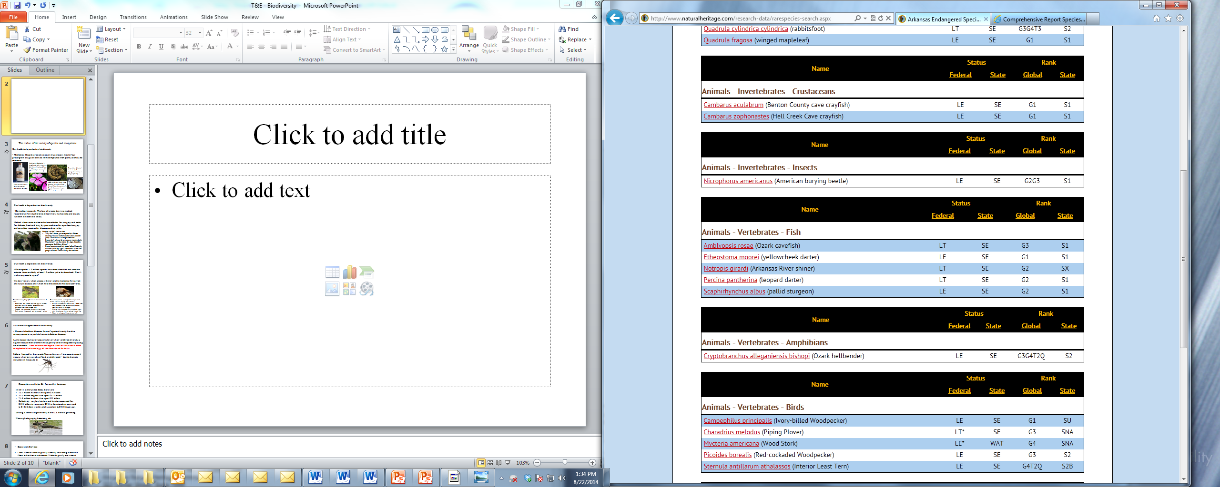

Slide 17
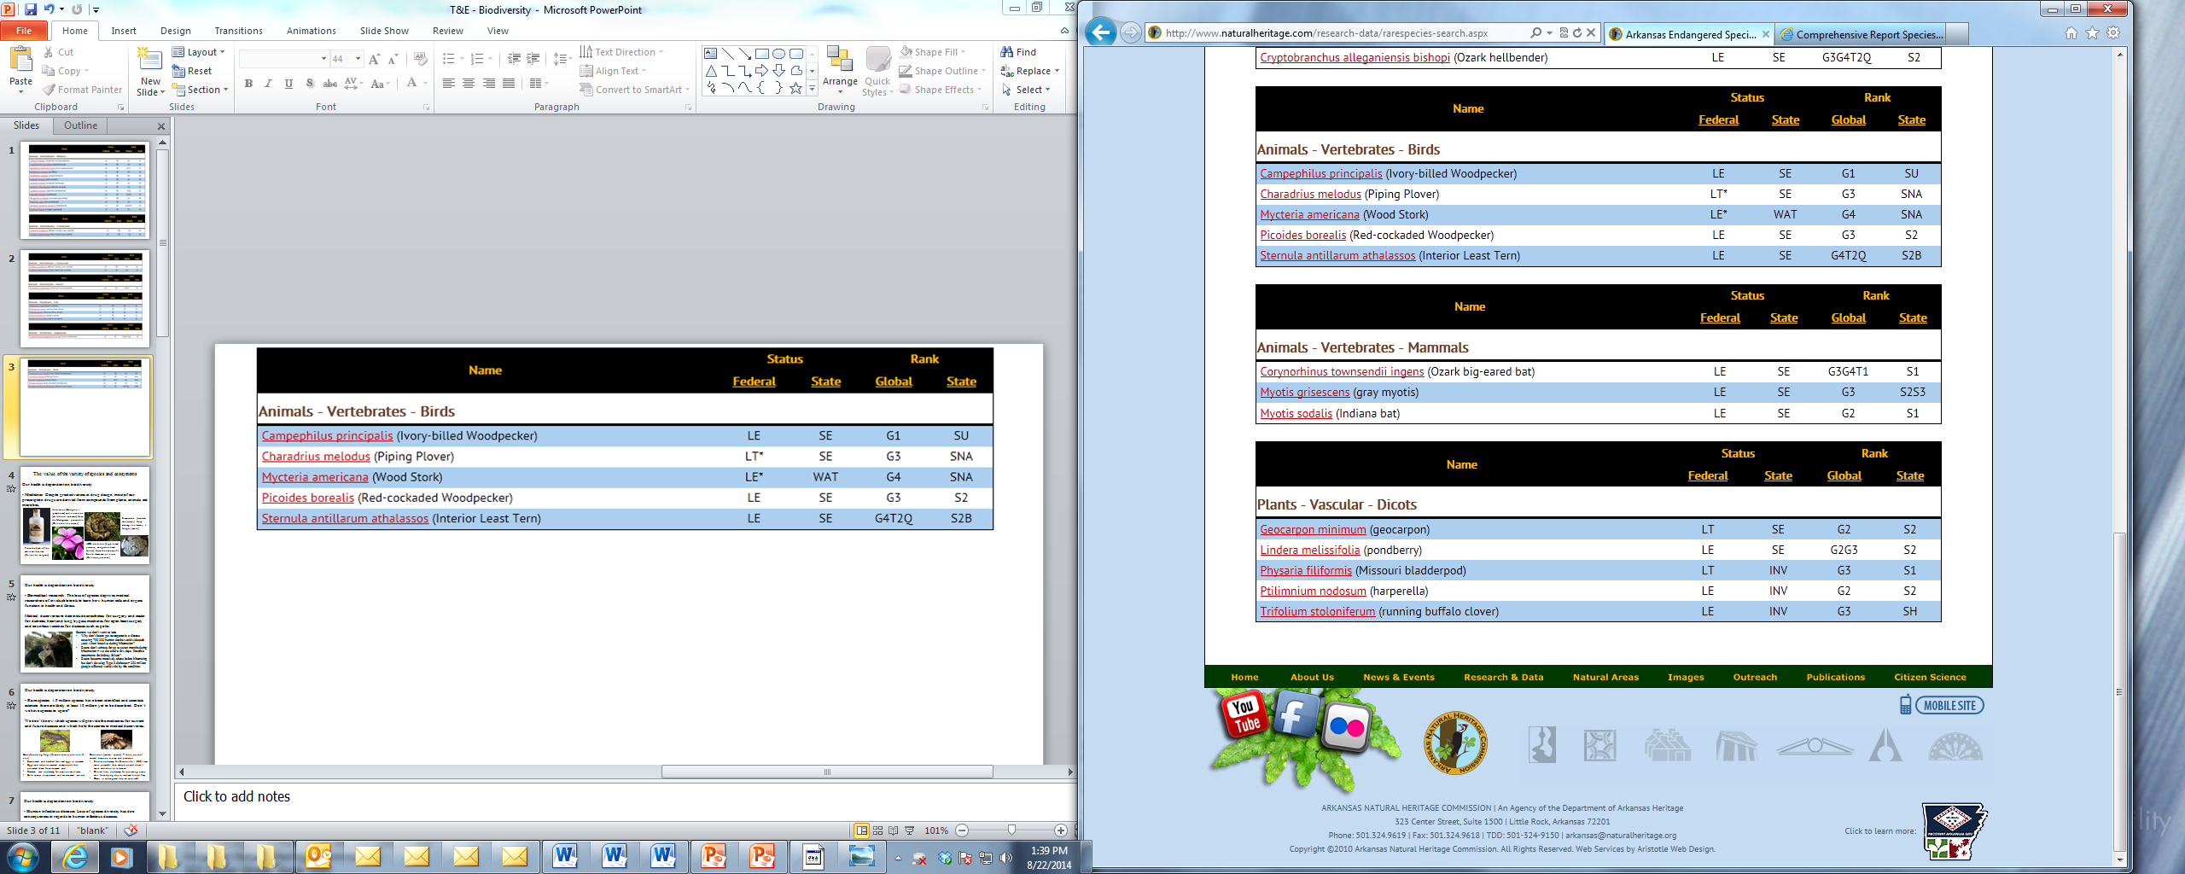

Slide 18
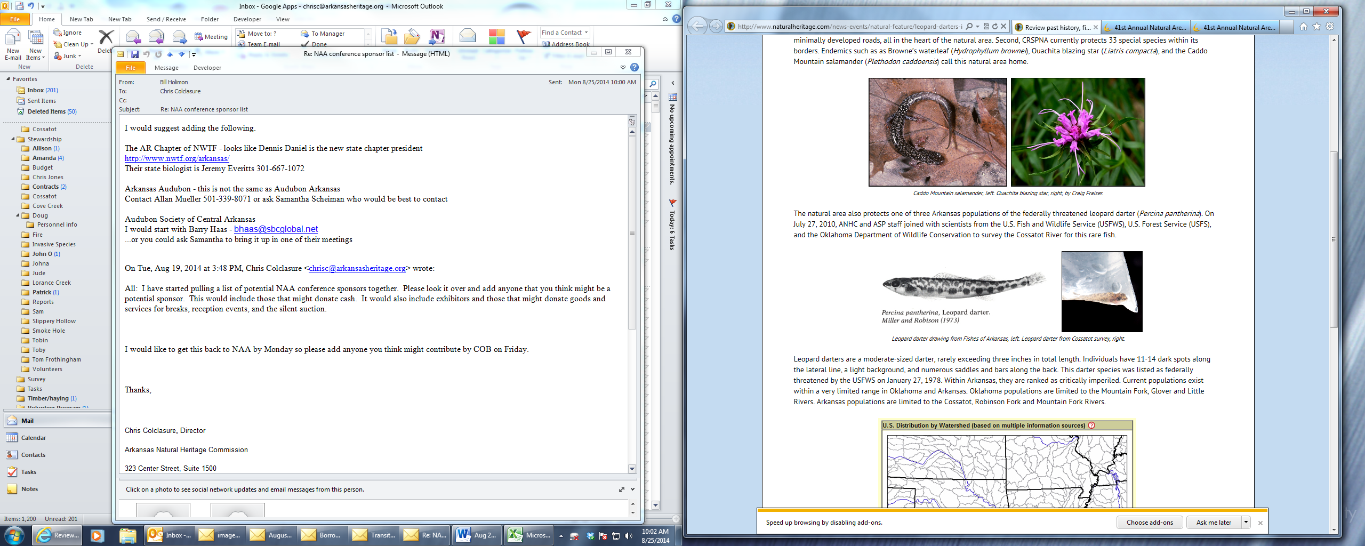
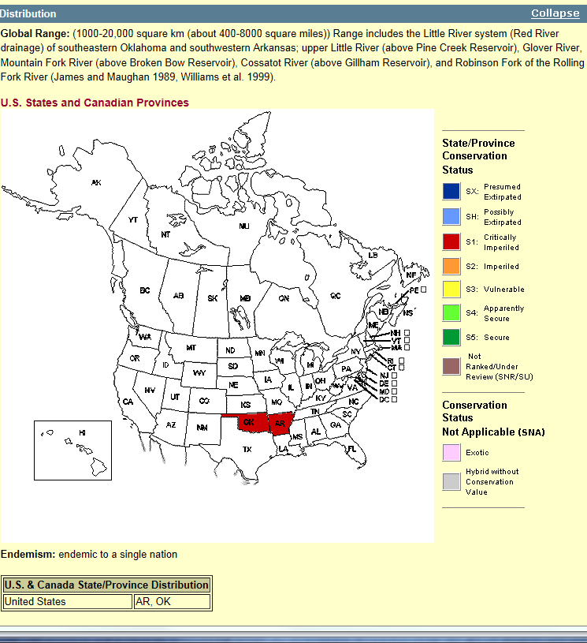
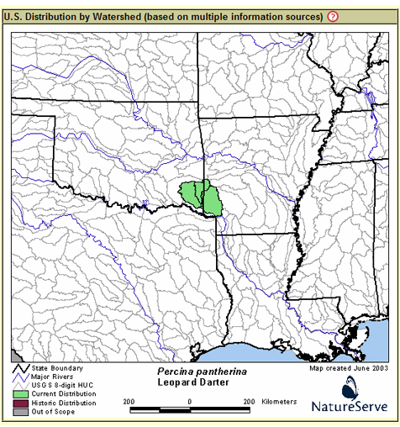
Leopard Darter
Percina pantherina

Slide 19
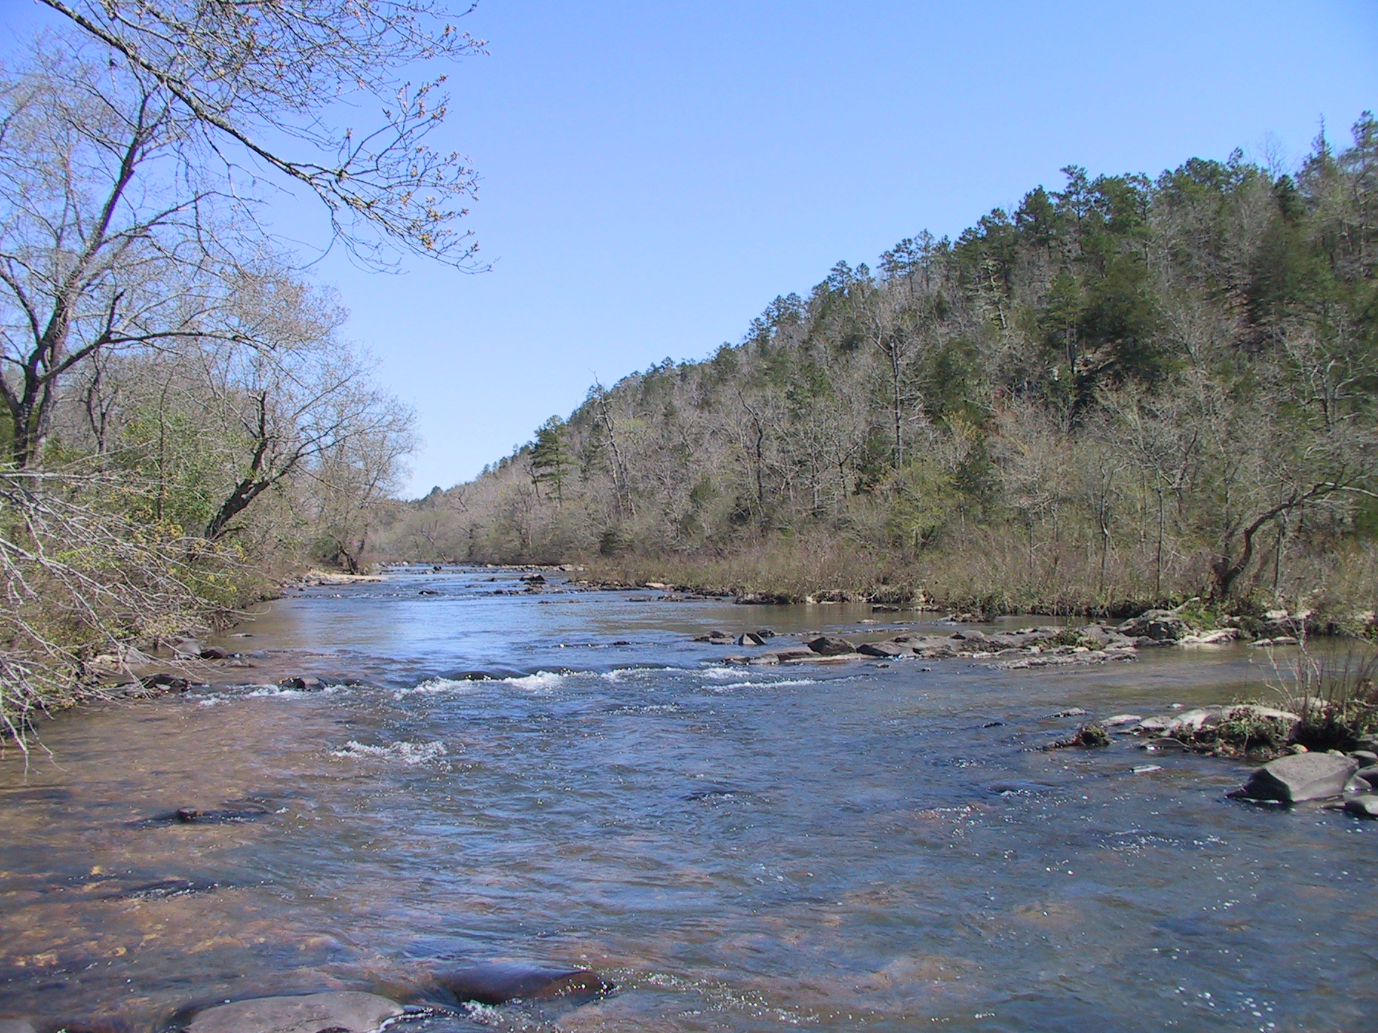
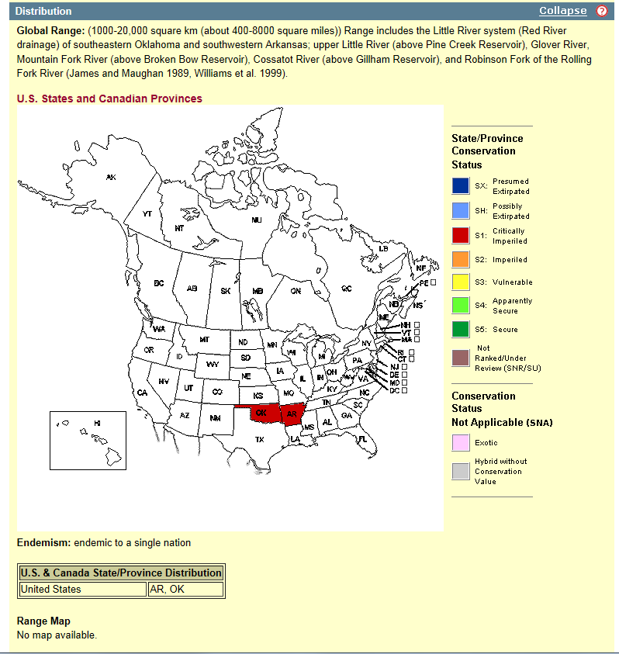
Tendencies / Public Perception:
Increased focus on the T&E species
Reduced focus on the place
and other species
that benefit
Cossatot River

Slide 20
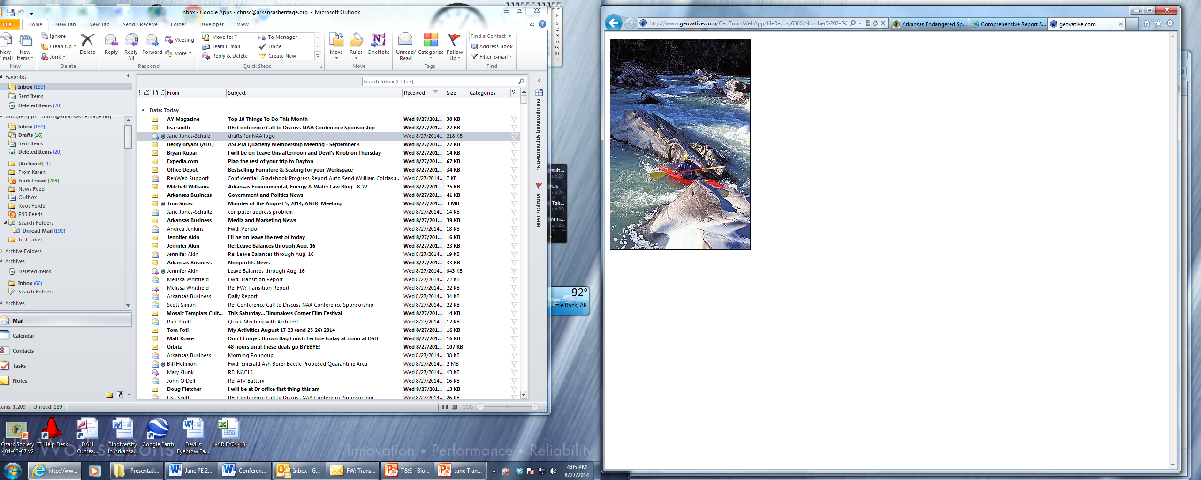
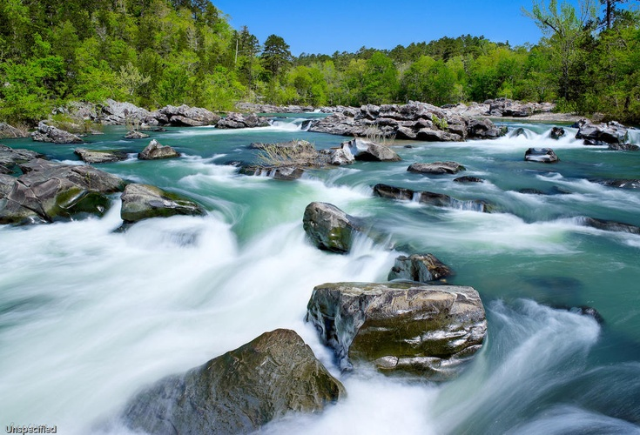
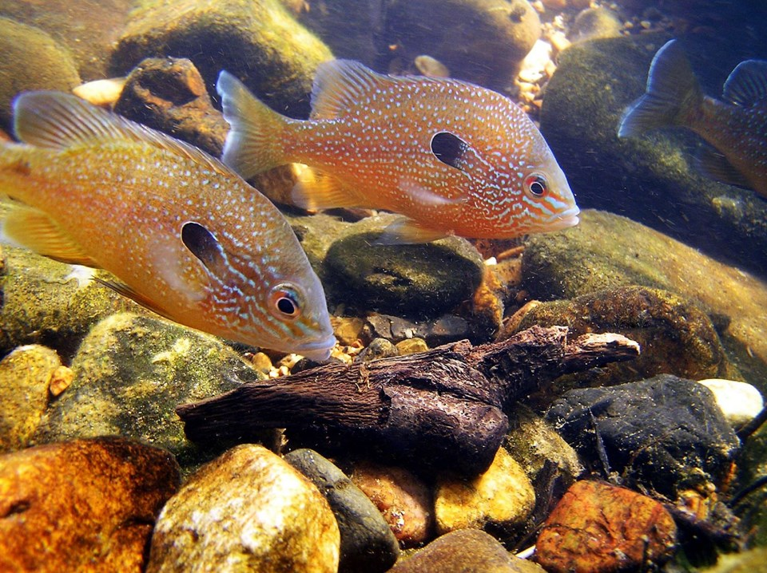
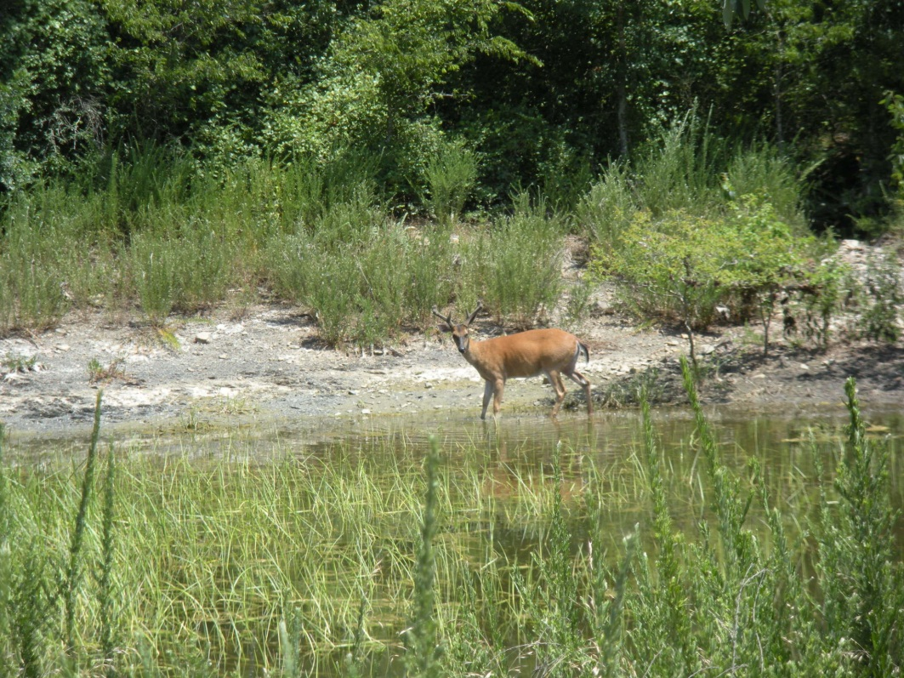

Slide 21
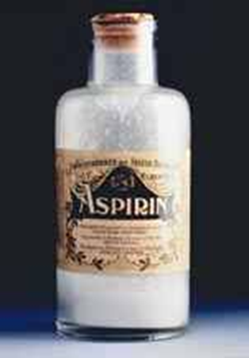
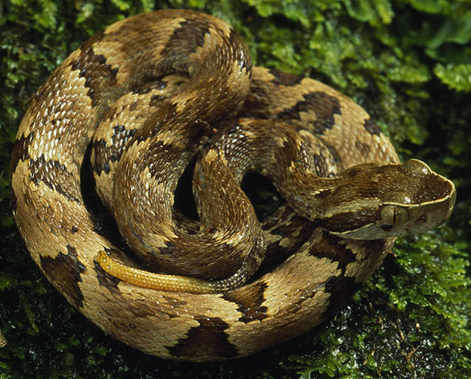

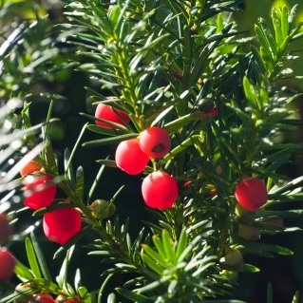
The value of the variety of species and ecosystems
Why do we need biodiversity?
- Medicines: Despite great advances in drug design, most of our prescription drugs are derived from compounds from plants, animals, and microbes.
Vinblastine (Hodgkin’s lymphoma) and vincristine (childhood leukemia) from the Madagascar periwinkle (Catharanthus roseus)
Taxol, from the bark of the Pacific yew tree (Taxus brevifolia) and is used in the treatment of breast, lung, and ovarian cancer, as well as Kaposi's sarcoma.
ACE inhibitors (high blood pressure, congestive heart failure) from the venom of a South American pit viper (Bothrops jararaca)
From the bark of the white willow tree (Salix alba vulgaris)

Slide 22
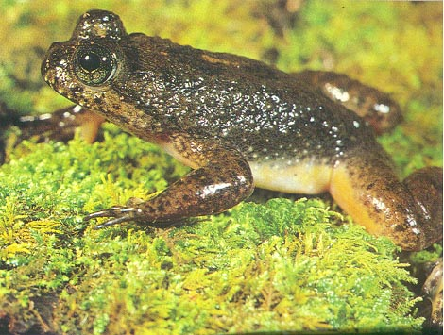
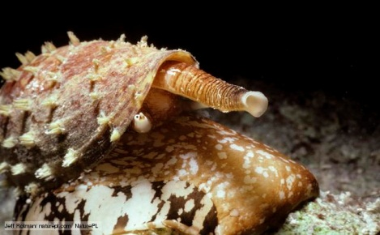
Our health is dependent on biodiversity
- Rare species: 1.9 million species have been identified and scientists estimate there are likely at least 10 million yet to be described. Don’t we have species to spare?
We don’t know which species will provide the medicines for current and future diseases and which hold the secrets to medical discoveries.
Gastric-brooding frogs (Rheobatrachus vitellinus, R. silus)
Swallowed and hatched fertilized eggs in stomach
Eggs and tadpoles secreted compounds that protected them from stomach acid
Research was underway for peptic ulcer disease
Both species disappeared and are assumed extinct
Cone snails (several species) – shoot poison-coated harpoon at prey and predators
Studies underway for Ziconotide, 1,000 times more powerful than morphine and doesn’t cause addiction or tolerance
Clinical trials underway for protecting nerve cells from dying due to reduced blood flow
Occur in endangered tropical coral reefs

Slide 23
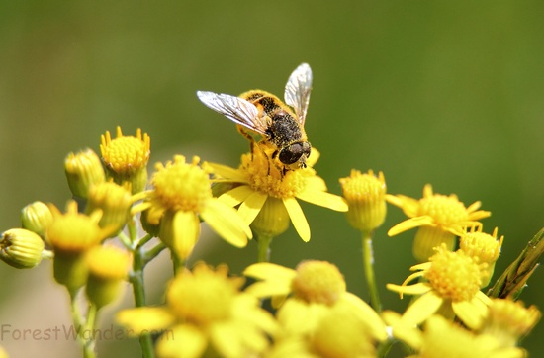

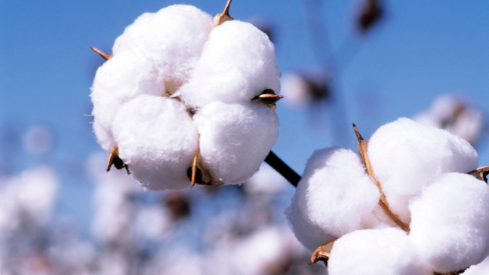
Diversity of Pollinators: Food / Clothing
Honeybees and wild bees are the most important pollinators of many of the fruits and vegetables we eat.
Of 100 crop species that provide 90% of our global food supply, 71 are bee-pollinated.
The value of pollination of food crops by bees in the U.S. alone is estimated at $16 billion and insect pollinators in general contribute $29 billion to U.S. farm income (CNN)

Slide 24
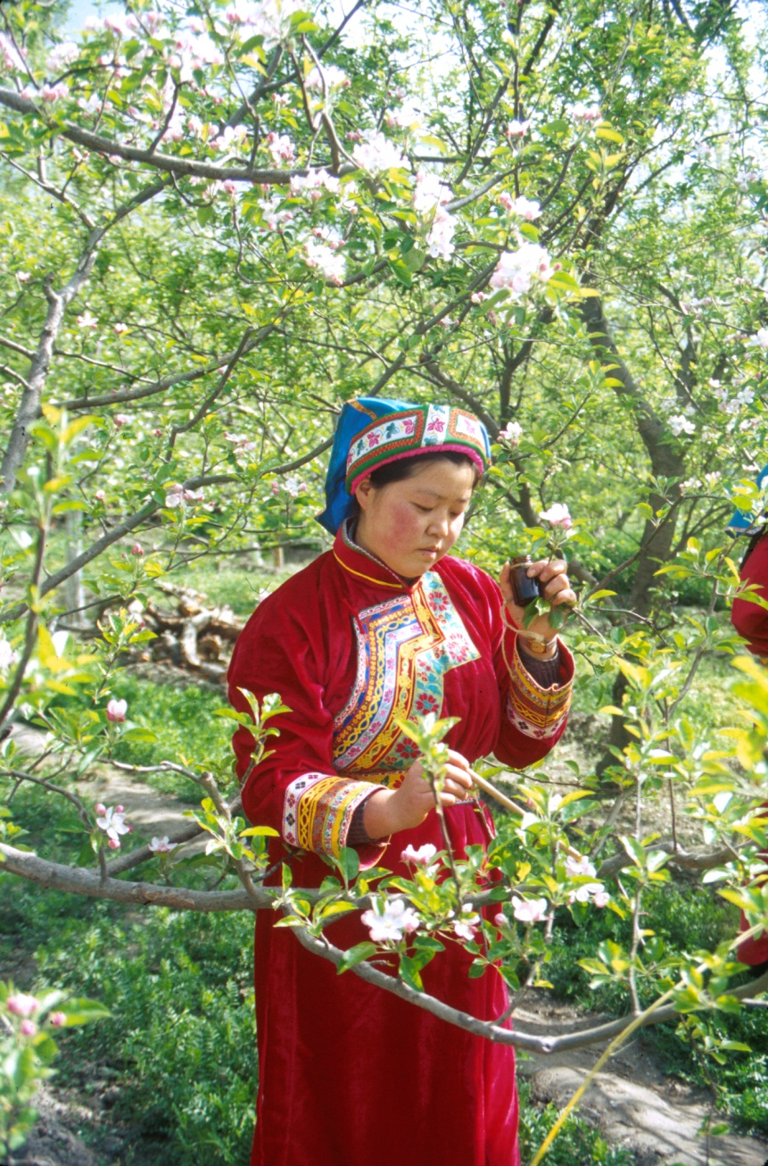
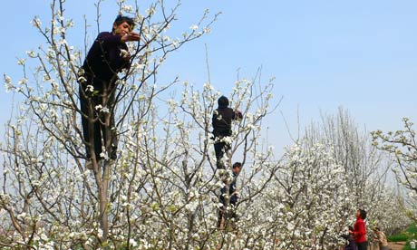
Hand-pollination in China

Slide 25
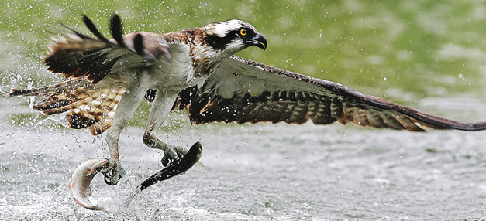
Recreation and jobs: Big fun and big business.
In 2011 in the United States, there were
13.7 million hunters who spent $34 billion
33.1 million anglers who spent $41.8 billion
71.8 million birders who spent $55 billion
Collectively, anglers, birders, and hunters accounted for $131 billion in revenue in 2011 in America alone compared to $156 billion worldwide by Apple in its 2012 fiscal year.
Birding is second largest hobby in the U.S. behind gardening.
Nature photography, botanizing, etc.

Slide 26

Ecosystem Services
Clean water – wetlands purify water by soils acting as massive filters to bind toxic substances. Wetlands purify our water at such a vast scale that there is no economically feasible substitute.
Clean air – take up and store carbon, give off oxygen
Food, timber, other goods
- Green spaces:
Quality of life / connectivity
Greater productivity by workers
Attracts industry
Recreation

Slide 27

The Little Things Are Important!
Bottom-line = What are we passing down to the next generation?

Slide 28


The Natural Heritage Commission protects and manages some of the most diverse areas in our state: System of Natural Areas
living museums…
aid in the recovery of rare species…
blue prints for restoration…
The System is currently made up of 71 Natural Areas (61,000 acres) around the state.

Slide 29

Arkansas Natural Heritage Commission
Preserving Arkansas’s Natural Heritage
Chris Colclasure
323 Center Street, Suite 1500
Little Rock, AR 72201
(501) 324-9760
Email: chrisc@arkansasheritage.org

