Slide 1

Comprehensive Watershed Modeling for 12-digit HUC Priority Watersheds – Phase II
Presented by:
Naresh Pai
PI: Dharmendra Saraswat
Collaborator: Mike Daniels
ANRC 2012 NPS Project Review Meeting, Sept. 27
Cooperative Extension Service

Slide 2
Objective
Project Objective
Prioritize 12-digit HUCs using SWAT model output
ANRC 2012 NPS Project Review Meeting, Sept. 27
Cooperative Extension Service

Slide 3
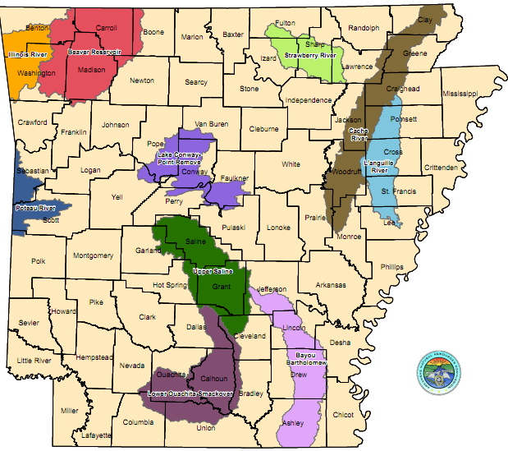
Background
2
1
3
4
Phase I
(2008 – 2010)
5
SWAT Modeling Project
12-digit HUC Prioritization
ANRC 2012 NPS Project Review Meeting, Sept. 27
Cooperative Extension Service

Slide 4
Background
2
1
Phase II
(2011 – 2013)
3
SWAT Modeling Project
12-digit HUC Prioritization
ANRC 2012 NPS Project Review Meeting, Sept. 27
Cooperative Extension Service

Slide 5
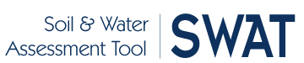

SWAT Model New Feature
SWAT2009: Integrates land-use changes during simulation
Headwater Poteau
1999 2006
Bens Creek
1999 2006
Cedar Creek
1999 2006
Urban (1.8%)
Urban (6%)
Urban (3.8%)
Urban (13.7%)
Urban (8.3%)
Urban (29.1%)
ANRC 2012 NPS Project Review Meeting, Sept. 27
Cooperative Extension Service

Slide 6
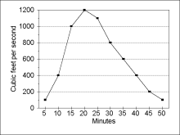




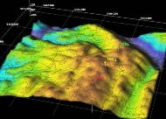
Overall Project Approach
Precipitation
PBIAS
NSE
R²
RSR
Temperature
Calibration/
Validation
SWAT
Prioritization
(Flow-weighted
concentration)
Soils
Land-use/
management
practices
Point
Sources
Topography
ANRC 2012 NPS Project Review Meeting, Sept. 27
Cooperative Extension Service

Slide 7
SWAT Model Setup: Spatial Data
SWAT 2009
Boundary
(12-digit HUC)
Elevation
(DEM-5 m)
Soil Map
(SSURGO)
Landuse
(92, 99, 01, 04, 06)
Streams
(NHD)
Weather (NEXRAD, Gages)
ANRC 2012 NPS Project Review Meeting, Sept. 27
Cooperative Extension Service

Slide 8
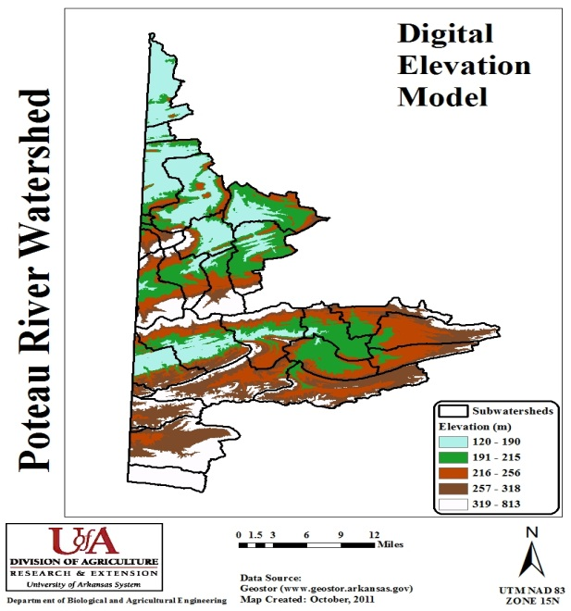
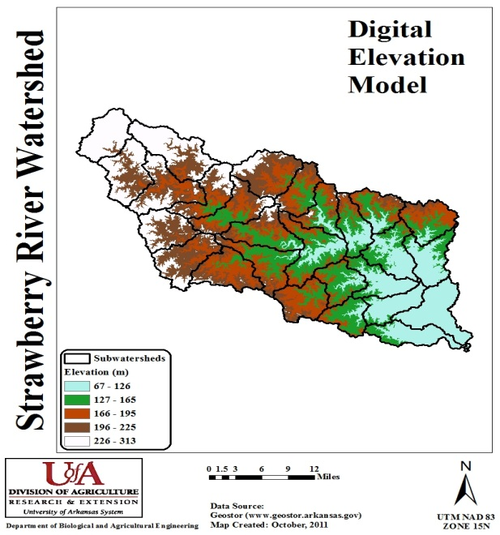
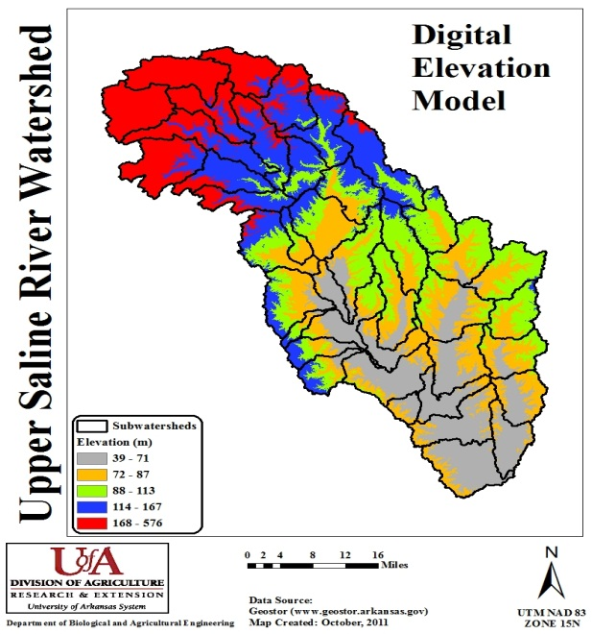
SWAT Data Processing
Elevation:
Download DEM from Geostor
Clip to watershed boundary
ANRC 2012 NPS Project Review Meeting, Sept. 27
Cooperative Extension Service

Slide 9
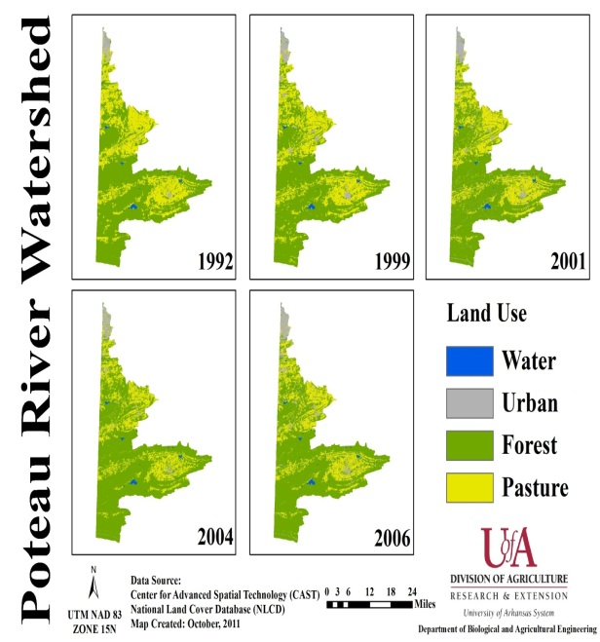
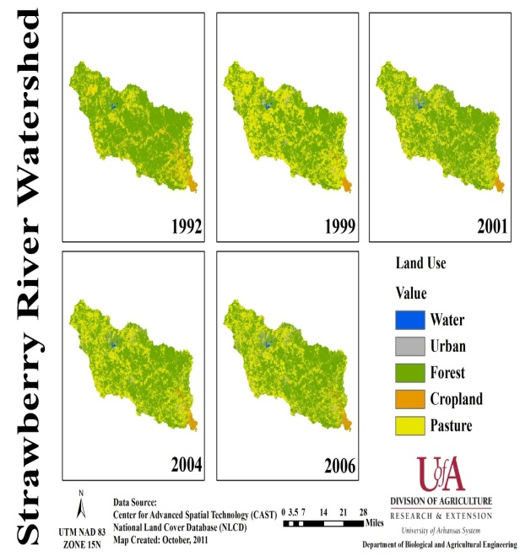
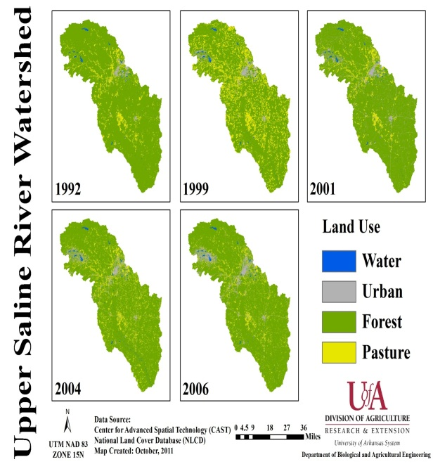
SWAT Data Processing
Land-use:
LULC: 1992, 1999, 2001, 2004, 2006
Activate land-use update module
ANRC 2012 NPS Project Review Meeting, Sept. 27
Cooperative Extension Service

Slide 10
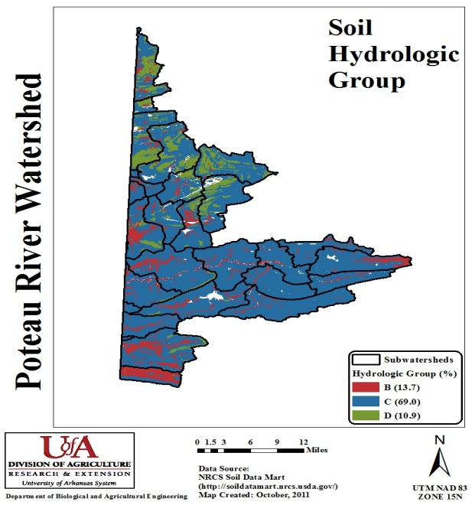
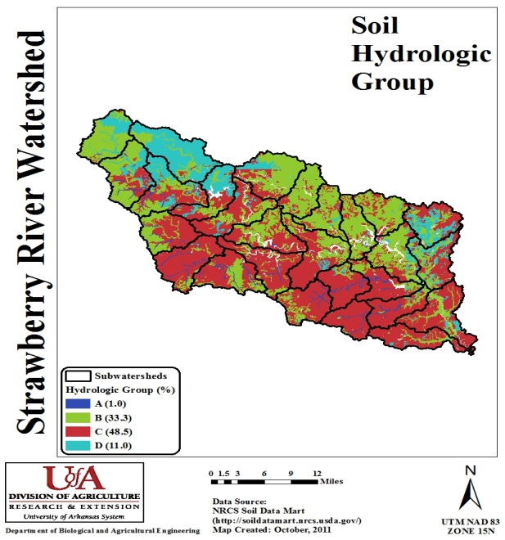
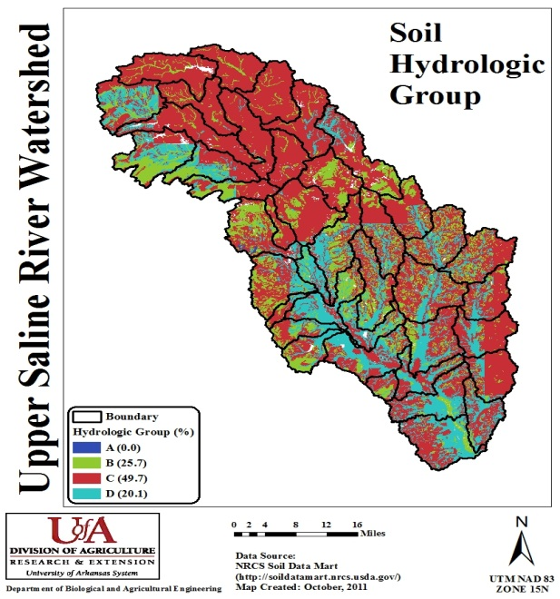
SWAT Data Processing
Soil:
Download and clip SSURGO soil layer
Update SWAT soil database
ANRC 2012 NPS Project Review Meeting, Sept. 27
Cooperative Extension Service

Slide 11
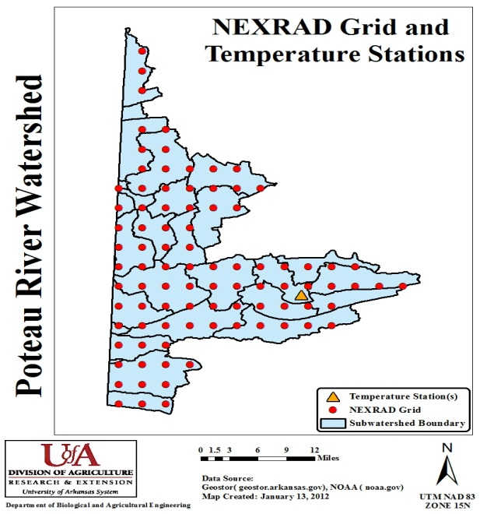
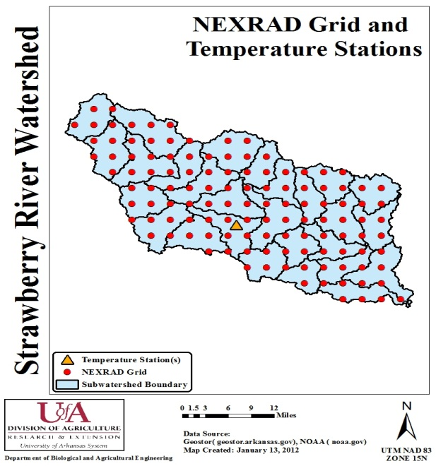
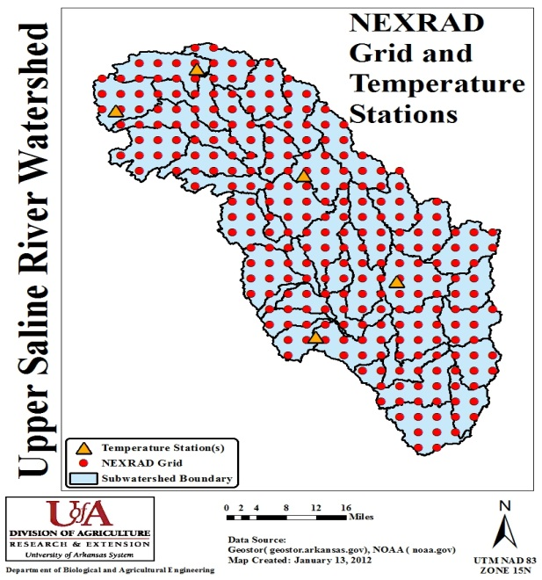
SWAT Data Processing
Weather:
Precipitation: Aggregate NEXRAD to daily scale for each subwatershed
Temperature: daily data from gages
ANRC 2012 NPS Project Review Meeting, Sept. 27
Cooperative Extension Service

Slide 12
SWAT Data Processing
User-defined subwatershed boundaries:
Download certified 12-digit HUC boundaries and post-process to make it SWAT compatible
Streams:
Download NHD data and post-process to make it compatible with user-defined subwatershed boundaries
ANRC 2012 NPS Project Review Meeting, Sept. 27
Cooperative Extension Service

Slide 13
SWAT Model Setup: Tabular Data
Management Data
Crop rotation
Timing & frequency of tillage
Planting date
Harvesting date
Timing and rate of fertilizer application
Irrigation
Pesticides
SWAT 2009
Cropping practices for each county
Point source discharge
(ADEQ)
ANRC 2012 NPS Project Review Meeting, Sept. 27
Cooperative Extension Service

Slide 14
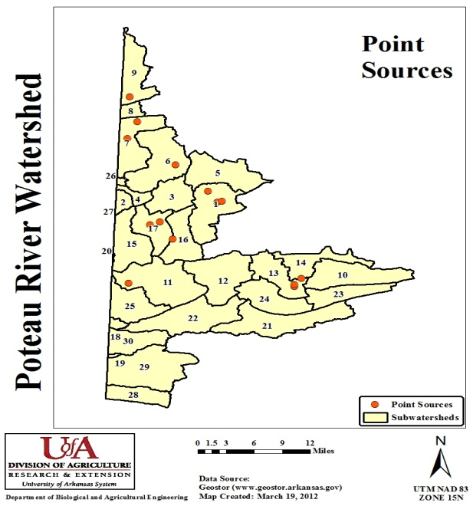
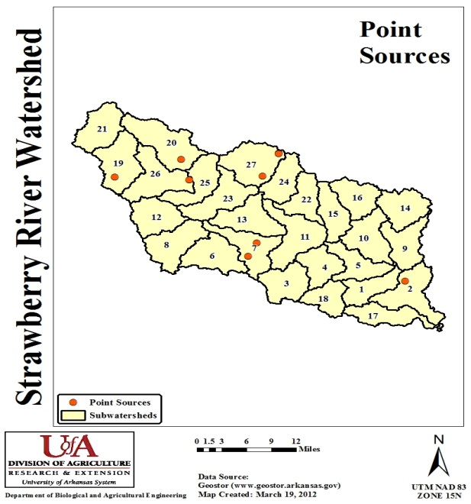
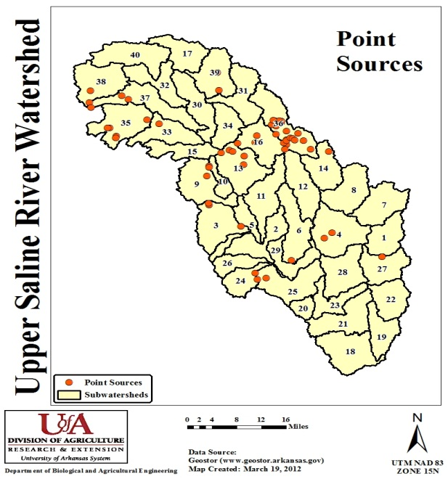
SWAT Data Processing
Point Sources:
Process ADEQ data into SWAT compatible format
ANRC 2012 NPS Project Review Meeting, Sept. 27
Cooperative Extension Service

Slide 15
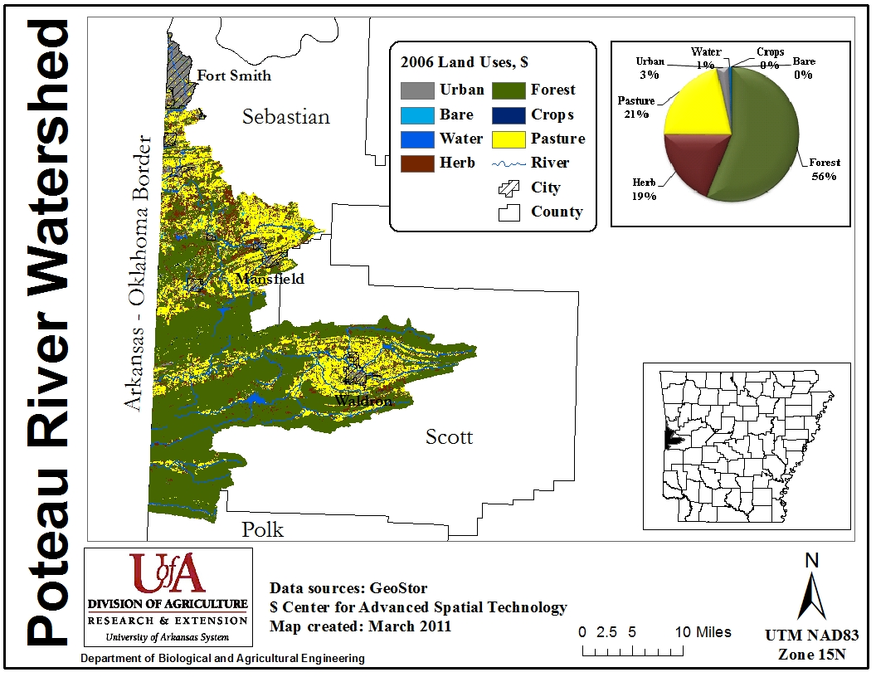
Watershed Profile
Poteau River Watershed
Area: 556 sq. mi.
Land-use: Forest (56%)
Pasture (21%)
Urban (3%)
Elevation: 865 ft. (mean)
Slope: 46% area under >8% slope
Soil: 80% area under group C/D
Precipitation: 40 inch (mean)
ANRC 2012 NPS Project Review Meeting, Sept. 27
Cooperative Extension Service

Slide 16
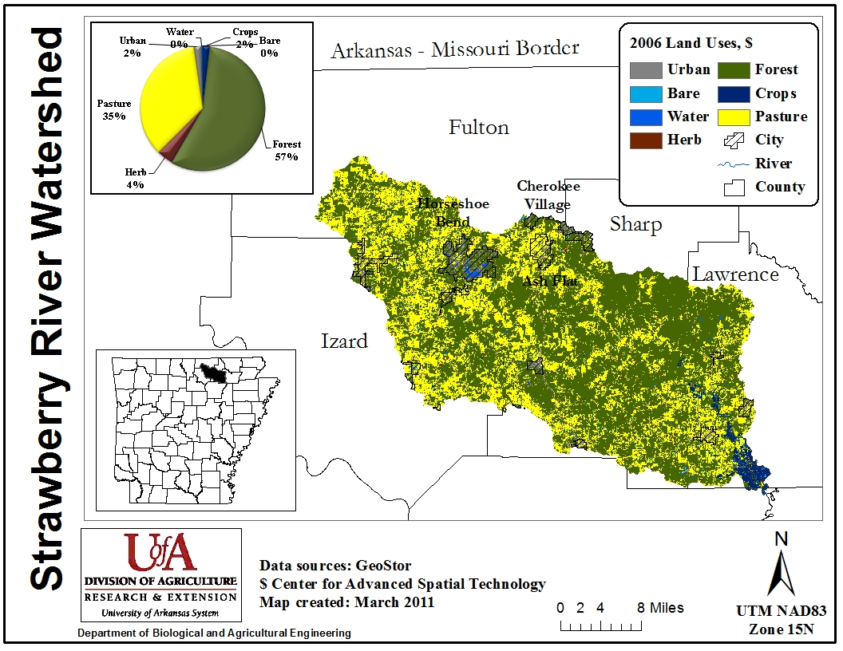
Watershed Profile
Strawberry River Watershed
Area: 761 sq. mi.
Land-use: Forest (58%)
Pasture (33%)
Urban (3%)
Elevation: 574 ft. (mean)
Slope: 39% area under >8% slope
Soil: 60% area under group C/D
Precipitation: 43 inch (mean)
ANRC 2012 NPS Project Review Meeting, Sept. 27
Cooperative Extension Service

Slide 17
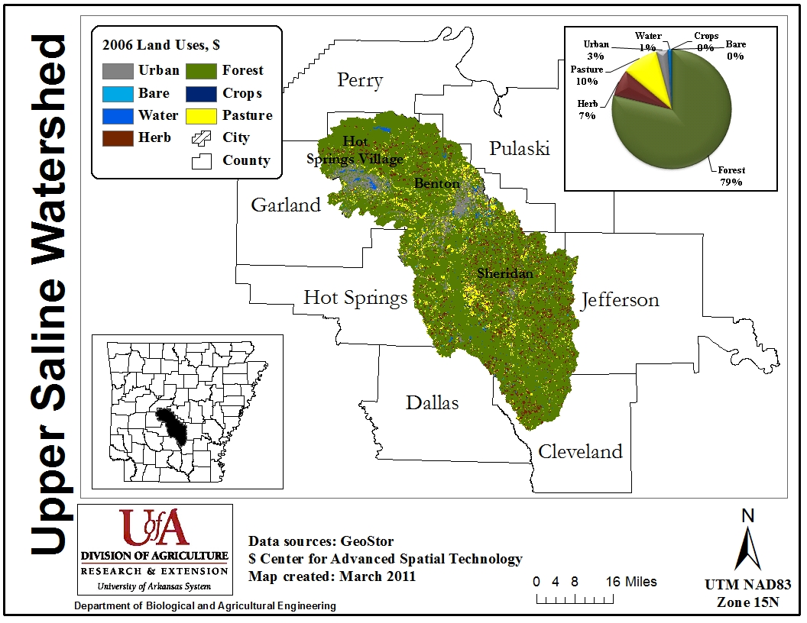
Watershed Profile
Upper Saline Watershed
Area: 1715 sq. mi.
Land-use: Forest (79%)
Pasture (10%)
Urban (3%)
Elevation: 390 ft. (mean)
Slope: 26% area under >8% slope
Soil: 70% area under group C/D
Precipitation: 45 inch (mean)
ANRC 2012 NPS Project Review Meeting, Sept. 27
Cooperative Extension Service

Slide 18
Remaining Tasks
Sensitivity analysis
Check potential model problems using SWAT Check*
Annual calibration
Monthly calibration/validation
Qualitative comparison with AWRC data (2011-2012)
Uncertainty analysis
Subwatershed prioritization
*White et al., 2012
ANRC 2012 NPS Project Review Meeting, Sept. 27
Cooperative Extension Service

Slide 19

Acknowledgements
Mike White, Jeff Arnold, Nancy Sammons, USDA-ARS
Raghavan Srinivasan, Texas A&M University
ANRC 2012 NPS Project Review Meeting, Sept. 27
Cooperative Extension Service

