Slide 1
Lower Norfork Dam Project
Baxter County Conservation District

Slide 2
Lower Norfork Dam Project
Baxter County Conservation District
Arkansas Natural Resources Commission
EPA Section 319 of Clean Water Act

Slide 3
Those aiding in the project
Baxter County Conservation District
Arkansas Natural Resources Commission
US Environmental Protection Agency
Arkansas Association of Conservation
Baxter County Cattlemen’s Association
Baxter County Cooperative Extension Service
Baxter County Fair Board
Mountain Home FFA

Slide 4
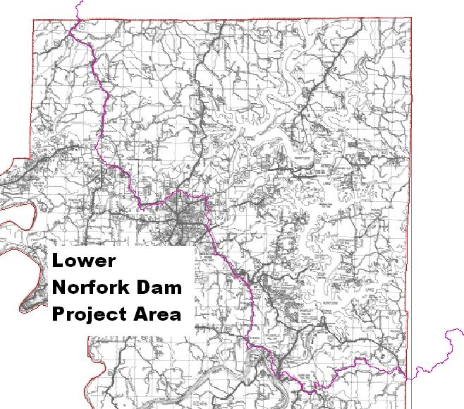

Slide 5
Best Management Practices
Fencing
Pasture Establishment
Brush and Weed Management
Watering Facilities
Heavy Use Areas
Stream Development
Animal Waste Systems
Stream Bank and Shoreline Protection
Buffer Areas

Slide 6
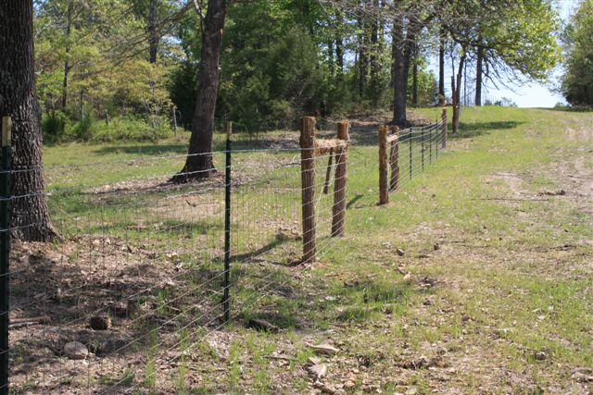
Fencing

Slide 7
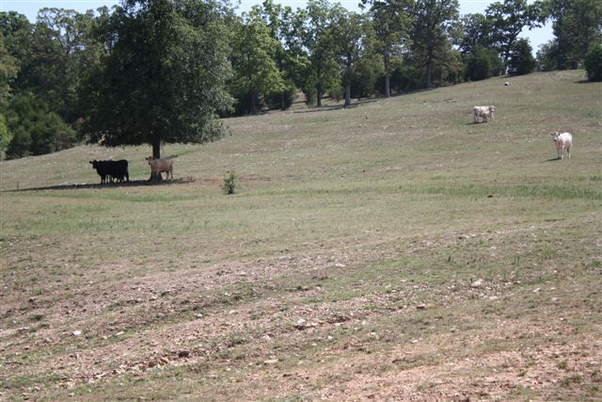
Pasture Loss Due To Severe Drought

Slide 8
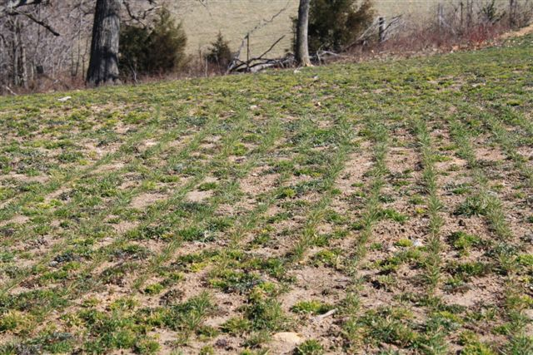
Pasture Establishment

Slide 9
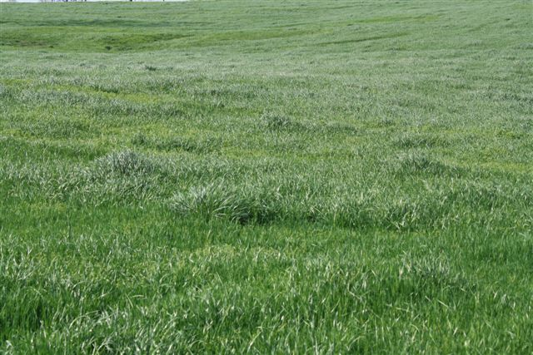
Pasture Establishment

Slide 10
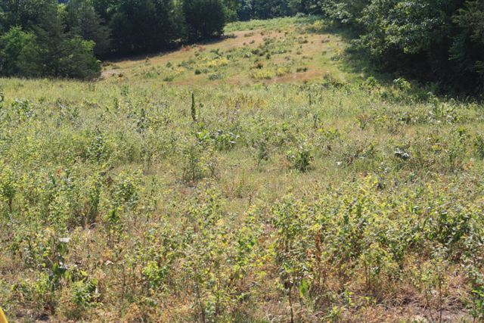
Brush Management

Slide 11
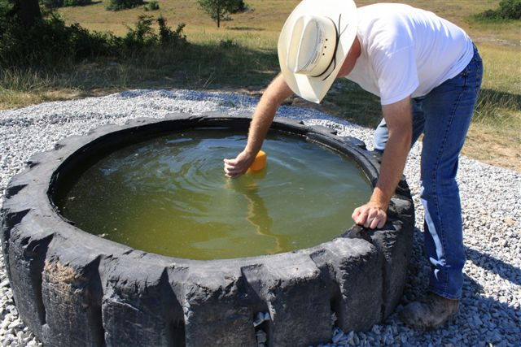
Watering Facilities

Slide 12
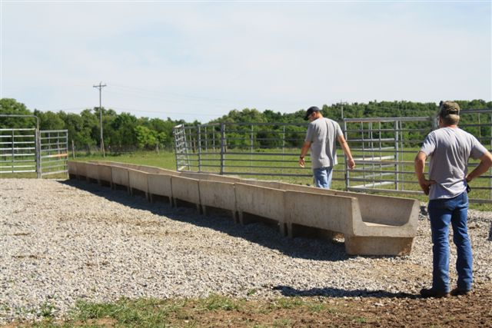
Heavy use areas

Slide 13
Project Goals
150 Conservation Plans on 21,750 Acres of Pasture Land.
6.5 Miles of Stream Bank with voluntary livestock exclusion.
Establish a GOOD WORKING RELATIONSHIP with landowners

Slide 14
Getting The Word Out
Newsletters
Radio spots
Magazine articles
Public meetings
Field days
Booth at the Baxter County Fair
People in the program talking to other people

Slide 15
Results
59 Conservation Plans Written.
93% of Cost Share Funds In The Landowner’s Hands.
BMP’s Implemented on 2,236Acres.
11,131 Feet of Fencing Installed
Utilization of Equipment Made Available by the Lower Norfork Dam Watershed Project.
Improve Attitudes Among Landowners Concerning Water Quality and Government Projects

Slide 16
Lessons Learned
Don’t let participants get too much going at once.
Stay in close contact with the landowner.
Be ready to listen!

Slide 17
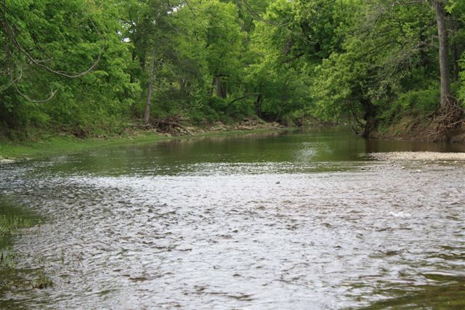
Water Quality

Slide 18
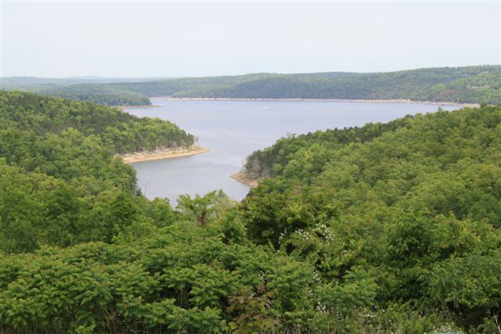
Questions?

