Slide 1

NPS Pollution Prevention
BMP E-Education
FY09-1700
Jane Maginot, John Pennington, Katie Teague
Washington County Cooperative Extension Service

Slide 2
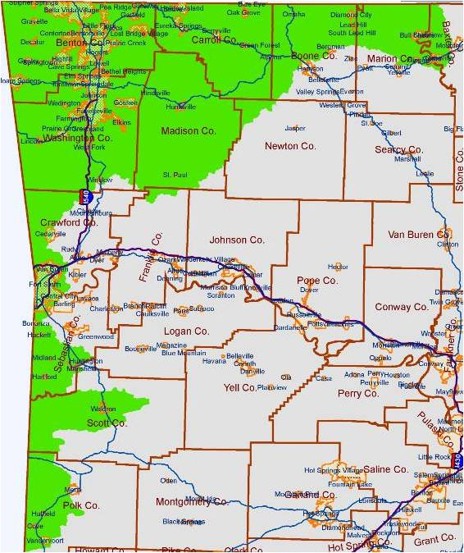
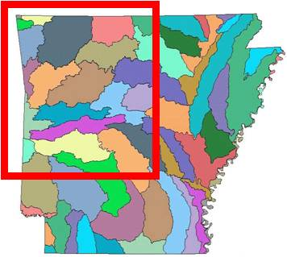
Project Goals/Objectives:
Develop and use electronic teaching tools to reduce nutrient nonpoint source pollution in NSA watersheds

Slide 3

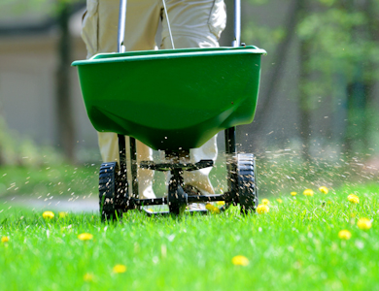
Task 1: Nonpoint source pollution prevention BMP podcasts
Develop and post a series of 2- to 10-minute video podcasts to educate the public about the ease and effectiveness of NPS pollution prevention homeowner BMPs

Slide 4


Developed 19 Educational
Water Quality Video Podcasts
Soil testing
Measure your lawn/garden
Purchasing type/amount of fertilizer
Fertilizer spreader calibration
Composting
Yard waste management
Lawn and garden Integrated Pest Management (IPM)
Build/use rain barrels
Create/use rain gardens
Household hazardous waste (HHW) management
Pet waste management
Riparian buffer function, improvement, maintenance
What is water quality?
What are watersheds?
Stormwater runoff
Creek clean participation
Link to podcasts:
www.uaex.edu

Slide 5
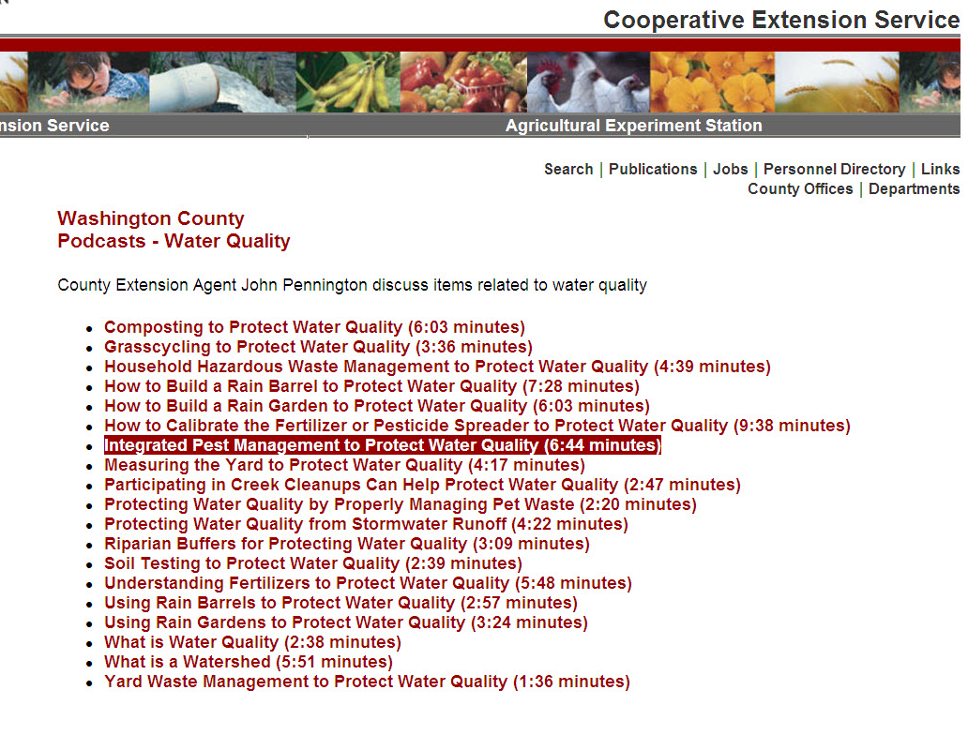

Slide 6
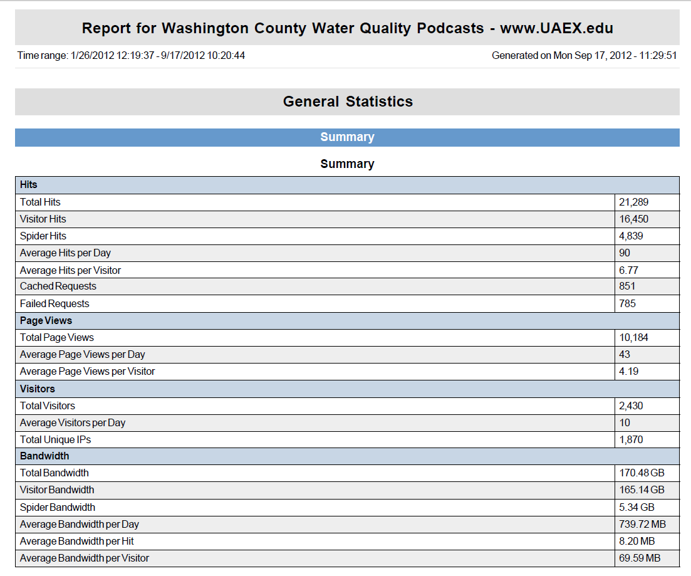
Podcast Viewership
21,289 - Total hits
90 – Average hits per day
6.77 Total hits per visitor

Slide 7
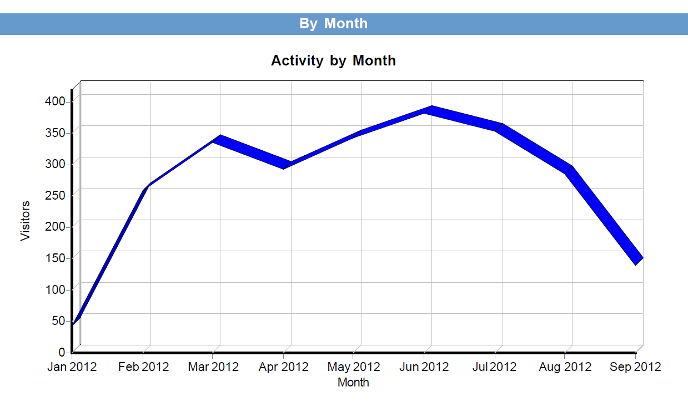
Podcast Viewership
Direct relationship with promotional efforts

Slide 8
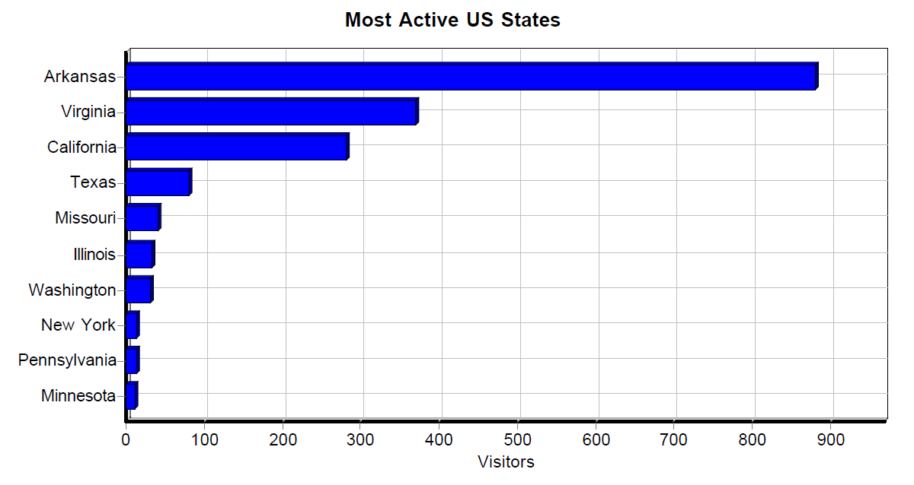
Podcast Views by State

Slide 9
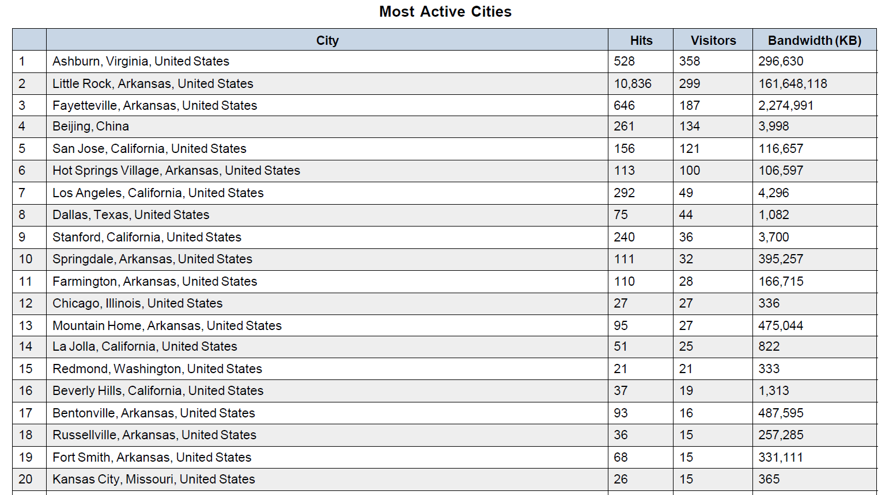
Podcast Views by City
Little Rock – 10,836 hits
Fayetteville – 261 hits
Springdale – 111 hits
Farmington – 110 hits

Slide 10
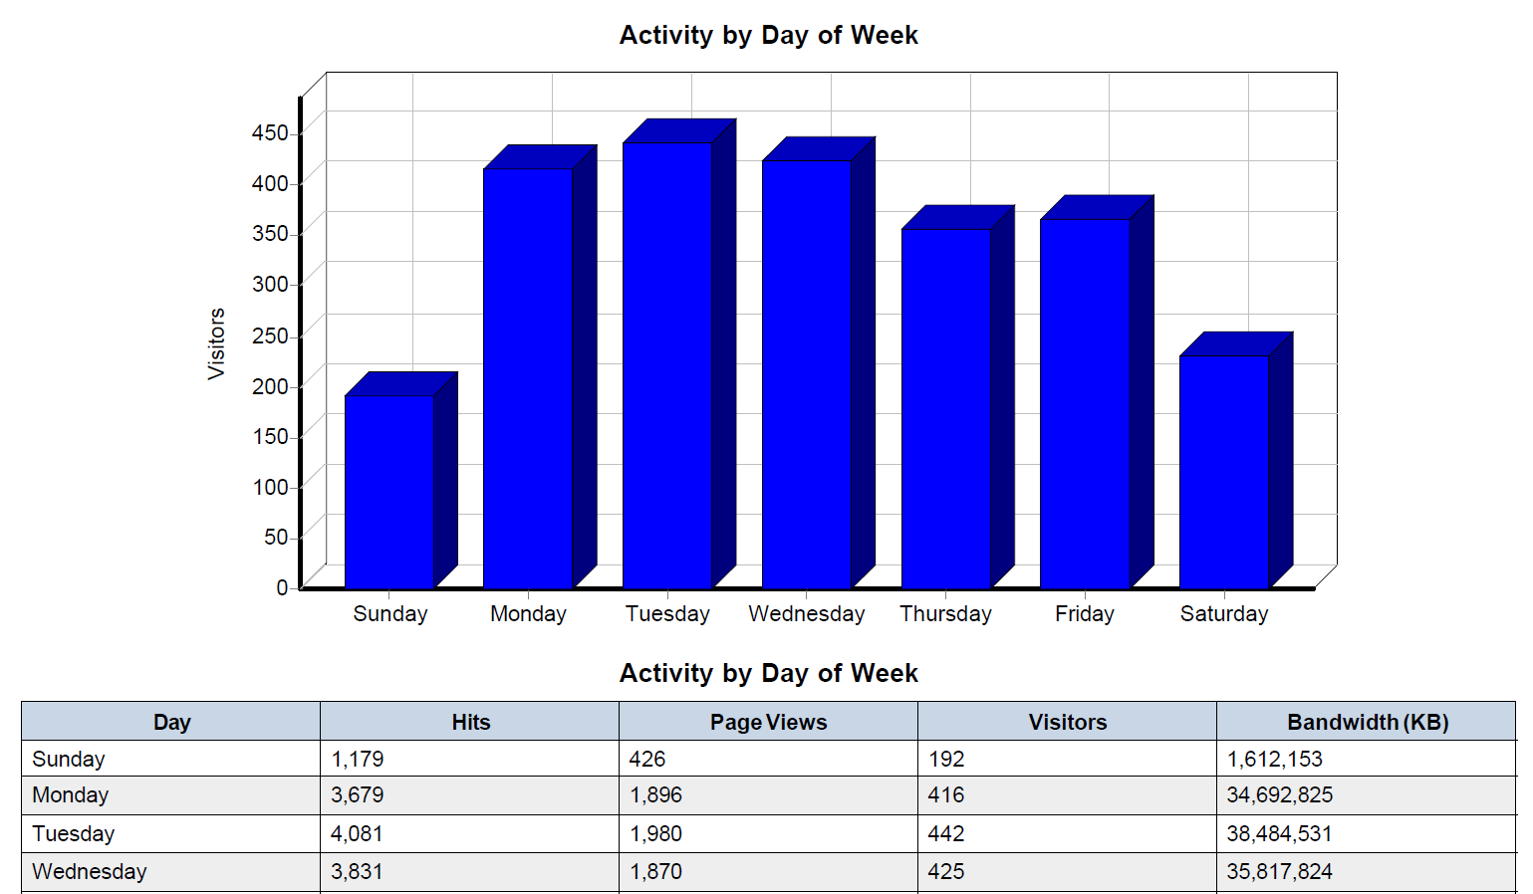
Podcast Views by Day of Week

Slide 11
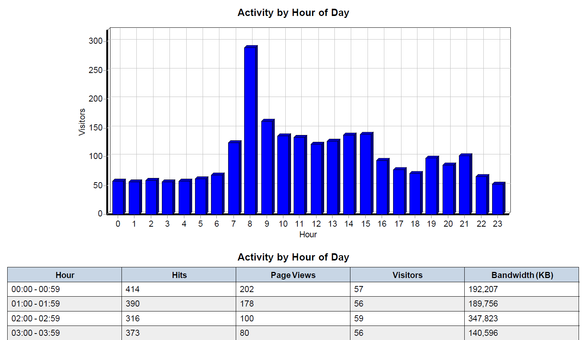
Podcast Views by Hour of Day

Slide 12



Task 2: Online BMP training
An online BMP guide will be developed using the Moodle platform with PowerPoint and Articulate Studio…
Interactive learning – BMPs for homeowners, business owners, and land managers

Slide 13

Online “Greening Your Life”
Training Guide
Water Quality in Arkansas
Nutrient Management
Yard Waste Management
Lawn and Garden IPM
Runoff Management/
Water Conservation
HHW Management
Pet Waste Management
Riparian Management
Getting Involved in Community Efforts
http://courses.uaex.edu

Slide 14
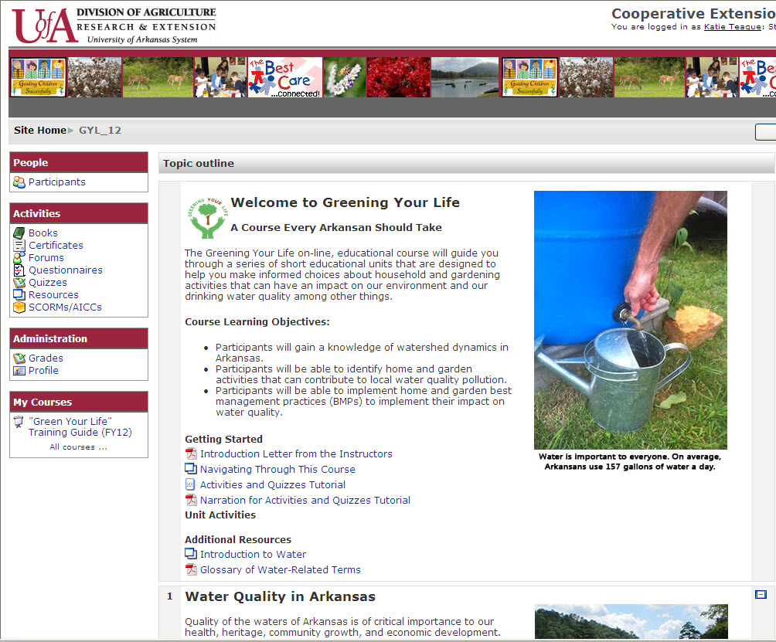

Slide 15
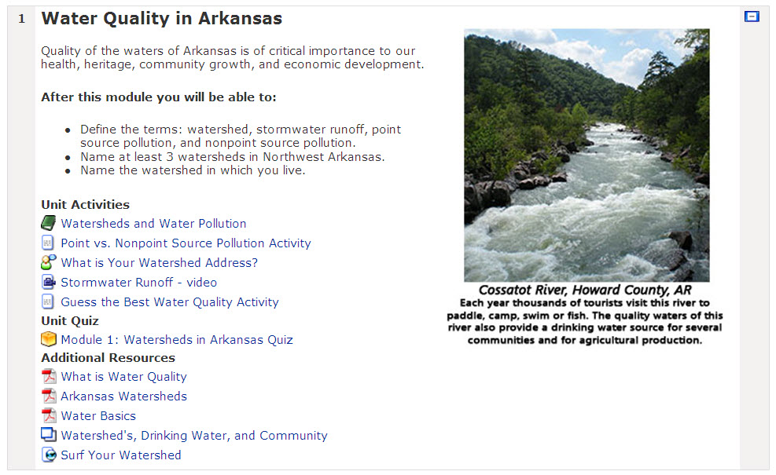
Books
Discussion forums
Videos
Activities
Quizzes
Resource information

Slide 16

Let’s look at a few course components online…

Slide 17
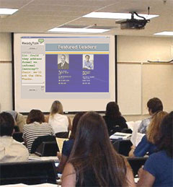
Task 3: BMP workshops in NSA counties
For those who do not have home/business access to the internet or prefer group learning, sessions of the online BMP guide will be conducted as workshops across the NSA counties.

Slide 18
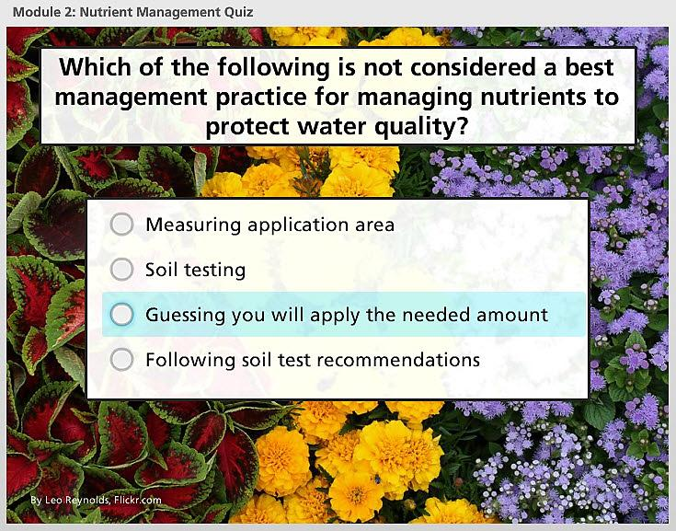
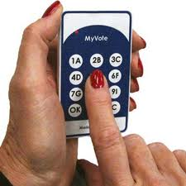
Engage participants with audience response!
Master Gardener Trainings:
  Baxter County
  Benton County
  Carroll County
  Marion County
  Polk County
  Sebastian County
  Washington County
Garden and Civic Presentations:
Crawford County garden club
Flower Garden & Nature Society
Sebastian County garden club
UA Environmental Health
Washington County garden clubs

Slide 19
Impacts
Created podcasts, online guide, and interactive workshops
Reaching a widespread audience through electronic education
Easily transferable and adoptable BMP education, outreach, and management actions

Slide 20
Questions?
Jane Maginot, jmaginot@uaex.edu
John Pennington, jhpennington@uaex.edu
Katie Teague, kteague@uaex.edu
479-444-1755

