Slide 1
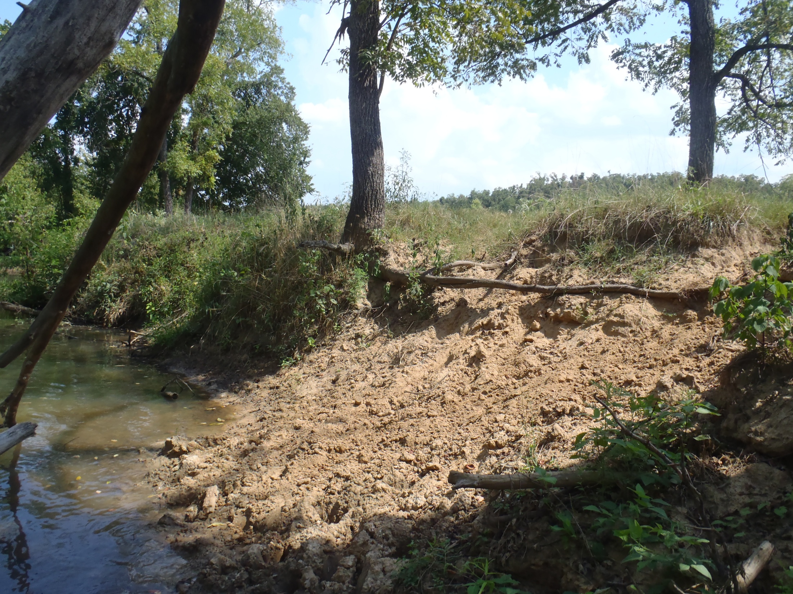
Year Three Review of Water Quality Monitoring on the Upper Strawberry River
Project 07-1000
T.R. Brueggen¹and J.L. Bouldin^{1,2}
¹ Environmental Sciences Graduate Program, Arkansas State University, State University, AR 72467
²Department of Biological Sciences, Arkansas State University, State University, AR 72467

Slide 2
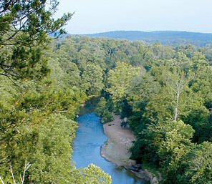
Overview
Major headwater streams in the upper Strawberry River watershed
  Little Strawberry (LS)
  Sandy Creek (SC)
  Greasy Creek (GC)
Above and below BMP
implementation
Surface Water Quality Tests
  Nutrients
    Nitrites
    Nitrates
    Ortho-Phosphates
  Total Suspended Solids
http://arkansas-dar.org/strawberryriver.htm

Slide 3
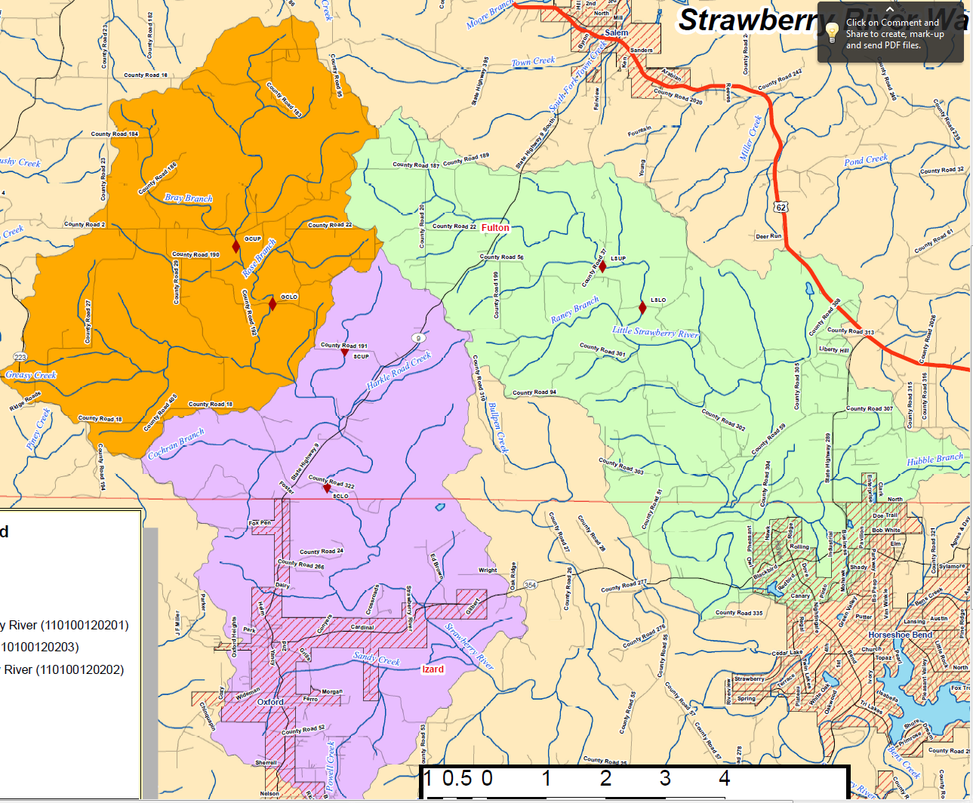
GCUP
LSUP
GCLO
LSLO
Greasy Creek (GC) Subwatershed
SCUP
Little Strawberry (LS) Subwatershed
SCLO
Sandy Creek (SC) Subwatershed

Slide 4
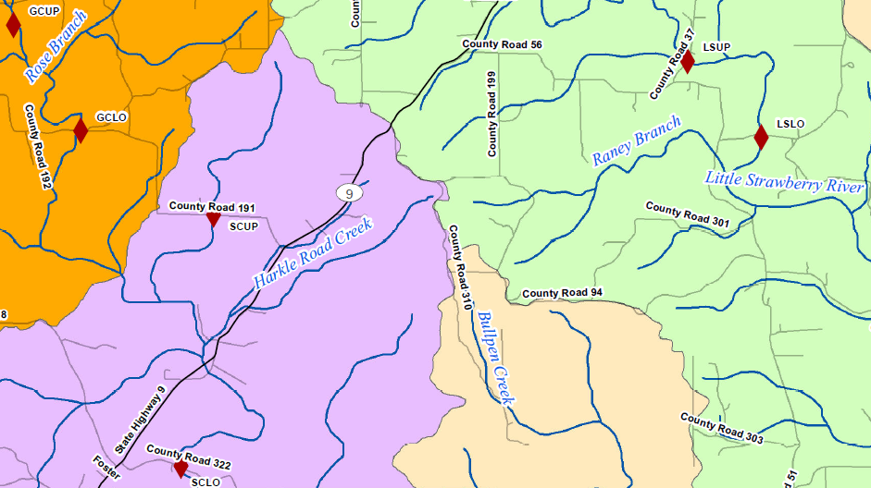
Sampling sites
GCUP
Fulton County
LSUP
GCLO
LSLO
SCUP
Greasy Creek
Little Strawberry
Sandy Creek
SCLO

Slide 5
Little Strawberry (LS) NO_{X} Data
Upper
Lower

Slide 6
Little Strawberry (LS) Ortho-Phosphate Data
Upper
Lower

Slide 7
Little Strawberry Total Suspended Solid (TSS) Data
Upper
Lower

Slide 8
Greasy Creek (GC) NO_{X} Data
Upper
Lower

Slide 9
Greasy Creek (GC) Ortho-Phosphate Data
Upper
Lower

Slide 10
Greasy Creek (GC) Total Suspended Solid (TSS) Data
Upper
670.0
Lower

Slide 11
Sandy Creek (SC) NO_{X} Data
Upper
2011
2011 (Post-BMP)
Lower

Slide 12
Sandy Creek (SC) Ortho-Phosphate Data
Upper
2011
2011 (Post-BMP)
Lower

Slide 13
Sandy Creek (SC) Total Suspended Solid (TSS) Data
179.8
Upper
2011
2011 (Post-BMP)
Lower

Slide 14
High and Mean Values:
Pre-BMP 2008, 2009, 2010
Nitrate (mg/L)
 | Pre-BMP |  | 2009 |  | 2010 |  | 2011 (Jan-June) |  | Post BMP (July-Aug 25)
Site | High | Mean | High | Mean | High | Mean | High | Mean | High | Mean
LSUP | 2.05 | 0.76 | 1.34 | 0.67 | 2.95 | 1.09 | 3.97 | 1.38 | 2.07 | 0.49
LSLO | 2.37 | 0.56 | 0.90 | 0.58 | 1.18 | 0.43 | 1.34 | 0.57 | 1.26 | 0.13
GCUP | 0.67 | 0.29 | 0.69 | 0.30 | 0.48 | 0.19 | 0.92 | 0.31 | 0.80 | 0.10
GCLO | 1.28 | 0.29 | 0.73 | 0.34 | 0.71 | 0.24 | 0.89 | 0.19 | BDL | BDL
SCUP | 2.30 | 0.46 | 1.11 | 0.40 | 0.83 | 0.31 | 1.46 | 0.43 | 1.04 | NA
SCLO | 0.74 | 0.31 | 0.54 | 0.27 | 0.73 | 0.24 | 0.63 | 0.15 | BDL | BDL

Slide 15
High and Mean Values:
Pre-BMP 2008, 2009, 2010
Nitrite (mg/L)
 | Pre-BMP |  | 2009 |  | 2010 |  | 2011 (Jan-June) |  | Post BMP (July-Aug 25)
Site | High | Mean | High | Mean | High | Mean | High | Mean | High | Mean
LSUP | 0.16 | 0.16 | BDL | BDL | BDL | BDL | BDL | BDL | BDL | BDL
LSLO | BDL | BDL | BDL | BDL | BDL | BDL | BDL | BDL | BDL | BDL
GCUP | BDL | BDL | BDL | BDL | BDL | BDL | BDL | BDL | BDL | BDL
GCLO | BDL | BDL | BDL | BDL | BDL | BDL | BDL | BDL | BDL | BDL
SCUP | 0.13 | 0.13 | BDL | BDL | BDL | BDL | BDL | BDL | BDL | BDL
SCLO | BDL | BDL | BDL | BDL | BDL | BDL | BDL | BDL | BDL | BDL

Slide 16
High and Mean Values:
Pre-BMP 2008, 2009, 2010
Ortho-phosphate (mg/L)
 | Pre-BMP |  | 2009 |  | 2010 |  | 2011 (Jan-June) |  | Post BMP (July-Aug 25)
Site | High | Mean | High | Mean | High | Mean | High | Mean | High | Mean
LSUP | 0.18 | 0.04 | 0.11 | 0.05 | 0.09 | 0.05 | 0.14 | 0.05 | 0.48 | 0.06
LSLO | 0.06 | 0.01 | 0.12 | 0.05 | 0.09 | 0.04 | 0.09 | 0.03 | 0.14 | 0.04
GCUP | 0.05 | 0.02 | 0.08 | 0.02 | 0.05 | 0.03 | 0.09 | 0.04 | 0.06 | 0.03
GCLO | 0.08 | 0.03 | 0.13 | 0.05 | 0.05 | 0.03 | 0.18 | 0.05 | 0.14 | 0.04
SCUP | 0.05 | 0.03 | 0.13 | 0.05 | 0.21 | 0.05 | 0.13 | 0.04 | 0.14 | NA
SCLO | 0.04 | 0.02 | 0.14 | 0.05 | 0.06 | 0.03 | 0.06 | 0.04 | 0.14 | 0.04

Slide 17
High and Mean Values:
Pre-BMP 2008, 2009, 2010
TSS (mg/L)
 | Pre-BMP |  | 2009 |  | 2010 |  | 2011 (Jan-June) |  | Post BMP (July-Sept 15)
Site | High | Mean | High | Mean | High | Mean | High | Mean | High | Mean
LSUP | 26.6 | 4.2 | 55.8 | 7.6 | 7.9 | 4.0 | 15.9 | 7.5 | 35.0 | 7.2
LSLO | 41.3 | 5.0 | 20.0 | 4.6 | 8.9 | 4.3 | 19.6 | 7.7 | 33.8 | 7.2
GCUP | 14.3 | 2.4 | 16.6 | 4.4 | 4.4 | 2.9 | 158.7 | 29.2 | 8.0 | 3.5
GCLO | 13.9 | 4.4 | 14.6 | 5.2 | 15.9 | 7.8 | 670.0 | 115.3 | 10.5 | 5.2
SCUP | 71.4 | 8.8 | 36.6 | 7.1 | 19.3 | 5.0 | 179.8 | 41.0 | 10.5 | NA
SCLO | 29.3 | 4.6 | 8.8 | 3.5 | 37.7 | 8.1 | 32.6 | 10.9 | 18.5 | 5.2

Slide 18
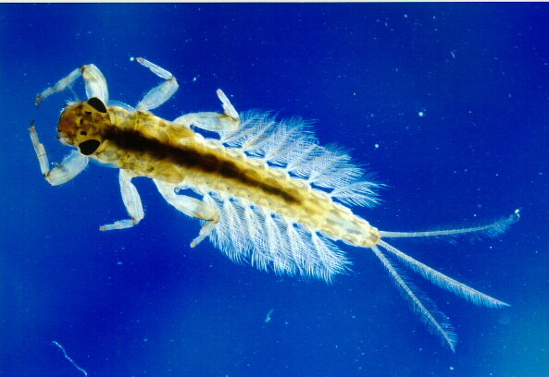
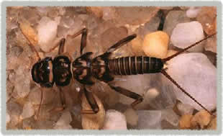
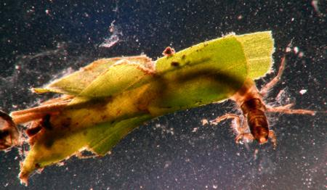
Other Analyses
Stream bank erosion
Benthic macroinvertebrate survey
Escherichia coli
Supported by 104-B Grant: AWRC and Arkansas State University
http://www.famu.org/mayfly/images/pluteus_nym.jpg
http://www.esf.edu/rwls/Research/Benthic/ACRONE1-1.jpg
http://www.lifeinfreshwater.org.uk/species%20pages/caddis%20flies.jpg.html

Slide 19
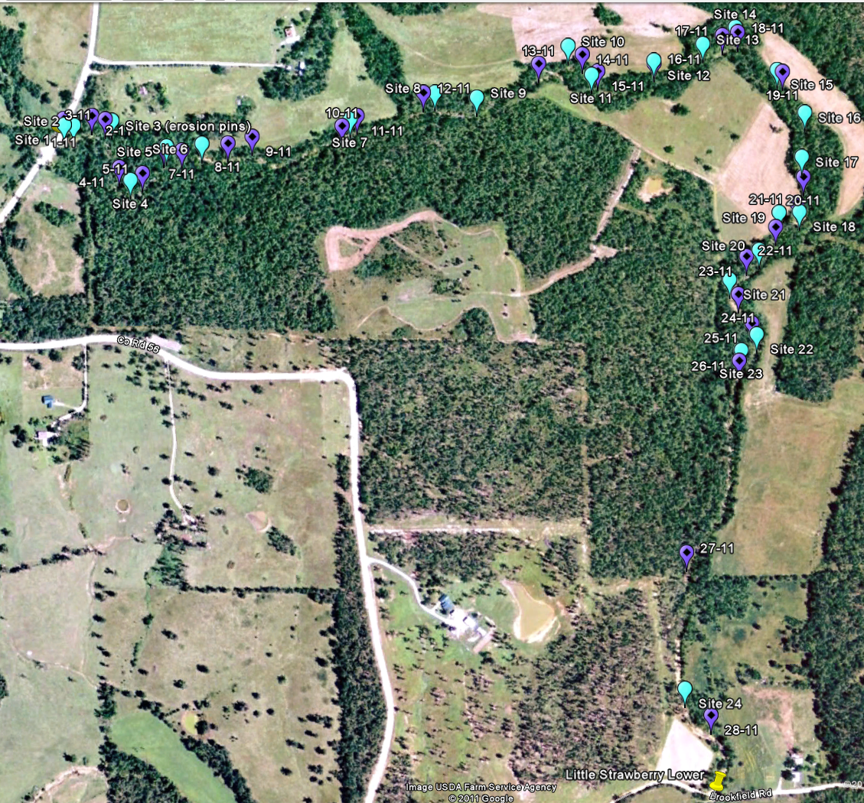
Little Strawberry
  ≈2.74 stream km (1.7 miles) surveyed
    5,480 m stream bank
  2010 (light blue)
    24 sites determined of severe or very severe erosion
    746 m stream bank
  2011 (purple)
    28 sites determined of severe or very severe erosion
    995 m stream bank

Slide 20
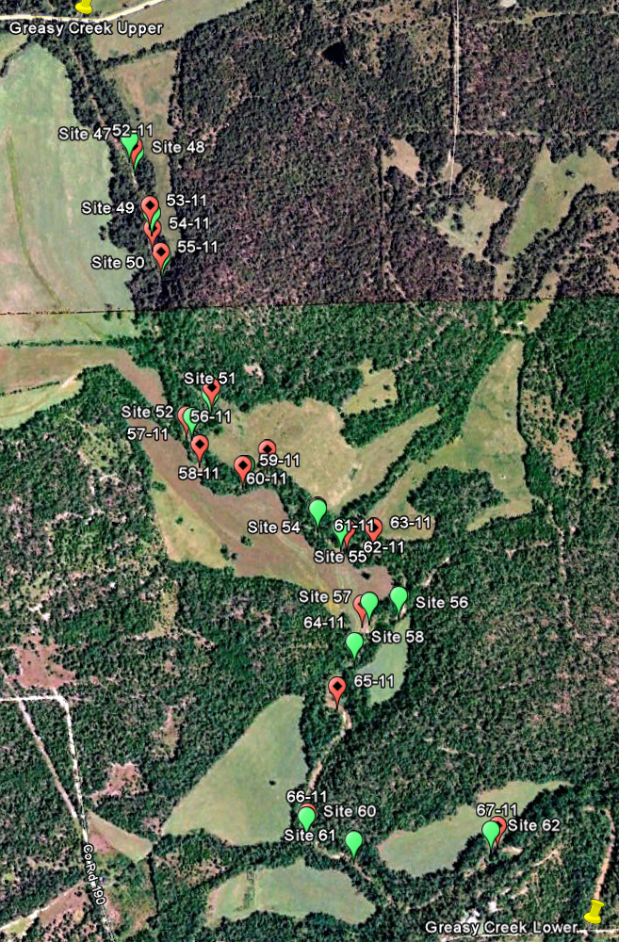
Greasy Creek
  ≈3.17 stream km (2.0 miles) surveyed
    6,340 m stream bank
  2010 (green)
    16 sites determined of severe or very severe erosion
    500 m stream bank
  2011 (red)
    16 sites determined of severe or very severe erosion
    575 m stream bank

Slide 21
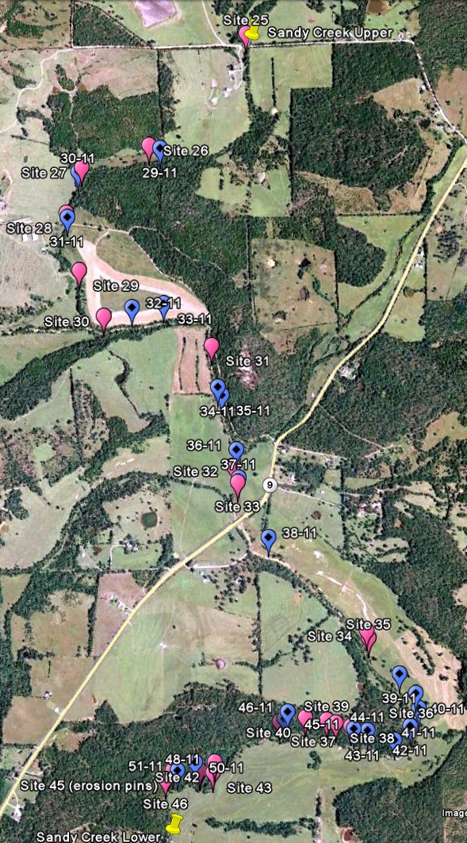
Sandy Creek
  ≈6.63 stream km (4.1 miles) surveyed
    13,260 m stream bank
  2010 (pink)
    22 sites determined of severe or very severe erosion
    505 m stream bank
  2011 (blue)
    21 sites determined of severe or very severe erosion
    525 m stream bank

Slide 22
Benthic Macroinvertebrates Abundance
 | Spring 2009 | Spring 2010
High (yellow) | 456 | 750*
Low (white) | 21 | 99
*704 Chironomidae
 | Fall 2009 | Fall 2010
High (yellow) | 295 | 795*
Low (white) | 135 | 36
*715 Chironomidae

Slide 23
Family Richness

Slide 24
Ephemeroptera, Plecoptera and Trichoptera (EPT)

Slide 25
Escherichia coli
*
*
* No values for June, July, August 2009
* Samples exceeded 298 CFU/100mL maximum for single samples for ERW, ESW, and NSW
* Samples exceeded 1490 CFU/100mL max for single sample during the remainder of
the year for ERW, ESW, and NSW

Slide 26
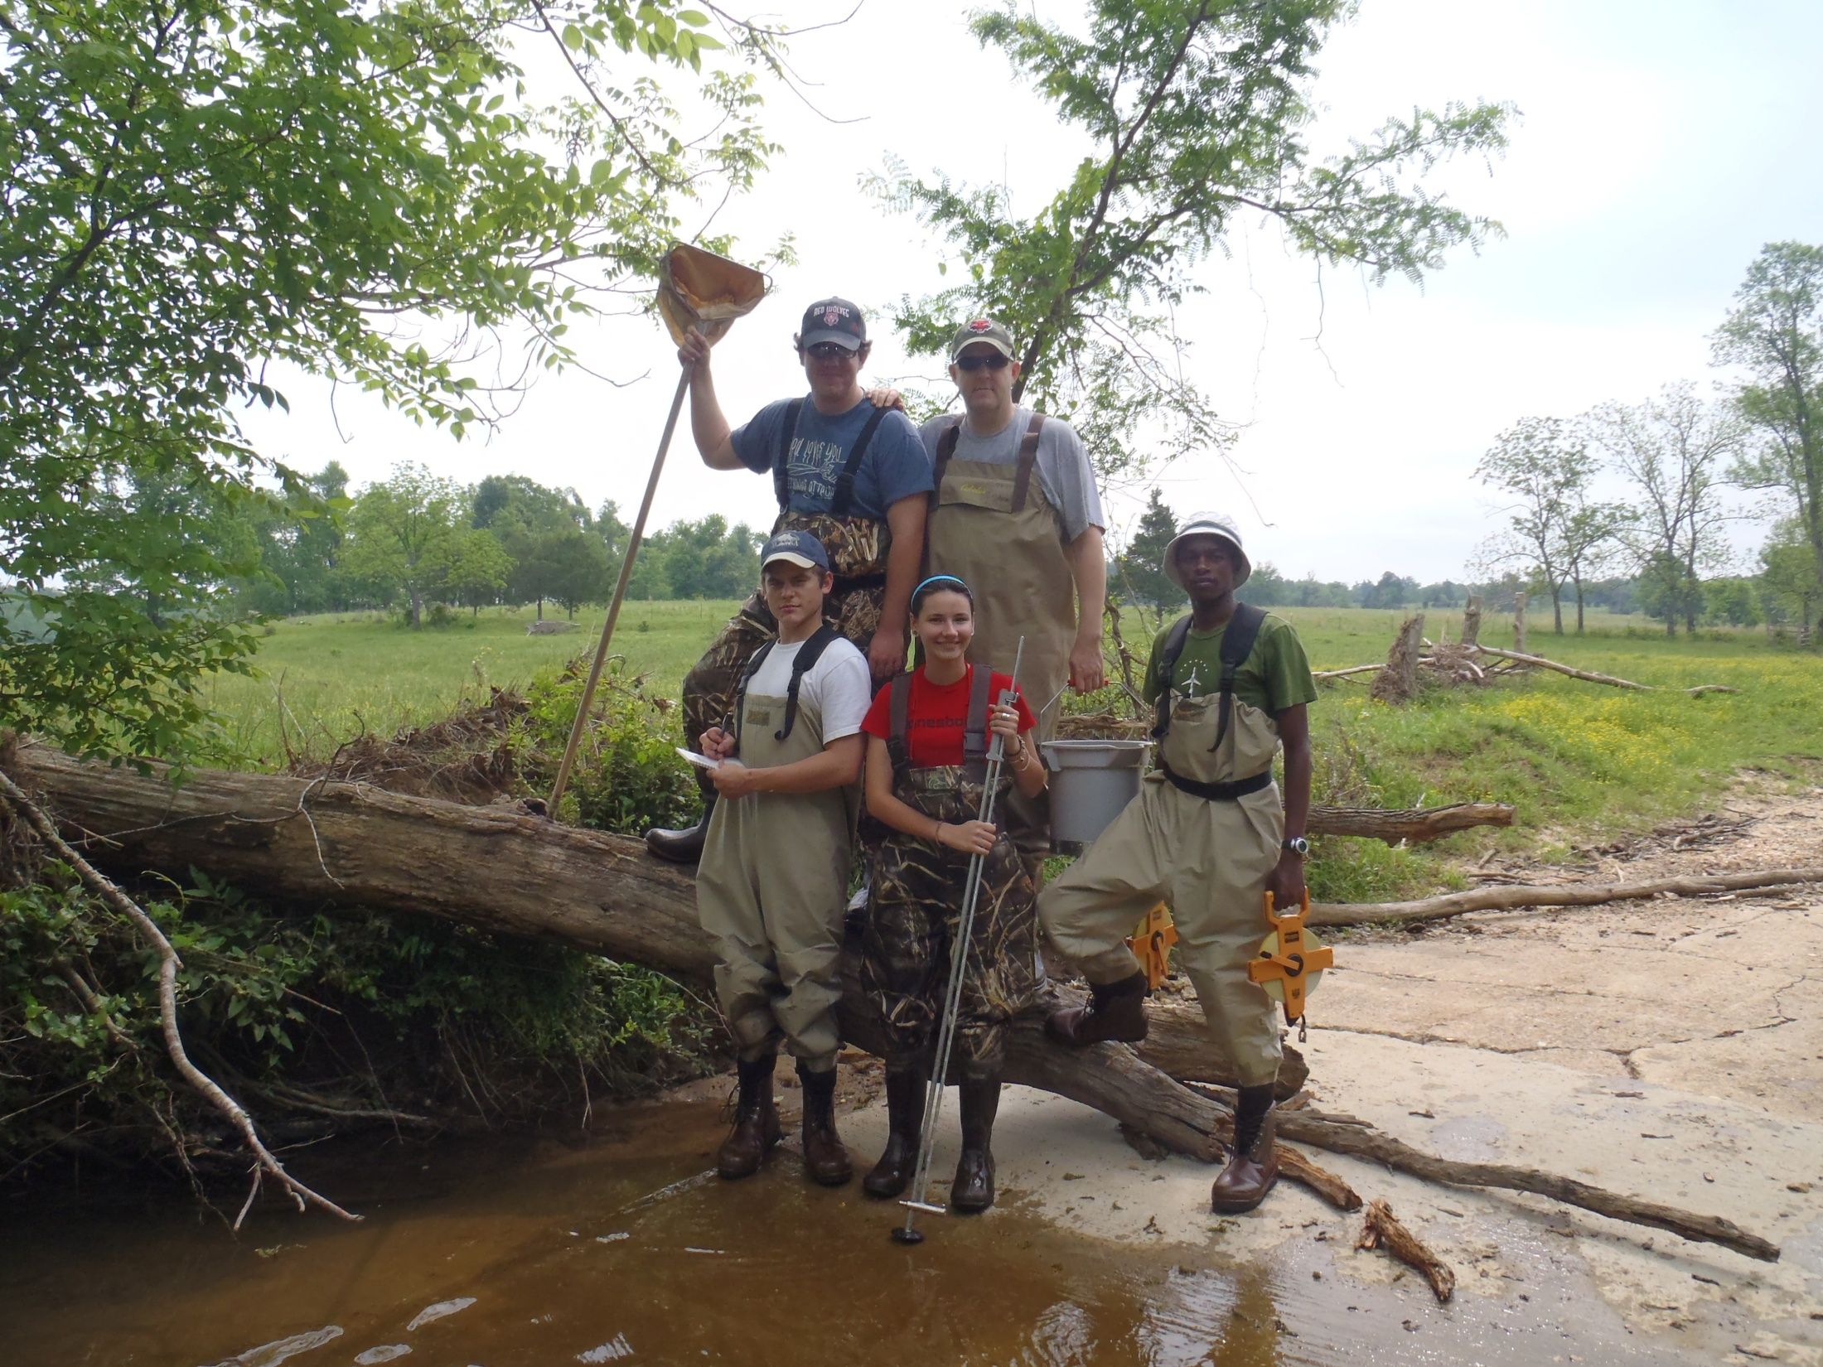
Acknowledgments
USEPA 319 Grant
AWRC 104-B USGS Grant
Fulton County Conservation District
Arkansas State University (ASU) Environmental Sciences Graduate Program
All graduate and undergraduate ASU Ecotoxicology Research Facility Workers

Slide 27
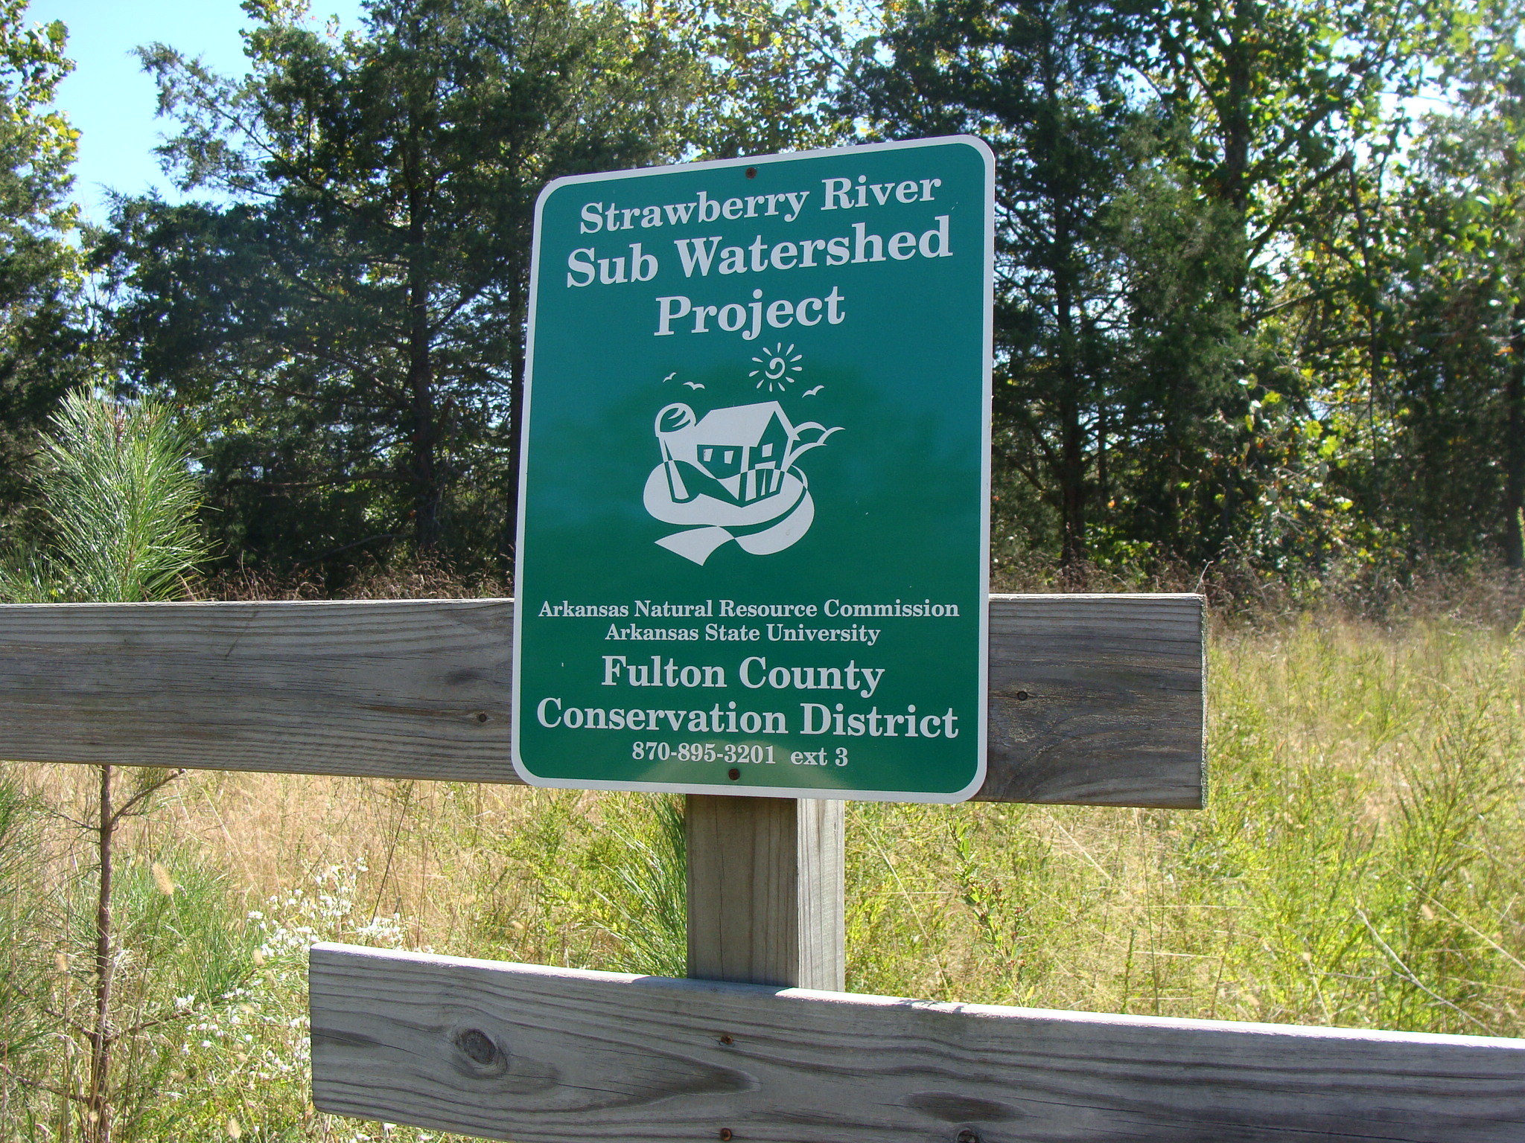
Questions?

