Slide 1
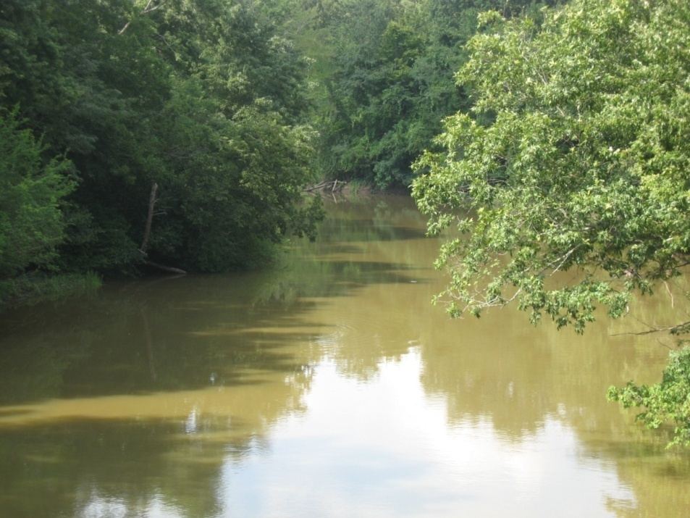

Best Management Practices- A Decision Making Framework
Presented by:
Dharmendra Saraswat
dsaraswat@uaex.edu
Co-Authors:
Naresh Pai and Mike Daniels
ANRC 2011 NPS Project Review Meeting, Sept. 22
Cooperative Extension Service

Slide 2
BACKGROUND
Choice of BMPs is tied to a variety of factors (land use, soil type, slope, proximity to stream, etc.)
E² based BMP selection and placement is usually practiced
Number of fields and choice of BMPs are always very large
Optimal combination of BMPs that meet E² criteria is a challenge from planning perspective
10 producers, 4 BMPs
>1 million evaluations¹
¹After Maringanti et al., 2008
ANRC 2011 NPS Project Review Meeting, Sept. 22
Cooperative Extension Service

Slide 3
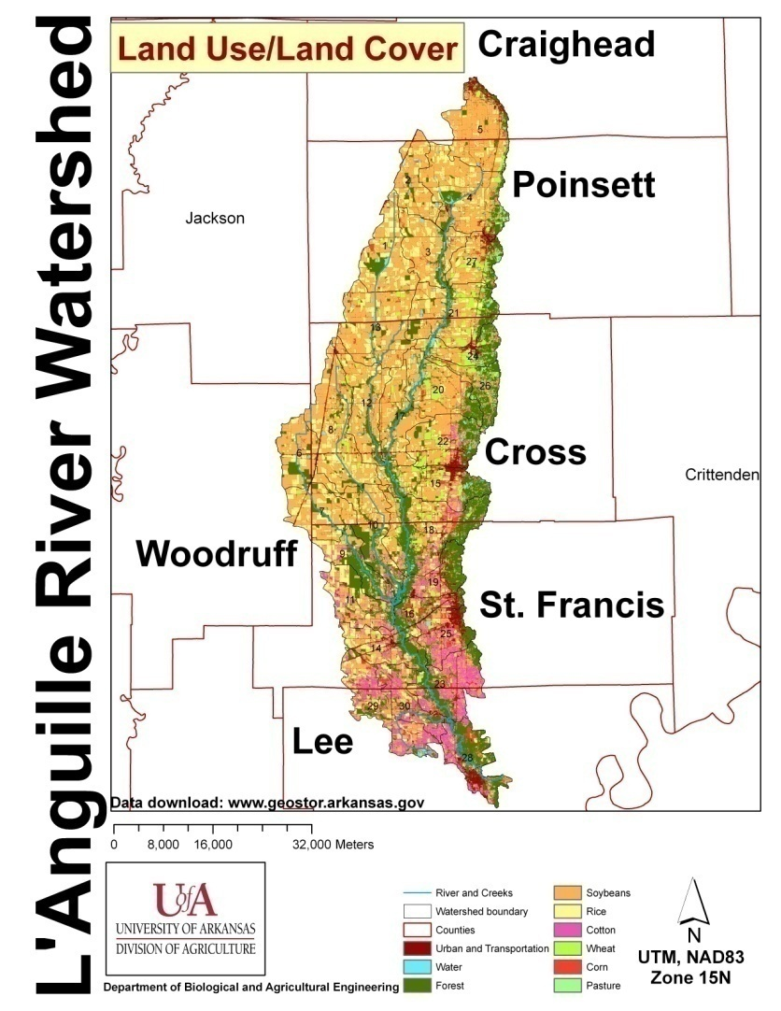

L’anguille River Watershed
8-digit priority watershed
2008 303(d) list
Sources of impairment
  ditching/channelization
  Silt loads from row crops
Area under row crops (70%)
Reducing source loads through BMPs
(Source: Center for Advanced Spatial Technologies (CAST), 2006)
ANRC 2011 NPS Project Review Meeting, Sept. 22
Cooperative Extension Service
Notes:
So lets start with a little bit of information about the watershed.
As most of you know, LRW is one of the 8-digit priority watershed that was listed in the 2005 – 2010 NPS management plan and is also in the list of 2011 – 2016 management plan.
The L’Anguille River is on the 303(d) list of impaired water bodies in the State.
The sources of impairment of the LR is due to in-stream sediment erosion (likely due to ditching/channelization in the watershed) and excessive silt load from row crops.
And since 70% of the watershed is under row crops it is also likely that nutrients such as phosphorus and nitrogen are carried in the water body.
Overall, implementing BMPs in this watershed is useful to reduce the load originating from various sources.

Slide 4





BMP Database
Inventory existing BMP practices in L’Anguille
Sources:
  Arkansaswater.org (319 document database)
  BMP demonstration reports
  NRCS
  Conservation districts
  Ducks Unlimited
  Academic literature
ANRC 2011 NPS Project Review Meeting, Sept. 22
Cooperative Extension Service
Notes:
So the first task was to create an inventory of all the past BMP efforts in this watershed.
We started out with searching the Arkansaswater.org, 319 document database. This database has reports from projects conducted in the watershed since the last 11 years. The reports gave a lot of information on some of the BMP demonstration and cost share project conducted by various conservation districts, state agencies, federal agencies and NRCS. All information was collected and organized which gave a sense of the all the work that has been done. It also gives a background on what are the BMPs that are feasible based on field conditions.

Slide 5
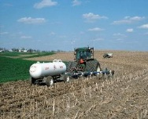
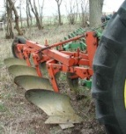
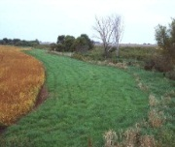
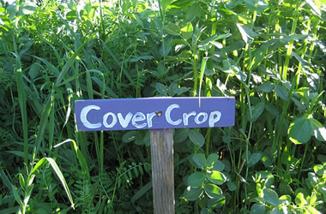
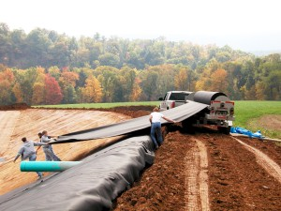


BMP Database
Cover Crop
Vegetative Filter Strips
Nutrient Mgt Plans
Conservation/ No Till
B
Water Control Structure
Grade Stabilization
Riparian planting
Cost information from NRCS eFOTG guide on $/acre basis
ANRC 2011 NPS Project Review Meeting, Sept. 22
Cooperative Extension Service
Notes:
So, some of the BMPs we came across were cover crops, vegetative filter strips, nutrient management plans, changing tillage practice to no till, and implementing water control structures.
The database also includes the location, land use, agency, and corresponding NRCS code for each BMP. For instance, based on NRCS data it was found that NMP’s were written for 470 farms covering about 22,523 acres in the entire watershed. Also, with financial support from the Arkansas Natural Resources Commission (ANRC), the St. Francis and Lee County Conservation districts made a no-till drill freely available to interested farmers when they agreed to plant no-till for at least two years. Similarly, the L’Anguille watershed partners and Ducks Unlimited implemented a cost share program to install water control structures in rice fields.
This meta-analysis was critical for understanding BMPs that can be implemented and spatially optimized in the watershed.

Slide 6
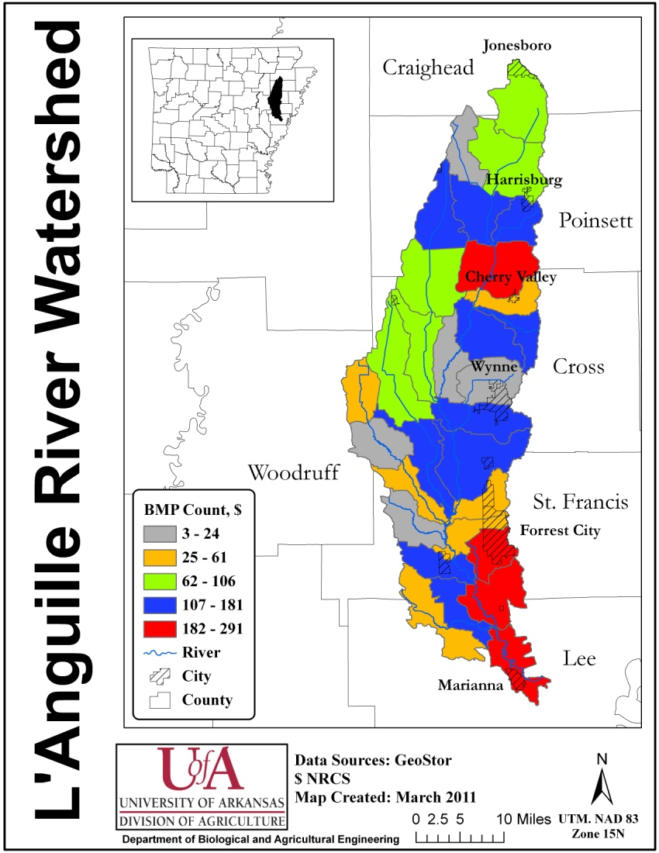
BMP Database
ANRC 2011 NPS Project Review Meeting, Sept. 22
Cooperative Extension Service
Notes:
This map summarizes the information collected in the BMP database by showing the number of BMPs implemented in each 12-digit HUC watershed. Since, implementation is now being encouraged at the 12-digit HUC level, it is useful to look at where BMPs were implemented.

Slide 7


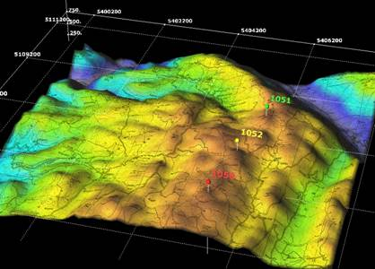

SWAT BMP Representation
SWAT Watershed Division
Crop Growth
Watershed
12-digit sub-watershed
Hydrological Response Units
Filter Strips
Nutrient
Mgt. Plan
Cover Crop
No
Till
33 BMP Combinations
Precipitation
Land-uses
Topography
Soil
ANRC 2011 NPS Project Review Meeting, Sept. 22
Cooperative Extension Service
Notes:
The next task was to represent BMPs in a validated watershed model for the L’Anguille River.
Before that, it useful to understand how BMPs are represented in the SWAT model. The SWAT model uses a GIS to delineate a watershed into 12-digit HUC subwatersheds and then subwatershed are further divided into smaller areas called hydrological response units or HRUs, in short. HRUs are similar to fields or farms in a watershed although it may not exactly be of that size and shape.
Each HRU is then tied up with several GIS databases and remote sensing layers such as daily precipitation (for about 23 years in our case), land-uses, topography information such as elevation and slope, and the SSURGO soil database which includes soil physical and biological information at the highest spatial resolution.
Using this information, HRUs simulate all the watershed processes such hydrology, plant growth, pollutant transport, etc. One that is most important in our case in crop growth. Each HRU can be customized to include various management operations such as tillage, sowing, irrigation, fertilizer application, harvest, residue management, etc. It also calculates the hydrology, sediment and nutrient loss.
HRUs also have the facility of representing various BMPs such as filter strips, NMPs, no till practices, and cover crop. So using the BMP database information, we developed 33 BMP combinations and implemented them on HRUs based on particular land use and simulated the model using 23 years of data to estimate the effectiveness on a long-term basis.

Slide 8
BMP SCENARIOS
Each scenario was run for a period of 23 years (1986 – 2008) at an annual time stamp.
BMP# | Rice | BMP# | Soybean | BMP# | Cotton
1 | with NMP¹ | 4 | with NMP | 19 | with NMP
2 | with cover crop | 5 | with no-till | 20 | with no-till
3 | with NMP and cover crop | 6 | with VFSRatio 10 | 21 | with VFSRatio 10
 |  | 7 | with VFSRatio 30 | 22 | with VFSRatio 30
 |  | 8 | with VFSRatio 60 | 23 | with VFSRatio 60
 |  | 9 | with NMP and no-till | 24 | with NMP and no-till
 |  | 10 | with NMP, and VFSRatio 10 | 25 | with NMP, and VFSRatio 10
 |  | 11 | with NMP, and VFSRatio 30 | 26 | with NMP, and VFSRatio 30
 |  | 12 | with NMP, and VFSRatio 60 | 27 | with NMP, and VFSRatio 60
 |  | 13 | with no-till and VFSRatio 10 | 28 | with no-till and VFSRatio 10
 |  | 14 | with no-till and VFSRatio 30 | 29 | with no-till and VFSRatio 30
 |  | 15 | with no-till and VFSRatio 60 | 30 | with no-till and VFSRatio 60
 |  | 16 | with NMP, no-till, and VFSRatio 10 | 31 | with NMP, no-till, and VFSRatio 10
 |  | 17 | with NMP, no-till, and VFSRatio 30 | 32 | with NMP, no-till, and VFSRatio 30
 |  | 18 | with NMP, no-till, and VFSRatio 60 | 33 | with NMP, no-till, and VFSRatio 60
ANRC 2011 NPS Project Review Meeting, Sept. 22
Cooperative Extension Service

Slide 9

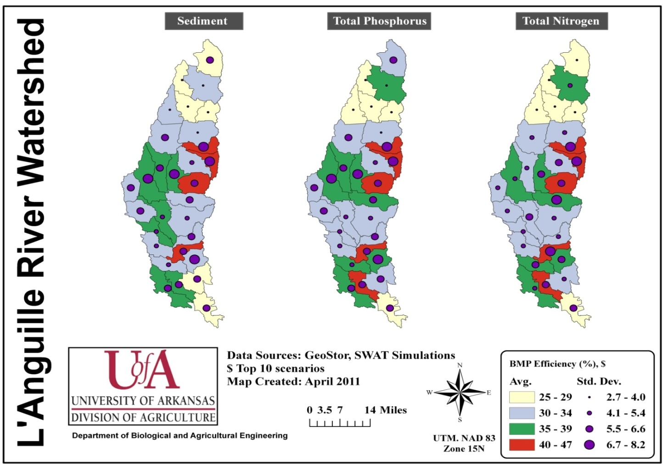
BMP Effectiveness
ANRC 2011 NPS Project Review Meeting, Sept. 22
Cooperative Extension Service
Notes:
This map shows results obtained from top-10 BMP scenario application. There are separate maps for sediment, total phosphorus, and total nitrogen. These maps show how BMPs perform spatially.
Some of the highest BMP efficiencies were observed in the eastern part of the watershed which could be related to its steeper topography.
Interestingly, BMP efficiency for several subwatersheds was similar across the three maps. This correlation indicates that various pollutant interact with each other and hence, a BMP targeting sediment loss is likely to reduce total phosphorus and total nitrogen losses also.

Slide 10
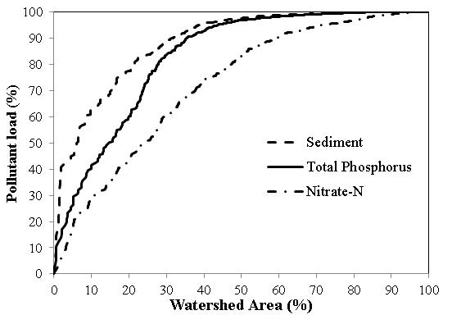
Why Optimize Spatially?
Non-uniform pollutant contribution
ANRC 2011 NPS Project Review Meeting, Sept. 22
Cooperative Extension Service
Notes:
That result also brings us to the need for optimizing the placement of BMPs. So this graph here shows the pollutant load contribution from against watershed area. It is clear that this relationship is not linear.
For instance, by identify optimal locations and target just 10% of the watershed about 60% of sediment load, 40% of TP load, and 30% of TN load could be reduced. However, such optimization can be computationally challenging as seen in the next slide.

Slide 11

Optimization
Computational challenge
  33 BMP combination possibilities
  833 HRUs
  23-year model run; daily basis
  Minimize cost Vs. maximize BMP efficiency
Artificial intelligence techniques on AHPCC used to reduce computations load¹
Identify optimal locations for placing BMPs
¹Maringanti et al. (2009)
ANRC 2011 NPS Project Review Meeting, Sept. 22
Cooperative Extension Service
Notes:
Spatial optimization of BMPs can quickly get complicated and computationally intensive. In this project, 33 BMP combinations were identified based on various land-use constraints. These could be potentially placed in 833 HRUs in the model. Also, since the model was setup for 23-year model run on a daily basis, the complexity to minimize cost and maximize BMP efficiency increased tremendously.
So an artificial intelligence technique on the super-computing facility at the U of A was used to search through various BMP combinations for each HRU and identify optimal locations for placing BMPs.

Slide 12
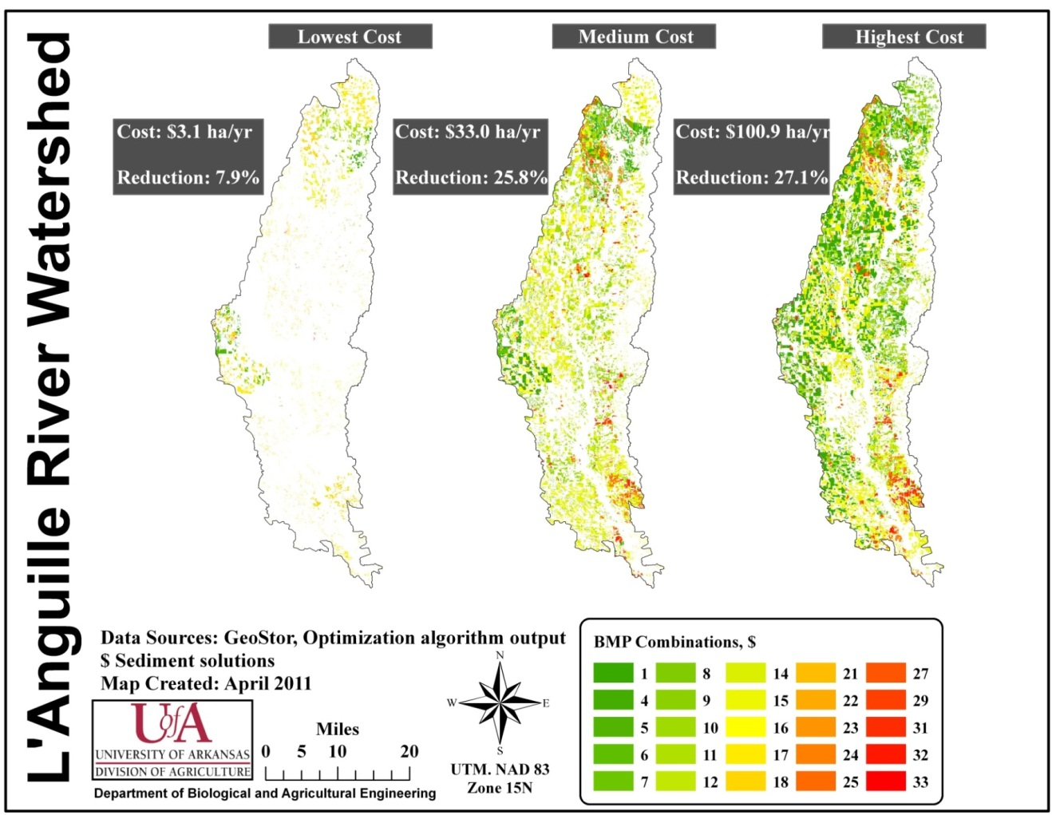
Sediment Optimization
ANRC 2011 NPS Project Review Meeting, Sept. 22
Cooperative Extension Service
Notes:
The result of this exercise was that we were able to identify what are those ideal BMP locations that can result in maximum pollutant reduction at a particular cost. To demonstrate this, three cost scenarios were picked up: lowest, highest and medium cost to see where those BMPs are. Results showed that the sediment loss reduction ranged from 7.9% to 27.1% depending on various cost scenarios.
Typically, larger cost investment resulted in greater sediment reduction. However, the benefits were not always proportional to cost. When the investments were increased from $33 ha/yr to $100 ha/yr, the sediment reduction was not appreciable. This highlights the need for strategic placement of BMPs and targeting those areas where maximum return on investment can be achieved.
It was also found that multiple BMP combination resulted in higher pollutant reduction. For instance, BMP scenario 16 (NMP + no-till + VFSRatio 10) was applied on 13%, and 17% HRUs for medium, and highest cost scenarios, respectively. This shows that BMP combination on hot spot areas can be more effective than single BMPs applied across many fields in the watershed.

Slide 13
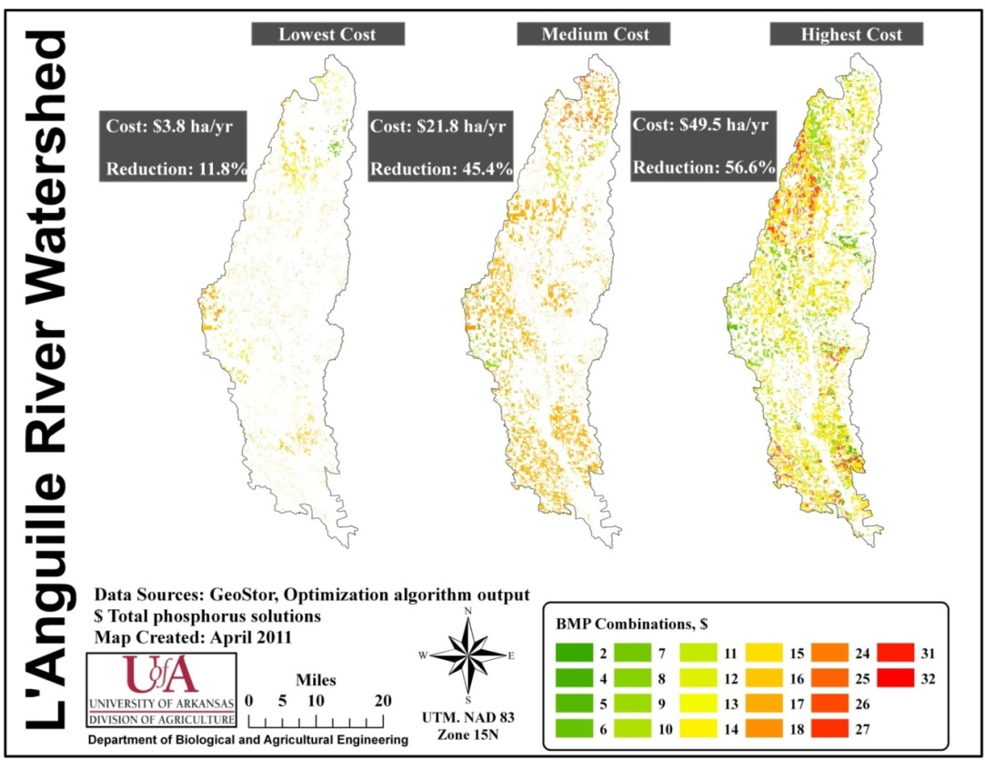
Phosphorus Optimization
ANRC 2011 NPS Project Review Meeting, Sept. 22
Cooperative Extension Service
Notes:
Because row crop agriculture occupies about 70% of the watershed area, nutrient loss from farm operations is a major concern.
As seen in the sediment optimization results, the benefits were not always proportional to cost. An increase in investment from $21 ha/yr (medium) to $49 ha/yr (maximum) resulted in a smaller and disproportionate TP reduction from 45.5% to 56.6%. Hence, targeting combination BMPs is critical.

Slide 14
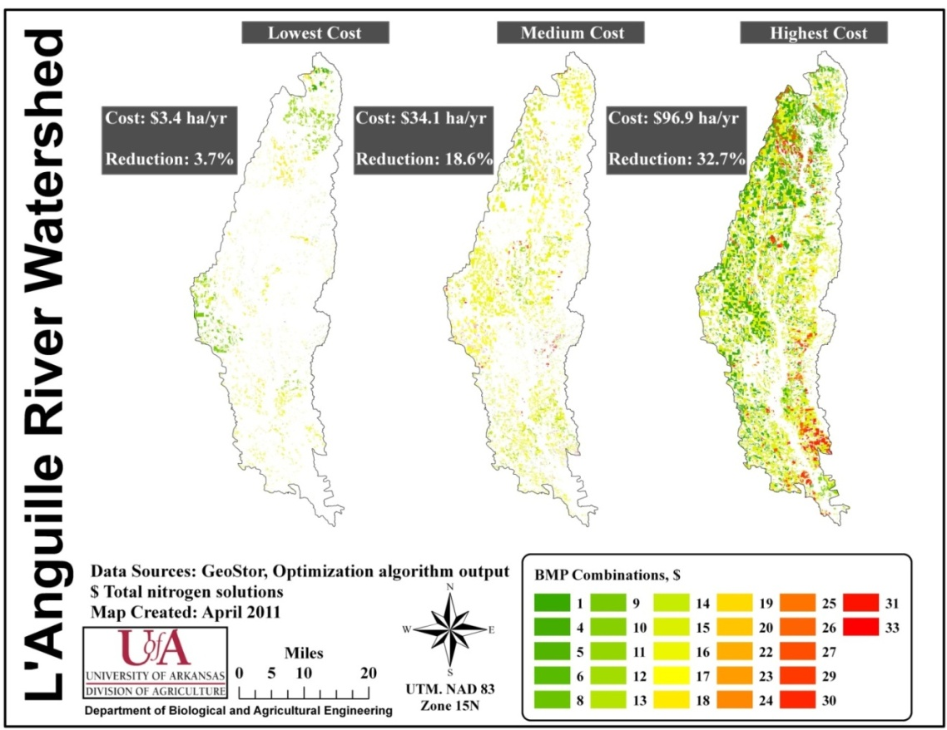
Nitrogen Optimization
ANRC 2011 NPS Project Review Meeting, Sept. 22
Cooperative Extension Service
Notes:
Similar results were seen in TN. An increase in investment from $34.1 ha/yr (average) to $96.9 ha/yr (maximum) resulted in TN reduction from 18.6% to 32.7%

Slide 15
Summary
BMP database for LRW developed
33 BMP scenarios evaluated over 23 year period
Spatially optimized for maximum WQ benefits at least cost using AI techniques
Multiple BMP combination was more effective compared to single BMP
This approach could be extended to other watersheds in the state
ANRC 2011 NPS Project Review Meeting, Sept. 22
Cooperative Extension Service
Notes:
So in summary:
In this project a BMP database was developed for LRW.
Several information sources were utilized to create a inventory of BMPs and cost information.
Out of that, some BMPs were selected for representation within a validated SWAT model. 33 scenarios were simulated over 23 years.
Using an AI technique, BMPs were spatially optimized for reducing cost and maximizing WQ benefits.
The results from this analysis provided locations in the watershed where BMPs could be targeted. It was found that using a combination of BMPs from hotspots or area with highest pollutant loss can be a very efficient way to improve WQ in L’Anguille River.

Slide 16



Acknowledgements
ANRC 2011 NPS Project Review Meeting, Sept. 22
Cooperative Extension Service

Slide 17
Questions/Suggestions
Contact:
Dharmendra Saraswat
Phone: 501-681-5987
Email: dsaraswat@uaex.edu
ANRC 2011 NPS Project Review Meeting, Sept. 22
Cooperative Extension Service

