Slide 1
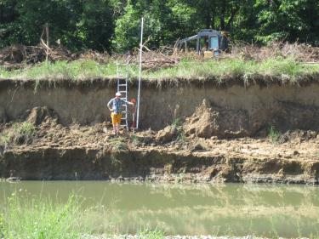
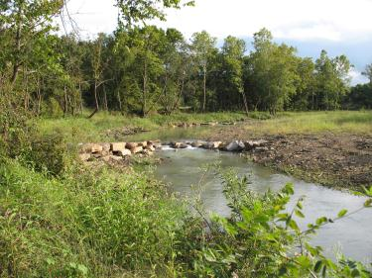
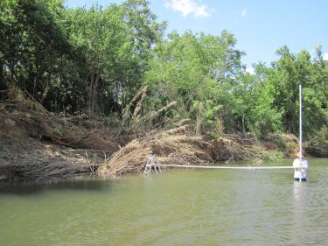
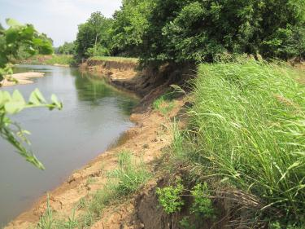
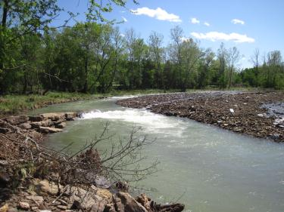
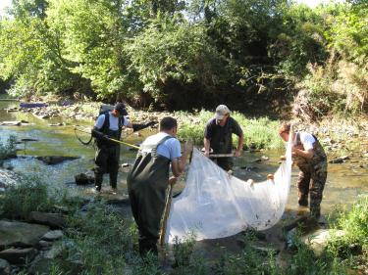
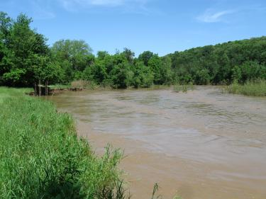
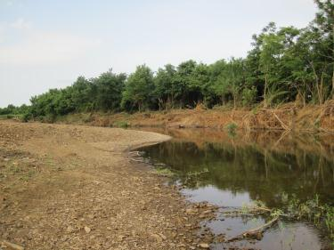
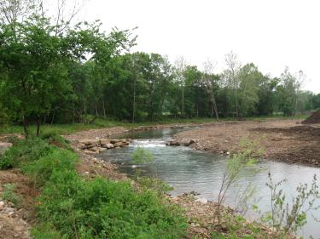
Watershed Conservation Resource Center
319 Program Stream Restoration Projects Update
WFWR Near Brentwood
  07-400 (Original Project Completed 2010)
  07-2000 Project Repair/Maintenance
White River Bank Stabilization
  09-1900
WFWR Fayetteville Executive Airport
  07-410 Phase I (Completed 2011)
  09-1600 Phase II

Slide 2
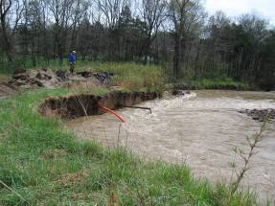
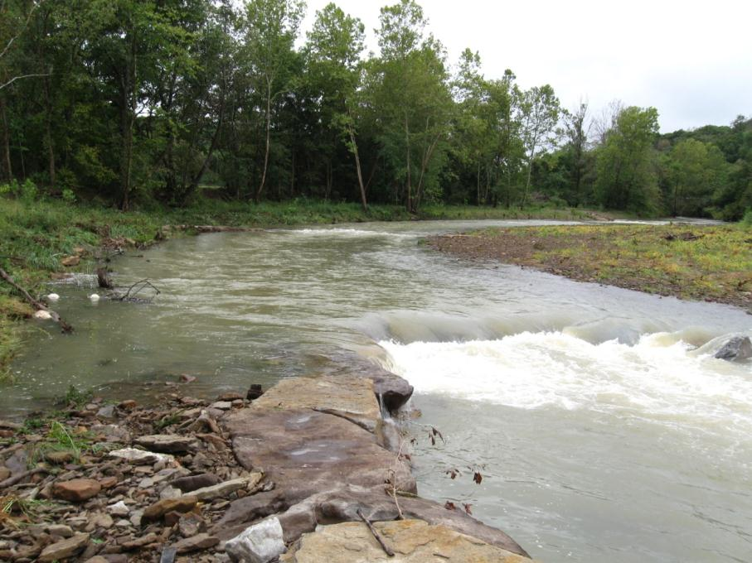
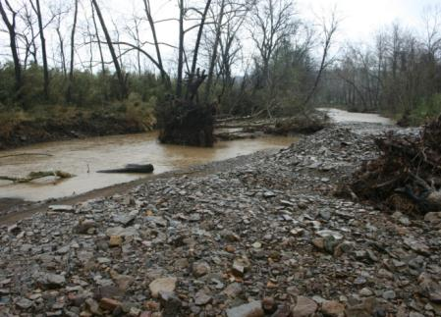
07-400/07-2000 West Fork White River
Stream Restoration Project Update
Watershed Conservation Resource Center
Arkansas Game and Fish Commission, Beaver Water District, Northwest Arkansas Land Trust, Arkansas Natural Resources Commission, Environmental Protection Agency

Slide 3
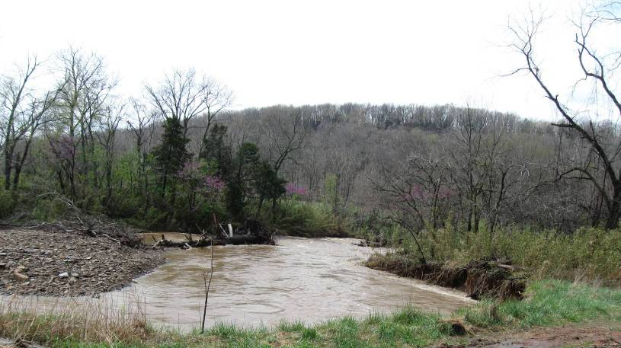
Project Goal
Demonstrate an rural stream restoration using a natural channel design approach

Slide 4
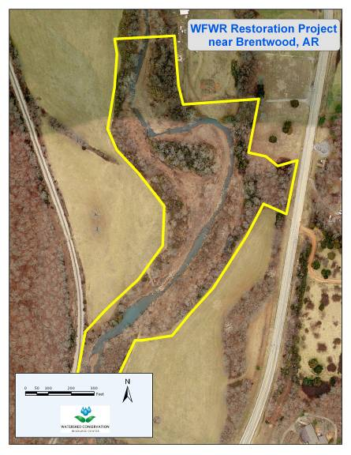
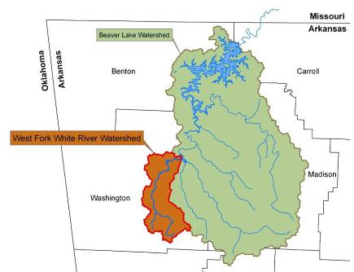
WFWR near Brentwood, AR
Drainage Area 18 mi²
Rural Watershed
  Forest
  Pasture
~1,800’ of Stream Channel
Rosgen C4/1-Type Stream
3 Landowners

Slide 5
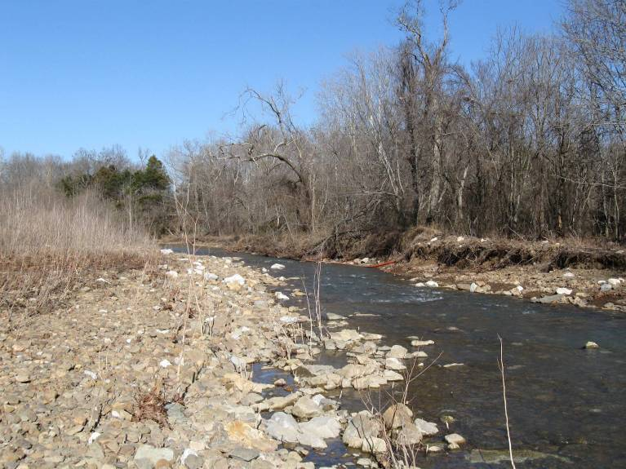
Site Photos
Before Restoration (upstream)

Slide 6
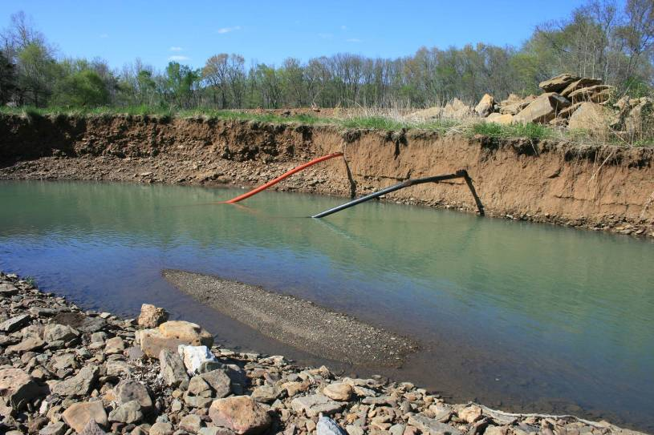
Site Photos
Before Restoration (mid-section)

Slide 7
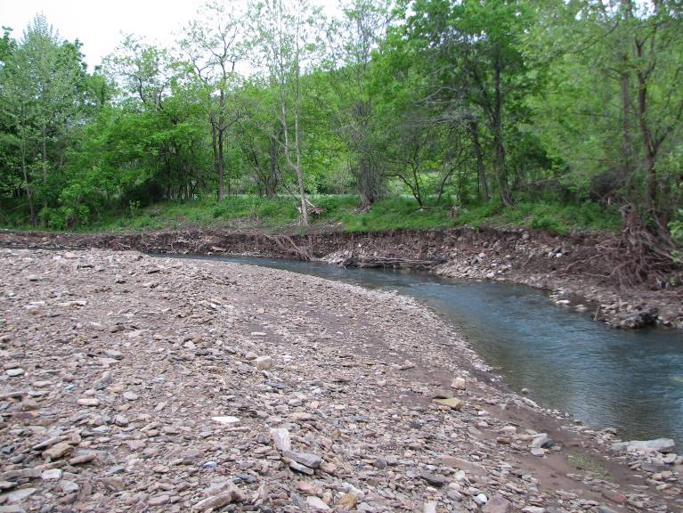
Site Photos
Before Restoration (downstream)

Slide 8
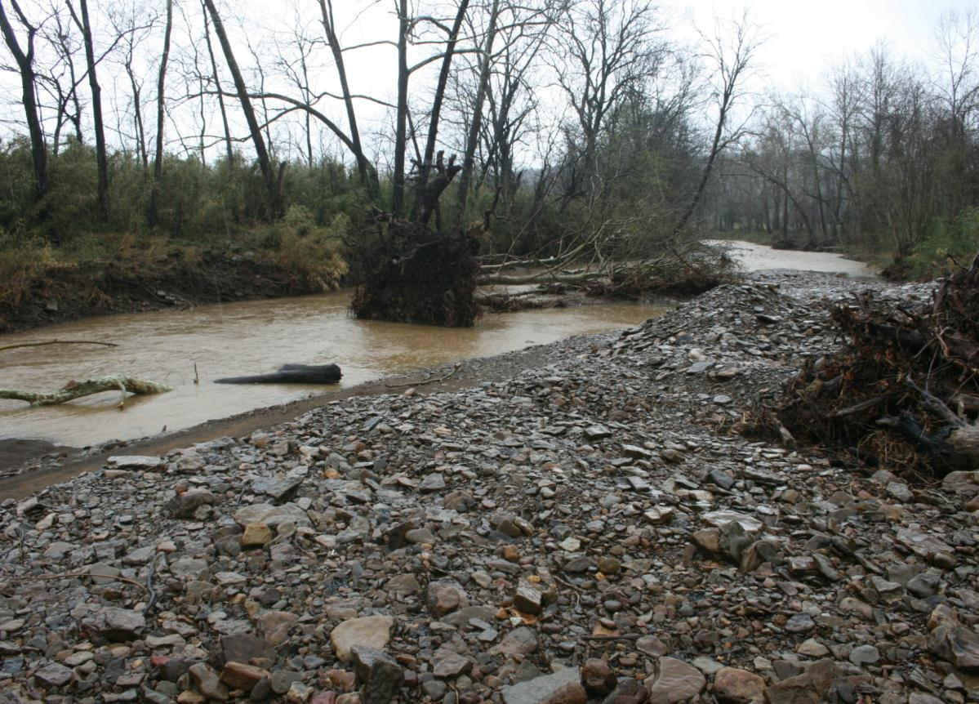
Site Photos
Before Restoration (downstream)

Slide 9
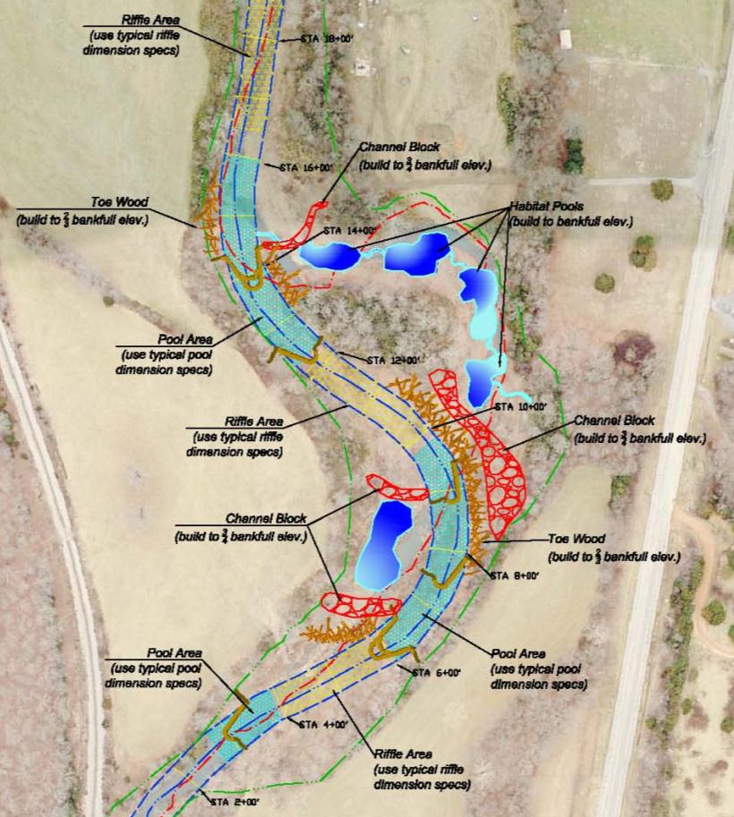
Stream Restoration Design
General Design
Approach
Eliminate Tight Meander Bend Radii
Avoid Old Growth Riparian Areas
Maintain Stream Length
Create Wetlands

Slide 10
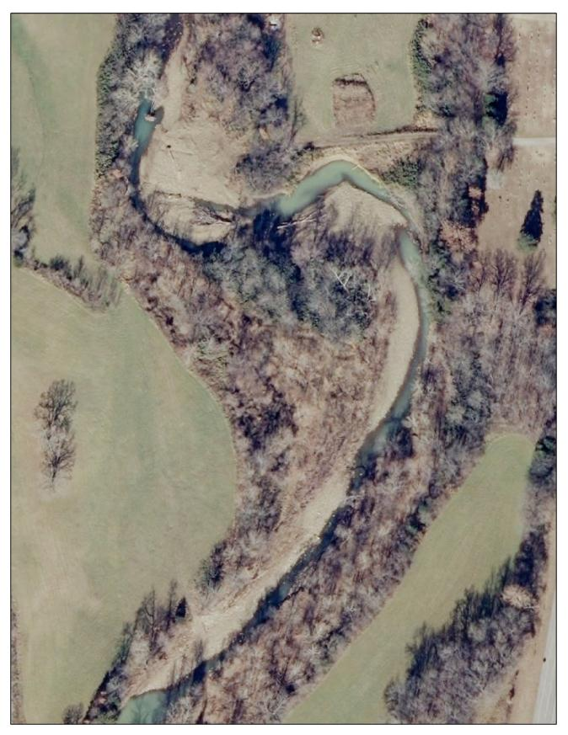
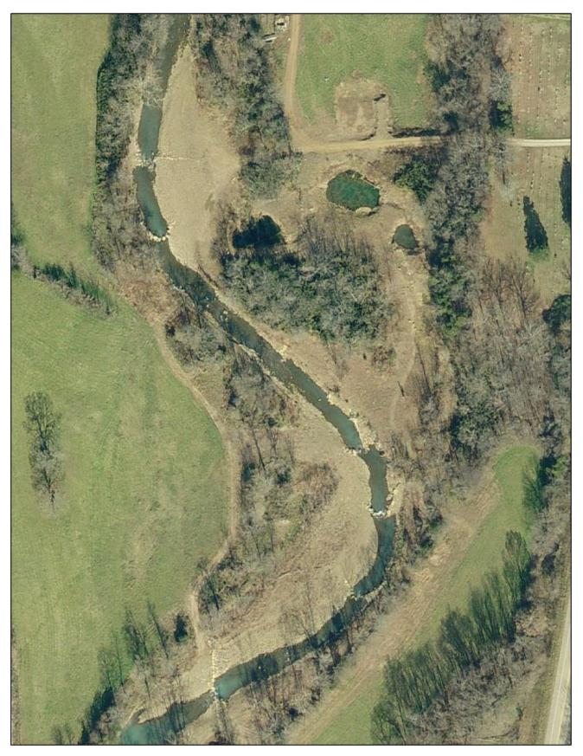
Stream Restoration Design

Slide 11
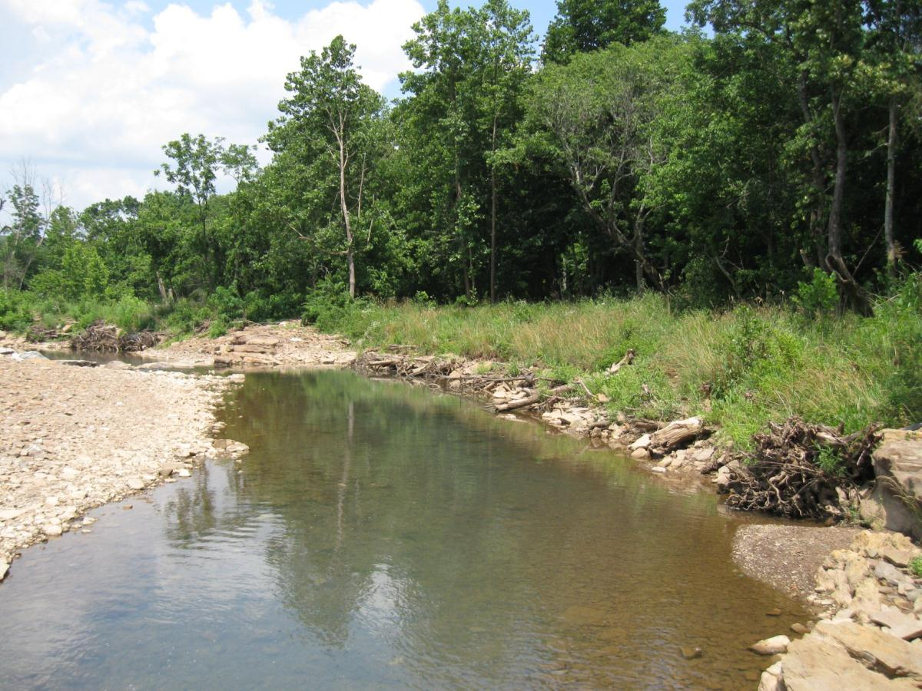
Site Photos
After Restoration (upstream)

Slide 12
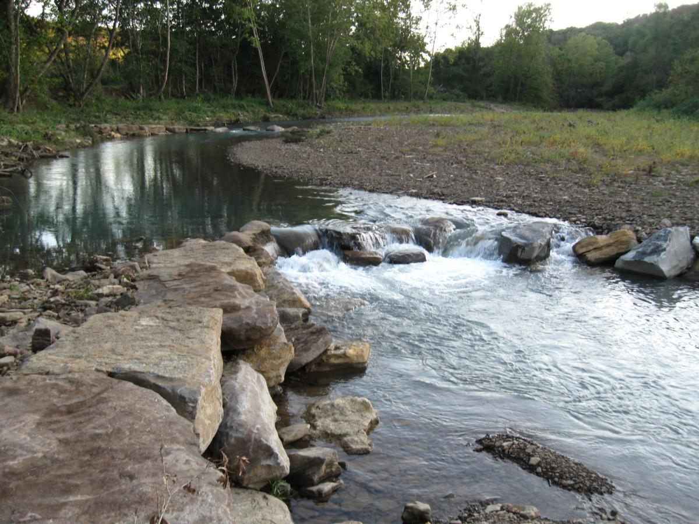
Site Photos
After Restoration (mid-section)

Slide 13
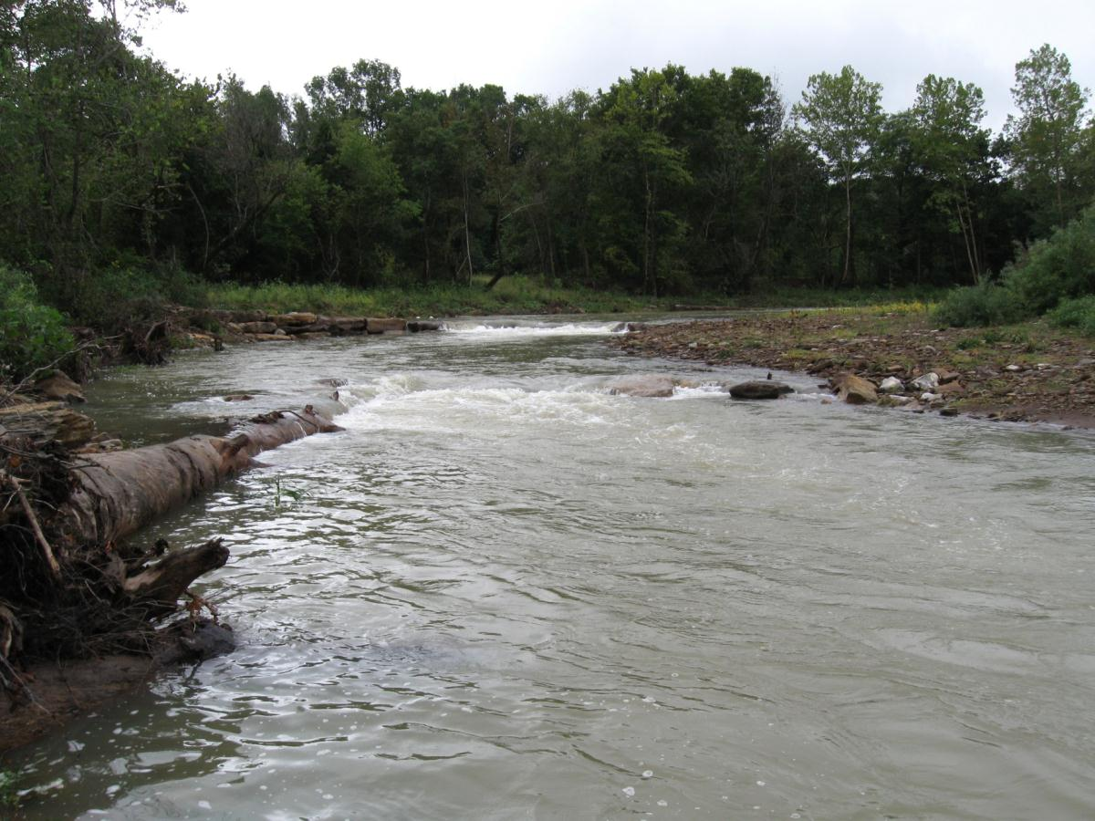
Site Photos
After Restoration (mid-section)

Slide 14
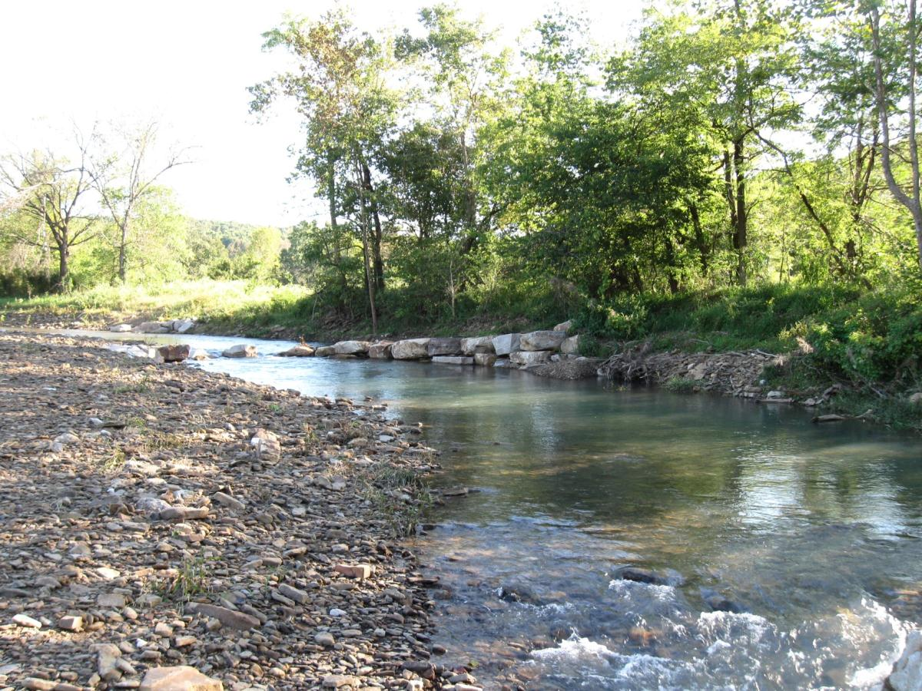
Site Photos
After Restoration (downstream)

Slide 15
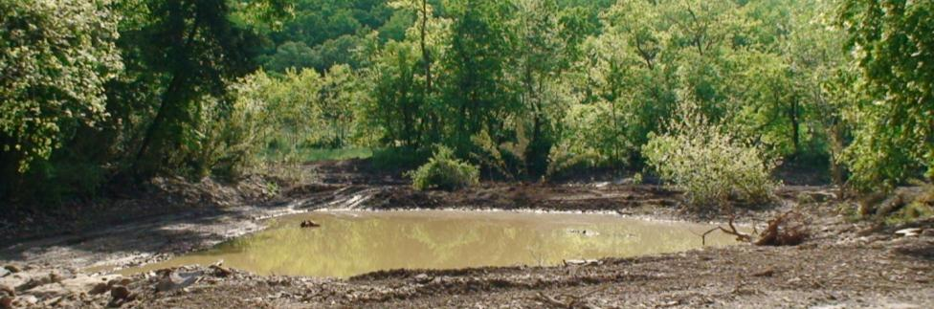
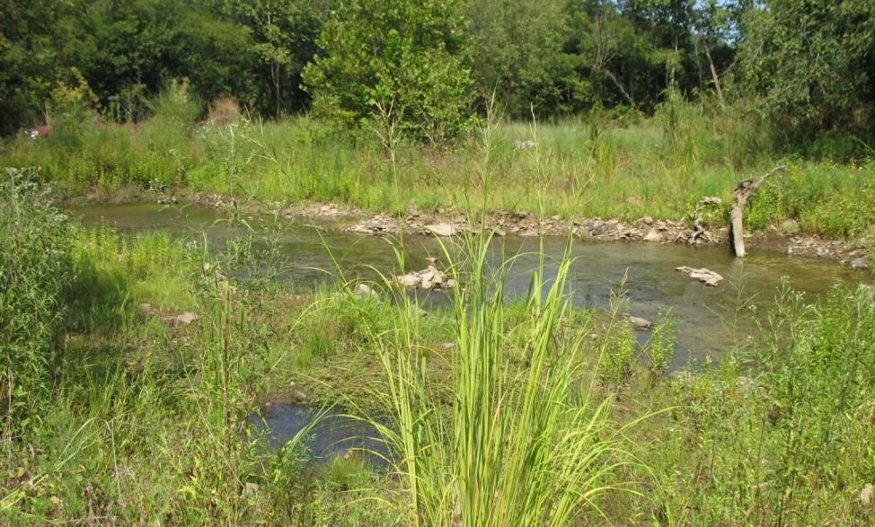
Site Photos: Constructed Wetlands

Slide 16
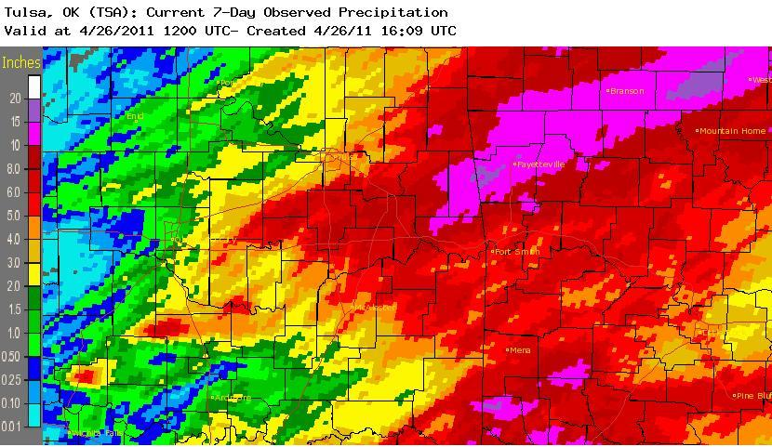
April Flood – NWA 2011
Fayetteville
Project Location
10”-14” Rainfall over 7 Days
4”-6” Rainfall fell on during the PM of April 25th

Slide 17
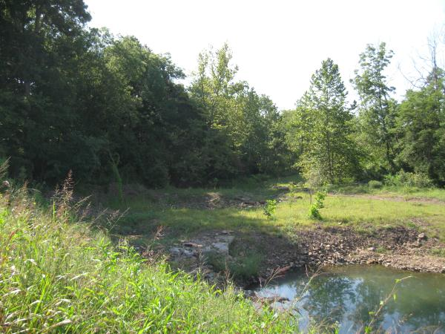
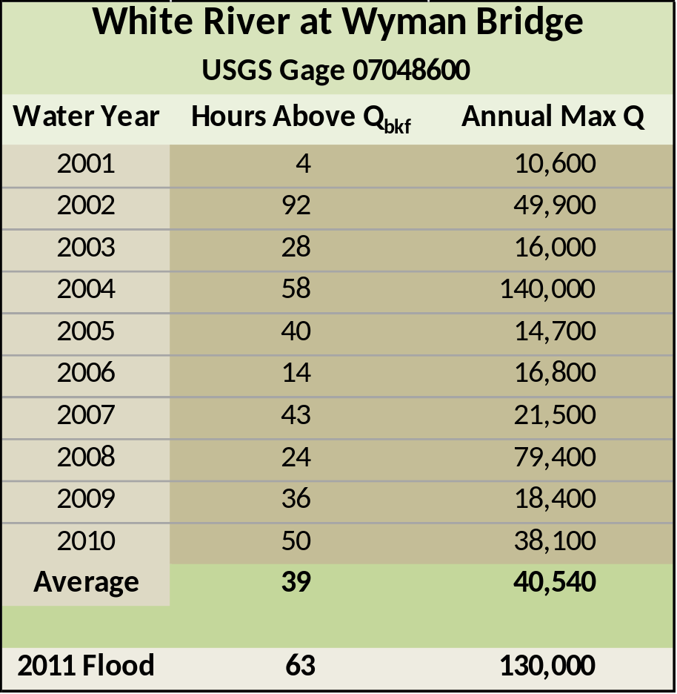
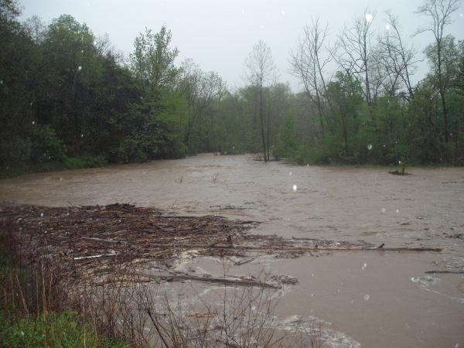
April Flood – NWA 2011

Slide 18
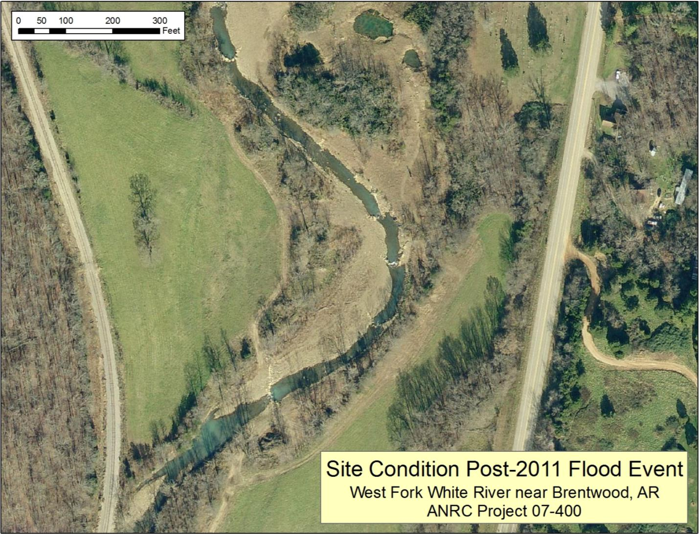
Bank Line After Flood Event
Location of Log Vane
Major Gravel Deposition
Direction of Flood Flow

Slide 19
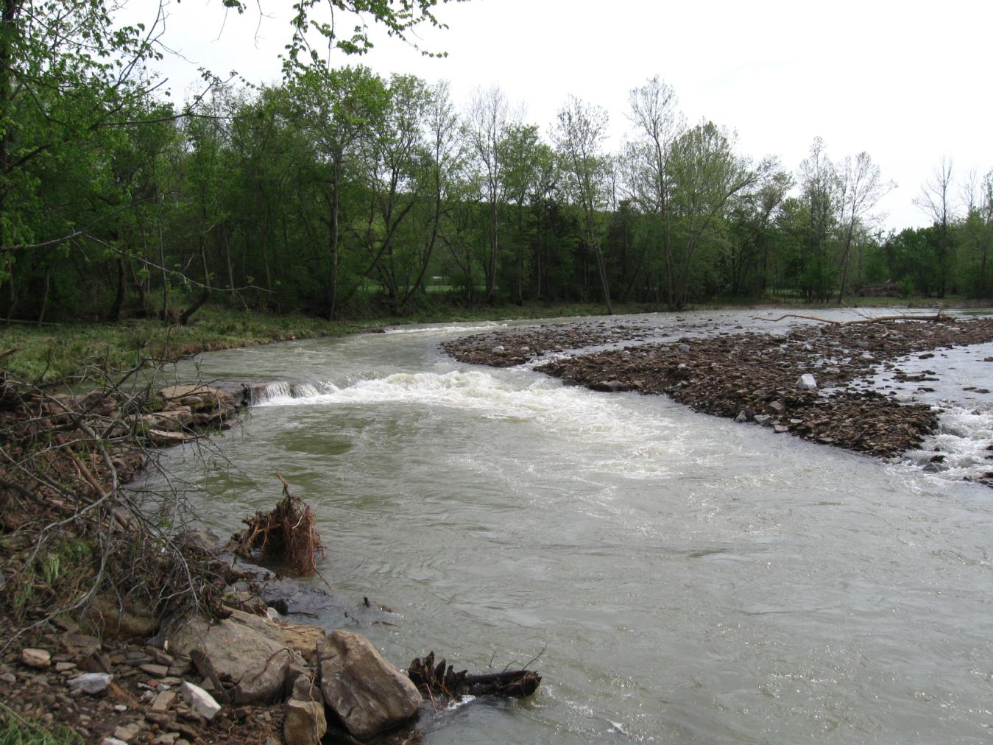
WFWR Steam Restoration Flood Damage
Aggradation/Enchroachment on Rock Vane
Direction of Flow During High Water
Aggradation from Backwater (caused by flow running directly into bank)

Slide 20
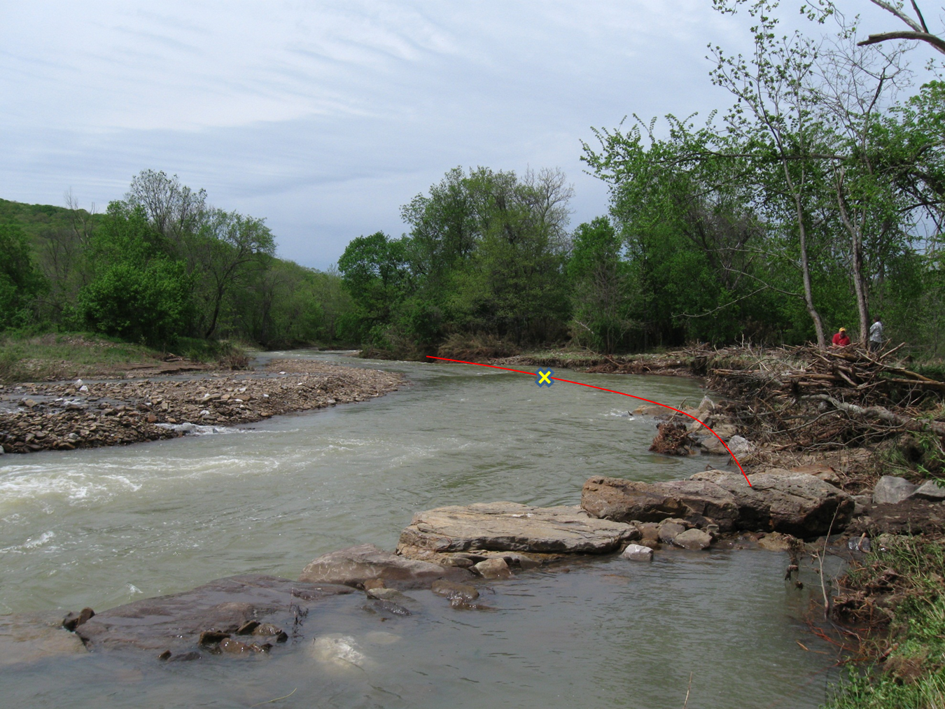
WFWR Steam Restoration Flood Damage
Location of Log Vane
Accumulated Gravel
Location of Right Bank Before Flood
Scour Around End of Rock Vane

Slide 21
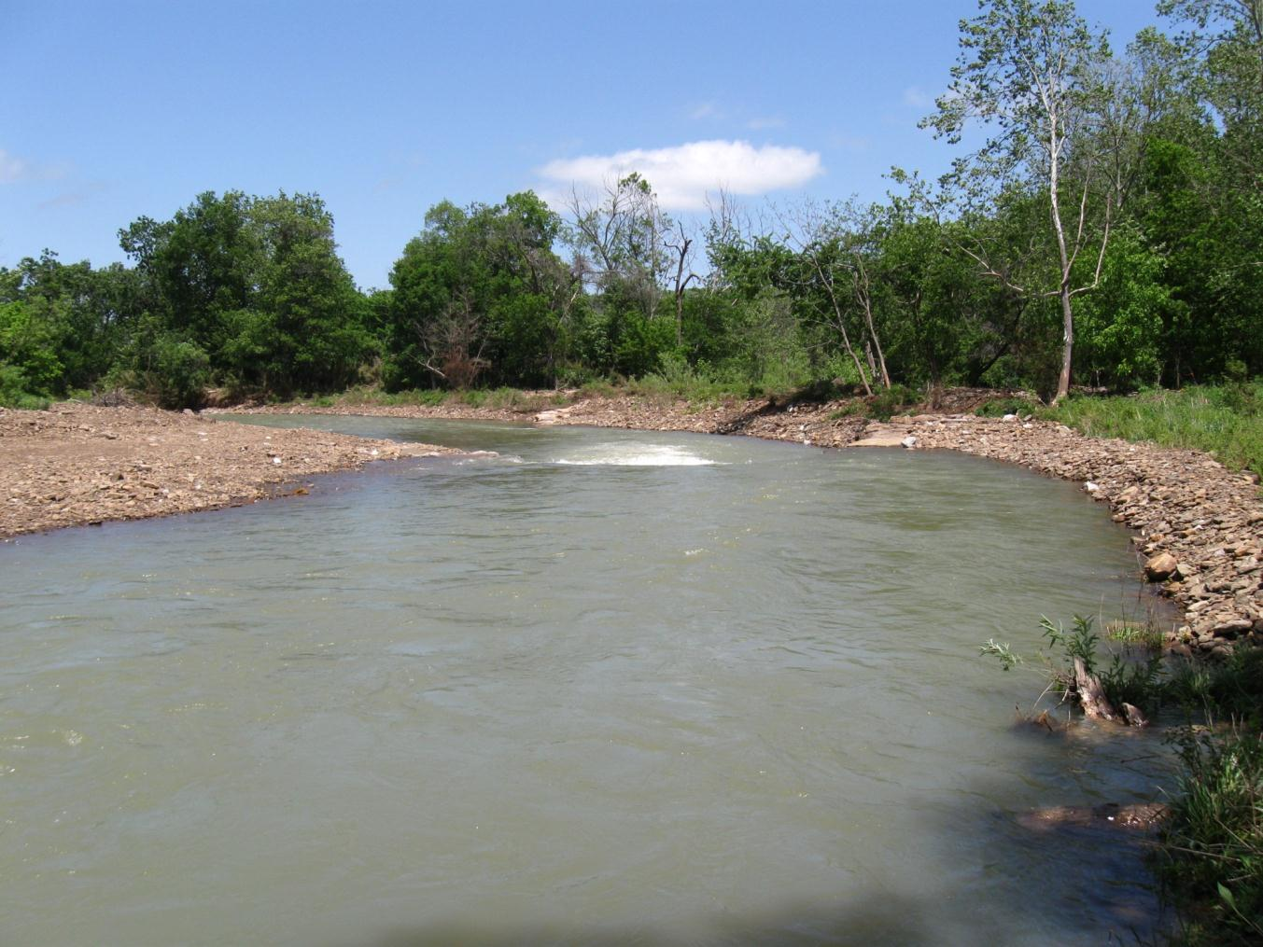
WFWR Steam Restoration Repairs
Reinforce plug toe with large rock
Create bankfull bench on new toe
Construct a rock vane to protect plug
Remove accumulated gravels

Slide 22
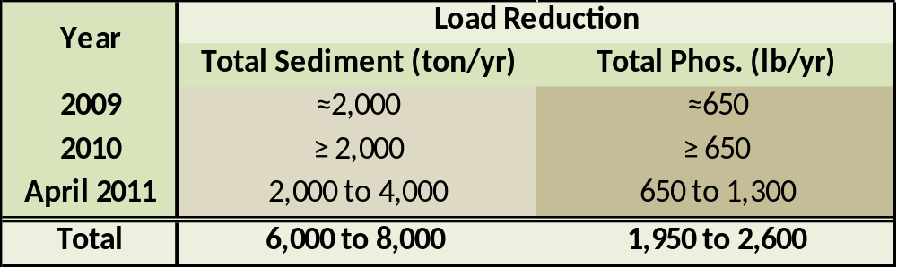
WFWR Steam Restoration
Although historic flooding caused damage to the project in 2011, significant loads reductions are being realized
Without this project:
Land would have been lost
Un-marked Graves would have been threatened
Access road would have been destroyed
River instability would increase

Slide 23
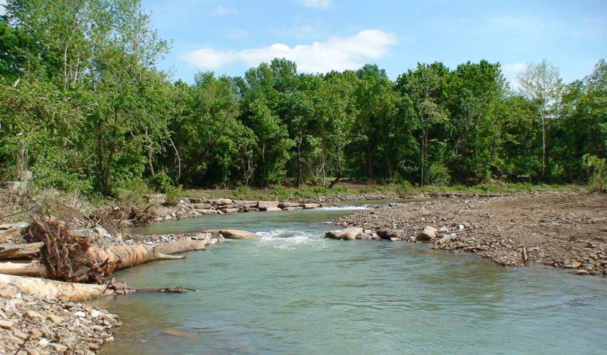
Lessons Learned
Avoid Placement of Log Vanes in Critical Areas
Priority 2 Restoration – Watch flood channel dimensions within and upstream and downstream of your project
Priority 2 Restoration: Plan for Channel Maintenance
“Work with the River” when possible
Go with rock in most vulnerable areas
Develop contingency funding mechanisms
  Bonds
  Set-asides
Pre-implementation budgets and on the ground realities do not always coincide
Get in and repair ASAP to avoid further damage

Slide 24
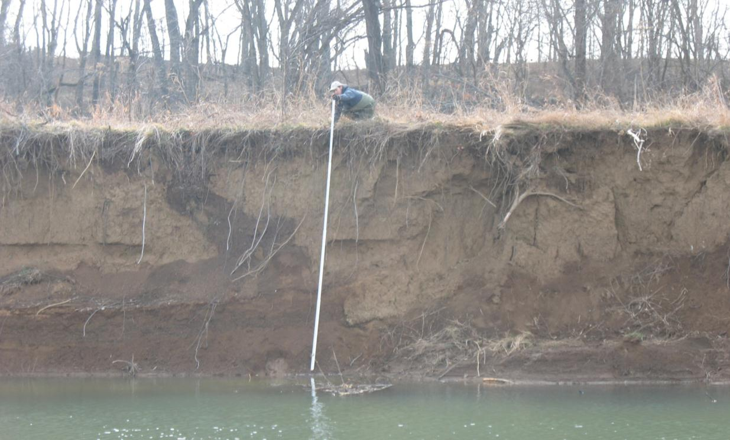
09-1900 White River
Bank Stabilization Project
Watershed Conservation Resource Center
City of Fayetteville, CH2M Hill, Arkansas Natural Resources Commission, Environmental Protection Agency

Slide 25
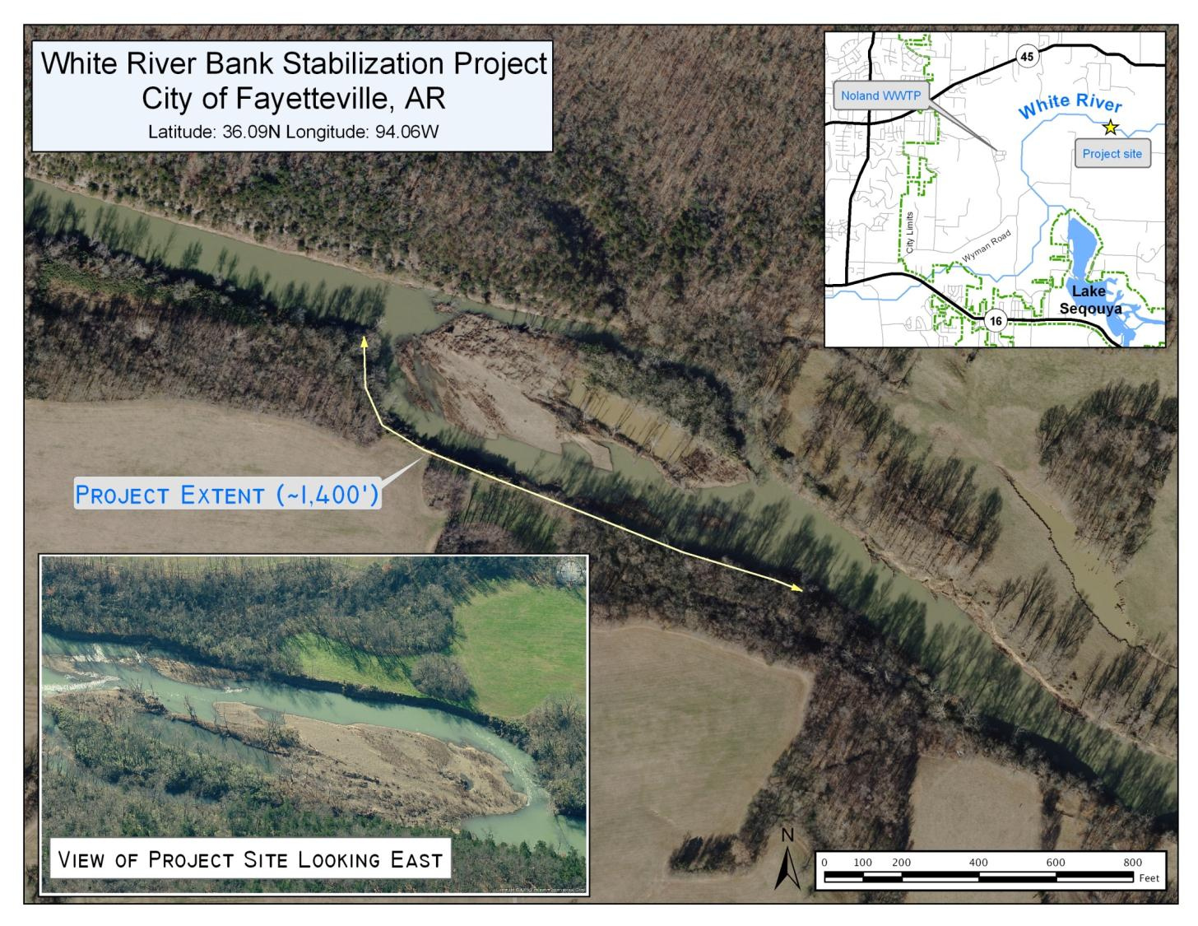

Slide 26
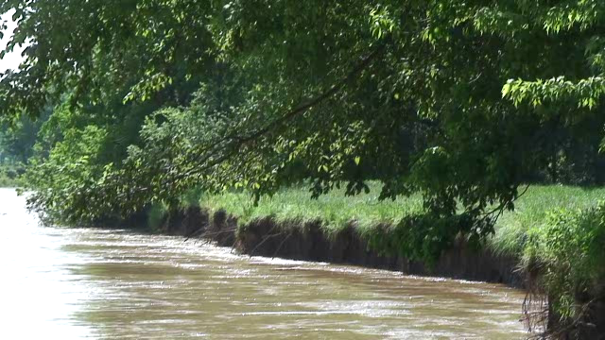
Erosion During Bankfull Event

Slide 27
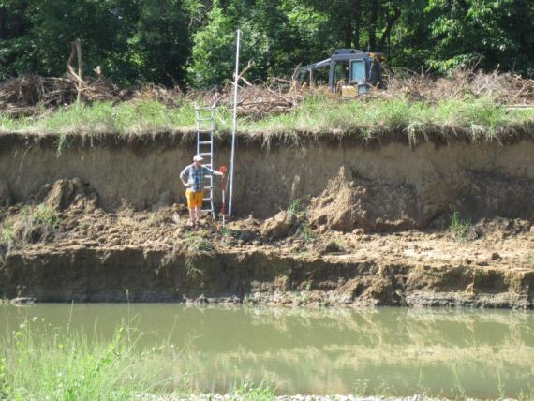
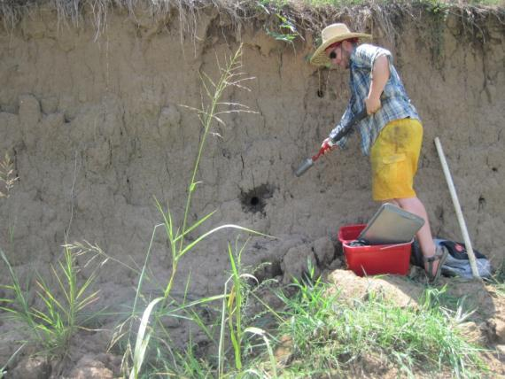
Pre-Restoration Site Monitoring
Bank Erosion Monitoring
  Toe Pin Installation
  Resurvey After Spring Rain
Bank Material Sampling
  30 Samples
  Particle Size and Nutrient Analysis
Measured Erosion: 21.4’

Slide 28
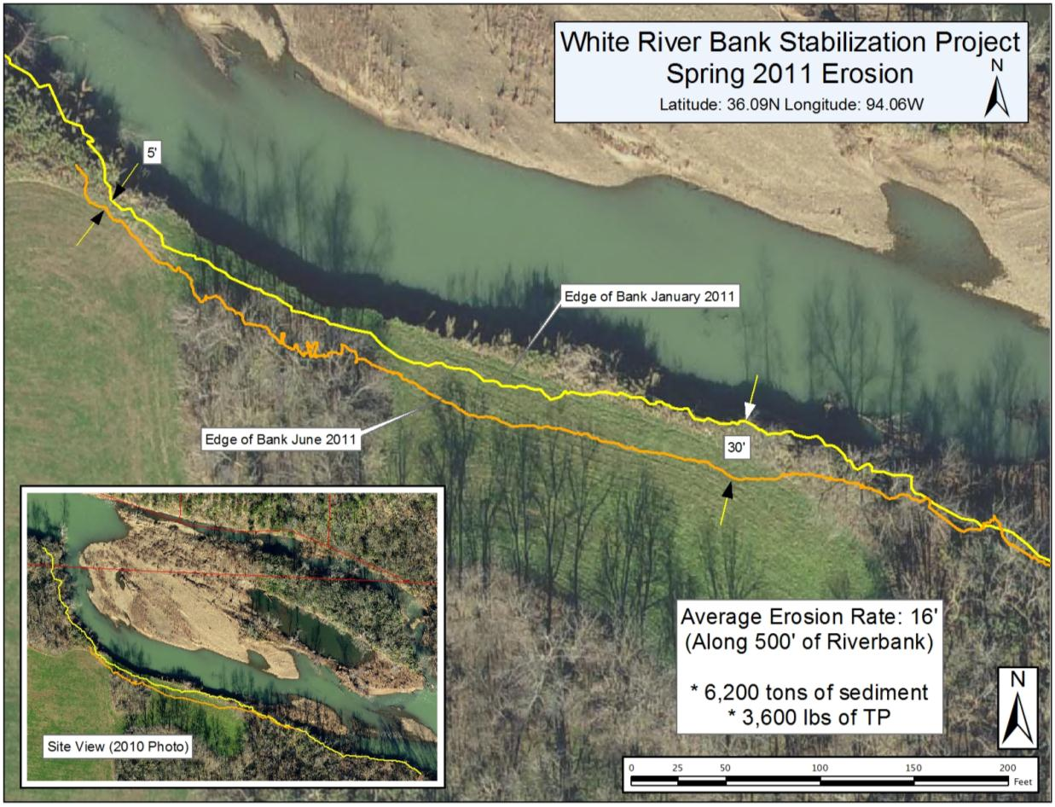
Pre-Restoration Site Monitoring

Slide 29
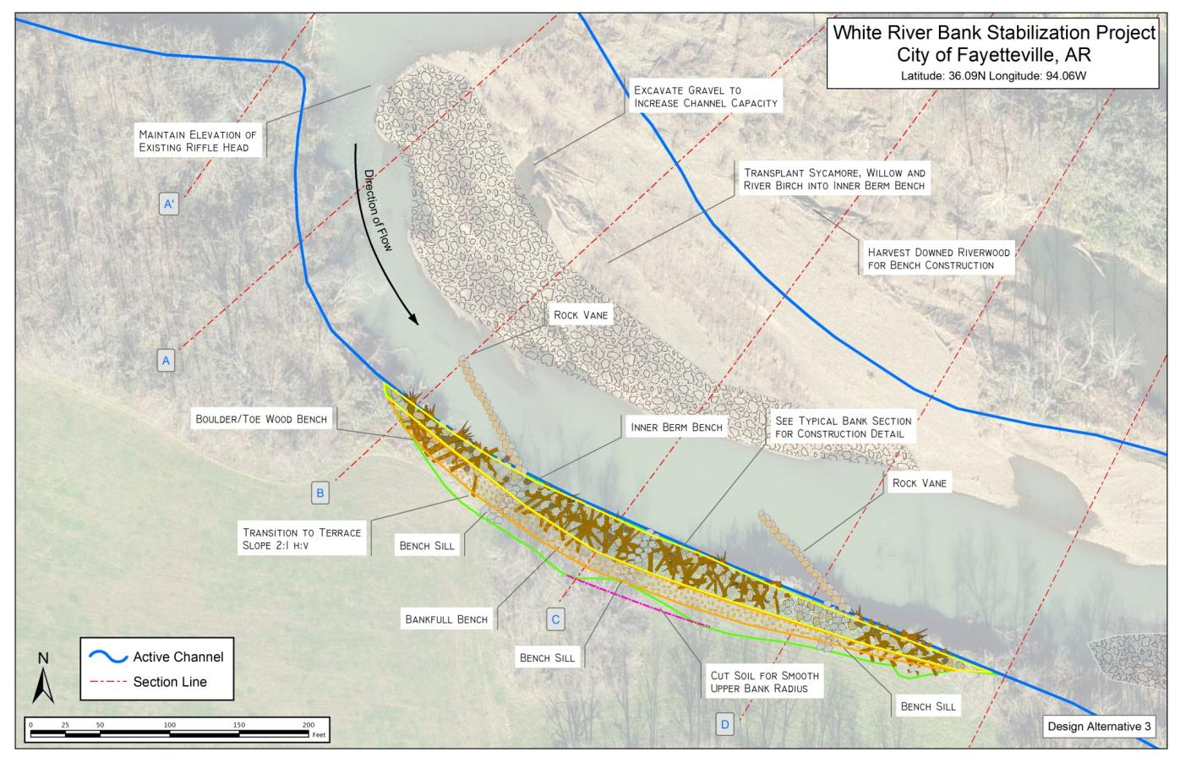
Restoration Design

Slide 30
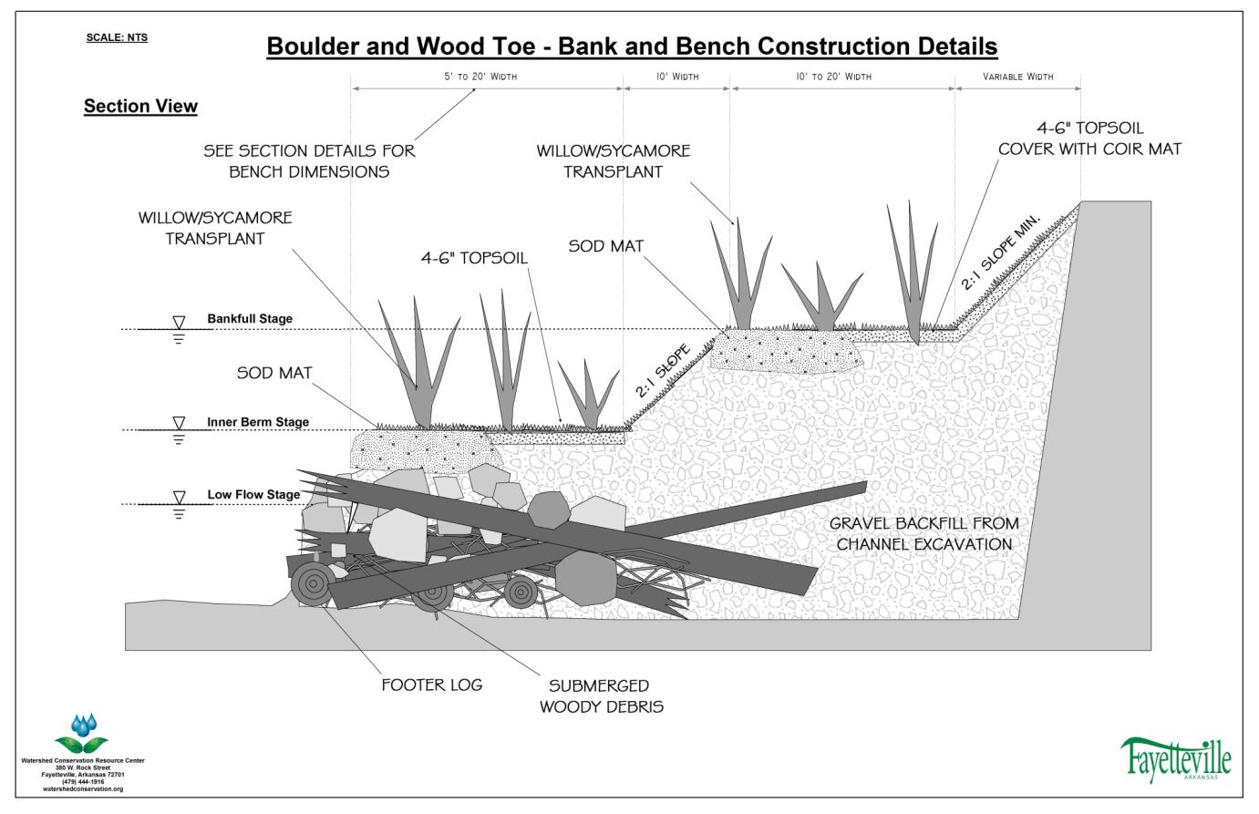
Restoration Design

Slide 31
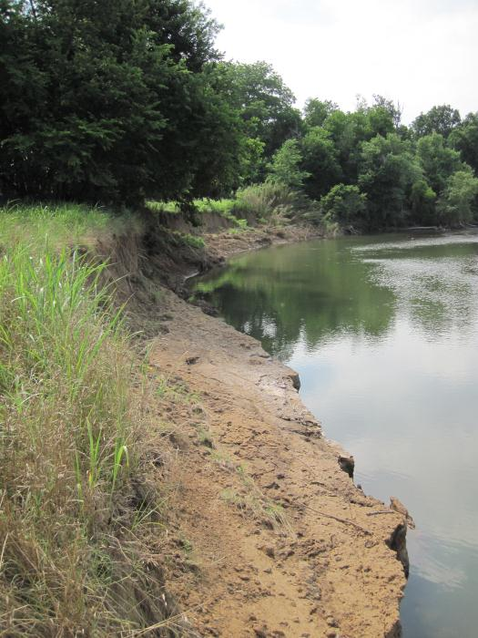
Project Status and Schedule
✓
Develop QAPP
Collect Pre-Implementation Data
  Bank erosion inventory
  Install and survey toe pins
  Collect and Analyze Bank Samples
  Survey site morphology
  Re-survey toe pins to estimate erosion
Develop Stabilization Plan
  Construction Documents
  Request Bids
Implement Plan
Follow-up Monitoring
✓
✓
✓
✓
✓
✓
Ongoing
Nearly Completed
Late September / Early October
November / December 2011
Through 2012
Greatest constraint remaining is water levels during proposed construction timeframe

Slide 32
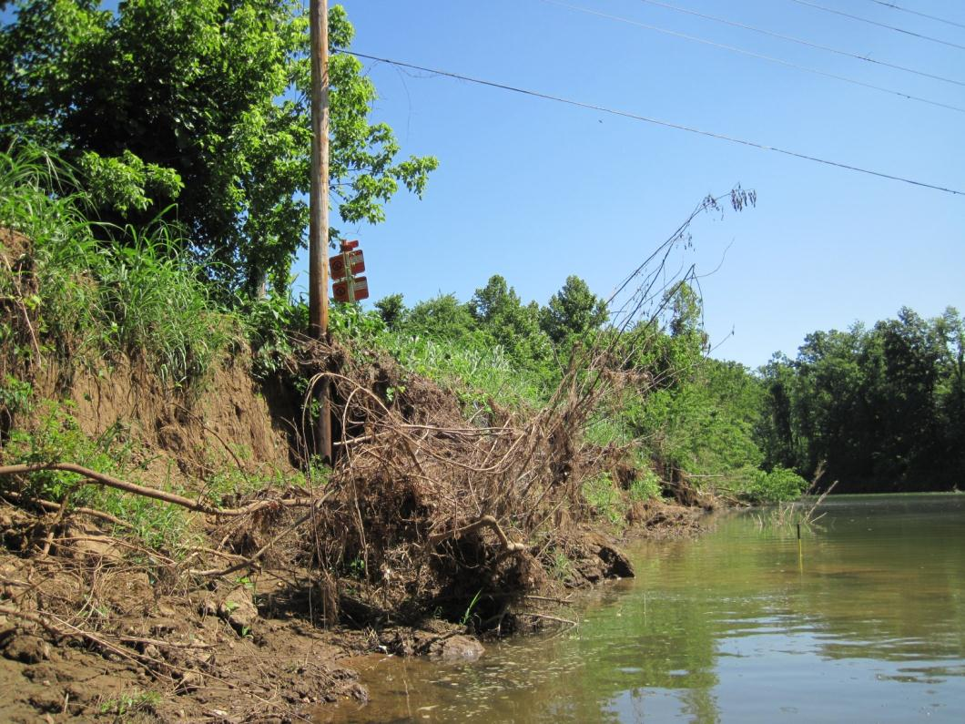
07-410 WFWR Airport Phase I
09-2000 WFWR Airport Phase II
Watershed Conservation Resource Center
City of Fayetteville, Beaver Water District, Arkansas Game and Fish Commission,
Arkansas Natural Resources Commission, Environmental Protection Agency

Slide 33
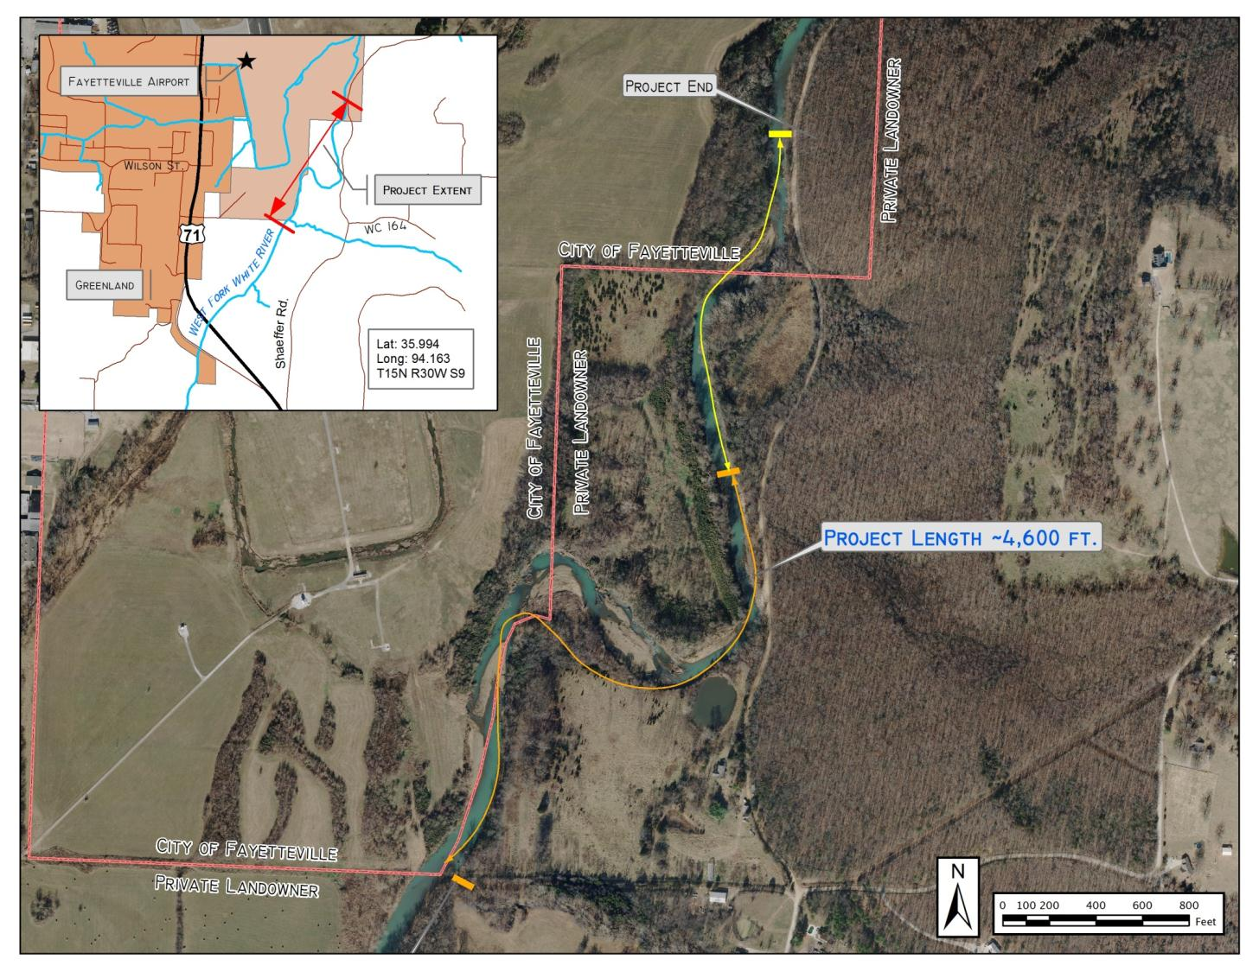



Slide 34
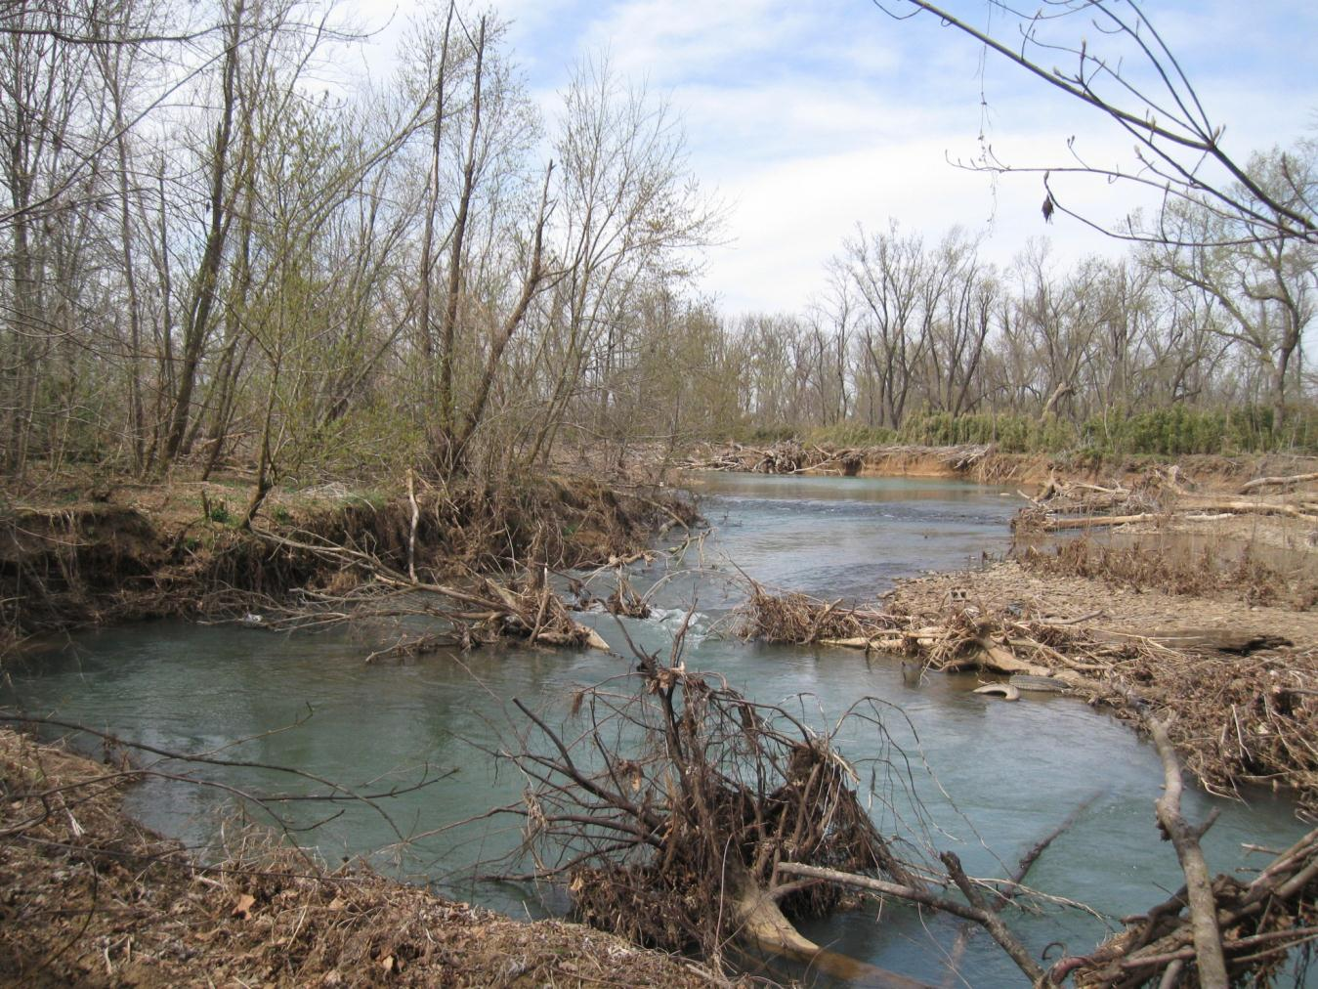

Slide 35


Pre-Restoration Site Monitoring

Slide 36

Pre-Restoration Site Monitoring

Slide 37




Pre-Restoration Site Monitoring

Slide 38

Pre-Restoration Site Monitoring
Measured loading rates exceeded predicted erosion rates by 3x due to Spring floods in NWA

Slide 39




Pre-Restoration Site Monitoring

Slide 40

Site History

Slide 41

Site History

Slide 42

Site History

Slide 43

Site History

Slide 44

Site History

Slide 45

Site History

Slide 46

Restoration Design

Slide 47

Project Status and Schedule
✓
Develop QAPP
Collect Pre-Implementation Data
  Bank erosion inventory
  Install and survey toe pins
  Collect and Analyze Bank Samples
  Survey site morphology
  Re-survey toe pins to estimate erosion
  Biologic Monitoring
Develop Restoration Plan
  Create Construction Documents
  Request Bids
Implement Plan
  Lower Gas Line
  Construct Project
Follow-up Monitoring
✓
✓
✓
✓
✓
✓
✓
Ongoing
Completed
Early 2012
Spring 2012
Summer 2012
Through 2013

Slide 48

Questions and Discussion

