Slide 1
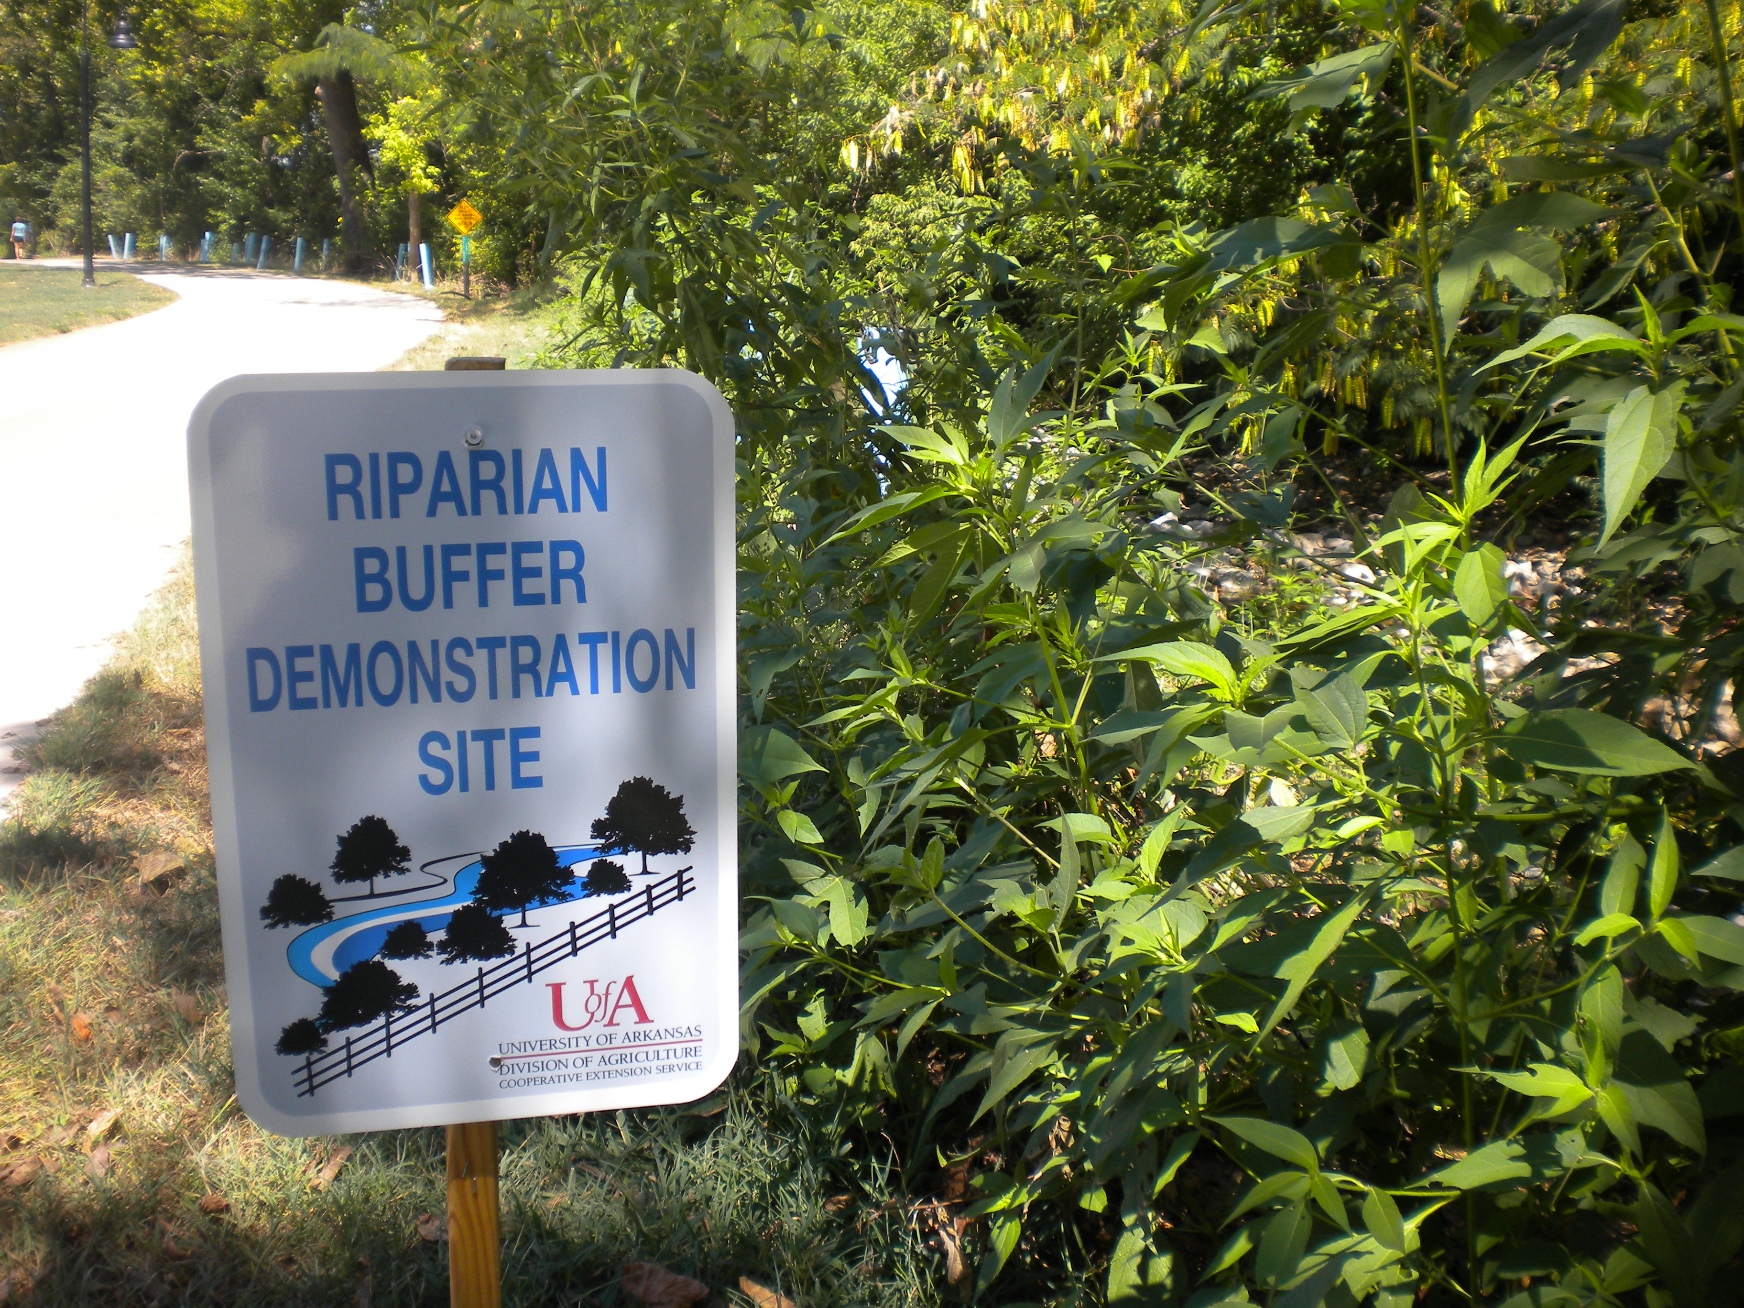
Clear Creek Riparian Management Education and Demonstration Grant
09-1200 FY09 CWA 319(h)
John Pennington and Katie Teague
County Extension Agents – Agriculture/Water Quality

Slide 2
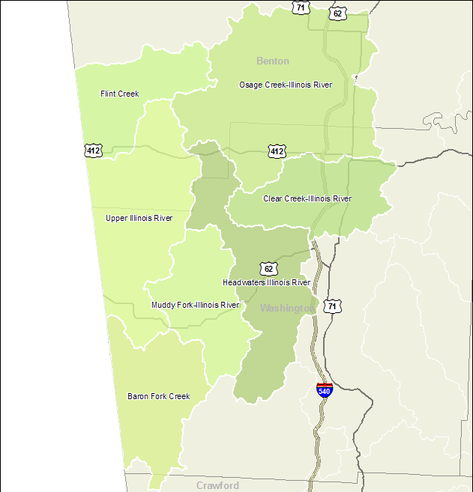
Clear Creek Watershed Location

Slide 3
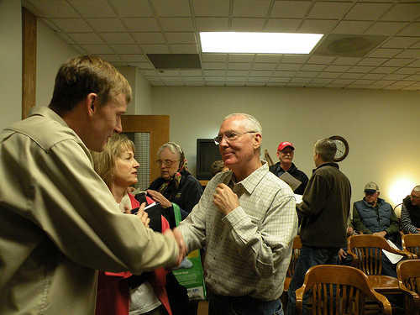
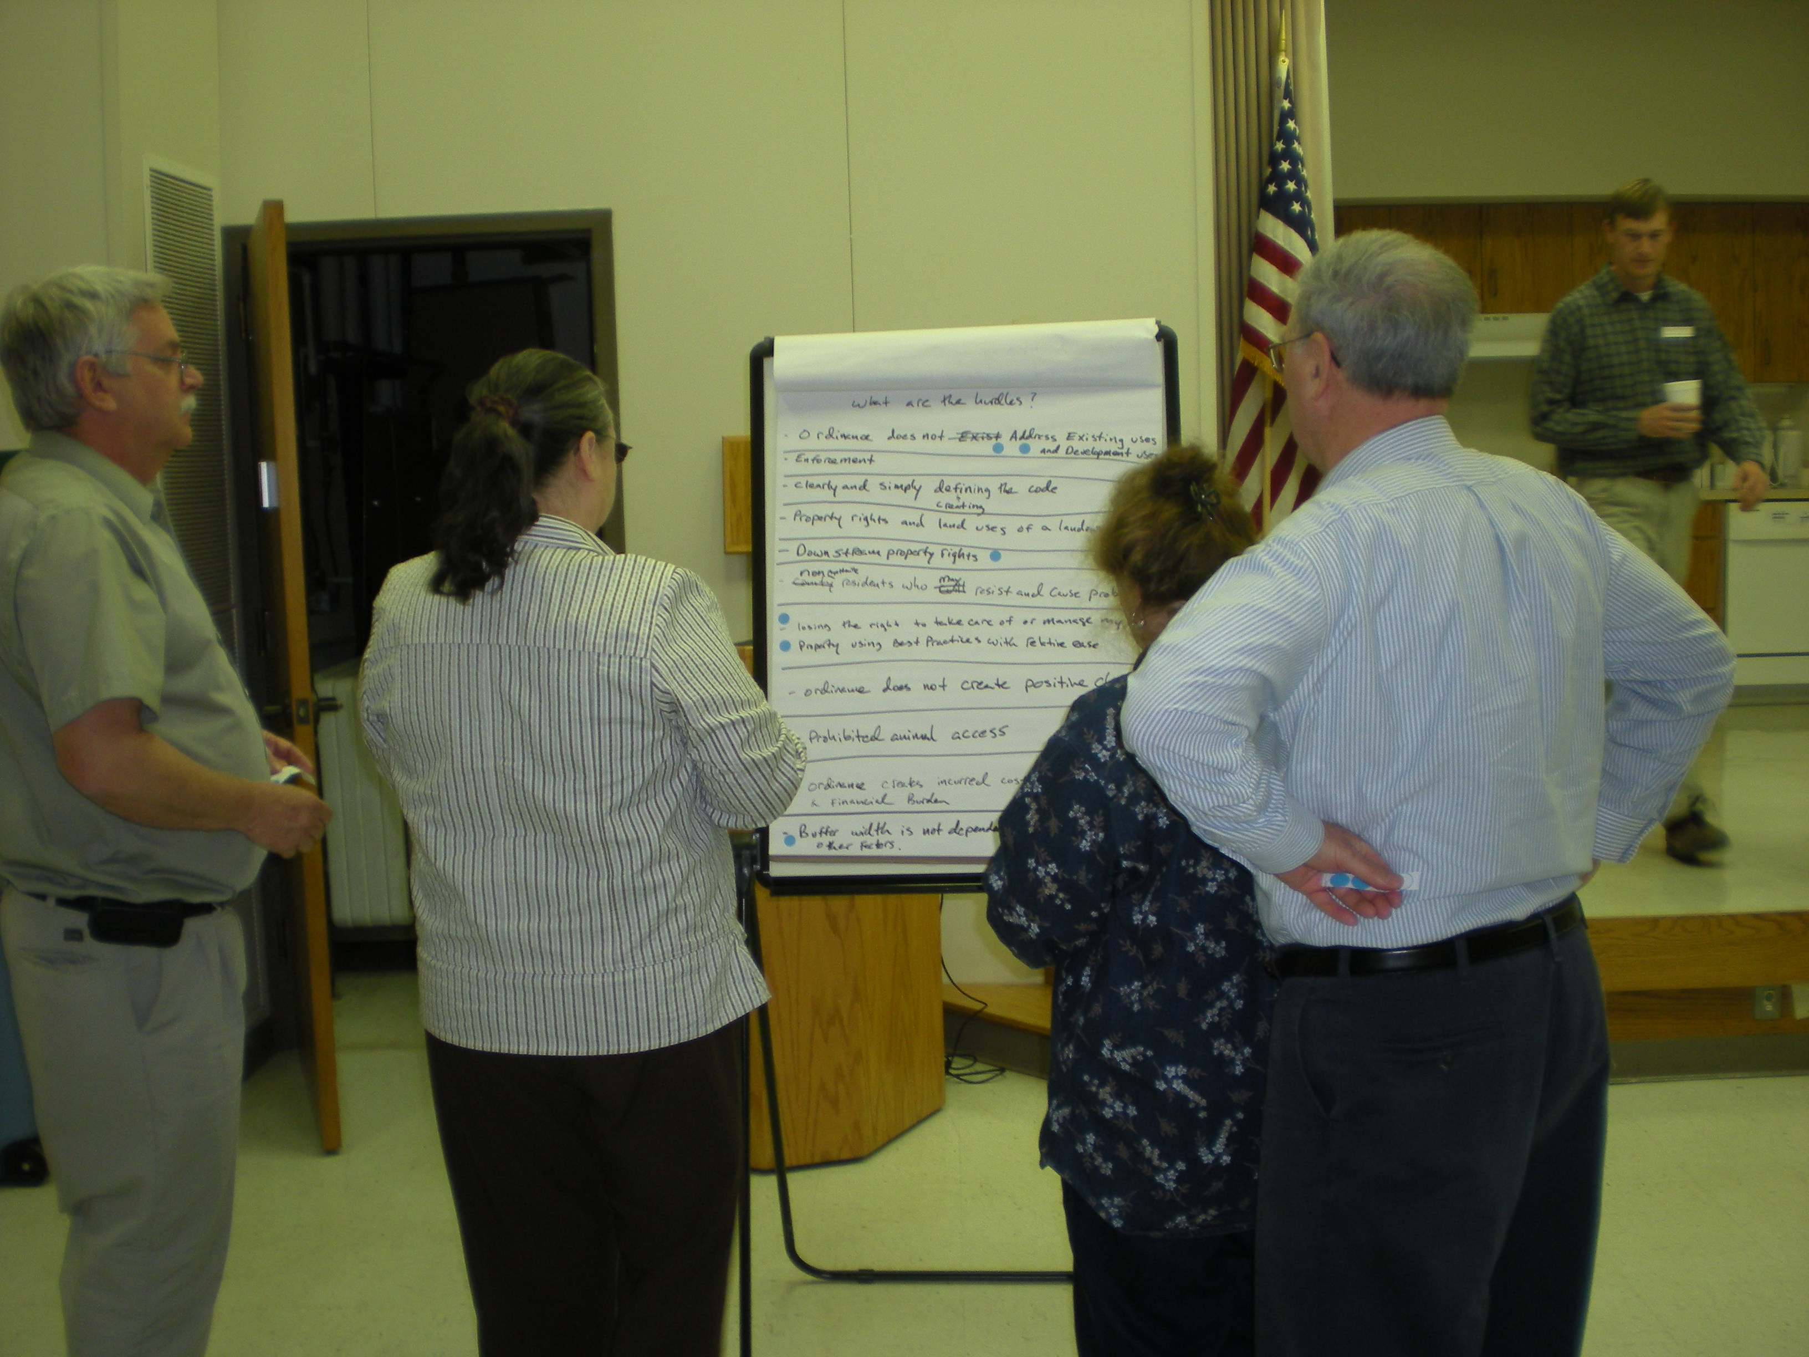
Project Overview
A project to engage streamside landowners and all stakeholder groups
  Urban & Rural
  Agricultural and Non-Agricultural
  Homeowners
  Landowners
  Businesses
  Industries
  Municipalities
Streamside or riparian landowners are the last line of defense for a stream.
  Streambank stability
  Pollutant filtration
  Wildlife habitat
  Noticing problems
There are approximately 1,700 streamside owners
Streamside owners can do a lot for a stream’s health

Slide 4
NPS Management Program Elements in Project
  Agriculture (4.1-4.12) Direct technical assistance to landowners in targeted watersheds. Provide and improve extensive education and training to promote BMP implementation and to acquaint landowners with conservation practices to reduce runoff, sediment transport
  Silviculture (5.1 -5.3 ) Develop additional mechanisms for delivering BMP implementation training targeted at private landowners and continue to promote incentives for landowners to increase voluntary BMP implementation
  Surface Erosion (7.9-7.10) Develop education programs for landowners and developers concerning proper stream corridor management and corridor restoration
  Household and Business Activities (8.8) Continue to maintain and implement broad based education programs aimed at increasing awareness and disseminating BMP to urban and rural households and businesses

Slide 5
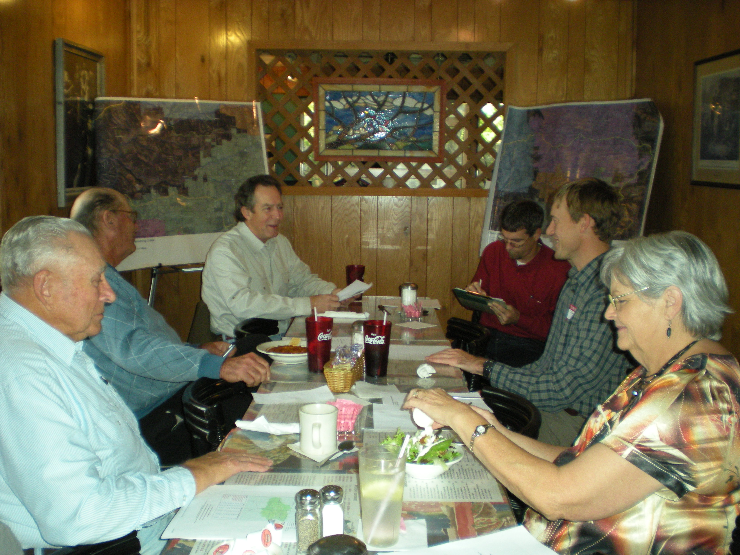
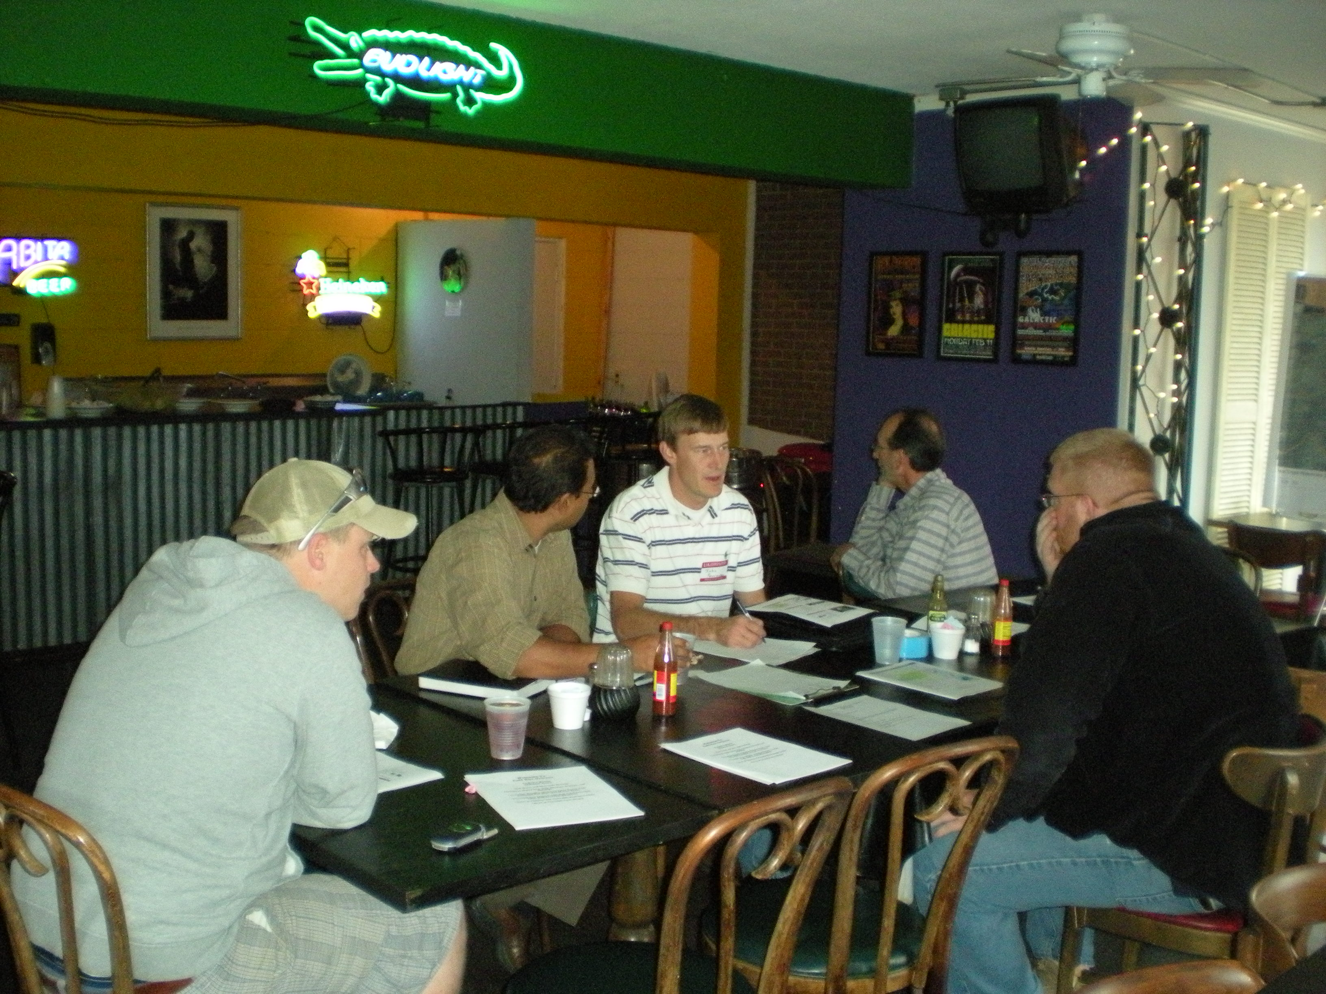
Grant Project Task 1
Planning and Input – Establish landowner database and collect stakeholder input through focus group meetings.
  Utilize the Watershed Approach

Slide 6
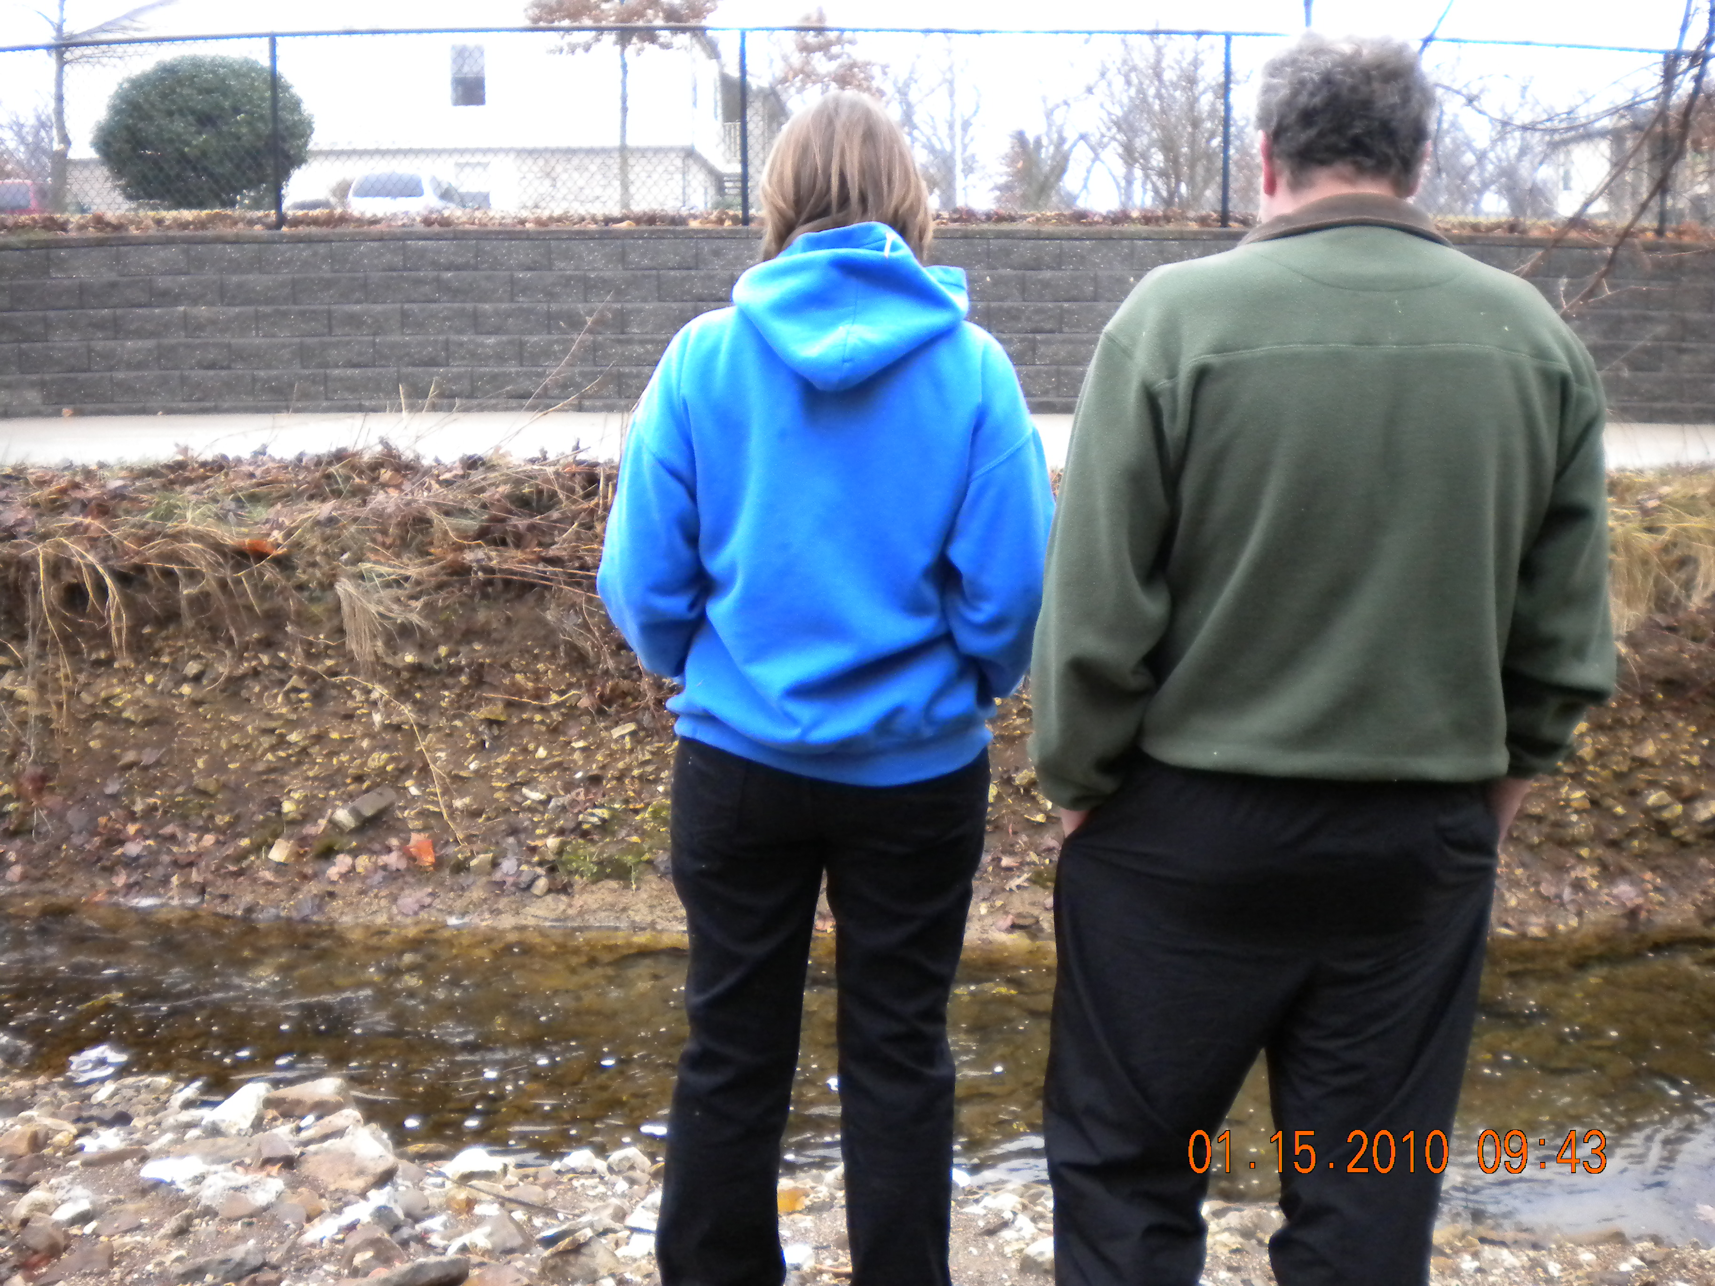
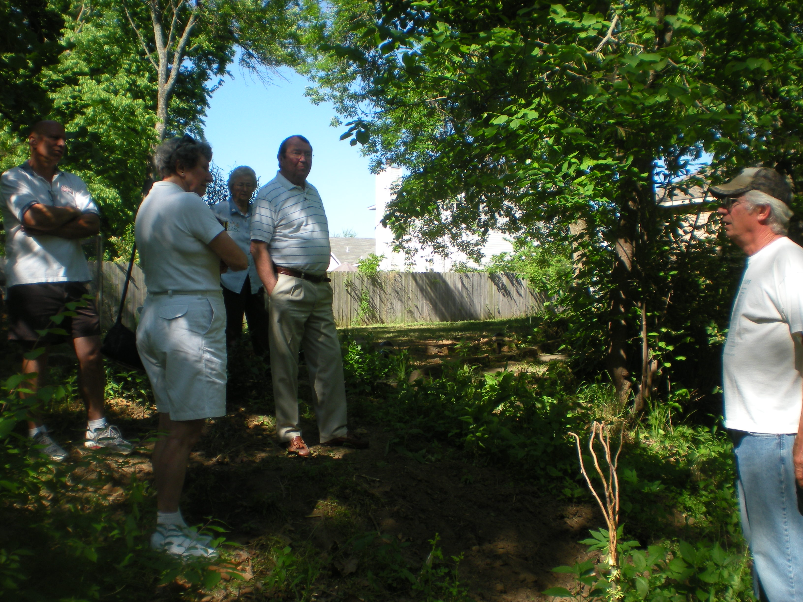
Grant Project Task 2
Individual Landowner Riparian Assessments - Asses the condition of riparian lands, provide information and education on how to improve or maintain these areas, connect landowners with technical assistance needed.
  108 Assessments
  269 improvements made so far
  46 leading to technical assistance beyond me
    FSA - CREP enrollment
    NRCS - EQIP enrollment
    Stream Team
    Watershed Conservation Resource Center
    Arkansas Forestry Commission
    Washington County Environmental Affairs
    Conservation District

Slide 7
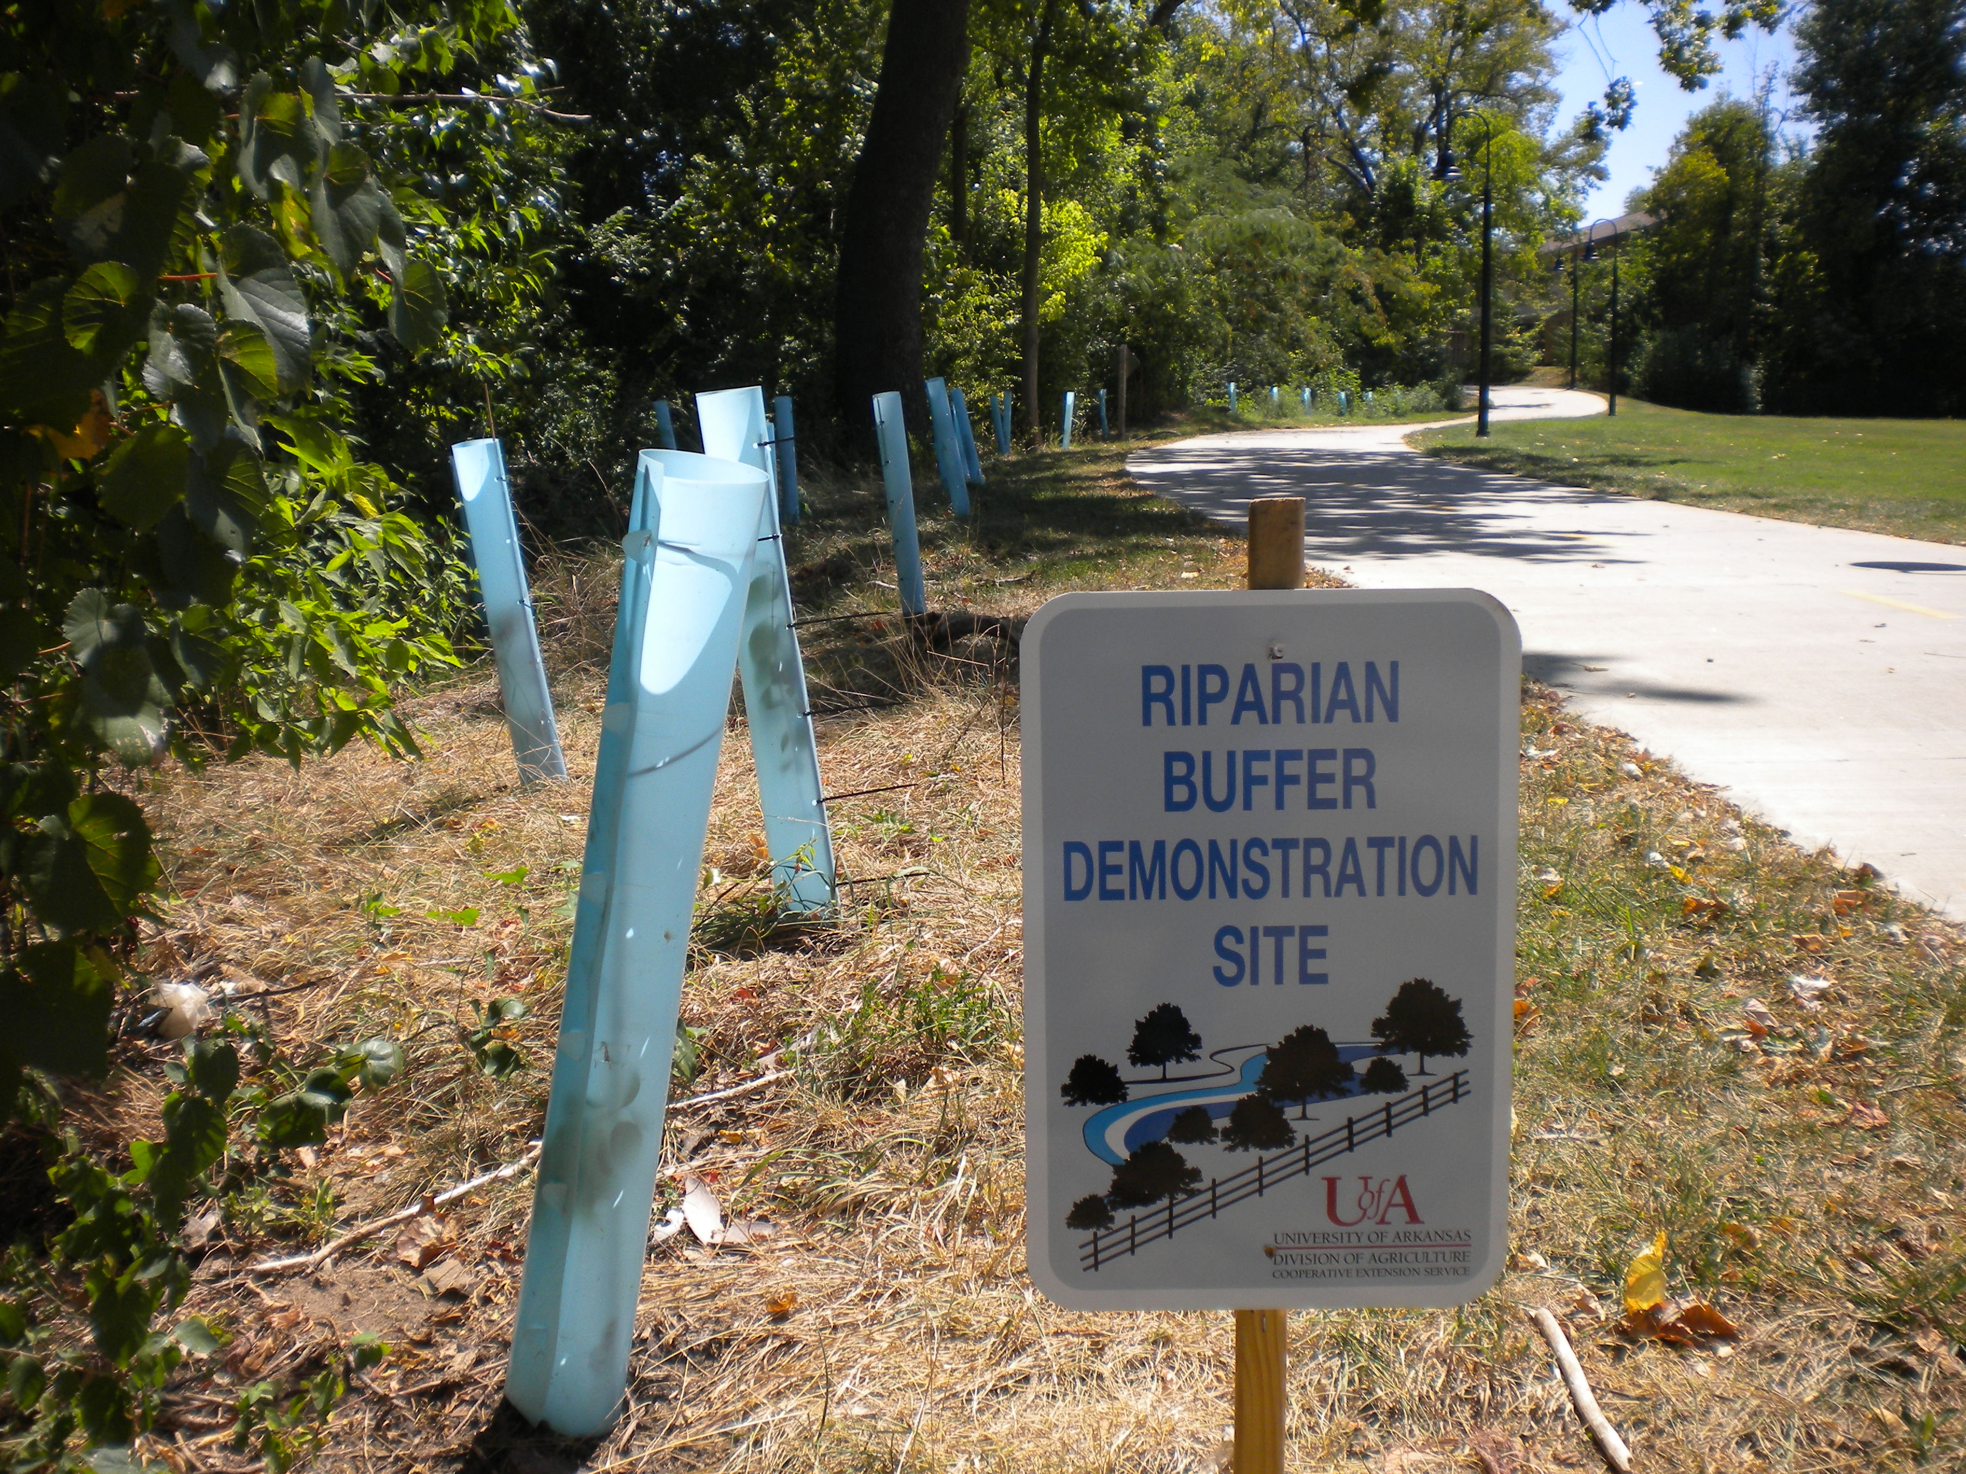
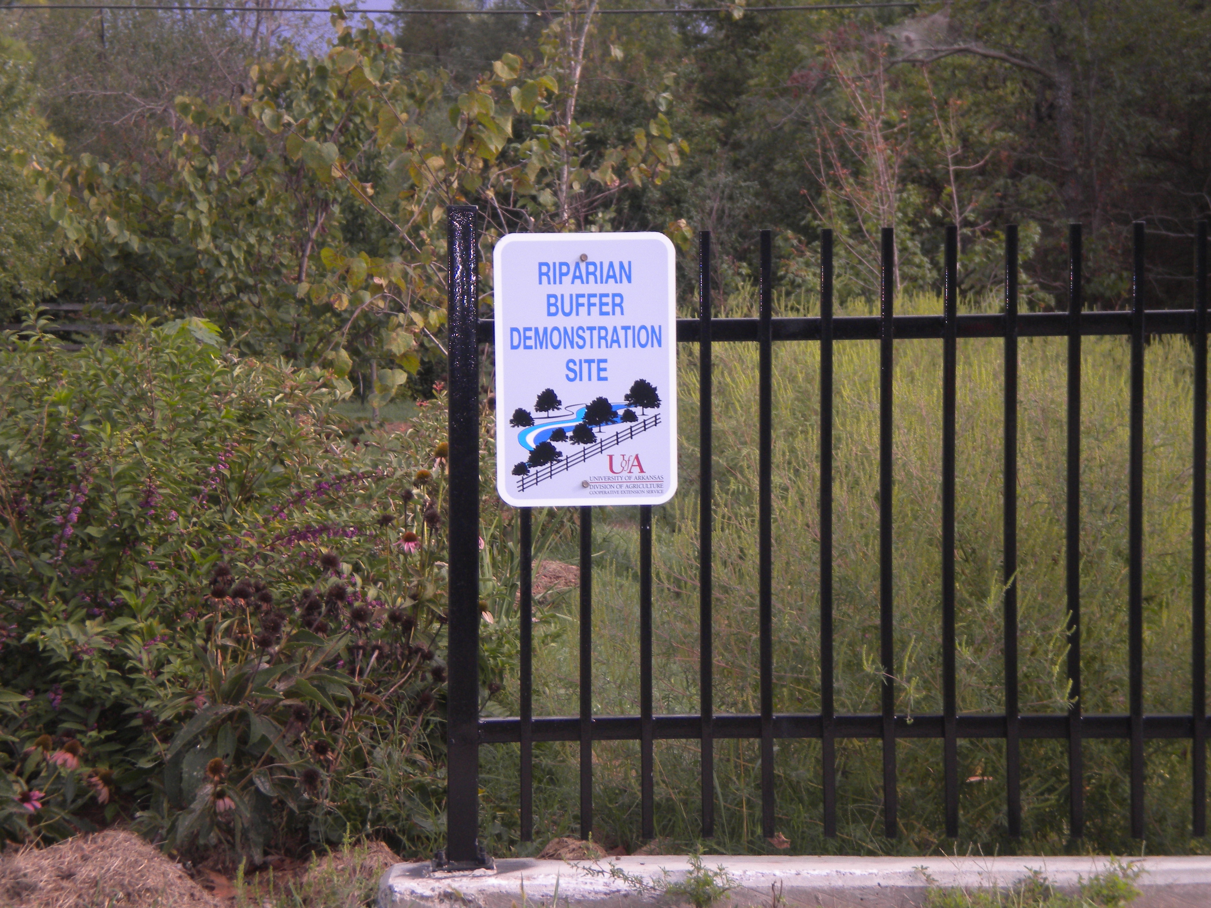
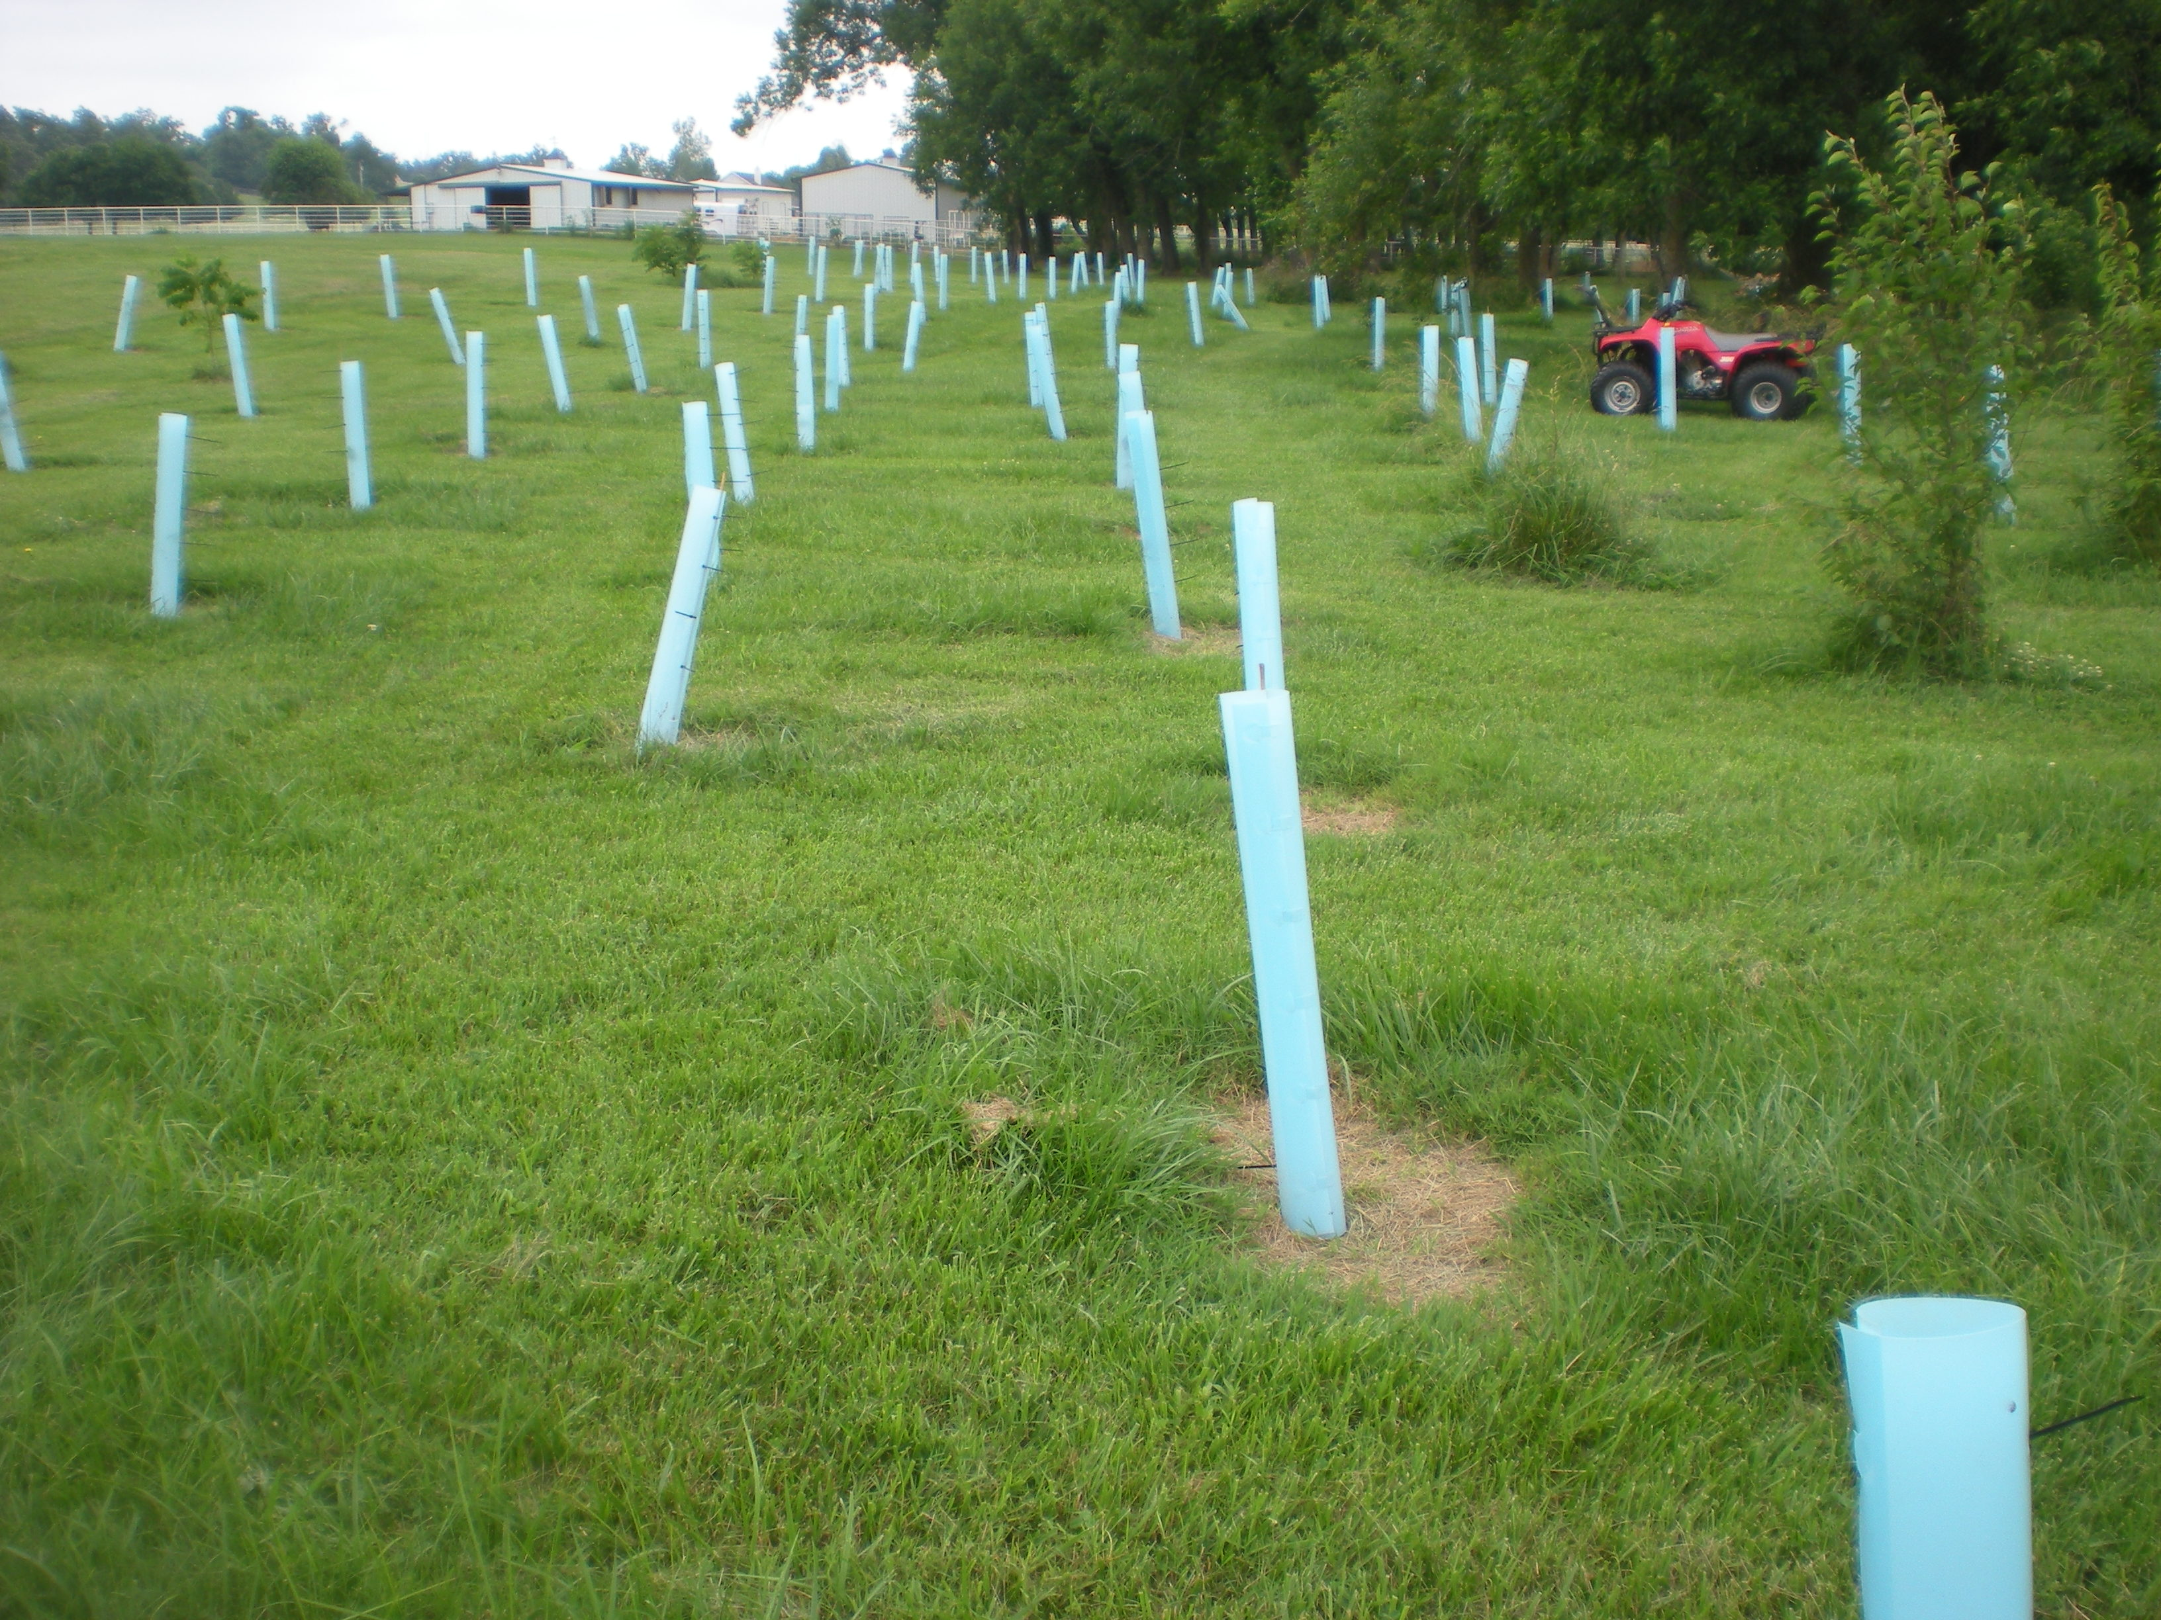
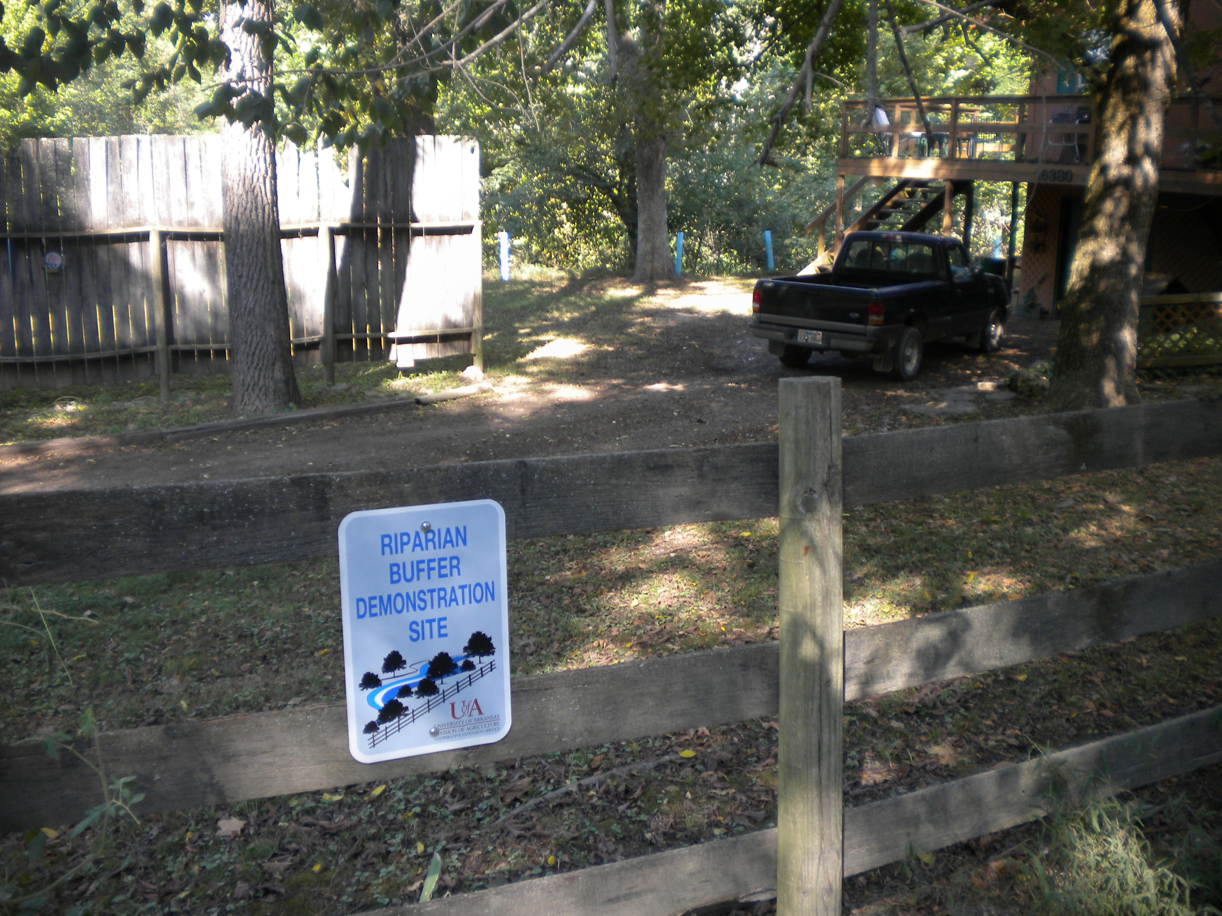
Grant Project Task 3
Establish Riparian Management Implementation – Establish residential, municipal, and rural riparian management demonstration sites, and work with property owners, conservation organizations, technical service providers, municipalities, communities, and the University of Arkansas to encourage proper riparian management.
Collaborate with the City of
Fayetteville to develop a “streamside
protection ordinance”
  15 demo sites
  1,200 streamside owners
  18 conservation organizations
  7 technical service providers
  5 municipalities
  3 communities
  University

Slide 8
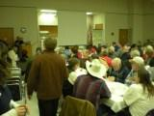
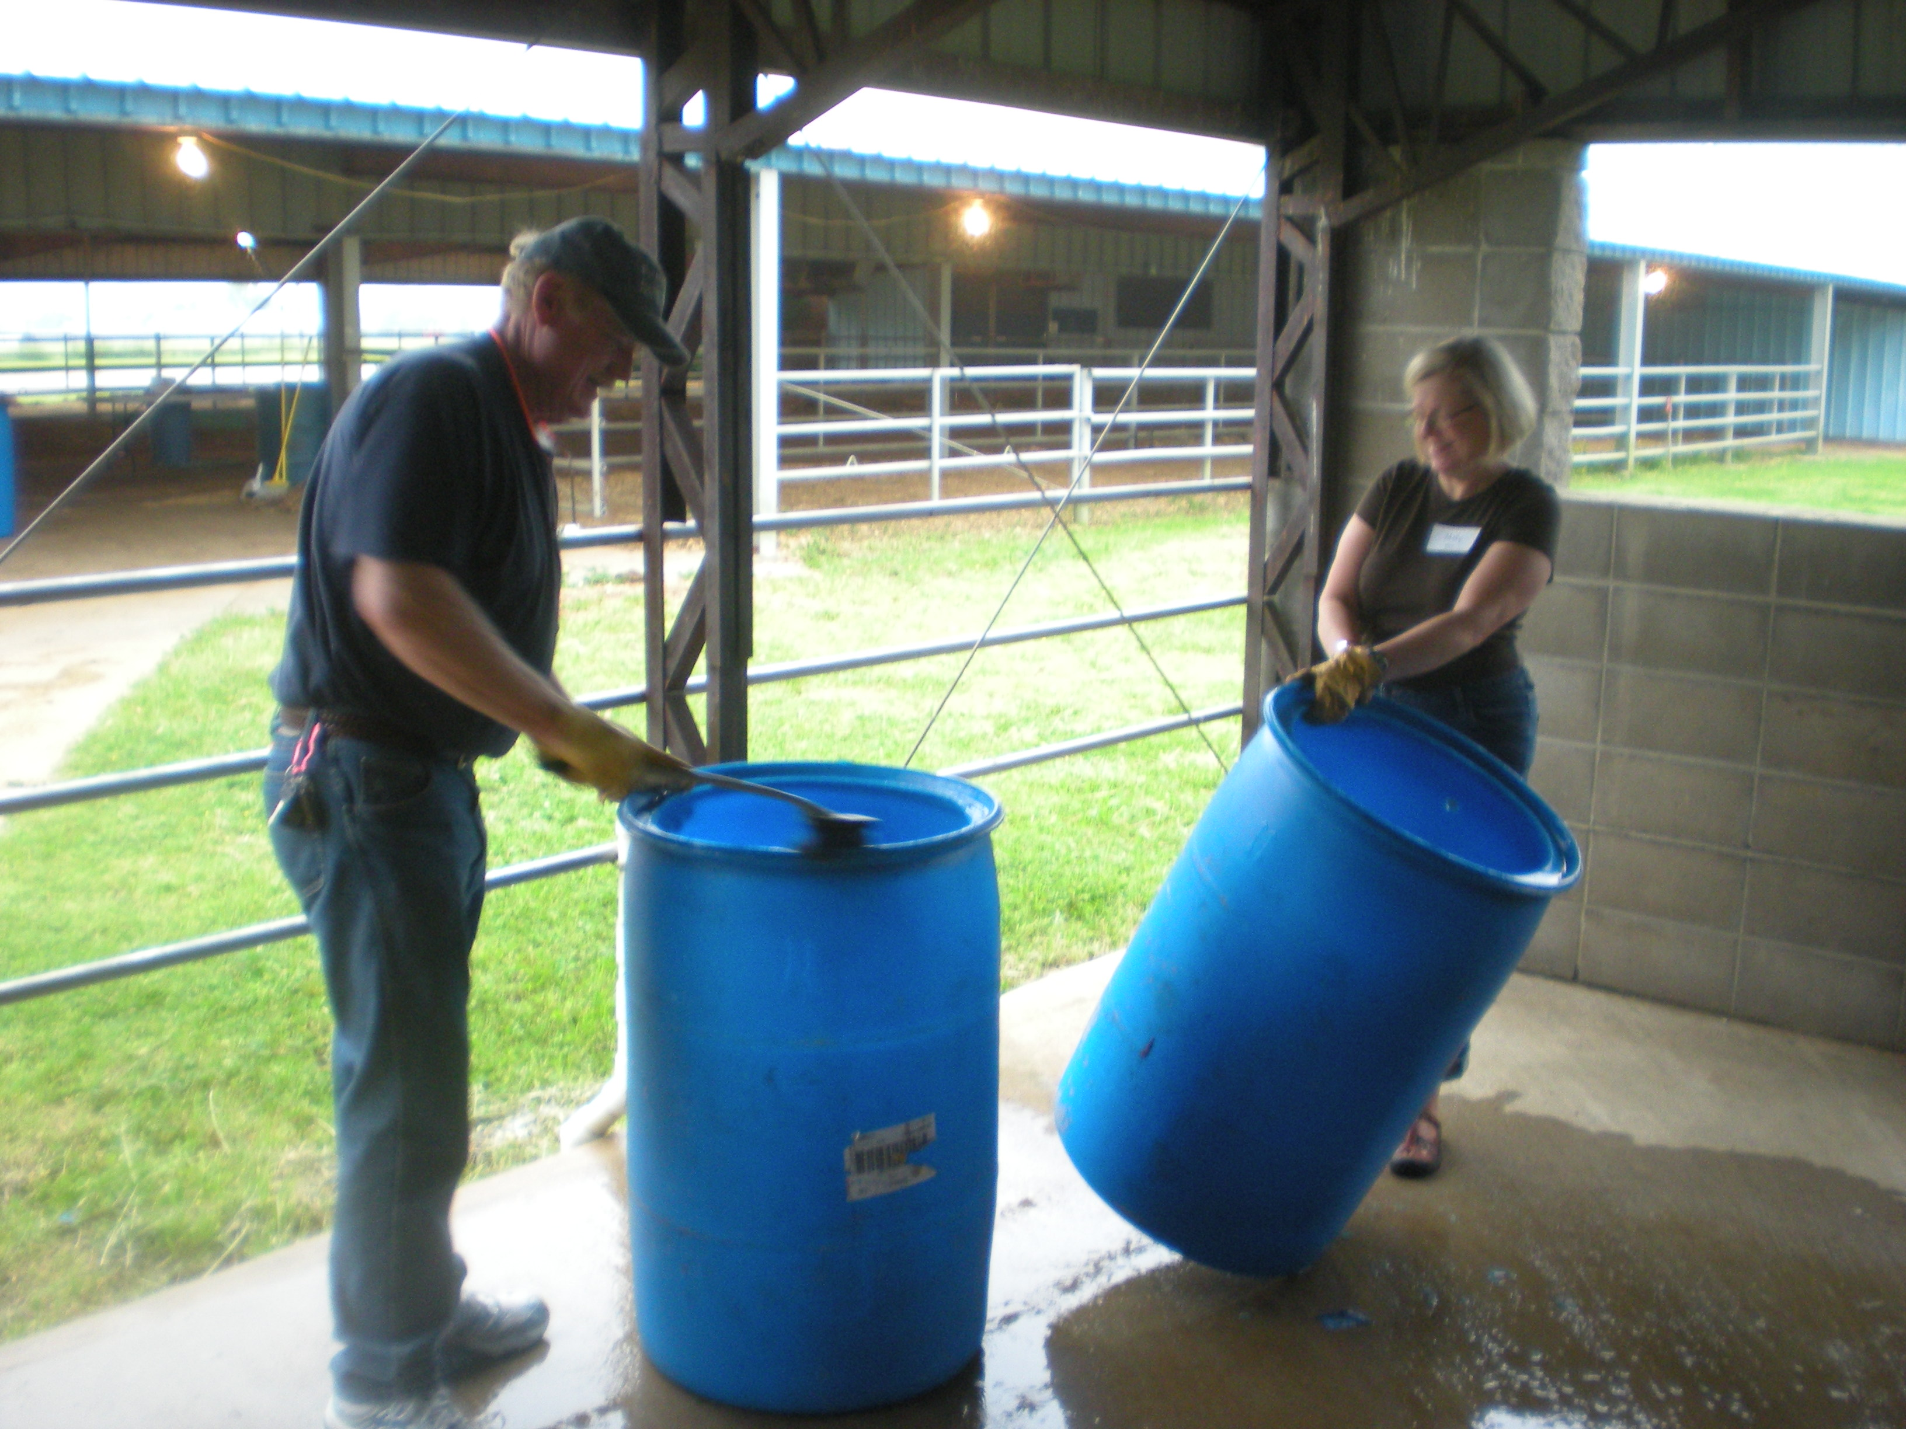
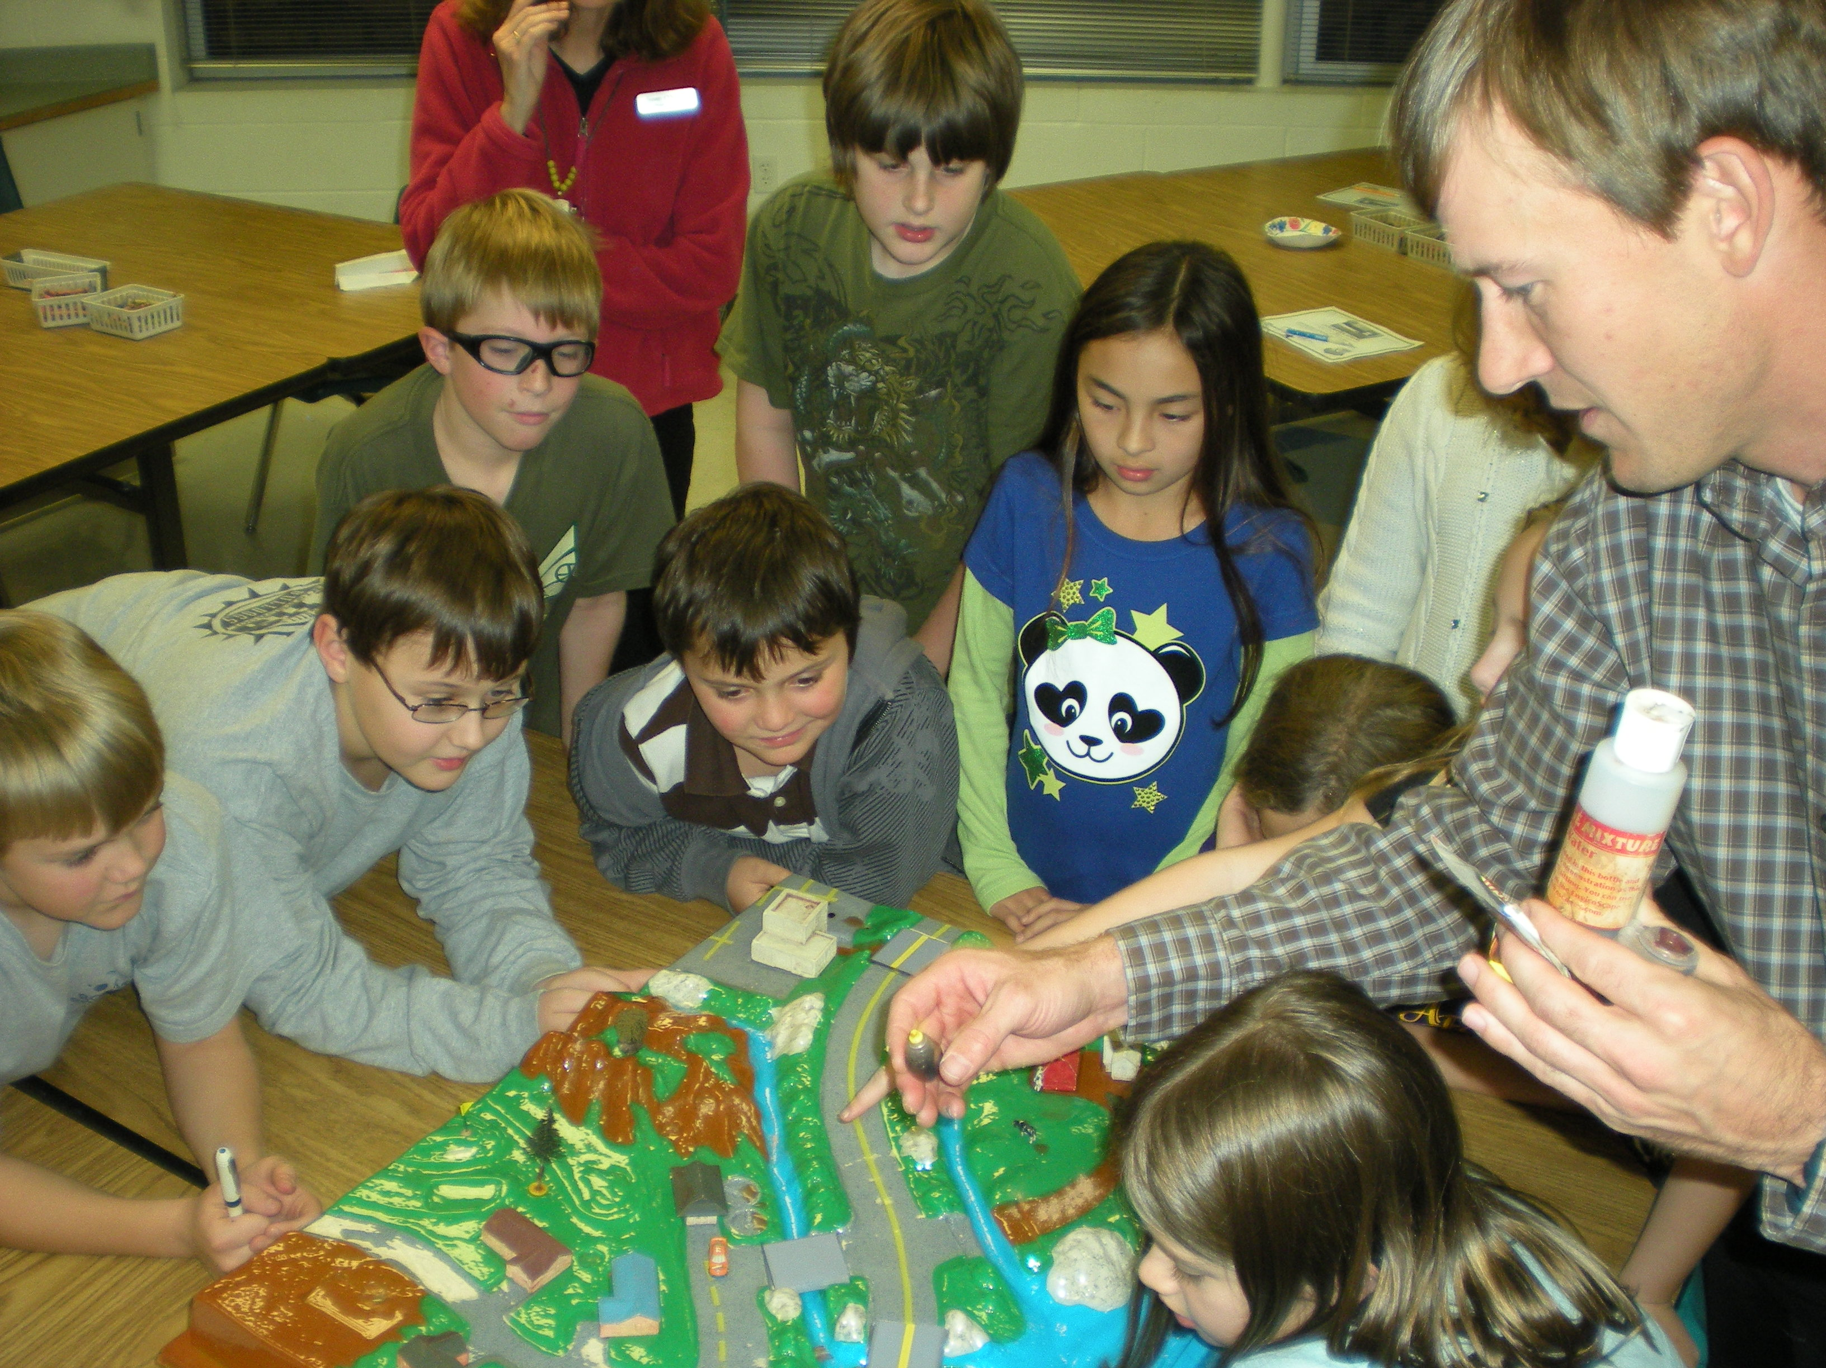
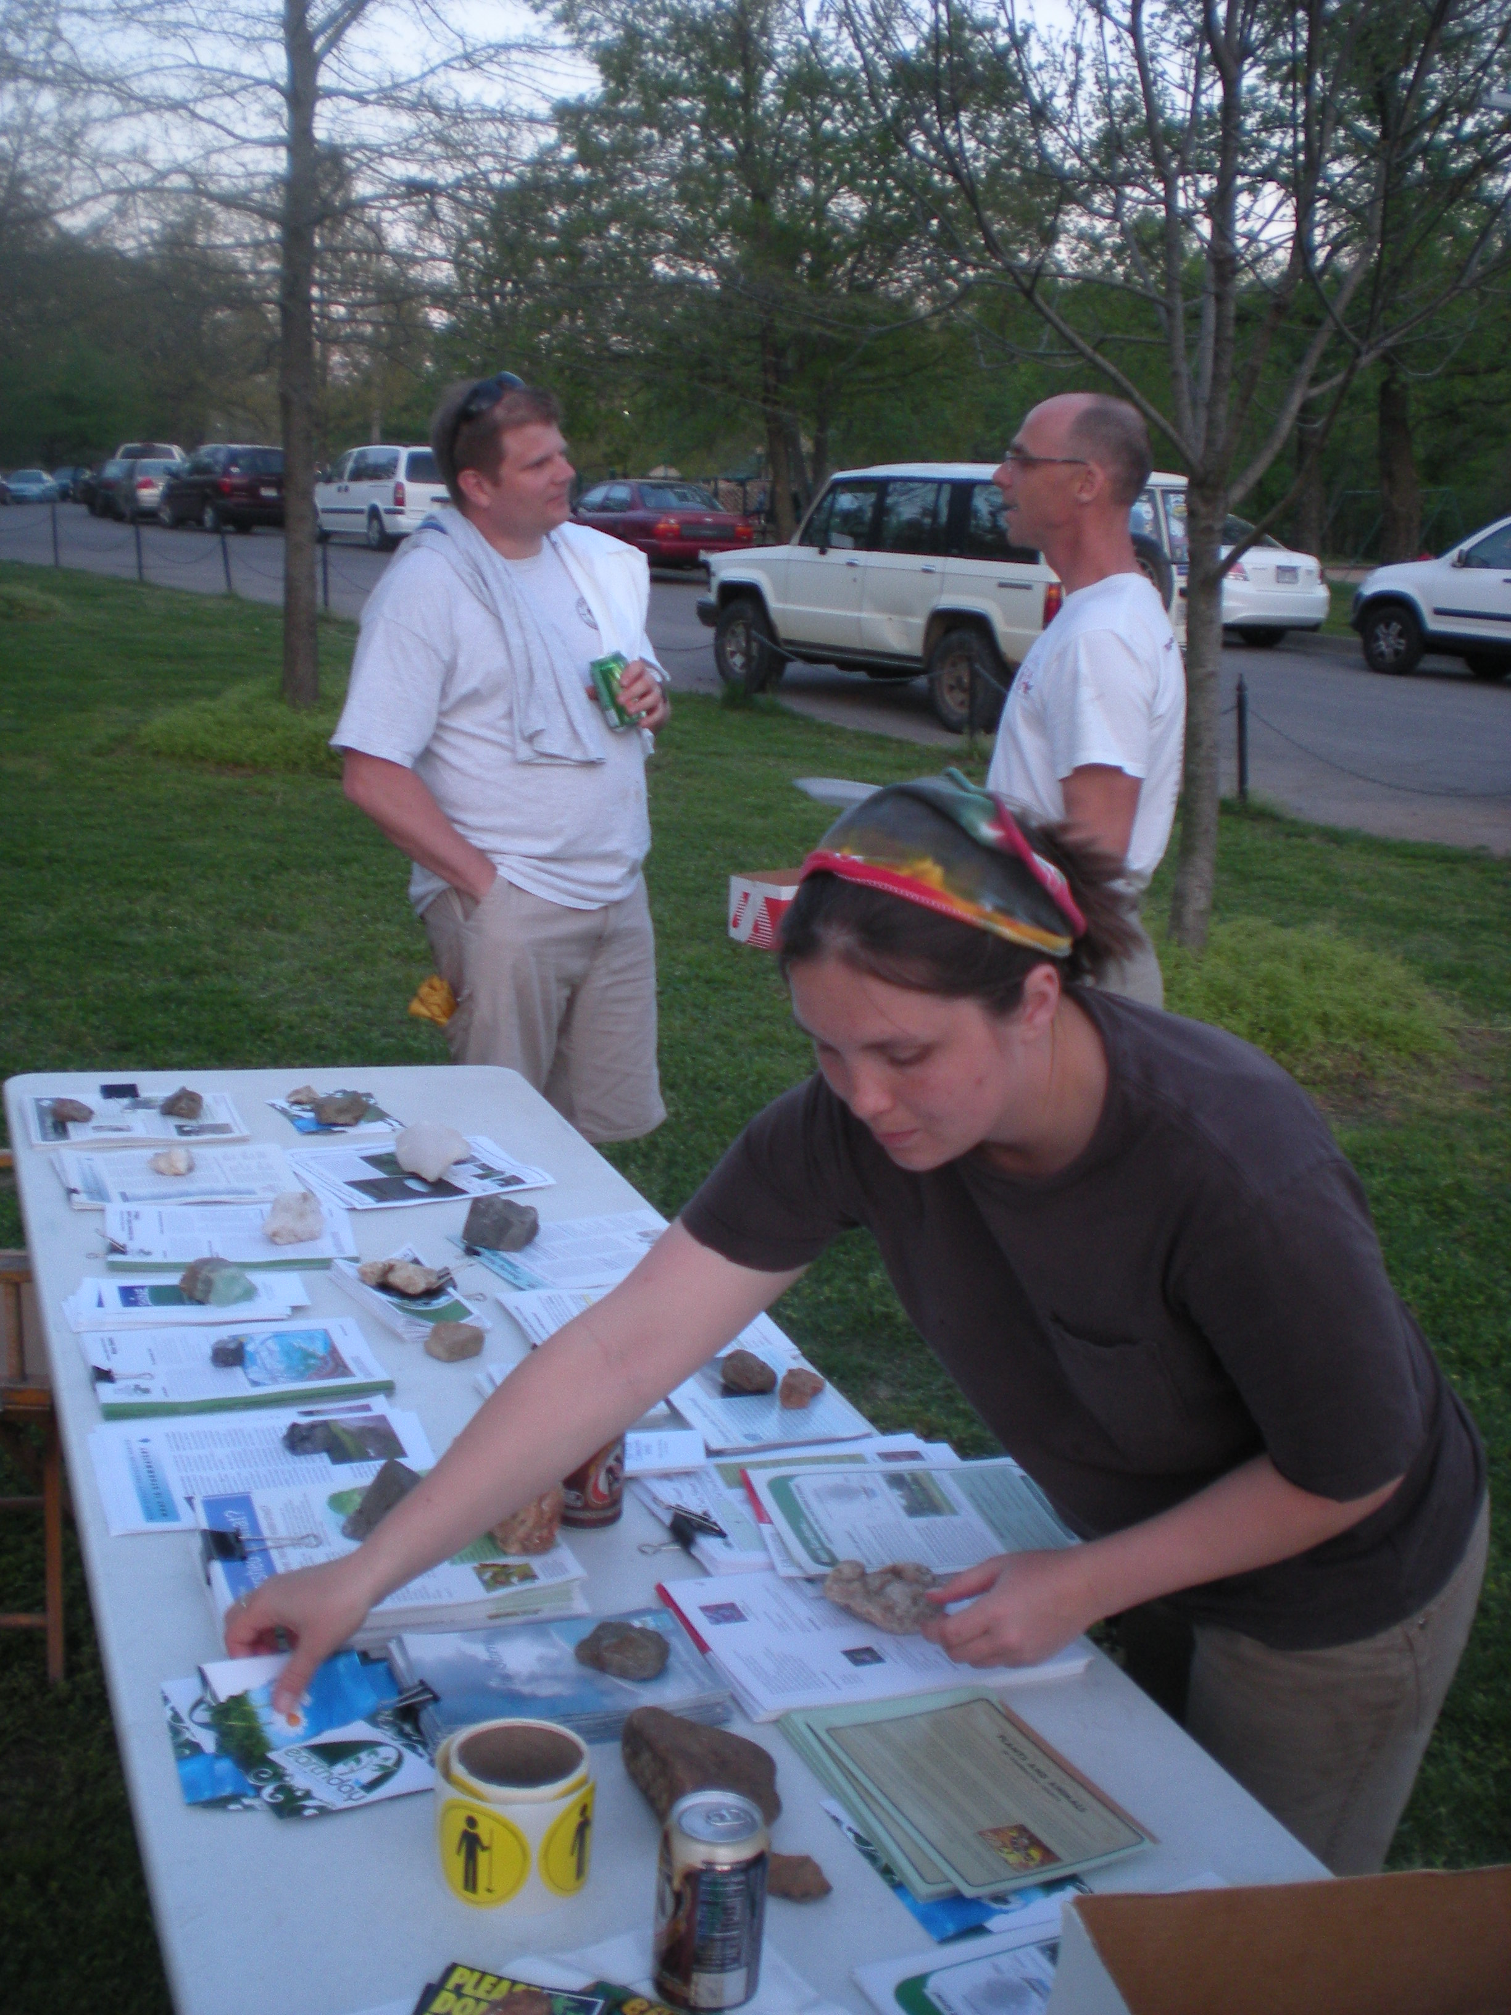
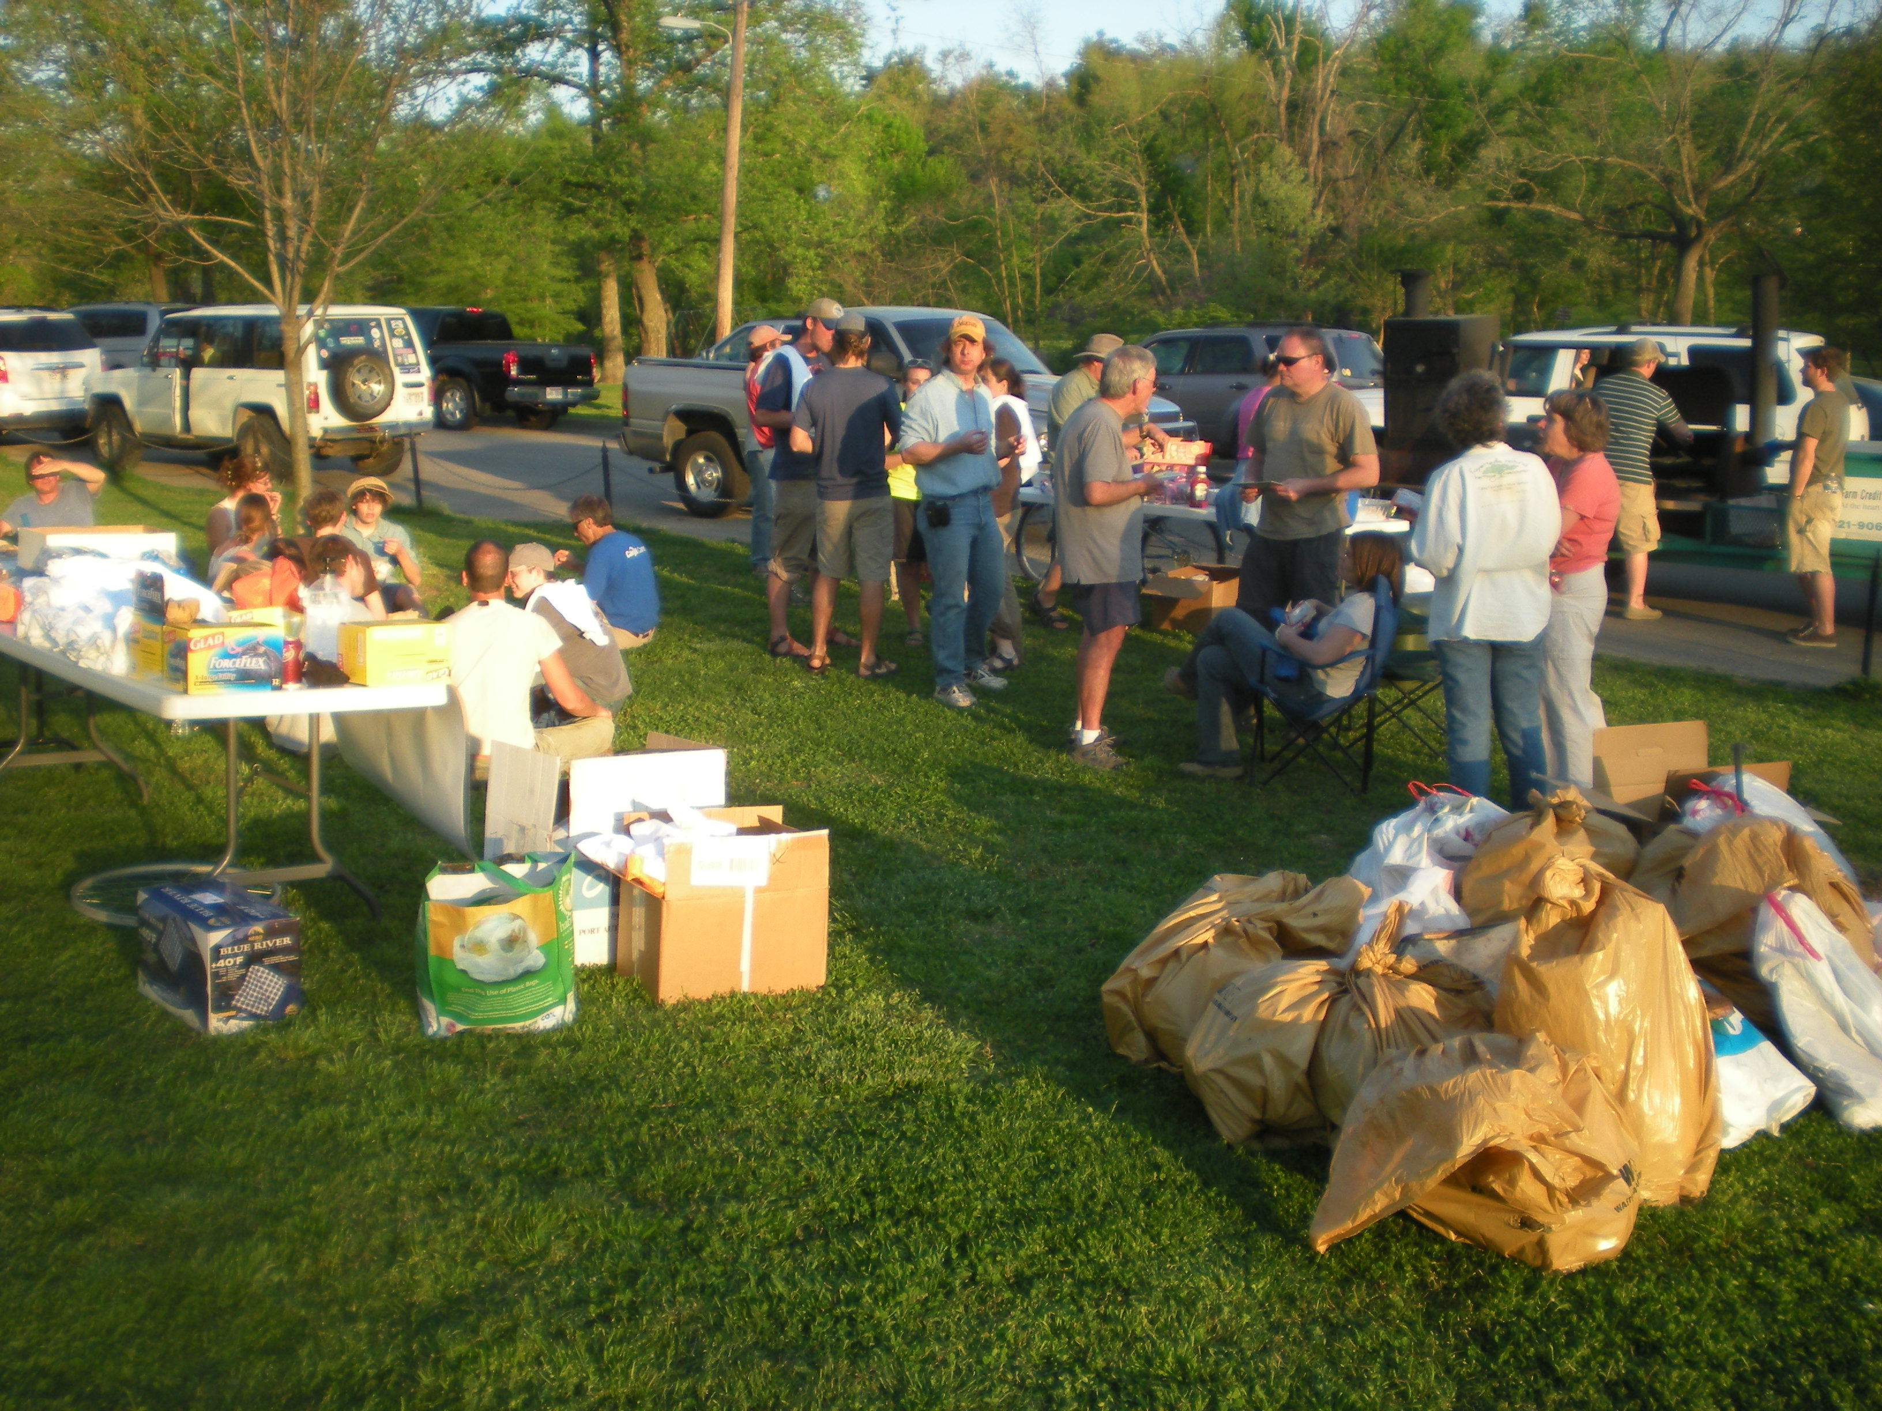
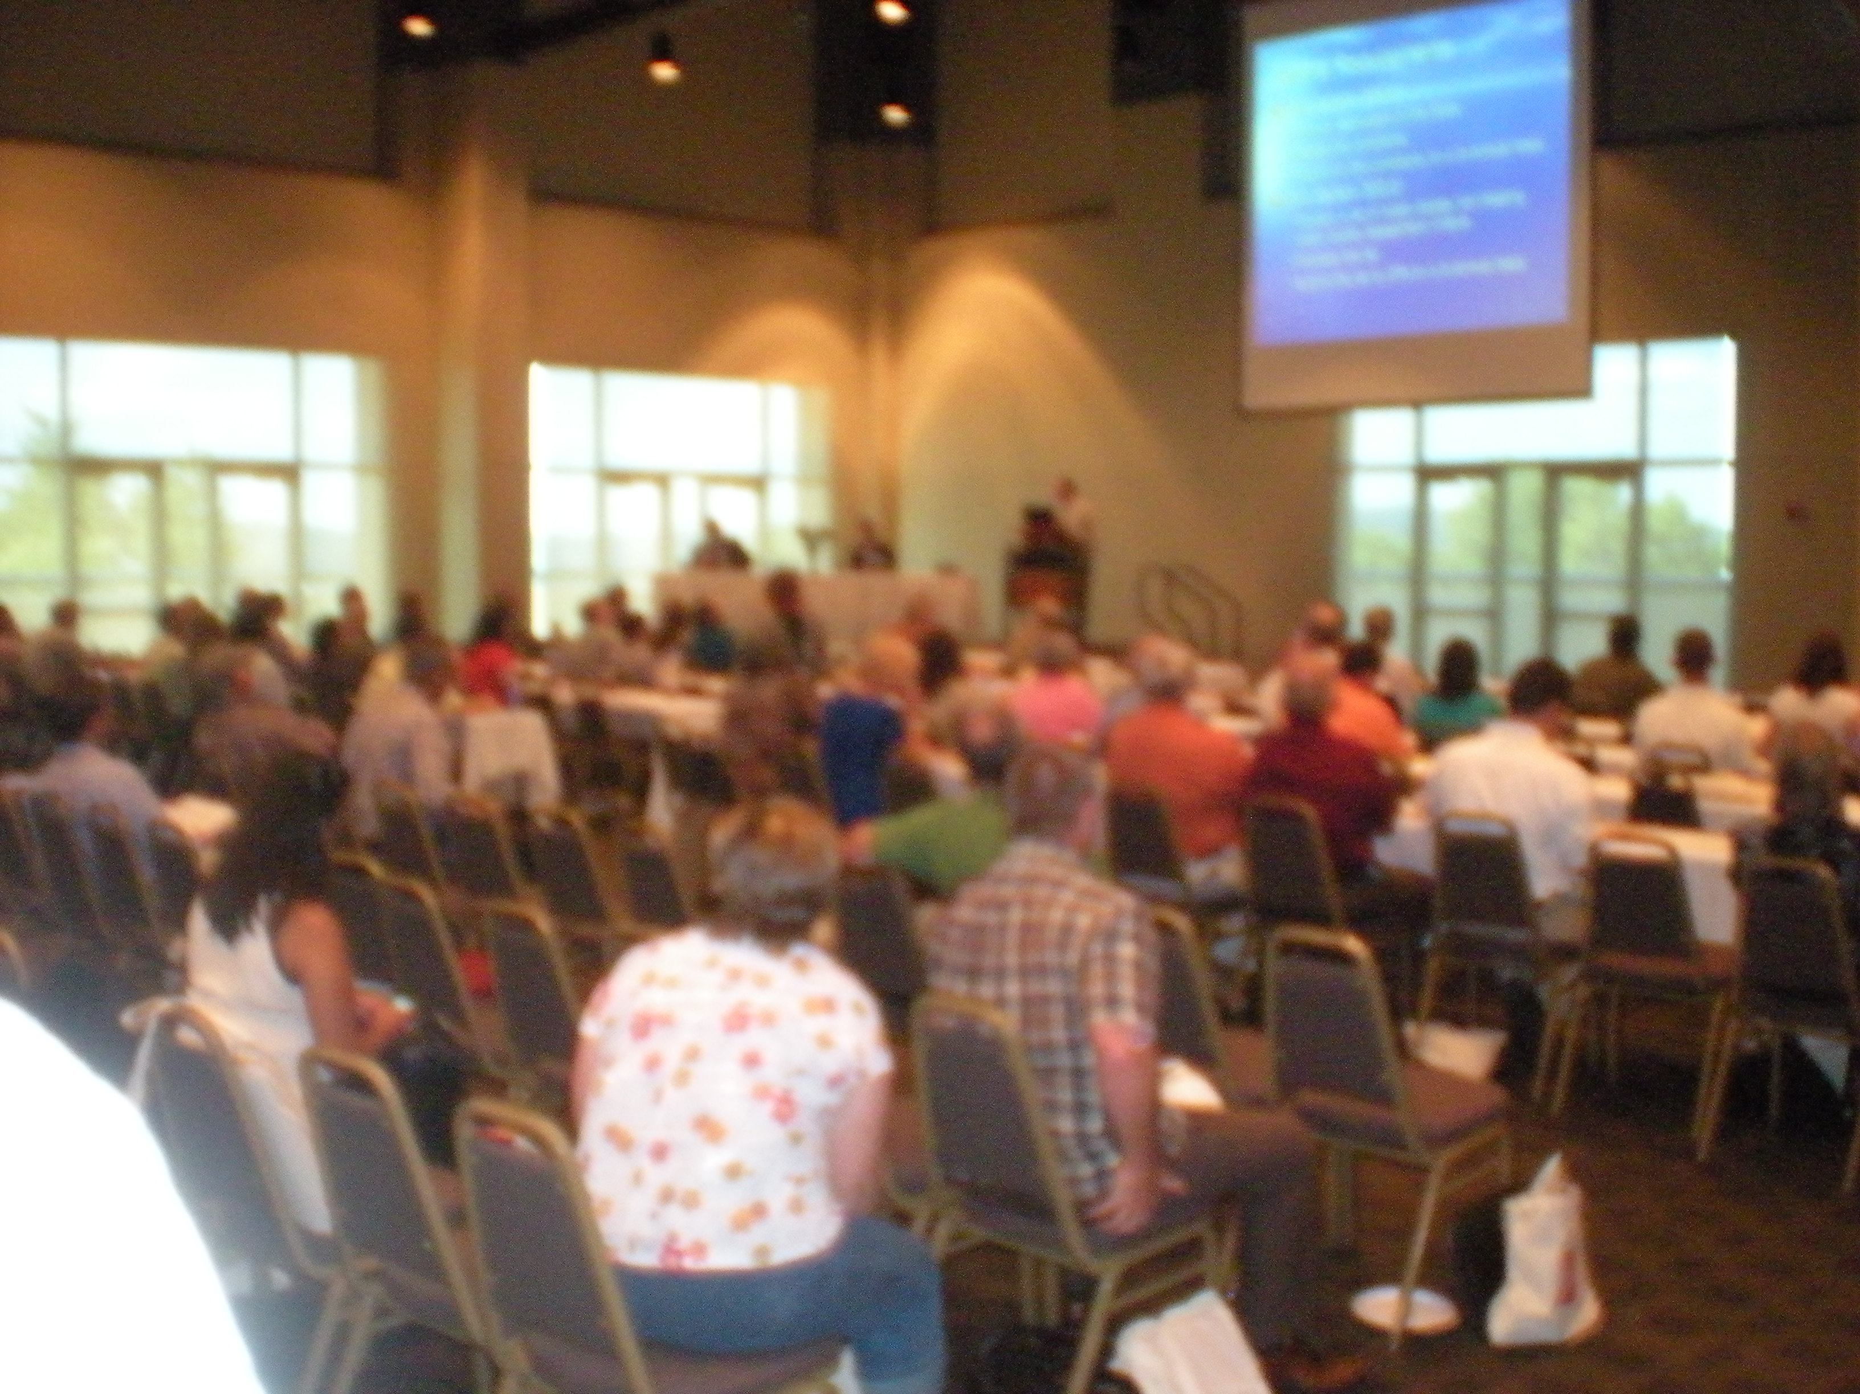
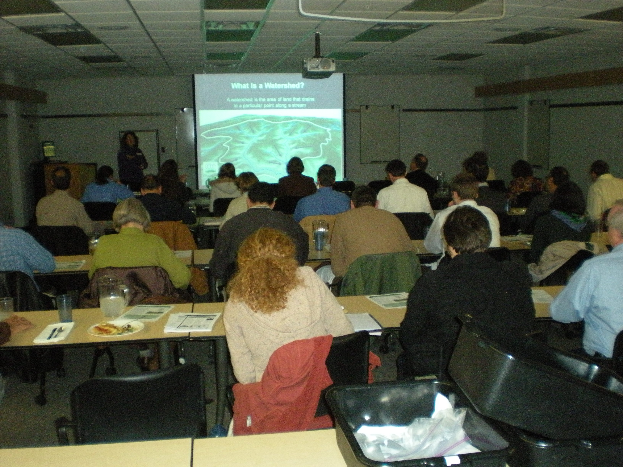
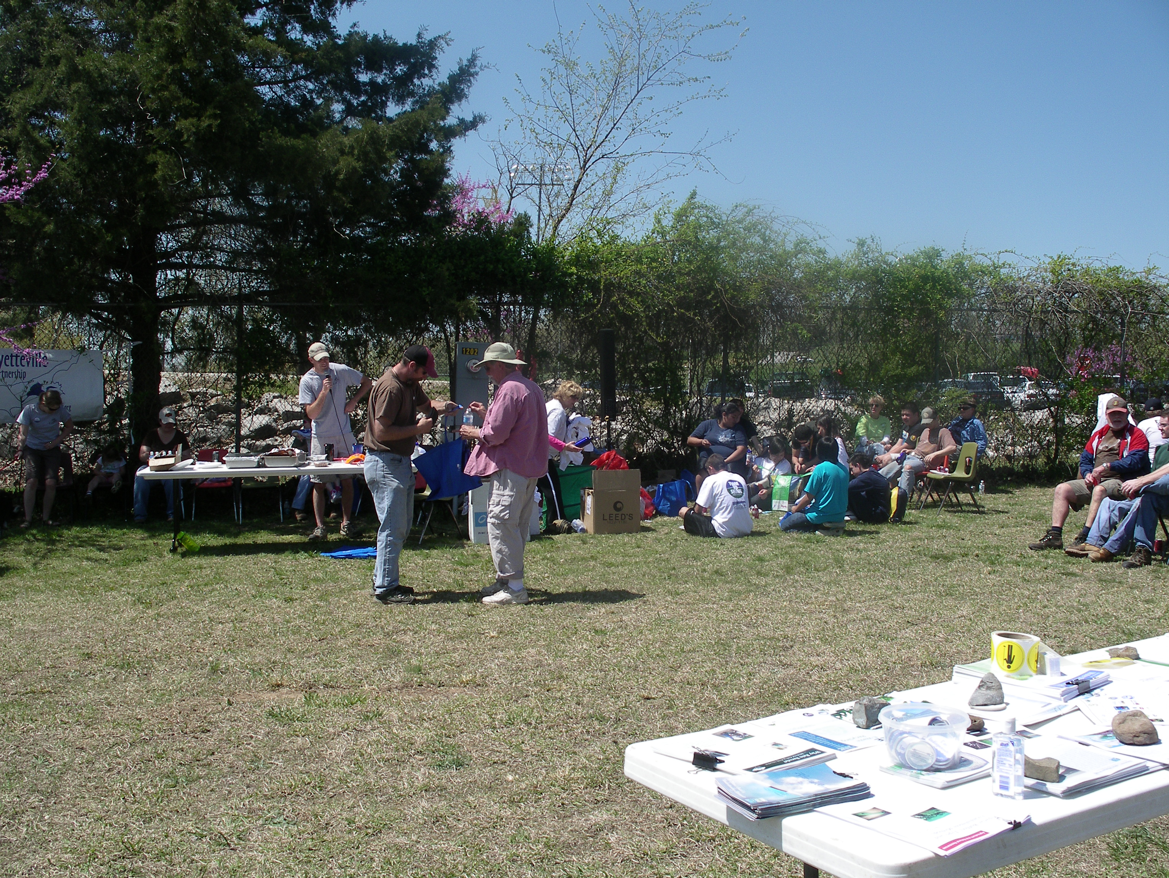
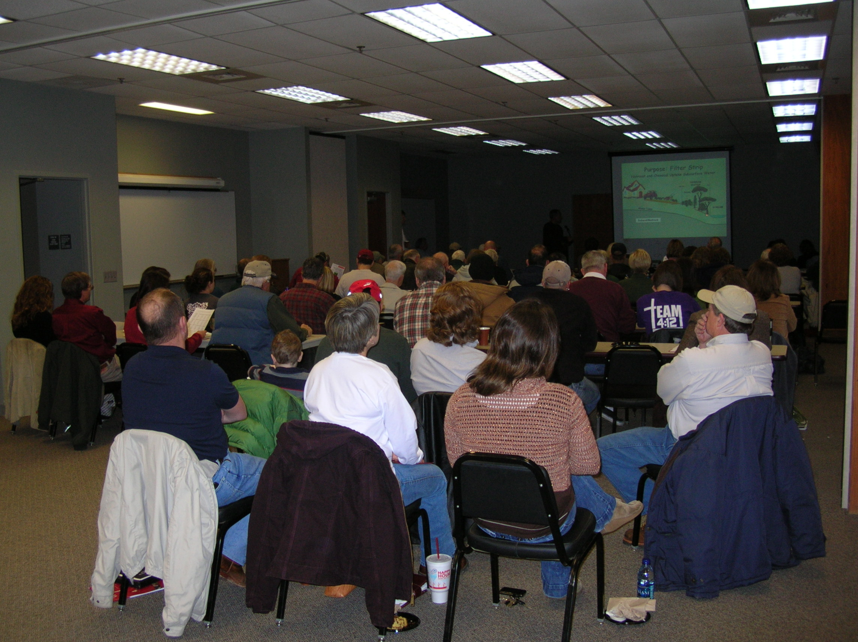
Grant Project Task 4
Public Outreach and Education - work in a grassroots-style synergistic effort with watershed, conservation, and municipal organizations, and watershed stakeholders to carry out individual contacts, school programs, creek walks, creek cleanups, riparian management workshops, a streamside assessment guide for landowners, media releases, and riparian buffer ordinance
input and education meetings.

Slide 9
Grant Project Task 4
Bi-monthly newsletter mailed to 1,800 streamside landowners
587 participants at 7 creek clean-ups - 5 associated fact sheets
169 volunteers for 72 buffer plantings - 3.5 miles buffers installed
236 participants in 12 ordinance input meetings
  100 % found this process beneficial
  91% found education was beneficial for giving ordinance input
  98% learned more about functions and values of riparian areas
530 participants at 20 other educational programs
21 new educational materials in all made so far
Presented at AWRC and National County Ag Agents Conference
Still need to complete Streamside Landowners Assessment Guide – Stream*A*Syst

Slide 10
Grant Project Task 5
Technology Transfer - Share successful methods for fostering participation, affecting public policy positively, and inciting BMP implementation and conservation program adoption among riparian landowners with watershed and conservation organizations, county, state, and federal agencies. This project will serve as a model for organizations and agencies that are working to affect conservation practices among riparian landowners throughout the Illinois River Watershed, Beaver Lake Watershed, and Beyond.
  Showed 3 watershed organizations it is okay to work with tough policy like a riparian ordinance
  Showing other watershed organizations how to approach the topic of land use planning
  Helped 1 organization get a better logo
  Helped 4 organizations have more impactful events
  Showed the FSA how to identify streamside landowners for the CREP program
  Showed 2 organizations how to best educate elected officials and involve the public
  Shared techniques for outreach and education with several other watershed organizations across the state

Slide 11


















Partners
Crop Soil and Environmental Science Club

Slide 12












Sponsors
Southtown Sporting Goods 2

