Slide 1
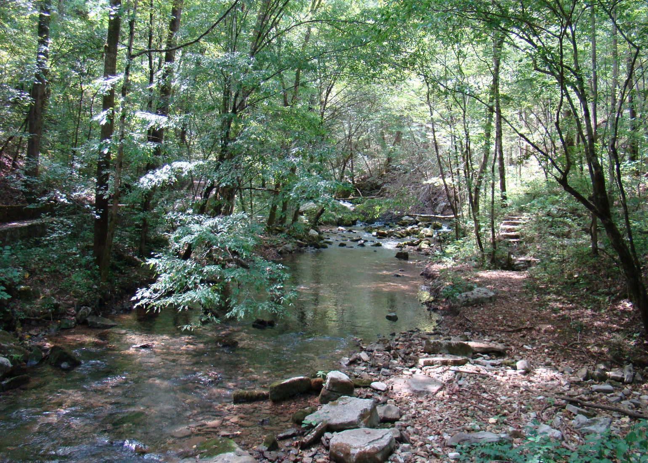

Arkansas Forestry Commission
U of A
Cooperative
Extension Service
September 21-23,
2010
2010 NPS 319(h) Project Review

Slide 2
Arkansas Silvicultural NPS Project
Project # 08-700
Technical & Non-Technical BMP Training
Courtesy Exams
Logger/Landowner Forestry Conference
AFC BMP Guideline Books and Materials
AFC Silviculture 7th BMP Assessment

Slide 3
Silvicultural BMP Assessment
Previous BMP Implementation Averages
  2005-2006: 88%
  2007-2008: 86%
  2010 – 2011: In Progress

Slide 4
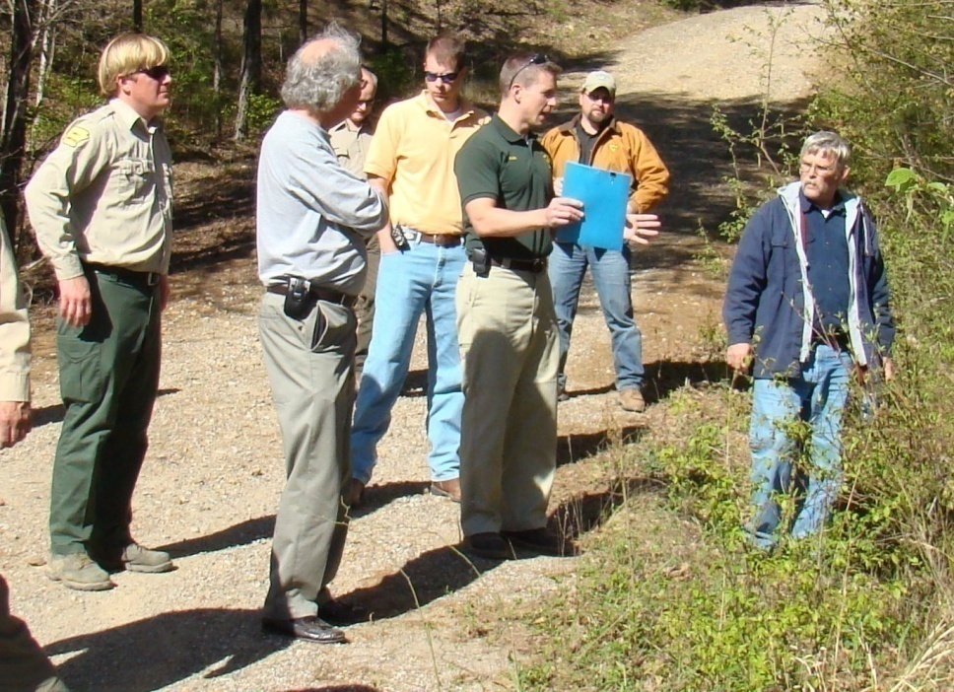
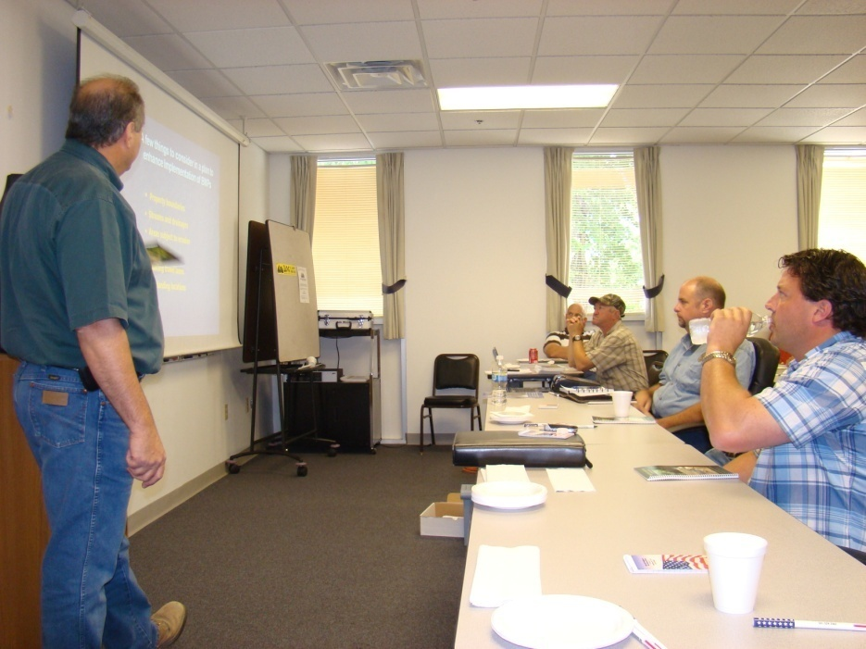
Technical and Non-technical Training
Technical BMP Training
  Loggers and Foresters
  27 Workshops with 809 Trainees

Slide 5
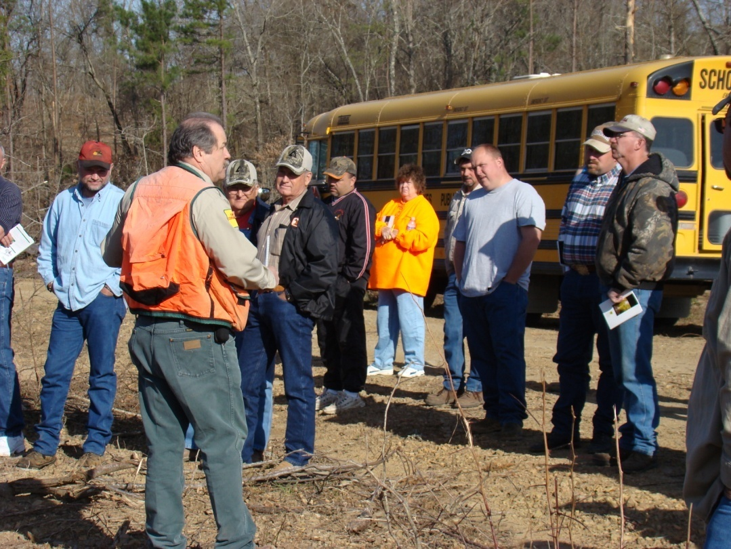
Technical and Non-Technical Training
Non-Technical BMP Training
  Increase Landowner Awareness
  6 Workshops with 318 Landowners Attending

Slide 6
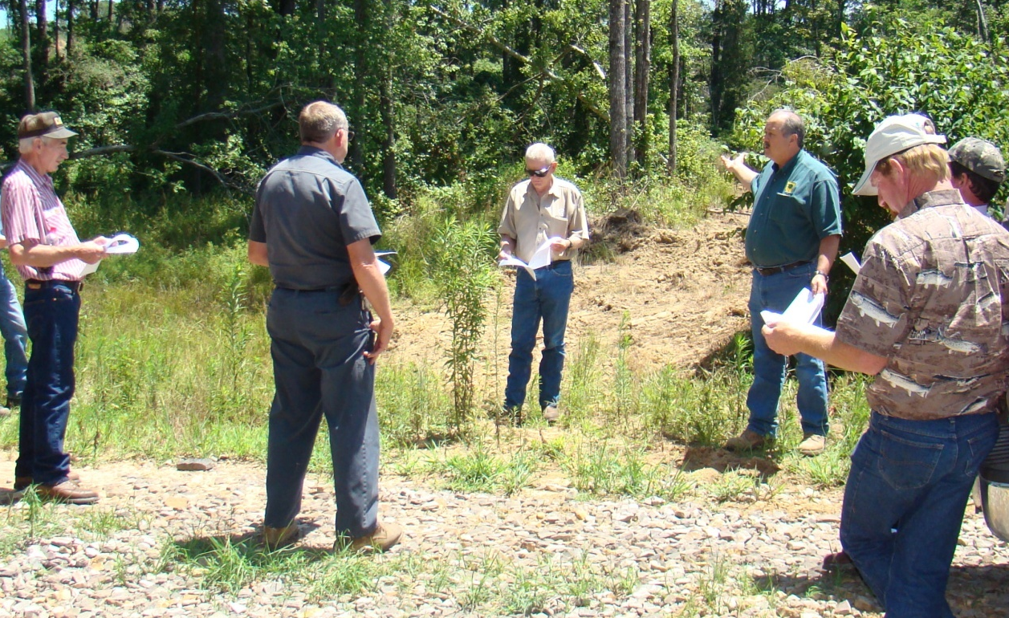
Courtesy Exams
Program Taking Root
  Site Specific Training
  12 Sessions with 81 Foresters, Loggers and Landowners

Slide 7
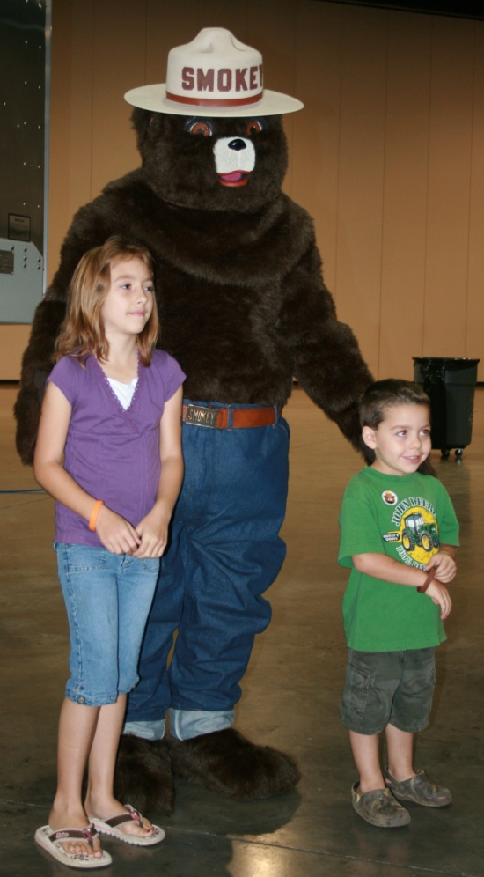
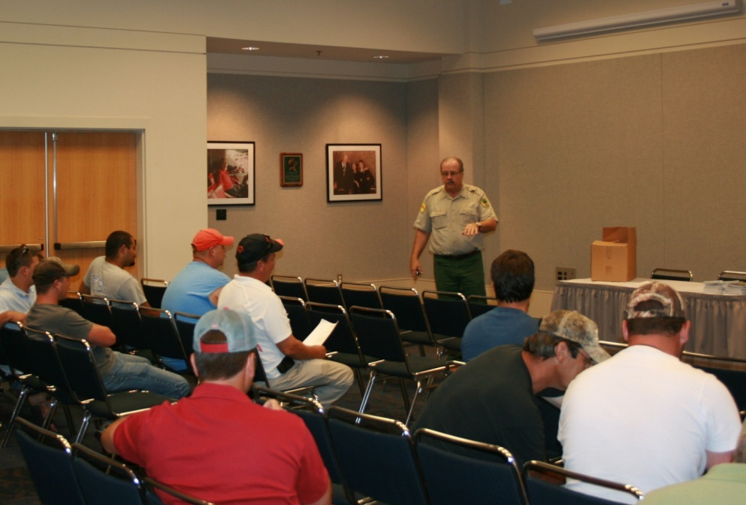
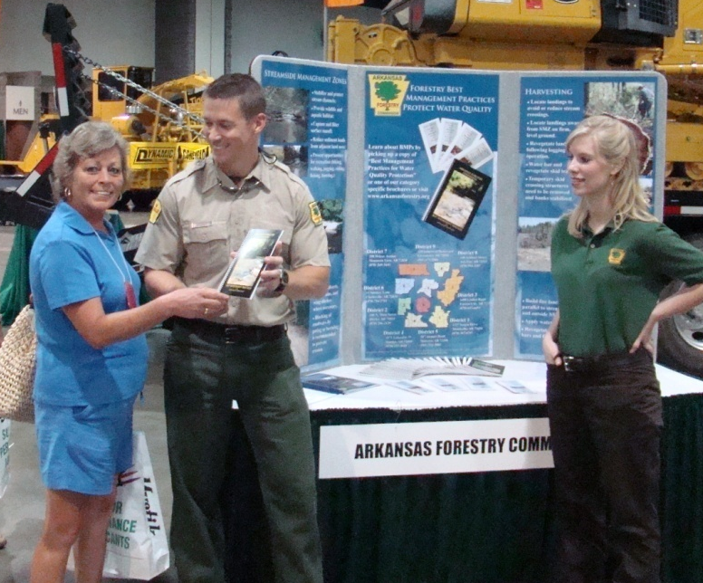
Southwest Forest Products Exposition/Conference

Slide 8

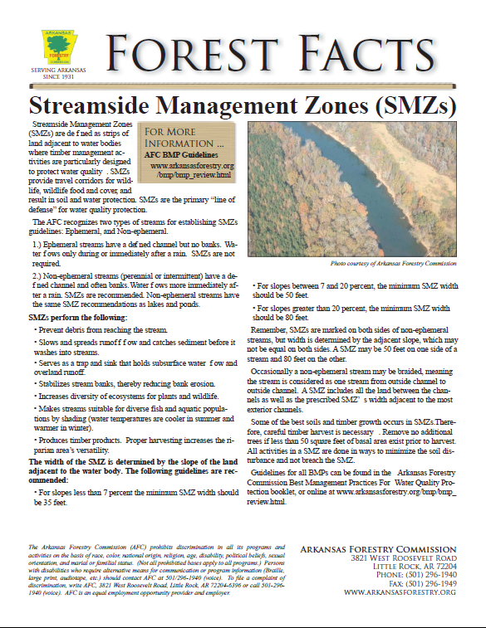
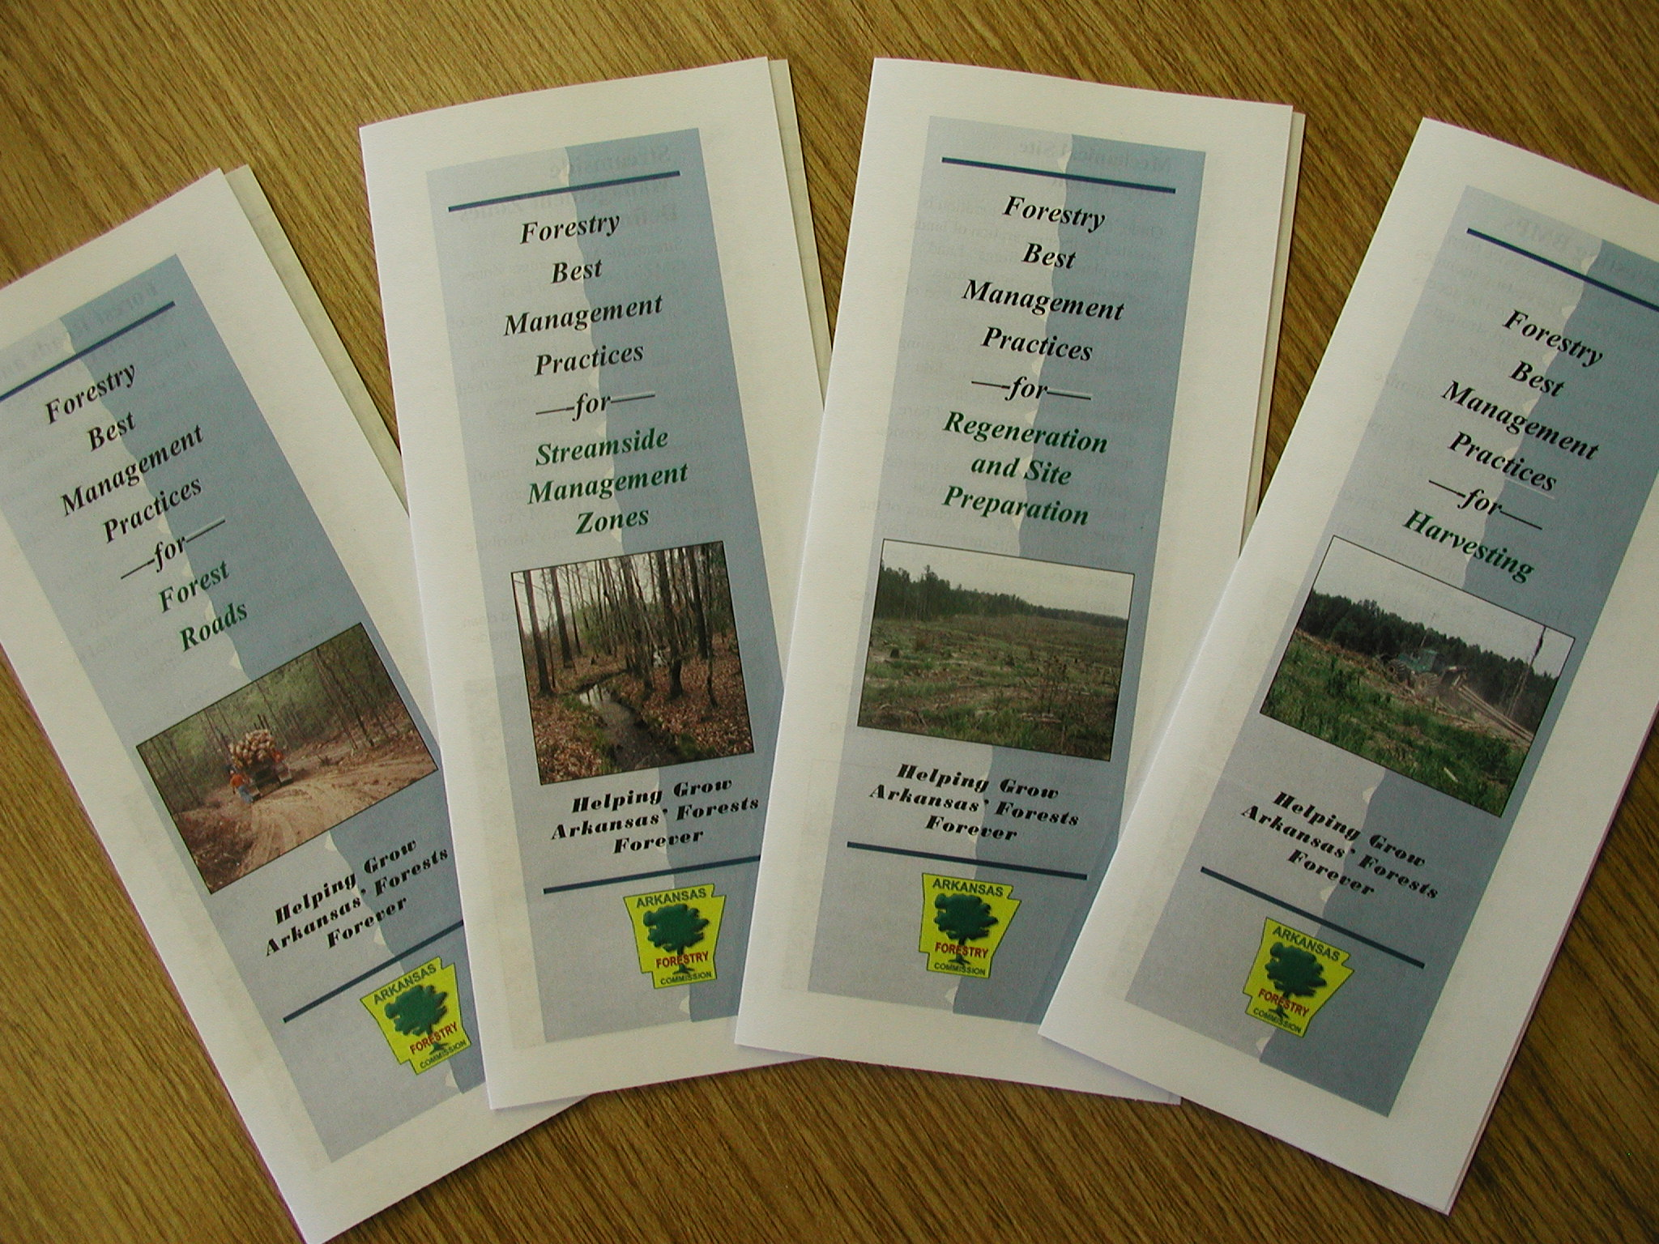

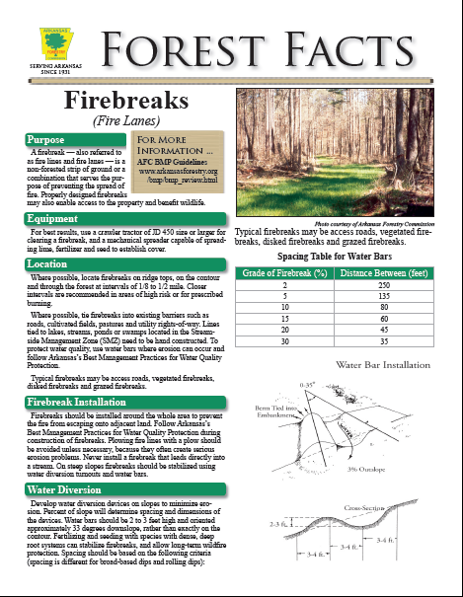
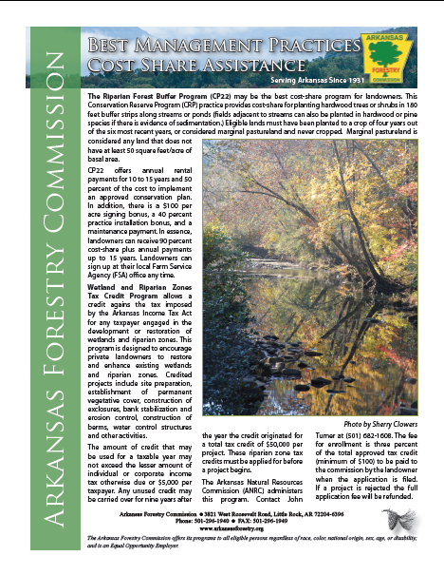
BMP Guideline Book & Materials

Slide 9
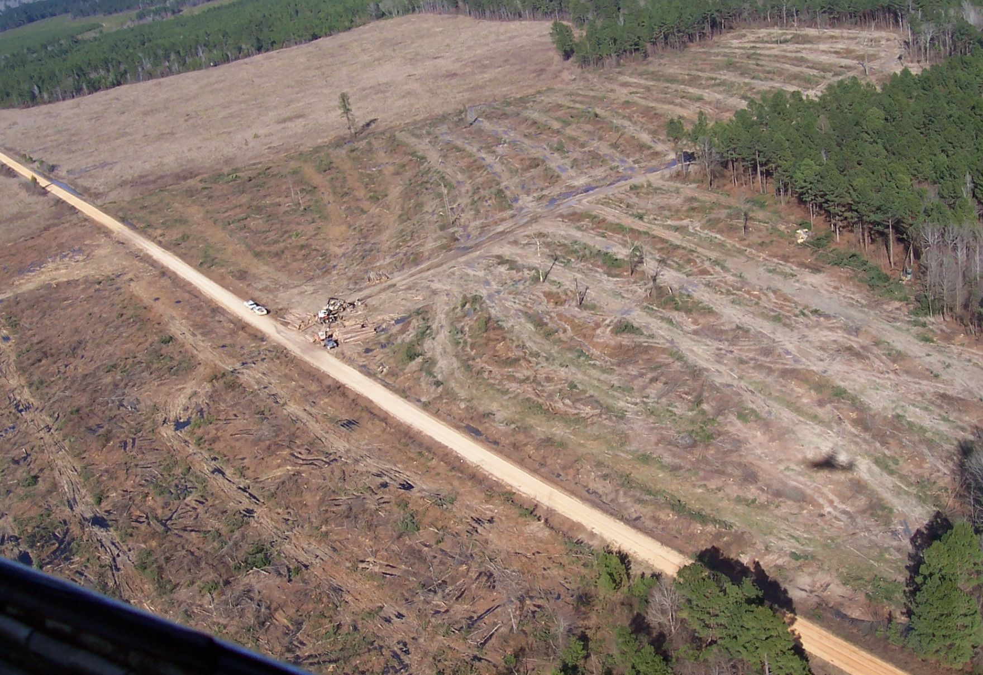
Silviculture BMP Assessment

Slide 10
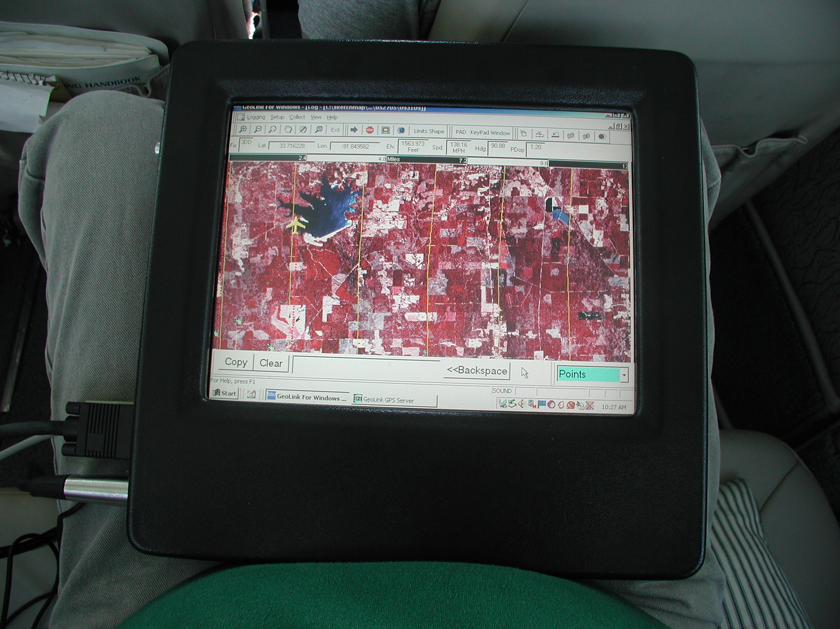
Silviculture BMP Assessment

Slide 11
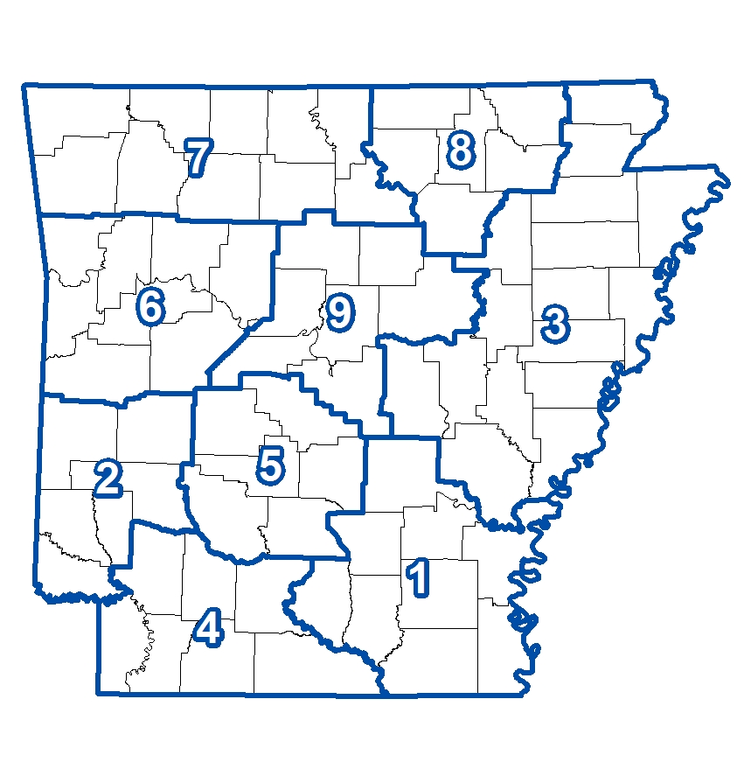
Silviculture BMP Assessment

Slide 12
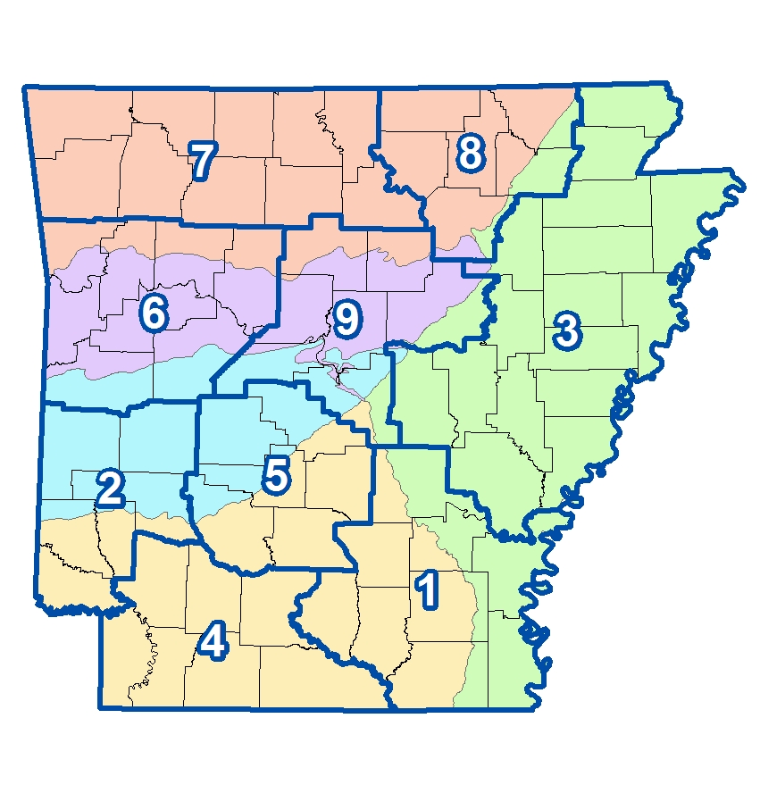
Silviculture BMP Assessment

Slide 13
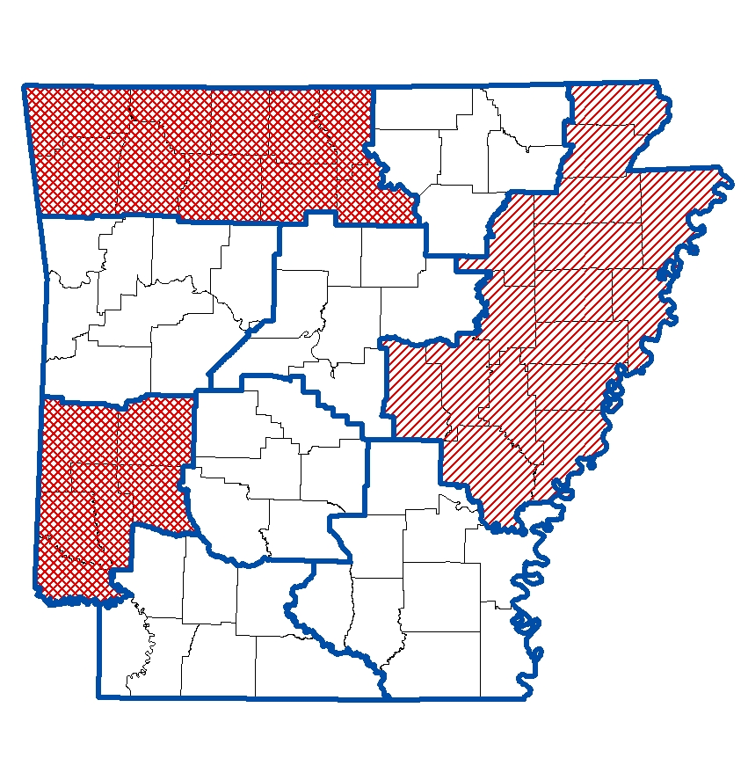
Silviculture BMP Assessment

Slide 14
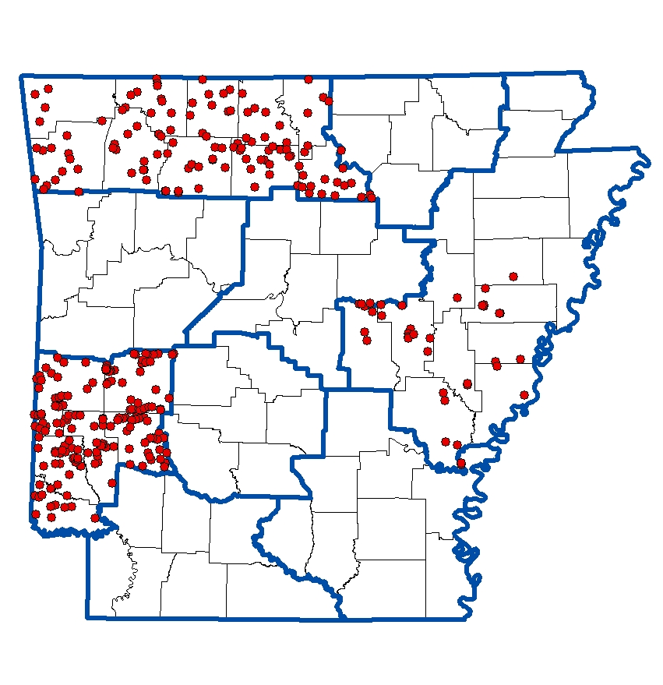
Silviculture BMP Assessment

Slide 15

Silviculture BMP Assessment

Slide 16
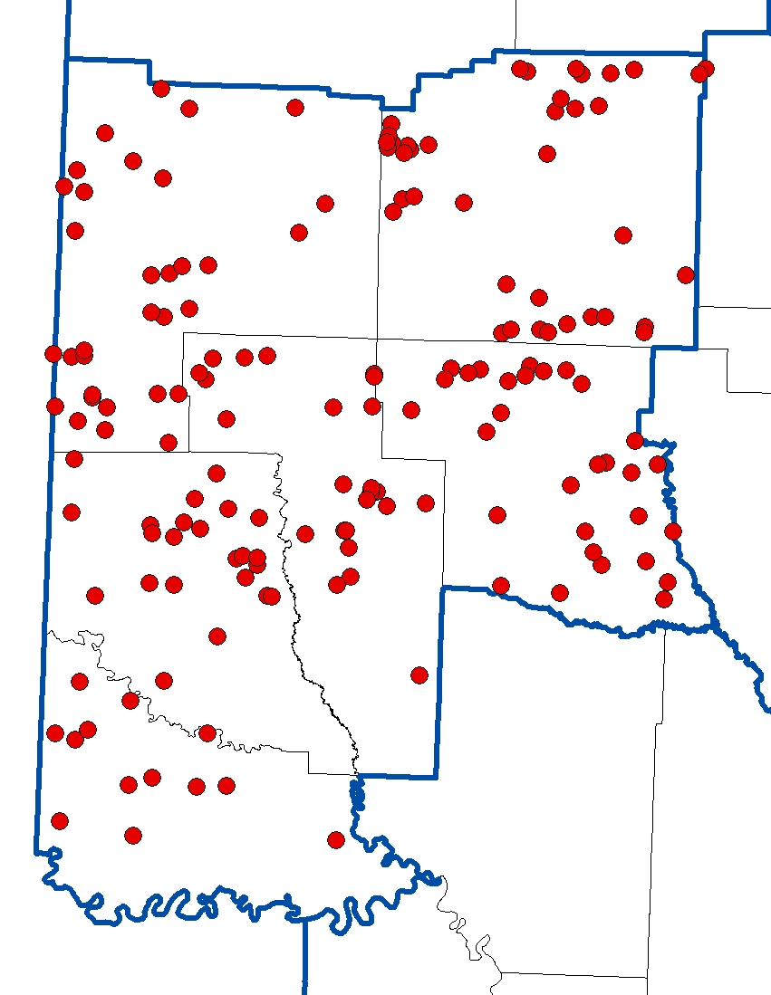
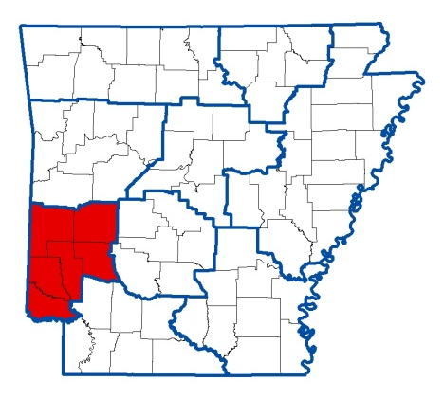
Silviculture BMP Assessment

Slide 17
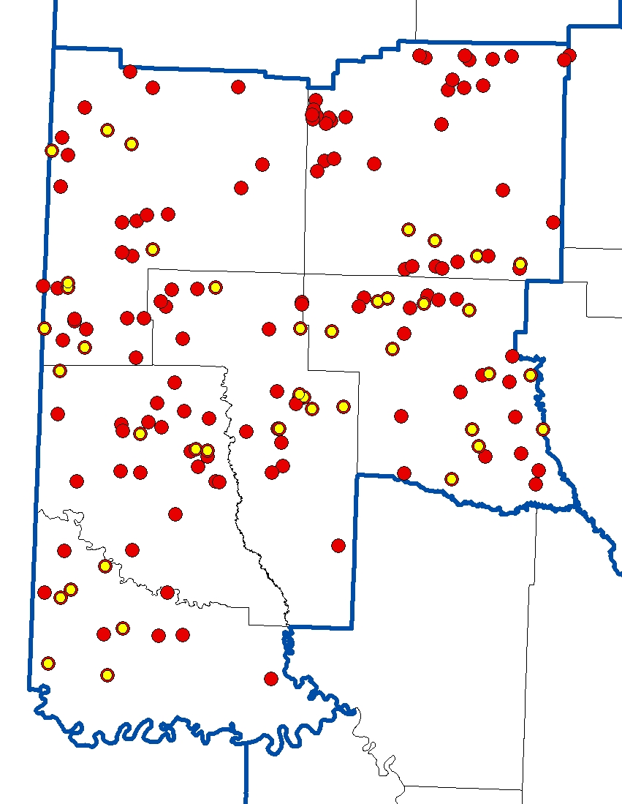
Silviculture BMP Assessment

Slide 18
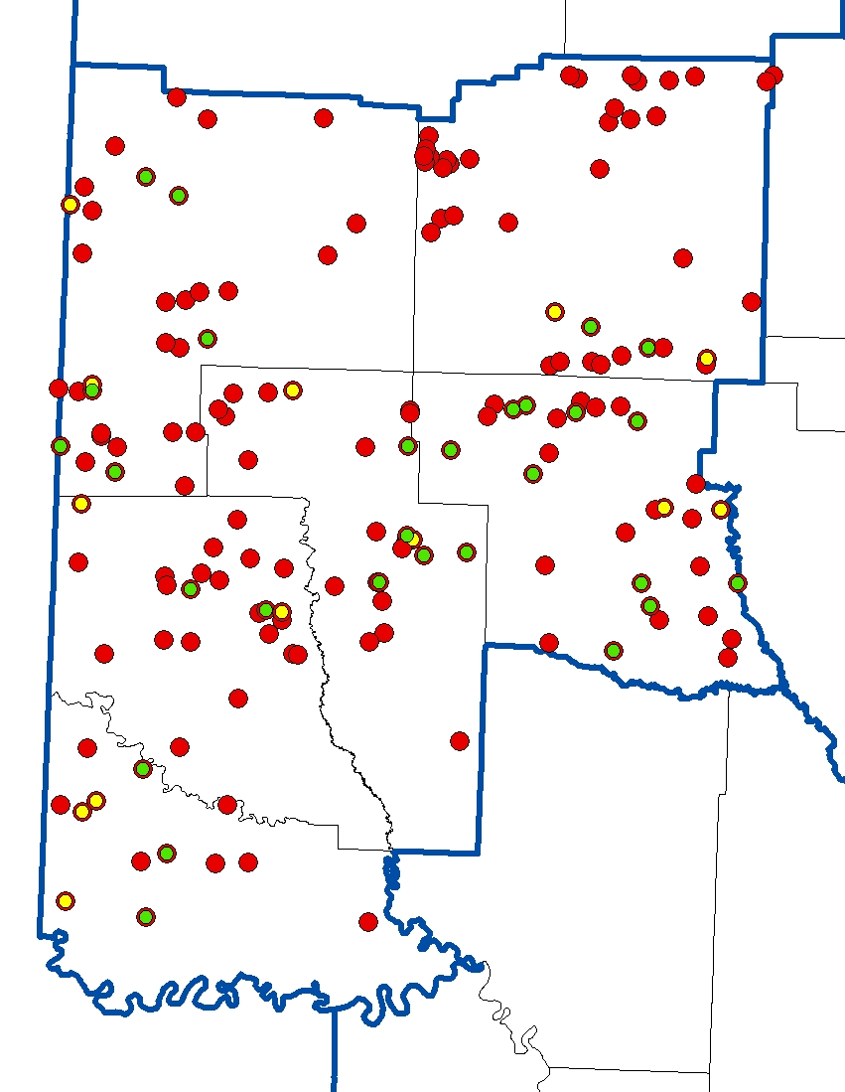
Silviculture BMP Assessment
BMP Category | # of Sites | Implementation Rate (%)
SMZ | 22 | 78.18
Roads | 26 | 90.09
Harvesting | 28 | 94.51
Regeneration | 9 | 100
TOTAL | 28 | 88.73 (ME=5.19)

Slide 19
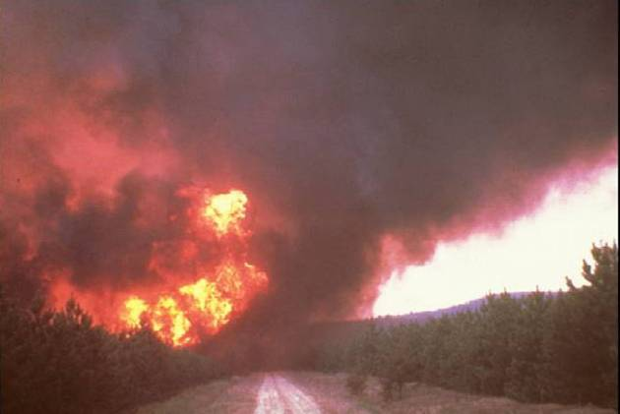
Obstacles Encountered
Courtesy Exams – Trust, Reduced Harvesting
BMP Assessment – New Hire, High Fire Danger

Slide 20





Acknowledgements
Arkansas Natural Resource Commission
Environmental Protection Agency,
Region 6
Arkansas Timber Producers Association
Arkansas Forestry Association
School of Forest Resources

Slide 21
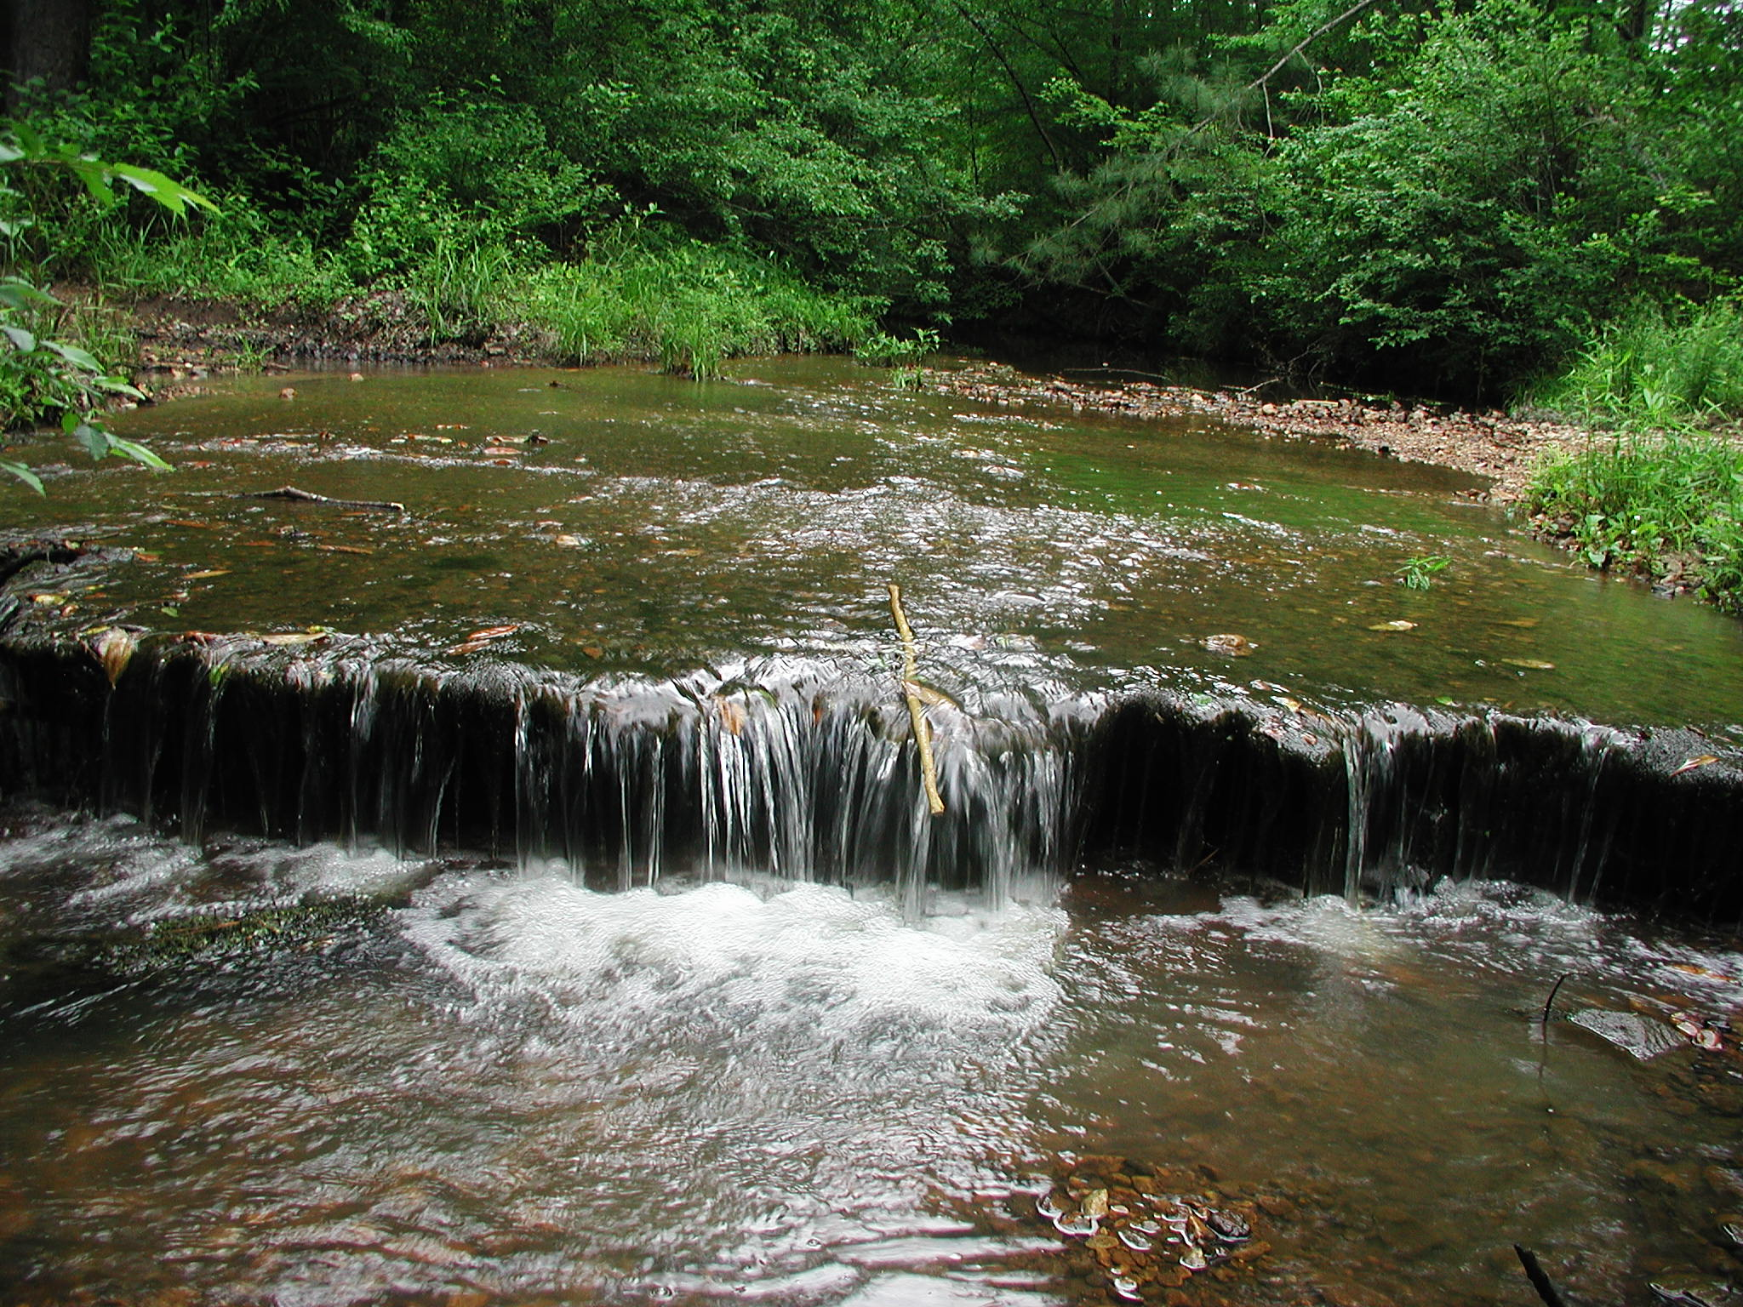

Arkansas Forestry Commission
Questions?
www.arkansasforestry.org
Arnold Hameister Brad Ostrom
AFC BMP Coordinator AFC BMP Specialist

