Slide 1
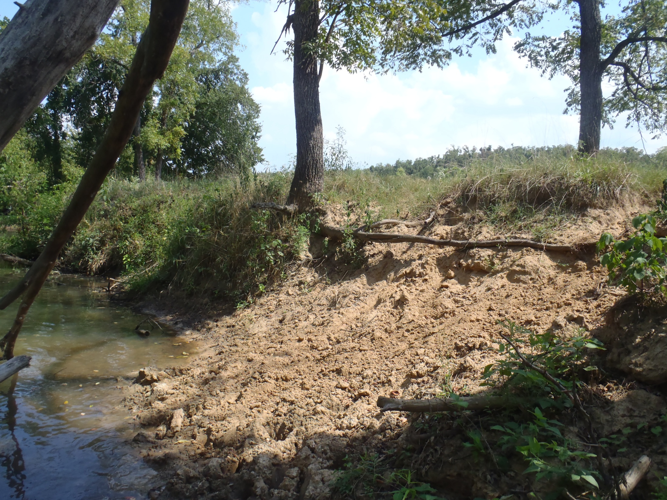
Year Two Review of Water Quality Monitoring on the Upper Strawberry River
Project 07-1000
T.R. Brueggen¹and J.L. Bouldin^{1,2}
¹ Environmental Sciences Graduate Program, Arkansas State University, State University, AR 72467
²Department of Biological Sciences, Arkansas State University, State University, AR 72467

Slide 2
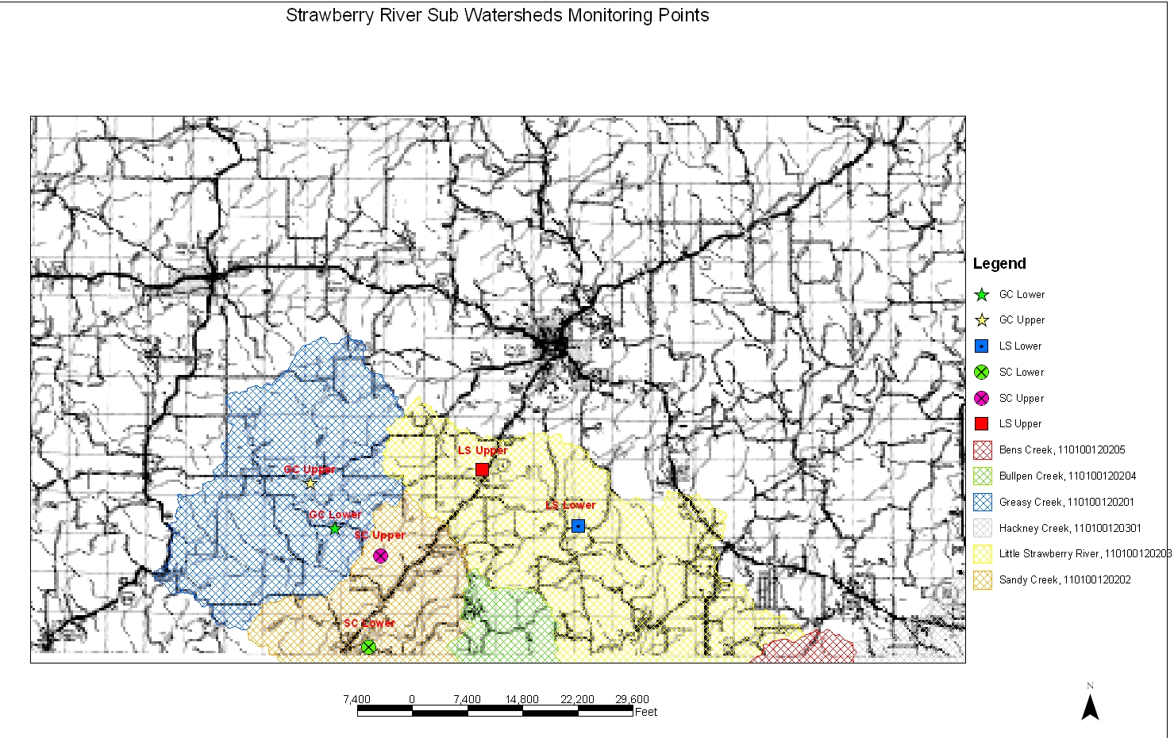
Sampling sites
Fulton County
Salem
Greasy Creek
Little Strawberry
Sandy Creek

Slide 3
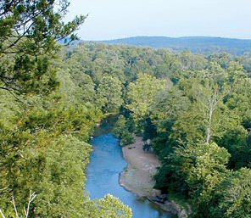
Overview
Major headwater streams in the upper Strawberry River watershed
  Little Strawberry (LS)
  Sandy Creek (SC)
  Greasy Creek (GC)
Above and below BMP
implementation
Surface Water Quality Tests
  Nutrients
    Nitrites
    Nitrates
    Ortho-Phosphates
  Total Suspended Solids
http://arkansas-dar.org/strawberryriver.htm

Slide 4
Little Strawberry River Subwatershed
Largest subwatershed of the Strawberry River

Slide 5
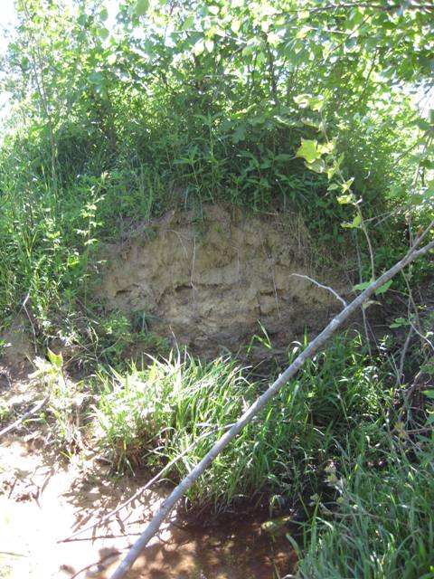
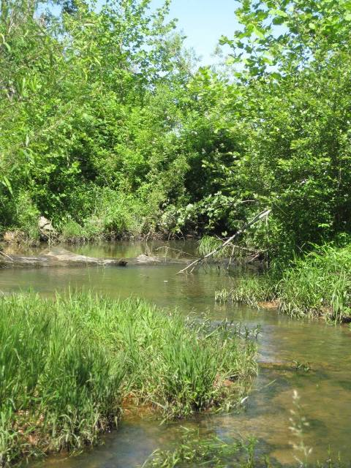
Little Strawberry Upper

Slide 6
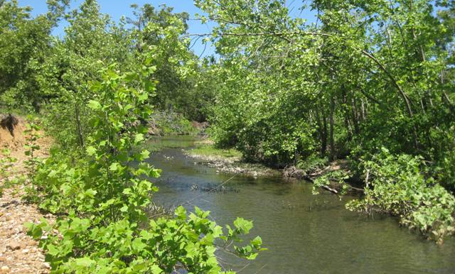
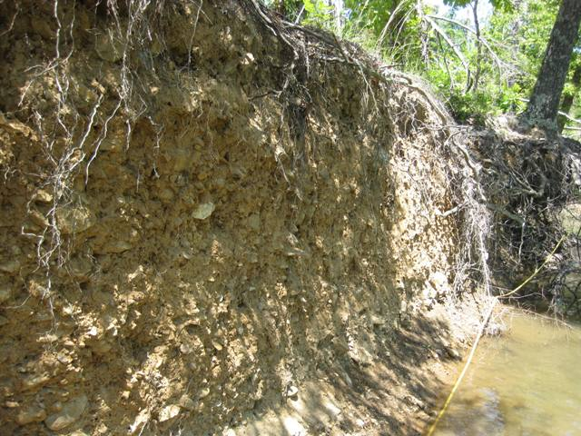
Little Strawberry
Lower

Slide 7
Little Strawberry (LS) NO_{X} Data
Upper
Lower

Slide 8
Little Strawberry (LS) Ortho-Phosphate Data
Upper
Lower

Slide 9
Little Strawberry Total Suspended Solid (TSS) Data
Upper
Lower

Slide 10
Greasy Creek Subwatershed
2nd largest subwatershed of the Strawberry River

Slide 11
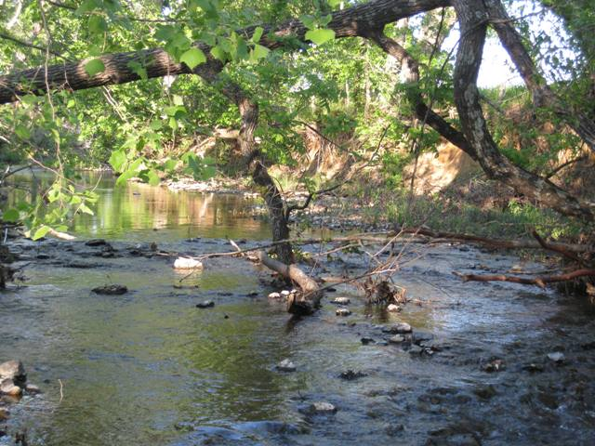
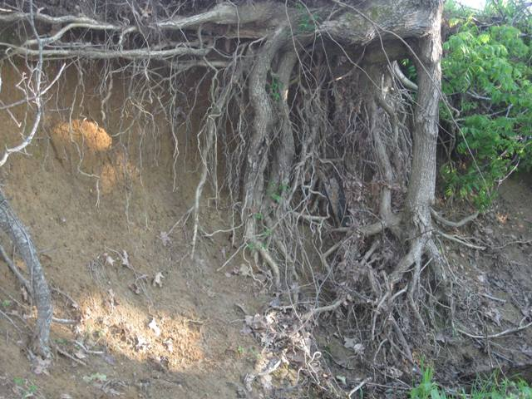
Greasy Creek Upper

Slide 12
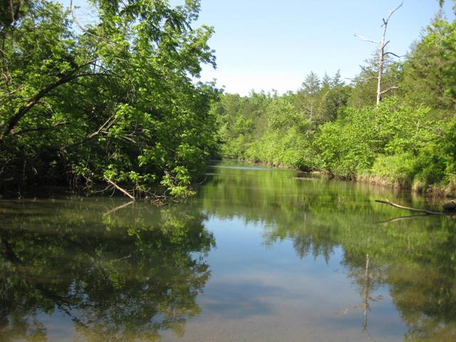
Greasy Creek Lower

Slide 13
Greasy Creek (GC) NO_{X} Data
Upper
Lower

Slide 14
Greasy Creek (GC) Ortho-Phosphate Data
Upper
Lower

Slide 15
Greasy Creek (GC) Total Suspended Solid (TSS) Data
Upper
Lower

Slide 16
Sandy Creek Subwatershed
Smallest subwatershed of the Strawberry River

Slide 17
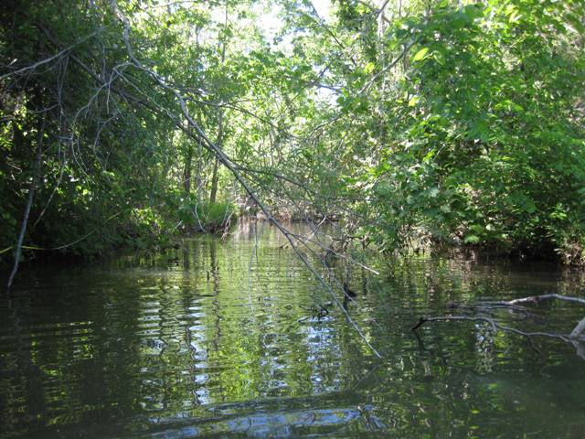
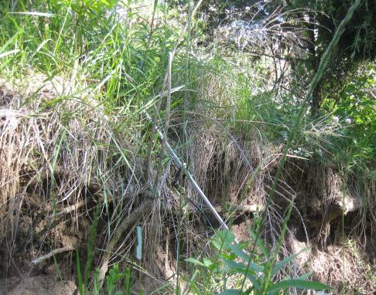
Sandy Creek
Upper

Slide 18
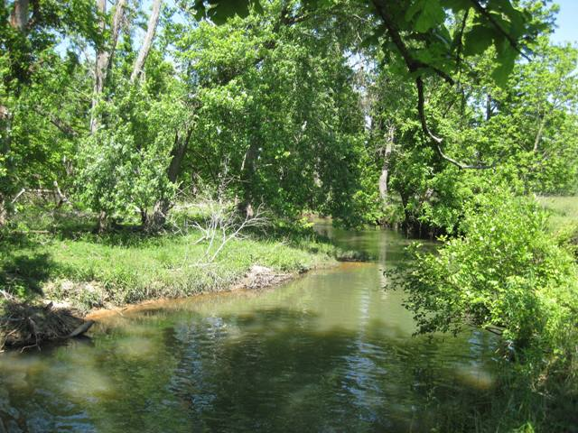
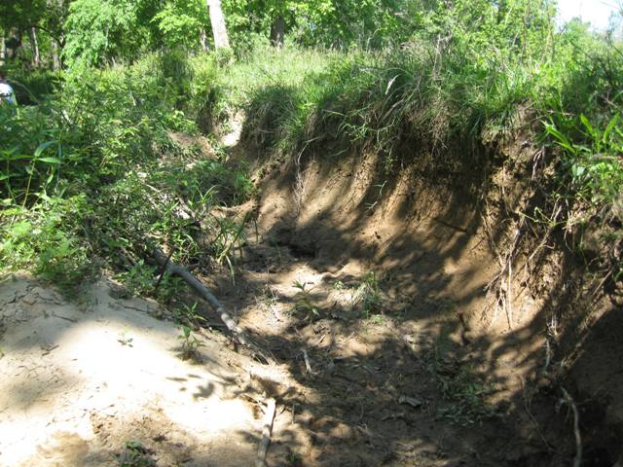
Sandy Creek
Lower

Slide 19
Sandy Creek (SC) NO_{X} Data
Upper
Lower

Slide 20
Sandy Creek (SC) Ortho-Phosphate Data
Upper
Lower

Slide 21
Sandy Creek (SC) Total Suspended Solid (TSS) Data
Upper
Lower

Slide 22
High and Mean Values:
Pre-BMP 2008, 2009, 2010
Nitrate (mg/L)
 | Pre-BMP |  | 2009 |  | 2010 (thru July)
Site | High | Mean | High | Mean | High | Mean
LSUP | 2.05 | 0.76 | 1.34 | 0.67 | 1.54 | 0.97
LSLO | 2.37 | 0.56 | 0.90 | 0.58 | 1.18 | 0.70
GCUP | 0.67 | 0.29 | 0.69 | 0.30 | 0.48 | 0.29
GCLO | 1.28 | 0.29 | 0.73 | 0.34 | 0.71 | 0.44
SCUP | 2.30 | 0.46 | 1.11 | 0.40 | 0.83 | 0.44
SCLO | 0.74 | 0.31 | 0.54 | 0.27 | 0.73 | 0.42

Slide 23
High and Mean Values:
Pre-BMP 2008, 2009, 2010
Nitrite (mg/L)
 | Pre-BMP |  | 2009 |  | 2010
Site | High | Mean | High | Mean | High | Mean
LSUP | 0.16 | 0.16 | BDL | BDL | BDL | BDL
LSLO | BDL | BDL | BDL | BDL | BDL | BDL
GCUP | BDL | BDL | BDL | BDL | BDL | BDL
GCLO | BDL | BDL | BDL | BDL | BDL | BDL
SCUP | 0.13 | 0.13 | BDL | BDL | BDL | BDL
SCLO | BDL | BDL | BDL | BDL | BDL | BDL

Slide 24
High and Mean Values:
Pre-BMP 2008, 2009, 2010
Ortho-phosphate (mg/L)
 | Pre-BMP |  | 2009 |  | 2010
Site | High | Mean | High | Mean | High | Mean
LSUP | 0.18 | 0.04 | 0.11 | 0.05 | 0.06 | 0.04
LSLO | 0.06 | 0.01 | 0.12 | 0.05 | 0.09 | 0.04
GCUP | 0.05 | 0.02 | 0.08 | 0.02 | 0.05 | 0.03
GCLO | 0.08 | 0.03 | 0.13 | 0.05 | 0.05 | 0.03
SCUP | 0.05 | 0.03 | 0.13 | 0.05 | 0.05 | 0.03
SCLO | 0.04 | 0.02 | 0.14 | 0.05 | 0.06 | 0.03

Slide 25
High and Mean Values:
Pre-BMP 2008, 2009, 2010
TSS (mg/L)
 | Pre-BMP |  | 2009 |  | 2010
Site | High | Mean | High | Mean | High | Mean
LSUP | 26.6 | 4.2 | 55.8 | 7.6 | 6.7 | 3.3
LSLO | 41.3 | 5.0 | 20.0 | 4.6 | 8.9 | 3.9
GCUP | 14.3 | 2.4 | 16.6 | 4.4 | 4.4 | 3.1
GCLO | 13.9 | 4.4 | 14.6 | 5.2 | 15.2 | 6.7
SCUP | 71.4 | 8.8 | 36.6 | 7.1 | 5.8 | 2.8
SCLO | 29.3 | 4.6 | 8.8 | 3.5 | 14.0 | 5.7

Slide 26
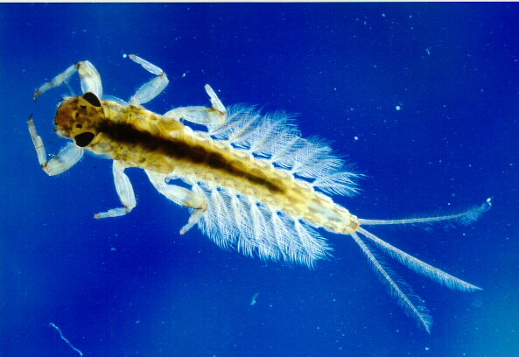
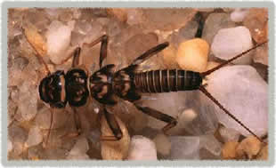
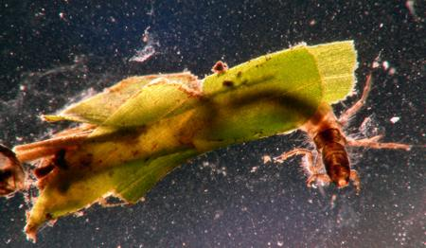
Other Analyses
Stream bank erosion
Benthic macroinvertebrate survey
Escherichia coli
Supported by 104-B Grant: AWRC and Arkansas State University
http://www.famu.org/mayfly/images/pluteus_nym.jpg
http://www.esf.edu/rwls/Research/Benthic/ACRONE1-1.jpg
http://www.lifeinfreshwater.org.uk/species%20pages/caddis%20flies.jpg.html

Slide 27
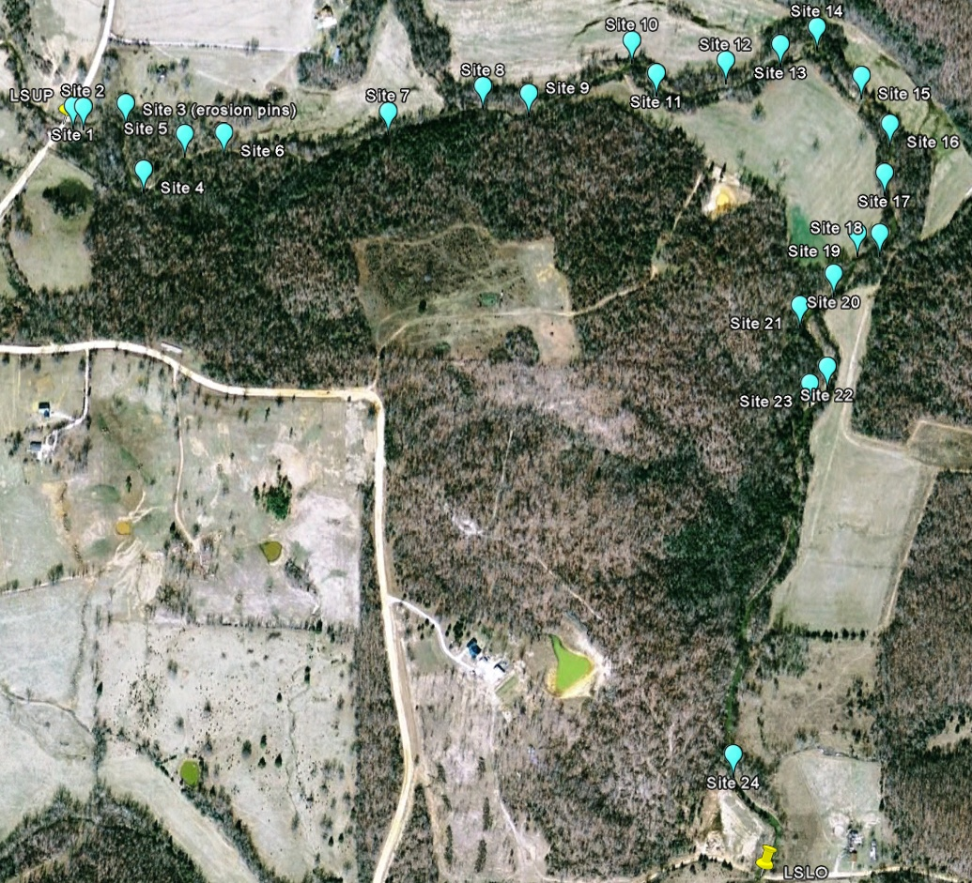
Little Strawberry
  ≈2.74 km (1.7 miles) surveyed
  24 sites determined of severe or very severe erosion

Slide 28
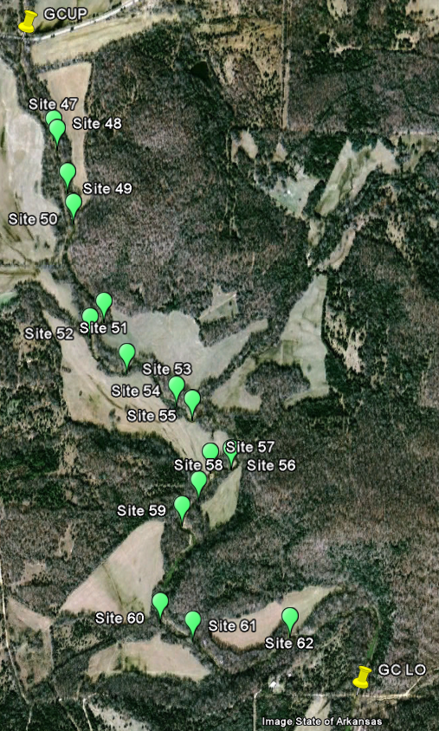
Greasy Creek
  ≈3.17 km (2.0 miles) surveyed
  16 sites determined of severe or very severe erosion

Slide 29
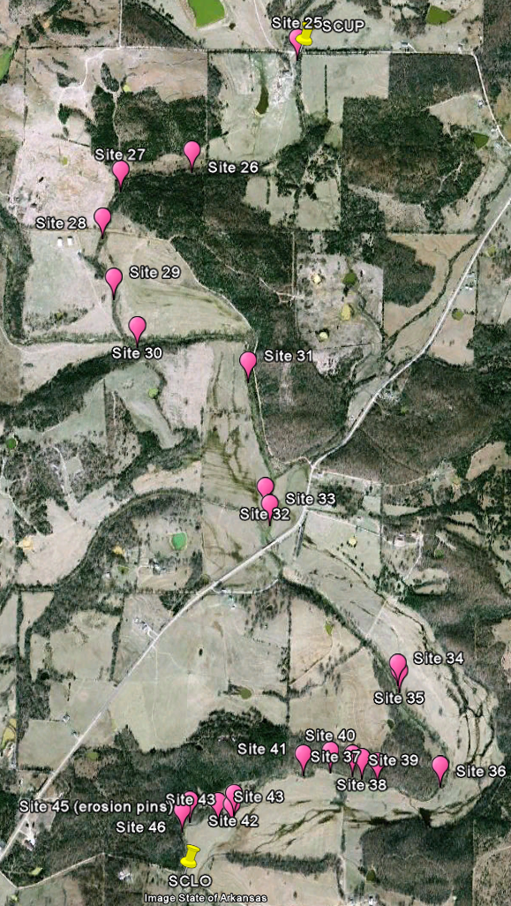
Sandy Creek
  ≈6.63 km (4.1 miles) surveyed
  22 sites determined of severe or very severe erosion

Slide 30
Benthic Macroinvertebrates Abundance
Spring 2009
Low: SCLO (21)
High: GCLO (456)
Fall 2009
Low: SCLO (135)
High: LSUP (295)

Slide 31
Ephemeroptera, Plecoptera and Trichoptera (EPT)
1 or less: POOR
Between 2 and 5: MODERATE
More than 5: GOOD
Fall 2009

Slide 32
Escherichia coli

Slide 33
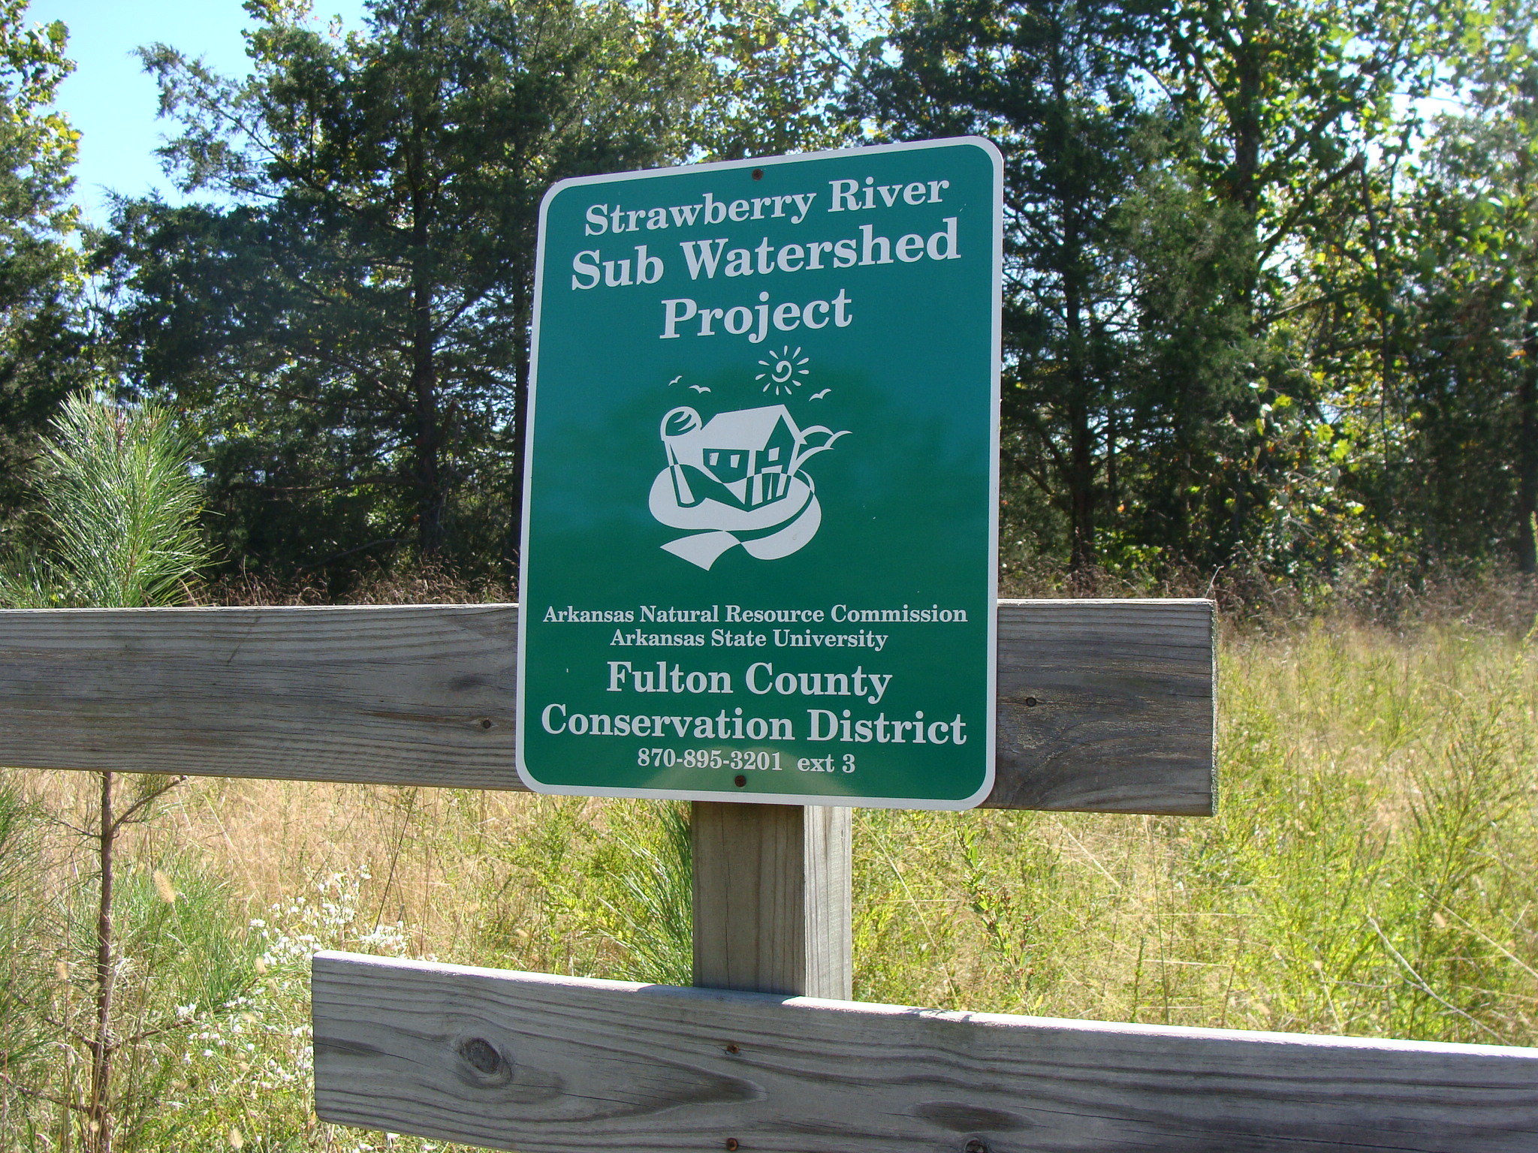
Questions?

