Slide 1
Water Quality Monitoring on Larkin Creek
St. Francis County, AR
JL Bouldin
RA Warby
Arkansas State University

Slide 2
Background
Larkin Creek is a tributary of the L’Anguille River
  dominated by row crop agriculture.
L’Anguille River is a tributary of the St. Francis River in eastern Arkansas in the Delta ecoregion
ADEQ authorized the St. Francis County Conservation District to implement BMPs to reduce pollutant loading to L’Anguille

Slide 3
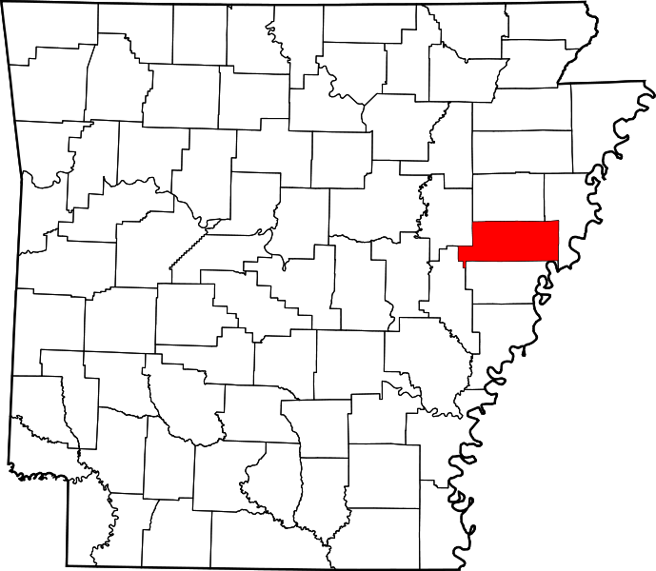
Site description
St. Francis County
Lateral 1-A of Larkin Creek
  Tributary of the L’Anguille River
  HUC#080202050506

Slide 4
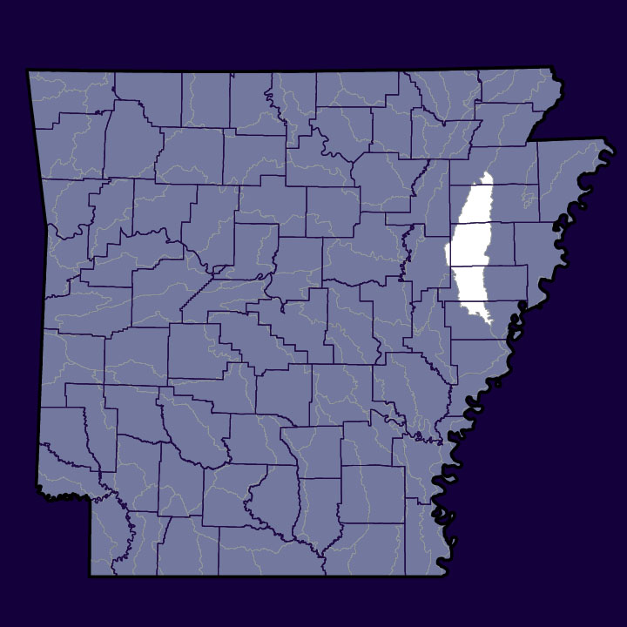
Site description
St. Francis County

Slide 5
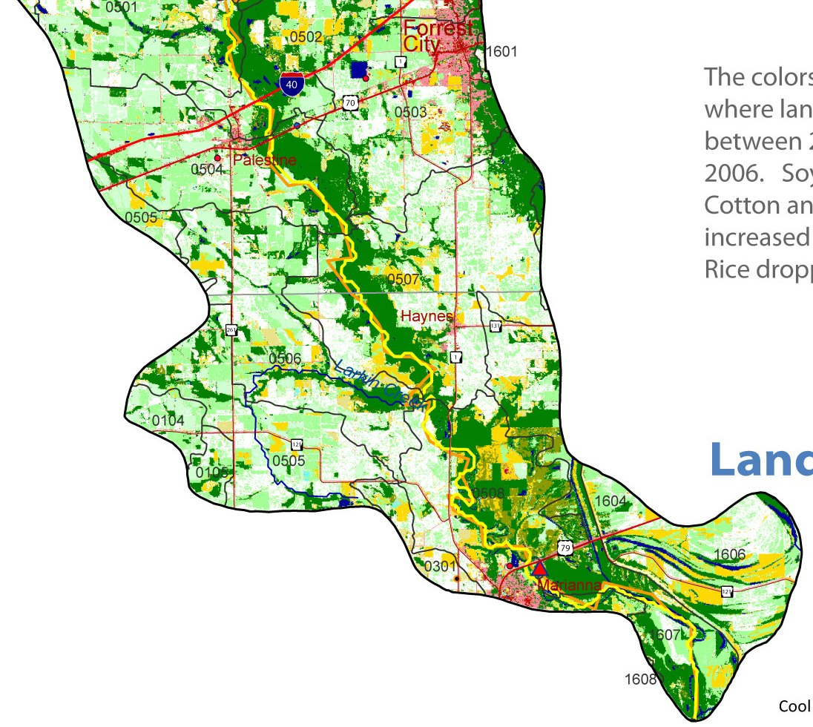
Site description
Lateral 1-A of Larkin Creek
  Tributary of the L’Anguille River
  HUC#080202050506

Slide 6
BMPs
St. Francis County Conservation District
sediment pond construction
plant riparian buffers
remove sediment
restore the channel
  Lateral 1-A of Larkin Creek
L’Anguille River
Agricultural activities cited as major cause of the impairment within watershed
  excessive turbidity from silt, suspended solids loading, sedimentation

Slide 7
Objectives
Determine baseline data prior to BMP implementation
Weekly grab samples
Total Suspended Solids
pH
Dissolved Oxygen
Nutrients
  Nitrate, Nitrite, Orthophosphate

Slide 8
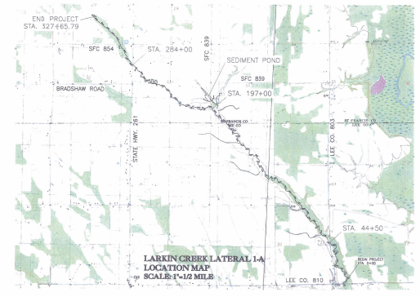

Slide 9
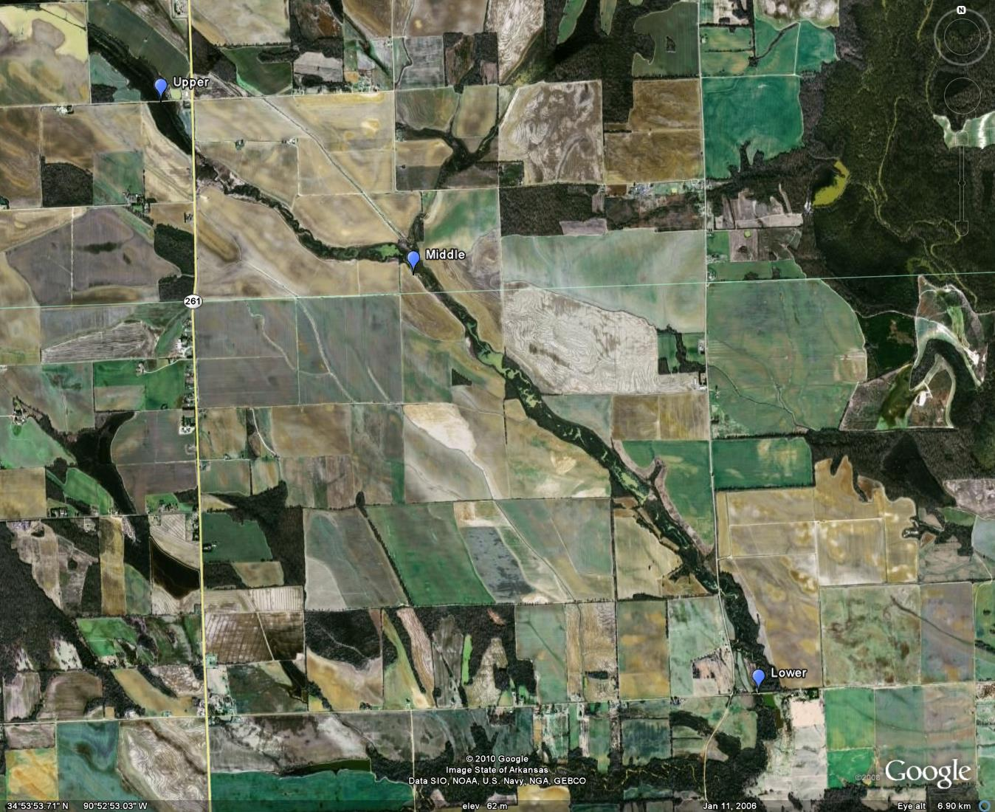

Slide 10
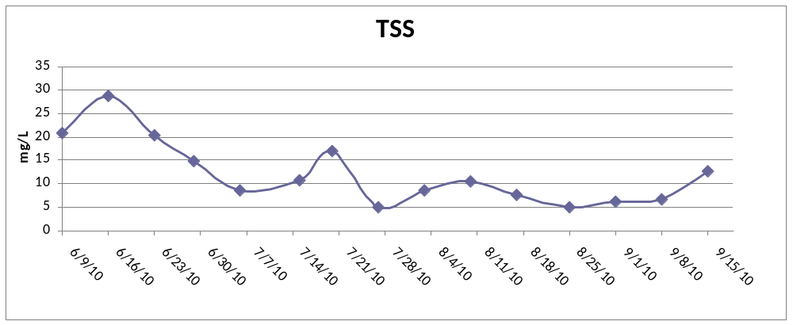
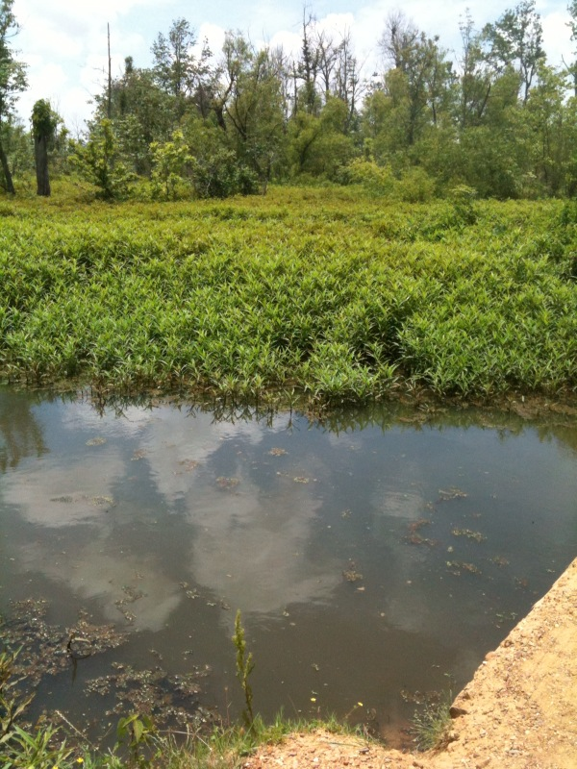
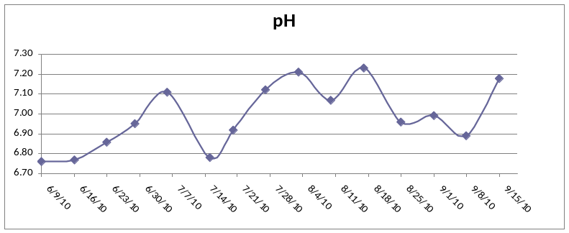
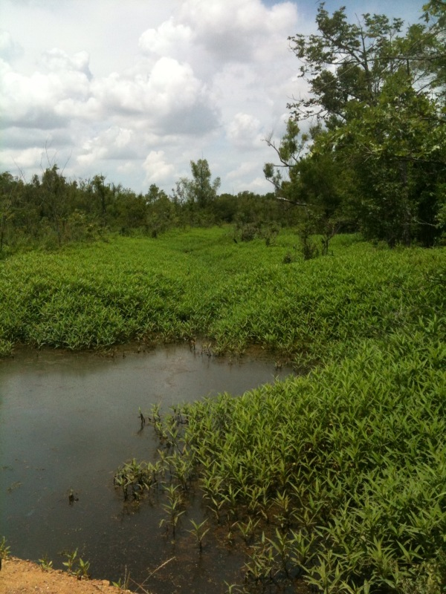
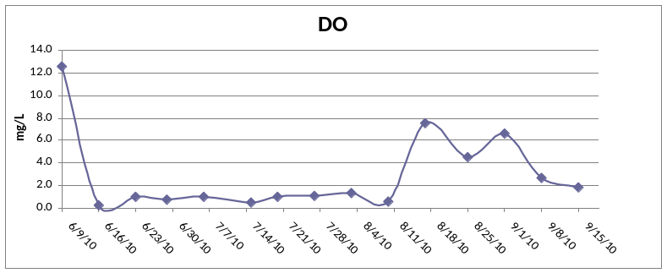
Upper Larkin Creek site
Upstream
Downstream

Slide 11
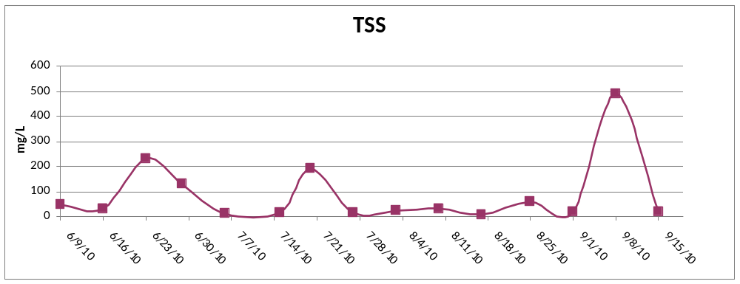
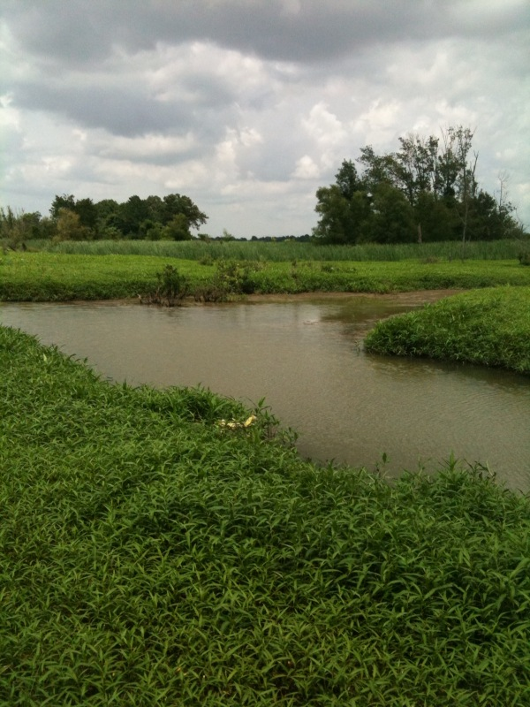
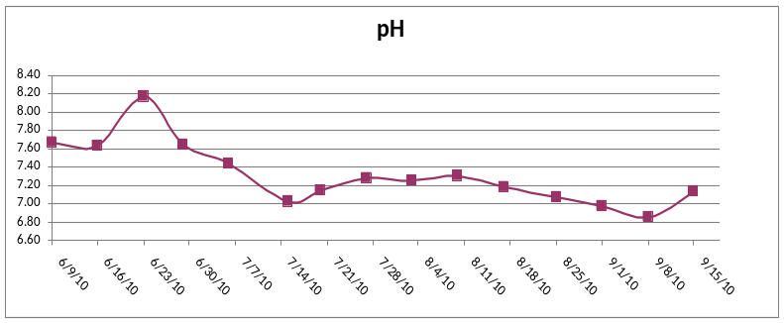
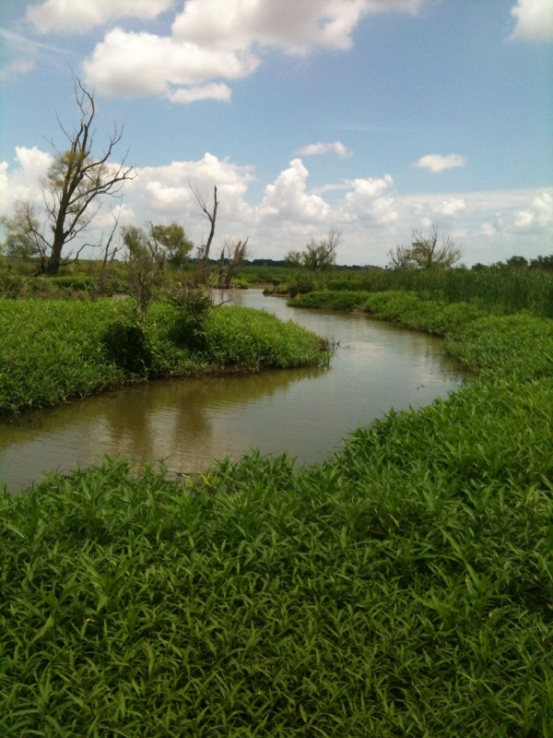
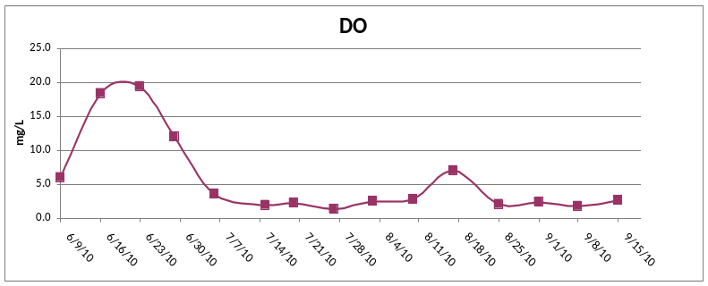
Middle Larkin Creek site
Upstream
Downstream

Slide 12
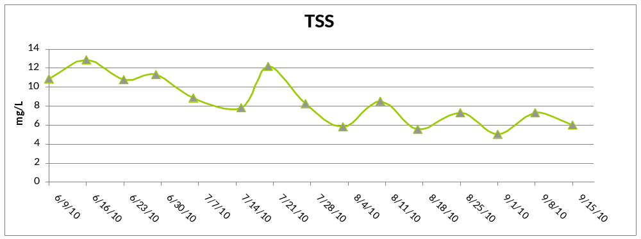
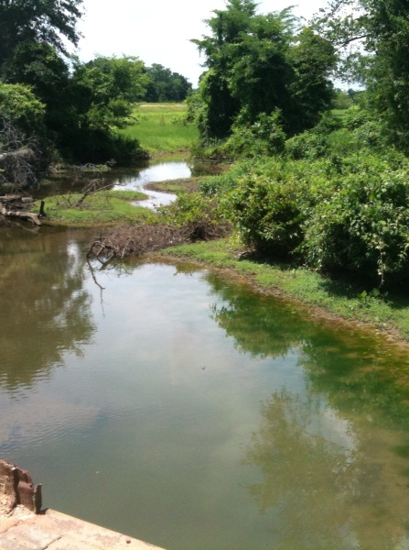
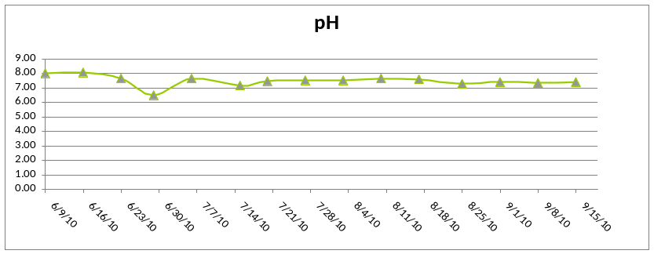
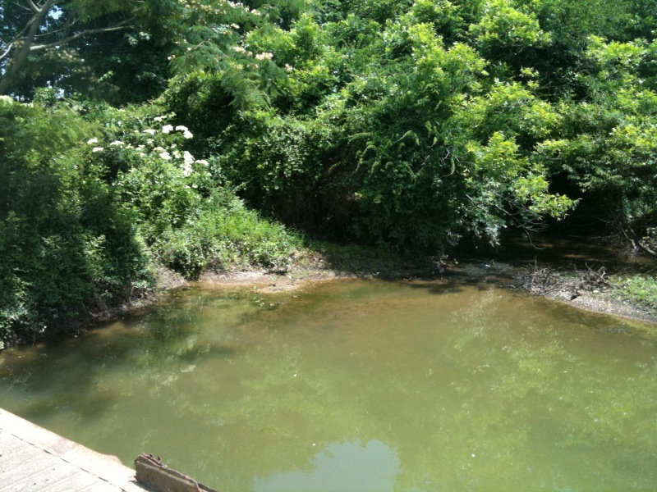
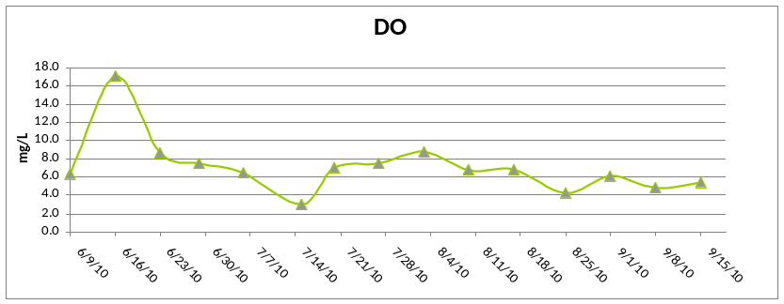
Lower Larkin Creek site
Upstream
Downstream

Slide 13
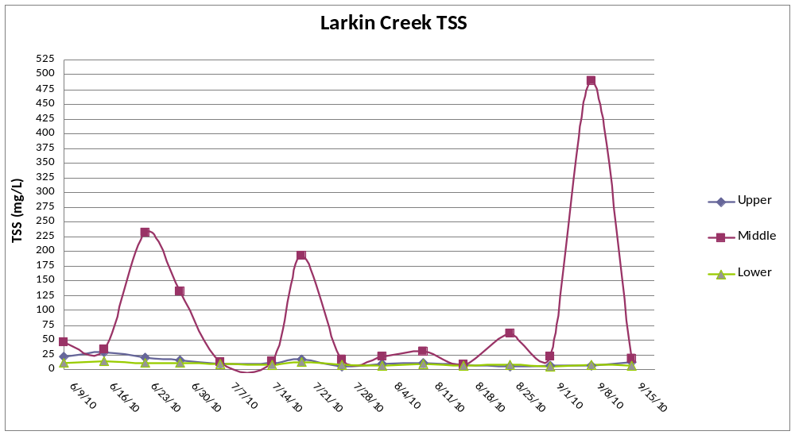
TSS at all sites

Slide 14
Preliminary results
TSS highest at Middle Site
  Especially following rain events
  Will benefit from upstream sedimentation pond
pH lowest at Upper and Middle sites from temporary acidification following rain events
DO high due to increased primary production and early afternoon sampling times
Final sampling and nutrient data pending

Slide 15
Questions?
Upper Larkin Creek
Middle Larkin Creek
Lower Larkin Creek

