Slide 1

SWAT Model Study for
Illinois River Drainage Area (IRDA) in Arkansas
Presented by:
Dharmendra Saraswat
Co-Authors: M. Daniels, P. Tacker, and N. Pai
ANRC 2009 NPS Project Review Meeting, Sept. 16
Cooperative Extension Service

Slide 2
INTRODUCTION
Illinois River Watershed:
757 mi² (1960 km² )
Counties: Benton (39.5%), Washington (60.3%), and Crawford (0.2%)
Concern: siltation/turbidity, pathogens, total phosphorus, and nitrogen
ANRC 2009 NPS Project Review Meeting, Sept. 16
Cooperative Extension Service

Slide 3
OBJECTIVE
The study was conducted to:
Organize input data for the Soil and Water Assessment Tool (SWAT) model setup
Calibrate and validate the SWAT model for flow, sediment, and nutrients
Use model outputs to identify 12-digit hydrologic unit code (HUC) watersheds based on their contribution to sediment and nutrients
ANRC 2009 NPS Project Review Meeting, Sept. 16
Cooperative Extension Service

Slide 4

POINT TO REMEMBER
MODEL IS AN ABSTRACTION OF REALITY
ANRC 2009 NPS Project Review Meeting, Sept. 16
Cooperative Extension Service

Slide 5
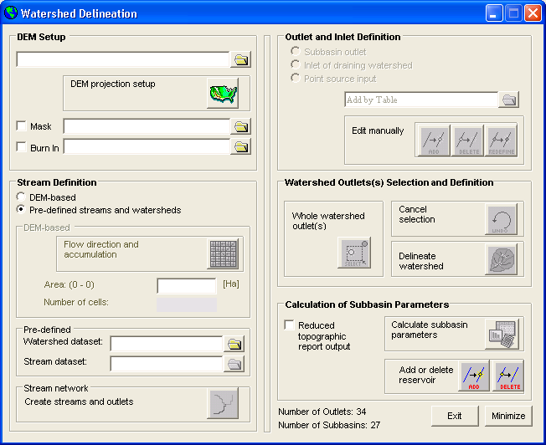
MODEL SETUP
Interface: ArcSWAT Ver. 2.1.5a
Model: SWAT2005
Delineation: USGS 12-digit HUC
DEM: 10 m
Soil: SSURGO
Land Use: 2006 LULC
Point Sources: 7 WWTP(ADEQ)
Pond: 9019 (1550.4 ha)
27 subwatersheds- 1272 HRUs
(10% soil and 5% land cover)
Study Period:
Calibration: 1996-2004(92-95)
Validation: 2005-2007
ANRC 2009 NPS Project Review Meeting, Sept. 16
Cooperative Extension Service

Slide 6
DATA USED
Weather
Period: 1981 – 2007
Daily precipitation and temperature
1981-1993 – 3 weather stations*
1994 – 2007 – NEXRAD*
  Hourly data
  4 x 4 km resolution
  82 grid cells
* NOAA -NWS
ANRC 2009 NPS Project Review Meeting, Sept. 16
Cooperative Extension Service
Notes:
Precipitation is one of the most uncertain inputs to a hydrological model. Several SWAT studies have found radar estimated precipitation to improve hydrological predictions (Di Luzio and Arnold, 2004; Moon et al., 2004; Jayakrishnan et al., 2005; Kalin and Hantush, 2006) The Next Generation Weather Radar (NEXRAD) of the National Weather Service (NWS) has a network of 160 radars throughout the US that distribute four products depending upon the calibration and quality control (Fulton et al., 1998). Among the four products, stage III data is widely used because it undergoes bias correction using rain guage data and is available for an entire river forecasting center (Kalin and Hantush, 2006; Xie et al., 2005). The time period of NEXRAD data used in this study ranged from 1994 to 2007. Hourly interval NEXRAD data for eighty two 4 x 4 km grid cells within the watershed was downloaded from the Distributed Modeling Intercomparison Project of the NWS (DMIP; Smith et al. 2004) (Figure 5). The data required several levels of post processing including unzipping, untarring, and transformation from the NEXRAD hydrological rainfall analysis project (HRAP) grid to a geographical coordinate system (Reed and Maidment, 1998). All NEXRAD grid points falling within a subwatershed were aggregated, an average value was calculated, and assigned to pseudo weather stations located at the centroid of each subwatershed. This approach satisfied the SWAT requirement of accepting data from only one weather station per subwatershed.

Slide 7
DATA USED
Management Data
Nutrient Sensitive Area- home to a number of animal enterprises including poultry, pigs/hogs, and cows (beef and dairy)
Estimated animal population: USDA- NASS, 2002/2007
Data organization:
Grazing and manure deposition
Poultry litter application
Pig manure application
Urban lawn management
ANRC 2009 NPS Project Review Meeting, Sept. 16
Cooperative Extension Service

Slide 8
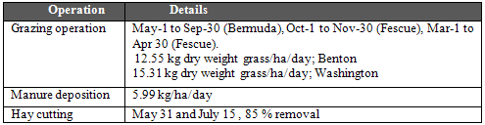
DATA USED
Management Data—contd.
Grazing and manure deposition
Watershed level cow population (dairy and beef) determined through weighted area
Cow population was further apportioned to sub-watershed
ANRC 2009 NPS Project Review Meeting, Sept. 16
Cooperative Extension Service

Slide 9
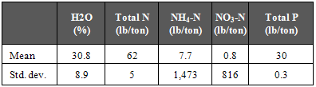
DATA USED
Management Data—contd.
Poultry litter application
SWAT model was adjusted for broiler litter nutrients based on Arkansas data
Litter application rate adjusted for type of grasses and temporally as well*
Cool-season: 2 tons/acre Warm season: 3 tons/acre
January 2004 onwards, rate declined to 1.16 tons/acre
(*Sharpley et al., 2009)
(Sharpley et al., unpublished report)
ANRC 2009 NPS Project Review Meeting, Sept. 16
Cooperative Extension Service
Notes:
Land application of poultry litter can provide nutrients and organic matter to agricultural crops, however, when overdone, could become a major NPS pollution to nearby streams.

Slide 10
CALIBRATION
Sensitivity Analysis
Purpose: Identify critical parameters in the model for calibration
Tool: Latin Hypercube and One-factor-at-a-time (OAT) sampling
Variables included: 41; 420 SWAT Model runs
Evaluation criteria: Calibrate first using top 5 sensitive parameters
ANRC 2009 NPS Project Review Meeting, Sept. 16
Cooperative Extension Service

Slide 11
CALIBRATION
Sensitivity Analysis
Output | Ranking
 | 1 | 2 | 3 | 4 | 5
Total Flow | ALPHA_BF | SURLAG | RCHRG_DP | ESCO | CN2
Sediment | SPCON | ALPHA_BF | PRF | SPEXP | SURLAG
Organic P | CN2 | SURLAG | BLAI | SOL_Z | CH_K2
Mineral P | SOL_Z | SOL_AWC | ALPHA_BF | CN2 | ESCO
Nitrates | RCHRG_DP | CN2 | CH_K2 | BLAI | ALPHA_BF
ANRC 2009 NPS Project Review Meeting, Sept. 16
Cooperative Extension Service

Slide 12
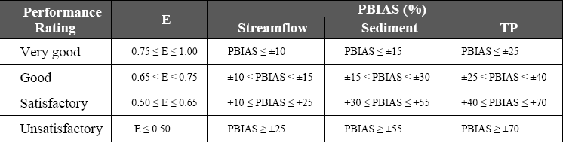
CALIBRATION
Model Performance Parameters
Source: Moriasi et al., 2007
ANRC 2009 NPS Project Review Meeting, Sept. 16
Cooperative Extension Service

Slide 13
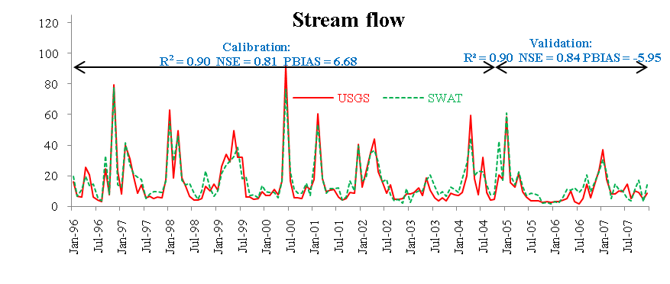
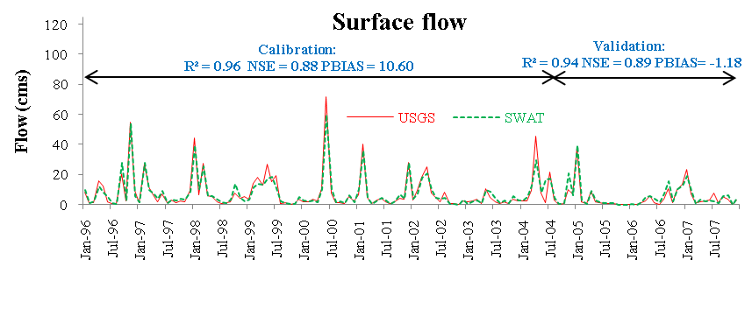
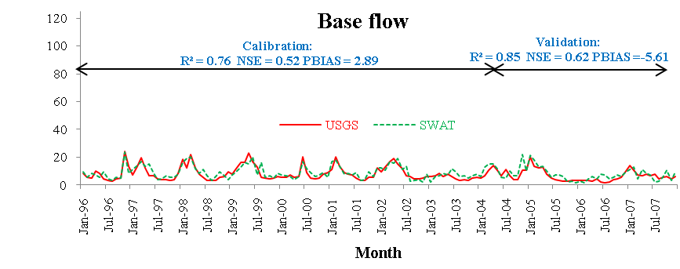
CALIBRATION/VALIDATION
Stream flow @ Siloam Springs
ANRC 2009 NPS Project Review Meeting, Sept. 16
Cooperative Extension Service

Slide 14
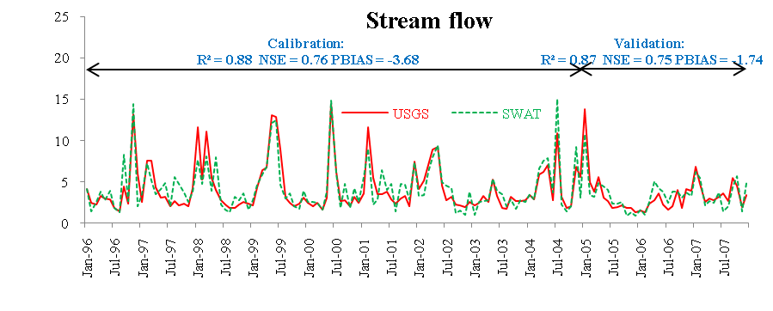
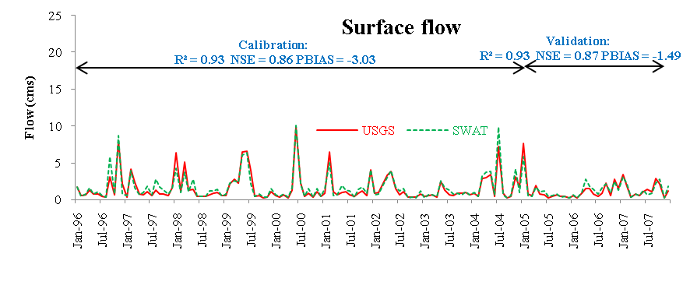
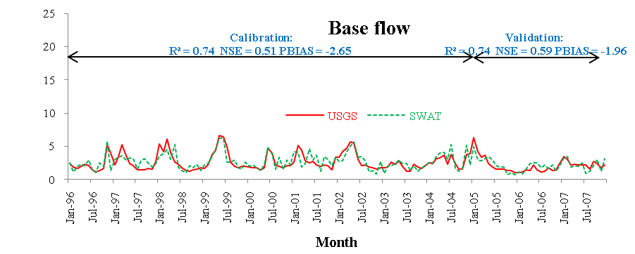
CALIBRATION/VALIDATION
Stream flow @ Osage Creek
ANRC 2009 NPS Project Review Meeting, Sept. 16
Cooperative Extension Service

Slide 15
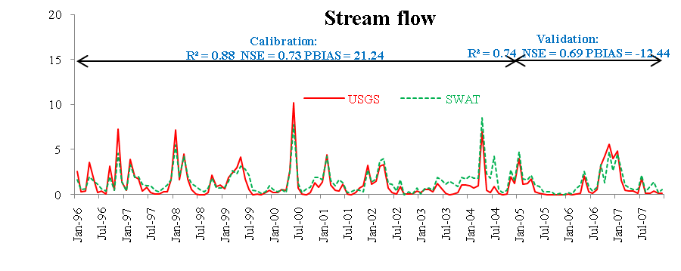
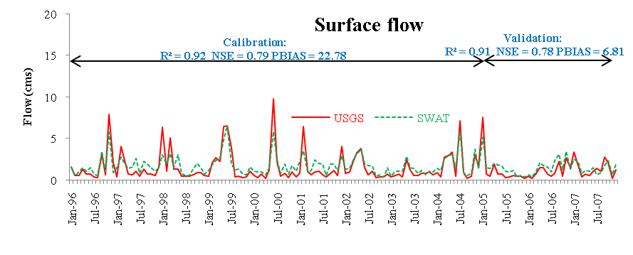
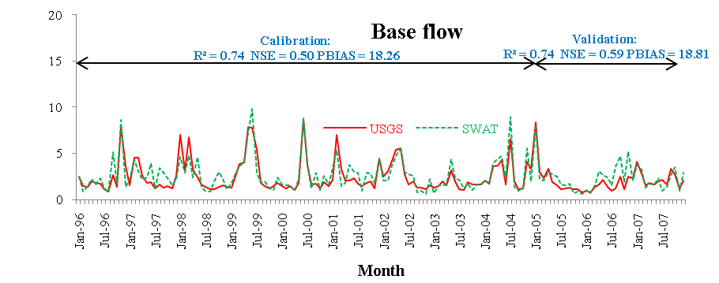
CALIBRATION/VALIDATION
Stream flow @ Baron Fork
ANRC 2009 NPS Project Review Meeting, Sept. 16
Cooperative Extension Service

Slide 16
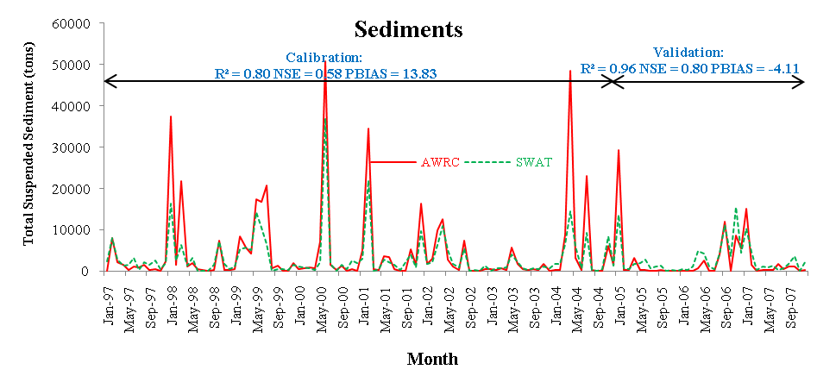
CALIBRATION/VALIDATION
Sediment @ Siloam Springs
ANRC 2009 NPS Project Review Meeting, Sept. 16
Cooperative Extension Service

Slide 17
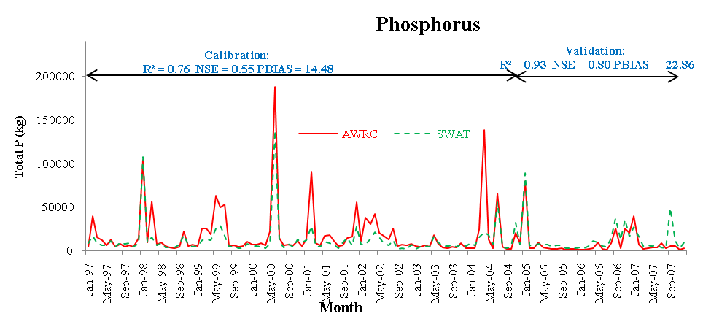
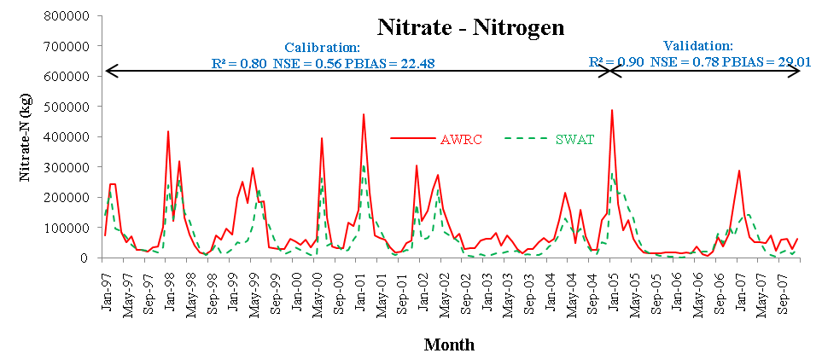
CALIBRATION/VALIDATION
Nutrients@ Siloam Springs
ANRC 2009 NPS Project Review Meeting, Sept. 16
Cooperative Extension Service

Slide 18
SUBWATERSHED IDENTIFICATION
Three approaches
A. Percentile Ranking
B. Average annual phosphorus yield
C. Cartographic Score
  Loadings for sediment, TP, and nitrogen divided into quartiles
  Each sub-watershed assigned a score of 1 to 4
  Higher cumulative score indicates sub-watershed likely to contribute more NPS pollution
ANRC 2009 NPS Project Review Meeting, Sept. 16
Cooperative Extension Service

Slide 19
SUBWATERSHED IDENTIFICATION
Percentile Approach – Sediment
ANRC 2009 NPS Project Review Meeting, Sept. 16
Cooperative Extension Service

Slide 20
SUBWATERSHED IDENTIFICATION
Percentile Approach – Phosphorus
ANRC 2009 NPS Project Review Meeting, Sept. 16
Cooperative Extension Service

Slide 21
SUBWATERSHED IDENTIFICATION
Percentile Approach – Nitrogen
ANRC 2009 NPS Project Review Meeting, Sept. 16
Cooperative Extension Service

Slide 22
SUBWATERSHED IDENTIFICATION
Annual P loading
ANRC 2009 NPS Project Review Meeting, Sept. 16
Cooperative Extension Service

Slide 23
SUBWATERSHED IDENTIFICATION
Cartographic modeling
ANRC 2009 NPS Project Review Meeting, Sept. 16
Cooperative Extension Service

Slide 24
SUBWATERSHED IDENTIFICATION
Frequent subwatersheds
Sub-watershed | Frequency
5 (Sager Creek) | 5
1 (Osage Creek) | 5
4 (Little Osage) | 4
22 (Clear Creek) | 4
18 (Goose Creek) | 4
These five subwatersheds encompass 23.6% of the total watershed area but contributed 32.6% of annual P load, 36.9% of annual nitrate-nitrogen load, and 62.3% of annual average sediment load
Cooperative Extension Service

Slide 25
SUMMARY
Most recent input data and NEXRAD data were used for model setup
SWAT model was calibrated for 1996 – 2004 and validated for 2005 – 2007
Simulated flow, sediments, TP, and nitrate had good to very good correlation with measure data
Model responses were used to identify subwatersheds using three approaches
In conjunction with other known information, these subwatersheds are prime candidates for further management support
ANRC 2009 NPS Project Review Meeting, Sept. 16
Cooperative Extension Service

Slide 26
ACKNOWLEDGMENTS
Arkansas Natural Resource Commission (ANRC)
Many individuals, groups, state and federal agencies
University of Arkansas subject matter specialists and extension agents for fine tuning the management data
Mr. John Pennington, Washington County extension agent
SWAT model developers, namely Dr. Raghavan Srinivasan, Dr. Jeff Arnold and his team at USDA-ARS, Temple, TX
ANRC 2009 NPS Project Review Meeting, Sept. 16
Cooperative Extension Service

Slide 27
QUESTIONS?
dsaraswat@uaex.edu
ANRC 2009 NPS Project Review Meeting, Sept. 16
Cooperative Extension Service

Slide 28
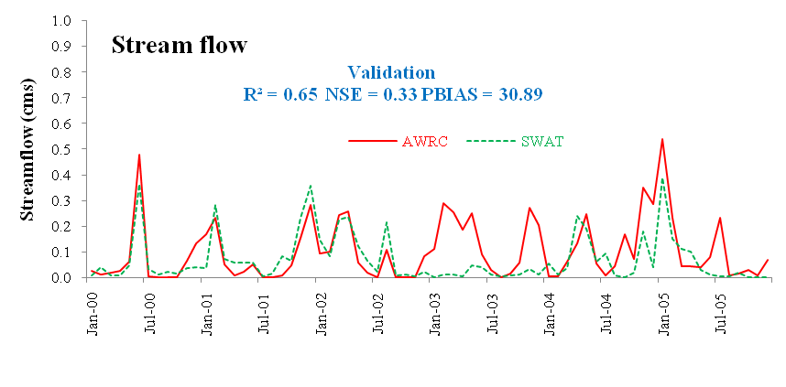
VALIDATION
Stream flow @Moore’s Creek
Cooperative Extension Service
Notes:
The AWRC monitoring gauge at Moore’s creek has an area of 1000 ha. Since we had enforced 12-digit HUC layer to delineate sub-watersheds in SWAT Model, output was available at ~6000 ha sub-watershed outlet. To validate our model at this gauging station we calculated area weighted SWAT responses at the outlet of the 12 digit HUC sub-watershed and compared with the AWRC’s data.

Slide 29
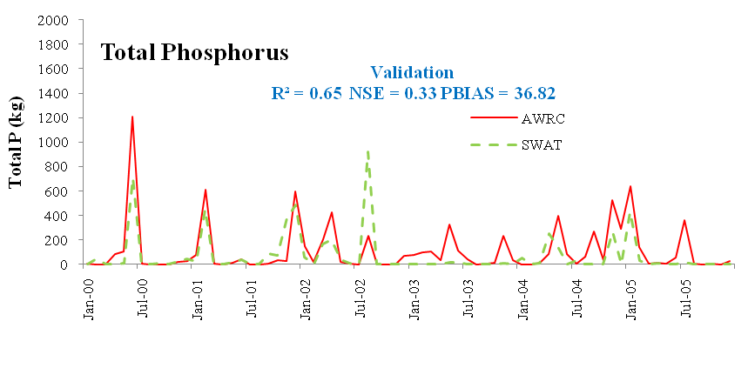
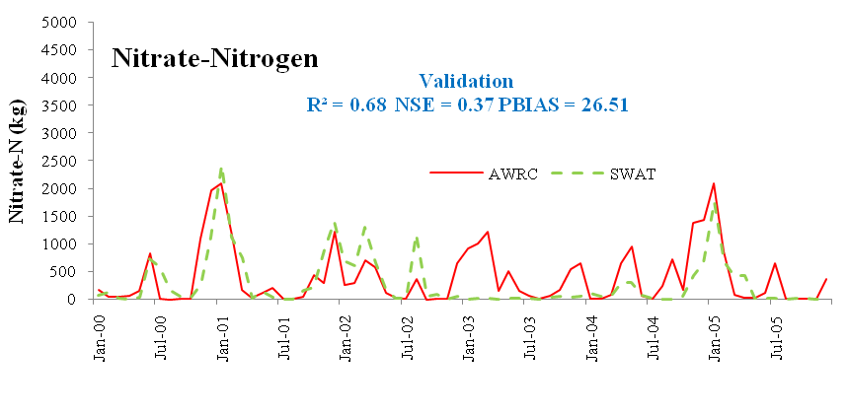
VALIDATION
Nutrients @Moore’s Creek
Cooperative Extension Service

