Slide 1

Water Quality Sampling, Analysis and Annual Load Determinations for the Illinois River at Arkansas Highway 59 Bridge, 2008
Brian E. Haggard
Arkansas Water Resources Center
UA Division of Agriculture

Slide 2
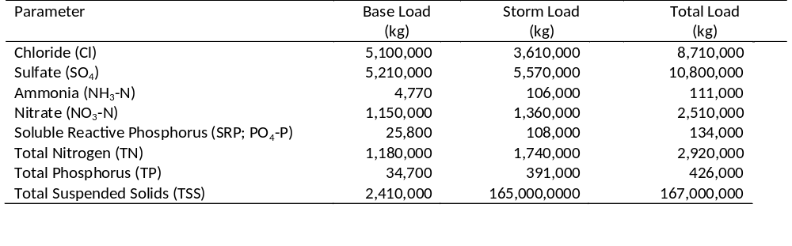
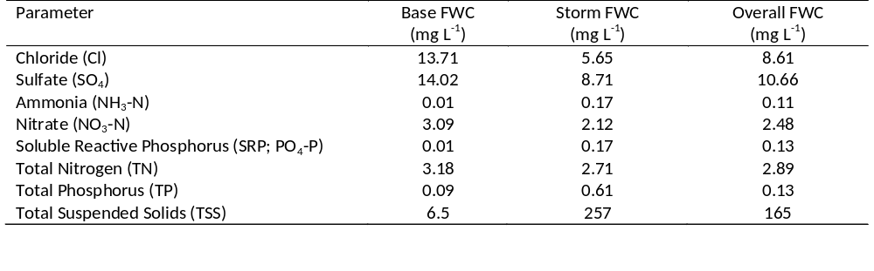
Summary 2008
Loads and Flow-Weighted Concentrations

Slide 3
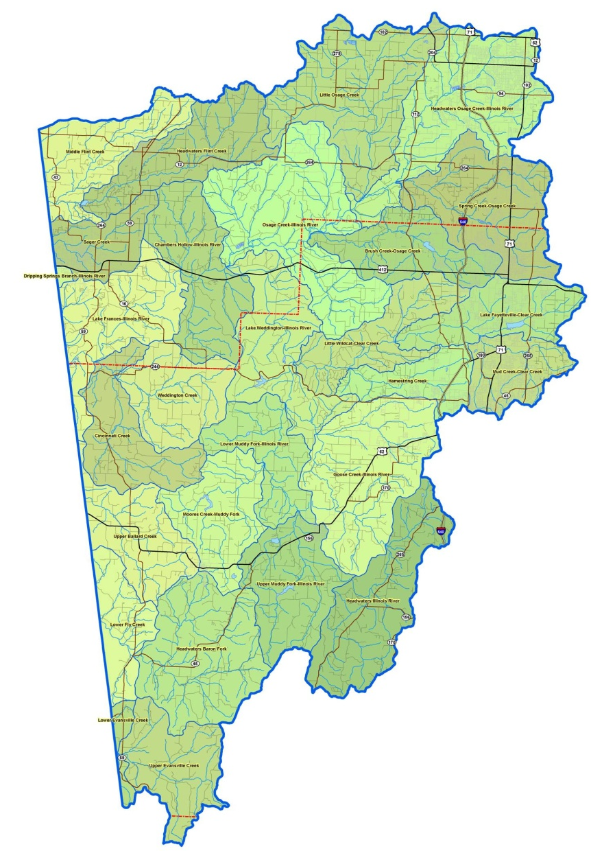
Water samples were collected at the AR Highway 59 Bridge during base flow and storm flow events.
Stage recorded in 30 min intervals by U.S. Geological Survey to estimate discharge.
Water samples were collected every other week during base flow, plus composite samples during storm events (i.e., stage exceeded 5 ft).
Water samples were analyzed at the AWRC WQL for:
  NO₃-N
  NH₃-N
  TN
  TP
  SRP
  TSS
  SO₄
  Cl
Annual loads and flow-weighted concentrations of select constituents were calculated for 2008.
Illinois River
Arkansas Highway 59

Slide 4
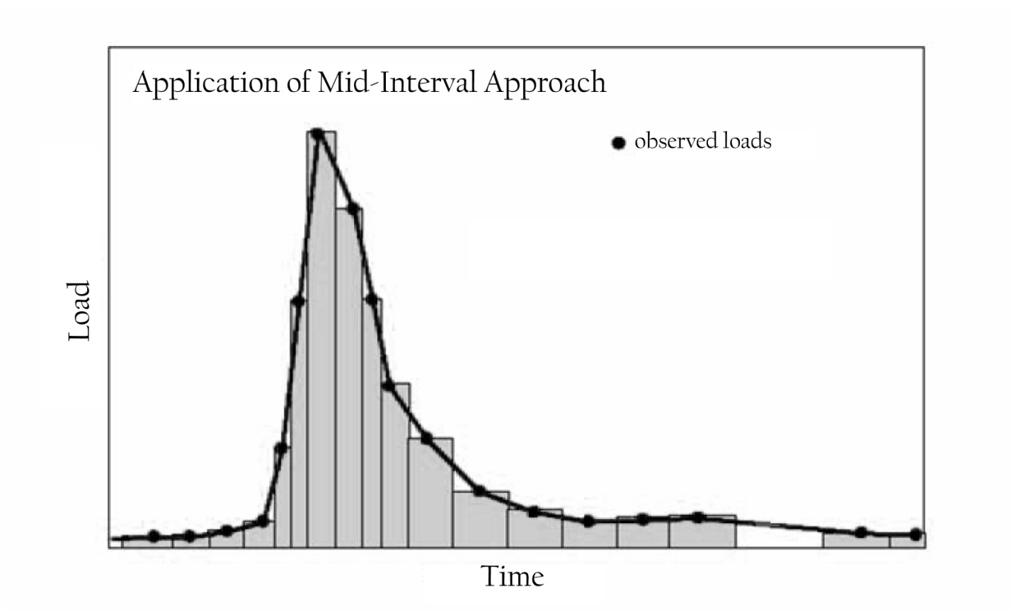
Load Determination & Mean Concentration
Loads (kg)
  Calculated using the mid-interval approach, and summed into monthly and annual.
Flow-weighted concentration (mg L⁻¹)
  − Total load divided by discharge volume during selected time period (e.g., annual).

Slide 5
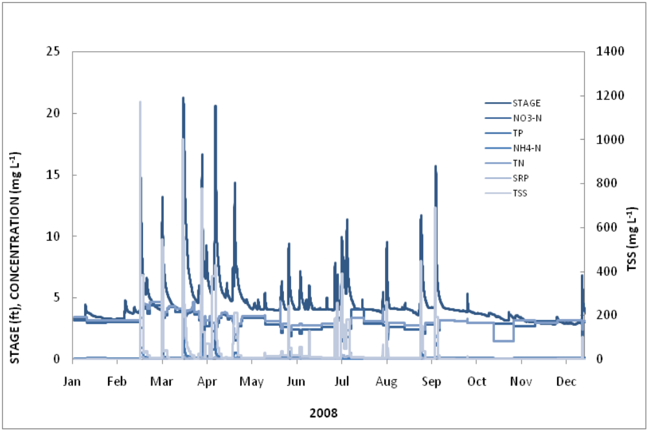
Discharge and constituent concentrations were variable throughout the year.
Total discharge: 1,010,000,000 m³
  Base flow: 37%
  Storm flow: 63%
26 samples were collected during base flow
26 composite samples during storm events

Slide 6

Cl, SO₄, NO₃-N, TN flow-weighted concentrations were greater during base flow.

Slide 7
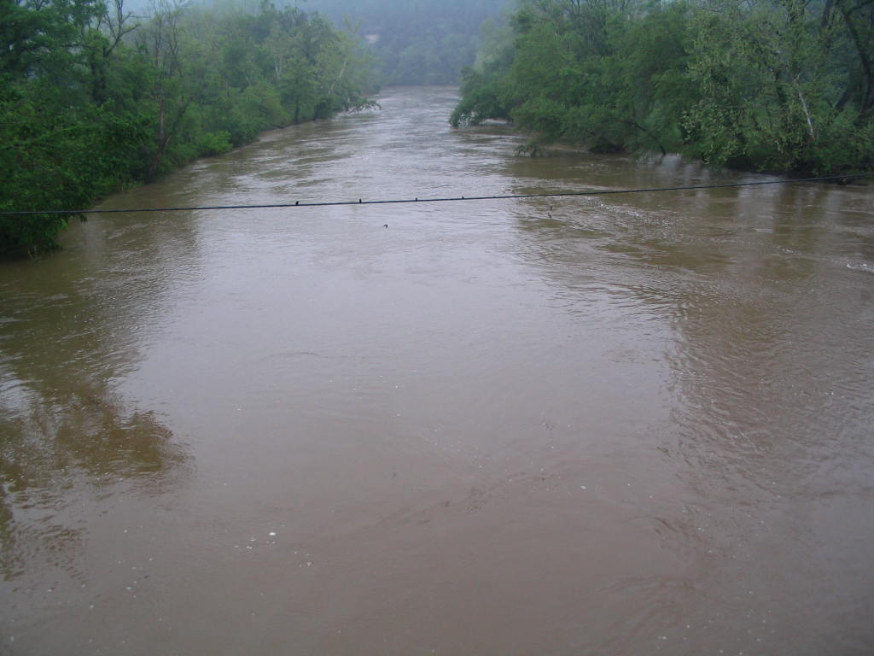
And, SRP, TP, NH₃-N, and TSS flow-weighted concentrations were greater during storm flow.

Slide 8
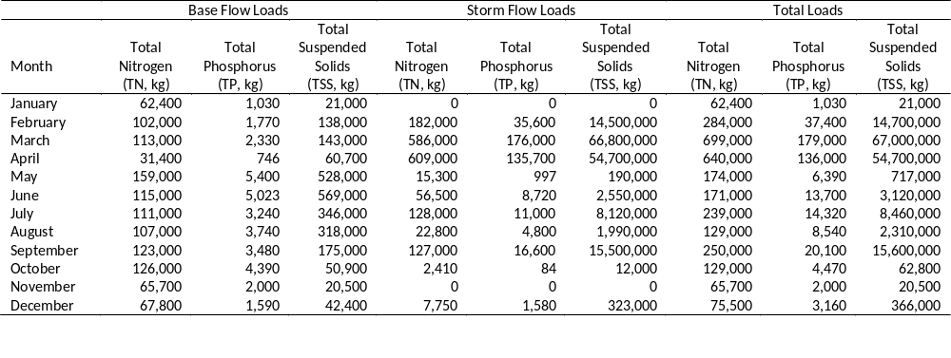
The constituent loads at Illinois River varied by orders of magnitude between months.
Monthly loads were variable depending on the frequency of storm event during the month.
  Greatest loads during spring (March & April)
  Lowest loads during fall and winter
    No storms in January or November

Slide 9
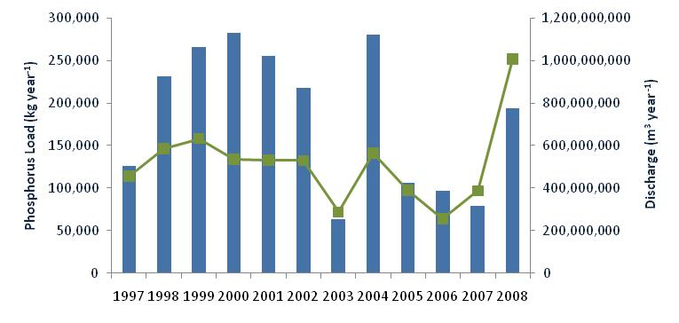
Phosphorus loads have been variable following the general trend in annual discharge.
Phosphorus loads in 2008 were 2.5 times greater than 2007 loads, but were less than those reported in 1998 through 2002.

Slide 10
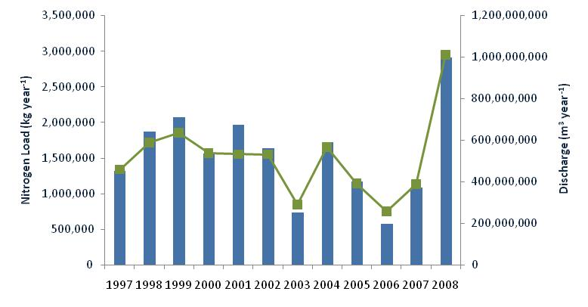
Nitrogen loads in 2008 were the greatest since monitoring started in 1997.

Slide 11
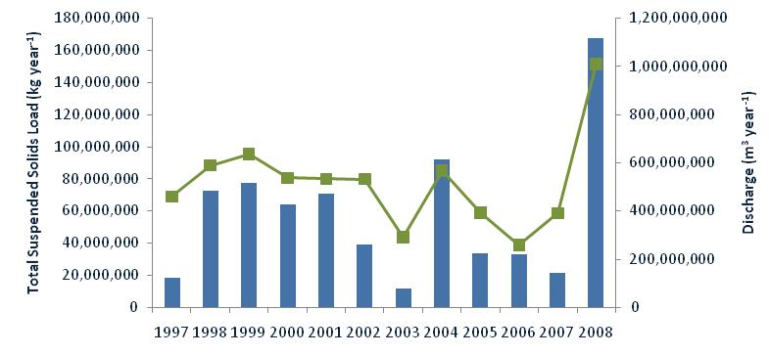
Total suspended solids loads in 2008 were also the greatest since monitoring started.

Slide 12
Summary 2008
Loads and Flow-Weighted Concentrations

Slide 13
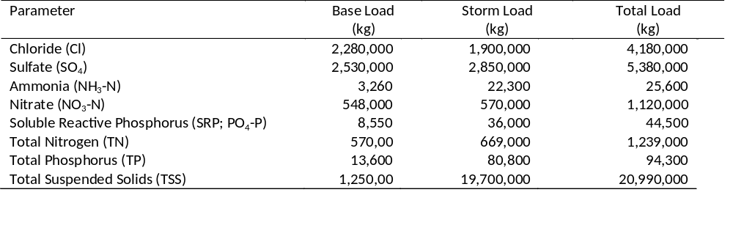
What about the data collected from January to June 2009?
Total discharge was 469,000,000 m³
  Base flow: 40%
    13 base flow samples collected
  Storm flow: 60%
    22 composite storm sampled

Slide 14

Monitoring is on-going at this site.
Water quality sampling and load estimation is being continued at the Illinois River.
The monitoring program has changed, collecting more frequent samples on fixed intervals (i.e., weekly) plus storm chasing.
The partial loads from 2009 combined with the continued monitoring data will be used to calculate annual loads for CY 2009.

Slide 15
Take Home Message: Total constituent loading is dependent on annual discharge volume which is closely tied to the frequency and duration of storm events.
QUESTIONS?

